Slide 1
Lesson 29
j /j/

Slide 2
Notes:
ufliteracy.org

Slide 4
Lesson 29
j /j/

Slide 6
Notes:
See UFLI Foundations lesson plan Step 1 for phonemic awareness activity.

Slide 8
Notes:
See UFLI Foundations lesson plan Step 2 for student phoneme responses.

Slide 9
w

Slide 10
l

Slide 11
r

Slide 12
h

Slide 13
k

Slide 14
s

Slide 15
e

Slide 16
b

Slide 17
g

Slide 18
u

Slide 19
c

Slide 20
d

Slide 21
o

Slide 22
n

Slide 23
i

Slide 24
f

Slide 25
p

Slide 26
t

Slide 27
m

Slide 28
a

Slide 30
Notes:
See UFLI Foundations lesson plan Step 3 for auditory drill activity.

Slide 31
Notes:
No slides needed for auditory drill.

Slide 33
Notes:
See UFLI Foundations lesson plan Step 4 for blending drill word chain and grid.
Visit ufliteracy.org to access the Blending Board app.

Slide 35
Notes:
See UFLI Foundations lesson plan Step 5 for recommended teacher language and activities to introduce the new concept.

Slide 36
j

Slide 37
job
jet
j

Slide 38
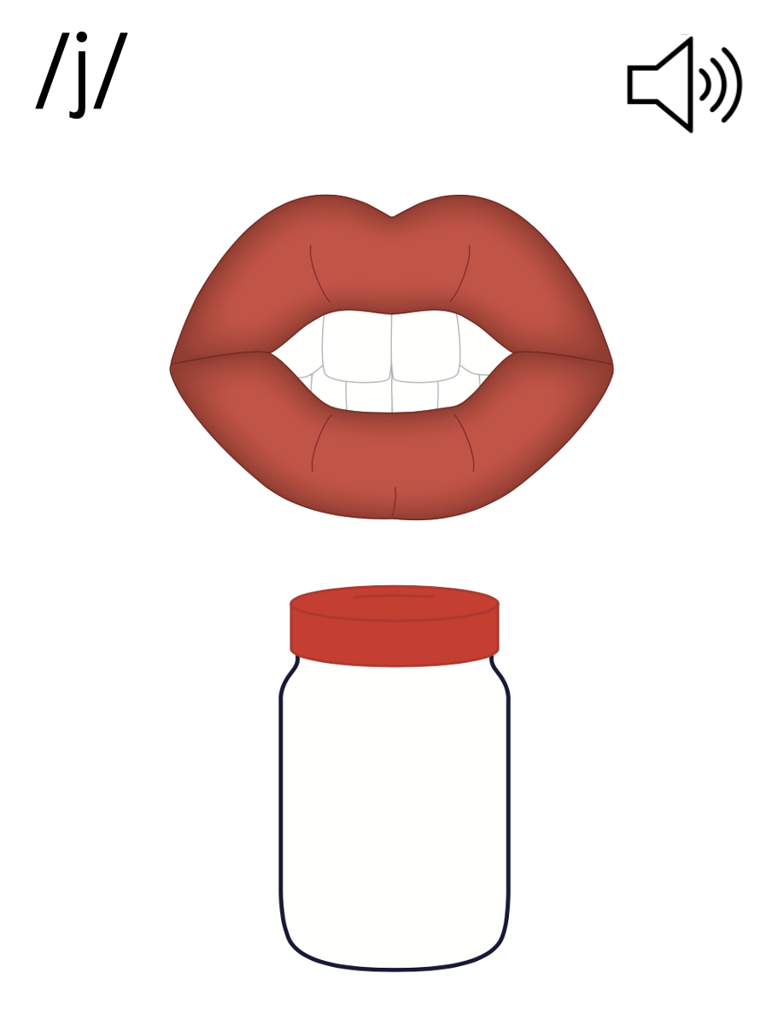
j

Slide 41
Notes:
Uppercase J gif

Slide 43
Notes:
Lowercase j gif

Slide 44
jog
just

Slide 45
jig
jet
jab
jot
jam
jobs

Slide 46
jump
just
jest

Slide 47
Notes:
See UFLI Foundations lesson plan Step 5 for words to spell.
Handwriting paper to model spelling.

Slide 48
Notes:
See UFLI Foundations lesson plan Step 5 for words to spell.
Handwriting paper for guided spelling practice.

Slide 50
Insert brief reinforcement activity and/or transition to next part of reading block.

Slide 51
Lesson 29
j /j/

Slide 53
New Concept Review
Notes:
See UFLI Foundations lesson plan Step 5 for recommended teacher language and activities to review the new concept.

Slide 54
j

Slide 55
job
jet
j

Slide 56
j

Slide 57
Notes:
Lowercase j gif

Slide 58
jet
jam
just
jump

Slide 60
Notes:
See UFLI Foundations lesson plan Step 6 for word work activity.
Visit ufliteracy.org to access the Word Work Mat apps.

Slide 62
Notes:
See UFLI Foundations lesson plan Step 7 for irregular word activities.
The white rectangle under each word may be used in editing mode. Cover the heart and square icons then reveal them one at a time during instruction.

Slide 63
Notes:
See UFLI Foundations manual for more information about reviewing irregular words.

Slide 64
look
Notes:
Lessons 26-88
*Temporarily irregular
OO /oo/ has not been introduced yet.
The white rectangle under the word may be used in editing mode. Cover the heart and square icons then reveal them one at a time during instruction.

Slide 65
book
Notes:
Lessons 26-88
*Temporarily irregular
OO /oo/ has not been introduced yet.
The white rectangle under the word may be used in editing mode. Cover the heart and square icons then reveal them one at a time during instruction.

Slide 66
are
Notes:
Lessons 27-76
AR /ar/ has not been introduced yet.
The final E is silent but does not follow the long vowel VCe pattern.
The white rectangle under the word may be used in editing mode. Cover the heart and square icons then reveal them one at a time during instruction.

Slide 67
Notes:
Handwriting paper for irregular word spelling practice. Use as needed.
See UFLI Foundations manual for more information about reviewing irregular words.

Slide 68
Teach
Notes:
The orange star indicates these are new irregular words that need to be introduced.
See UFLI Foundations manual for more information about teaching irregular words.

Slide 69
was
Notes:
Lesson 29+
A represents the /ŏ/ sound.​
S /z/ has already been introduced.
The white rectangle under the word may be used in editing mode. Cover the heart and square icons then reveal them one at a time during instruction.

Slide 70
Notes:
Handwriting paper for irregular word spelling practice. Use as needed.
See UFLI Foundations manual for more information about teaching irregular words.

Slide 72
Notes:
See UFLI Foundations lesson plan Step 8 for connected text activities.

Slide 73
Jeb and I jog.

Slide 74
He got me red jam.

Slide 75
I was just a bit mad.

Slide 76
Notes:
See UFLI Foundations lesson plan Step 8 for sentences to write.

Slide 77
Notes:
The UFLI Foundations decodable text is provided here. See UFLI Foundations decodable text guide for additional text options.

Slide 78
The Jet
Jim is in a jet. The jet is fast.
His job is to jump from the jet.
He sees a pond he can jump in.

Slide 79
Jim jumps from the jet.
He lands in the pond and gets wet.
Jim swims in the pond and looks up at the jet.

Slide 81
Insert brief reinforcement activity and/or transition to next part of reading block.

