Slide 1
Lesson 27
l /l/ Part 2

Slide 2
Notes:
ufliteracy.org

Slide 4
Lesson 27
l /l/ Part 2

Slide 6
Notes:
See UFLI Foundations lesson plan Step 1 for phonemic awareness activity.

Slide 8
Notes:
See UFLI Foundations lesson plan Step 2 for student phoneme responses.

Slide 9
l

Slide 10
r

Slide 11
h

Slide 12
k

Slide 13
s

Slide 14
e

Slide 15
b

Slide 16
g

Slide 17
u

Slide 18
c

Slide 19
d

Slide 20
o

Slide 21
n

Slide 22
i

Slide 23
f

Slide 24
p

Slide 25
t

Slide 26
m

Slide 27
a

Slide 29
Notes:
See UFLI Foundations lesson plan Step 3 for auditory drill activity.

Slide 30
Notes:
No slides needed for auditory drill.

Slide 32
Notes:
See UFLI Foundations lesson plan Step 4 for blending drill word chain and grid.
Visit ufliteracy.org to access the Blending Board app.

Slide 34
Notes:
See UFLI Foundations lesson plan Step 5 for recommended teacher language and activities to introduce the new concept.

Slide 35
l

Slide 36
pal
gal
a
l

Slide 37
slip
glad

Slide 38
p l o p
c l u b

Slide 39
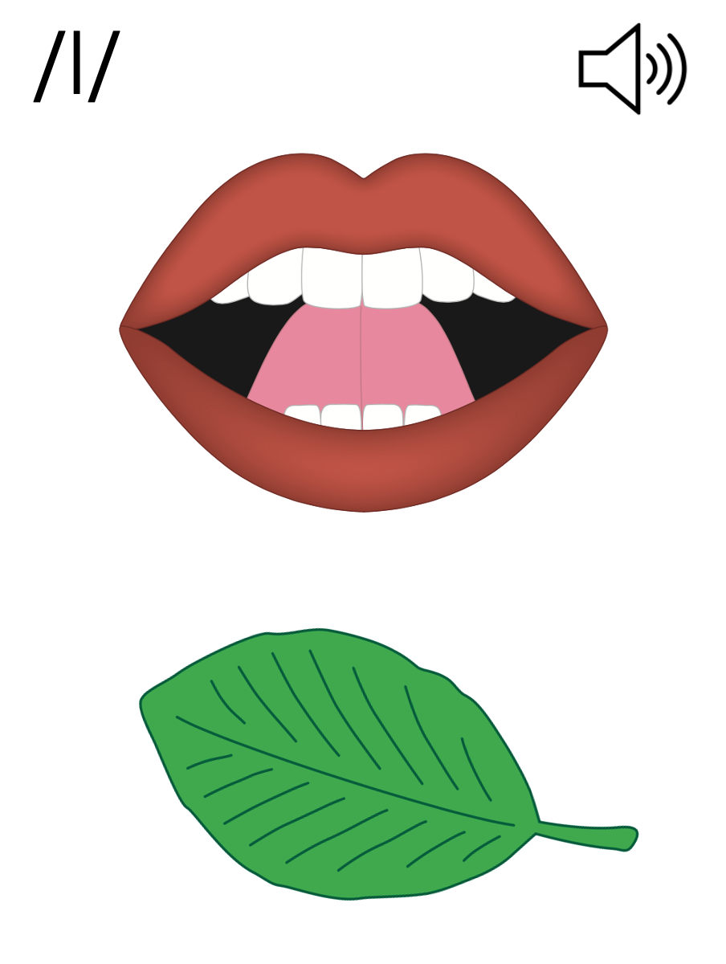
l

Slide 42
Notes:
Lowercase l gif

Slide 43
gal
flip
slug

Slide 44
pal
flip
flag
glad
plan
clap

Slide 45
slam
help
plant

Slide 46
Notes:
See UFLI Foundations lesson plan Step 5 for words to spell.
Handwriting paper to model spelling.

Slide 47
Notes:
See UFLI Foundations lesson plan Step 5 for words to spell.
Handwriting paper for guided spelling practice.

Slide 49
Insert brief reinforcement activity and/or transition to next part of reading block.

Slide 50
Lesson 27
l /l/ Part 2

Slide 52
New Concept Review
Notes:
See UFLI Foundations lesson plan Step 5 for recommended teacher language and activities to review the new concept.

Slide 53
l

Slide 54
pal
gal
a
l

Slide 55
slip
glad

Slide 56
p l o p
c l u b

Slide 57
l

Slide 58
Notes:
Lowercase l gif

Slide 59
flip
glad
help
held

Slide 61
Notes:
See UFLI Foundations lesson plan Step 6 for word work activity.
Visit ufliteracy.org to access the Word Work Mat apps.

Slide 63
Notes:
See UFLI Foundations lesson plan Step 7 for irregular word activities.
The white rectangle under each word may be used in editing mode. Cover the heart and square icons then reveal them one at a time during instruction.

Slide 64
Notes:
See UFLI Foundations manual for more information about reviewing irregular words.

Slide 65
he
Notes:
Lessons 23-65
*Temporarily irregular
E /ē/ has not been introduced yet.
The white rectangle under the word may be used in editing mode. Cover the heart and square icons then reveal them one at a time during instruction.

Slide 66
be
Notes:
Lessons 23-65
*Temporarily irregular
E /ē/ has not been introduced yet.
The white rectangle under the word may be used in editing mode. Cover the heart and square icons then reveal them one at a time during instruction.

Slide 67
me
Notes:
Lessons 23-65
*Temporarily irregular
E /ē/ has not been introduced yet.
The white rectangle under the word may be used in editing mode. Cover the heart and square icons then reveal them one at a time during instruction.

Slide 68
look
Notes:
Lessons 26-88
*Temporarily irregular
OO /oo/ has not been introduced yet.
The white rectangle under the word may be used in editing mode. Cover the heart and square icons then reveal them one at a time during instruction.

Slide 69
book
Notes:
Lessons 26-88
*Temporarily irregular
OO /oo/ has not been introduced yet.
The white rectangle under the word may be used in editing mode. Cover the heart and square icons then reveal them one at a time during instruction.

Slide 70
ask
Notes:
Lessons 22-77AUS
*Temporarily irregular
A /ar/ has not been introduced yet.
The white rectangle under the word may be used in editing mode. Cover the heart and square icons then reveal them one at a time during instruction.

Slide 71
fast
Notes:
Lessons 22-77AUS
*Temporarily irregular
A /ar/ has not been introduced yet.
The white rectangle under the word may be used in editing mode. Cover the heart and square icons then reveal them one at a time during instruction.

Slide 72
Notes:
Handwriting paper for irregular word spelling practice. Use as needed.
See UFLI Foundations manual for more information about reviewing irregular words.

Slide 73
Teach
Notes:
The orange star indicates these are new irregular words that need to be introduced.
See UFLI Foundations manual for more information about teaching irregular words.

Slide 74
are
Notes:
Lessons 27-76
AR /ar/ has not been introduced yet.
The final E is silent but does not follow the long vowel VCe pattern.
The white rectangle under the word may be used in editing mode. Cover the heart and square icons then reveal them one at a time during instruction.

Slide 75
Notes:
Handwriting paper for irregular word spelling practice. Use as needed.
See UFLI Foundations manual for more information about teaching irregular words.

Slide 77
Notes:
See UFLI Foundations lesson plan Step 8 for connected text activities.

Slide 78
The frog can flip!

Slide 79
The pals are in a club.

Slide 80
Did Cal plug the lamp in?

Slide 81
Notes:
See UFLI Foundations lesson plan Step 8 for sentences to write.

Slide 82
Notes:
The UFLI Foundations decodable text is provided here. See UFLI Foundations decodable text guide for additional text options.

Slide 83
Slugs on a Plant
Glen and Al are slugs.
Glen and Al are pals.
Al can not run.
Glen can not trot.
Glen and Al are not fast.

Slide 84
Al is glum.
“Slugs can not do a lot,” Al said.
“Slugs can rest!” Glen said.
Glen and Al plop on top of a plant.

Slide 85
Slugs are the best at rest.
Al is glad.
Glen and Al nap on the plant.

Slide 87
Insert brief reinforcement activity and/or transition to next part of reading block.

