Slide 1
Lesson 26
l /l/ Part 1

Slide 2
Notes:
ufliteracy.org

Slide 4
Lesson 26
l /l/ Part 1

Slide 6
Notes:
See UFLI Foundations lesson plan Step 1 for phonemic awareness activity.

Slide 8
Notes:
See UFLI Foundations lesson plan Step 2 for student phoneme responses.

Slide 9
r

Slide 10
h

Slide 11
k

Slide 12
s

Slide 13
e

Slide 14
b

Slide 15
g

Slide 16
u

Slide 17
c

Slide 18
d

Slide 19
o

Slide 20
n

Slide 21
i

Slide 22
f

Slide 23
p

Slide 24
t

Slide 25
m

Slide 26
a

Slide 28
Notes:
See UFLI Foundations lesson plan Step 3 for auditory drill activity.

Slide 29
Notes:
No slides needed for auditory drill.

Slide 31
Notes:
See UFLI Foundations lesson plan Step 4 for blending drill word chain and grid.
Visit ufliteracy.org to access the Blending Board app.

Slide 33
Notes:
See UFLI Foundations lesson plan Step 5 for recommended teacher language and activities to introduce the new concept.

Slide 34
l

Slide 35
lap
let
l

Slide 36
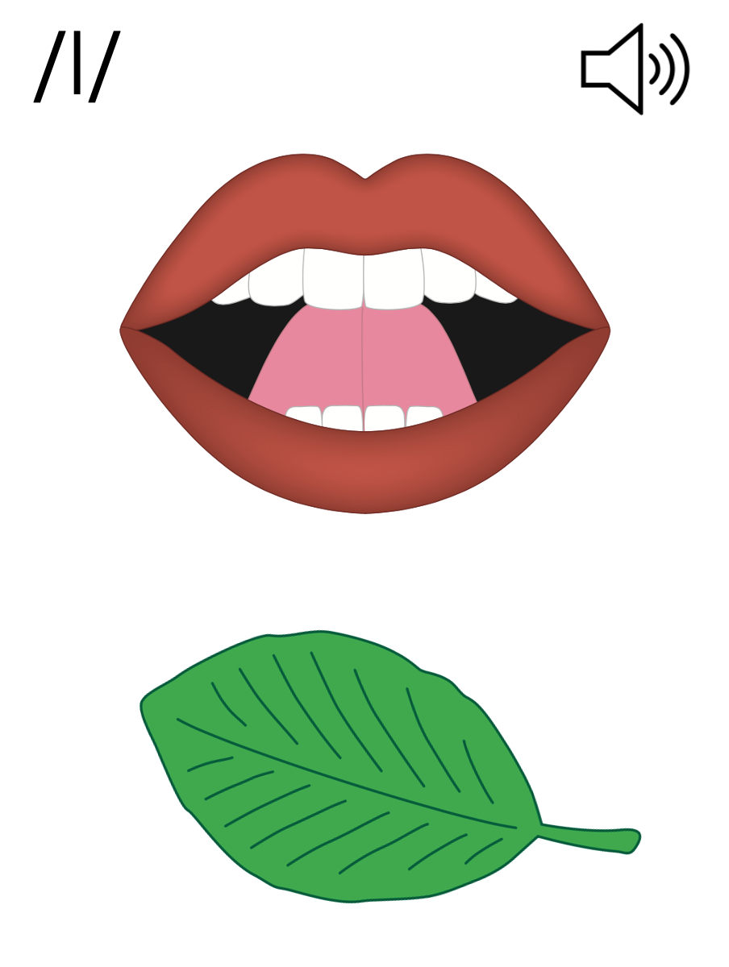
l

Slide 39
Notes:
Uppercase L gif

Slide 41
Notes:
Lowercase l gif

Slide 42
lip
lost

Slide 43
let
lap
lid
lots
left
lost

Slide 44
list
land
lump

Slide 45
Notes:
See UFLI Foundations lesson plan Step 5 for words to spell.
Handwriting paper to model spelling.

Slide 46
Notes:
See UFLI Foundations lesson plan Step 5 for words to spell.
Handwriting paper for guided spelling practice.

Slide 48
Insert brief reinforcement activity and/or transition to next part of reading block.

Slide 49
Lesson 26
l /l/ Part 1

Slide 51
New Concept Review
Notes:
See UFLI Foundations lesson plan Step 5 for recommended teacher language and activities to review the new concept.

Slide 52
l

Slide 53
lap
let
l

Slide 54
l

Slide 55
Notes:
Lowercase l gif

Slide 56
let
lip
lost
left

Slide 58
Notes:
See UFLI Foundations lesson plan Step 6 for word work activity.
Visit ufliteracy.org to access the Word Work Mat apps.

Slide 60
Notes:
See UFLI Foundations lesson plan Step 7 for irregular word activities.
The white rectangle under each word may be used in editing mode. Cover the heart and square icons then reveal them one at a time during instruction.

Slide 61
Notes:
See UFLI Foundations manual for more information about reviewing irregular words.

Slide 62
he
Notes:
Lessons 23-65
*Temporarily irregular
E /ē/ has not been introduced yet.
The white rectangle under the word may be used in editing mode. Cover the heart and square icons then reveal them one at a time during instruction.

Slide 63
be
Notes:
Lessons 23-65
*Temporarily irregular
E /ē/ has not been introduced yet.
The white rectangle under the word may be used in editing mode. Cover the heart and square icons then reveal them one at a time during instruction.

Slide 64
me
Notes:
Lessons 23-65
*Temporarily irregular
E /ē/ has not been introduced yet.
The white rectangle under the word may be used in editing mode. Cover the heart and square icons then reveal them one at a time during instruction.

Slide 65
ask
Notes:
Lessons 22-77AUS
*Temporarily irregular
A /ar/ has not been introduced yet.
The white rectangle under the word may be used in editing mode. Cover the heart and square icons then reveal them one at a time during instruction.

Slide 66
fast
Notes:
Lessons 22-77AUS
*Temporarily irregular
A /ar/ has not been introduced yet.
The white rectangle under the word may be used in editing mode. Cover the heart and square icons then reveal them one at a time during instruction.

Slide 67
Notes:
Handwriting paper for irregular word spelling practice. Use as needed.
See UFLI Foundations manual for more information about reviewing irregular words.

Slide 68
Teach
Notes:
The orange star indicates these are new irregular words that need to be introduced.
See UFLI Foundations manual for more information about teaching irregular words.

Slide 69
look
Notes:
Lessons 26-88
*Temporarily irregular
OO /oo/ has not been introduced yet.
The white rectangle under the word may be used in editing mode. Cover the heart and square icons then reveal them one at a time during instruction.

Slide 70
book
Notes:
Lessons 26-88
*Temporarily irregular
OO /oo/ has not been introduced yet.
The white rectangle under the word may be used in editing mode. Cover the heart and square icons then reveal them one at a time during instruction.

Slide 71
Notes:
Handwriting paper for irregular word spelling practice. Use as needed.
See UFLI Foundations manual for more information about teaching irregular words.

Slide 73
Notes:
See UFLI Foundations lesson plan Step 8 for connected text activities.

Slide 74
Is the lamp on?

Slide 75
Lin lost the book.

Slide 76
Mel let me look at the book.

Slide 77
Notes:
See UFLI Foundations lesson plan Step 8 for sentences to write.

Slide 78
Notes:
The UFLI Foundations decodable text is provided here. See UFLI Foundations decodable text guide for additional text options.

Slide 79
Lost in the Lab
Gil is in a big lab.
Gil got lost in the big lab.
The lamp in the lab is not on.
Gil can not see.

Slide 80
“Help!” said Gil.
Mel gets to the lab.
Mel can help.
Mel taps the lamp.

Slide 81
The lamp is on.
Gil can see!
Mel hands Gil his books.
Gil left the lab.

Slide 83
Insert brief reinforcement activity and/or transition to next part of reading block.

