Slide 1
Lesson 25
r /r/ Part 2

Slide 2
Notes:
ufliteracy.org

Slide 4
Lesson 25
r /r/ Part 2

Slide 6
Notes:
See UFLI Foundations lesson plan Step 1 for phonemic awareness activity.

Slide 8
Notes:
See UFLI Foundations lesson plan Step 2 for student phoneme responses.

Slide 9
r

Slide 10
h

Slide 11
k

Slide 12
s

Slide 13
e

Slide 14
b

Slide 15
g

Slide 16
u

Slide 17
c

Slide 18
d

Slide 19
o

Slide 20
n

Slide 21
i

Slide 22
f

Slide 23
p

Slide 24
t

Slide 25
m

Slide 26
a

Slide 28
Notes:
See UFLI Foundations lesson plan Step 3 for auditory drill activity.

Slide 29
Notes:
No slides needed for auditory drill.

Slide 31
Notes:
See UFLI Foundations lesson plan Step 4 for blending drill word chain and grid.
Visit ufliteracy.org to access the Blending Board app.

Slide 33
Notes:
See UFLI Foundations lesson plan Step 5 for recommended teacher language and activities to introduce the new concept.

Slide 34
rat
run
r

Slide 35
grab
frog

Slide 36
c r o p
t r i p

Slide 37
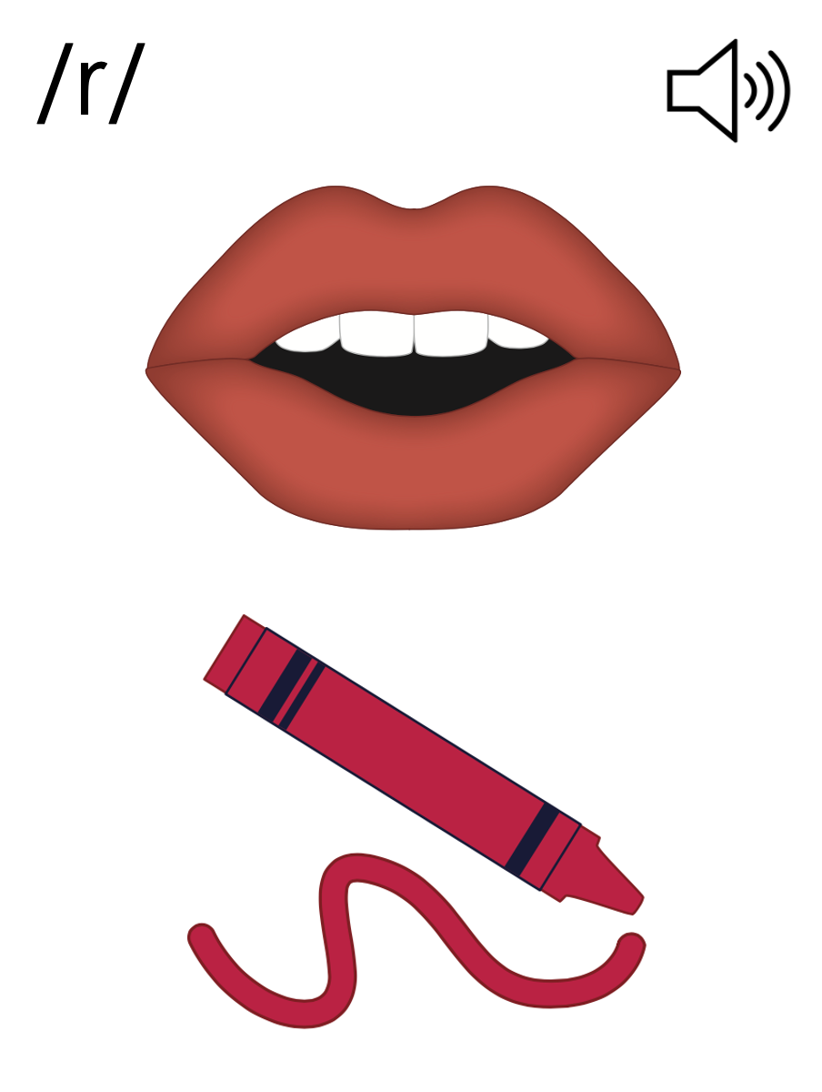
r

Slide 38
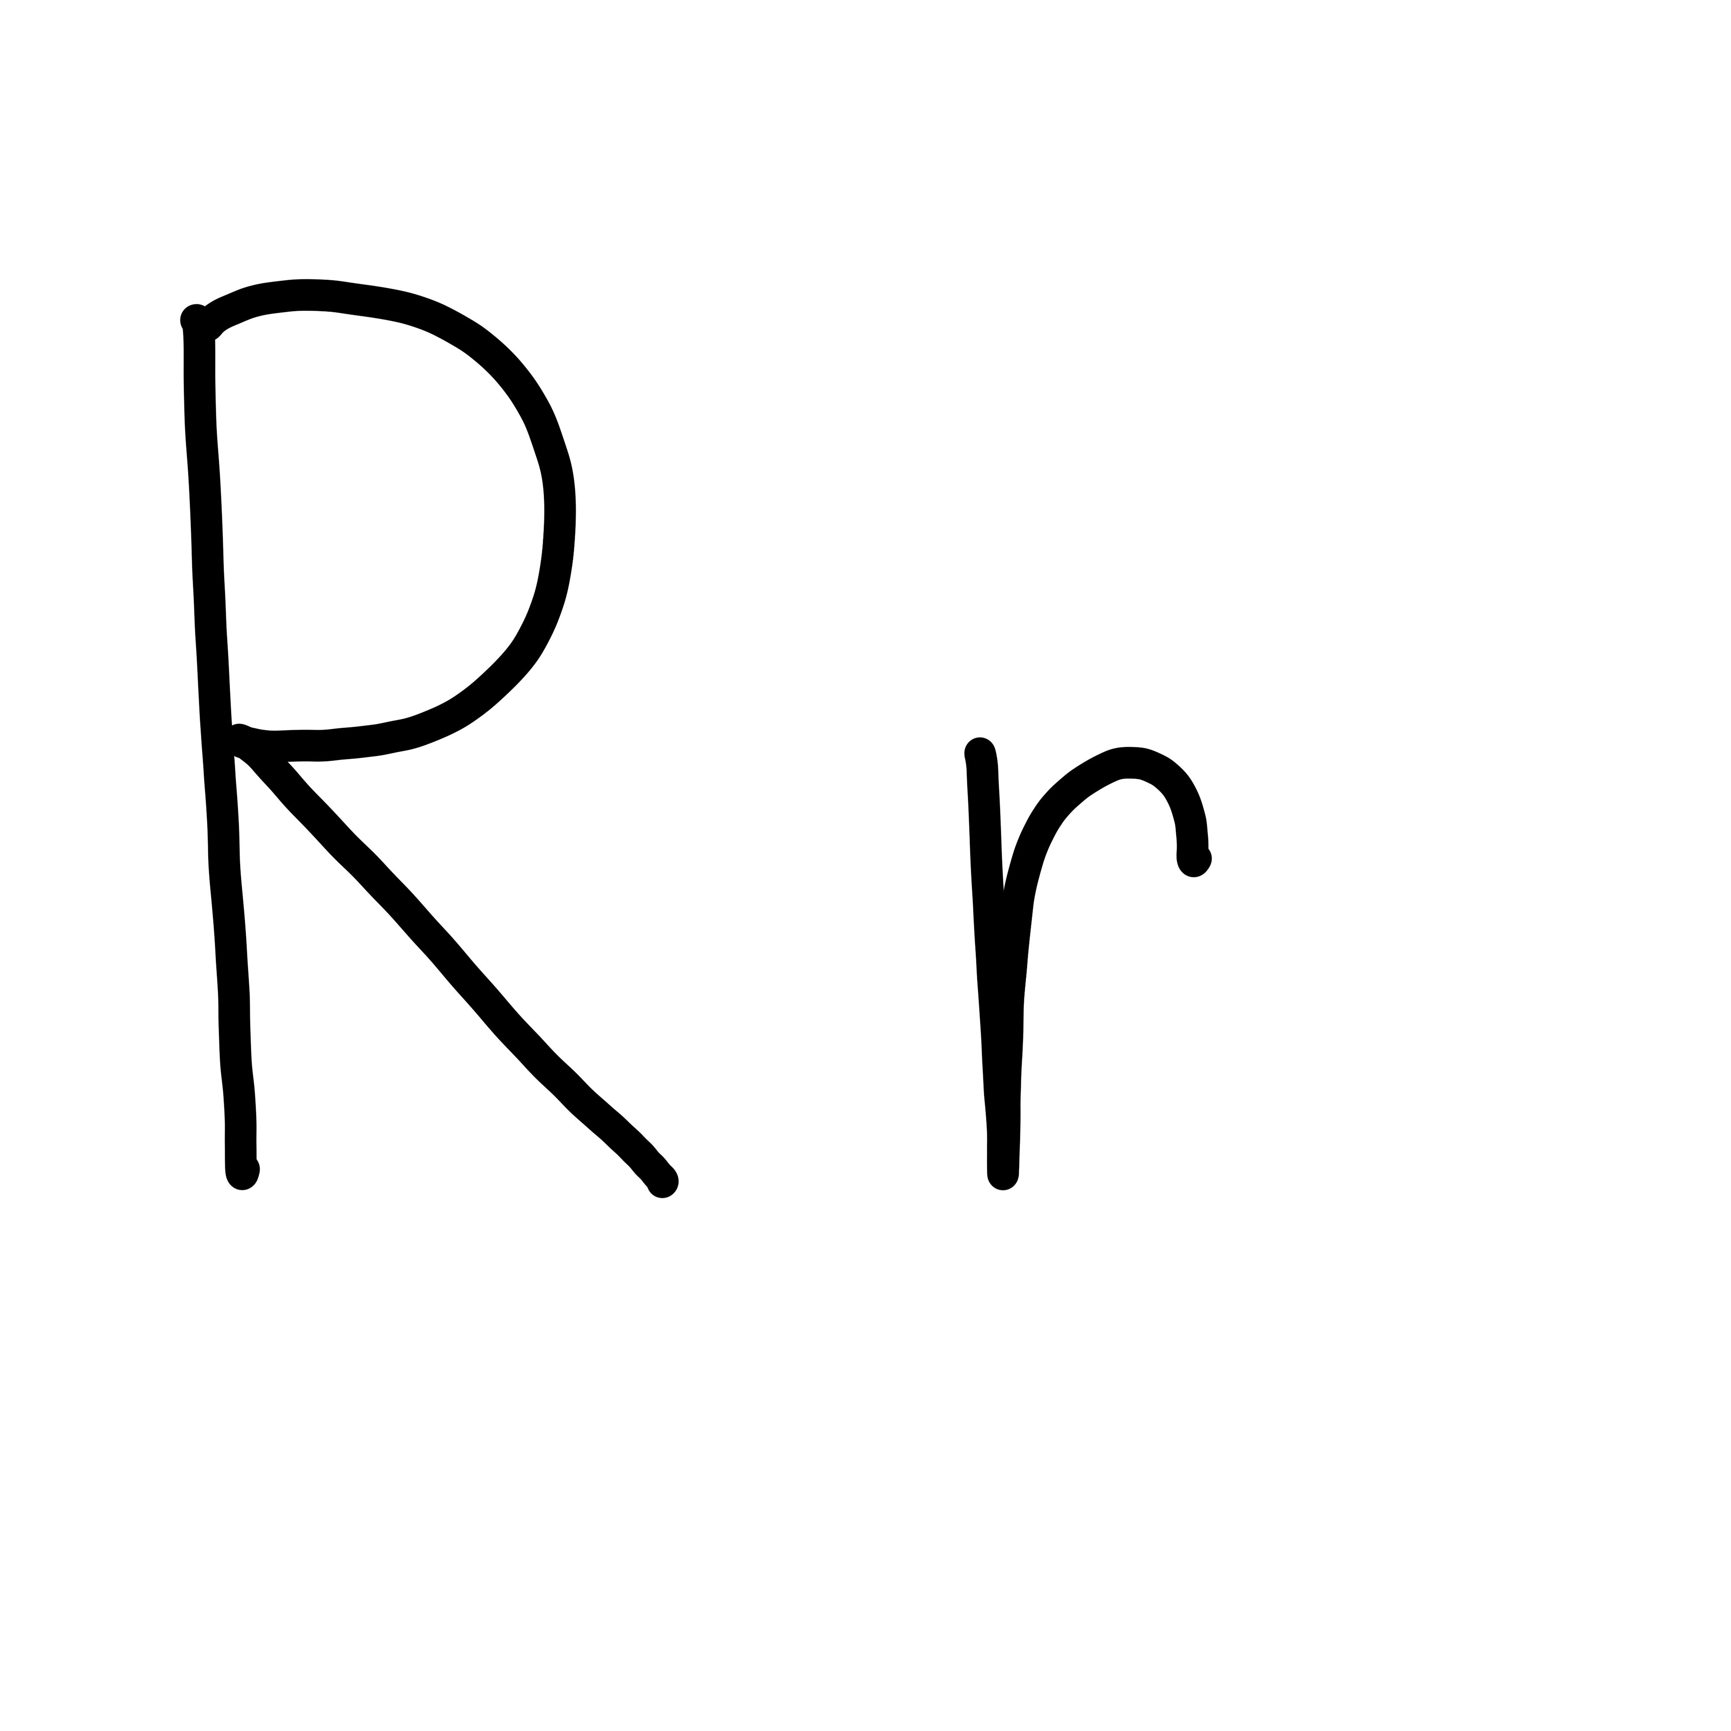

Slide 40
Notes:
Lowercase r gif

Slide 41
brag

Slide 42
crab
trim
drop
crib
drip
grab

Slide 43
prop
grub
grins

Slide 44
Notes:
See UFLI Foundations lesson plan Step 5 for words to spell.
Handwriting paper to model spelling.

Slide 45
Notes:
See UFLI Foundations lesson plan Step 5 for words to spell.
Handwriting paper for guided spelling practice.

Slide 47
Insert brief reinforcement activity and/or transition to next part of reading block.

Slide 48
Lesson 25
r /r/ Part 2

Slide 50
New Concept Review
Notes:
See UFLI Foundations lesson plan Step 5 for recommended teacher language and activities to review the new concept.

Slide 51
rat
run
r

Slide 52
grab
frog

Slide 53
c r o p
t r i p

Slide 54
r

Slide 55
Notes:
Lowercase r gif

Slide 56
frog
trip
grab
drum

Slide 58
Notes:
See UFLI Foundations lesson plan Step 6 for word work activity.
Visit ufliteracy.org to access the Word Work Mat apps.

Slide 60
Notes:
See UFLI Foundations lesson plan Step 7 for irregular word activities.
The white rectangle under each word may be used in editing mode. Cover the heart and square icons then reveal them one at a time during instruction.

Slide 61
Notes:
See UFLI Foundations manual for more information about reviewing irregular words.

Slide 62
see
Notes:
Lessons 19-84
*Temporarily irregular
EE /ē/ has not been introduced yet.
The white rectangle under the word may be used in editing mode. Cover the heart and square icons then reveal them one at a time during instruction.

Slide 63
he
Notes:
Lessons 23-65
*Temporarily irregular
E /ē/ has not been introduced yet.
The white rectangle under the word may be used in editing mode. Cover the heart and square icons then reveal them one at a time during instruction.

Slide 64
be
Notes:
Lessons 23-65
*Temporarily irregular
E /ē/ has not been introduced yet.
The white rectangle under the word may be used in editing mode. Cover the heart and square icons then reveal them one at a time during instruction.

Slide 65
me
Notes:
Lessons 23-65
*Temporarily irregular
E /ē/ has not been introduced yet.
The white rectangle under the word may be used in editing mode. Cover the heart and square icons then reveal them one at a time during instruction.

Slide 66
ask
Notes:
Lessons 22-77AUS
*Temporarily irregular
A /ar/ has not been introduced yet.
The white rectangle under the word may be used in editing mode. Cover the heart and square icons then reveal them one at a time during instruction.

Slide 67
fast
Notes:
Lessons 22-77AUS
*Temporarily irregular
A /ar/ has not been introduced yet.
The white rectangle under the word may be used in editing mode. Cover the heart and square icons then reveal them one at a time during instruction.

Slide 68
Notes:
Handwriting paper for irregular word spelling practice. Use as needed.
See UFLI Foundations manual for more information about reviewing irregular words.

Slide 70
Notes:
See UFLI Foundations lesson plan Step 8 for connected text activities.

Slide 71
Greg grins at me.

Slide 72
Do not drop the drum!

Slide 73
Grab a hat from the bin.

Slide 74
Notes:
See UFLI Foundations lesson plan Step 8 for sentences to write.

Slide 75
Notes:
The UFLI Foundations decodable text is provided here. See UFLI Foundations decodable text guide for additional text options.

Slide 76
The Drums
Greg and Brent get drums.
Greg’s drum is big and red.
Greg taps the drum.
The drum is fun.

Slide 77
Greg trips and drops his drum.
BAM! The drum is bent.
Greg is sad.
“Do not fret, Greg,” said Brent.

Slide 78
Brent grabs his drum and hands it to Greg.
Greg grins at Brent.
Greg and Brent tap Brent’s drum.

Slide 80
Insert brief reinforcement activity and/or transition to next part of reading block.

