Slide 1
Lesson 23
h /h/

Slide 2
Notes:
ufliteracy.org

Slide 4
Lesson 23
h /h/

Slide 6
Notes:
See UFLI Foundations lesson plan Step 1 for phonemic awareness activity.

Slide 8
Notes:
See UFLI Foundations lesson plan Step 2 for student phoneme responses.

Slide 9
k

Slide 10
s

Slide 11
e

Slide 12
b

Slide 13
g

Slide 14
u

Slide 15
c

Slide 16
d

Slide 17
o

Slide 18
n

Slide 19
i

Slide 20
f

Slide 21
p

Slide 22
t

Slide 23
m

Slide 24
a

Slide 26
Notes:
See UFLI Foundations lesson plan Step 3 for auditory drill activity.

Slide 27
Notes:
No slides needed for auditory drill.

Slide 29
Notes:
See UFLI Foundations lesson plan Step 4 for blending drill word chain and grid.
Visit ufliteracy.org to access the Blending Board app.

Slide 31
Notes:
See UFLI Foundations lesson plan Step 5 for recommended teacher language and activities to introduce the new concept.

Slide 32
h

Slide 33
had
has
h

Slide 34
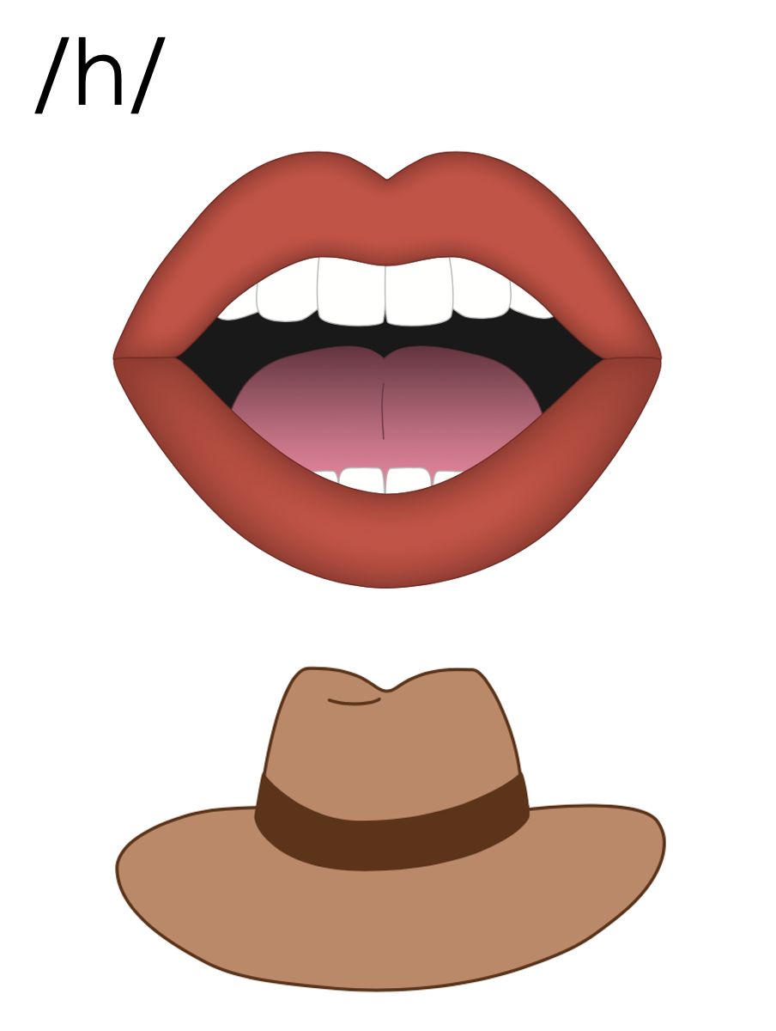
h

Slide 37
Notes:
Uppercase H gif

Slide 39
Notes:
Lowercase h gif

Slide 40
hat

Slide 41
had
has
him
hug
hen
hum

Slide 42
hunt
hint
hand

Slide 43
Notes:
See UFLI Foundations lesson plan Step 5 for words to spell.
Handwriting paper to model spelling.

Slide 44
Notes:
See UFLI Foundations lesson plan Step 5 for words to spell.
Handwriting paper for guided spelling practice.

Slide 46
Insert brief reinforcement activity and/or transition to next part of reading block.

Slide 47
Lesson 23
h /h/

Slide 49
New Concept Review
Notes:
See UFLI Foundations lesson plan Step 5 for recommended teacher language and activities to review the new concept.

Slide 50
h

Slide 51
had
has
h

Slide 52
h

Slide 53
Notes:
Lowercase h gif

Slide 54
had
has
him
hint

Slide 56
Notes:
See UFLI Foundations lesson plan Step 6 for word work activity.
Visit ufliteracy.org to access the Word Work Mat apps.

Slide 58
Notes:
See UFLI Foundations lesson plan Step 7 for irregular word activities.
The white rectangle under each word may be used in editing mode. Cover the heart and square icons then reveal them one at a time during instruction.

Slide 59
Notes:
See UFLI Foundations manual for more information about reviewing irregular words.

Slide 60
to
Notes:
Lesson 15+
O represents the /ū/ sound.
The white rectangle under the word may be used in editing mode. Cover the heart and square icons then reveal them one at a time during instruction.

Slide 61
do
Notes:
Lesson 15+
O represents the /ū/ sound.
The white rectangle under the word may be used in editing mode. Cover the heart and square icons then reveal them one at a time during instruction.

Slide 62
of
Notes:
Lesson 17+
O represents the /ŏ/ sound.
F represents the /v/ sound.
The white rectangle under the word may be used in editing mode. Cover the heart and square icons then reveal them one at a time during instruction.

Slide 63
see
Notes:
Lessons 19-84
*Temporarily irregular
EE /ē/ has not been introduced yet.
The white rectangle under the word may be used in editing mode. Cover the heart and square icons then reveal them one at a time during instruction.

Slide 64
ask
Notes:
Lessons 22-77AUS
*Temporarily irregular
A /ar/ has not been introduced yet.
The white rectangle under the word may be used in editing mode. Cover the heart and square icons then reveal them one at a time during instruction.

Slide 65
fast
Notes:
Lessons 22-77AUS
*Temporarily irregular
A /ar/ has not been introduced yet.
The white rectangle under the word may be used in editing mode. Cover the heart and square icons then reveal them one at a time during instruction.

Slide 66
Notes:
Handwriting paper for irregular word spelling practice. Use as needed.
See UFLI Foundations manual for more information about reviewing irregular words.

Slide 67
Teach
Notes:
The orange star indicates these are new irregular words that need to be introduced.
See UFLI Foundations manual for more information about teaching irregular words.

Slide 68
he
Notes:
Lessons 23-65
*Temporarily irregular
E /ē/ has not been introduced yet.
The white rectangle under the word may be used in editing mode. Cover the heart and square icons then reveal them one at a time during instruction.

Slide 69
be
Notes:
Lessons 23-65
*Temporarily irregular
E /ē/ has not been introduced yet.
The white rectangle under the word may be used in editing mode. Cover the heart and square icons then reveal them one at a time during instruction.

Slide 70
me
Notes:
Lessons 23-65
*Temporarily irregular
E /ē/ has not been introduced yet.
The white rectangle under the word may be used in editing mode. Cover the heart and square icons then reveal them one at a time during instruction.

Slide 71
Notes:
Handwriting paper for irregular word spelling practice. Use as needed.
See UFLI Foundations manual for more information about teaching irregular words.

Slide 73
Notes:
See UFLI Foundations lesson plan Step 8 for connected text activities.

Slide 74
It is hot in the hut.

Slide 75
Did he hit his hand?

Slide 76
Deb got me a big hat!

Slide 77
Notes:
See UFLI Foundations lesson plan Step 8 for sentences to write.

Slide 78
Notes:
The UFLI Foundations decodable text is provided here. See UFLI Foundations decodable text guide for additional text options.

Slide 79
The Big Hut
The hen sits in the big hut.
The hog sees the hut.
The hog asks the hen if he can sit in the hut.

Slide 80
The hog and the hen sit in the hut.
The dog sees the hut.
The dog asks the hen if he can sit in the hut.

Slide 81
The dog, the hog, and the hen sit in the big hut.

Slide 83
Insert brief reinforcement activity and/or transition to next part of reading block.

