Slide 1
Lesson 22
k /k/

Slide 2
Notes:
ufliteracy.org

Slide 4
Lesson 22
k /k/

Slide 6
Notes:
See UFLI Foundations lesson plan Step 1 for phonemic awareness activity.

Slide 8
Notes:
See UFLI Foundations lesson plan Step 2 for student phoneme responses.

Slide 9
s

Slide 10
e

Slide 11
b

Slide 12
g

Slide 13
u

Slide 14
c

Slide 15
d

Slide 16
o

Slide 17
n

Slide 18
i

Slide 19
f

Slide 20
p

Slide 21
t

Slide 22
m

Slide 23
a

Slide 25
Notes:
See UFLI Foundations lesson plan Step 3 for auditory drill activity.

Slide 26
Notes:
No slides needed for auditory drill.

Slide 28
Notes:
See UFLI Foundations lesson plan Step 4 for blending drill word chain and grid.
Visit ufliteracy.org to access the Blending Board app.

Slide 30
Notes:
See UFLI Foundations lesson plan Step 5 for recommended teacher language and activities to introduce the new concept.

Slide 31
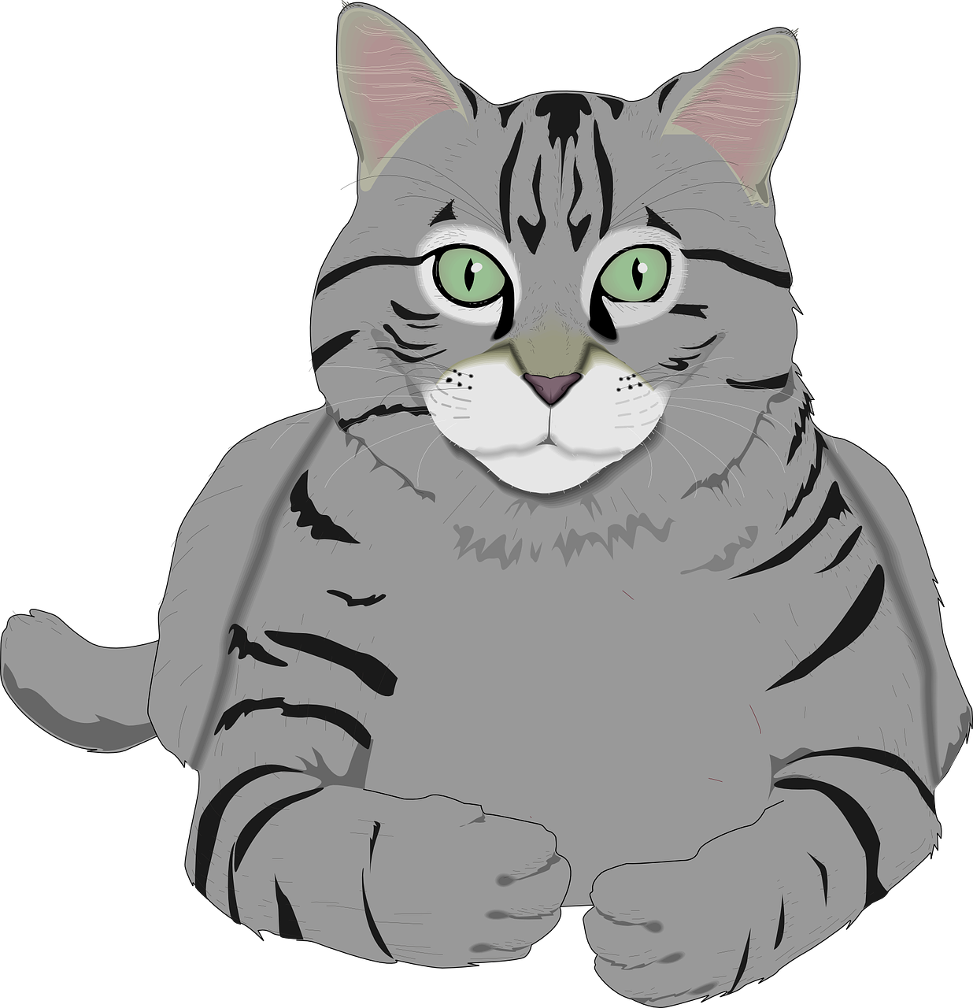
c

Slide 32
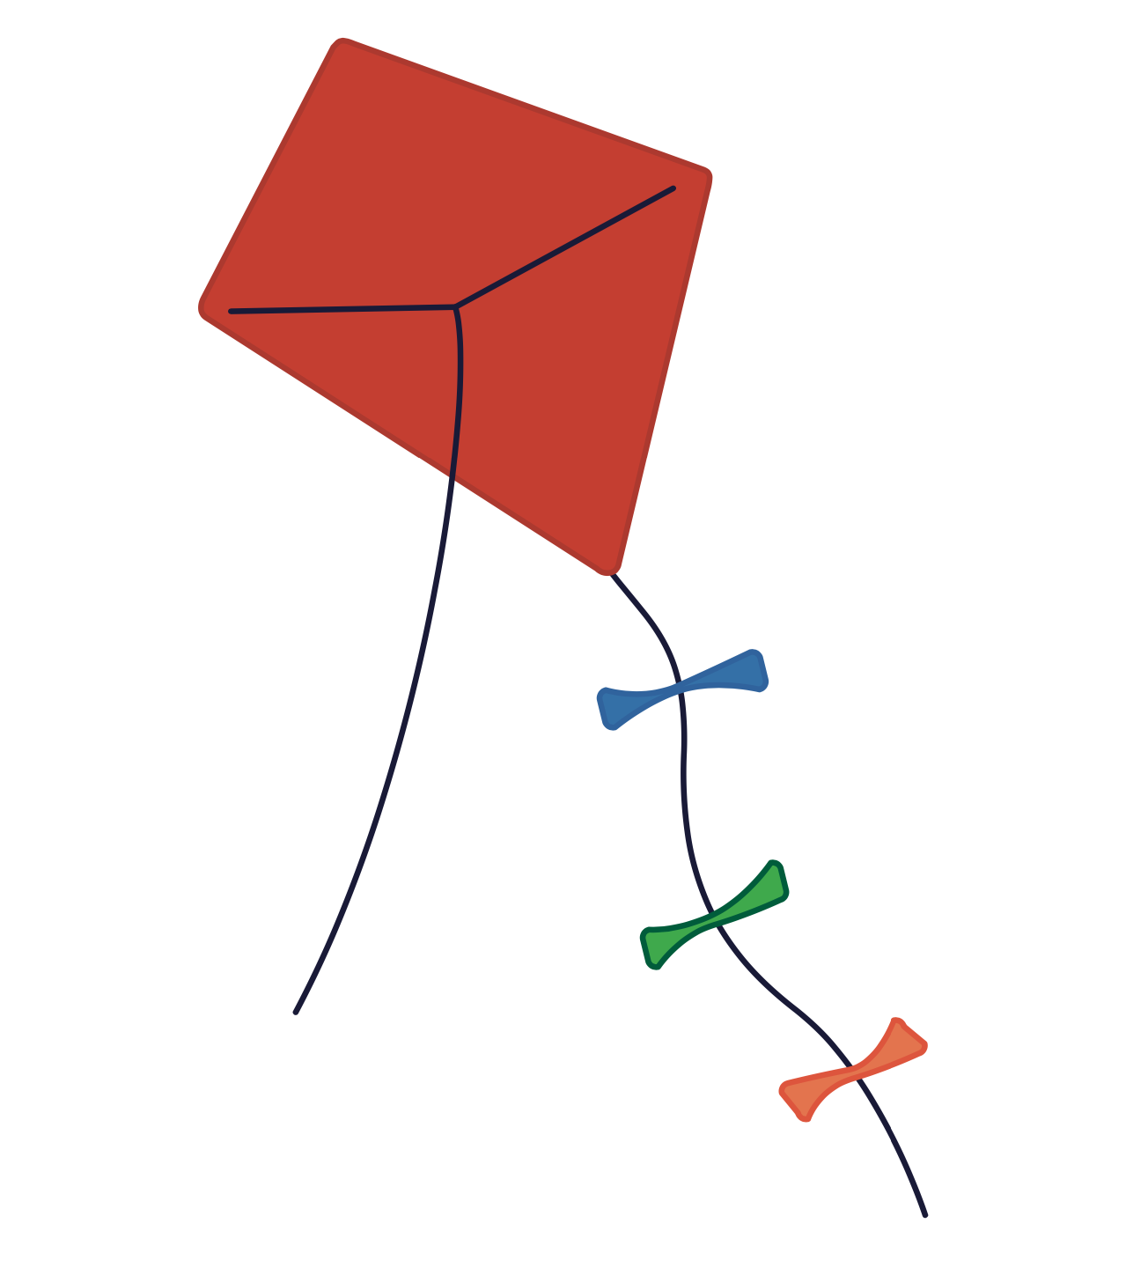
k

Slide 33
kid
kit
k

Slide 34
s
k
s k i p
d e s k

Slide 35
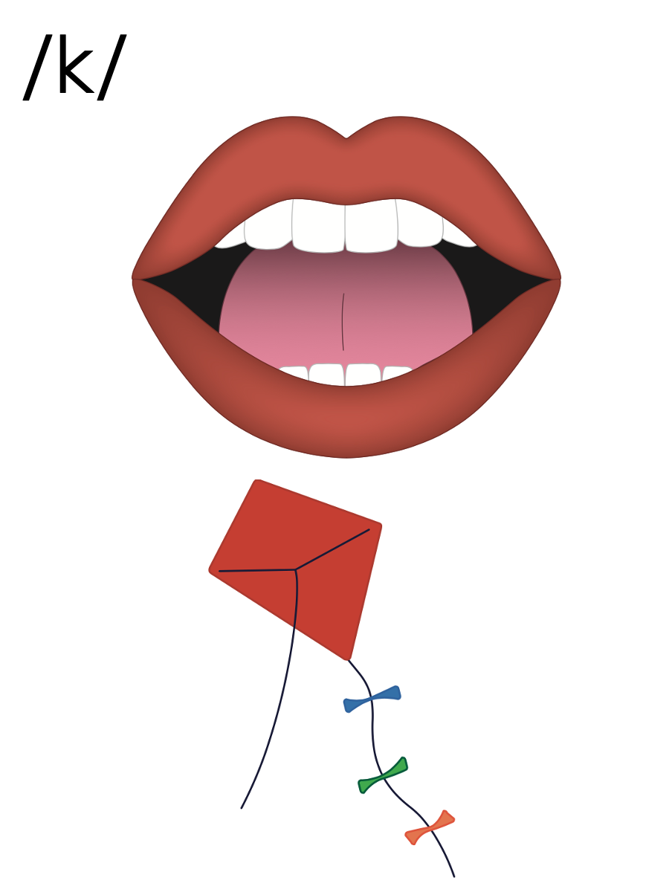
c
k

Slide 36
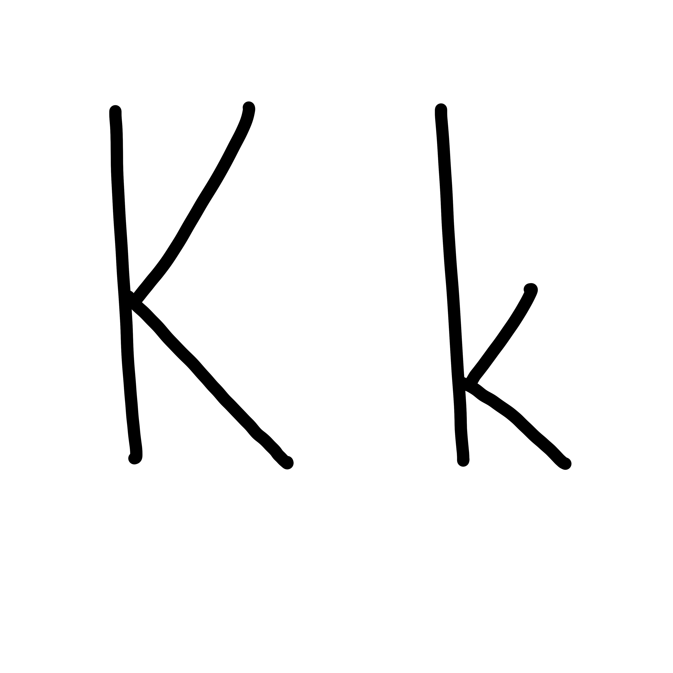

Slide 38
Notes:
Uppercase K gif

Slide 40
Notes:
Lowercase k gif

Slide 41
kit
desk

Slide 42
kin
kit
kids
skim
skit
skin

Slide 43
Notes:
See UFLI Foundations lesson plan Step 5 for words to spell.
Handwriting paper to model spelling.

Slide 44
Notes:
See UFLI Foundations lesson plan Step 5 for words to spell.
Handwriting paper for guided spelling practice.

Slide 46
Insert brief reinforcement activity and/or transition to next part of reading block.

Slide 47
Lesson 22
k /k/

Slide 49
New Concept Review
Notes:
See UFLI Foundations lesson plan Step 5 for recommended teacher language and activities to review the new concept.

Slide 50
c

Slide 51
k

Slide 52
kid
kit
k

Slide 53
s
k
s k i p
de s k

Slide 54
c
k

Slide 55
Notes:
Lowercase k gif

Slide 56
kid
kit
skip
desk

Slide 58
Notes:
See UFLI Foundations lesson plan Step 6 for word work activity.
Visit ufliteracy.org to access the Word Work Mat apps.

Slide 60
Notes:
See UFLI Foundations lesson plan Step 7 for irregular word activities.
The white rectangle under each word may be used in editing mode. Cover the heart and square icons then reveal them one at a time during instruction.

Slide 61
Notes:
See UFLI Foundations manual for more information about reviewing irregular words.

Slide 62
said
Notes:
Lesson 13+
AI represents the /ĕ/ sound.
The white rectangle under the word may be used in editing mode. Cover the heart and square icons then reveal them one at a time during instruction.

Slide 63
to
Notes:
Lesson 15+
O represents the /ū/ sound.
The white rectangle under the word may be used in editing mode. Cover the heart and square icons then reveal them one at a time during instruction.

Slide 64
do
Notes:
Lesson 15+
O represents the /ū/ sound.
The white rectangle under the word may be used in editing mode. Cover the heart and square icons then reveal them one at a time during instruction.

Slide 65
of
Notes:
Lesson 17+
O represents the /ŏ/ sound.
F represents the /v/ sound.
The white rectangle under the word may be used in editing mode. Cover the heart and square icons then reveal them one at a time during instruction.

Slide 66
see
Notes:
Lessons 19-84
*Temporarily irregular
EE /ē/ has not been introduced yet.
The white rectangle under the word may be used in editing mode. Cover the heart and square icons then reveal them one at a time during instruction.

Slide 67
Teach
Notes:
The orange star indicates these are new irregular words that need to be introduced.
See UFLI Foundations manual for more information about teaching irregular words.

Slide 68
ask
Notes:
Lessons 22-77AUS
*Temporarily irregular
A /ar/ has not been introduced yet.
The white rectangle under the word may be used in editing mode. Cover the heart and square icons then reveal them one at a time during instruction.

Slide 69
fast
Notes:
Lessons 22-77AUS
*Temporarily irregular
A /ar/ has not been introduced yet.
The white rectangle under the word may be used in editing mode. Cover the heart and square icons then reveal them one at a time during instruction.

Slide 70
Notes:
Handwriting paper for irregular word spelling practice. Use as needed.
See UFLI Foundations manual for more information about reviewing irregular words.

Slide 72
Notes:
See UFLI Foundations lesson plan Step 8 for connected text activities.

Slide 73
The kids skip.

Slide 74
I ask Kat to get the kit.

Slide 75
I can see dust on the
desk.

Slide 76
Notes:
See UFLI Foundations lesson plan Step 8 for sentences to write.

Slide 77
Notes:
The UFLI Foundations decodable text is provided here. See UFLI Foundations decodable text guide for additional text options.

Slide 78
Kip is the Best Pup
Kip is the best pup.
Kip digs.
Kip skips.
Kip sits in the sun.

Slide 79
Dad gets a disk.
Dad spins the disk up, up, up.
“Kip, get the disk,” said dad.
Kip is fast. Kip can see the disk.

Slide 80
But Kip did not see the mud.
“Stop, Kip!,” Dad said.
But Kip can not stop.
Kip skids into the mud.
Dad gets Kip and the disk in the tub.

Slide 82
Insert brief reinforcement activity and/or transition to next part of reading block.

