Slide 1
Lesson 21
-s /z/

Slide 2
Notes:
ufliteracy.org

Slide 4
Lesson 21
-s /z/

Slide 6
Notes:
See UFLI Foundations lesson plan Step 1 for phonemic awareness activity.

Slide 8
Notes:
See UFLI Foundations lesson plan Step 2 for student phoneme responses.

Slide 9
s

Slide 10
e

Slide 11
b

Slide 12
g

Slide 13
u

Slide 14
c

Slide 15
d

Slide 16
o

Slide 17
n

Slide 18
i

Slide 19
f

Slide 20
p

Slide 21
t

Slide 22
m

Slide 23
a

Slide 25
Notes:
See UFLI Foundations lesson plan Step 3 for auditory drill activity.

Slide 26
Notes:
No slides needed for auditory drill.

Slide 28
Notes:
See UFLI Foundations lesson plan Step 4 for blending drill word chain and grid.
Visit ufliteracy.org to access the Blending Board app.

Slide 30
Notes:
See UFLI Foundations lesson plan Step 5 for recommended teacher language and activities to introduce the new concept.

Slide 31
s

Slide 32
fans
pods

Slide 33
fans
pods

Slide 34
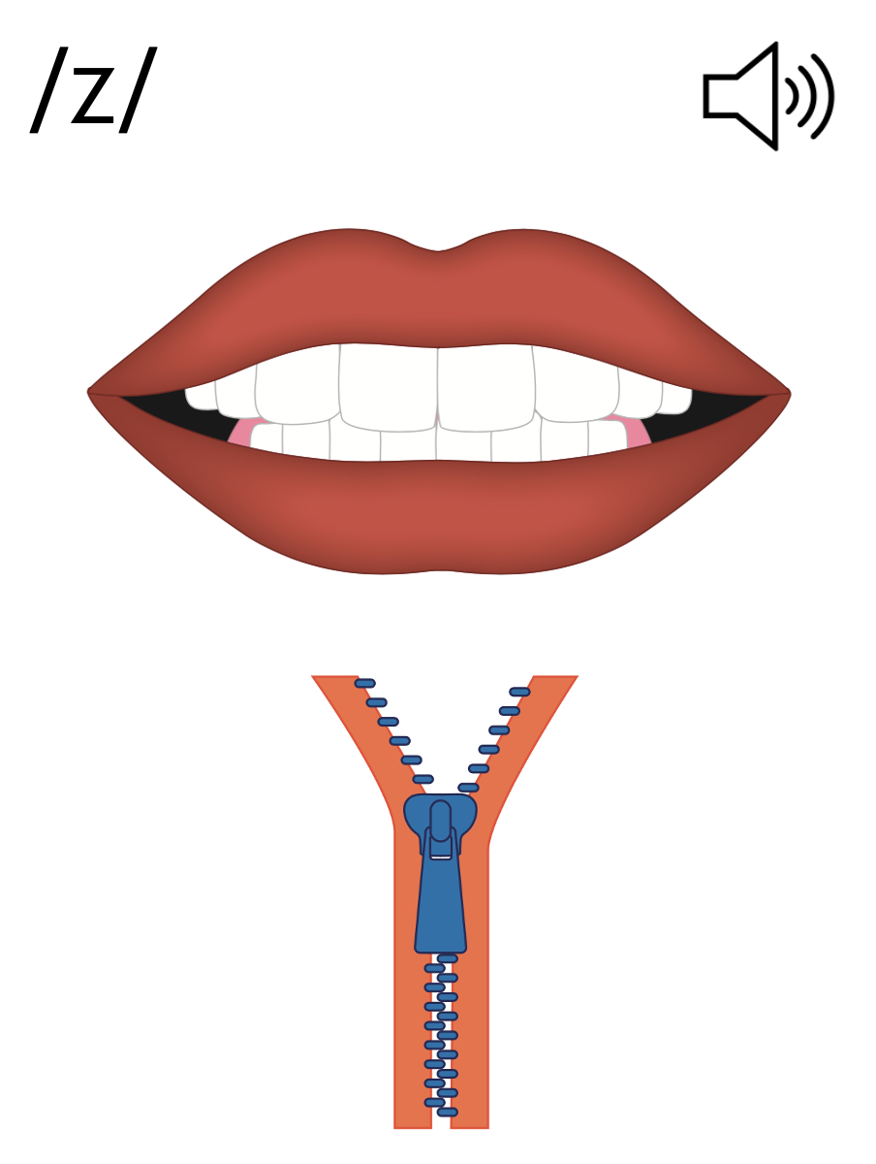
s

Slide 35
Notes:
Handwriting paper for letter formation practice. Use as needed.
See UFLI Foundations manual for more information about letter formation.

Slide 36
is
dads

Slide 37
is
as
fans
bugs
bags
pans

Slide 38
fins
dogs
suds

Slide 39
Notes:
See UFLI Foundations lesson plan Step 5 for words to spell.
Handwriting paper to model spelling.

Slide 40
Notes:
See UFLI Foundations lesson plan Step 5 for words to spell.
Handwriting paper for guided spelling practice.

Slide 42
Insert brief reinforcement activity and/or transition to next part of reading block.

Slide 43
Lesson 21
-s /z/

Slide 45
New Concept Review
Notes:
See UFLI Foundations lesson plan Step 5 for recommended teacher language and activities to review the new concept.

Slide 46
s

Slide 47
fans
pods

Slide 48
fans
pods

Slide 49
s

Slide 50
fins
bags
pens
bugs

Slide 52
Notes:
See UFLI Foundations lesson plan Step 6 for word work activity.
Visit ufliteracy.org to access the Word Work Mat apps.

Slide 54
Notes:
See UFLI Foundations lesson plan Step 7 for irregular word activities.
The white rectangle under each word may be used in editing mode. Cover the heart and square icons then reveal them one at a time during instruction.

Slide 55
Notes:
See UFLI Foundations manual for more information about reviewing irregular words.

Slide 56
said
Notes:
Lesson 13+
AI represents the /ĕ/ sound.
The white rectangle under the word may be used in editing mode. Cover the heart and square icons then reveal them one at a time during instruction.

Slide 57
to
Notes:
Lesson 15+
O represents the /ū/ sound.
The white rectangle under the word may be used in editing mode. Cover the heart and square icons then reveal them one at a time during instruction.

Slide 58
do
Notes:
Lesson 15+
O represents the /ū/ sound.
The white rectangle under the word may be used in editing mode. Cover the heart and square icons then reveal them one at a time during instruction.

Slide 59
of
Notes:
Lesson 17+
O represents the /ŏ/ sound.
F represents the /v/ sound.
The white rectangle under the word may be used in editing mode. Cover the heart and square icons then reveal them one at a time during instruction.

Slide 60
see
Notes:
Lessons 19-84
*Temporarily irregular
EE /ē/ has not been introduced yet.
The white rectangle under the word may be used in editing mode. Cover the heart and square icons then reveal them one at a time during instruction.

Slide 61
Notes:
Handwriting paper for irregular word spelling practice. Use as needed.
See UFLI Foundations manual for more information about reviewing irregular words.

Slide 63
Notes:
See UFLI Foundations lesson plan Step 8 for connected text activities.

Slide 64
Dad tugs on the tag.

Slide 65
The dog is as big as Ben!

Slide 66
Nat said,“I can see ten pigs!”

Slide 67
Notes:
See UFLI Foundations lesson plan Step 8 for sentences to write.

Slide 68
Notes:
The UFLI Foundations decodable text is provided here. See UFLI Foundations decodable text guide for additional text options.

Slide 69
Cubs in the Den
Mum sees the cubs.
Mum and the cubs get in the den.
The den is big.

Slide 70
Mum sits in the den.
The cubs see bugs and bats in the den.
The cubs get the bugs.

Slide 71
The cubs do not get the bats.
Mum and the cubs nap in the den.

Slide 73
Insert brief reinforcement activity and/or transition to next part of reading block.

