Slide 1
Lesson 20
-s /s/

Slide 2
Notes:
ufliteracy.org

Slide 4
Lesson 20
-s /s/

Slide 6
Notes:
See UFLI Foundations lesson plan Step 1 for phonemic awareness activity.

Slide 8
Notes:
See UFLI Foundations lesson plan Step 2 for student phoneme responses.

Slide 9
e

Slide 10
b

Slide 11
g

Slide 12
u

Slide 13
c

Slide 14
d

Slide 15
o

Slide 16
n

Slide 17
i

Slide 18
f

Slide 19
p

Slide 20
t

Slide 21
s

Slide 22
m

Slide 23
a

Slide 25
Notes:
See UFLI Foundations lesson plan Step 3 for auditory drill activity.

Slide 26
Notes:
No slides needed for auditory drill.

Slide 28
Notes:
See UFLI Foundations lesson plan Step 4 for blending drill word chain and grid.
Visit ufliteracy.org to access the Blending Board app.

Slide 30
Notes:
See UFLI Foundations lesson plan Step 5 for recommended teacher language and activities to introduce the new concept.

Slide 31
s

Slide 32
cat

Slide 33
cats

Slide 34
cats

Slide 35
tap

Slide 36
taps

Slide 37
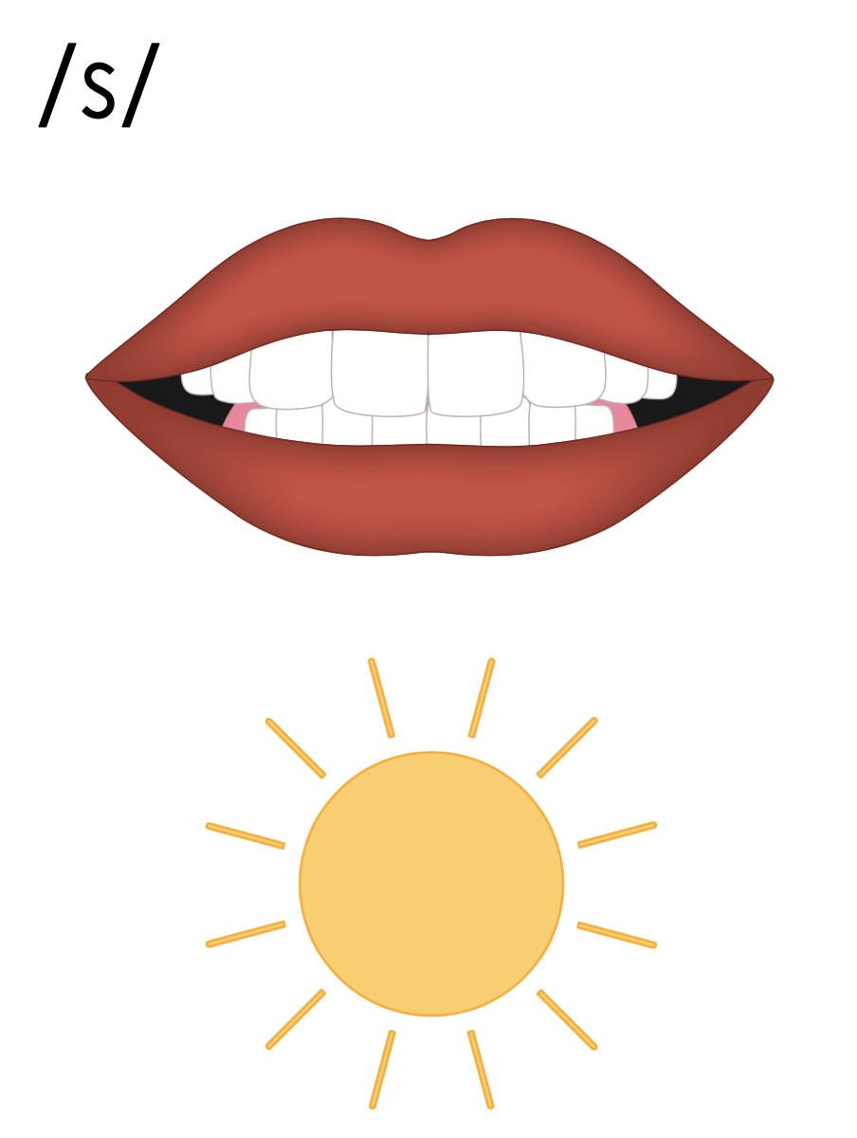

Slide 38
Notes:
Handwriting paper for letter formation practice. Use as needed.
See UFLI Foundations manual for more information about letter formation.

Slide 39
maps

Slide 40
mats
nets
nuts
pats
gets
tops

Slide 41
cats
sits
pots

Slide 42
Notes:
See UFLI Foundations lesson plan Step 5 for words to spell.
Handwriting paper to model spelling.

Slide 43
Notes:
See UFLI Foundations lesson plan Step 5 for words to spell.
Handwriting paper for guided spelling practice.

Slide 45
Insert brief reinforcement activity and/or transition to next part of reading block.

Slide 46
Lesson 20
-s /s/

Slide 48
New Concept Review
Notes:
See UFLI Foundations lesson plan Step 5 for recommended teacher language and activities to review the new concept.

Slide 49
s

Slide 50
cat

Slide 51
cats

Slide 52
cats

Slide 53
tap

Slide 54
taps

Slide 56
gets
cups
bats
sets

Slide 58
Notes:
See UFLI Foundations lesson plan Step 6 for word work activity.
Visit ufliteracy.org to access the Word Work Mat apps.

Slide 60
Notes:
See UFLI Foundations lesson plan Step 7 for irregular word activities.
The white rectangle under each word may be used in editing mode. Cover the heart and square icons then reveal them one at a time during instruction.

Slide 61
Notes:
See UFLI Foundations manual for more information about reviewing irregular words.

Slide 62
a
Notes:
Lesson 7+
A as a word can be pronounced /ā/ or /ŭ/.
The white rectangle under the word may be used in editing mode. Cover the heart and square icons then reveal them one at a time during instruction.

Slide 63
is
Notes:
Lessons 9-20
*Temporarily irregular
S /z/ has not been introduced yet.
The white rectangle under the word may be used in editing mode. Cover the heart and square icons then reveal them one at a time during instruction.

Slide 64
as
Notes:
Lessons 11-20
*Temporarily irregular
S /z/ has not been introduced yet.
The white rectangle under the word may be used in editing mode. Cover the heart and square icons then reveal them one at a time during instruction.

Slide 65
said
Notes:
Lesson 13+
AI represents the /ĕ/ sound.
The white rectangle under the word may be used in editing mode. Cover the heart and square icons then reveal them one at a time during instruction.

Slide 66
to
Notes:
Lesson 15+
O represents the /ū/ sound.
The white rectangle under the word may be used in editing mode. Cover the heart and square icons then reveal them one at a time during instruction.

Slide 67
do
Notes:
Lesson 15+
O represents the /ū/ sound.
The white rectangle under the word may be used in editing mode. Cover the heart and square icons then reveal them one at a time during instruction.

Slide 68
of
Notes:
Lesson 17+
O represents the /ŏ/ sound.
F represents the /v/ sound.
The white rectangle under the word may be used in editing mode. Cover the heart and square icons then reveal them one at a time during instruction.

Slide 69
see
Notes:
Lessons 19-84
*Temporarily irregular
EE /ē/ has not been introduced yet.
The white rectangle under the word may be used in editing mode. Cover the heart and square icons then reveal them one at a time during instruction.

Slide 70
Notes:
Handwriting paper for irregular word spelling practice. Use as needed.
See UFLI Foundations manual for more information about reviewing irregular words.

Slide 72
Notes:
See UFLI Foundations lesson plan Step 8 for connected text activities.

Slide 73
Dad naps on the bed.

Slide 74
The pups sat in the pen.

Slide 75
Sid and Meg see the cats.

Slide 76
Notes:
See UFLI Foundations lesson plan Step 8 for sentences to write.

Slide 77
Notes:
The UFLI Foundations decodable text is provided here. See UFLI Foundations decodable text guide for additional text options.

Slide 78
Pet Cats
Tam and Meg got cats.
“The cats can fit on the bed,” said Tam.

Slide 79
“The cats can sit on top of the cot,” said Meg.
Tam pets the cats.
Meg pets the cats.
The cats nap.

Slide 81
Insert brief reinforcement activity and/or transition to next part of reading block.

