Slide 1
Lesson 17
b /b/

Slide 2
Notes:
ufliteracy.org

Slide 4
Lesson 17
b /b/

Slide 6
Notes:
See UFLI Foundations lesson plan Step 1 for phonemic awareness activity.

Slide 8
Notes:
See UFLI Foundations lesson plan Step 2 for student phoneme responses.

Slide 9
g

Slide 10
u

Slide 11
c

Slide 12
d

Slide 13
o

Slide 14
n

Slide 15
i

Slide 16
f

Slide 17
p

Slide 18
t

Slide 19
s

Slide 20
m

Slide 21
a

Slide 23
Notes:
See UFLI Foundations lesson plan Step 3 for auditory drill activity.

Slide 24
Notes:
No slides needed for auditory drill.

Slide 26
Notes:
See UFLI Foundations lesson plan Step 4 for blending drill word chain and grid.
Visit ufliteracy.org to access the Blending Board app.

Slide 28
Notes:
See UFLI Foundations lesson plan Step 5 for recommended teacher language and activities to introduce the new concept.

Slide 29
b

Slide 30
bat
big
b

Slide 31
cab
tub
b

Slide 32
b

Slide 33
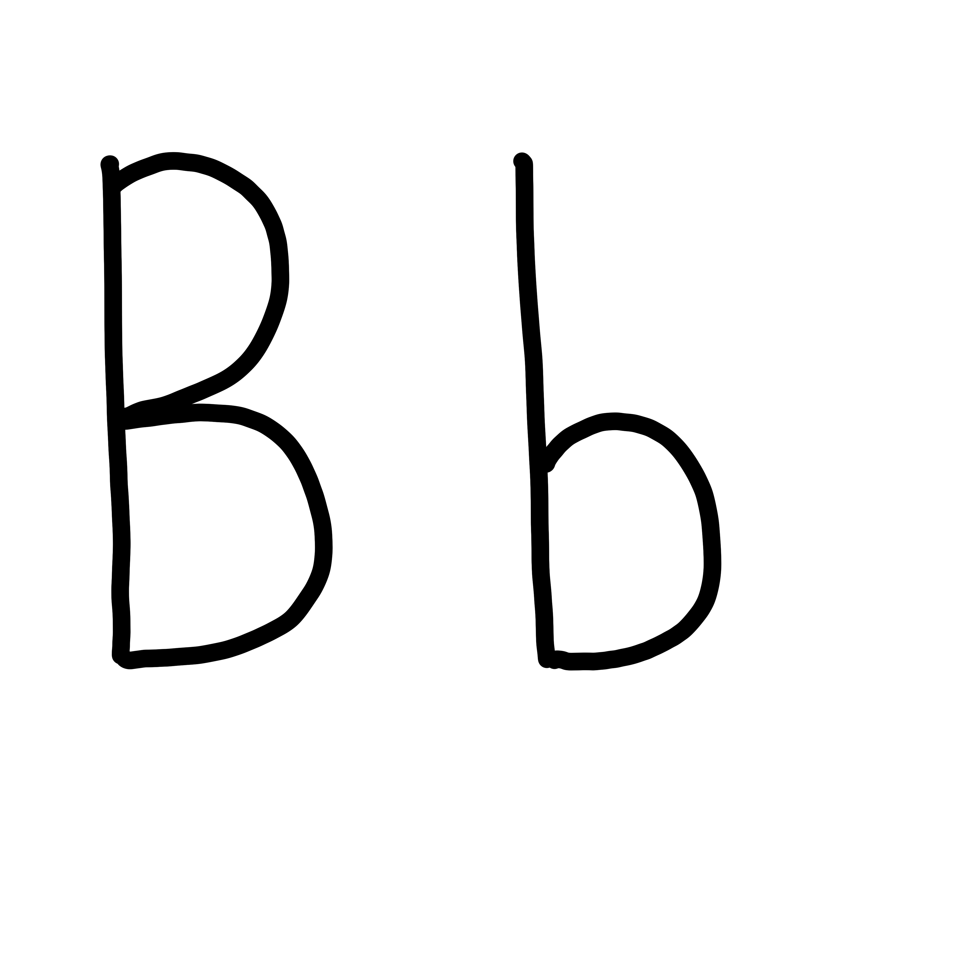

Slide 35
Notes:
Uppercase B gif

Slide 37
Notes:
Lowercase b gif

Slide 38
mob
bag

Slide 39
sob
cub
fib
tub
bat
bad

Slide 40
but
bus
big

Slide 41
Notes:
See UFLI Foundations lesson plan Step 5 for words to spell.
Handwriting paper to model spelling.

Slide 42
Notes:
See UFLI Foundations lesson plan Step 5 for words to spell.
Handwriting paper for guided spelling practice.

Slide 44
Insert brief reinforcement activity and/or transition to next part of reading block.

Slide 45
Lesson 17
b /b/

Slide 47
New Concept Review
Notes:
See UFLI Foundations lesson plan Step 5 for recommended teacher language and activities to review the new concept.

Slide 48
b

Slide 49
bat
big
b

Slide 50
cab
tub
b

Slide 51
b

Slide 52
Notes:
Lowercase b gif

Slide 53
but
big
mob
tub

Slide 55
Notes:
See UFLI Foundations lesson plan Step 6 for word work activity.
Visit ufliteracy.org to access the Word Work Mat apps.

Slide 57
Notes:
See UFLI Foundations lesson plan Step 7 for irregular word activities.
The white rectangle under each word may be used in editing mode. Cover the heart and square icons then reveal them one at a time during instruction.

Slide 58
Notes:
See UFLI Foundations manual for more information about reviewing irregular words.

Slide 59
and
Notes:
Lessons 13+
This temporarily irregular word is now decodable because nasalized A and D /d/ have been introduced.
The white rectangle under the word may be used in editing mode. Cover the heart and square icons then reveal them one at a time during instruction.

Slide 60
a
Notes:
Lesson 7+
A as a word can be pronounced /ā/ or /ŭ/.
The white rectangle under the word may be used in editing mode. Cover the heart and square icons then reveal them one at a time during instruction.

Slide 61
is
Notes:
Lessons 9-20
*Temporarily irregular
S /z/ has not been introduced yet.
The white rectangle under the word may be used in editing mode. Cover the heart and square icons then reveal them one at a time during instruction.

Slide 62
as
Notes:
Lessons 11-20
*Temporarily irregular
S /z/ has not been introduced yet.
The white rectangle under the word may be used in editing mode. Cover the heart and square icons then reveal them one at a time during instruction.

Slide 63
said
Notes:
Lesson 13+
AI represents the /ĕ/ sound.
The white rectangle under the word may be used in editing mode. Cover the heart and square icons then reveal them one at a time during instruction.

Slide 64
to
Notes:
Lesson 15+
O represents the /ū/ sound.
The white rectangle under the word may be used in editing mode. Cover the heart and square icons then reveal them one at a time during instruction.

Slide 65
do
Notes:
Lesson 15+
O represents the /ū/ sound.
The white rectangle under the word may be used in editing mode. Cover the heart and square icons then reveal them one at a time during instruction.

Slide 66
Notes:
Handwriting paper for irregular word spelling practice. Use as needed.
See UFLI Foundations manual for more information about reviewing irregular words.

Slide 67
Teach
Notes:
The orange star indicates these are new irregular words that need to be introduced.
See UFLI Foundations manual for more information about teaching irregular words.

Slide 68
of
Notes:
Lesson 17+
O represents the /ŏ/ sound.
F represents the /v/ sound.
The white rectangle under the word may be used in editing mode. Cover the heart and square icons then reveal them one at a time during instruction.

Slide 69
Notes:
Handwriting paper for irregular word spelling practice. Use as needed.
See UFLI Foundations manual for more information about teaching irregular words.

Slide 71
Notes:
See UFLI Foundations lesson plan Step 8 for connected text activities.

Slide 72
I got a big bag.

Slide 73
The pup is in the tub.

Slide 74
The bug is in the can.

Slide 75
Notes:
See UFLI Foundations lesson plan Step 8 for sentences to write.

Slide 76
Notes:
The UFLI Foundations decodable text is provided here. See UFLI Foundations decodable text guide for additional text options.

Slide 77
A Bug on the Bus
Sib got on the bus.
Bob, Gab, and Bim got on the bus.
A big, bad bug got on the bus.

Slide 78
“I can not sit on the bus,” said Sib.
Sib got up.
Bob got up.

Slide 79
Gab got up and Bim got up.
But the big, bad bug did not.

Slide 81
Insert brief reinforcement activity and/or transition to next part of reading block.

