Slide 1
Lesson 16
g /g/

Slide 2
Notes:
ufliteracy.org

Slide 4
Lesson 16
g /g/

Slide 6
Notes:
See UFLI Foundations lesson plan Step 1 for phonemic awareness activity.

Slide 8
Notes:
See UFLI Foundations lesson plan Step 2 for student phoneme responses.

Slide 9
u

Slide 10
c

Slide 11
d

Slide 12
o

Slide 13
n

Slide 14
i

Slide 15
f

Slide 16
p

Slide 17
t

Slide 18
s

Slide 19
m

Slide 20
a

Slide 22
Notes:
See UFLI Foundations lesson plan Step 3 for auditory drill activity.

Slide 23
Notes:
No slides needed for auditory drill.

Slide 25
Notes:
See UFLI Foundations lesson plan Step 4 for blending drill word chain and grid.
Visit ufliteracy.org to access the Blending Board app.

Slide 27
Notes:
See UFLI Foundations lesson plan Step 5 for recommended teacher language and activities to introduce the new concept.

Slide 28
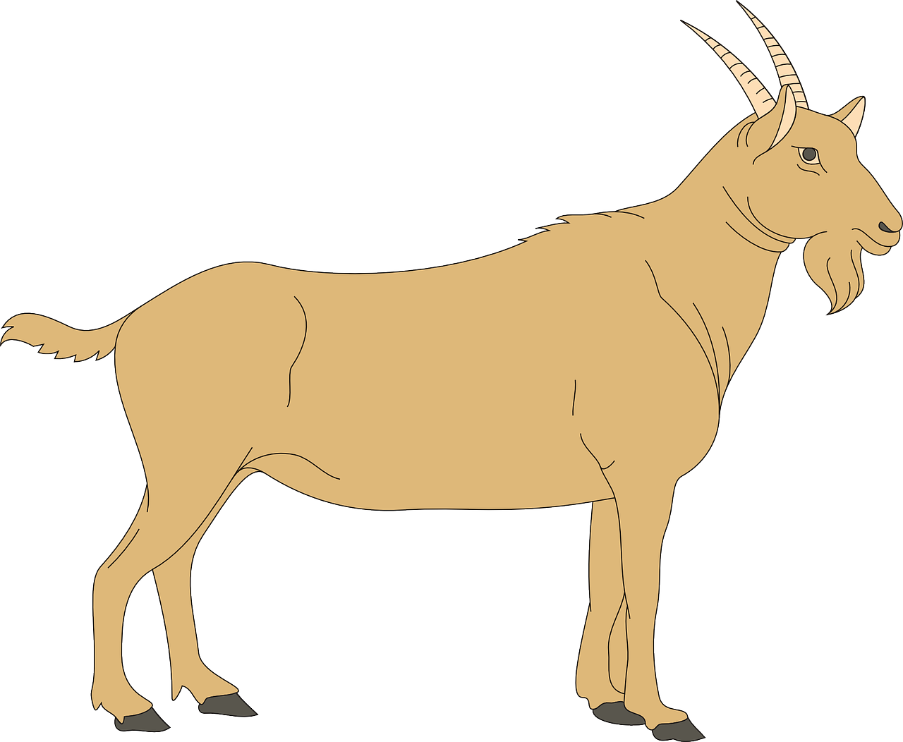
g

Slide 29
got
gas
g

Slide 30
dog
tag
g

Slide 31
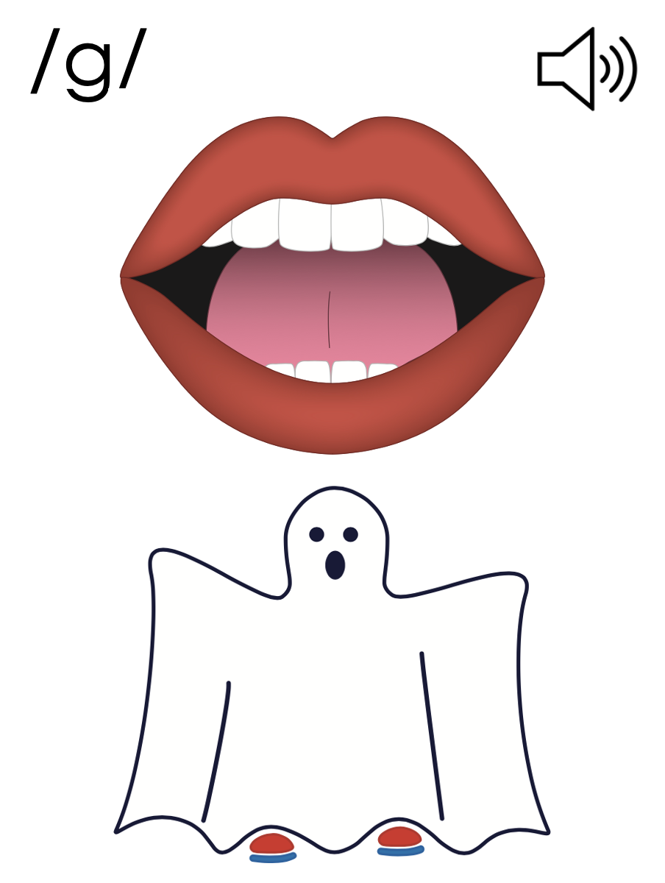
g

Slide 34
Notes:
Uppercase G gif

Slide 36
Notes:
Lowercase g gif

Slide 37
tug
gap

Slide 38
fog
mug
dog
tag
pig
got

Slide 39
gas
gum
gut

Slide 40
Notes:
See UFLI Foundations lesson plan Step 5 for words to spell.
Handwriting paper to model spelling.

Slide 41
Notes:
See UFLI Foundations lesson plan Step 5 for words to spell.
Handwriting paper for guided spelling practice.

Slide 43
Insert brief reinforcement activity and/or transition to next part of reading block.

Slide 44
Lesson 16
g /g/

Slide 46
New Concept Review
Notes:
See UFLI Foundations lesson plan Step 5 for recommended teacher language and activities to review the new concept.

Slide 47
g

Slide 48
got
gas
g

Slide 49
dog
tag
g

Slide 50
g

Slide 51
Notes:
Lowercase g gif

Slide 52
got
gas
dog
pig

Slide 54
Notes:
See UFLI Foundations lesson plan Step 6 for word work activity.
Visit ufliteracy.org to access the Word Work Mat apps.

Slide 56
Notes:
See UFLI Foundations lesson plan Step 7 for irregular word activities.
The white rectangle under each word may be used in editing mode. Cover the heart and square icons then reveal them one at a time during instruction.

Slide 57
Notes:
See UFLI Foundations manual for more information about reviewing irregular words.

Slide 58
the
Notes:
Lessons 1-45
The digraph TH has not been introduced yet.
E represents the /ŭ/ or /ə/ sound depending on stress.
The white rectangle under the word may be used in editing mode. Cover the heart and square icons then reveal them one at a time during instruction.

Slide 59
I
Notes:
Lessons 3-65
*Temporarily irregular
I /ī/ has not been introduced yet.
The white rectangle under the word may be used in editing mode. Cover the heart and square icons then reveal them one at a time during instruction.

Slide 60
and
Notes:
Lessons 13+
This temporarily irregular word is now decodable because nasalized A and D /d/ have been introduced.
The white rectangle under the word may be used in editing mode. Cover the heart and square icons then reveal them one at a time during instruction.

Slide 61
a
Notes:
Lesson 7+
A as a word can be pronounced /ā/ or /ŭ/.
The white rectangle under the word may be used in editing mode. Cover the heart and square icons then reveal them one at a time during instruction.

Slide 62
is
Notes:
Lessons 9-20
*Temporarily irregular
S /z/ has not been introduced yet.
The white rectangle under the word may be used in editing mode. Cover the heart and square icons then reveal them one at a time during instruction.

Slide 63
as
Notes:
Lessons 11-20
*Temporarily irregular
S /z/ has not been introduced yet.
The white rectangle under the word may be used in editing mode. Cover the heart and square icons then reveal them one at a time during instruction.

Slide 64
said
Notes:
Lesson 13+
AI represents the /ĕ/ sound.
The white rectangle under the word may be used in editing mode. Cover the heart and square icons then reveal them one at a time during instruction.

Slide 65
to
Notes:
Lesson 15+
O represents the /ū/ sound.
The white rectangle under the word may be used in editing mode. Cover the heart and square icons then reveal them one at a time during instruction.

Slide 66
do
Notes:
Lesson 15+
O represents the /ū/ sound.
The white rectangle under the word may be used in editing mode. Cover the heart and square icons then reveal them one at a time during instruction.

Slide 67
Notes:
Handwriting paper for irregular word spelling practice. Use as needed.
See UFLI Foundations manual for more information about reviewing irregular words.

Slide 69
Notes:
See UFLI Foundations lesson plan Step 8 for connected text activities.

Slide 70
Do not gag!

Slide 71
Mum got a mug.

Slide 72
A dog and pig dug.

Slide 73
Notes:
See UFLI Foundations lesson plan Step 8 for sentences to write.

Slide 74
Notes:
The UFLI Foundations decodable text is provided here. See UFLI Foundations decodable text guide for additional text options.

Slide 75
Gus the Dog
Gus is a dog.
Gus the dog is fun.
Gus the dog can dig.
Gus can dig in a pit.

Slide 76
Gus dug and dug and dug.
Gus dug in the mud!
“Gus! Do not dig in the mud!” said Mum.

Slide 78
Insert brief reinforcement activity and/or transition to next part of reading block.

