Slide 1
Lesson 119
-sion, -tion

Slide 2
Notes:
ufliteracy.org

Slide 4
Lesson 119
-sion, -tion

Slide 6
Notes:
See UFLI Foundations lesson plan Step 1 for phonemic awareness activity.

Slide 8
Notes:
See UFLI Foundations lesson plan Step 2 for student phoneme responses.

Slide 9
ch

Slide 10
gn

Slide 11
gh

Slide 12
c

Slide 13
g

Slide 14
ough

Slide 15
ew

Slide 16
eu

Slide 17
ue

Slide 18
ou

Slide 19
ei

Slide 20
eigh

Slide 21
ey

Slide 22
aigh

Slide 23
air

Slide 24
are

Slide 25
ear

Slide 26
our

Slide 27
or

Slide 28
ar

Slide 29
-ed

Slide 31
Notes:
See UFLI Foundations lesson plan Step 3 for auditory drill activity.

Slide 32
Notes:
No slides needed for auditory drill.

Slide 34
Notes:
See UFLI Foundations lesson plan Step 4 for blending drill word chain and grid.
Visit ufliteracy.org to access the Blending Board app.

Slide 36
Notes:
See UFLI Foundations lesson plan Step 5 for recommended teacher language and activities to introduce the new concept.

Slide 37
Syllables
Words or word parts with one vowel sound.

Slide 38
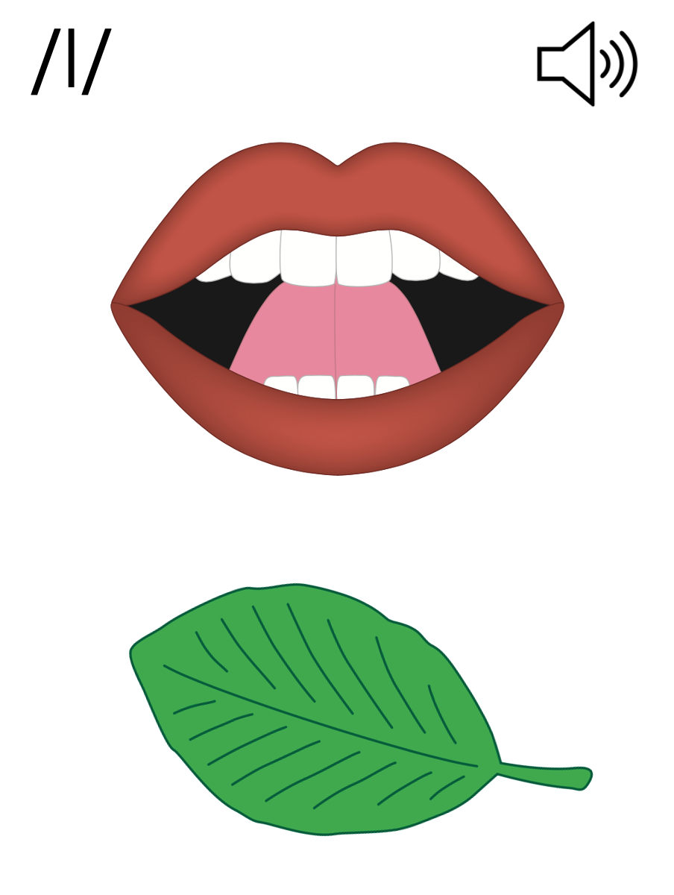
Final Stable Syllables
__ le
apple
puzzle

Slide 39
Final Stable Syllables
-sion
-tion

Slide 40
-sion
vision
diversion

Slide 41
-sion
passion
extension

Slide 42
-tion
fiction
question

Slide 43
ro
ta
tion
Notes:
**display in slideshow mode for animations

Slide 44
division

Slide 45
fraction
portion
section
question
invasion
vision

Slide 46
decision
confusion
equation

Slide 47
Notes:
See UFLI Foundations lesson plan Step 5 for words to spell.
Handwriting paper to model spelling.

Slide 48
Notes:
See UFLI Foundations lesson plan Step 5 for words to spell.
Handwriting paper for guided spelling practice.

Slide 50
Insert brief reinforcement activity and/or transition to next part of reading block.

Slide 51
Lesson 119
-sion, -tion

Slide 53
New Concept Review
Notes:
See UFLI Foundations lesson plan Step 5 for recommended teacher language and activities to review the new concept.

Slide 54
Syllables
Words or word parts with one vowel sound.

Slide 55
Final Stable Syllables
__ le
apple
puzzle

Slide 56
Final Stable Syllables
-sion
-tion

Slide 57
-sion
vision
diversion

Slide 58
-sion
passion
extension

Slide 59
-tion
fiction
question

Slide 60
ro
ta
tion
Notes:
**display in slideshow mode for animations

Slide 61
nation
portion

Slide 62
vision
question

Slide 64
Notes:
See UFLI Foundations lesson plan Step 6 for word work activity.
Visit ufliteracy.org to access the Word Work Mat apps.

Slide 65
Notes:
Display this slide in editing mode. Click and hold to drag words into the appropriate box.

Slide 67
Notes:
See UFLI Foundations lesson plan Step 7 for irregular word activities.
The white rectangle under each word may be used in editing mode. Cover the heart and square icons then reveal them one at a time during instruction.

Slide 68
Notes:
See UFLI Foundations manual for more information about reviewing irregular words.

Slide 69
guess
Notes:
Lesson 117+
UE represents the /ĕ/ sound, or U is silent.
The white rectangle under the word may be used in editing mode. Cover the heart and square icons then reveal them one at a time during instruction.

Slide 70
guest
Notes:
Lesson 117+
UE represents the /ĕ/ sound, or U is silent.
The white rectangle under the word may be used in editing mode. Cover the heart and square icons then reveal them one at a time during instruction.

Slide 71
guide
Notes:
Lesson 117+
UI represents the /ī/ sound, or U is silent.
The white rectangle under the word may be used in editing mode. Cover the heart and square icons then reveal them one at a time during instruction.

Slide 72
young
Notes:
Lesson 118+
OU represents the /ŭ/ sound.
The white rectangle under the word may be used in editing mode. Cover the heart and square icons then reveal them one at a time during instruction.

Slide 73
touch
Notes:
Lesson 118+
OU represents the /ŭ/ sound.
The white rectangle under the word may be used in editing mode. Cover the heart and square icons then reveal them one at a time during instruction.

Slide 74
Notes:
Handwriting paper for irregular word spelling practice. Use as needed.
See UFLI Foundations manual for more information about reviewing irregular words.

Slide 75
Teach
Notes:
The orange star indicates these are new irregular words that need to be introduced.
See UFLI Foundations manual for more information about teaching irregular words.

Slide 76
enough
Notes:
Lesson 119+
In some dialects, E represents /ī/ or /ə/ sound.
OU represents the /ŭ/ sound.
GH represents the /f/ sound.
Alternatively, O represents the /ŭ/ sound, and UGH represents the /f/ sound.
The white rectangle under the word may be used in editing mode. Cover the heart and square icons then reveal them one at a time during instruction.

Slide 77
tough
Notes:
Lesson 119+
OU represents the /ŭ/ sound.
GH represents the /f/ sound.
Alternatively, O represents the /ŭ/ sound, and UGH represents the /f/ sound
The white rectangle under the word may be used in editing mode. Cover the heart and square icons then reveal them one at a time during instruction.

Slide 78
rough
Notes:
Lesson 119+
OU represents the /ŭ/ sound.
GH represents the /f/ sound.
Alternatively, O represents the /ŭ/ sound, and UGH represents the /f/ sound
The white rectangle under the word may be used in editing mode. Cover the heart and square icons then reveal them one at a time during instruction.

Slide 79
Notes:
Handwriting paper for irregular word spelling practice. Use as needed.
See UFLI Foundations manual for more information about teaching irregular words.

Slide 81
Notes:
See UFLI Foundations lesson plan Step 8 for connected text activities.

Slide 82
It is time for an excursion because we
have worked enough.

Slide 83
They are on a mission to stop the invasion!

Slide 84
Reading fiction and watching television are my passions.

Slide 85
Notes:
See UFLI Foundations lesson plan Step 8 for sentences to write.

Slide 86
Notes:
The UFLI Foundations decodable text is provided here. See UFLI Foundations decodable text guide for additional text options.

Slide 87
The Audition
Today is a big day for Matilda. The theatre club is holding auditions for the school play. Acting is Matilda’s passion. She is auditioning for the lead role. This year’s play is about a mission to outer space. It is packed with action and ends with a real explosion!

Slide 88
Matilda walked into the theatre club meeting. She excitedly handed her permission slip to the director and found a seat. She listened as the director explained how the audition would work.
“Remember to be creative and use your imaginations. Any questions before we begin?”

Slide 89
No questions. Everyone was ready to begin. The students took turns auditioning for the director. There was a lot of competition, but Matilda did a great job! Once the auditions were finished, the director announced the parts.

Slide 90
“This was a tough decision,” she said. “You each made a great impression. The lead role goes to... Matilda!” Matilda leaped out of her seat with joy. Her friends clapped for her. She could not wait to run home and start memorising her lines.

Slide 92
Insert brief reinforcement activity and/or transition to next part of reading block.

