Slide 1
Lesson 118
Alternate ch, gn, gh, silent t

Slide 2
Notes:
ufliteracy.org

Slide 4
Lesson 118
Alternate ch, gn, gh, silent t

Slide 6
Notes:
See UFLI Foundations lesson plan Step 1 for phonemic awareness activity.

Slide 8
Notes:
See UFLI Foundations lesson plan Step 2 for student phoneme responses.

Slide 9
c

Slide 10
g

Slide 11
ough

Slide 12
ew

Slide 13
eu

Slide 14
ue

Slide 15
ou

Slide 16
ei

Slide 17
eigh

Slide 18
ey

Slide 19
aigh

Slide 20
air

Slide 21
are

Slide 22
ear

Slide 23
our

Slide 24
or

Slide 25
ar

Slide 26
-ed

Slide 27
y

Slide 29
Notes:
See UFLI Foundations lesson plan Step 3 for auditory drill activity.

Slide 30
Notes:
No slides needed for auditory drill.

Slide 32
Notes:
See UFLI Foundations lesson plan Step 4 for blending drill word chain and grid.
Visit ufliteracy.org to access the Blending Board app.

Slide 34
Notes:
See UFLI Foundations lesson plan Step 5 for recommended teacher language and activities to introduce the new concept.

Slide 35
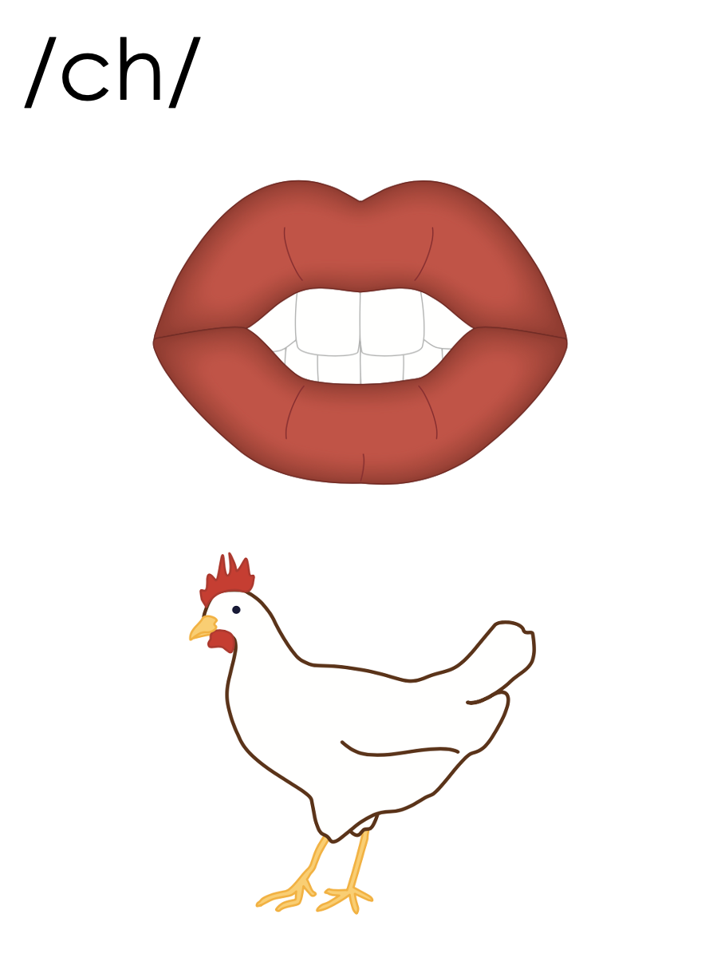
ch
chip

Slide 36
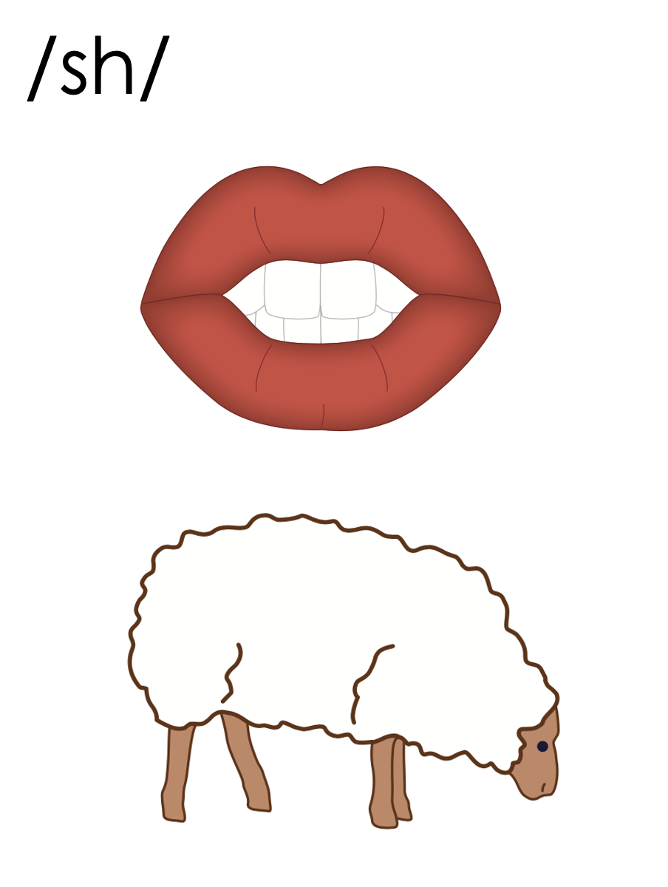
ch
chute

Slide 37
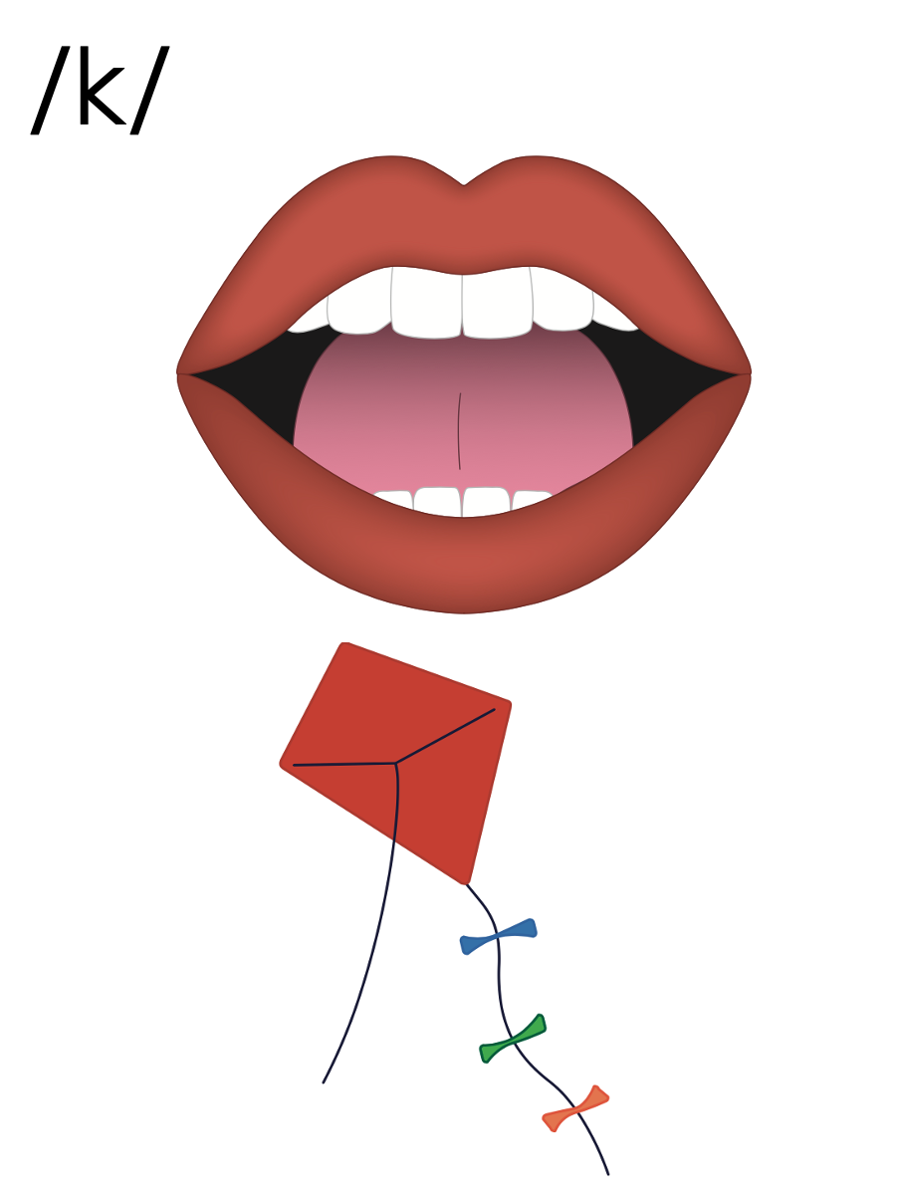
ch
chord

Slide 38
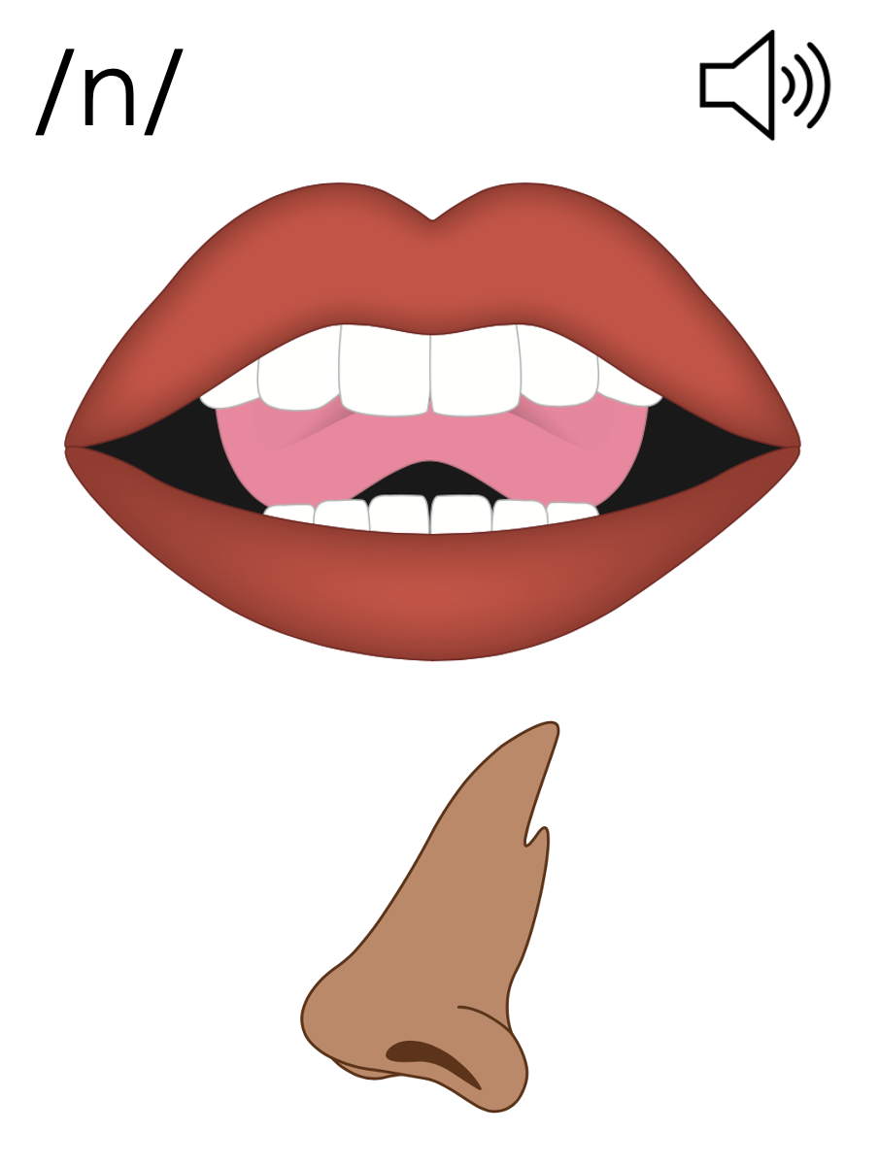
kn
knot

Slide 39
gn
gnat
reign

Slide 40
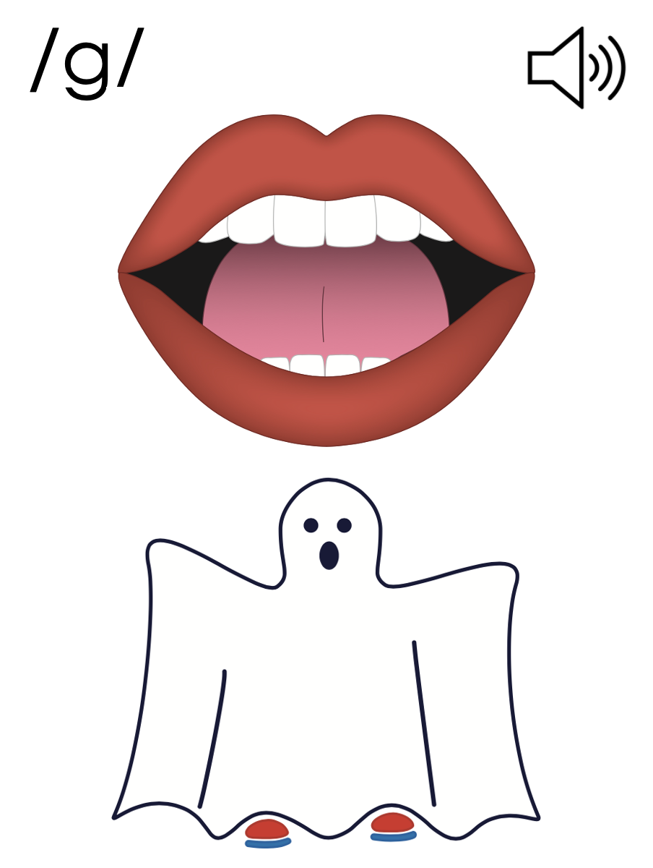
gh
ghost

Slide 41
t
-sten
-stle
listen
whistle

Slide 42
sh
c
n
g
ch
k
kn
gh
ck
gn
ch

Slide 43
echo
listen

Slide 44
chute
echo
school

Slide 45
anchor
chord
mustache

Slide 46
gnat
ghastly
bustle

Slide 47
castle
often
glisten

Slide 48
Notes:
See UFLI Foundations lesson plan Step 5 for words to spell.
Handwriting paper to model spelling.

Slide 49
Notes:
See UFLI Foundations lesson plan Step 5 for words to spell.
Handwriting paper for guided spelling practice.

Slide 51
Insert brief reinforcement activity and/or transition to next part of reading block.

Slide 52
Lesson 118
Alternate ch, gn, gh, silent t

Slide 54
New Concept Review
Notes:
See UFLI Foundations lesson plan Step 5 for recommended teacher language and activities to review the new concept.

Slide 55
ch
chip

Slide 56
ch
chute

Slide 57
ch
chord

Slide 58
kn
knot

Slide 59
gn
gnat
reign

Slide 60
gh
ghost

Slide 61
t
-sten
-stle
listen
whistle

Slide 62
sh
c
n
g
ch
k
kn
gh
ck
gn
ch

Slide 63
chef
school
listen

Slide 64
gnat
gnaw
ghost

Slide 66
Notes:
See UFLI Foundations lesson plan Step 6 for word work activity.
Visit ufliteracy.org to access the Word Work Mat apps.

Slide 68
Notes:
See UFLI Foundations lesson plan Step 7 for irregular word activities.
The white rectangle under each word may be used in editing mode. Cover the heart and square icons then reveal them one at a time during instruction.

Slide 69
Notes:
See UFLI Foundations manual for more information about reviewing irregular words.

Slide 70
buy
Notes:
Lesson 116+
UY represents the /ī/ sound or U is silent.
The white rectangle under the word may be used in editing mode. Cover the heart and square icons then reveal them one at a time during instruction.

Slide 71
guy
Notes:
Lesson 116+
UY represents the /ī/ sound, or U is silent.
The white rectangle under the word may be used in editing mode. Cover the heart and square icons then reveal them one at a time during instruction.

Slide 72
guess
Notes:
Lesson 117+
UE represents the /ĕ/ sound, or U is silent.
The white rectangle under the word may be used in editing mode. Cover the heart and square icons then reveal them one at a time during instruction.

Slide 73
guest
Notes:
Lesson 117+
UE represents the /ĕ/ sound, or U is silent.
The white rectangle under the word may be used in editing mode. Cover the heart and square icons then reveal them one at a time during instruction.

Slide 74
guide
Notes:
Lesson 117+
UI represents the /ī/ sound, or U is silent.
The white rectangle under the word may be used in editing mode. Cover the heart and square icons then reveal them one at a time during instruction.

Slide 75
Notes:
Handwriting paper for irregular word spelling practice. Use as needed.
See UFLI Foundations manual for more information about reviewing irregular words.

Slide 76
Teach
Notes:
The orange star indicates these are new irregular words that need to be introduced.
See UFLI Foundations manual for more information about teaching irregular words.

Slide 77
young
Notes:
Lesson 118+
OU represents the /ŭ/ sound.
The white rectangle under the word may be used in editing mode. Cover the heart and square icons then reveal them one at a time during instruction.

Slide 78
touch
Notes:
Lesson 118+
OU represents the /ŭ/ sound.
The white rectangle under the word may be used in editing mode. Cover the heart and square icons then reveal them one at a time during instruction.

Slide 79
Notes:
Handwriting paper for irregular word spelling practice. Use as needed.
See UFLI Foundations manual for more information about teaching irregular words.

Slide 81
Notes:
See UFLI Foundations lesson plan Step 8 for connected text activities.

Slide 82
The young girl wanted to go to school to become a chef.

Slide 83
How often do you listen to music?

Slide 84
They say there are ghosts and gnomes in the castle.

Slide 85
Notes:
See UFLI Foundations lesson plan Step 8 for sentences to write.

Slide 86
Notes:
The UFLI Foundations decodable text is provided here. See UFLI Foundations decodable text guide for additional text options.

Slide 87
The School Chorus
Chris is in the school chorus. The chorus is a group of students who sing together. Chris goes to chorus practice every day after school. At chorus practice, the students learn how to
sing new songs.

Slide 88
First, everyone listens to their teacher sing the song. Next, they hum the song. Then, they whistle the tune. Finally, they all sing together.

Slide 89
After many weeks of practice, the chorus learned eight new songs. They were now ready to sing with the orchestra. The orchestra is a group of students who play instruments together.

Slide 90
The chorus and the orchestra met in the auditorium to perform. The music they made was beautiful. It echoed through the halls and brought joy to all who could hear it.

Slide 92
Insert brief reinforcement activity and/or transition to next part of reading block.

