Slide 1

Lesson 115
Alternate Long U

Slide 2
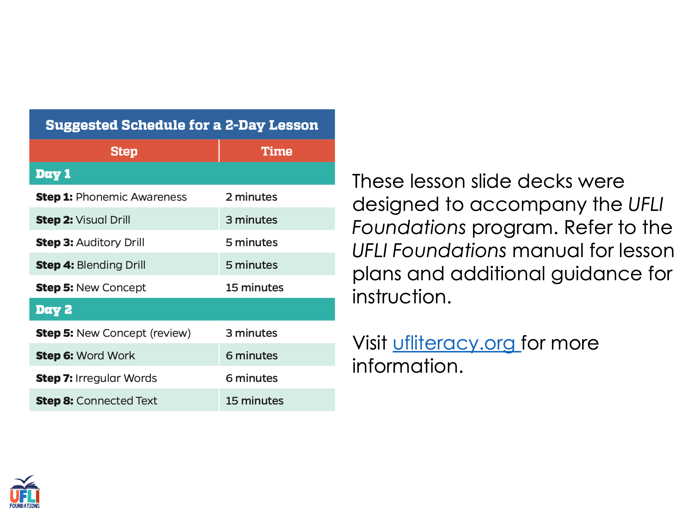
Notes:
ufliteracy.org

Slide 3
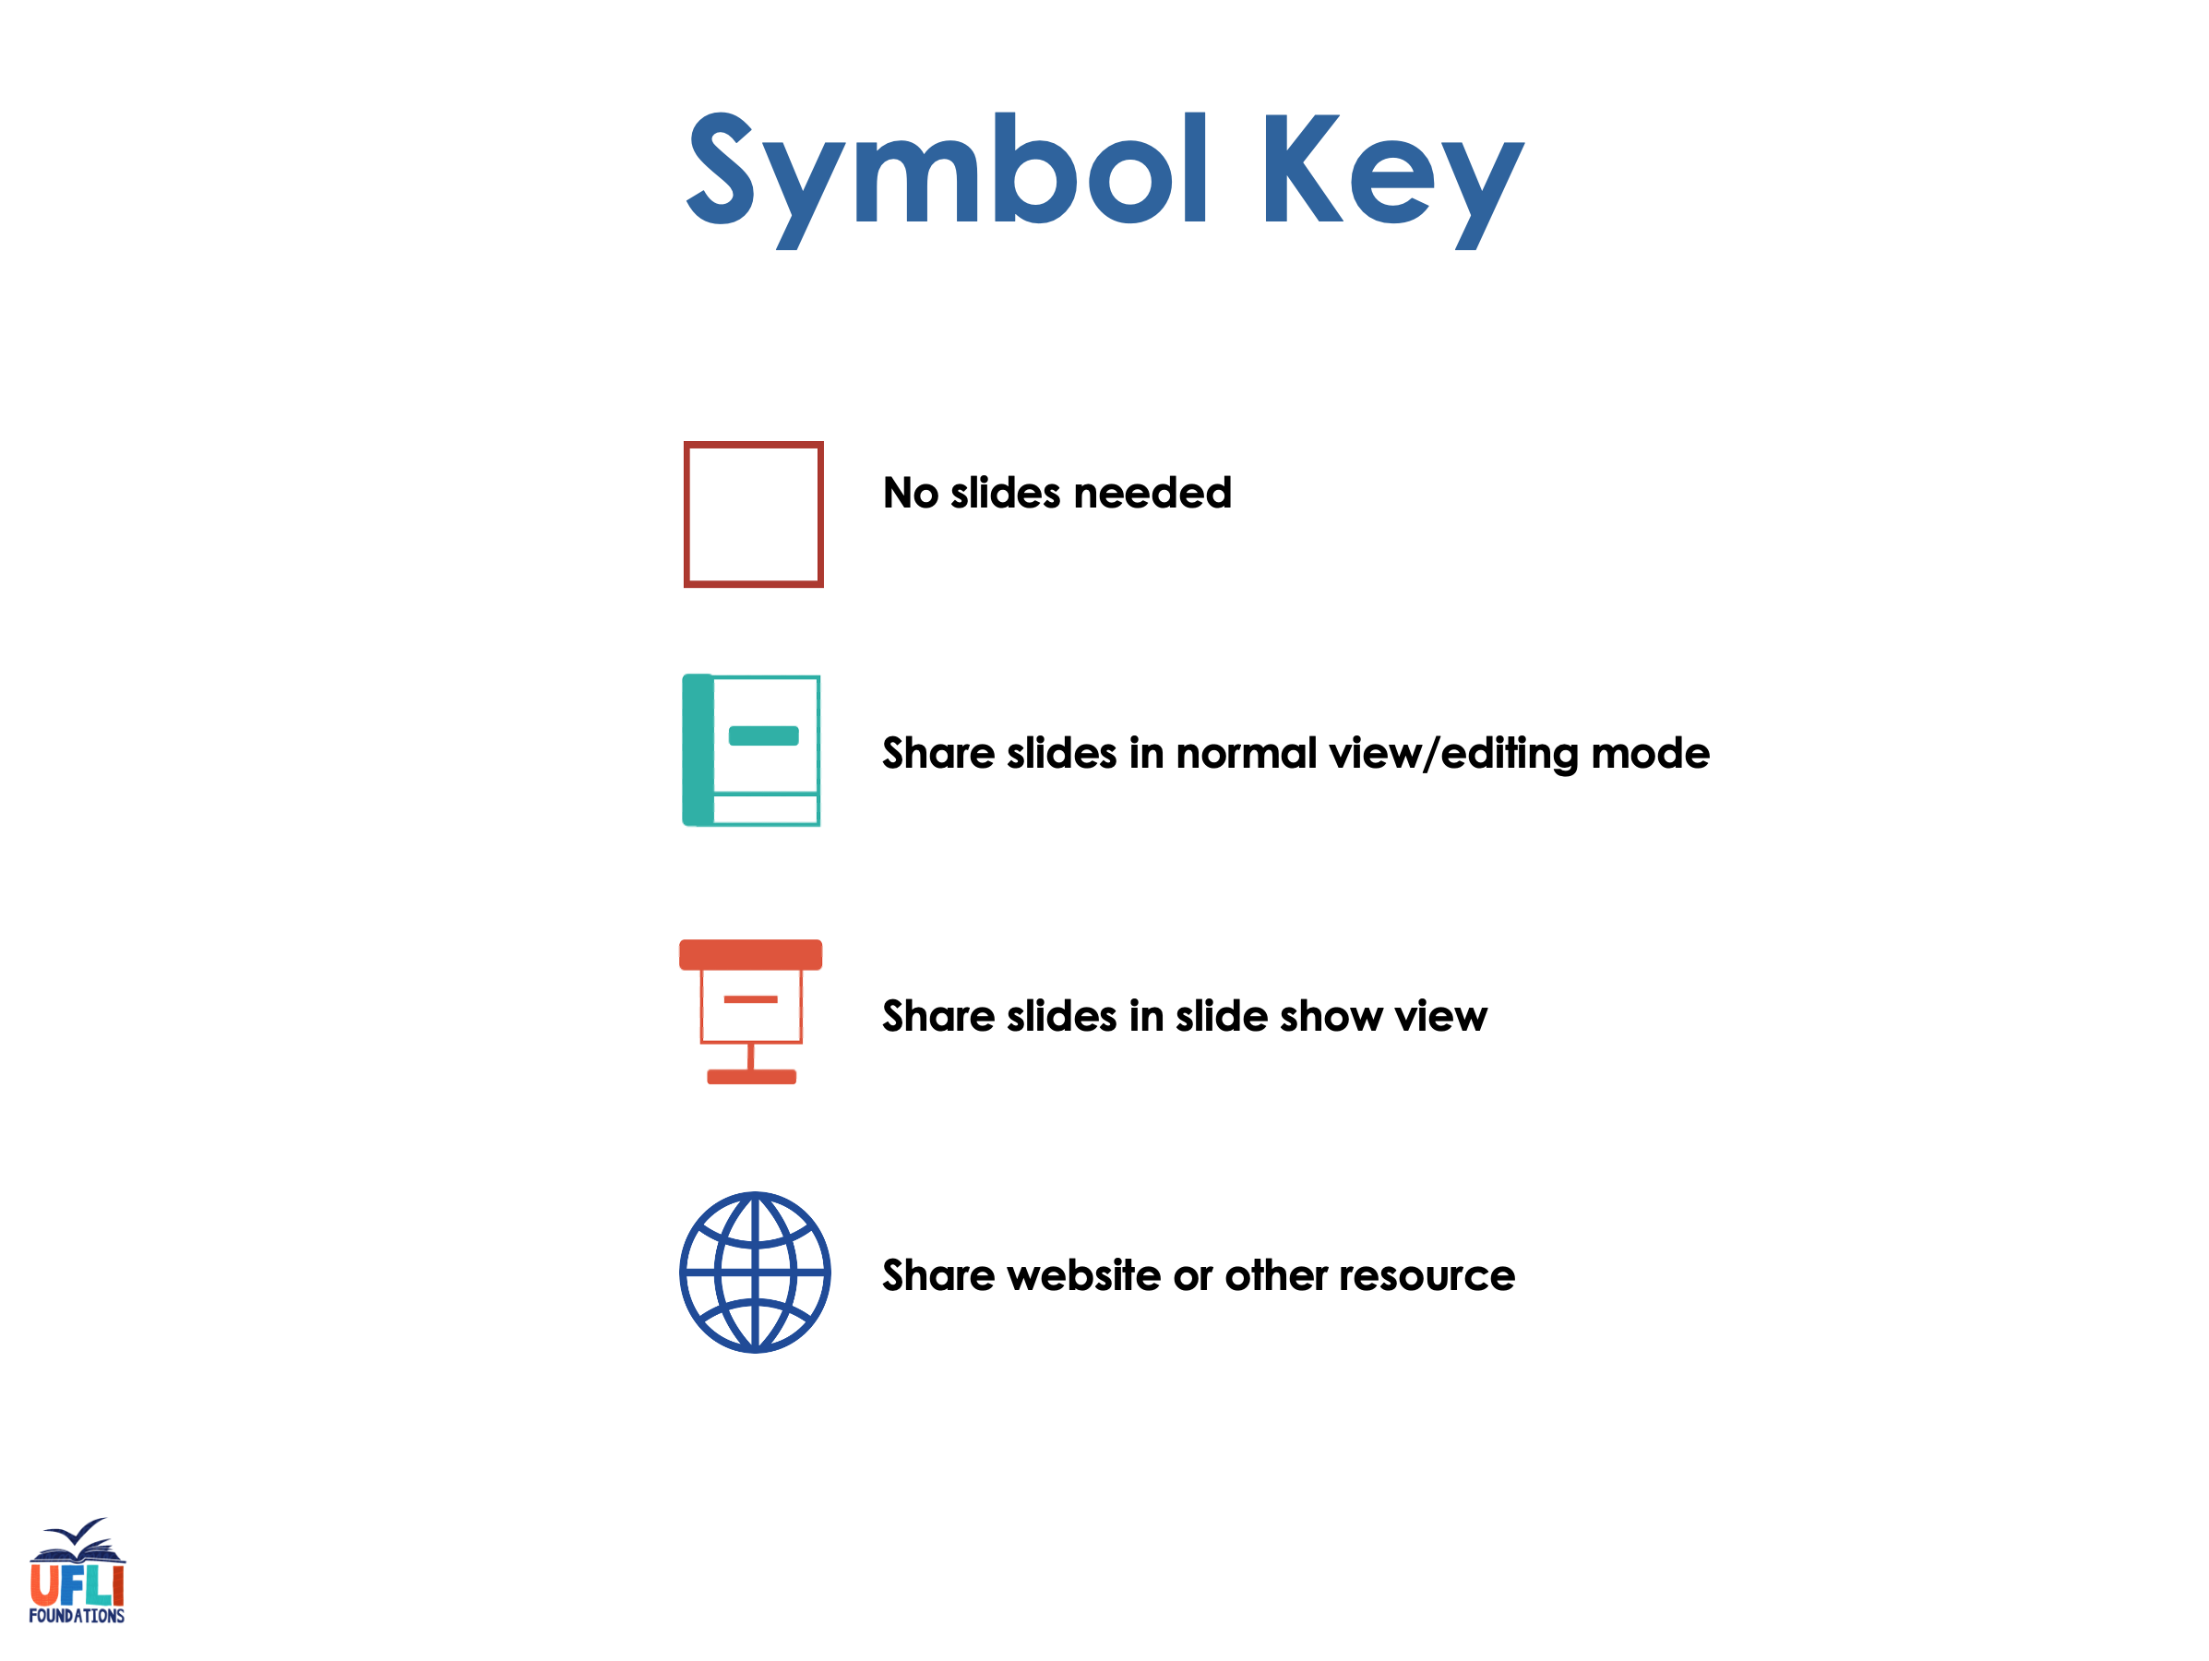

Slide 4

Lesson 115
Alternate Long U

Slide 5
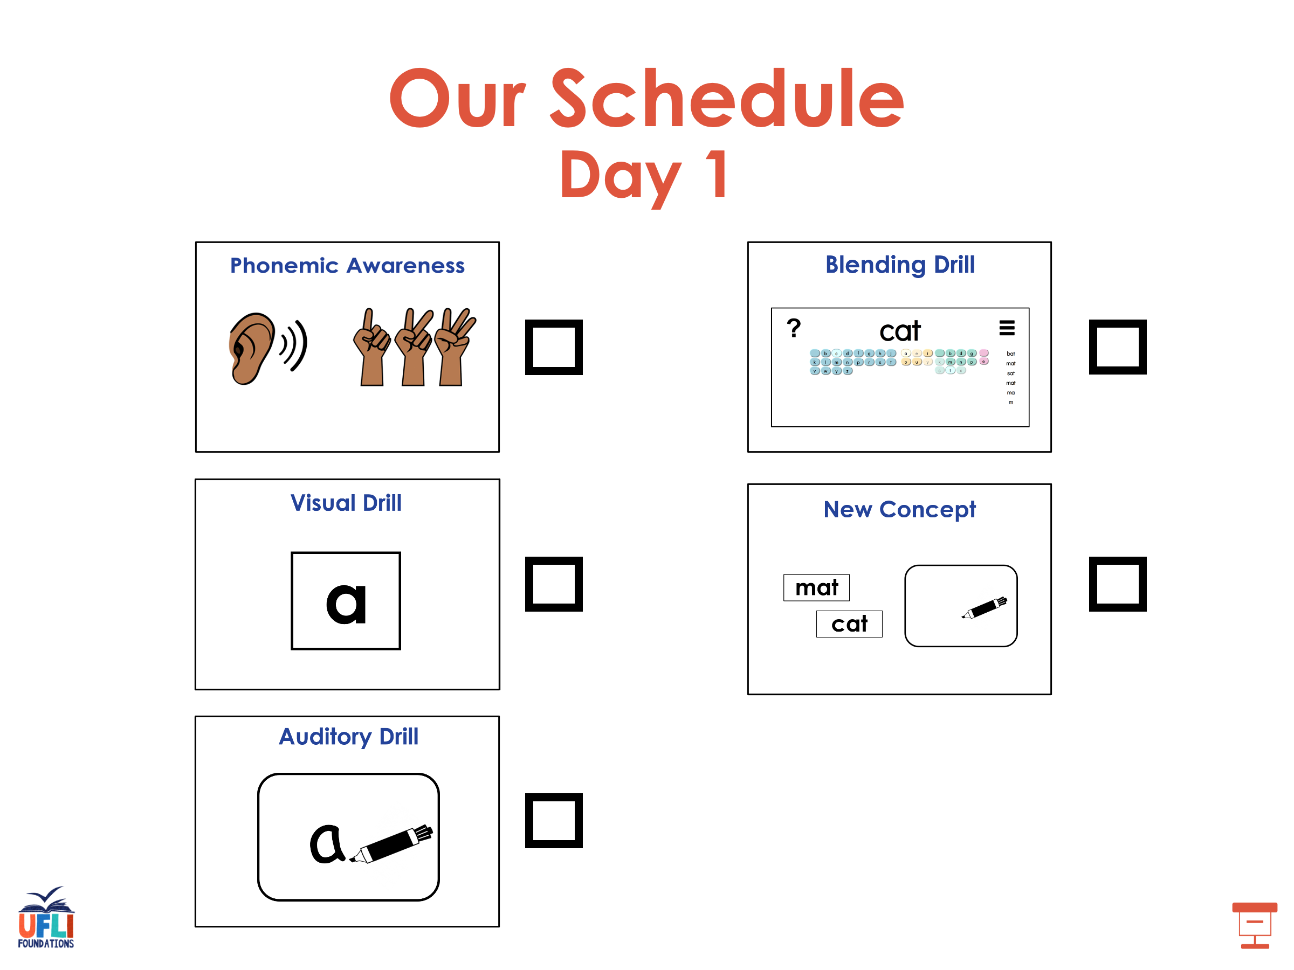

Slide 6
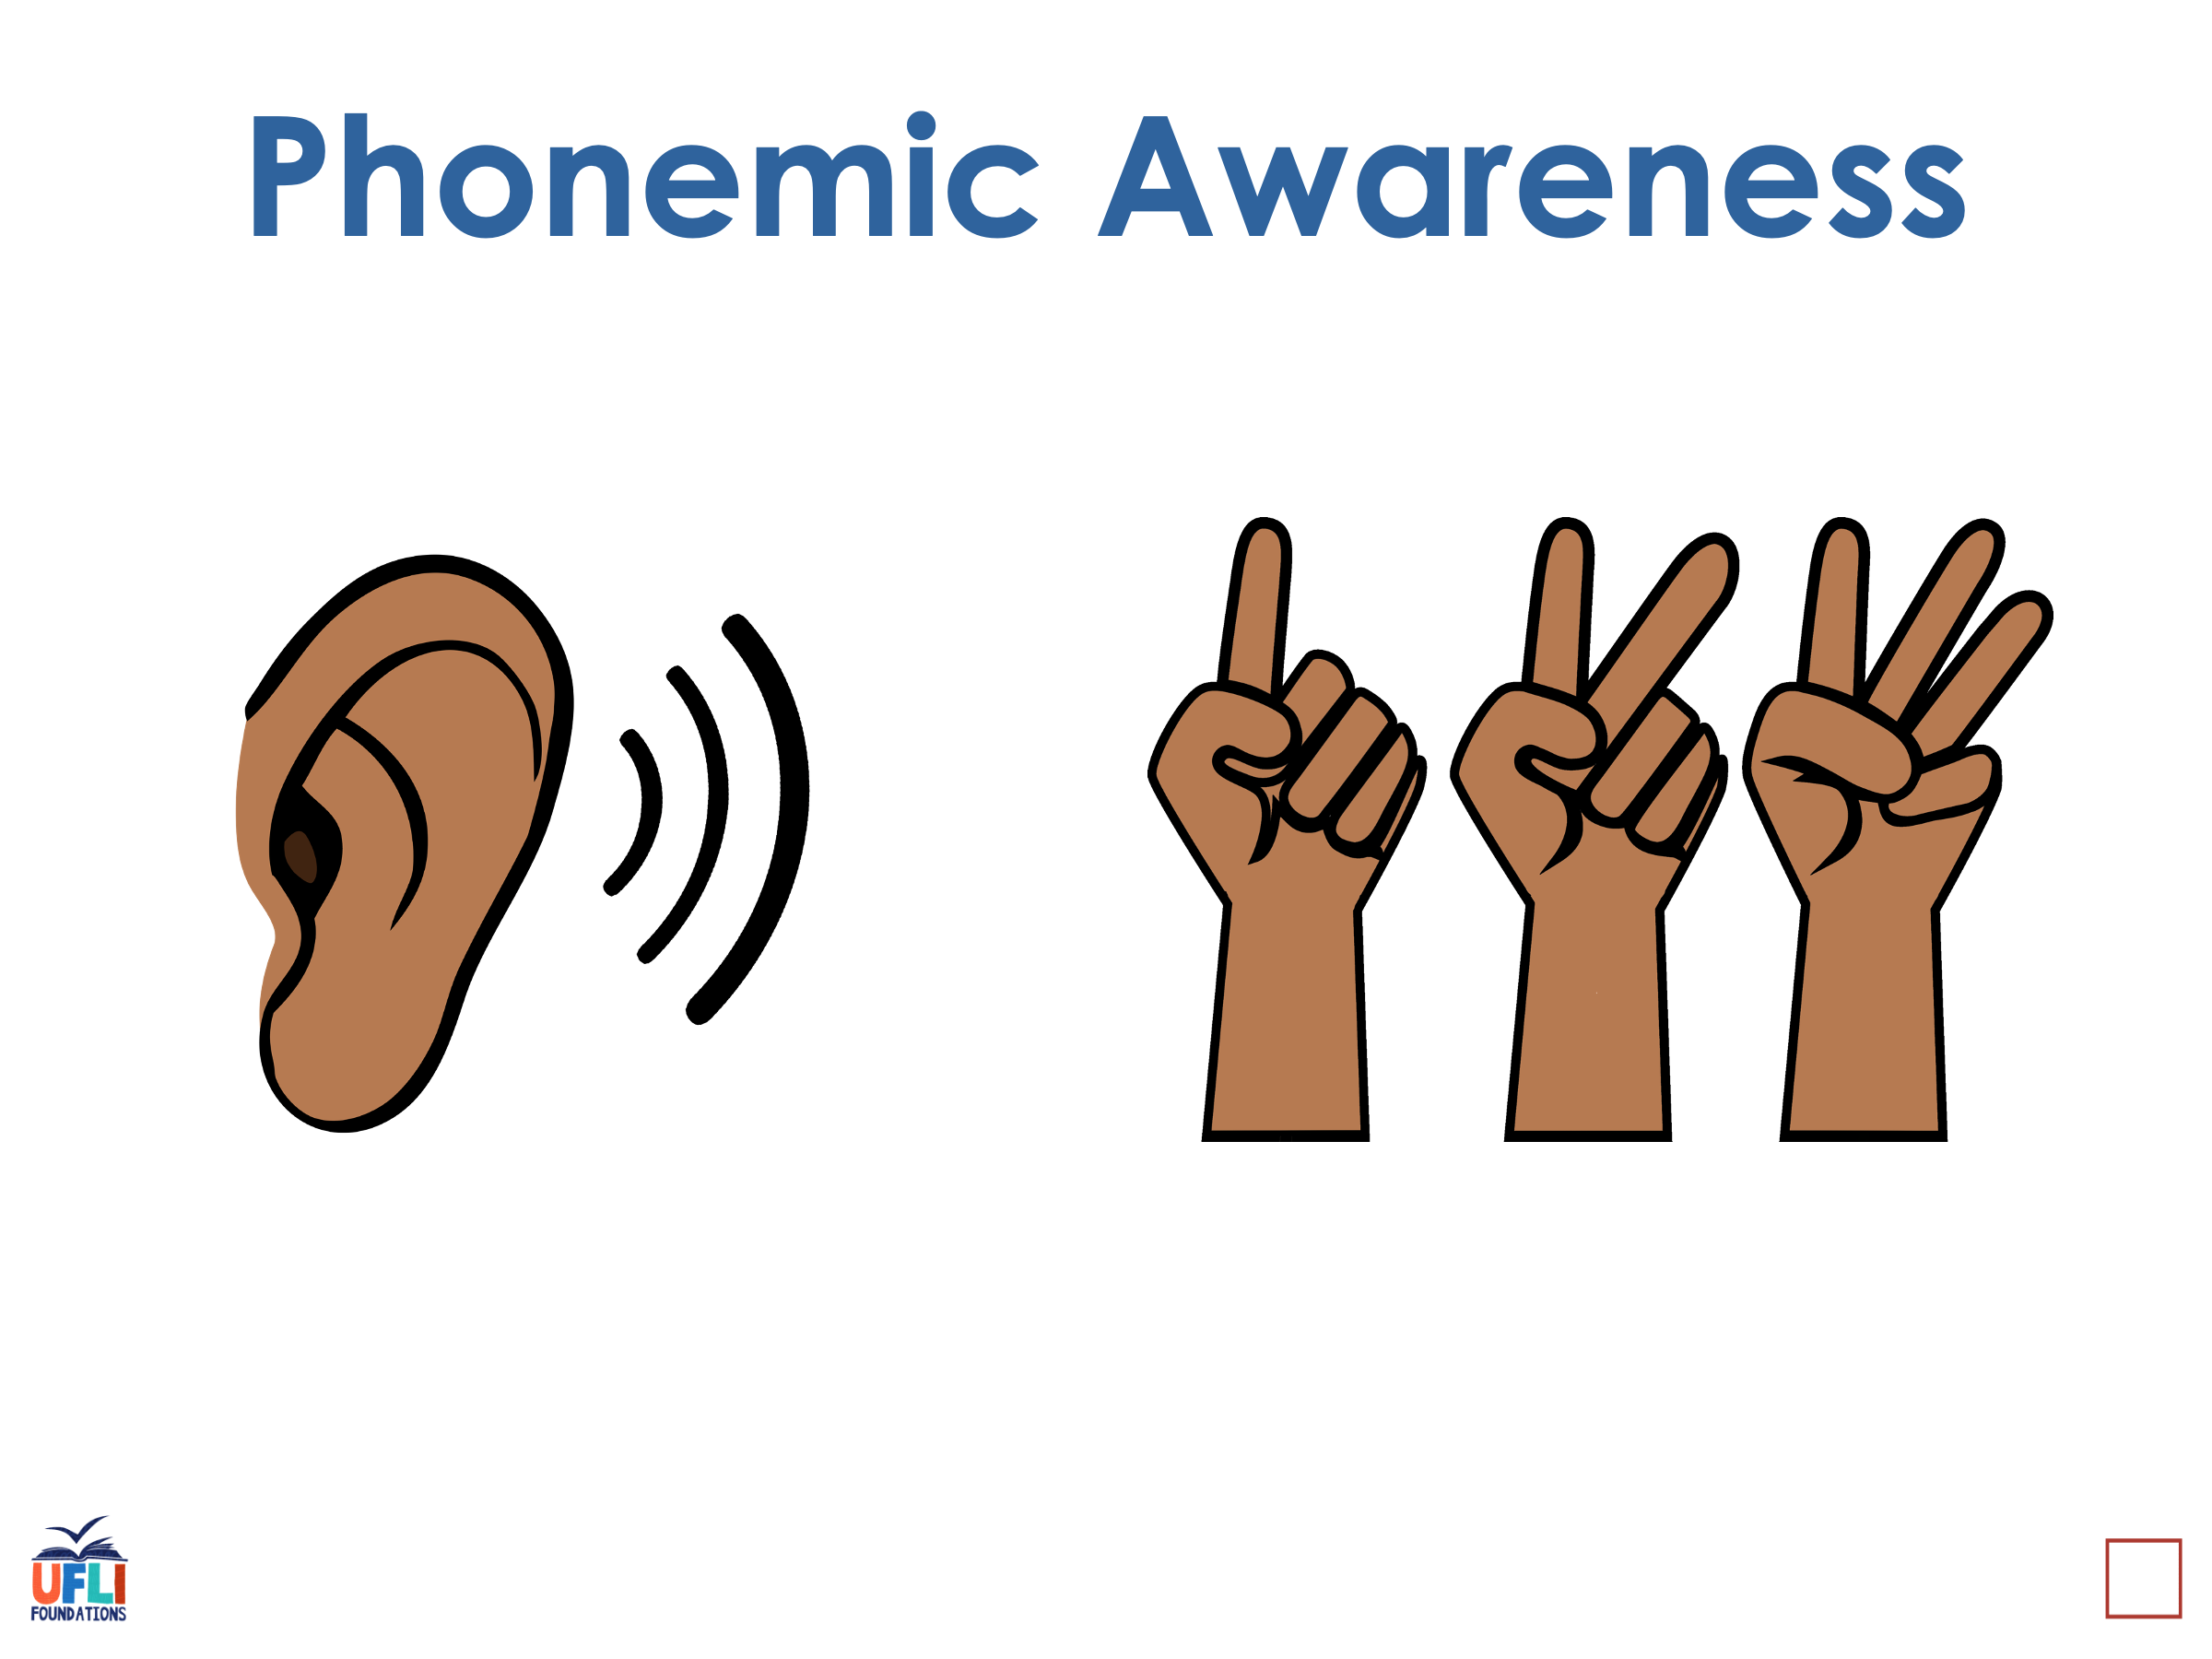
Notes:
See UFLI Foundations lesson plan Step 1 for phonemic awareness activity.

Slide 7
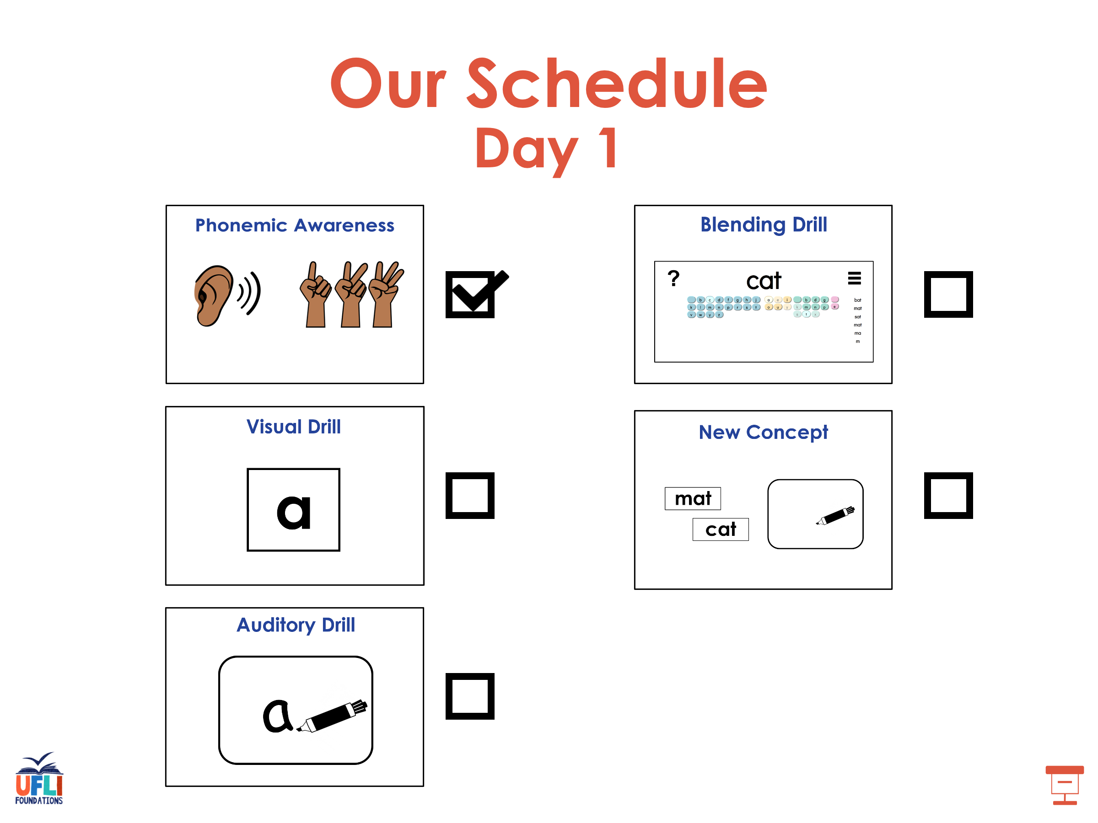

Slide 8
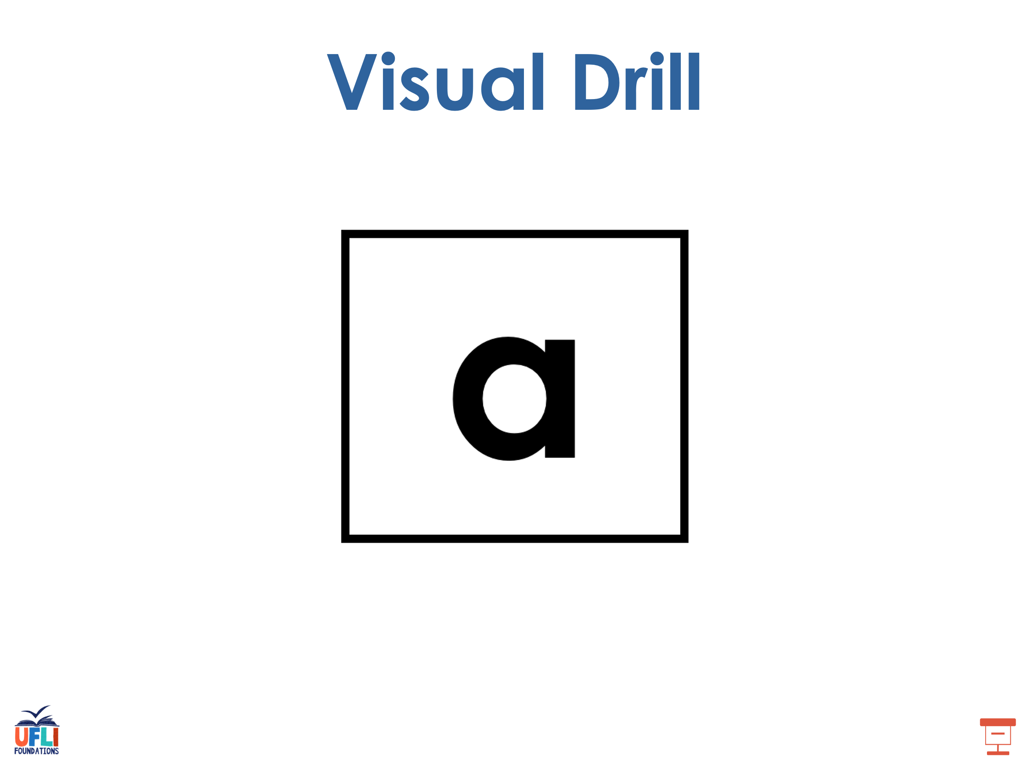
Notes:
See UFLI Foundations lesson plan Step 2 for student phoneme responses.

Slide 9
ei

Slide 10
eigh

Slide 11
ey

Slide 12
aigh

Slide 13
air

Slide 14
are

Slide 15
ear

Slide 16
our

Slide 17
or

Slide 18
ar

Slide 19
-ed

Slide 20
y

Slide 21
er

Slide 22
e

Slide 23
s

Slide 24
ou

Slide 25
ow

Slide 26
oi

Slide 27
oy

Slide 28
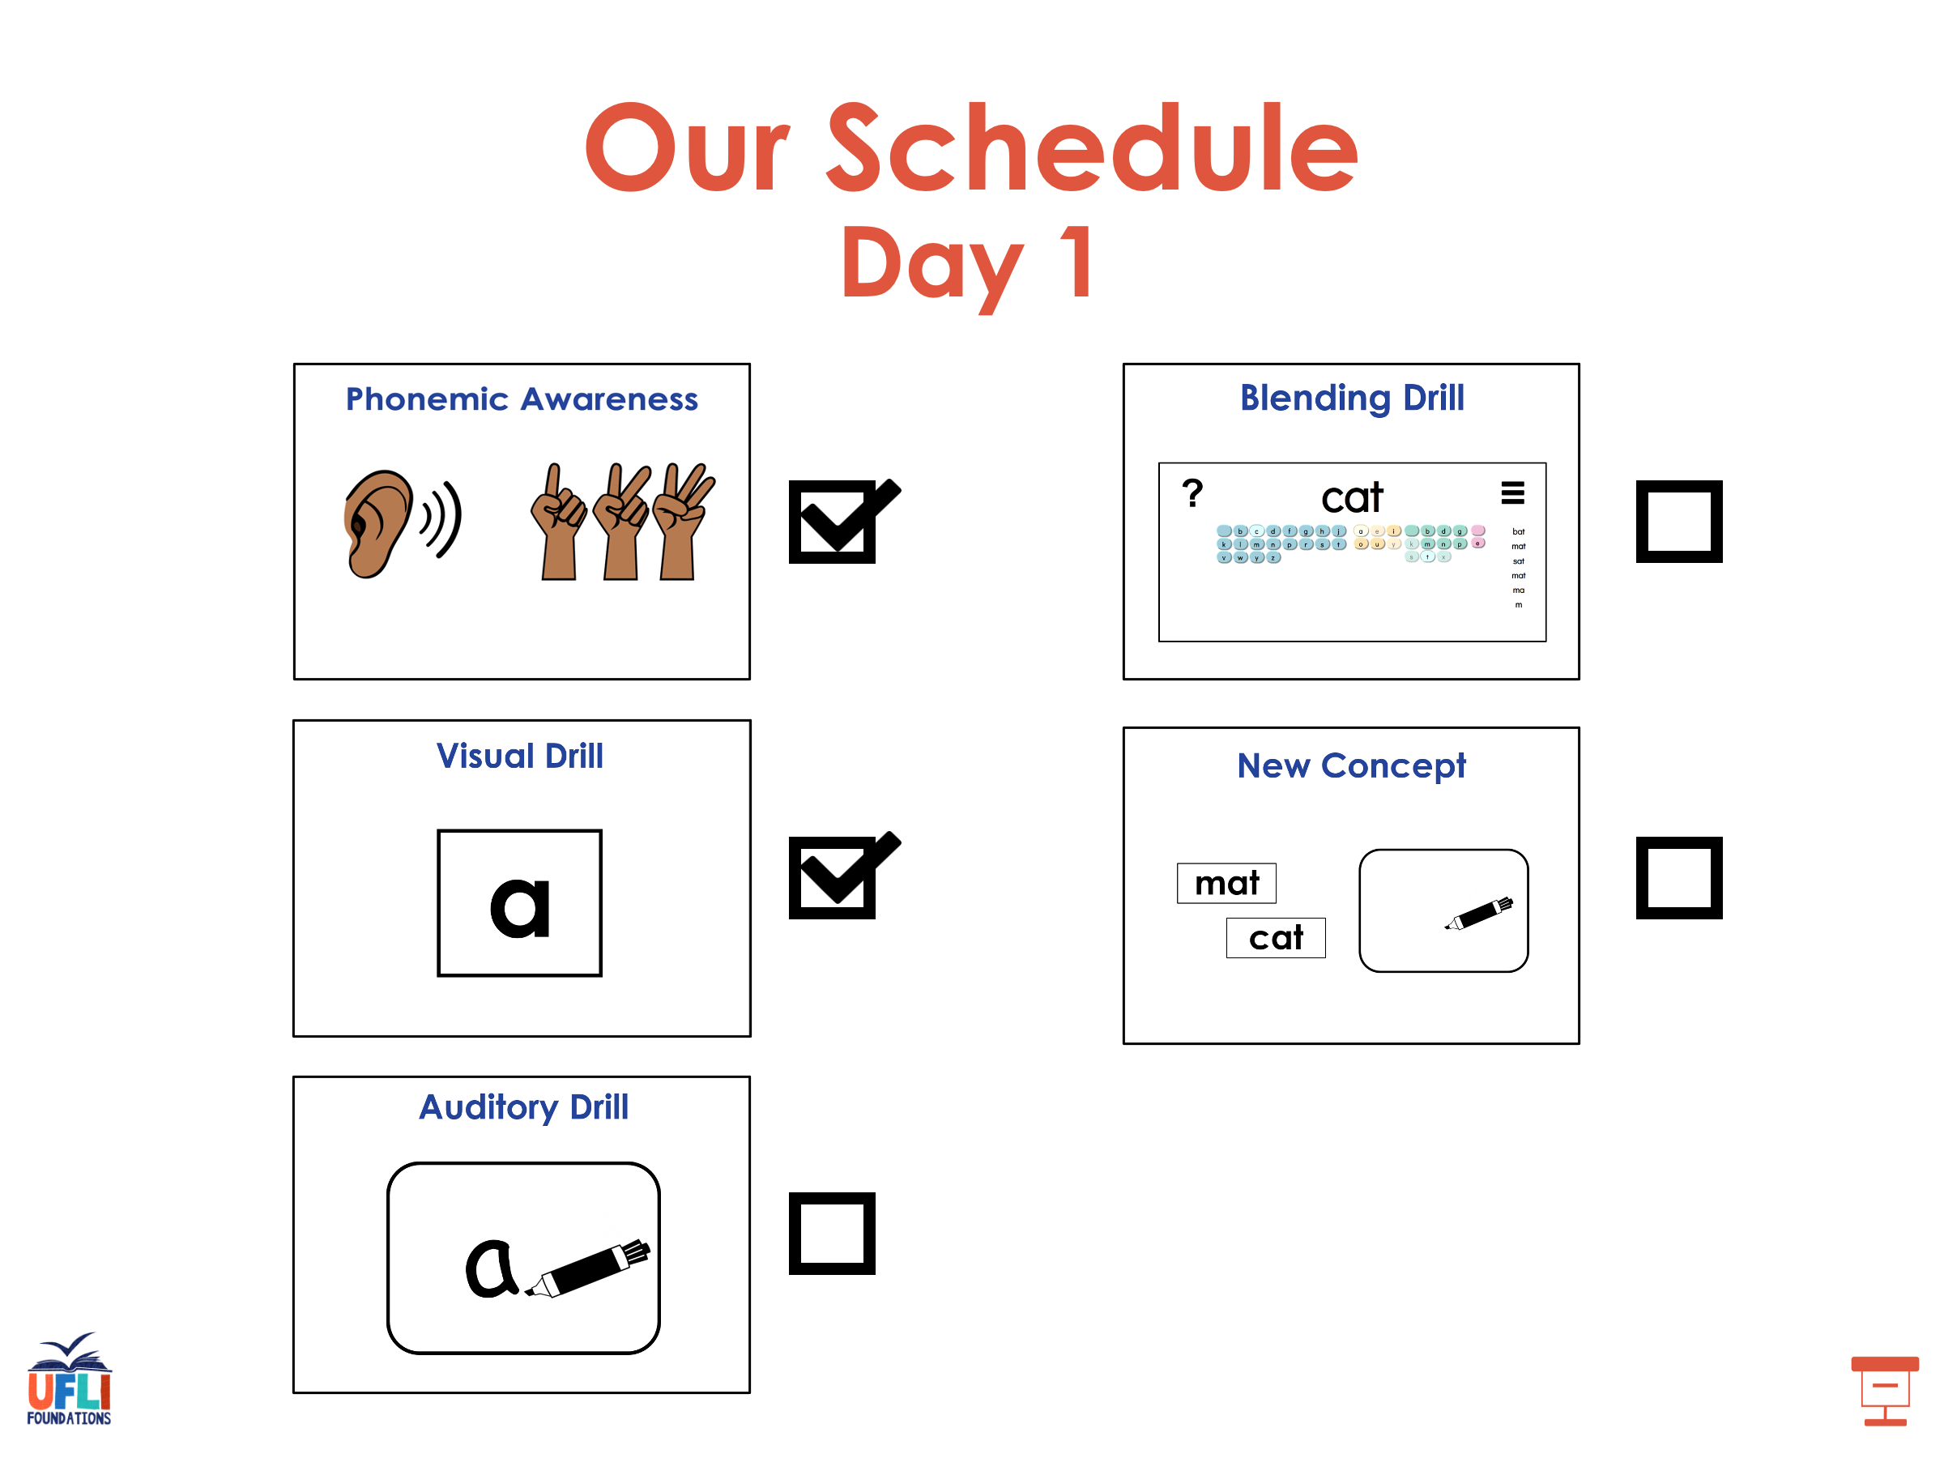

Slide 29
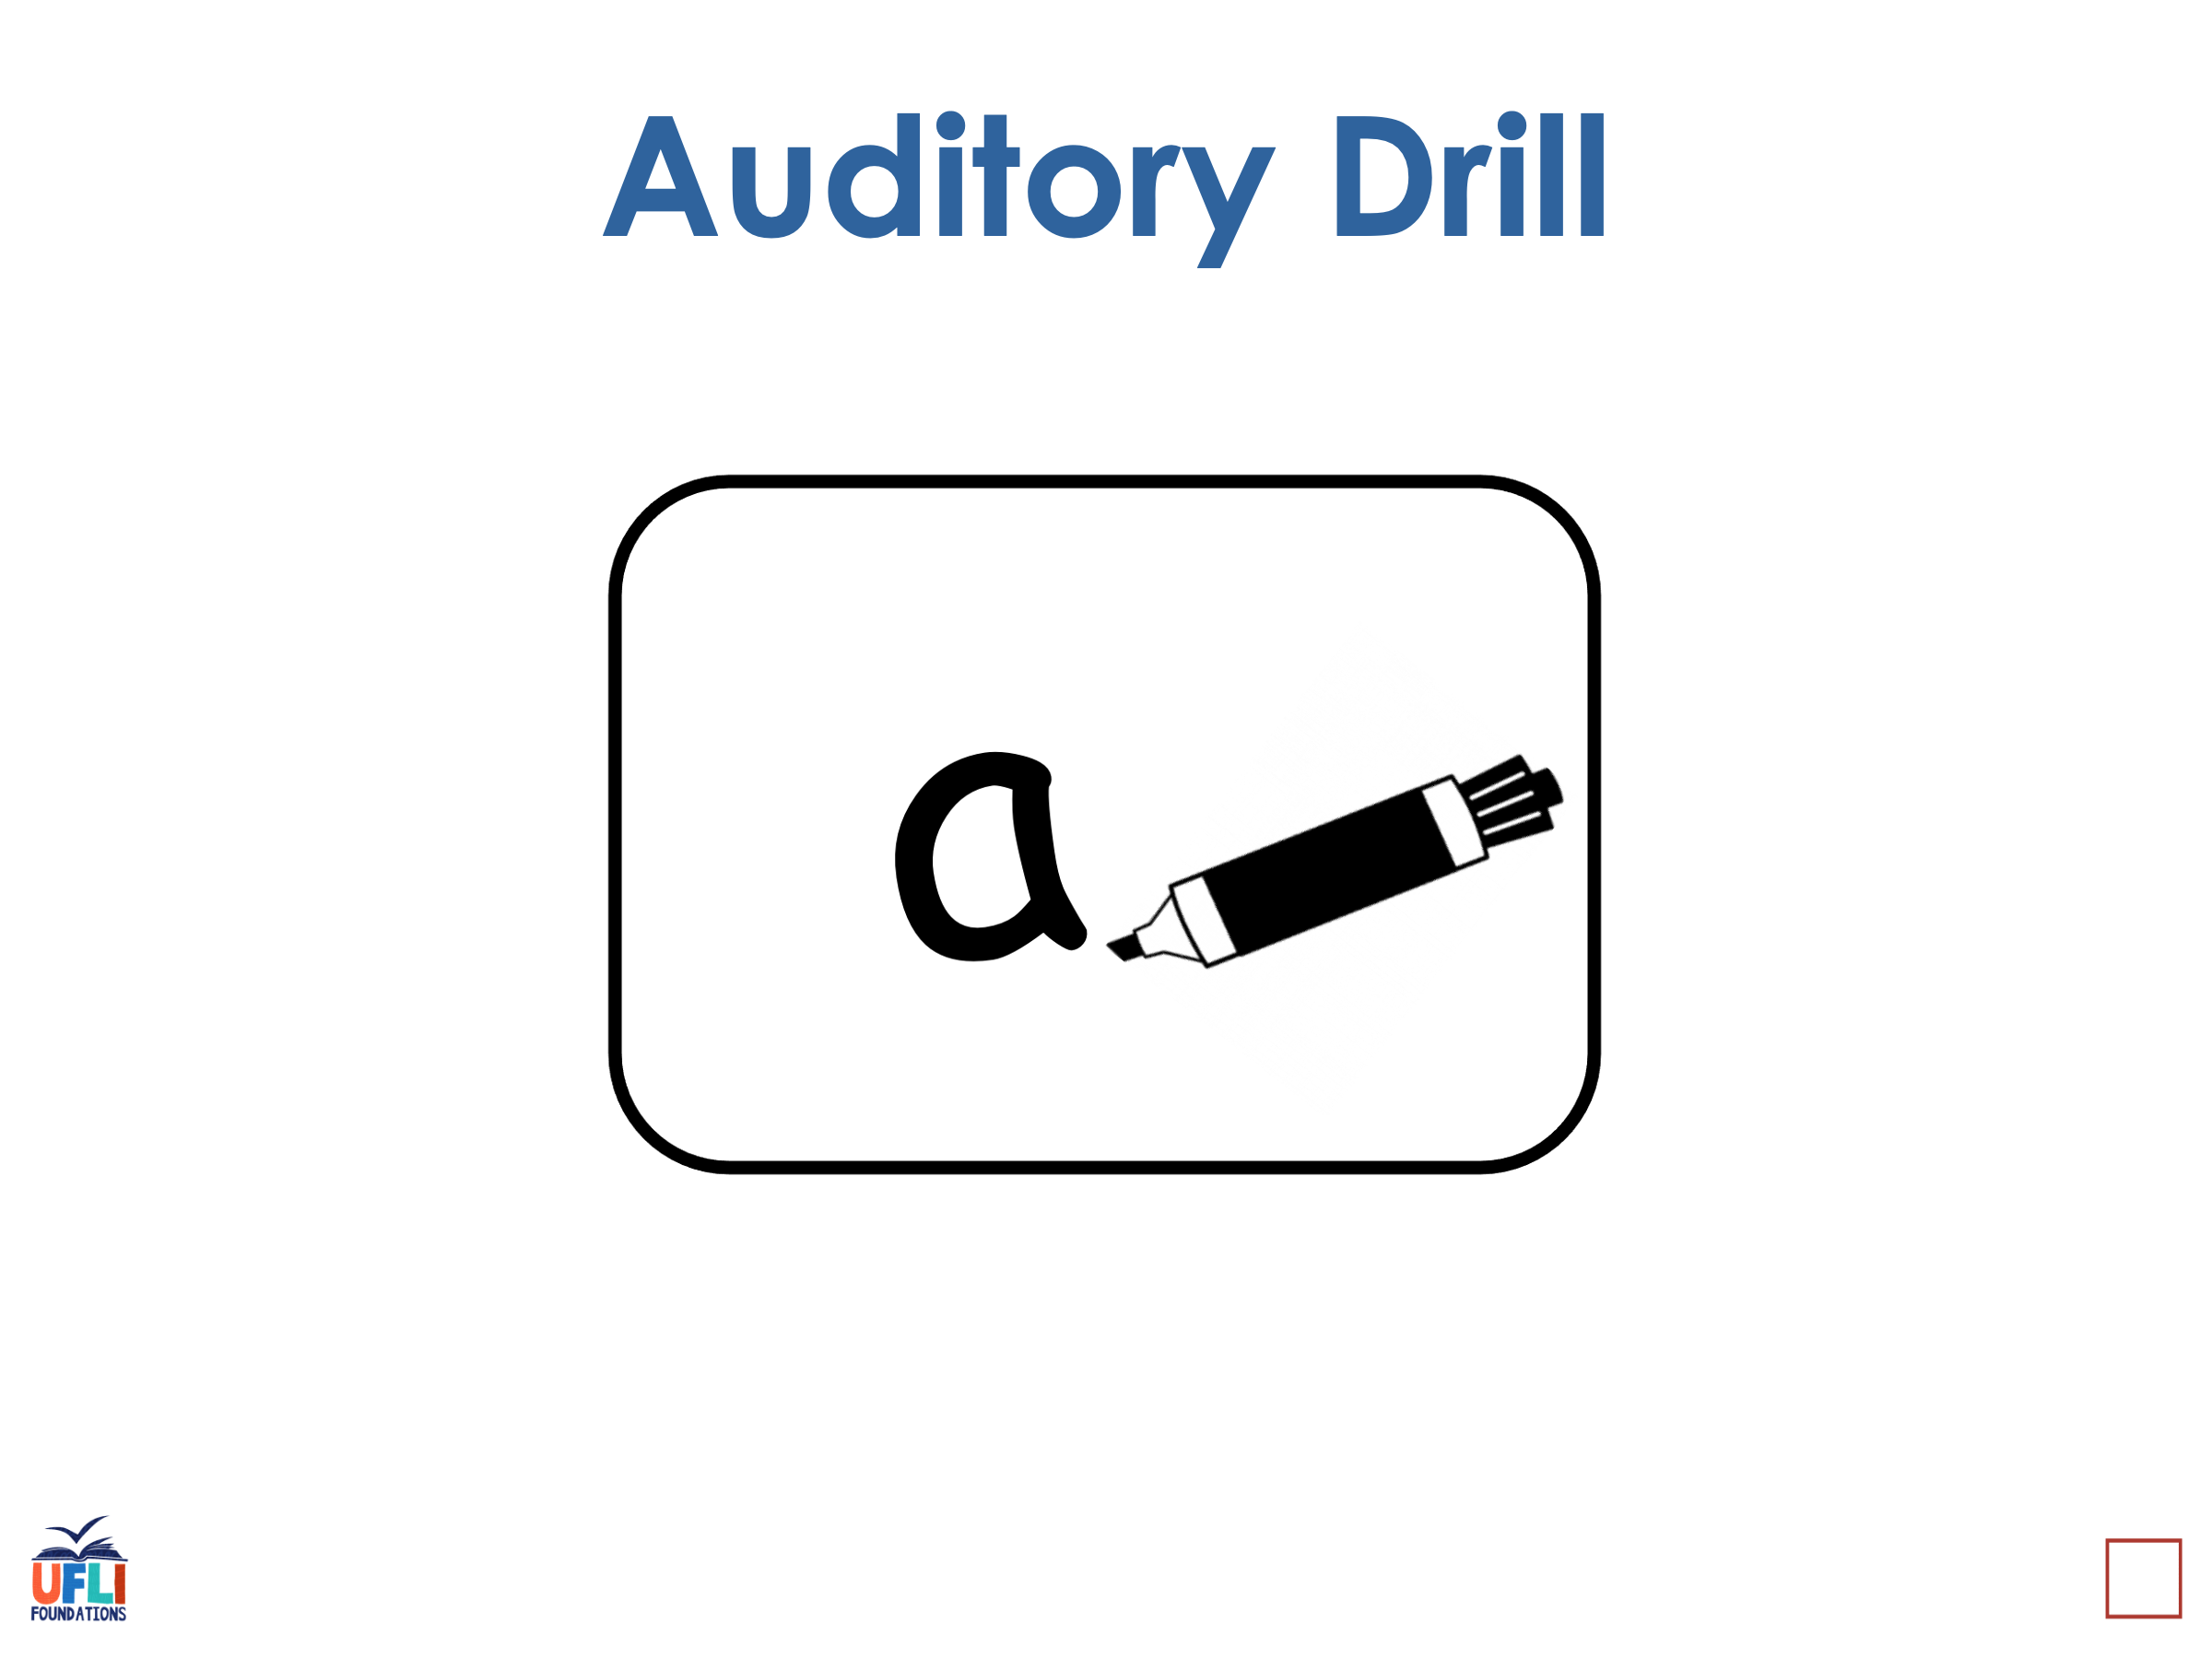
Notes:
See UFLI Foundations lesson plan Step 3 for auditory drill activity.

Slide 30
Notes:
No slides needed for auditory drill.

Slide 31
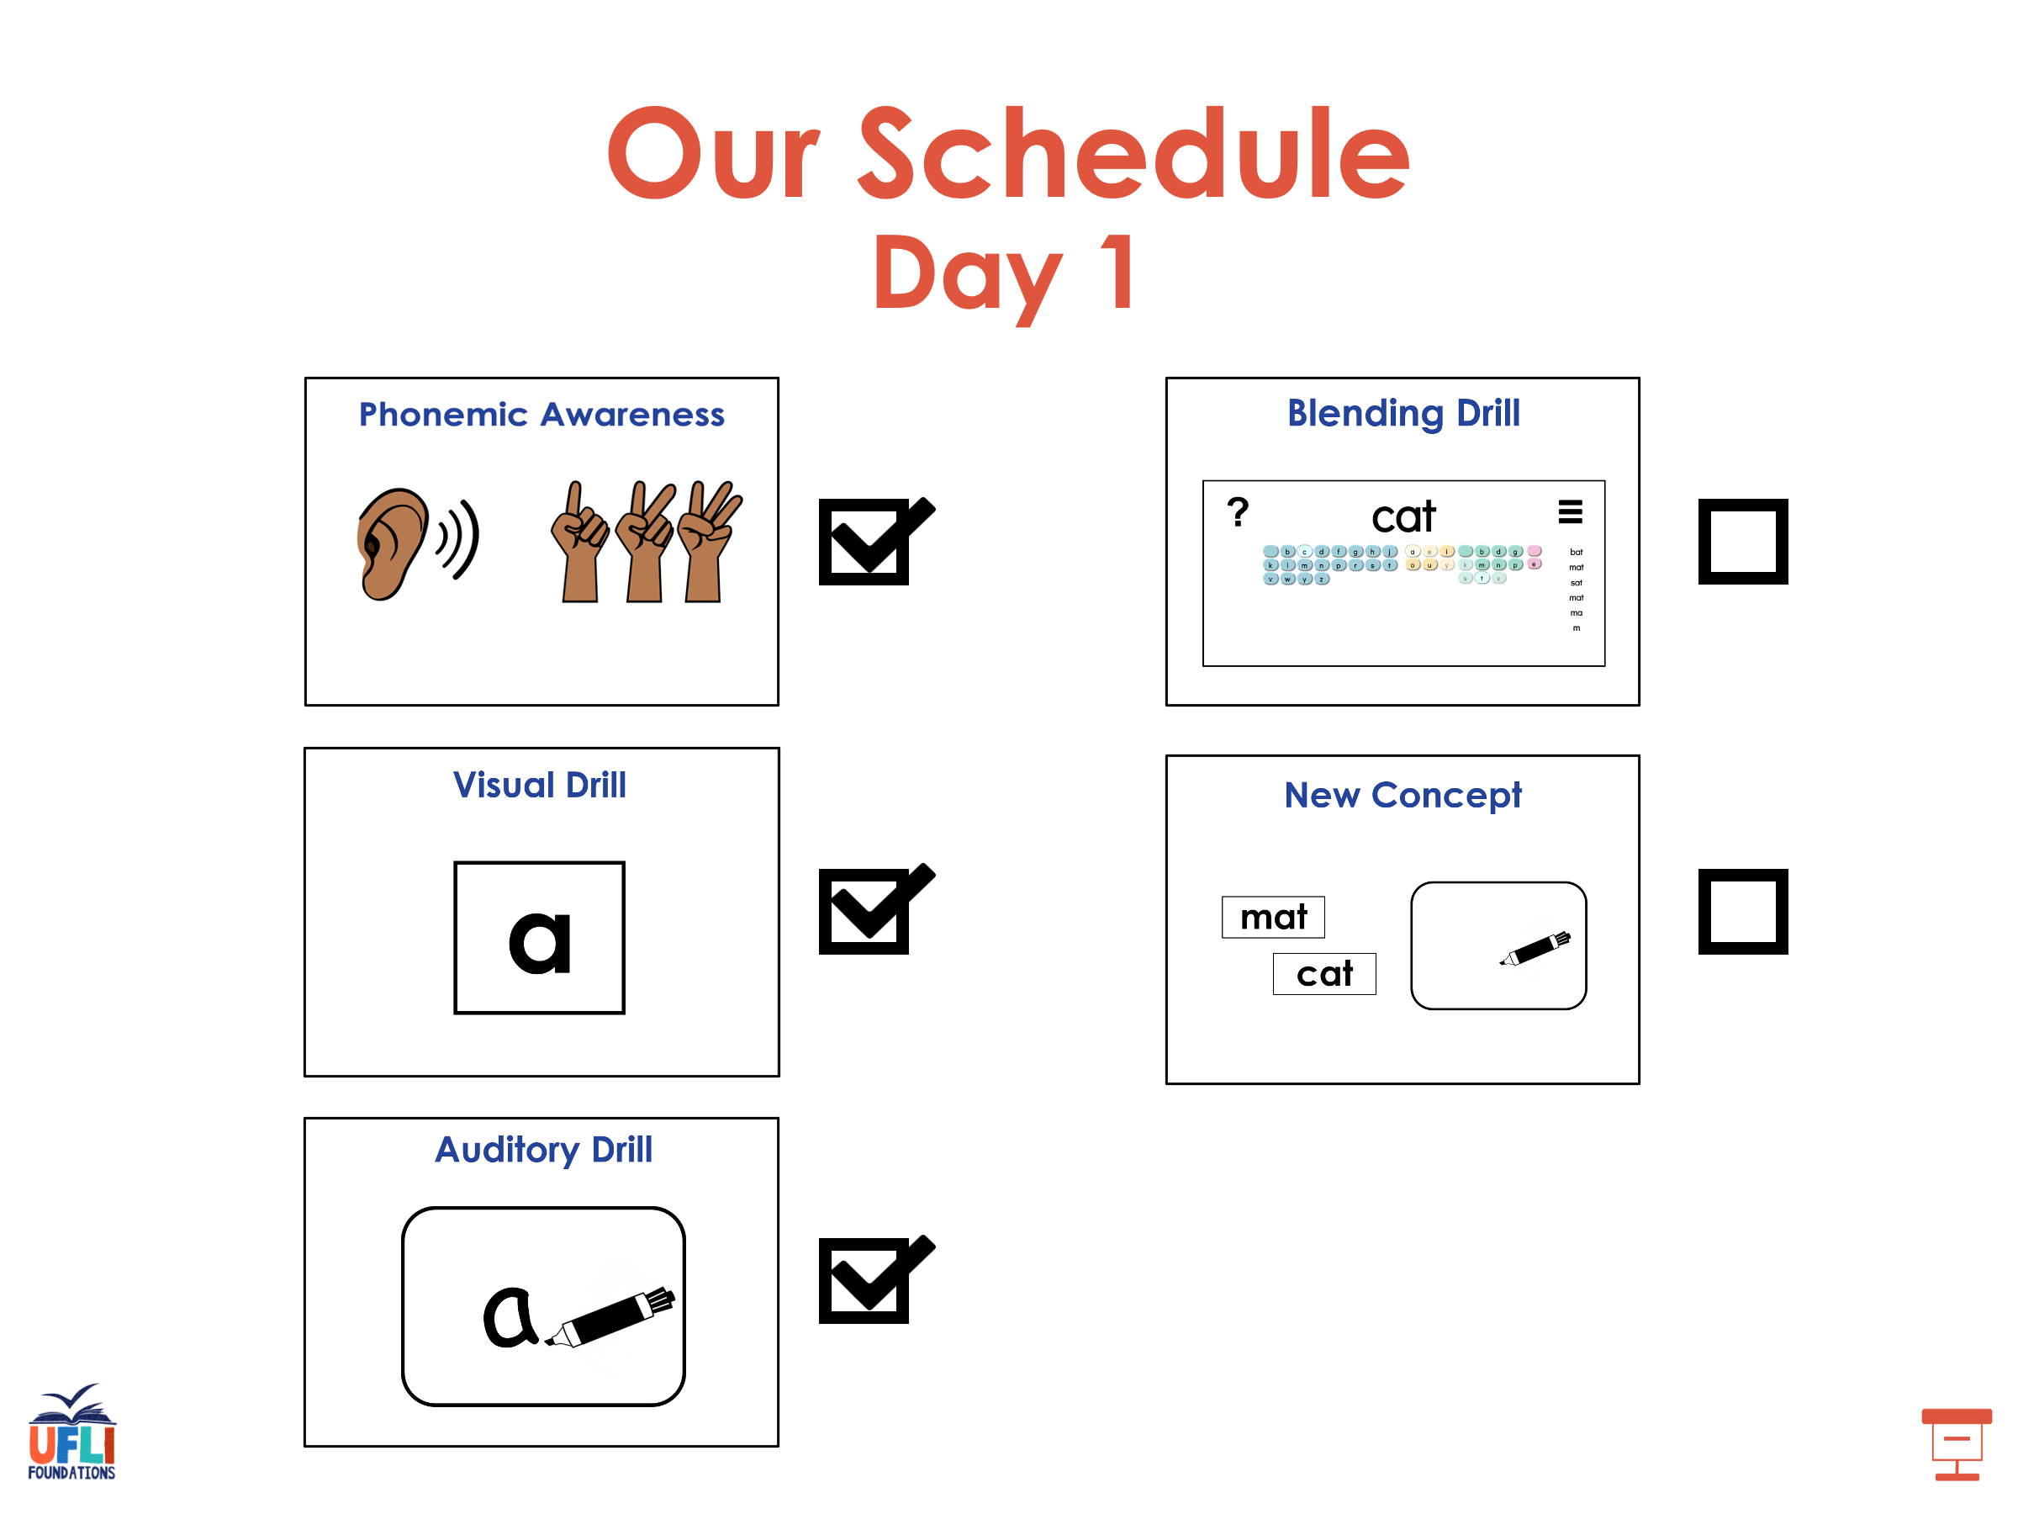

Slide 32
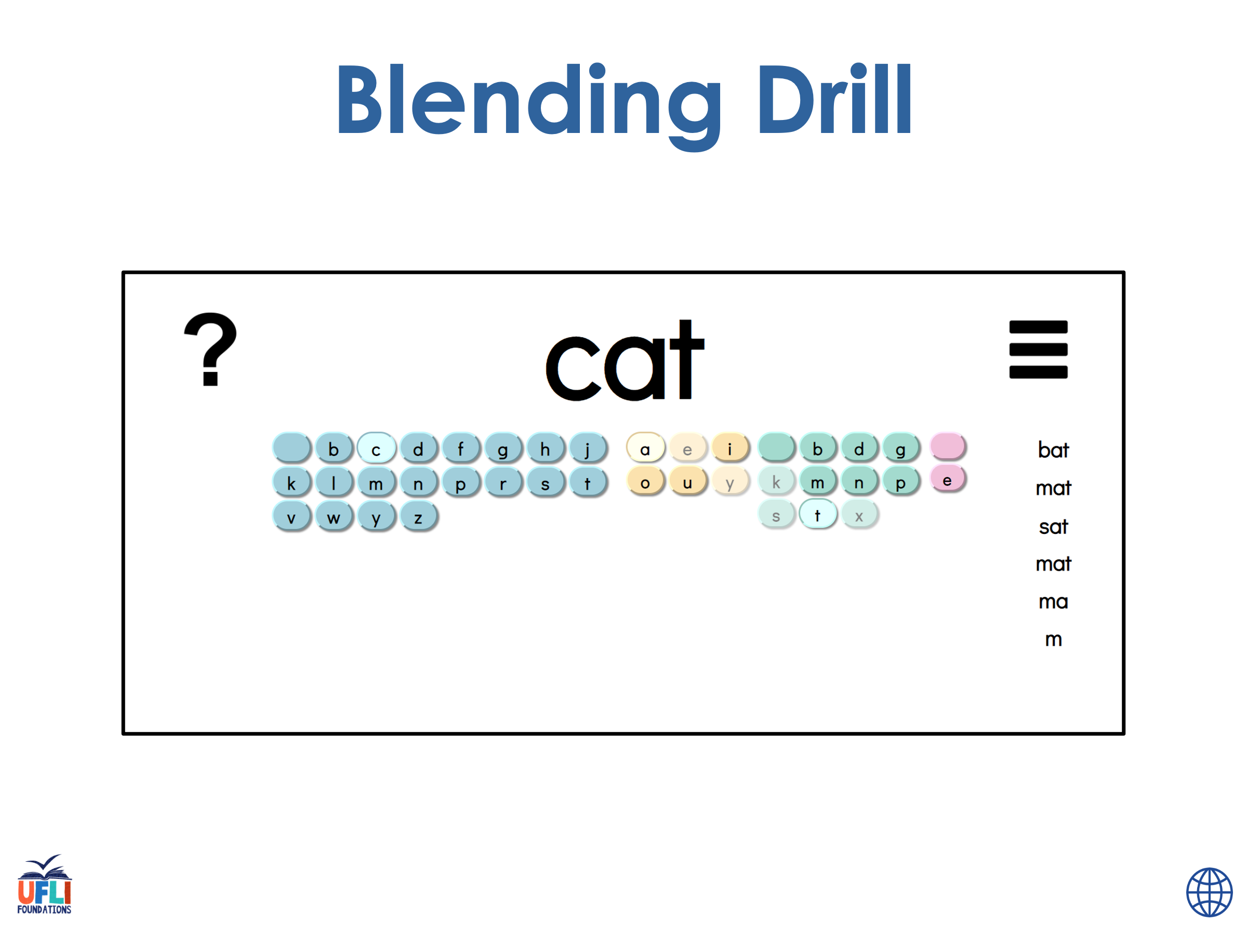
Notes:
See UFLI Foundations lesson plan Step 4 for blending drill word chain and grid.
Visit ufliteracy.org to access the Blending Board app.

Slide 33
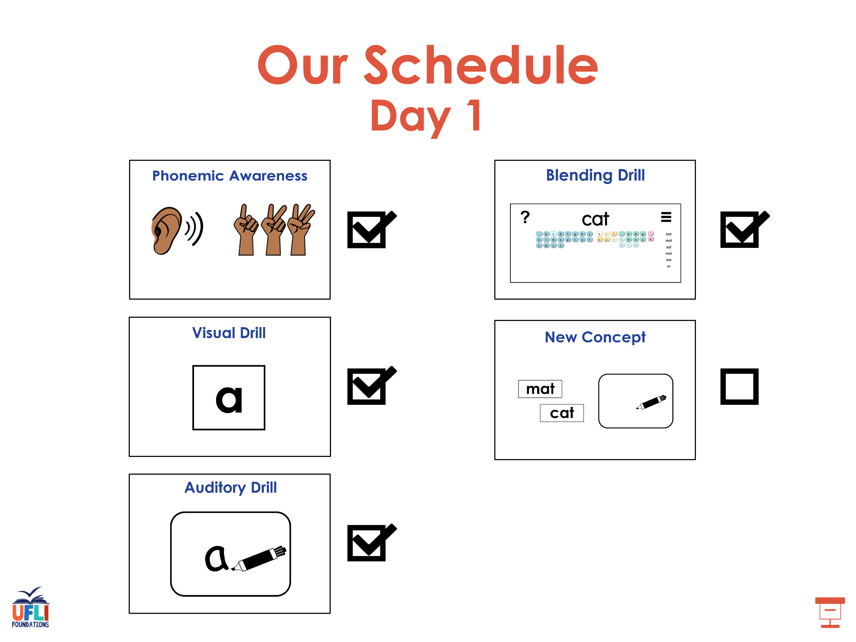

Slide 34
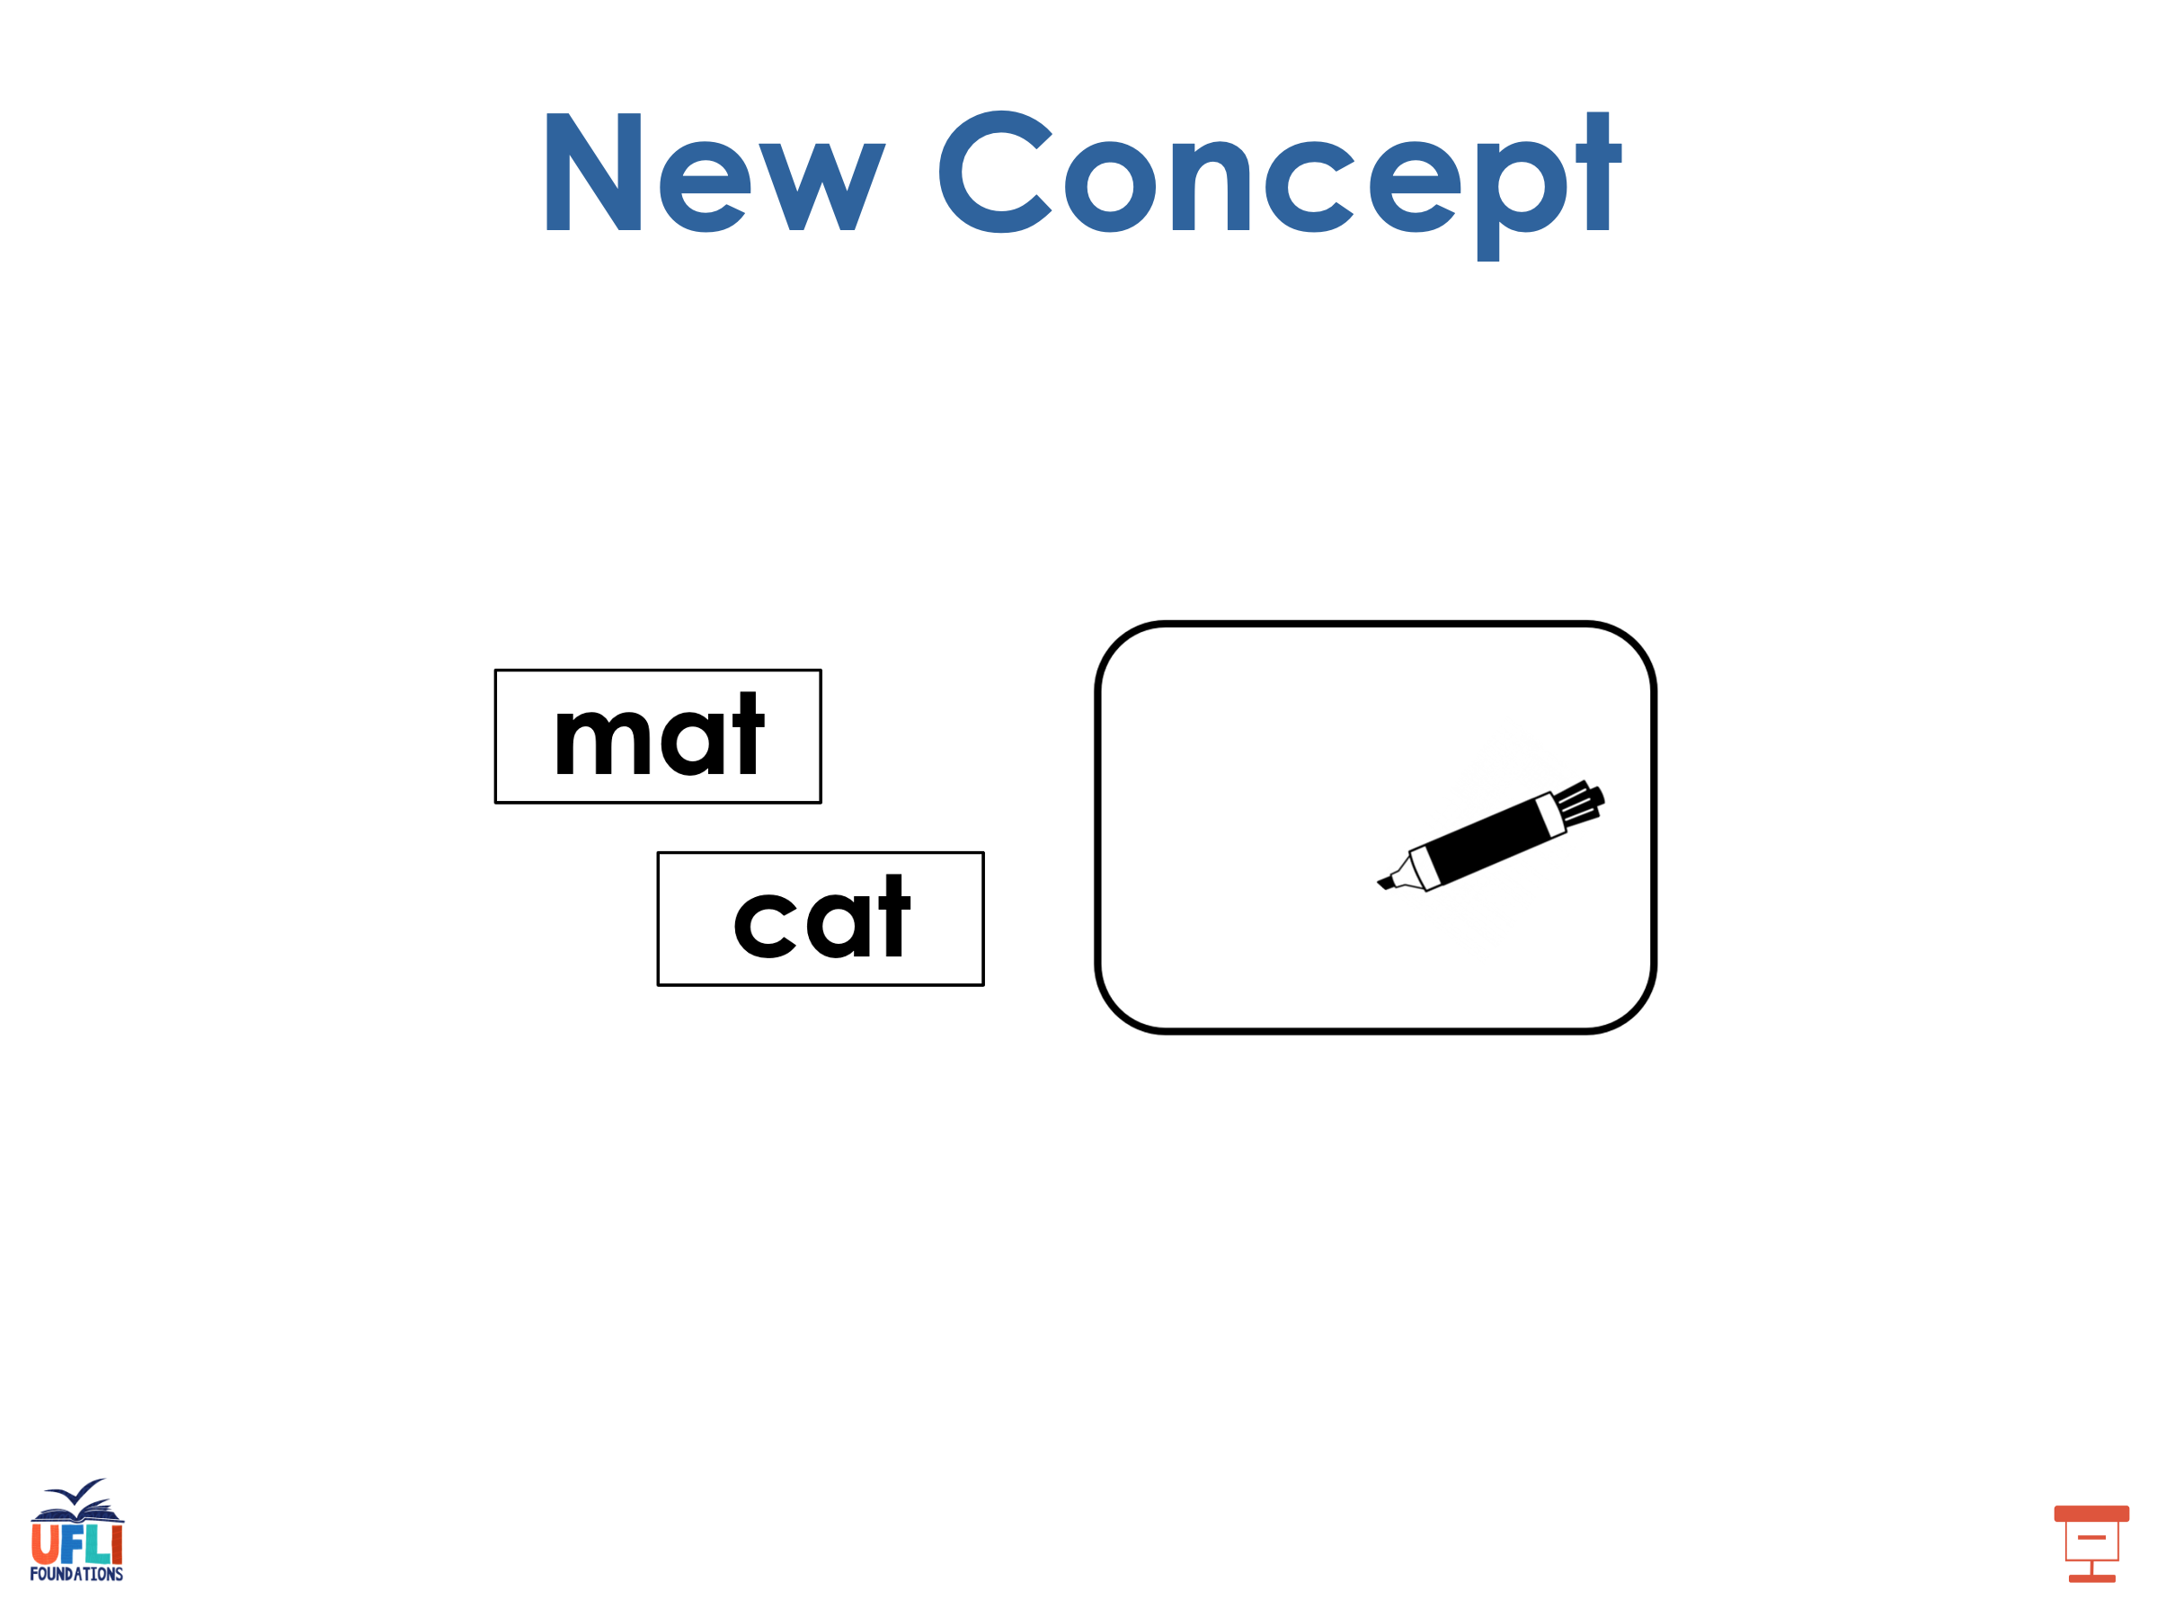
Notes:
See UFLI Foundations lesson plan Step 5 for recommended teacher language and activities to introduce the new concept.

Slide 35
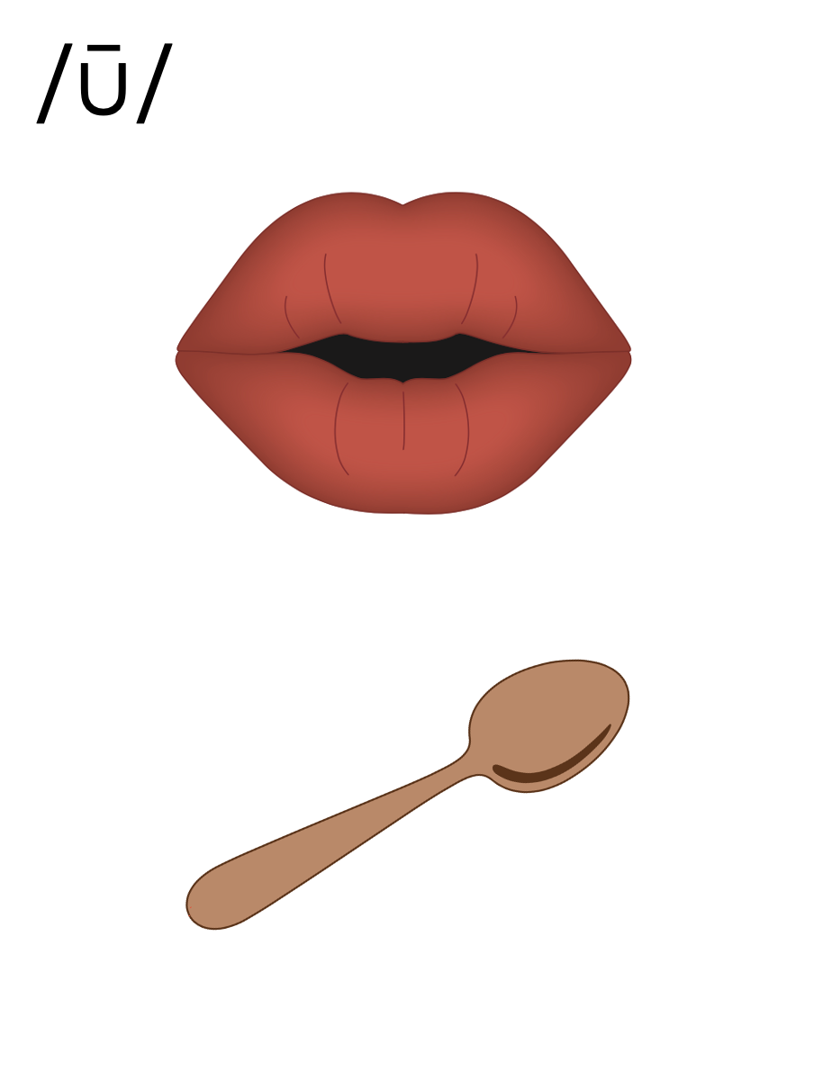
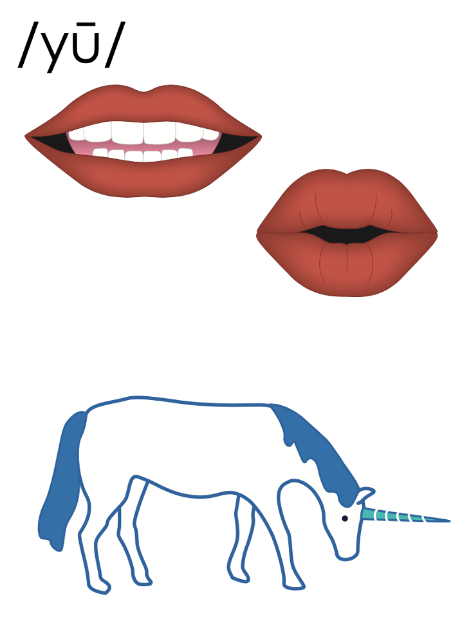
flew
cube

Slide 36
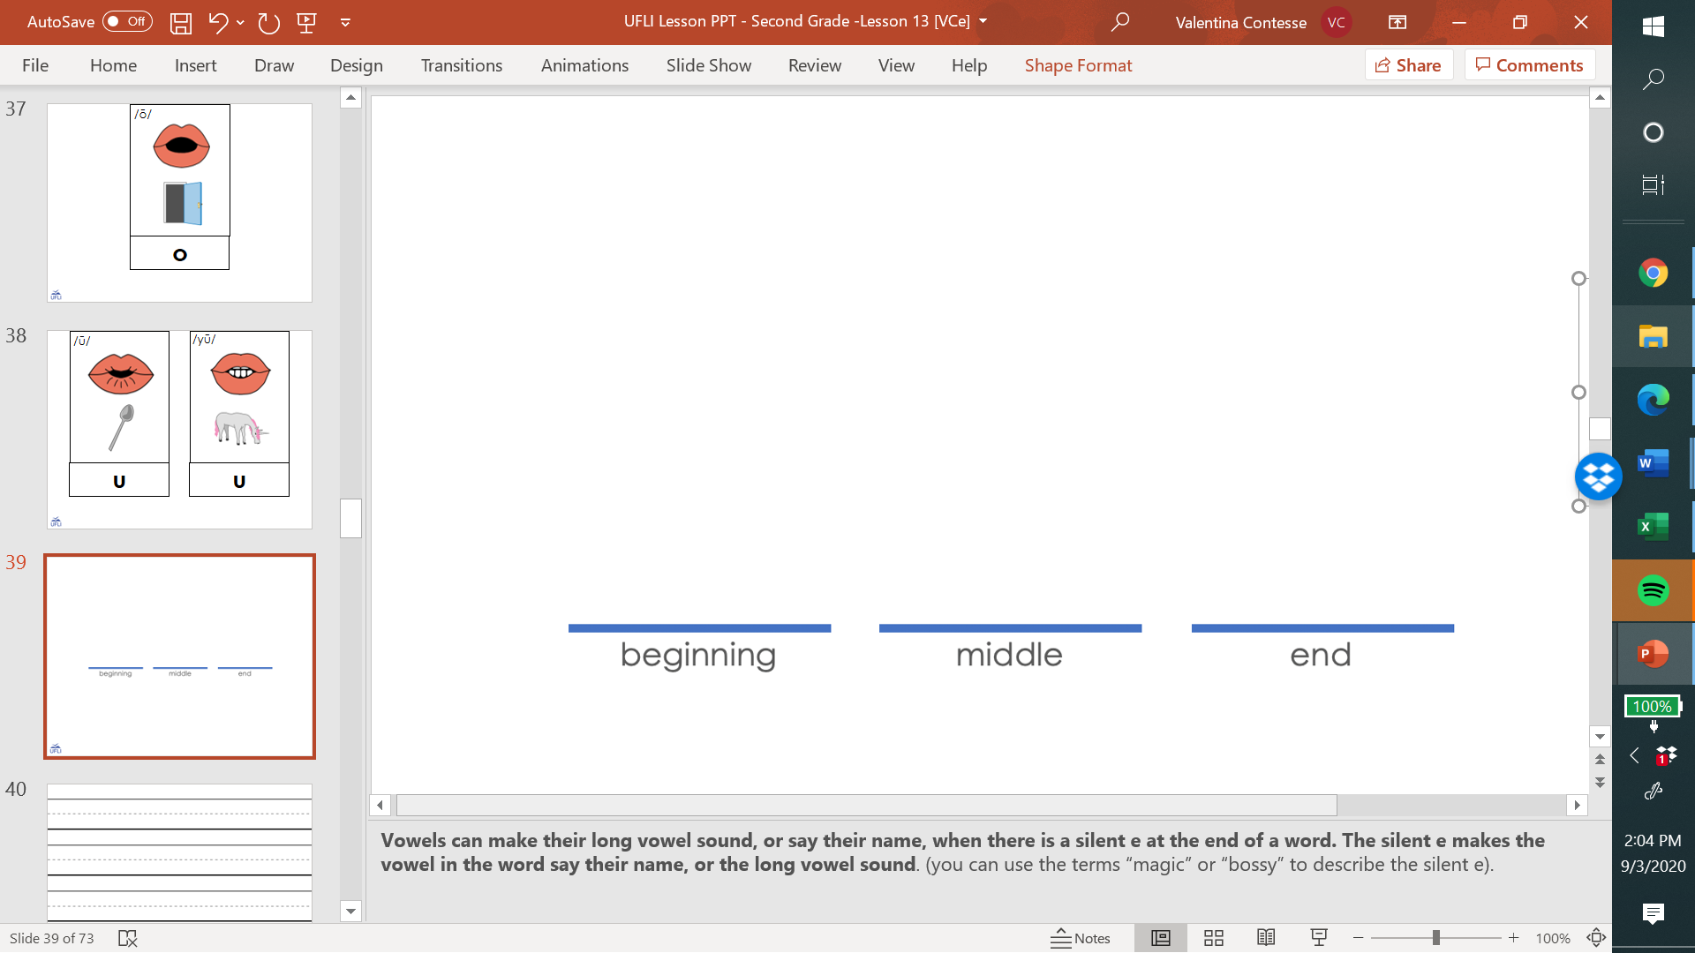
u_e
t
u
n
e

Slide 37
ew
chew

Slide 38
ui
fruit

Slide 39
ue
blue

Slide 40
ou

Slide 41
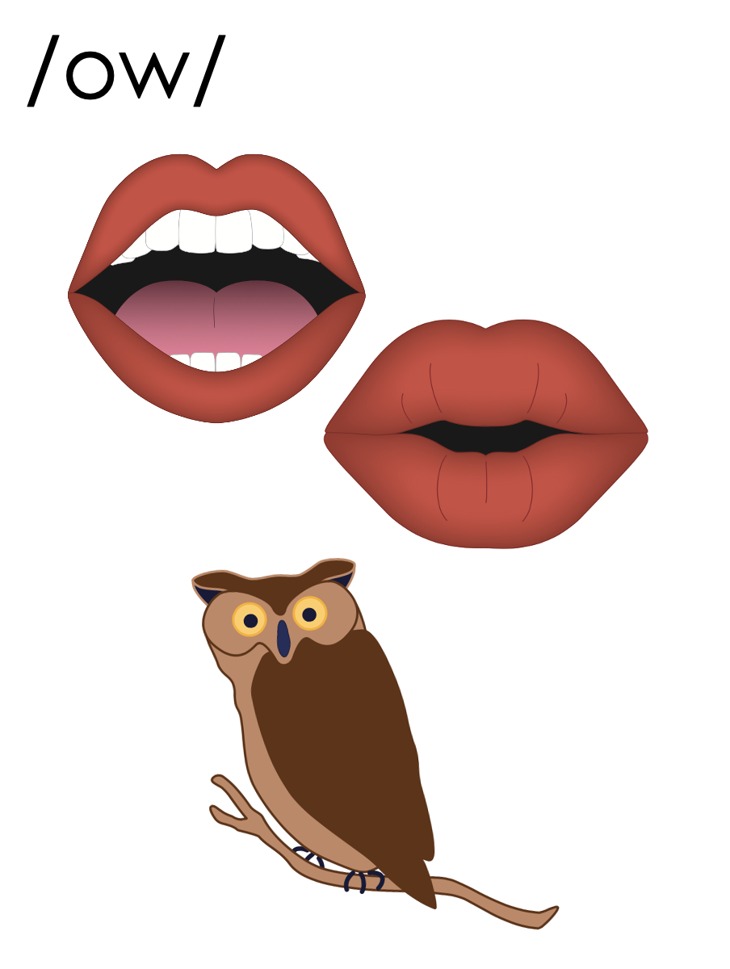
ou
shout

Slide 42
ou
soup
group

Slide 43
u_e
c
u
t
e

Slide 44
ew
ue
eu

Slide 45
spew
nephew
ew

Slide 46
value
rescue
ue

Slide 47
eucalyptus
eu

Slide 48
u_e | ew | ui | ue | ou | eu

Slide 49
u_e
u
u_e
u
oo
ew
ew
eu
ui
ue
ue
ou

Slide 50
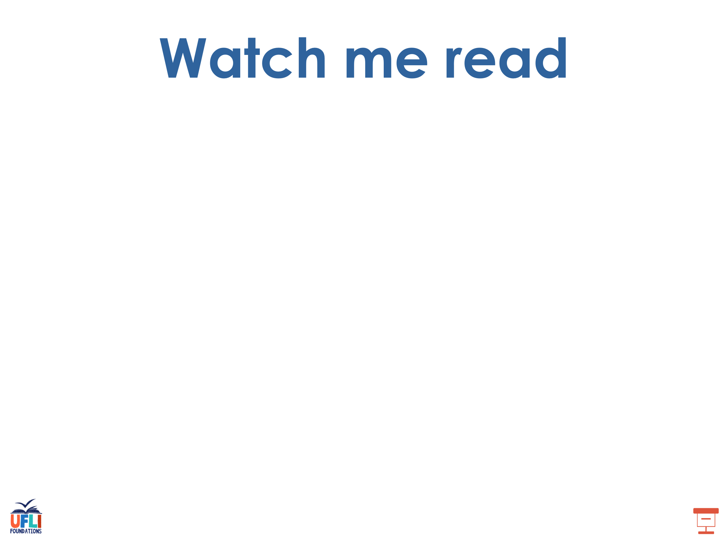
curfew
venue
you

Slide 51
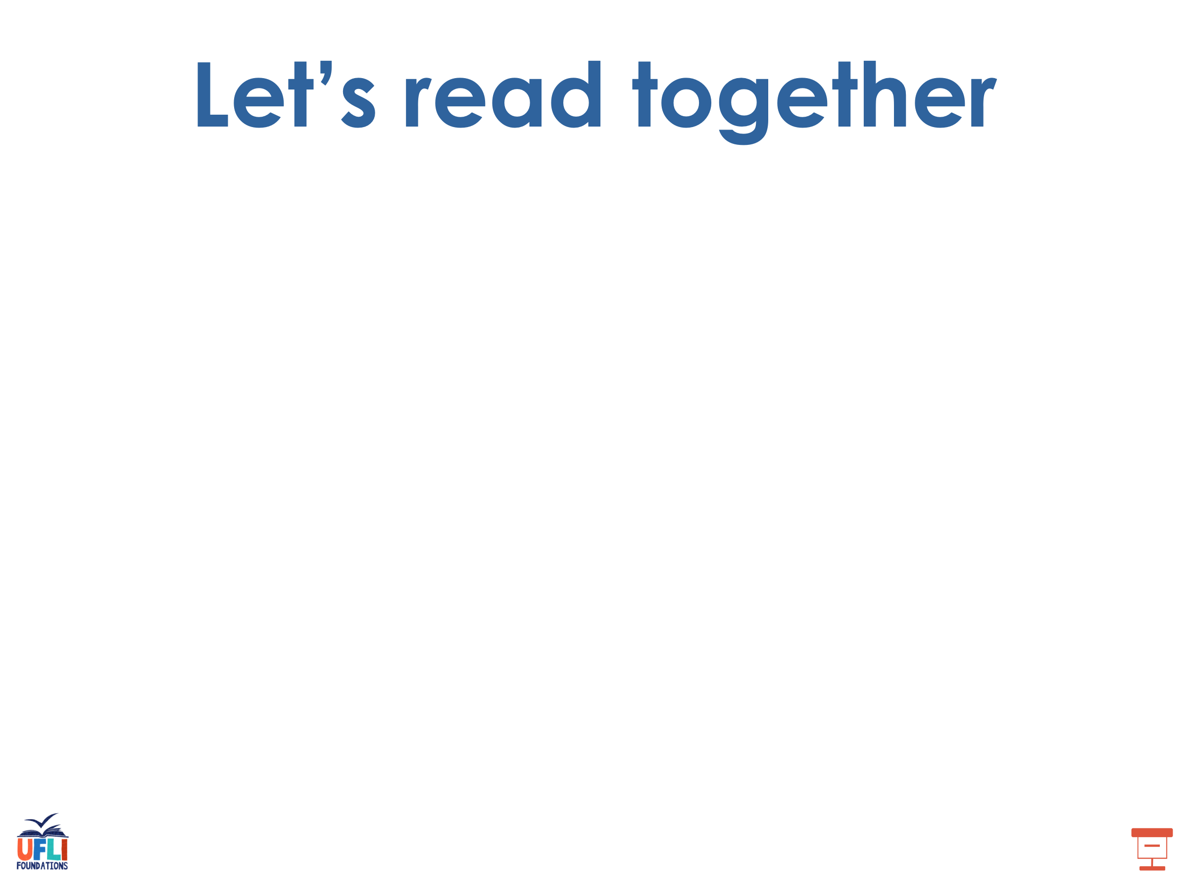
few
spew
skewed

Slide 52
nephew
hue
argue

Slide 53
rescue
value
group
youth

Slide 54
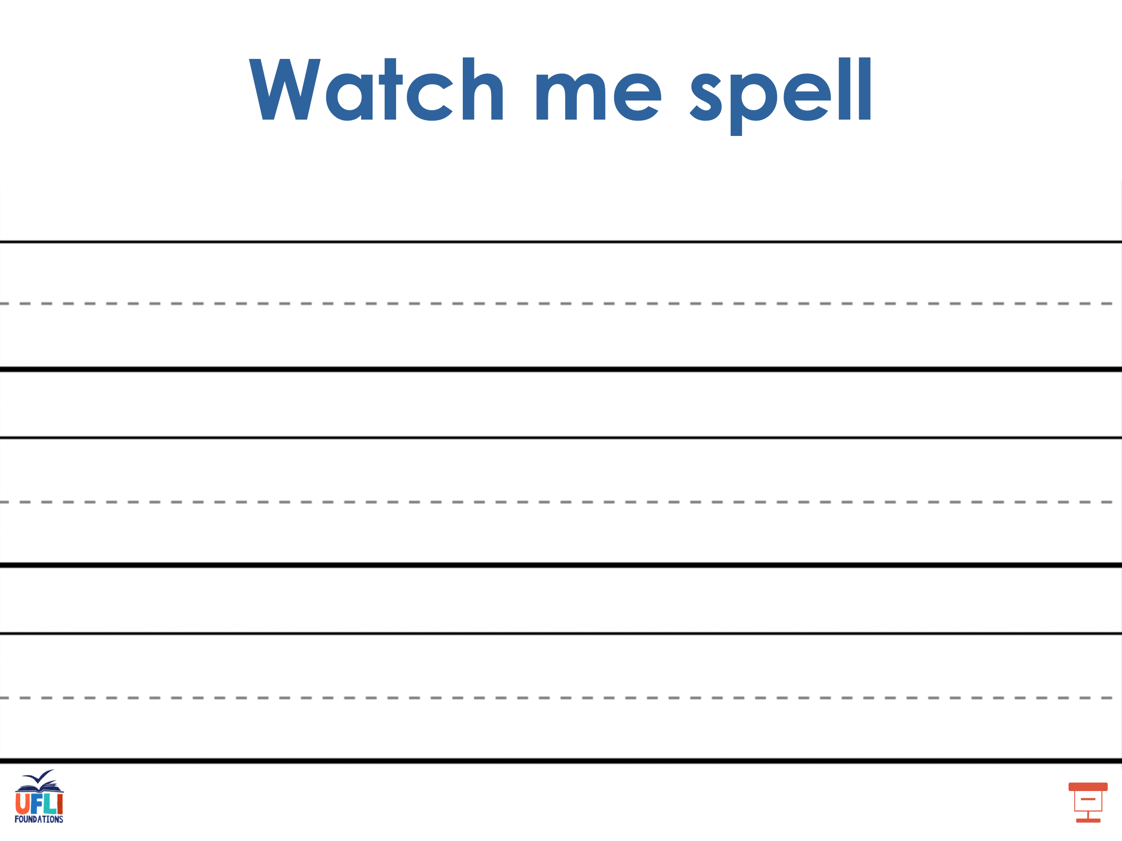
Notes:
See UFLI Foundations lesson plan Step 5 for words to spell.
Handwriting paper to model spelling.

Slide 55
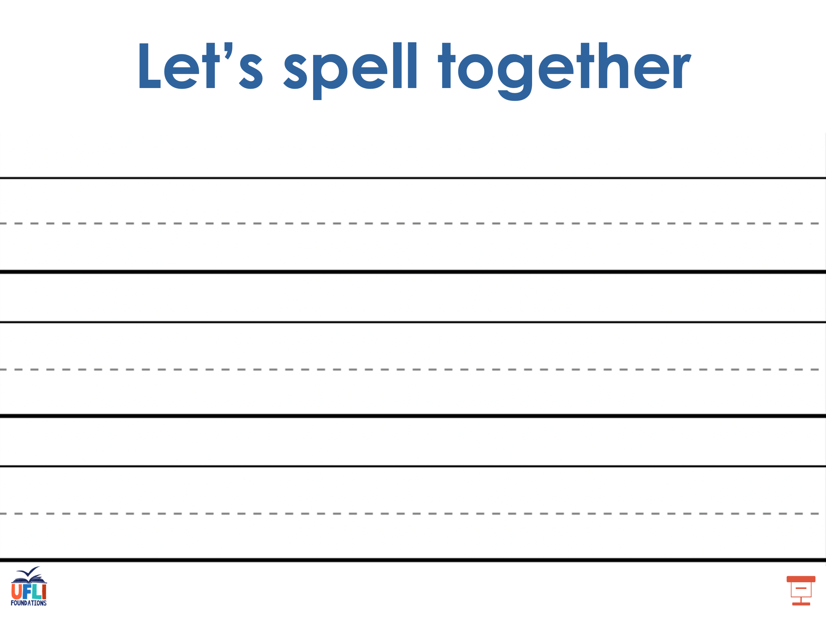
Notes:
See UFLI Foundations lesson plan Step 5 for words to spell.
Handwriting paper for guided spelling practice.

Slide 56
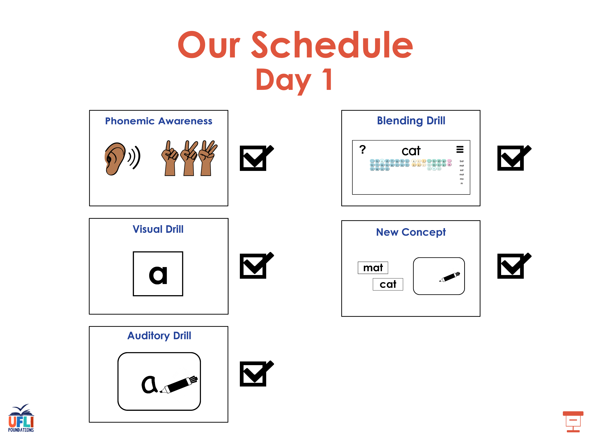

Slide 57

Insert brief reinforcement activity and/or transition to next part of reading block.

Slide 58

Lesson 115
Alternate Long U

Slide 59
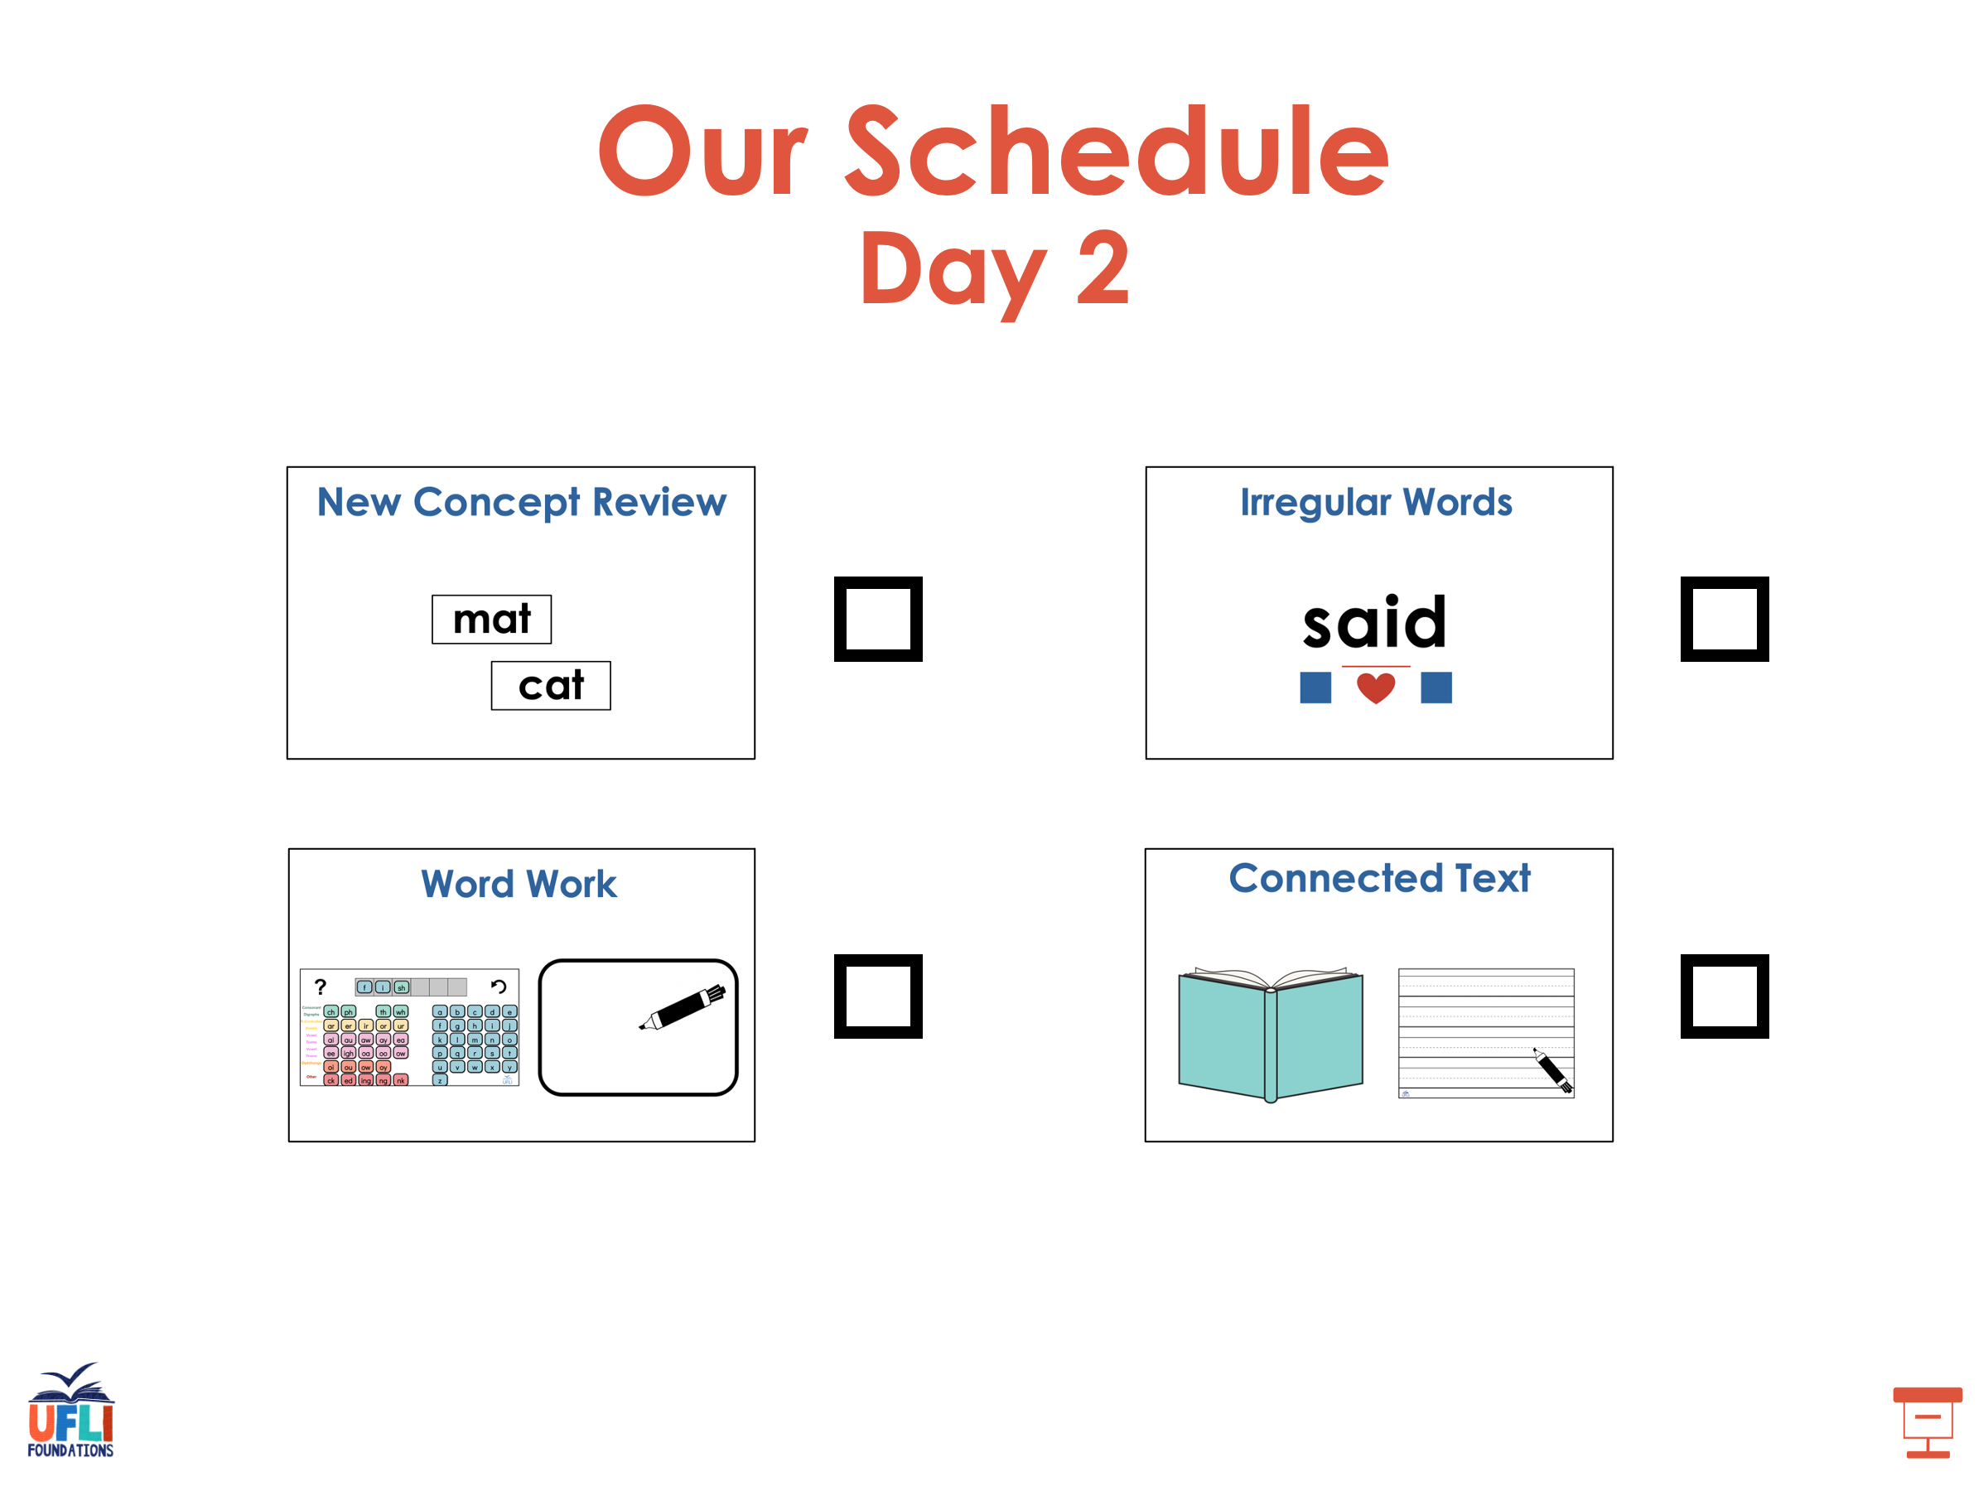

Slide 60
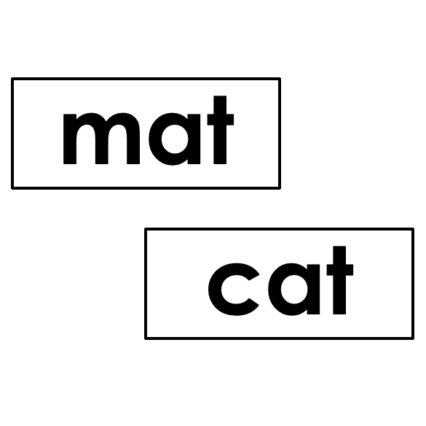


New Concept Review
Notes:
See UFLI Foundations lesson plan Step 5 for recommended teacher language and activities to review the new concept.

Slide 61
flew
cube

Slide 62
u_e
t
u
n
e

Slide 63
ew
chew

Slide 64
ui
fruit

Slide 65
ue
blue

Slide 66
ou

Slide 67
ou
shout

Slide 68
ou
soup
group

Slide 69
u_e
c
u
t
e

Slide 70
ew
ue
eu

Slide 71
spew
nephew
ew

Slide 72
value
rescue
ue

Slide 73
eucalyptus
eu

Slide 74
u_e | ew | ui | ue | ou | eu

Slide 75
u_e
u
u_e
u
oo
ew
ew
eu
ui
ue
ue
ou

Slide 76
few
feud
cue
group

Slide 77
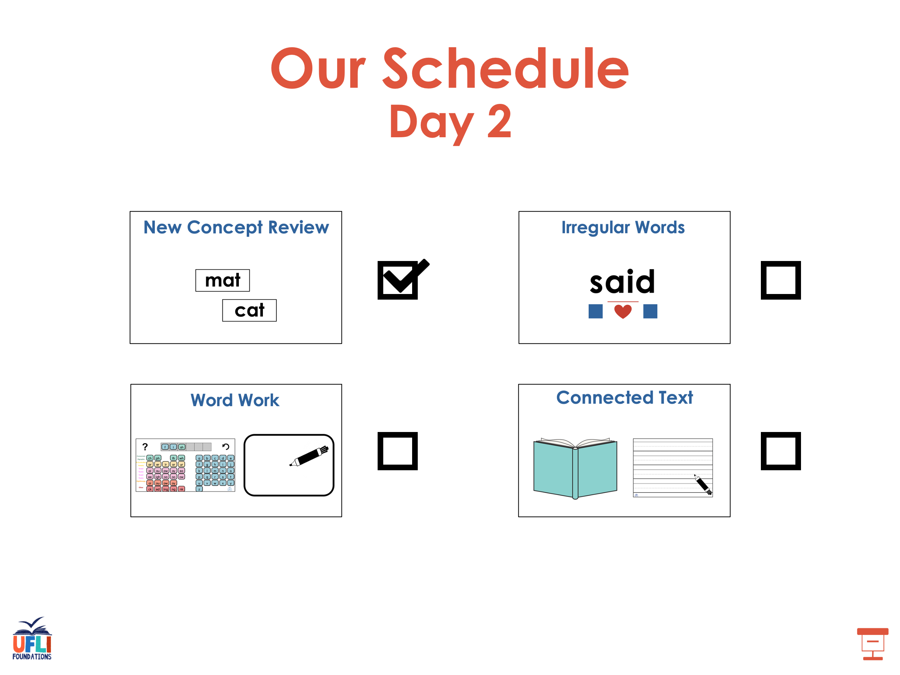

Slide 78
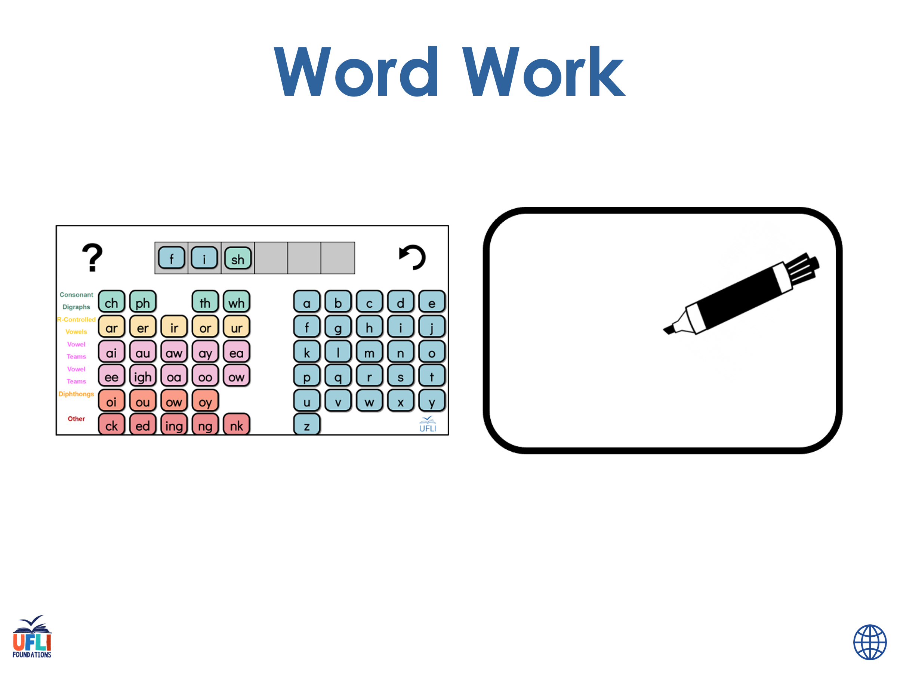

Notes:
See UFLI Foundations lesson plan Step 6 for word work activity.
Visit ufliteracy.org to access the Word Work Mat apps.

Slide 79
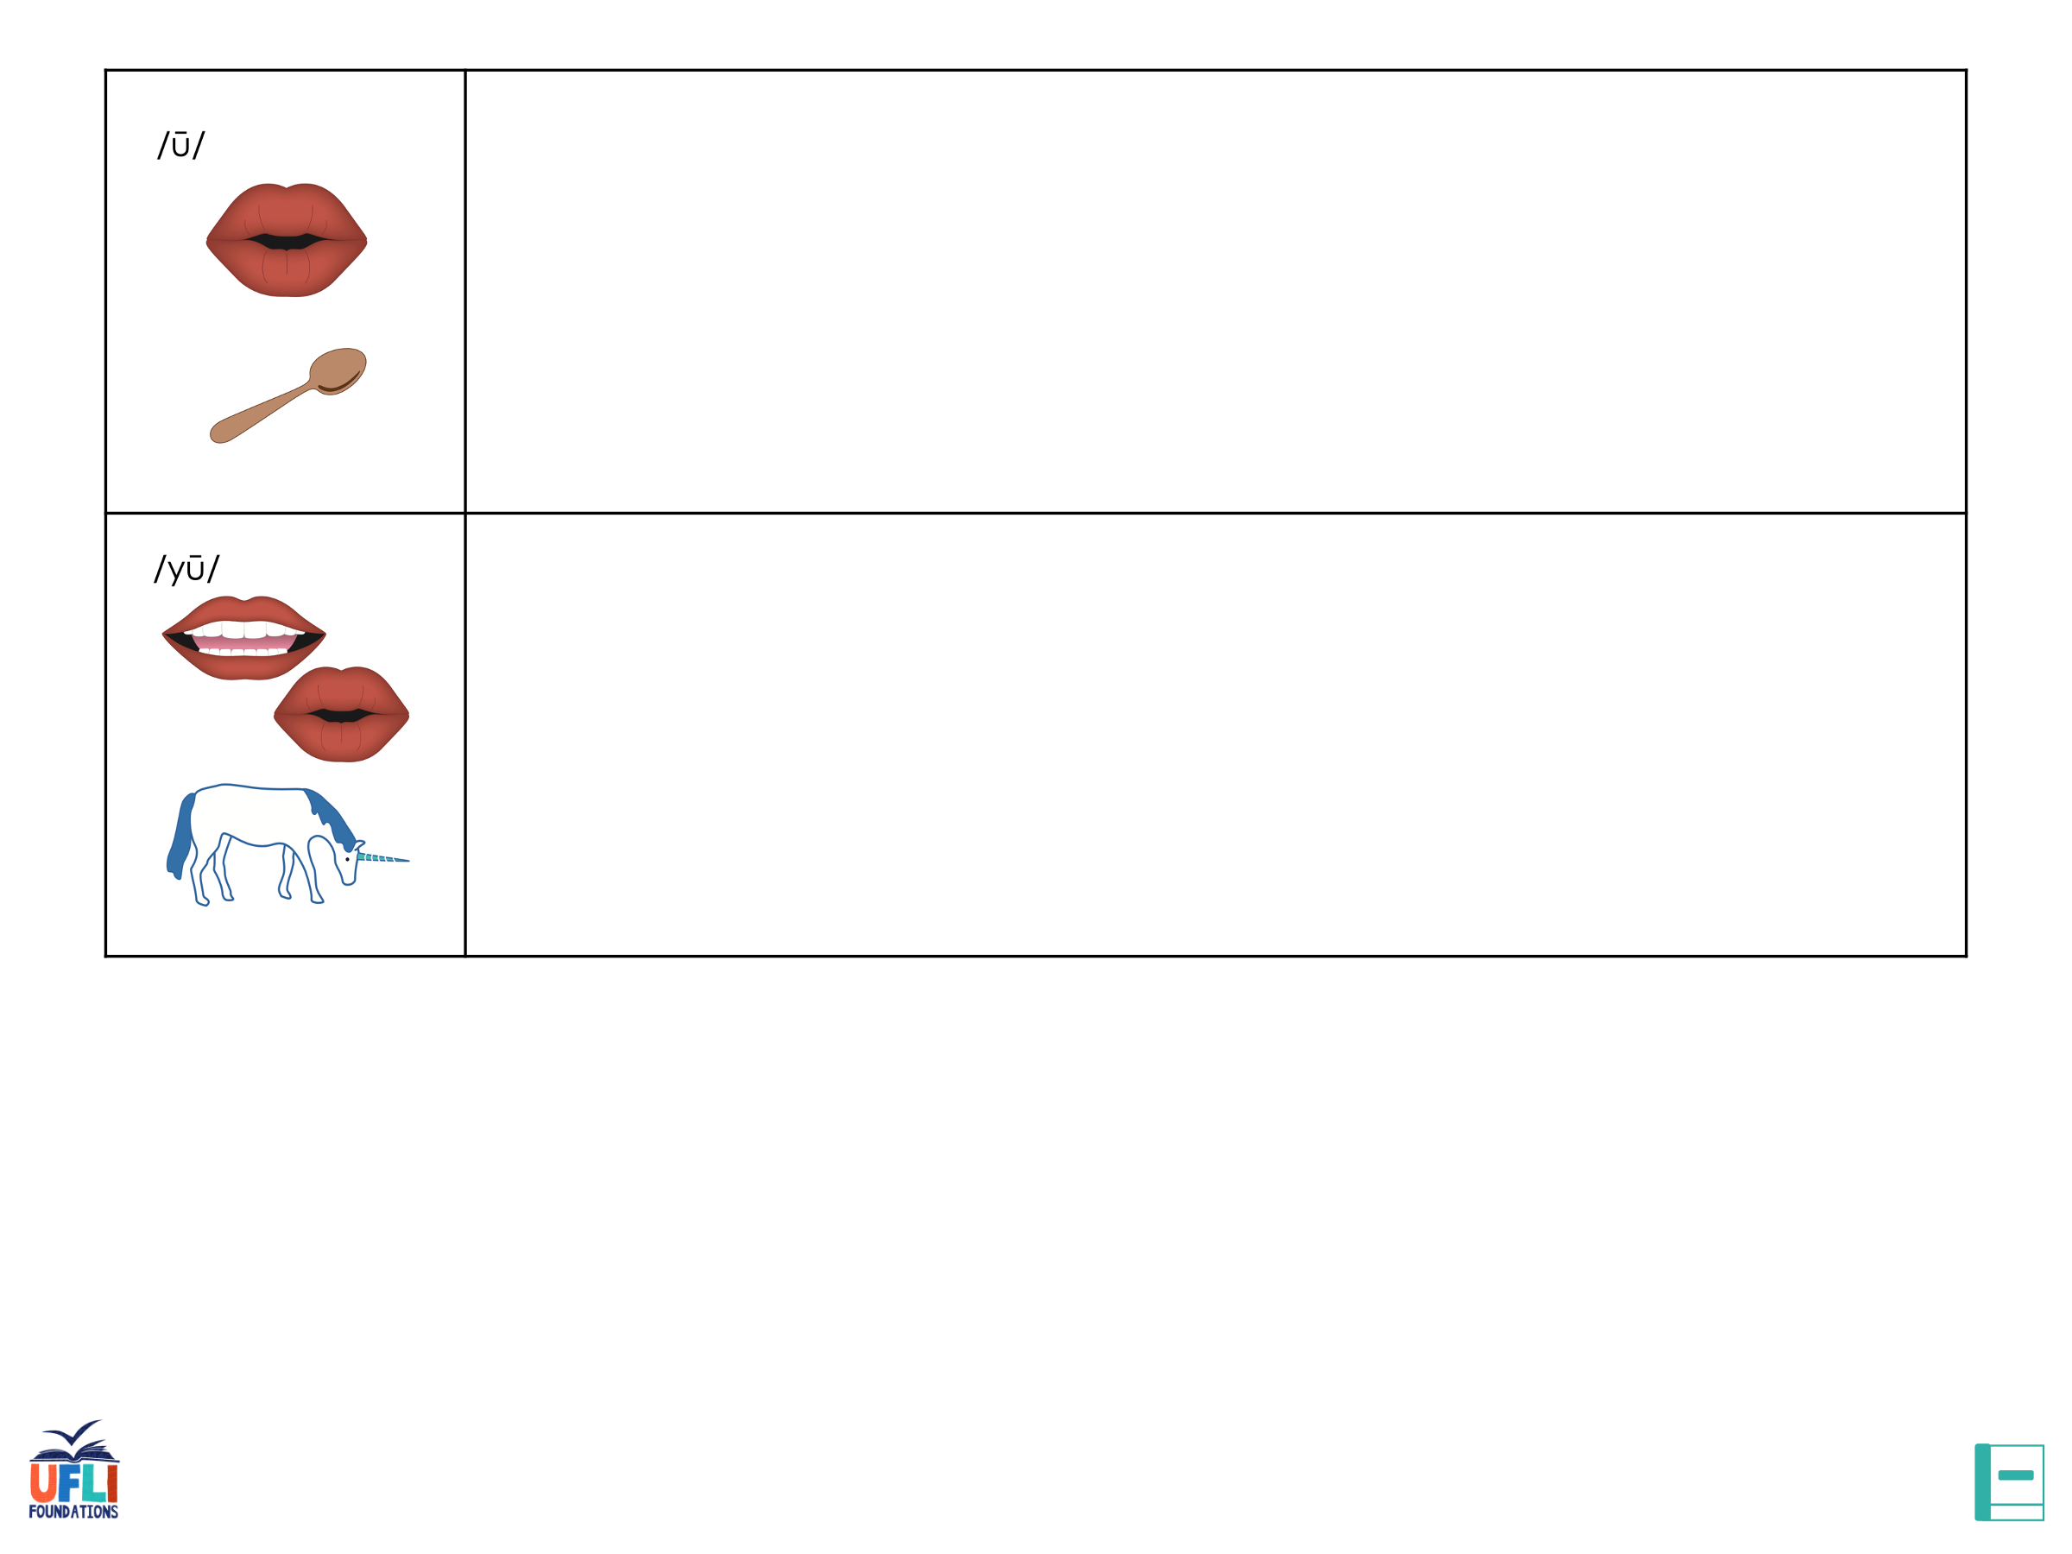



















Notes:
Display this slide in editing mode. Click and hold to drag the words to the correct row.

Slide 80
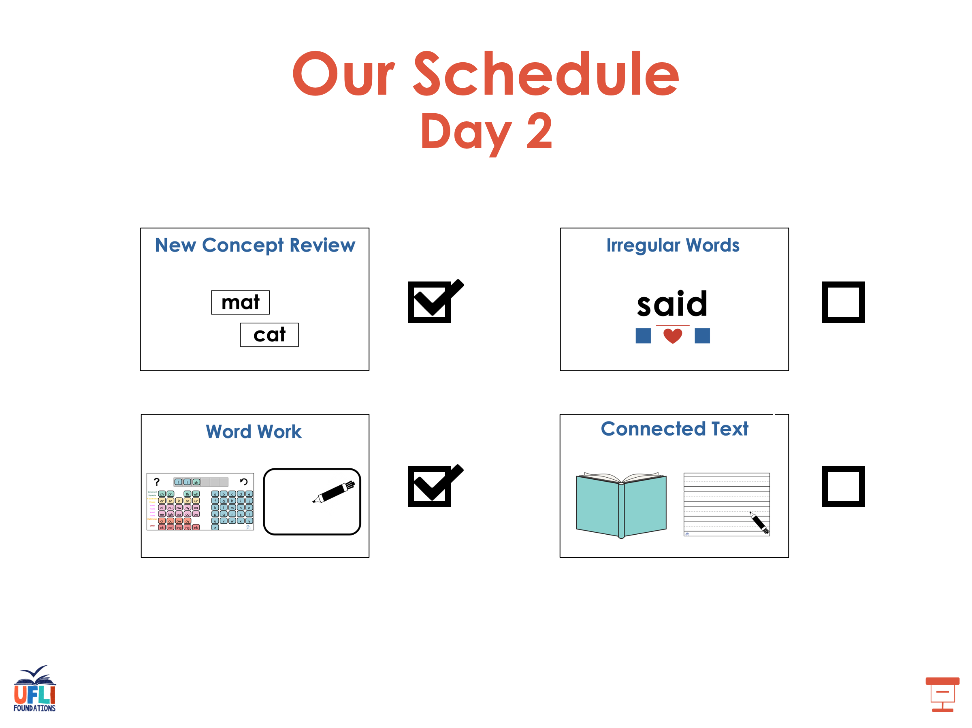

Slide 81
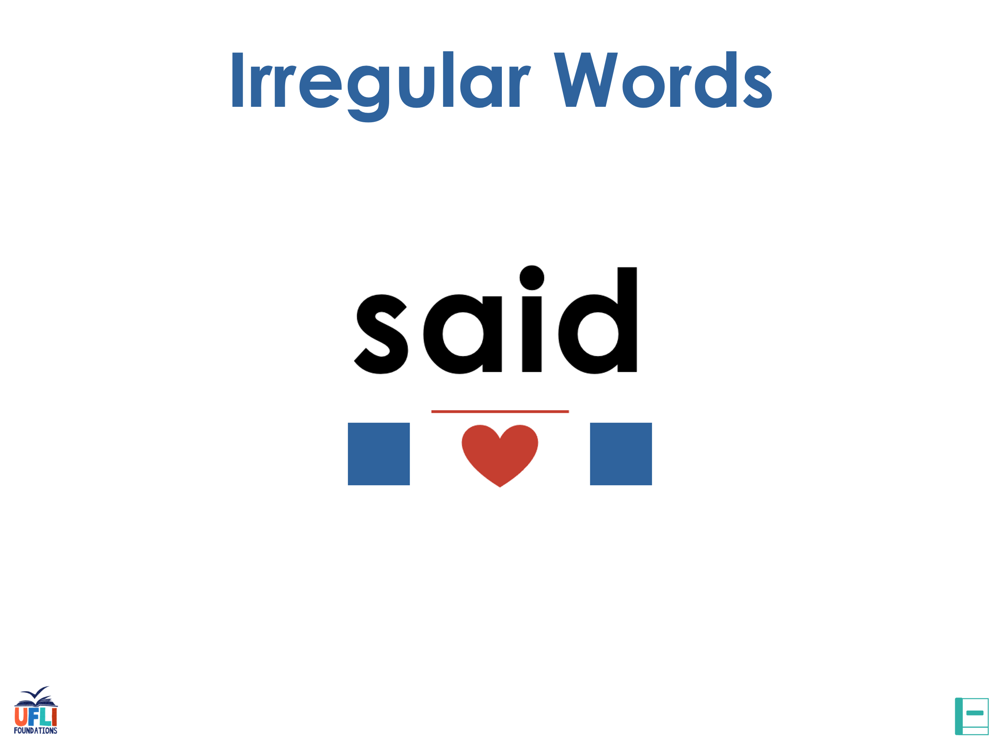
Notes:
See UFLI Foundations lesson plan Step 7 for irregular word activities.
The white rectangle under each word may be used in editing mode. Cover the heart and square icons then reveal them one at a time during instruction.

Slide 82

Notes:
See UFLI Foundations manual for more information about reviewing irregular words.

Slide 83
toward
Notes:
Lesson 113+
Depending on dialect, this word can be pronounced:
/t/+/or/+/d/,
/t/+/ə/+/w/+/or/ (or /er/) +/d/, or
/t/+/oo/+/w/+/or/ (or /er/) +/d/.
The white rectangle under the word may be used in editing mode. Cover the heart and square icons then reveal them one at a time during instruction.

Slide 84
through
Notes:
Lesson 114+
OUGH represents the /ū/ sound.
The white rectangle under the word may be used in editing mode. Cover the heart and square icons then reveal them one at a time during instruction.

Slide 85
Notes:
Handwriting paper for irregular word spelling practice. Use as needed.
See UFLI Foundations manual for more information about reviewing irregular words.

Slide 86
Teach
Notes:
The orange star indicates these are new irregular words that need to be introduced.
See UFLI Foundations manual for more information about teaching irregular words.

Slide 87
learn
Notes:
Lesson 115+
EAR represents the /er/ sound.
The white rectangle under the word may be used in editing mode. Cover the heart and square icons then reveal them one at a time during instruction.

Slide 88
earth
Notes:
Lesson 115+
EAR represents the /er/ sound.
The white rectangle under the word may be used in editing mode. Cover the heart and square icons then reveal them one at a time during instruction.

Slide 89
early
Notes:
Lesson 115+
EAR represents the /er/ sound.
The white rectangle under the word may be used in editing mode. Cover the heart and square icons then reveal them one at a time during instruction.

Slide 90
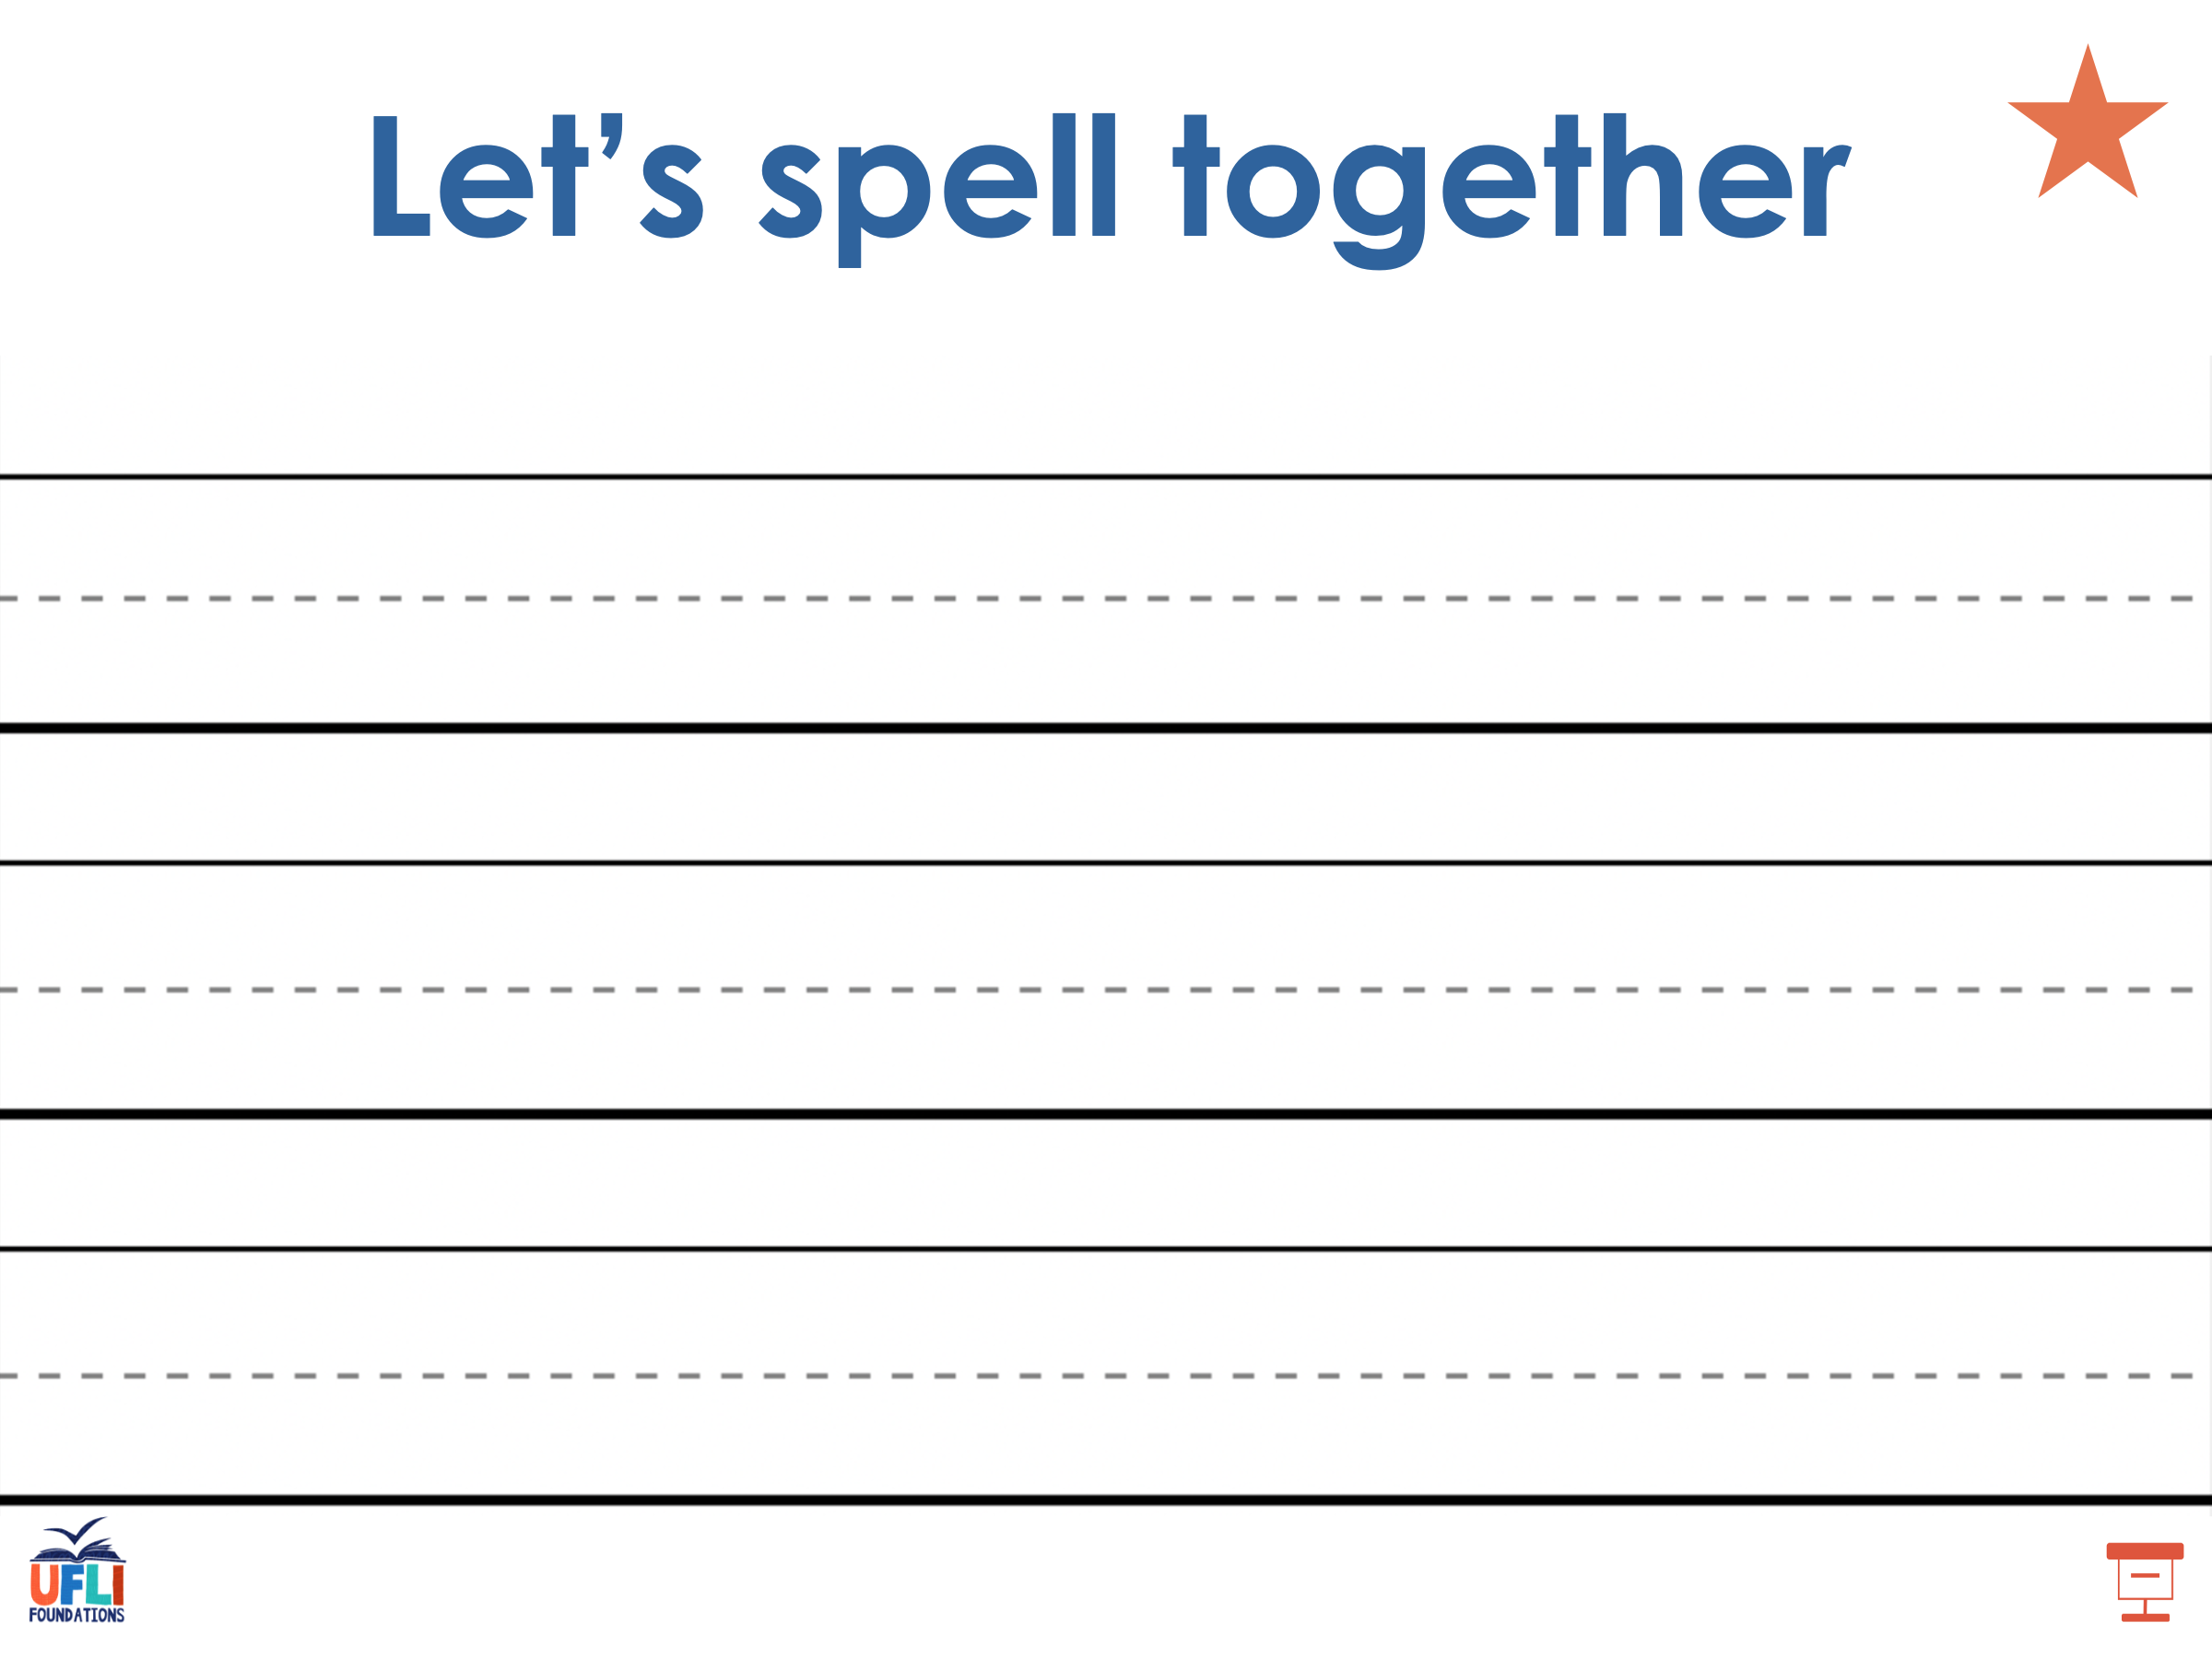
Notes:
Handwriting paper for irregular word spelling practice. Use as needed.
See UFLI Foundations manual for more information about teaching irregular words.

Slide 91
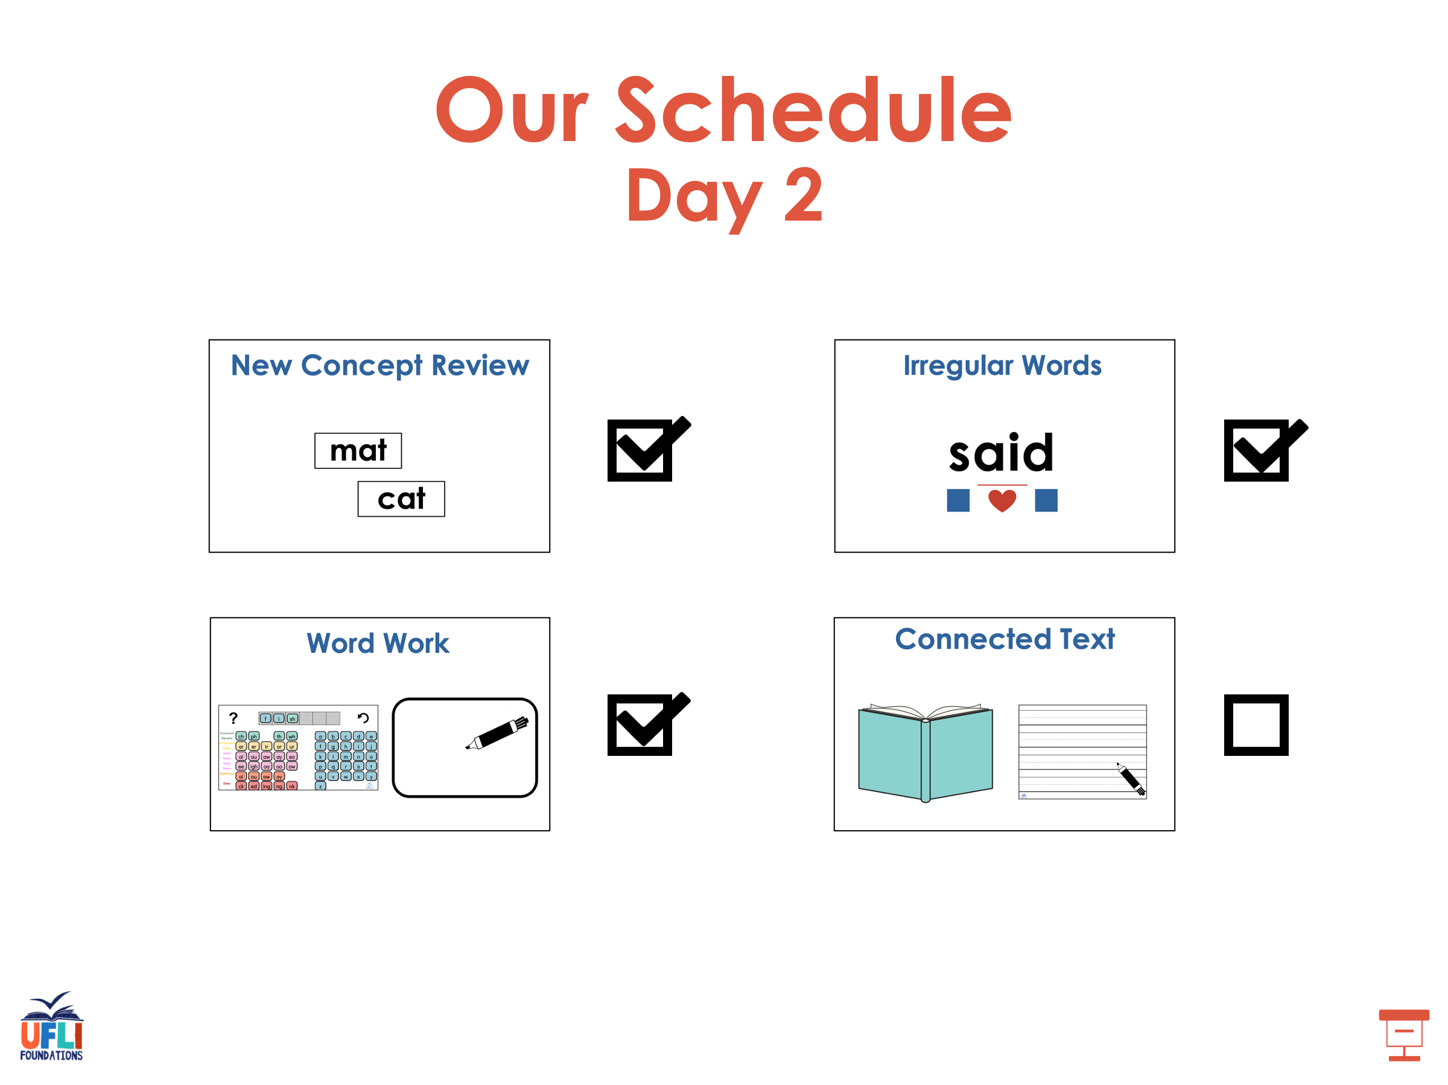

Slide 92
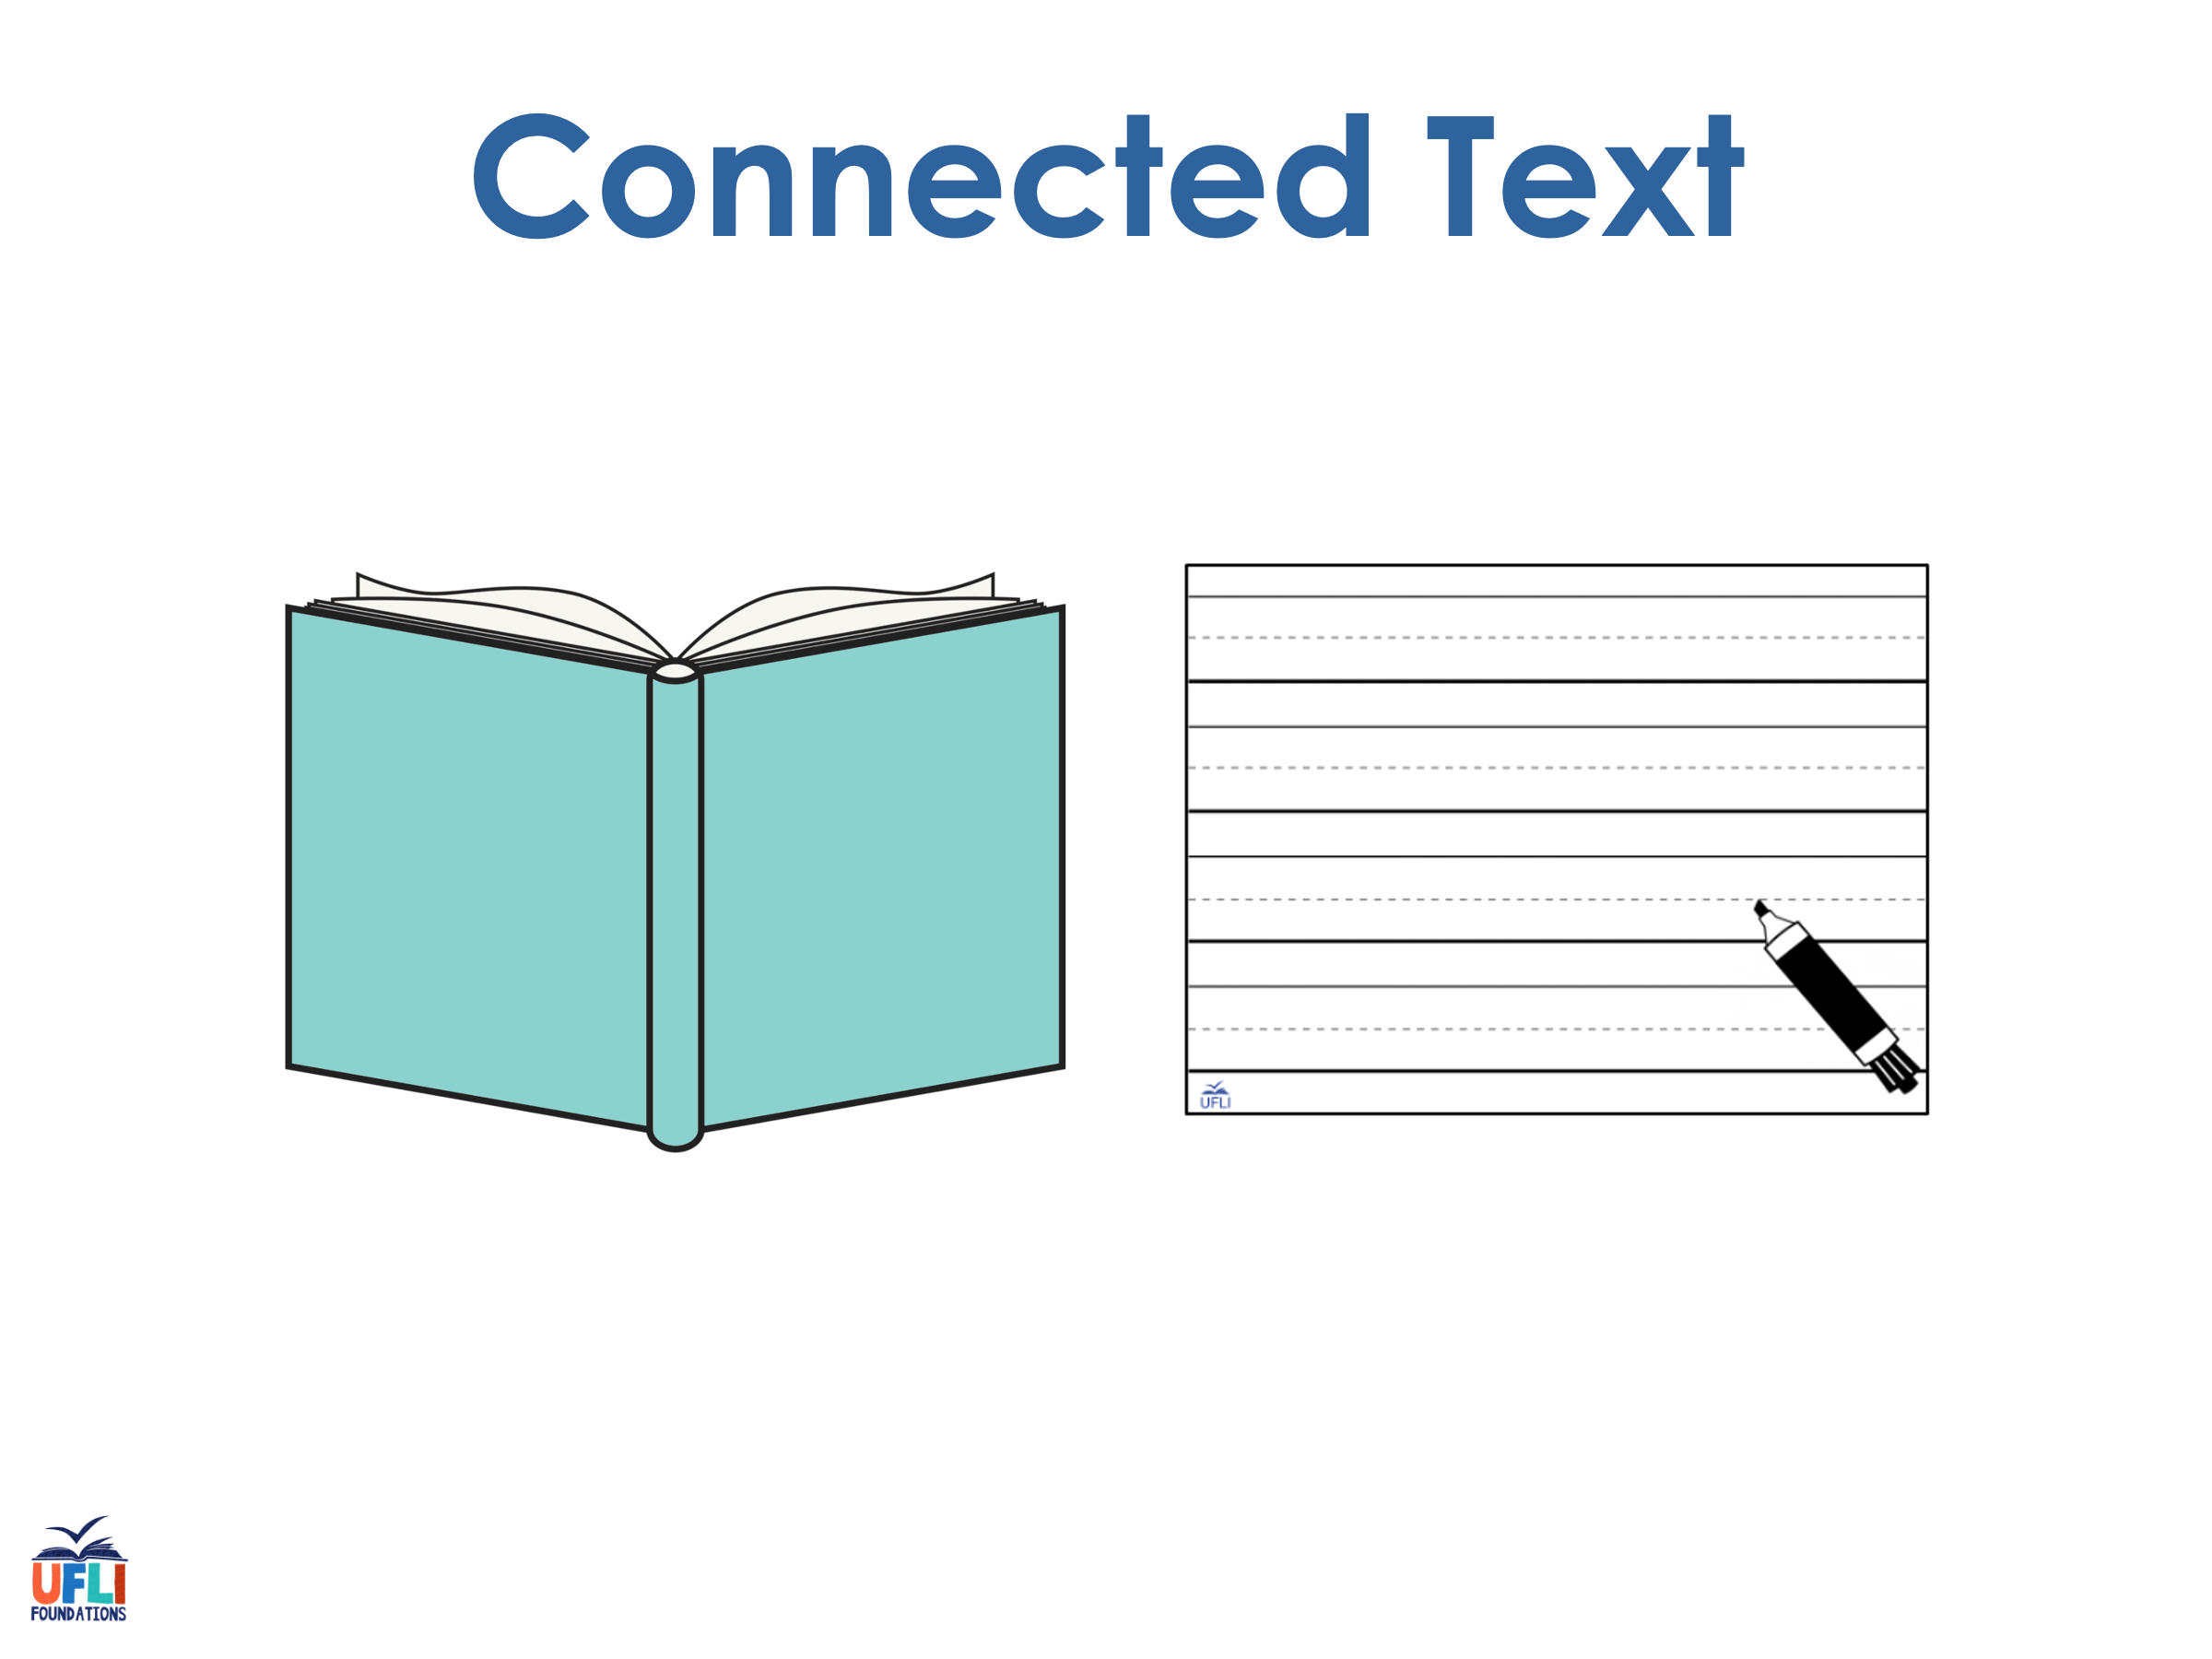
Notes:
See UFLI Foundations lesson plan Step 8 for connected text activities.

Slide 93
My nephew has the best rescue dog on earth!

Slide 94
We learned the true value of hard work early.

Slide 95
We need a few more people in this group.

Slide 96
Notes:
See UFLI Foundations lesson plan Step 8 for sentences to write.

Slide 97

Notes:
The UFLI Foundations decodable text is provided here. See UFLI Foundations decodable text guide for additional text options.

Slide 98
It’s No Fun to Argue
Stewart lives down the street from his nephew, Louis. They love to spend time together. Stewart calls Louis the best
nephew on earth and Louis calls Stewart the best uncle on earth.

Slide 99
Last Saturday, Stewart took Louis to the park to play. Louis played a new game with a group of his friends. The game was going well, but then a few of the kids started to argue about the rules. The game could not continue while the kids were arguing. This made the rest of the group angry.

Slide 100
After a few minutes, Stewart came to the rescue. He said, “if you all continue to argue, you will not have any time left to play.” This made everyone stop and think. The kids agreed that they wanted to spend their time playing instead of arguing.
“See,” Louis yelled, “this is why Stewart is the best uncle on earth!”

Slide 101
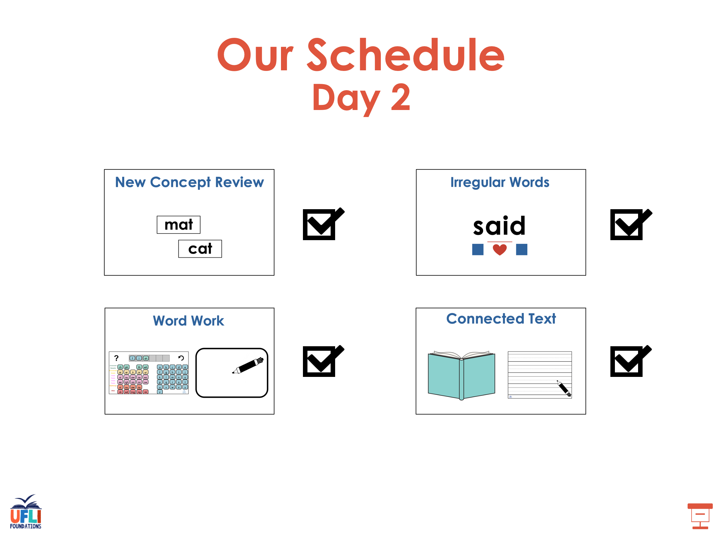

Slide 102
Insert brief reinforcement activity and/or transition to next part of reading block.

