Slide 1
Lesson 114
Alternate /ā/

Slide 2
Notes:
ufliteracy.org

Slide 4
Lesson 114
Alternate /ā/

Slide 6
Notes:
See UFLI Foundations lesson plan Step 1 for phonemic awareness activity.

Slide 8
Notes:
See UFLI Foundations lesson plan Step 2 for student phoneme responses.

Slide 9
air

Slide 10
are

Slide 11
ear

Slide 12
our

Slide 13
or

Slide 14
ar

Slide 15
-ed

Slide 16
y

Slide 17
er

Slide 18
e

Slide 19
t

Slide 20
s

Slide 21
ou

Slide 22
ow

Slide 23
oi

Slide 24
oy

Slide 25
ea

Slide 26
au

Slide 27
aw

Slide 28
augh

Slide 30
Notes:
See UFLI Foundations lesson plan Step 3 for auditory drill activity.

Slide 31
Notes:
No slides needed for auditory drill.

Slide 33
Notes:
See UFLI Foundations lesson plan Step 4 for blending drill word chain and grid.
Visit ufliteracy.org to access the Blending Board app.

Slide 35
Notes:
See UFLI Foundations lesson plan Step 5 for recommended teacher language and activities to introduce the new concept.

Slide 36
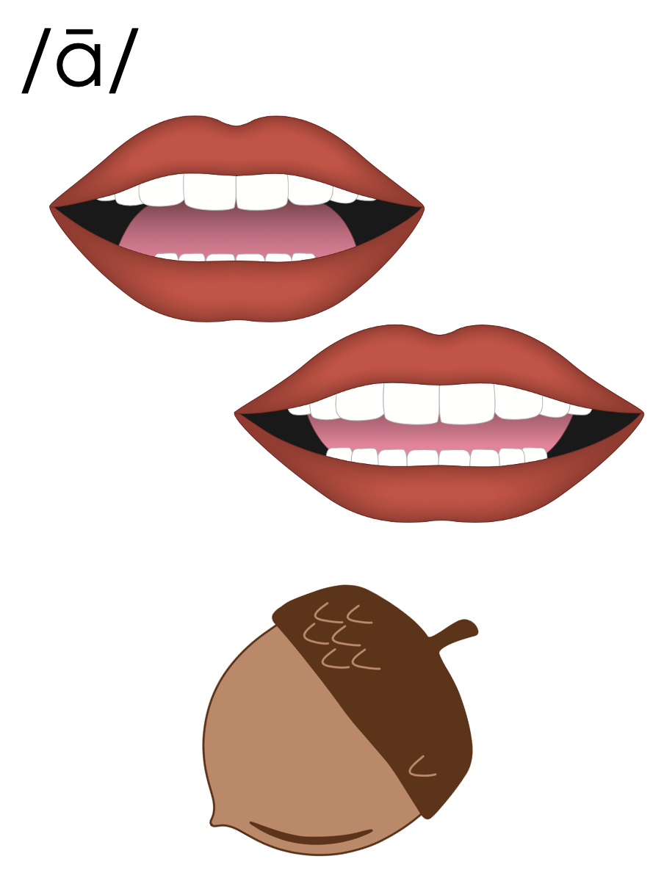

Slide 37
a_e
c
a
k
e

Slide 38
ai
rain

Slide 39
ay
may

Slide 40
a
Open Syllable
acorn

Slide 41
ei
vein

Slide 42
rein
veil
ei

Slide 43
ey
hey

Slide 44
they
obey
ey

Slide 45
eigh
eight

Slide 46
weight
freight
eigh

Slide 47
neigh
sleigh
eigh

Slide 48
eight
eighty
eigh

Slide 49
aigh
straight

Slide 50
straight
straighten
aigh

Slide 51
ea
great

Slide 52
break
ea

Slide 53
a_e
a
ai
ay
ei
ey
eigh
aigh
ea

Slide 54
hey
eight
straight

Slide 55
prey
eighty
straighter

Slide 56
survey
neighbour
straighten

Slide 57
reindeer
great
steak

Slide 58
Notes:
See UFLI Foundations lesson plan Step 5 for words to spell.
Handwriting paper to model spelling.

Slide 59
Notes:
See UFLI Foundations lesson plan Step 5 for words to spell.
Handwriting paper for guided spelling practice.

Slide 61
Insert brief reinforcement activity and/or transition to next part of reading block.

Slide 62
Lesson 114
Alternate /ā/

Slide 64
New Concept Review
Notes:
See UFLI Foundations lesson plan Step 5 for recommended teacher language and activities to review the new concept.

Slide 66
a_e
c
a
k
e

Slide 67
ai
rain

Slide 68
ay
may

Slide 69
a
Open Syllable
acorn

Slide 70
ei
vein

Slide 71
rein
veil
ei

Slide 72
ey
hey

Slide 73
they
obey
ey

Slide 74
eigh
eight

Slide 75
weight
freight
eigh

Slide 76
neigh
sleigh
eigh

Slide 77
eight
eighty
eigh

Slide 78
aigh
straight

Slide 79
straight
straighten
aigh

Slide 80
ea
great

Slide 81
break
ea

Slide 82
a_e
a
ai
ay
ei
ey
eigh
aigh
ea

Slide 83
vein
they
great

Slide 84
eight
straight

Slide 86
Notes:
See UFLI Foundations lesson plan Step 6 for word work activity.
Visit ufliteracy.org to access the Word Work Mat apps.

Slide 87
homophones
rein | Reins are the thin leather straps attached around a horse's neck for horseback riding.
rain | Rain is water that falls from the clouds in small drops.

Slide 88
homophones
wait | When you wait for something or someone, you spend time doing very little, because you cannot act until that thing happens or that person arrives.
weight | Weight is how heavy something is, measured in units like grams or kilograms.

Slide 89
homophones
waist | Your waist is the middle part of your body where it narrows slightly above your hips.
waste | If you waste something such as time, money, or energy, you use too much of it doing something that is not important or necessary.

Slide 90
homophones
way | If you describe a way of doing something, you are talking about how you can do it.
weigh | If you weigh something or someone, you measure how heavy they are.

Slide 91
homophones
great | Great is a word used to describe something that is important, famous, or exciting.
grate | If you grate food such as cheese or carrots, you rub it over a metal tool called a grater so that the food is cut into very small pieces.

Slide 92
homophones
eight | Eight is a number. I am eight years old.
ate | Ate is the past tense of eat. I ate some toast yesterday.

Slide 94
Notes:
See UFLI Foundations lesson plan Step 7 for irregular word activities.
The white rectangle under each word may be used in editing mode. Cover the heart and square icons then reveal them one at a time during instruction.

Slide 95
who
Notes:
Lesson 54+
WH represents the /h/ sound.
O represents the /ū/ sound.
The white rectangle under the word may be used in editing mode. Cover the heart and square icons then reveal them one at a time during instruction.

Slide 96
whom
Notes:
Lesson 111+
WH represents the /h/ sound.
O represents the /ū/ sound.
The white rectangle under the word may be used in editing mode. Cover the heart and square icons then reveal them one at a time during instruction.

Slide 97
whose
Notes:
Lesson 112+
WH represents the /h/ sound.
O represents the /ū/ sound.
The final E is silent but does not follow the long vowel VCe pattern.
The white rectangle under the word may be used in editing mode. Cover the heart and square icons then reveal them one at a time during instruction.

Slide 98
toward
Notes:
Lesson 113+
Depending on dialect, this word can be pronounced:
/t/+/or/+/d/,
/t/+/ə/+/w/+/or/ (or /er/) +/d/, or
/t/+/oo/+/w/+/or/ (or /er/) +/d/.
The white rectangle under the word may be used in editing mode. Cover the heart and square icons then reveal them one at a time during instruction.

Slide 99
Notes:
See UFLI Foundations manual for more information about reviewing irregular words.

Slide 100
Notes:
Handwriting paper for irregular word spelling practice. Use as needed.
See UFLI Foundations manual for more information about reviewing irregular words.

Slide 101
Teach
Notes:
The orange star indicates these are new irregular words that need to be introduced.
See UFLI Foundations manual for more information about teaching irregular words.

Slide 102
through
Notes:
Lesson 114+
OUGH represents the /ū/ sound.
The white rectangle under the word may be used in editing mode. Cover the heart and square icons then reveal them one at a time during instruction.

Slide 103
Notes:
Handwriting paper for irregular word spelling practice. Use as needed.
See UFLI Foundations manual for more information about teaching irregular words.

Slide 105
Notes:
See UFLI Foundations lesson plan Step 8 for connected text activities.

Slide 106
Did Martin have fun at his eighth birthday party?

Slide 107
They will have to wait for the freight train to pass through town.

Slide 108
Hold the reins and guide the sleigh straight down the hill.

Slide 109
Notes:
See UFLI Foundations lesson plan Step 8 for sentences to write.

Slide 110
Notes:
The UFLI Foundations decodable text is provided here. See UFLI Foundations decodable text guide for additional text options.

Slide 111
Greyson’s Neighborhood
Greyson lives in a beige house on the corner of Eighth Street and Great Lake Road. He has lived there for eighteen
years. Greyson loves his neighbourhood because he has great neighbours. Any time he passes someone on his street they always wave and say hey.

Slide 112
Greyson’s next-door neighbour is Corey. Corey loves to cook and has a huge grill in his backyard. Every Friday, Corey
hosts a dinner party for Greyson and some other neighbours. Last Friday, Corey grilled steak and corn. It was quite tasty!

Slide 113
Greyson’s neighbours across the street are Cosmo and Wanda. They have three dogs, four cats, and one fish. That’s eight pets! Sometimes, Greyson walks the dogs for Cosmo and Wanda if they need a break. When Greyson walks the dogs, they always go straight to the park to play fetch.

Slide 114
Greyson loves his beige house, his nice neighbourhood, and his friendly neighbours. He thinks he just might stay there for another eighteen years.

Slide 116
Insert brief reinforcement activity and/or transition to next part of reading block.

