Slide 1
Lesson 113
ear /ear/

Slide 2
Notes:
ufliteracy.org

Slide 4
Lesson 113
ear /ear/

Slide 6
Notes:
See UFLI Foundations lesson plan Step 1 for phonemic awareness activity.

Slide 8
Notes:
See UFLI Foundations lesson plan Step 2 for student phoneme responses.

Slide 9
air

Slide 10
are

Slide 11
ear

Slide 12
our

Slide 13
or

Slide 14
ar

Slide 15
-ed

Slide 16
y

Slide 17
er

Slide 18
e

Slide 19
t

Slide 20
s

Slide 21
ou

Slide 22
ow

Slide 23
oi

Slide 24
oy

Slide 25
ea

Slide 27
Notes:
See UFLI Foundations lesson plan Step 3 for auditory drill activity.

Slide 28
Notes:
No slides needed for auditory drill.

Slide 30
Notes:
See UFLI Foundations lesson plan Step 4 for blending drill word chain and grid.
Visit ufliteracy.org to access the Blending Board app.

Slide 32
Notes:
See UFLI Foundations lesson plan Step 5 for recommended teacher language and activities to introduce the new concept.

Slide 33
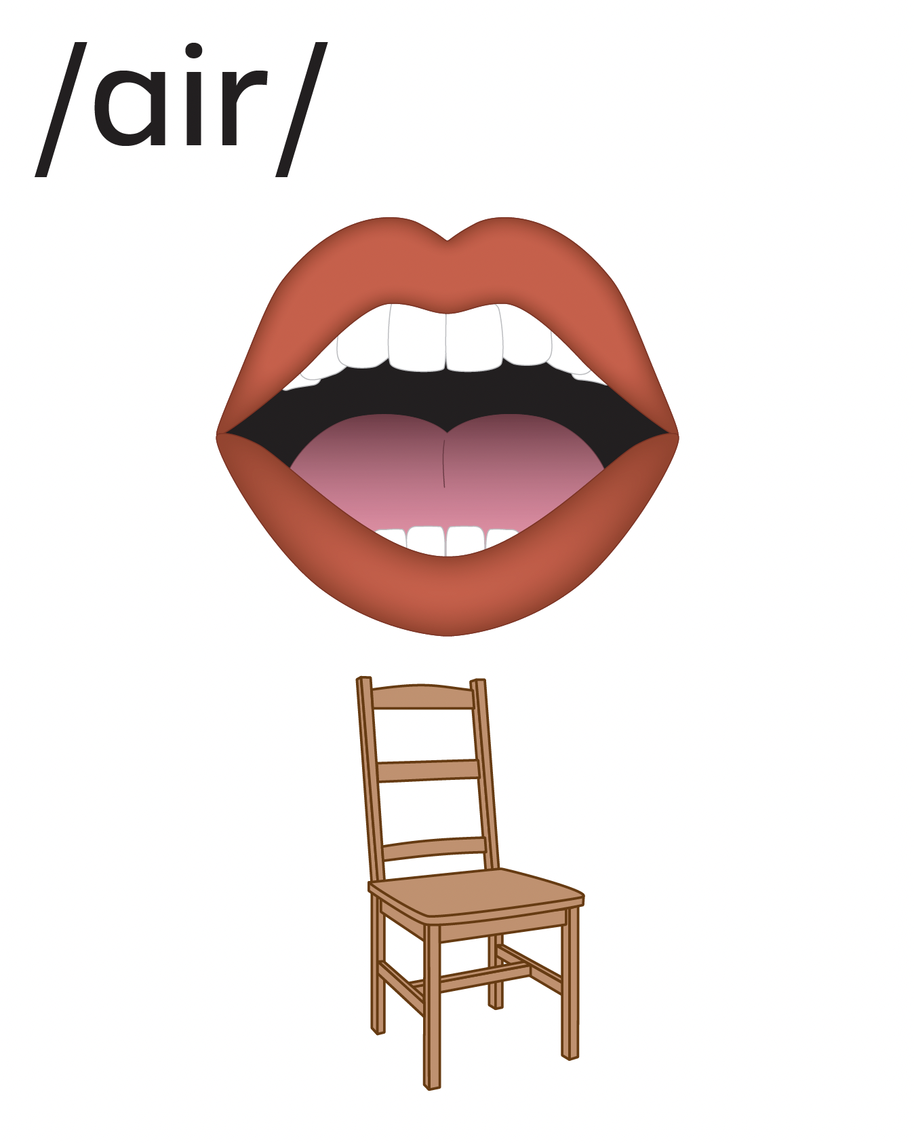

Slide 34
ear
bear

Slide 35
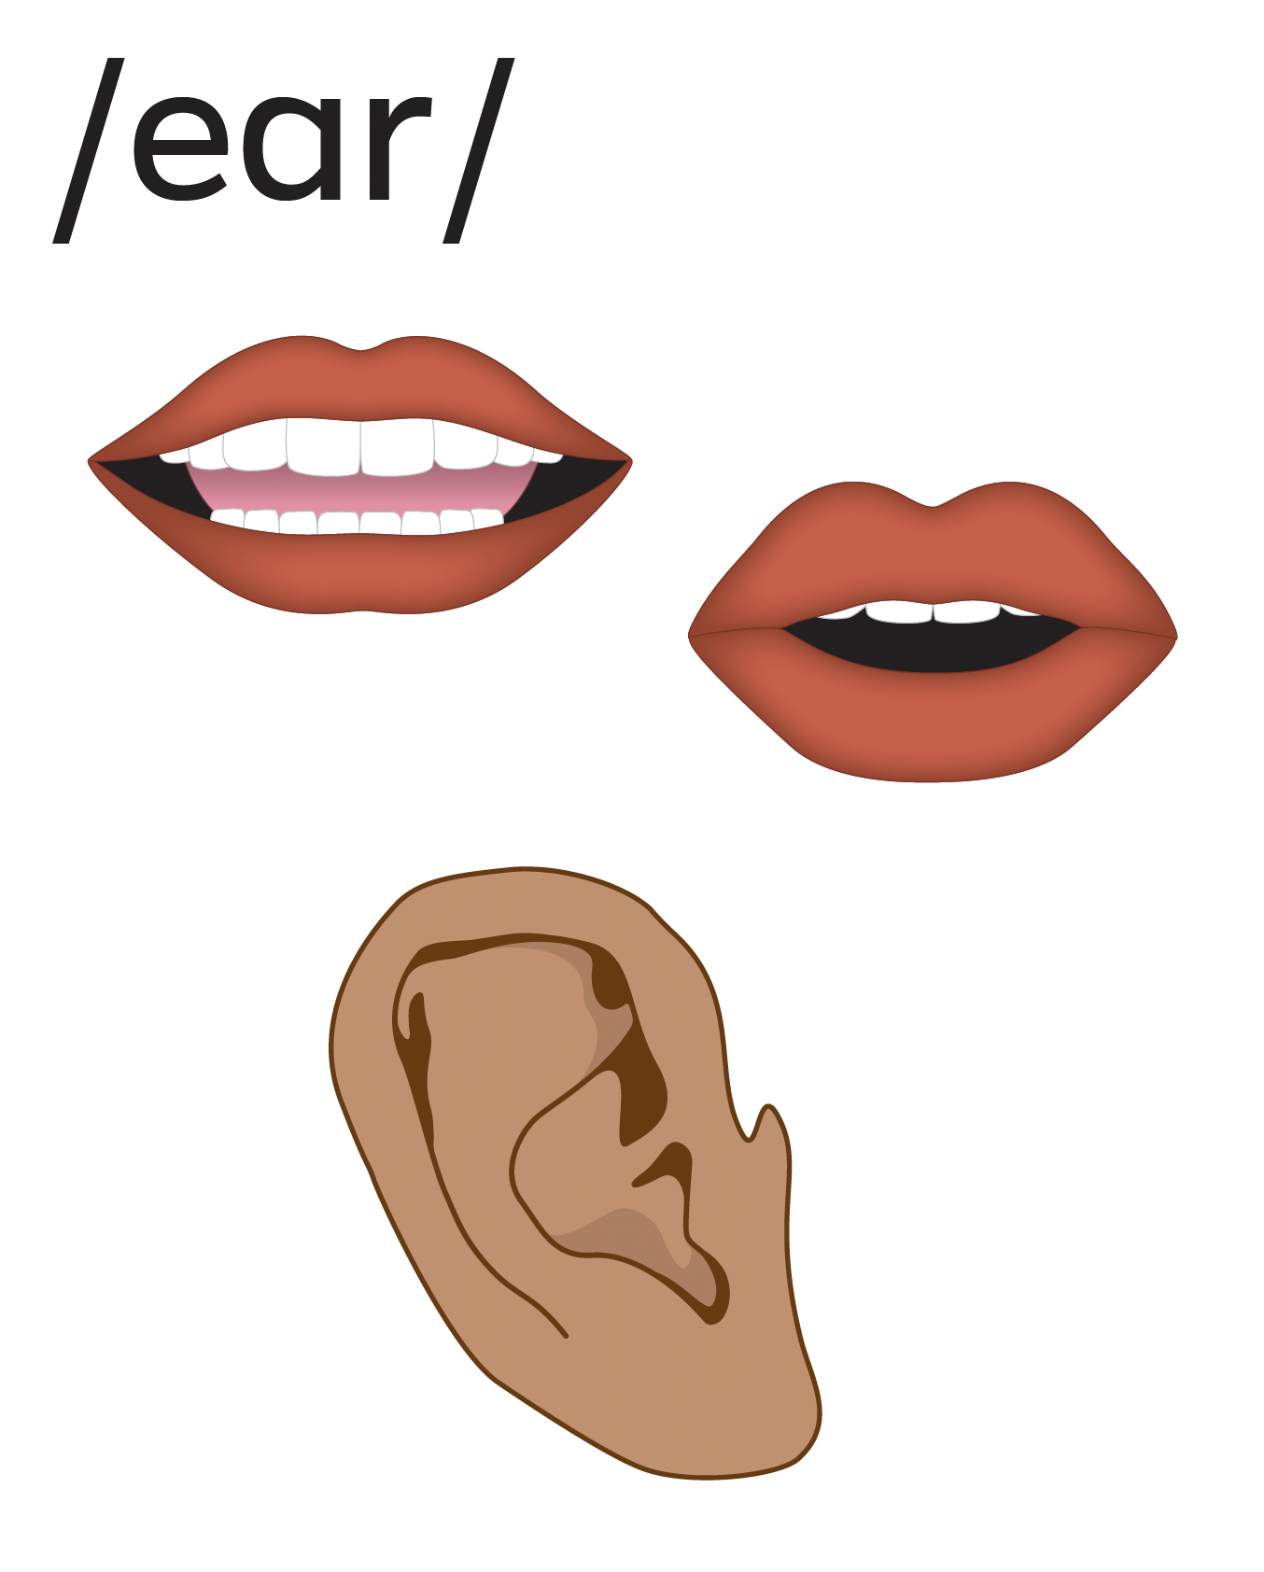
ear
hear

Slide 36
near
dear
ear

Slide 37
ear

Slide 38
hear
fear

Slide 39
near
year
dear

Slide 40
clear
smear
spear

Slide 41
Notes:
See UFLI Foundations lesson plan Step 5 for words to spell.
Handwriting paper to model spelling.

Slide 42
Notes:
See UFLI Foundations lesson plan Step 5 for words to spell.
Handwriting paper for guided spelling practice.

Slide 44
Insert brief reinforcement activity and/or transition to next part of reading block.

Slide 45
Lesson 113
ear /ear/

Slide 47
New Concept Review
Notes:
See UFLI Foundations lesson plan Step 5 for recommended teacher language and activities to review the new concept.

Slide 49
ear
bear

Slide 50
ear
hear

Slide 51
near
dear
ear

Slide 52
ear

Slide 53
hear
near
year
clear

Slide 55
Notes:
See UFLI Foundations lesson plan Step 6 for word work activity.
Visit ufliteracy.org to access the Word Work Mat apps.

Slide 58
Notes:
See UFLI Foundations lesson plan Step 7 for irregular word activities.
The white rectangle under each word may be used in editing mode. Cover the heart and square icons then reveal them one at a time during instruction.

Slide 59
Notes:
See UFLI Foundations manual for more information about reviewing irregular words.

Slide 60
laugh
Notes:
Lesson 101+
AU represents the /ar/ sound.
GH represents the /f/ sound.
Alternatively, A represents the /ă/ sound, and UGH represents the /f/ sound.
The white rectangle under the word may be used in editing mode. Cover the heart and square icons then reveal them one at a time during instruction.

Slide 61
who
Notes:
Lesson 54+
WH represents the /h/ sound.
O represents the /ū/ sound.
The white rectangle under the word may be used in editing mode. Cover the heart and square icons then reveal them one at a time during instruction.

Slide 62
whom
Notes:
Lesson 111+
WH represents the /h/ sound.
O represents the /ū/ sound.
The white rectangle under the word may be used in editing mode. Cover the heart and square icons then reveal them one at a time during instruction.

Slide 63
whose
Notes:
Lesson 112+
WH represents the /h/ sound.
O represents the /ū/ sound.
The final E is silent but does not follow the long vowel VCe pattern.
The white rectangle under the word may be used in editing mode. Cover the heart and square icons then reveal them one at a time during instruction.

Slide 64
Notes:
Handwriting paper for irregular word spelling practice. Use as needed.
See UFLI Foundations manual for more information about reviewing irregular words.

Slide 65
Teach
Notes:
The orange star indicates these are new irregular words that need to be introduced.
See UFLI Foundations manual for more information about teaching irregular words.

Slide 66
toward
Notes:
Lesson 113+
Depending on dialect, this word can be pronounced:
/t/+/or/+/d/,
/t/+/ə/+/w/+/or/ (or /er/) +/d/, or
/t/+/oo/+/w/+/or/ (or /er/) +/d/.
The white rectangle under the word may be used in editing mode. Cover the heart and square icons then reveal them one at a time during instruction.

Slide 67
Notes:
Handwriting paper for irregular word spelling practice. Use as needed.
See UFLI Foundations manual for more information about teaching irregular words.

Slide 69
Notes:
See UFLI Foundations lesson plan Step 8 for connected text activities.

Slide 70
What grade will they be in next year?

Slide 71
Please sit toward the rear of the ship.

Slide 72
The camping gear is too heavy to pick up.

Slide 73
Notes:
See UFLI Foundations lesson plan Step 8 for sentences to write.

Slide 74
Notes:
The UFLI Foundations decodable text is provided here. See UFLI Foundations decodable text guide for additional text options.

Slide 75
The Yearly Strawberry Festival
Did you hear? The Strawberry Festival is nearly here! Toward the beginning of each year, our town hosts this event to honour the strawberry farmers. It is always a blast to attend. You can eat all the yummiest strawberry treats including ice cream, cake, cookies, and milkshakes.

Slide 76
There are also rides and games. The most interesting game is hosted by the man with the long beard. He will guess your birthday. Somehow, he is always right, but nobody knows how he does it. There is also a person who does amazing card tricks. If you give them a card, they will make it disappear!

Slide 77
What if the weather is bad, you ask? Never fear! Even on a dreary day, there is fun to be had under the big tent. Music, dancing, and crafts are sure to delight. There are also clowns and comics to give you a good laugh. Remember, the Strawberry Festival is only in town once a year. Get your tickets
now so you do not miss out on the fun!

Slide 79
Insert brief reinforcement activity and/or transition to next part of reading block.

