Slide 1
Lesson 112
air, are, ear /air/

Slide 2
Notes:
ufliteracy.org

Slide 4
Lesson 112
air, are, ear /air/

Slide 6
Notes:
See UFLI Foundations lesson plan Step 1 for phonemic awareness activity.

Slide 8
Notes:
See UFLI Foundations lesson plan Step 2 for student phoneme responses.

Slide 9
our

Slide 10
or

Slide 11
ar

Slide 12
-ed

Slide 13
y

Slide 14
er

Slide 15
e

Slide 16
t

Slide 17
s

Slide 18
kn

Slide 19
wr

Slide 20
mb

Slide 21
ou

Slide 22
ow

Slide 23
oi

Slide 24
oy

Slide 25
ea

Slide 27
Notes:
See UFLI Foundations lesson plan Step 3 for auditory drill activity.

Slide 28
Notes:
No slides needed for auditory drill.

Slide 30
Notes:
See UFLI Foundations lesson plan Step 4 for blending drill word chain and grid.
Visit ufliteracy.org to access the Blending Board app.

Slide 32
Notes:
See UFLI Foundations lesson plan Step 5 for recommended teacher language and activities to introduce the new concept.

Slide 33
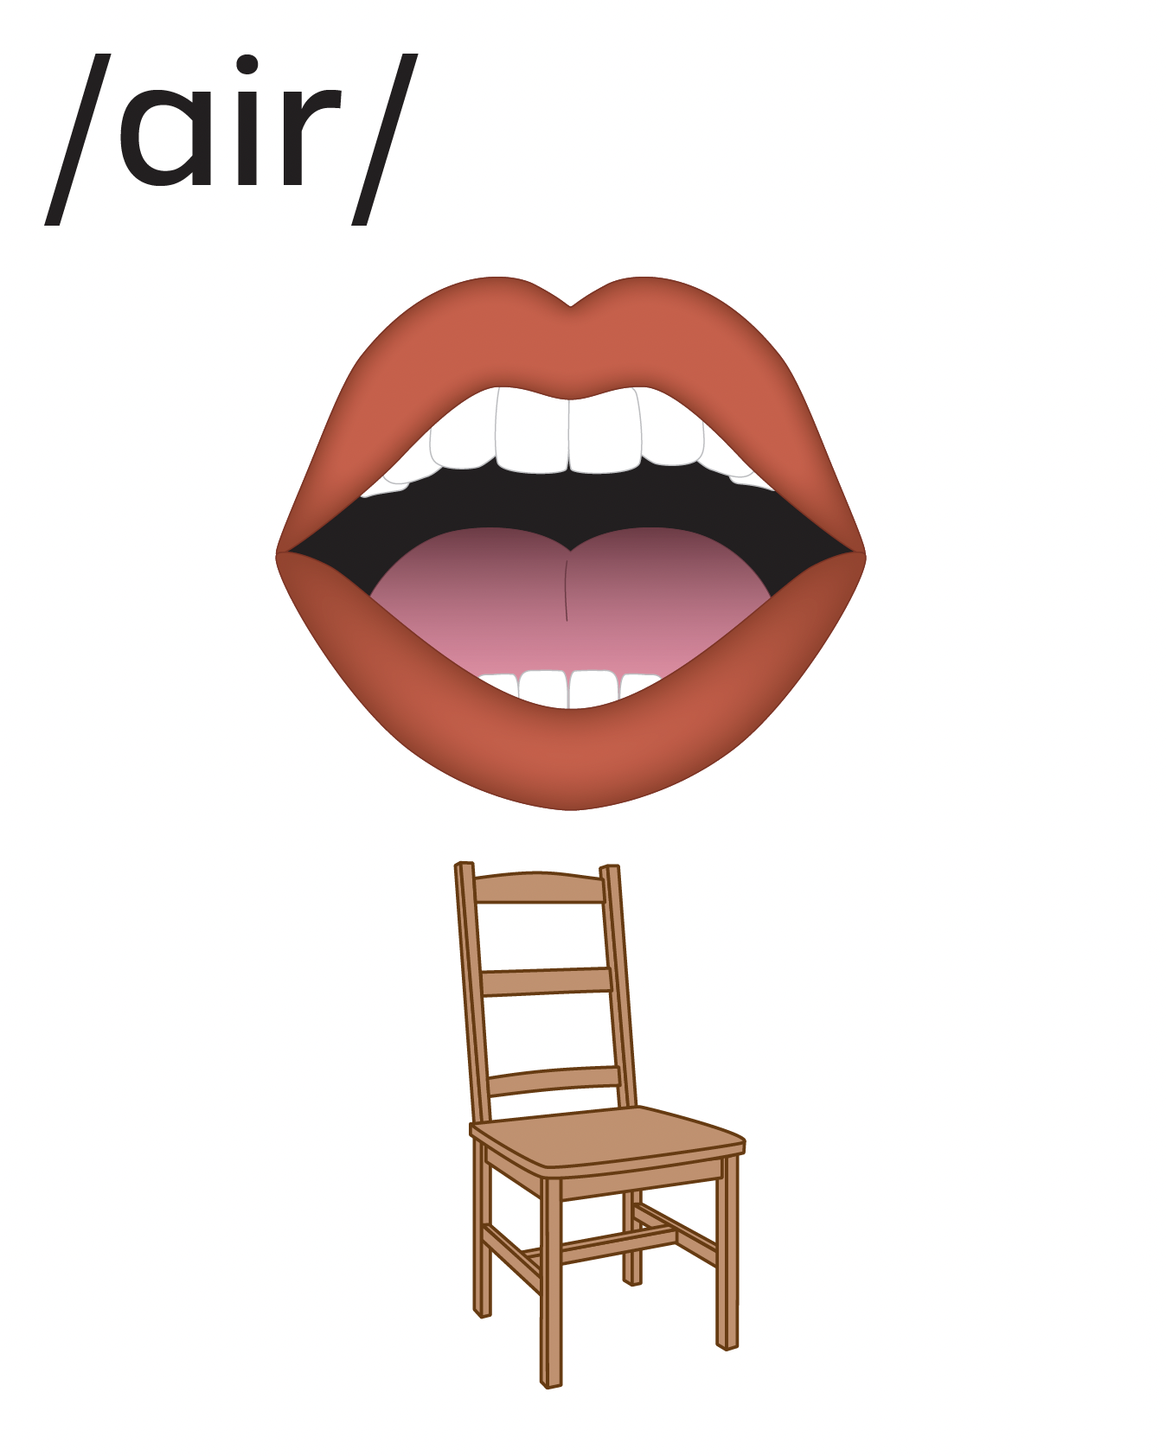

Slide 34
air
chair
stair

Slide 35
are
care
square

Slide 36
ear
bear
wear

Slide 37
air
care
tear

Slide 38
pair
stairs
share

Slide 39
scare
glare
dare

Slide 40
swear
bear

Slide 41
Notes:
See UFLI Foundations lesson plan Step 5 for words to spell.
Handwriting paper to model spelling.

Slide 42
Notes:
See UFLI Foundations lesson plan Step 5 for words to spell.
Handwriting paper for guided spelling practice.

Slide 44
Insert brief reinforcement activity and/or transition to next part of reading block.

Slide 45
Lesson 112
air, are, ear /air/

Slide 47
New Concept Review
Notes:
See UFLI Foundations lesson plan Step 5 for recommended teacher language and activities to review the new concept.

Slide 49
air
chair
stair

Slide 50
are
care
square

Slide 51
ear
bear
wear

Slide 52
air
chair
dare
wear

Slide 54
Notes:
See UFLI Foundations lesson plan Step 6 for word work activity.
Visit ufliteracy.org to access the Word Work Mat apps.

Slide 55
Notes:
Display this slide in editing mode. Click and hold to drag each word into the appropriate column.

Slide 57
Notes:
See UFLI Foundations lesson plan Step 7 for irregular word activities.
The white rectangle under each word may be used in editing mode. Cover the heart and square icons then reveal them one at a time during instruction.

Slide 58
Notes:
See UFLI Foundations manual for more information about reviewing irregular words.

Slide 59
sure
Notes:
Lesson 109+
S represents the /sh/ sound.
Depending on dialect, URE represents the /or/ sound.
Depending on dialect, U represents the /ū/ sound or UR represents the /er/ sound in which the final E is silent but does not follow the long vowel VCe pattern.
The white rectangle under the word may be used in editing mode. Cover the heart and square icons then reveal them one at a time during instruction.

Slide 60
laugh
Notes:
Lesson 101+
AU represents the /ar/ sound.
GH represents the /f/ sound.
Alternatively, A represents the /ă/ sound, and UGH represents the /f/ sound.
The white rectangle under the word may be used in editing mode. Cover the heart and square icons then reveal them one at a time during instruction.

Slide 61
who
Notes:
Lesson 54+
WH represents the /h/ sound.
O represents the /ū/ sound.
The white rectangle under the word may be used in editing mode. Cover the heart and square icons then reveal them one at a time during instruction.

Slide 62
whom
Notes:
Lesson 111+
WH represents the /h/ sound.
O represents the /ū/ sound.
The white rectangle under the word may be used in editing mode. Cover the heart and square icons then reveal them one at a time during instruction.

Slide 63
Notes:
Handwriting paper for irregular word spelling practice. Use as needed.
See UFLI Foundations manual for more information about reviewing irregular words.

Slide 64
Teach
Notes:
The orange star indicates these are new irregular words that need to be introduced.
See UFLI Foundations manual for more information about teaching irregular words.

Slide 65
whose
Notes:
Lesson 112+
WH represents the /h/ sound.
O represents the /ū/ sound.
The final E is silent but does not follow the long vowel VCe pattern.
The white rectangle under the word may be used in editing mode. Cover the heart and square icons then reveal them one at a time during instruction.

Slide 66
Notes:
Handwriting paper for irregular word spelling practice. Use as needed.
See UFLI Foundations manual for more information about teaching irregular words.

Slide 68
Notes:
See UFLI Foundations lesson plan Step 8 for connected text activities.

Slide 69
Love is in the air tonight!

Slide 70
Blair won the toy fair and square.

Slide 71
Whose doll has rainbow hair?

Slide 72
Notes:
See UFLI Foundations lesson plan Step 8 for sentences to write.

Slide 73
Notes:
The UFLI Foundations decodable text is provided here. See UFLI Foundations decodable text guide for additional text options.

Slide 74
A Smart Pair of Pants
Clare went shopping for a new pair of pants. After going to five stores, she could not find the pair she wanted. Then, at the sixth store, she found them. The pair she picked flared out at the
bottom. They were light as air and so comfortable.

Slide 75
When she put them on, she stared at herself in the mirror. Clare felt so fantastic in these pants that she twirled around and tossed her hair. She wanted to purchase two pairs so she would have a spare pair to wear.

Slide 76
She brought the pants to the checkout counter. “Those are nice pairs of pants,” said the clerk, “if you take good care of
them, they will last forever.” “Thank you,” answered Clare with a big smile, “I sure will.”

Slide 78
Insert brief reinforcement activity and/or transition to next part of reading block.

