Slide 1
Lesson 111
-ar, -or /ə/

Slide 2
Notes:
ufliteracy.org

Slide 4
Lesson 111
-ar, -or /ə/

Slide 6
Notes:
See UFLI Foundations lesson plan Step 1 for phonemic awareness activity.

Slide 8
Notes:
See UFLI Foundations lesson plan Step 2 for student phoneme responses.

Slide 9
-ed

Slide 10
y

Slide 11
er

Slide 12
e

Slide 13
t

Slide 14
s

Slide 15
kn

Slide 16
wr

Slide 17
mb

Slide 18
ou

Slide 19
ow

Slide 20
oi

Slide 21
oy

Slide 22
ea

Slide 23
au

Slide 24
aw

Slide 25
augh

Slide 27
Notes:
See UFLI Foundations lesson plan Step 3 for auditory drill activity.

Slide 28
Notes:
No slides needed for auditory drill.

Slide 30
Notes:
See UFLI Foundations lesson plan Step 4 for blending drill word chain and grid.
Visit ufliteracy.org to access the Blending Board app.

Slide 32
Notes:
See UFLI Foundations lesson plan Step 5 for recommended teacher language and activities to introduce the new concept.

Slide 33
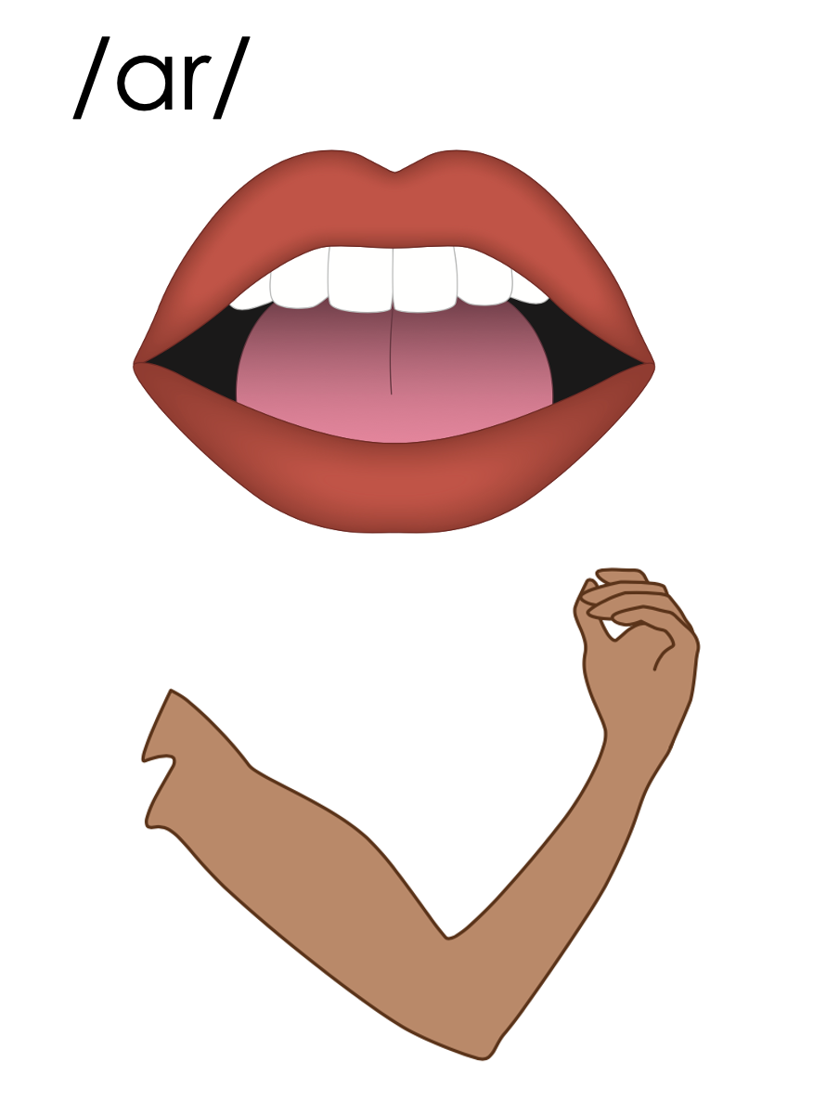
ar

Slide 34
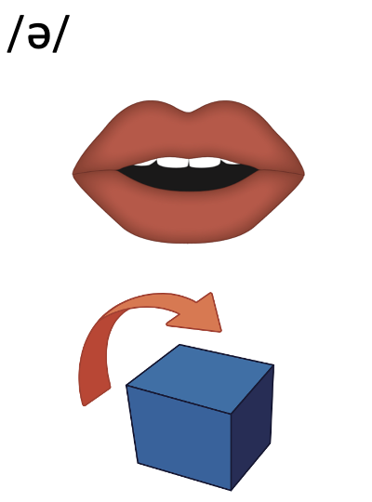
ar
dollar

Slide 35
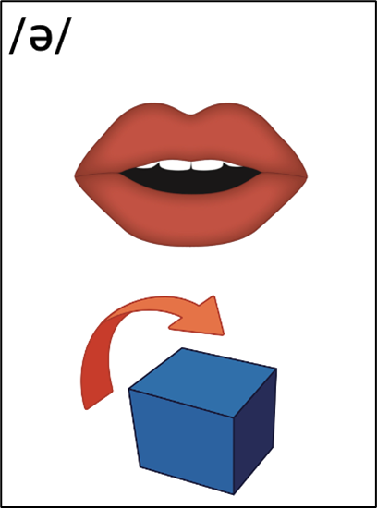
collar
nectar
ar
1st syllable
2nd syllable

Slide 36
upward
lizard
ar
1st syllable
2nd syllable

Slide 37
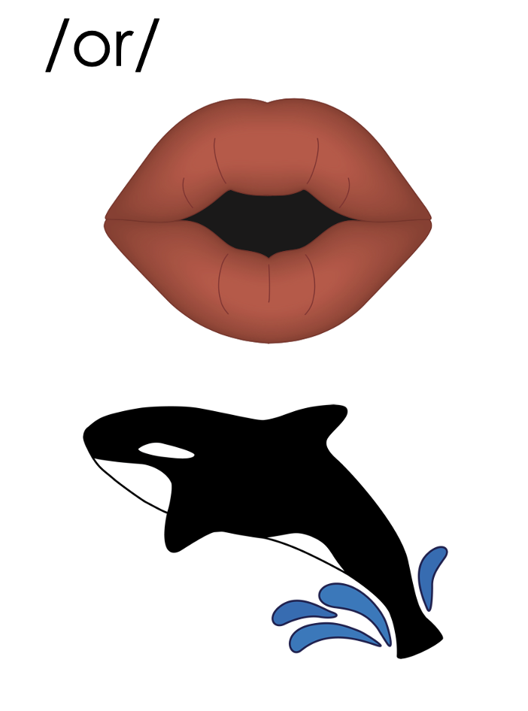
or

Slide 38
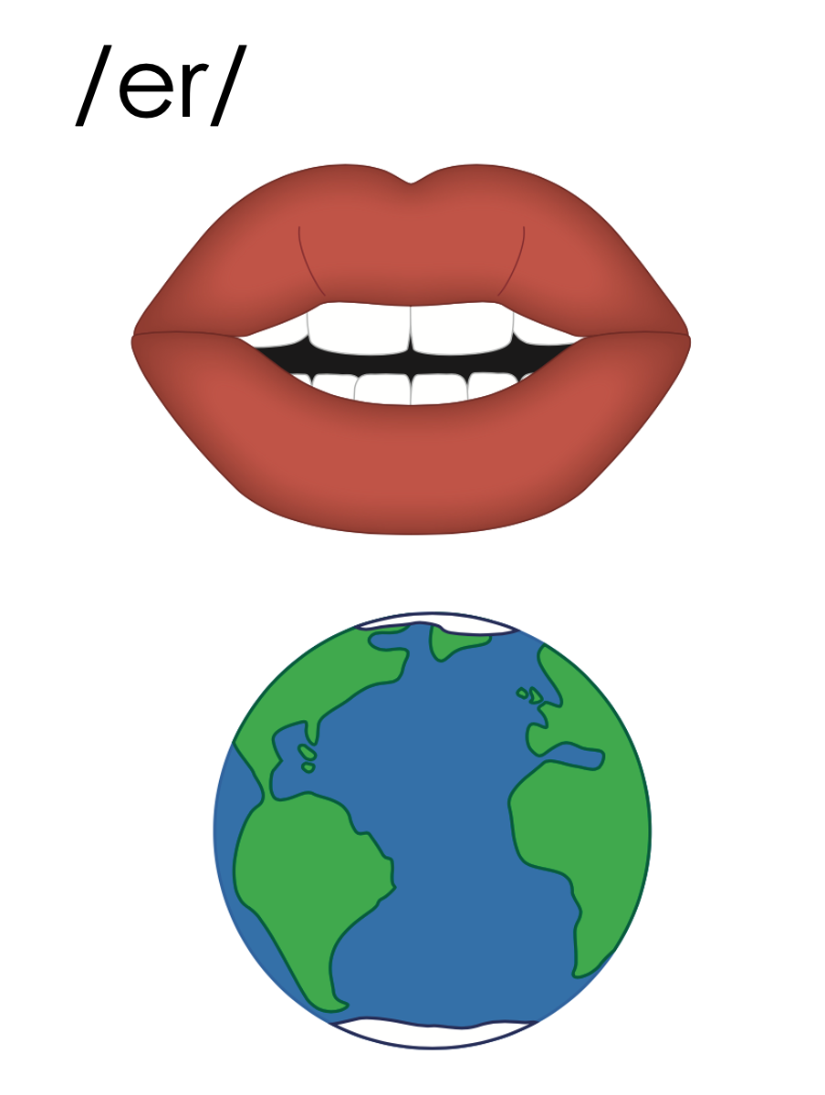
or
w
word
work

Slide 39
or

Slide 40
doctor
author
or
1st syllable
2nd syllable

Slide 41
our
our
hour

Slide 42
our

Slide 43
colour
flavour
our
1st syllable
2nd syllable

Slide 45
a
e
i
o
u
y
er
ar
or
our

Slide 46
Notes:
Handwriting paper for letter formation practice. Use as needed.
See UFLI Foundations manual for more information about letter formation.

Slide 47
dollar
doctor
rumour

Slide 48
nectar
collar
lizard

Slide 49
factor
flavour
tutor

Slide 50
author
visitor
similar

Slide 51
Notes:
See UFLI Foundations lesson plan Step 5 for words to spell.
Handwriting paper to model spelling.

Slide 52
Notes:
See UFLI Foundations lesson plan Step 5 for words to spell.
Handwriting paper for guided spelling practice.

Slide 54
Insert brief reinforcement activity and/or transition to next part of reading block.

Slide 55
Lesson 111
-ar, -or /ə/

Slide 57
New Concept Review
Notes:
See UFLI Foundations lesson plan Step 5 for recommended teacher language and activities to review the new concept.

Slide 58
ar

Slide 59
ar
dollar

Slide 60
collar
nectar
ar
1st syllable
2nd syllable

Slide 61
upward
lizard
ar
1st syllable
2nd syllable

Slide 62
or

Slide 63
or
w
word
work

Slide 64
or

Slide 65
doctor
author
or
1st syllable
2nd syllable

Slide 66
our
our
hour

Slide 67
our

Slide 68
colour
flavour
our
1st syllable
2nd syllable

Slide 70
a
e
i
o
u
y
er
ar
or
our

Slide 71
dollar
actor
solar
flavour

Slide 73
Notes:
See UFLI Foundations lesson plan Step 6 for word work activity.
Visit ufliteracy.org to access the Word Work Mat apps.

Slide 75
Notes:
See UFLI Foundations lesson plan Step 7 for irregular word activities.
The white rectangle under each word may be used in editing mode. Cover the heart and square icons then reveal them one at a time during instruction.

Slide 76
Notes:
See UFLI Foundations manual for more information about reviewing irregular words.

Slide 77
build
Notes:
Lesson 108+
UI represents the /ĭ/ sound.
The white rectangle under the word may be used in editing mode. Cover the heart and square icons then reveal them one at a time during instruction.

Slide 78
built
Notes:
Lesson 108+
UI represents the /ĭ/ sound.
The white rectangle under the word may be used in editing mode. Cover the heart and square icons then reveal them one at a time during instruction.

Slide 79
sure
Notes:
Lesson 109+
S represents the /sh/ sound.
Depending on dialect, URE represents the /or/ sound.
Depending on dialect, U represents the /ū/ sound or UR represents the /er/ sound in which the final E is silent but does not follow the long vowel VCe pattern.
The white rectangle under the word may be used in editing mode. Cover the heart and square icons then reveal them one at a time during instruction.

Slide 80
laugh
Notes:
Lesson 101+
AU represents the /ar/ sound.
GH represents the /f/ sound.
Alternatively, A represents the /ă/ sound, and UGH represents the /f/ sound.
The white rectangle under the word may be used in editing mode. Cover the heart and square icons then reveal them one at a time during instruction.

Slide 81
who
Notes:
From Lesson 54 Introduction – review to introduce whom
WH represents the /h/ sound.
O represents the /ū/ sound.
The white rectangle under the word may be used in editing mode. Cover the heart and square icons then reveal them one at a time during instruction.

Slide 82
Notes:
Handwriting paper for irregular word spelling practice. Use as needed.
See UFLI Foundations manual for more information about reviewing irregular words.

Slide 83
Teach
Notes:
The orange star indicates these are new irregular words that need to be introduced.
See UFLI Foundations manual for more information about teaching irregular words.

Slide 84
whom
Notes:
Lesson 111+
WH represents the /h/ sound.
O represents the /ū/ sound.
The white rectangle under the word may be used in editing mode. Cover the heart and square icons then reveal them one at a time during instruction.

Slide 85
Notes:
Handwriting paper for irregular word spelling practice. Use as needed.
See UFLI Foundations manual for more information about teaching irregular words.

Slide 87
Notes:
See UFLI Foundations lesson plan Step 8 for connected text activities.

Slide 88
Who will the doctor help next?

Slide 89
To whom should I give this dollar?

Slide 90
The actor played the role of a powerful wizard.

Slide 91
Notes:
See UFLI Foundations lesson plan Step 8 for sentences to write.

Slide 92
Notes:
The UFLI Foundations decodable text is provided here. See UFLI Foundations decodable text guide for additional text options.

Slide 93
A Pet Lizard
Have you ever considered getting a pet lizard? They may seem like an strange choice, but they can be lovely pets. Lizards are reptiles. They can be big or small and many different colours.

Slide 94
You can create a nice habitat for your lizard to live in. Start with a big cage so your lizard has room to roam. You will also need some food for your lizard. Lizards eat bugs and worms and plants. Some even like to eat flowers. Perhaps they like the flavour of the nectar inside the flowers.

Slide 95
Unlike dogs and cats, lizards do not need collars and do not need to be taken on walks. Just remember, if they ever get sick, take them to a doctor who can help them get better. So, what do you think? Would you want to have a pet lizard?

Slide 97
Insert brief reinforcement activity and/or transition to next part of reading block.

