Slide 1

Lesson 108
Doubling Rule -er, -est

Slide 2
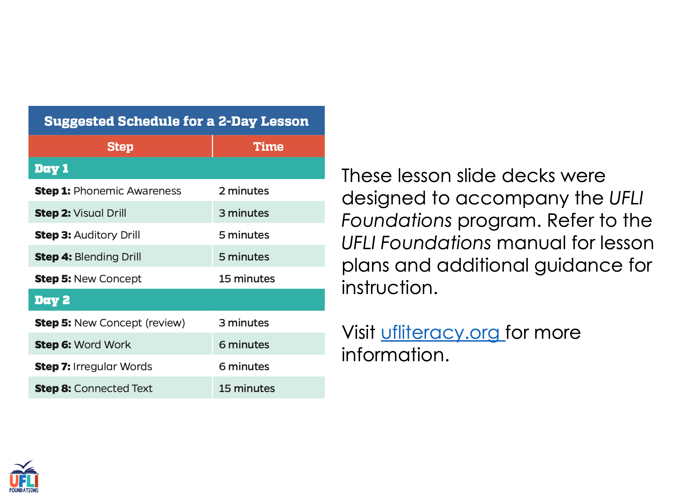
Notes:
ufliteracy.org

Slide 3
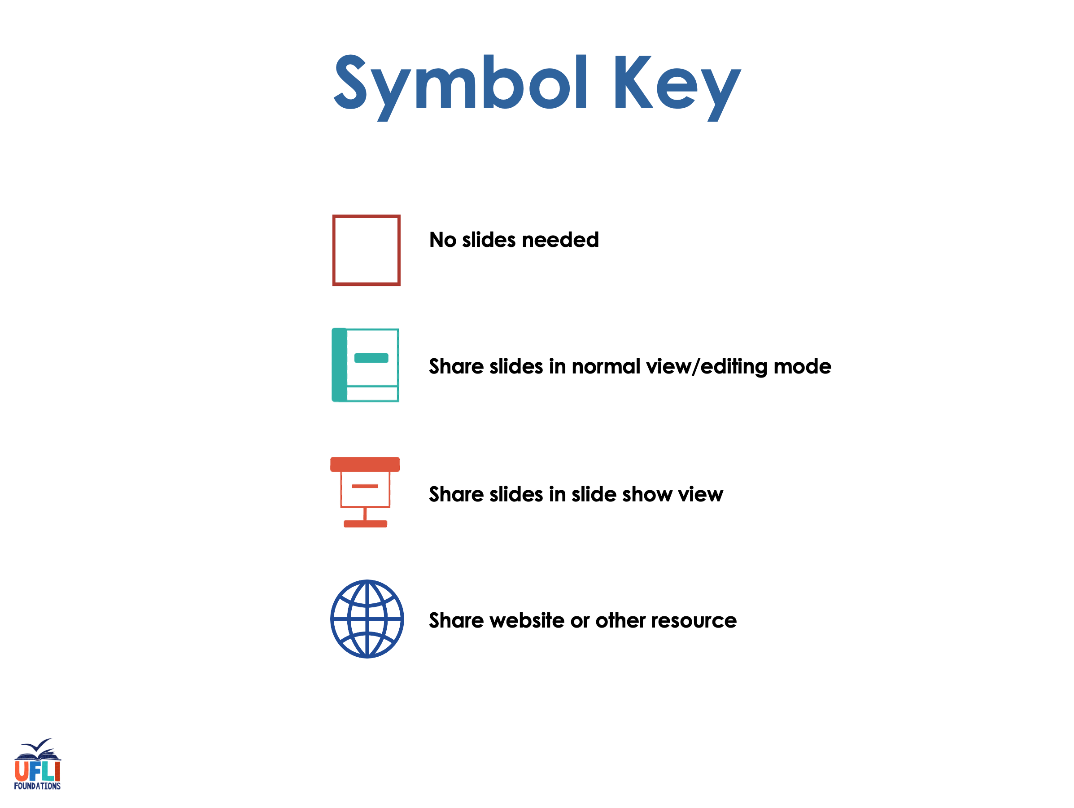

Slide 4

Lesson 108
Doubling Rule -er, -est

Slide 5
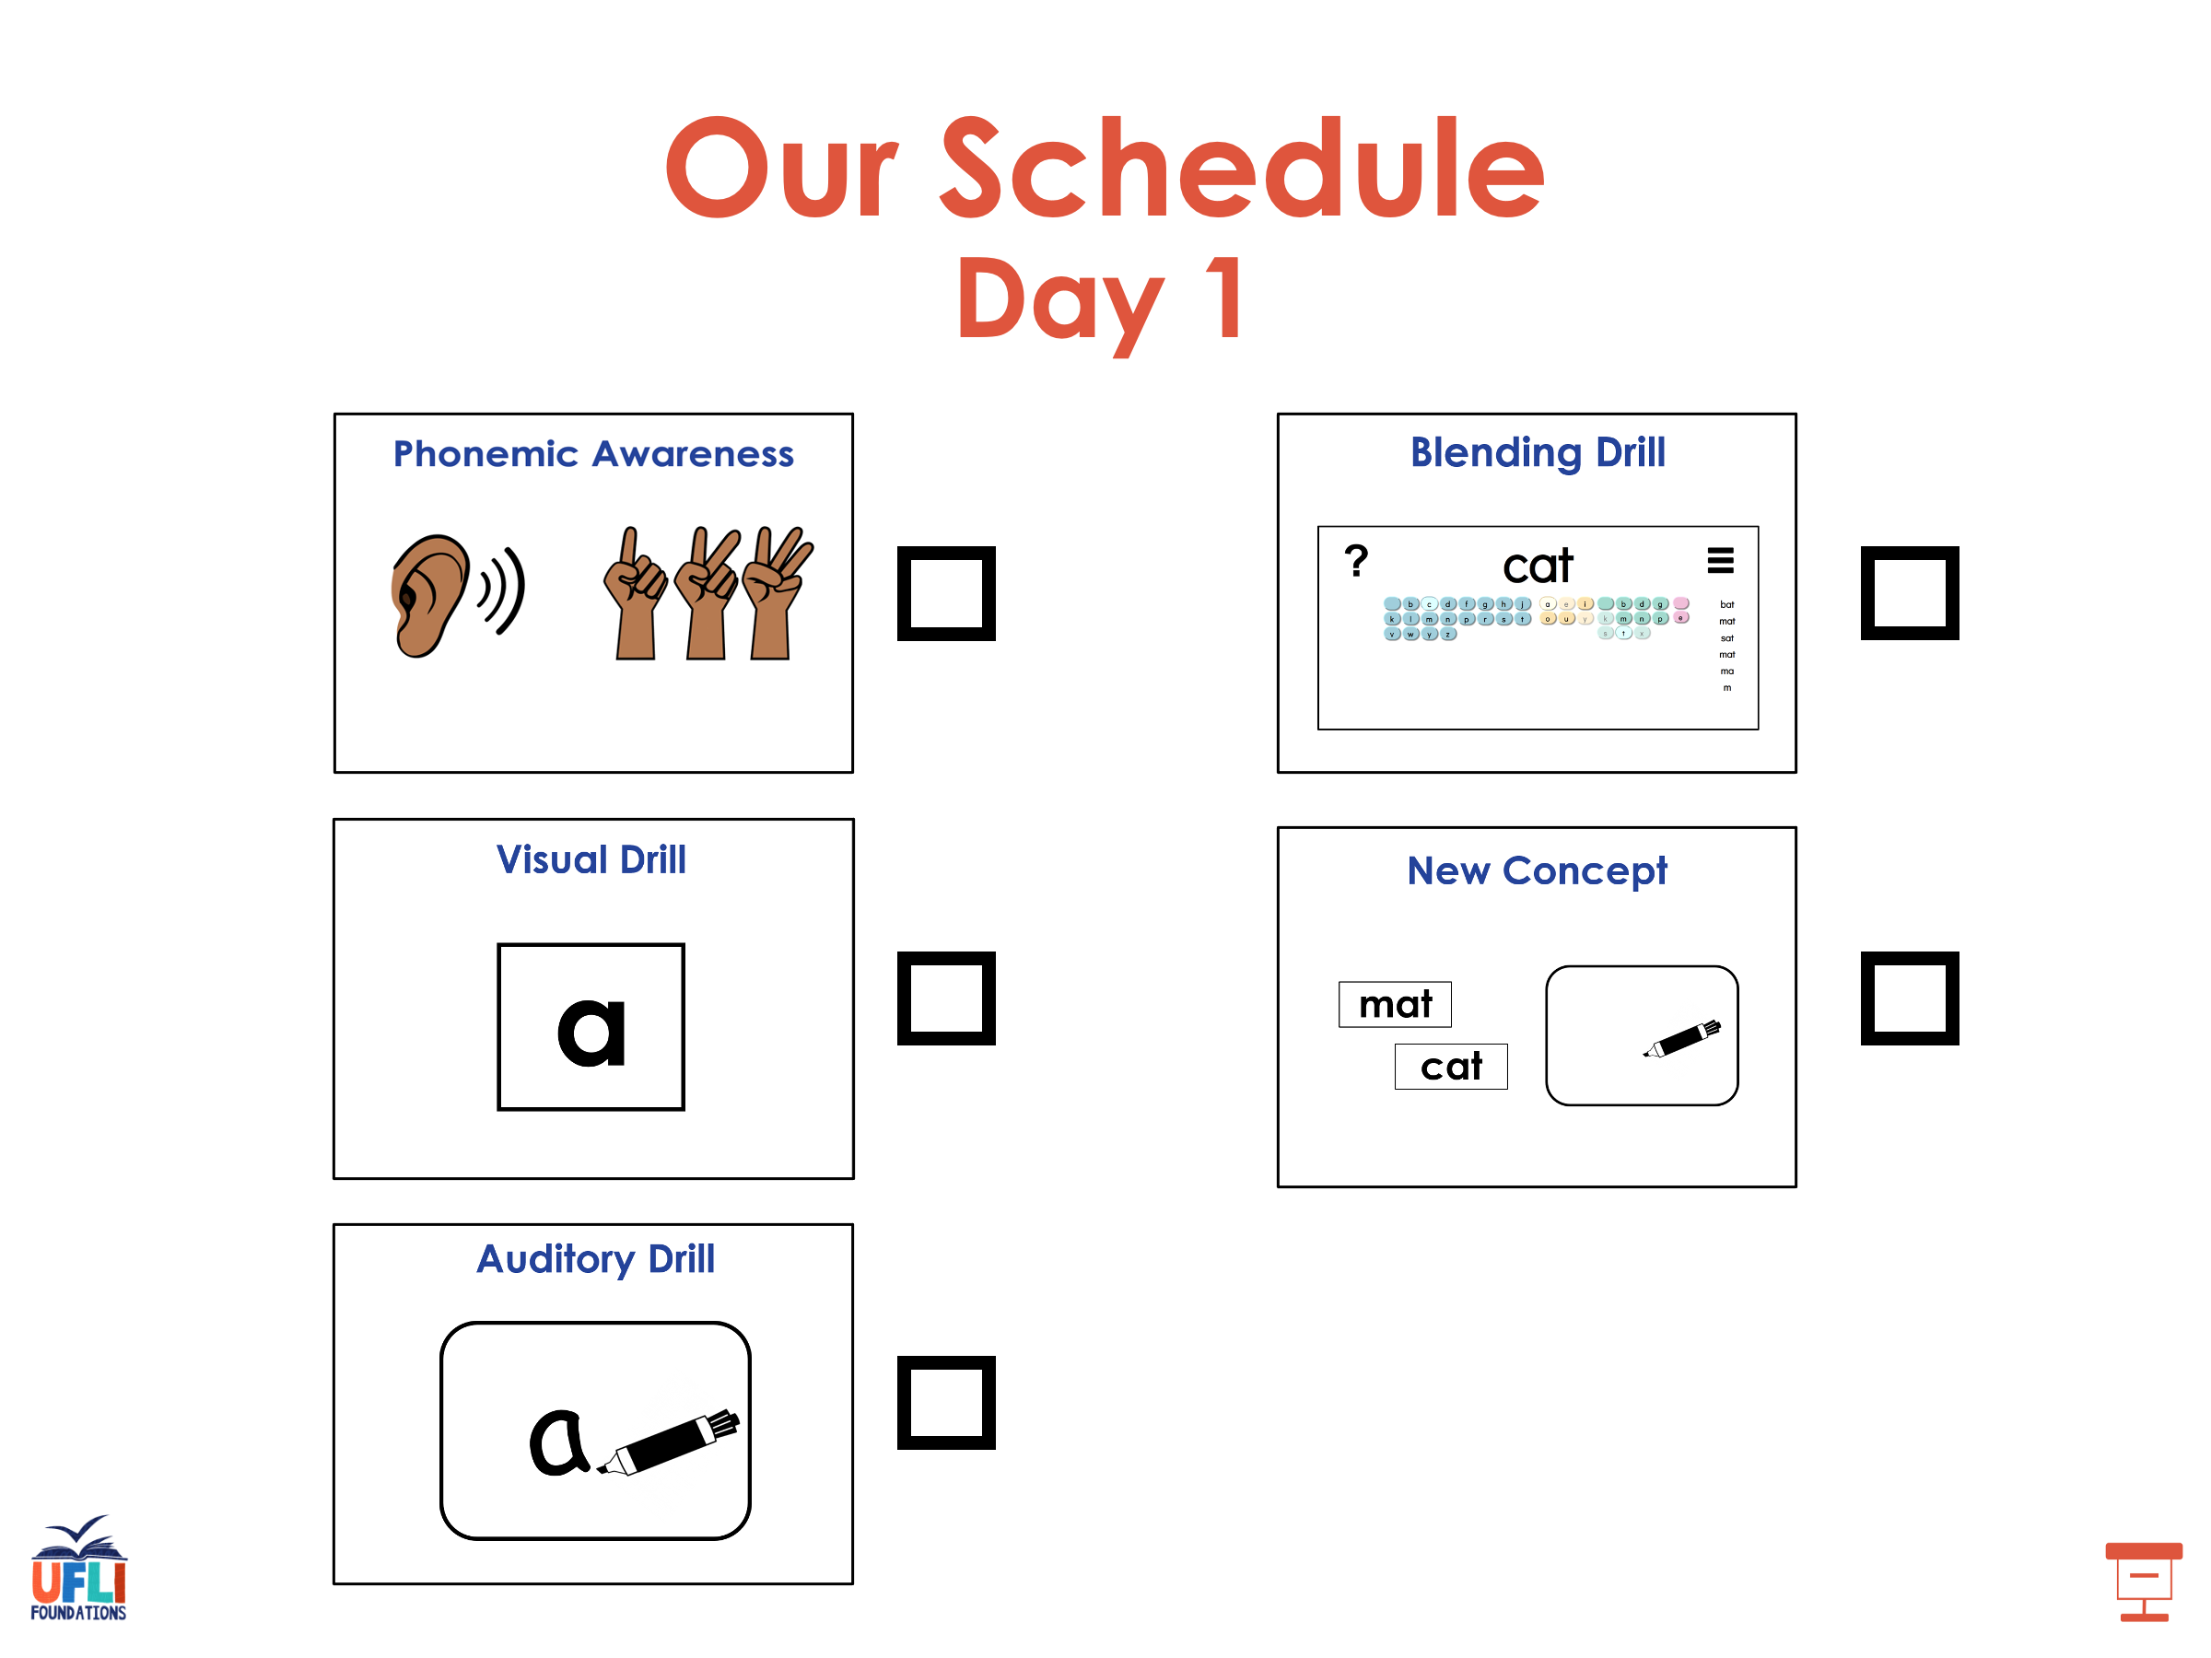

Slide 6
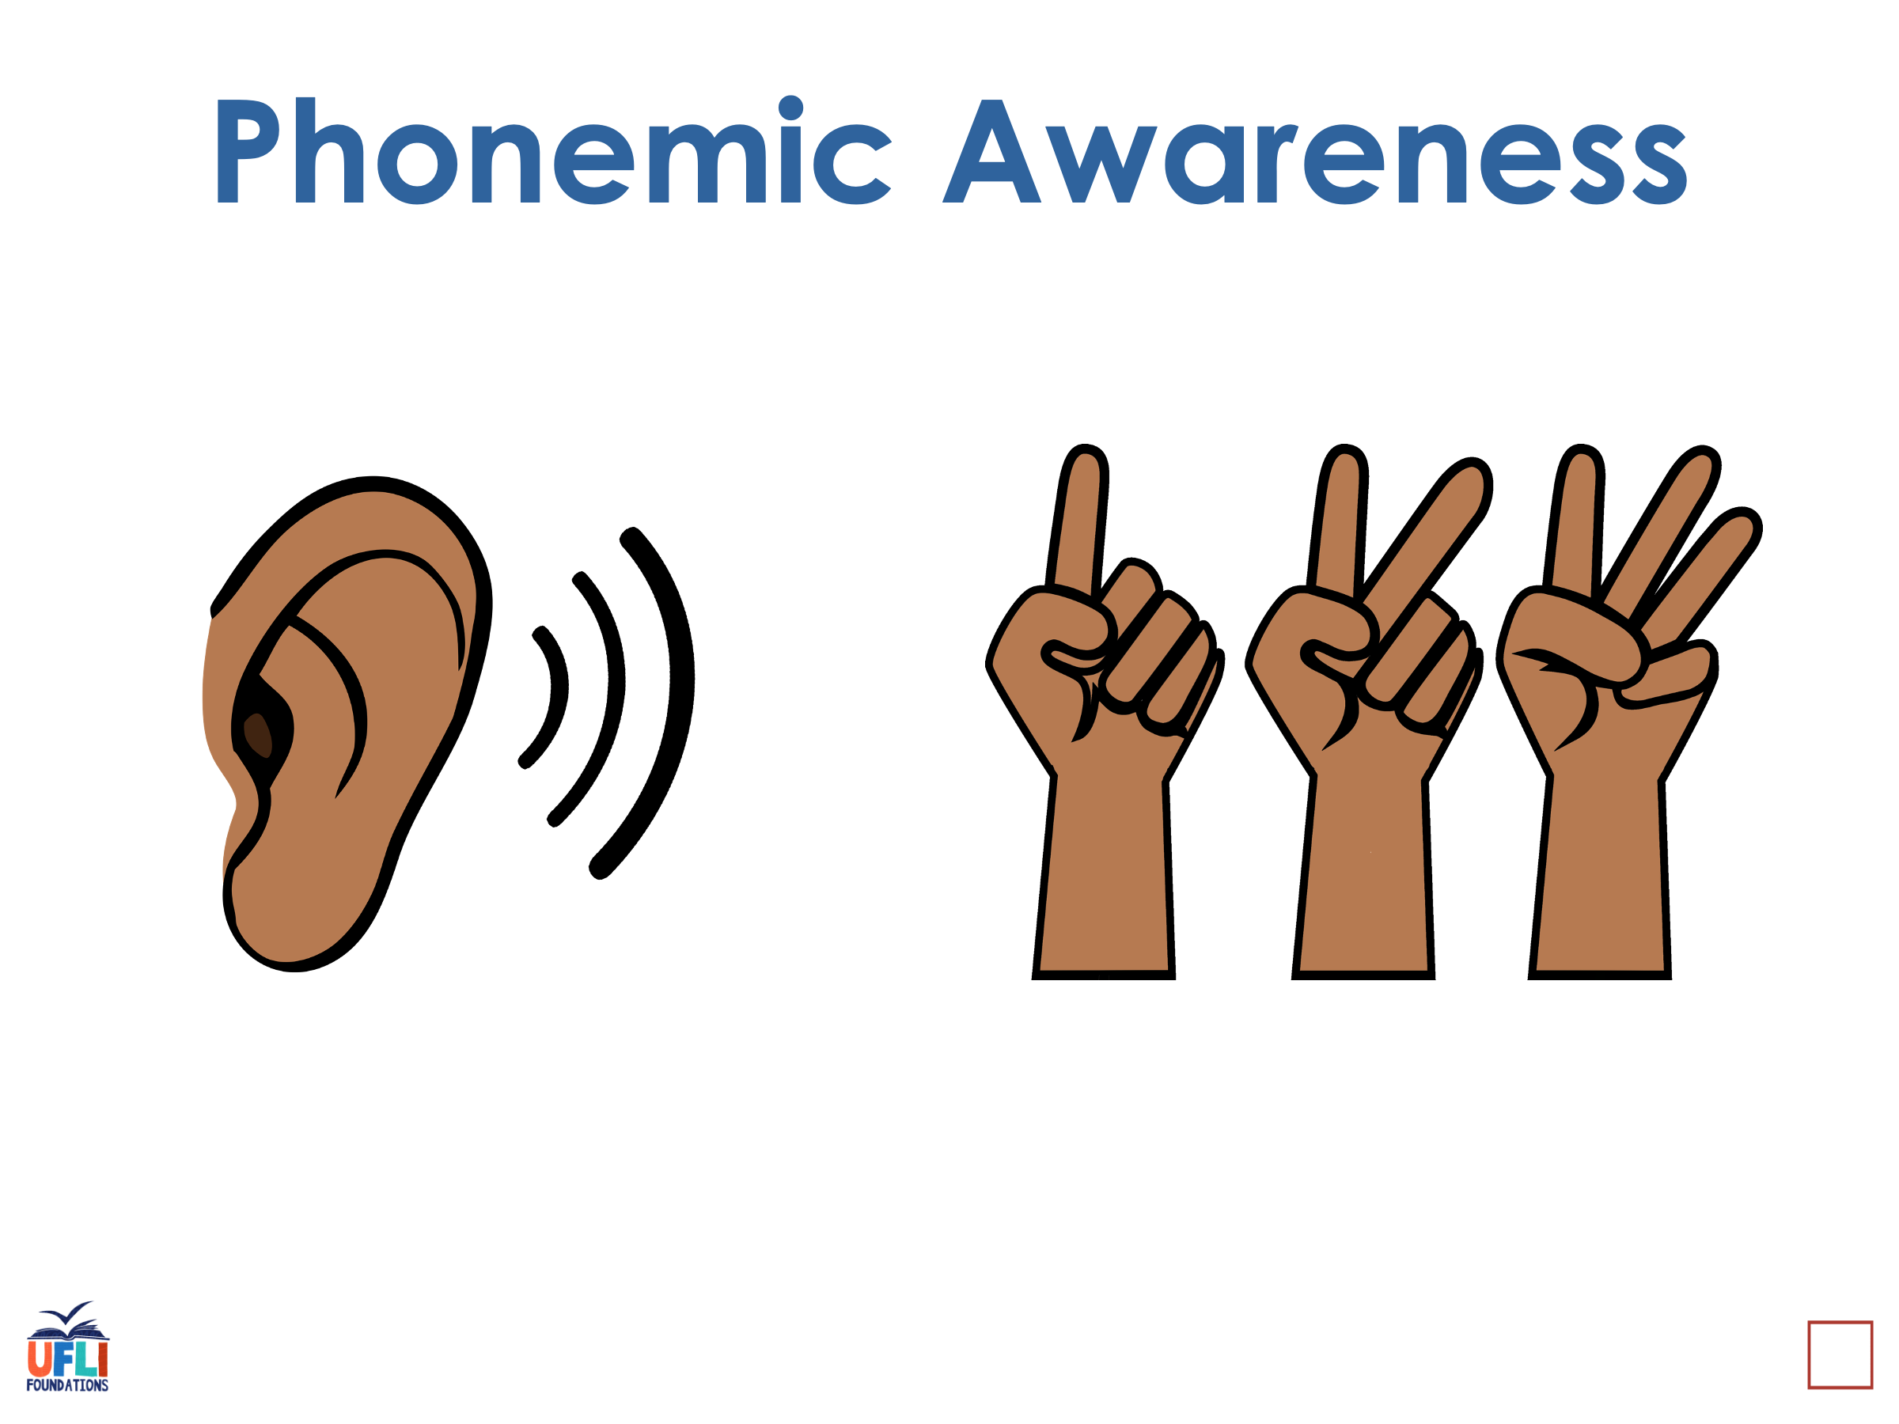
Notes:
See UFLI Foundations lesson plan Step 1 for phonemic awareness activity.

Slide 7
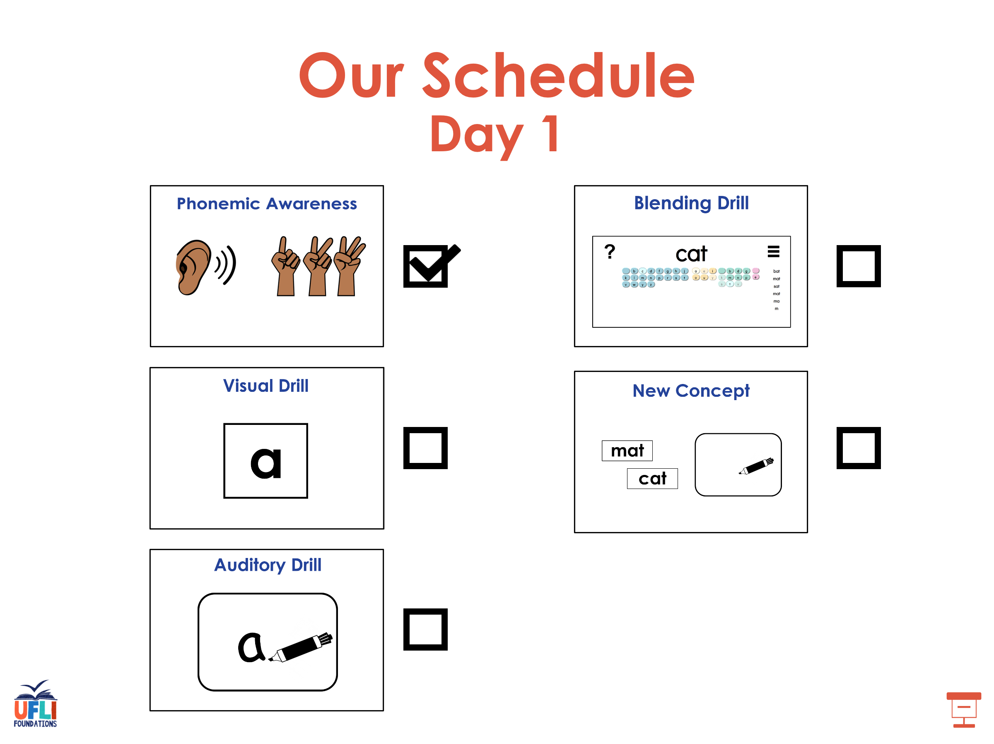

Slide 8
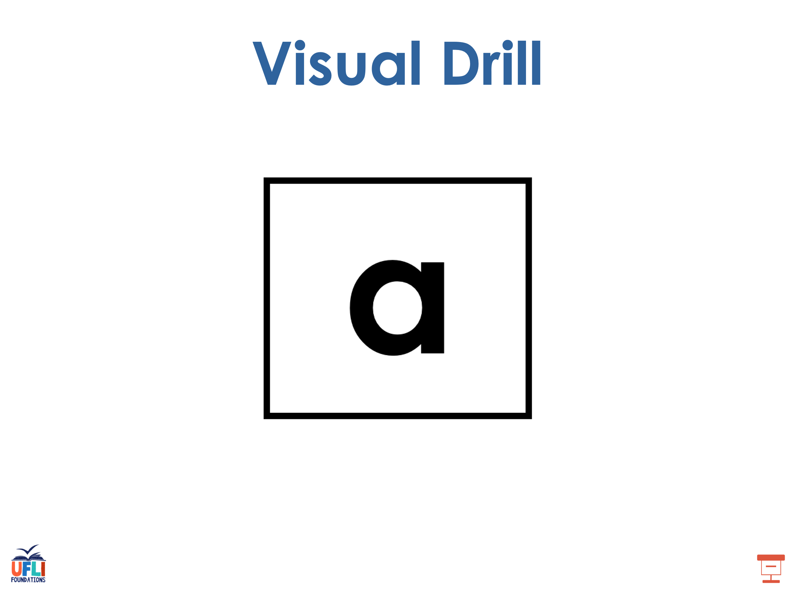
Notes:
See UFLI Foundations lesson plan Step 2 for student phoneme responses.

Slide 9
-ed

Slide 10
y

Slide 11
er

Slide 12
e

Slide 13
t

Slide 14
s

Slide 15
kn

Slide 16
wr

Slide 17
mb

Slide 18
ou

Slide 19
ow

Slide 20
oi

Slide 21
oy

Slide 22
ea

Slide 23
au

Slide 24
aw

Slide 25
augh

Slide 26
ew

Slide 27
ui

Slide 28
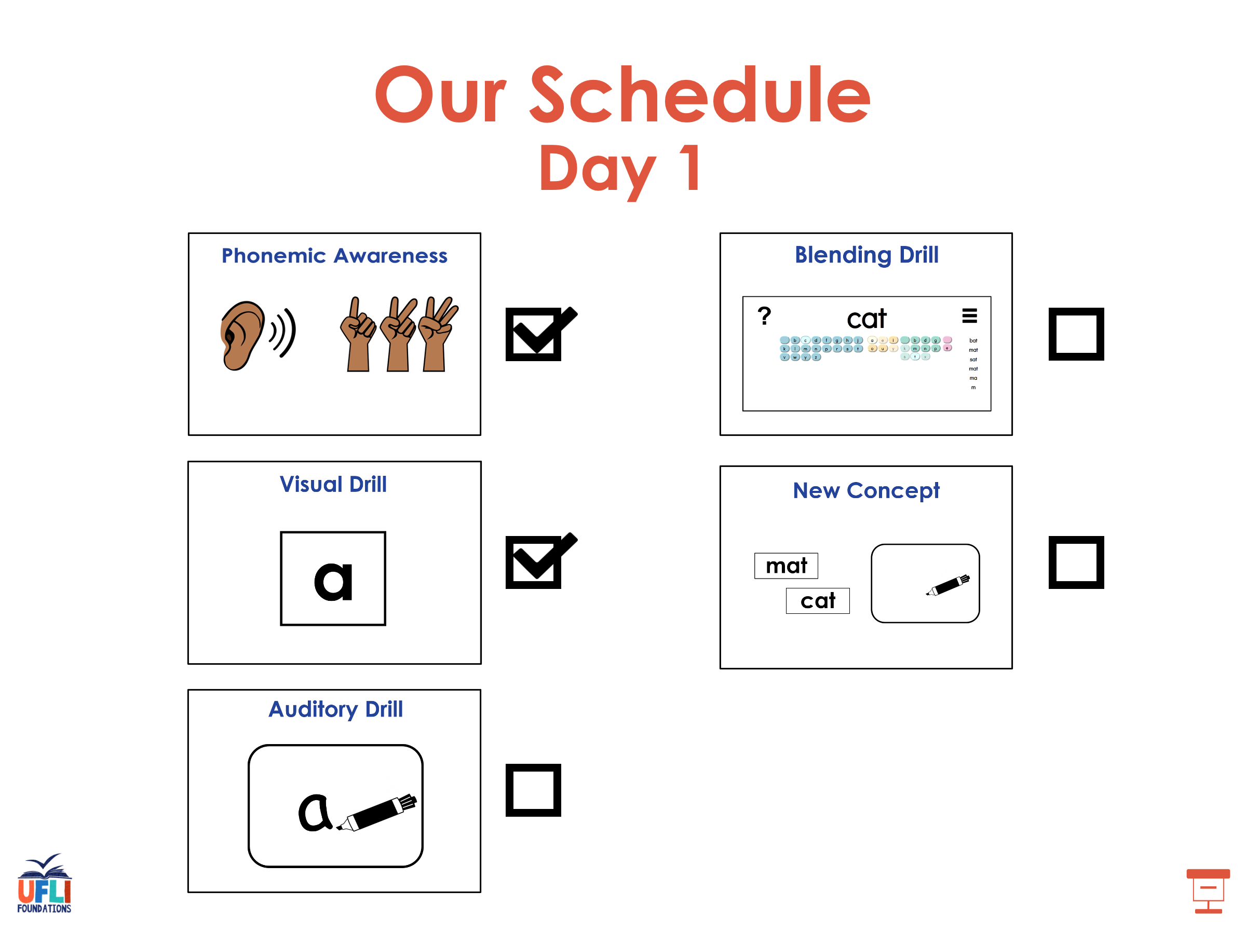

Slide 29
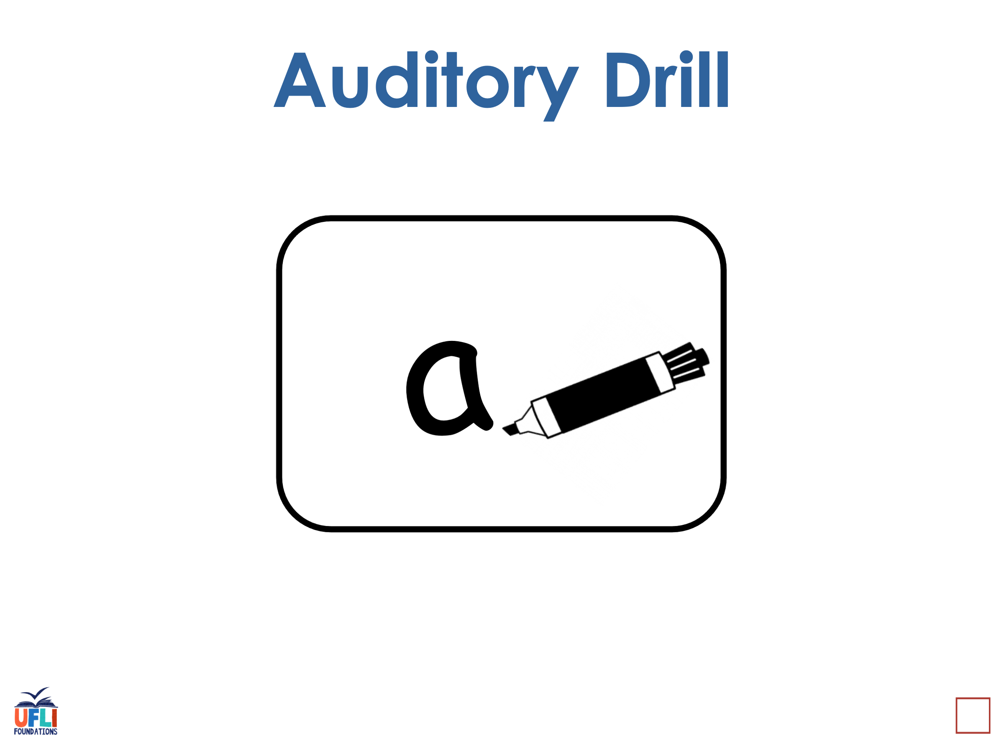
Notes:
See UFLI Foundations lesson plan Step 3 for auditory drill activity.

Slide 30
Notes:
No slides needed for auditory drill.

Slide 31
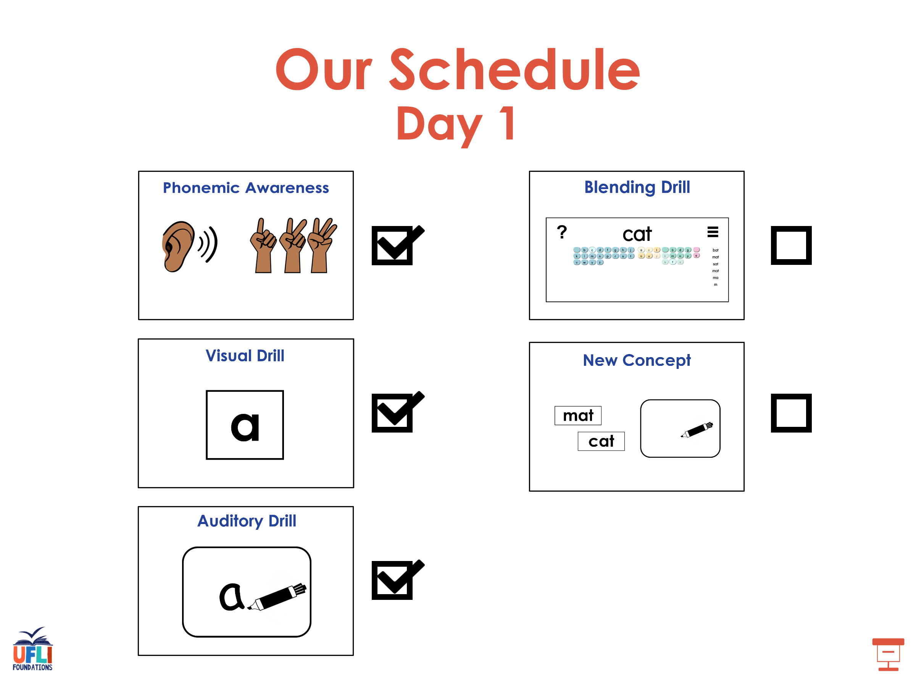

Slide 32
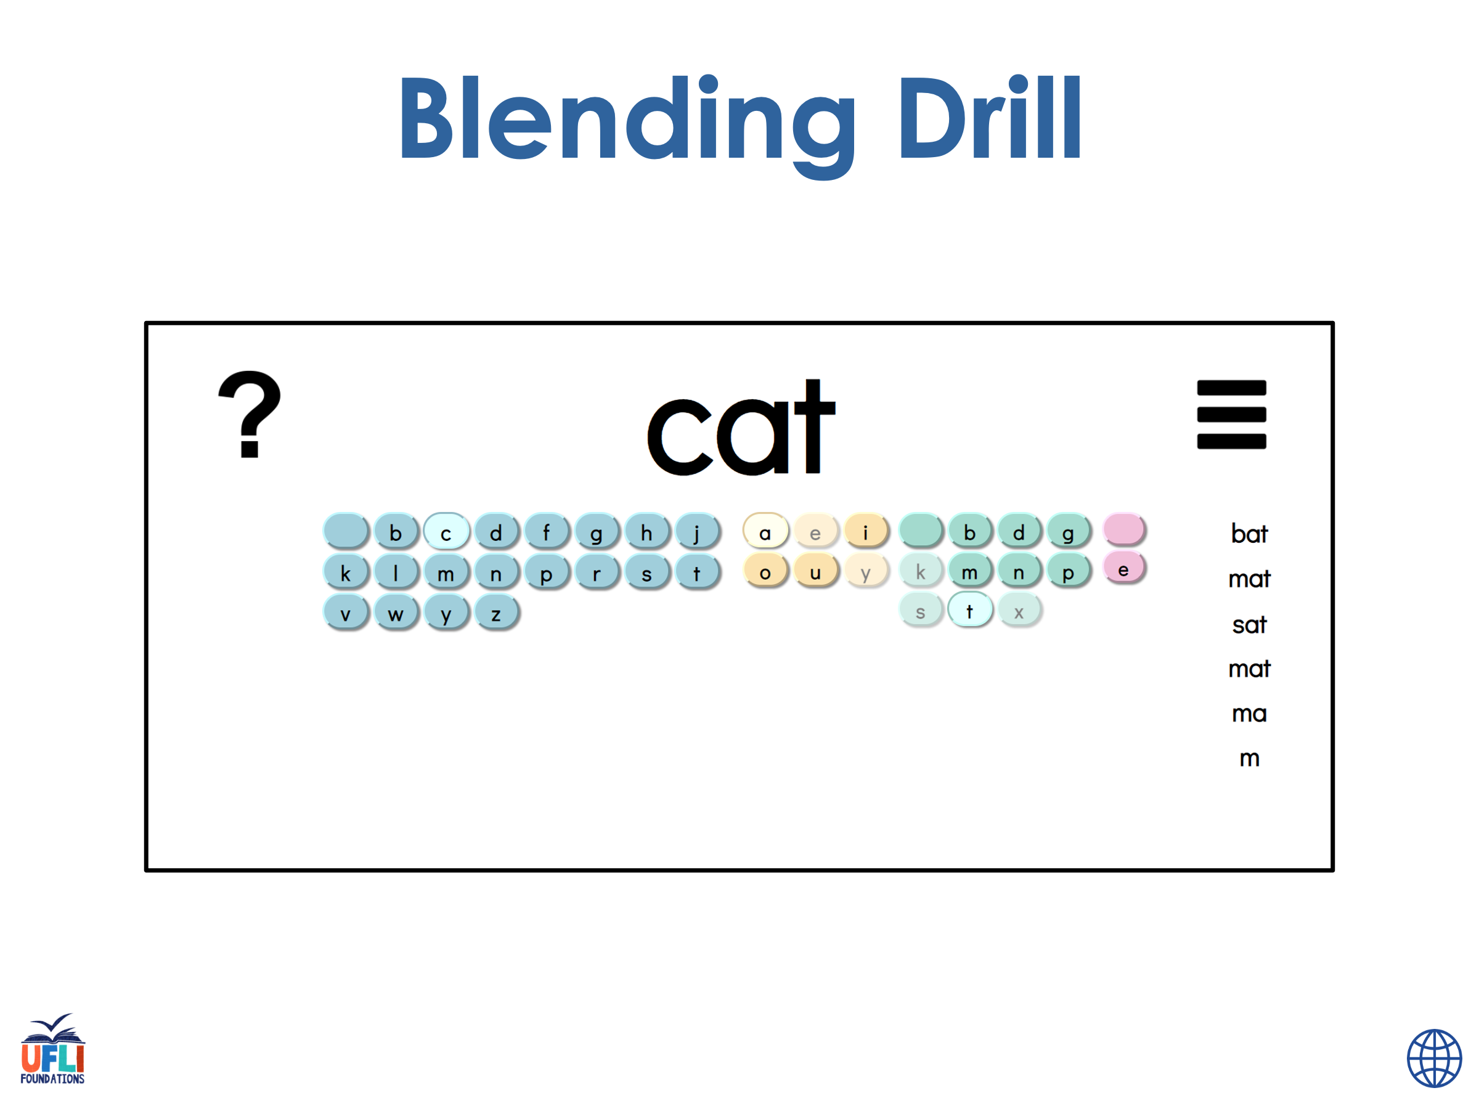
Notes:
See UFLI Foundations lesson plan Step 4 for blending drill word chain and grid.
Visit ufliteracy.org to access the Blending Board app.

Slide 33
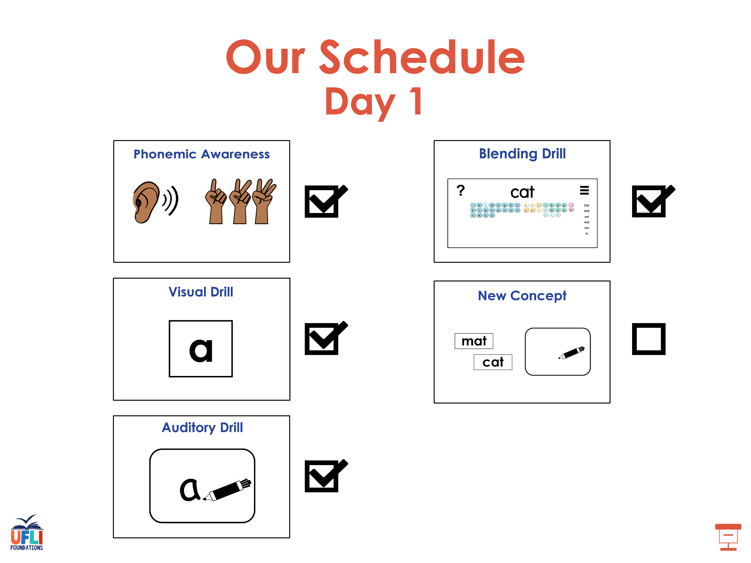

Slide 34
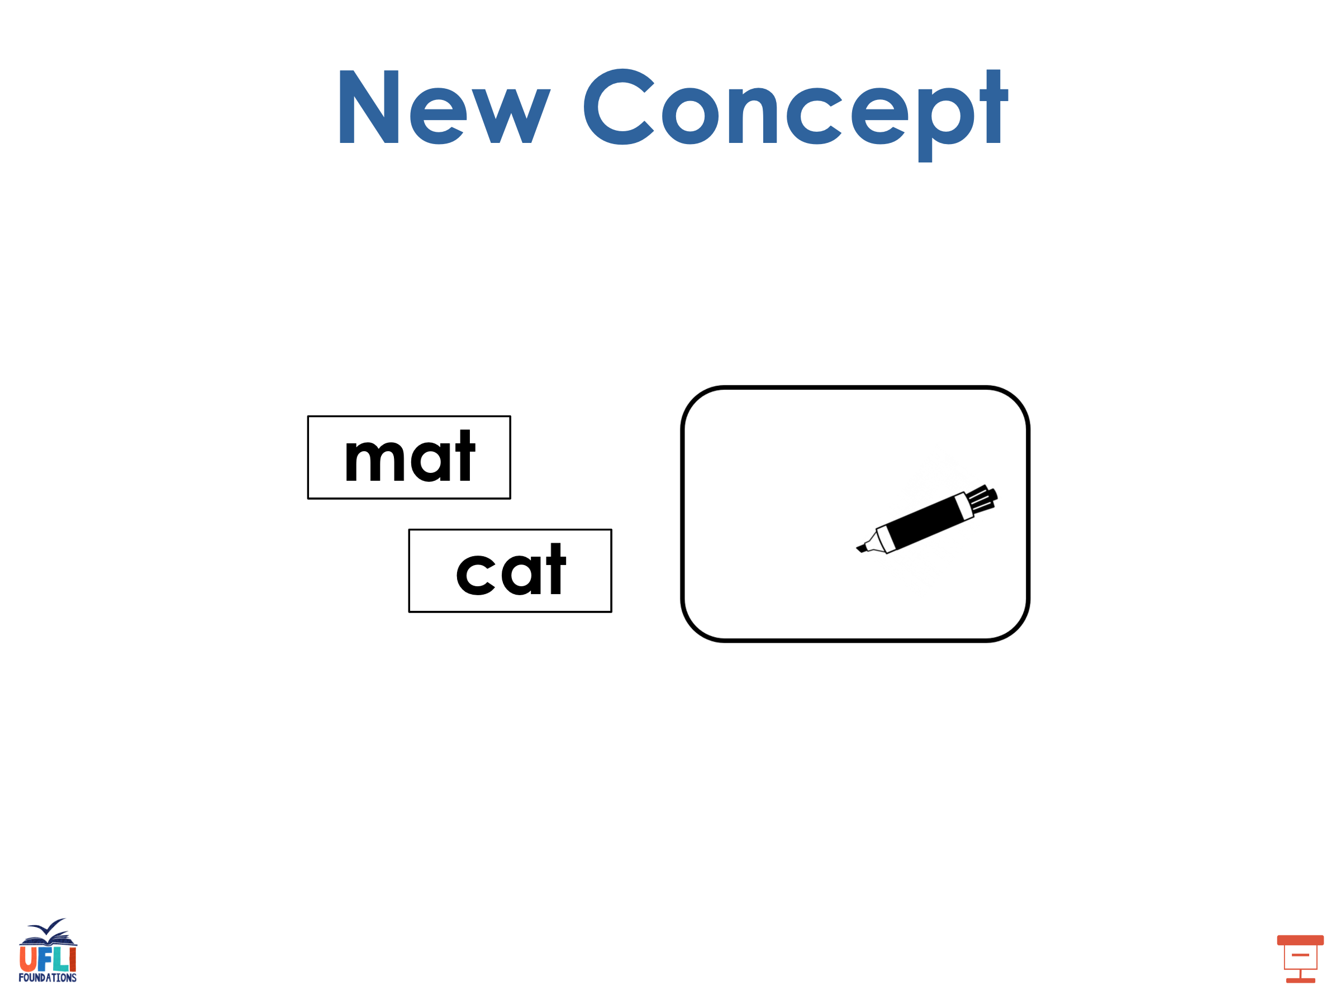
Notes:
See UFLI Foundations lesson plan Step 5 for recommended teacher language and activities to introduce the new concept.

Slide 35
-ed
-ing
stop
stop
ped
ping
stop
stop
v c
1 1
v c
1 1

Slide 36
-er
-est

Slide 37
big

Slide 38
big
v c
1 1

Slide 39
big
ger
v c
1 1

Slide 40
big
ger
v c
1 1
big
gest
v c
1 1

Slide 41
big
ger
v c
1 1
big
gest
v c
1 1

Slide 42
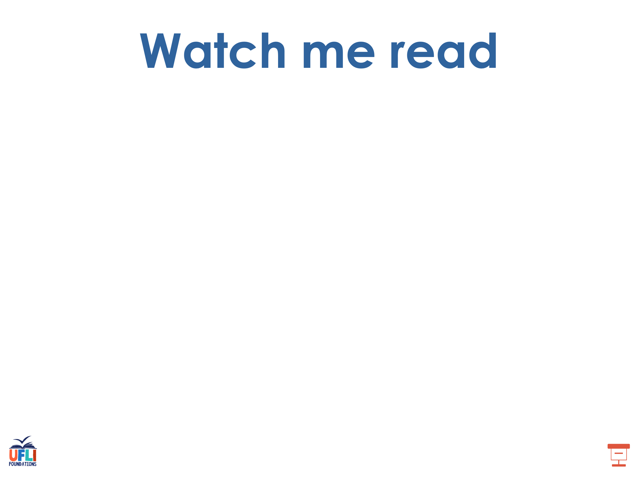
hot
hotter
hottest

Slide 43
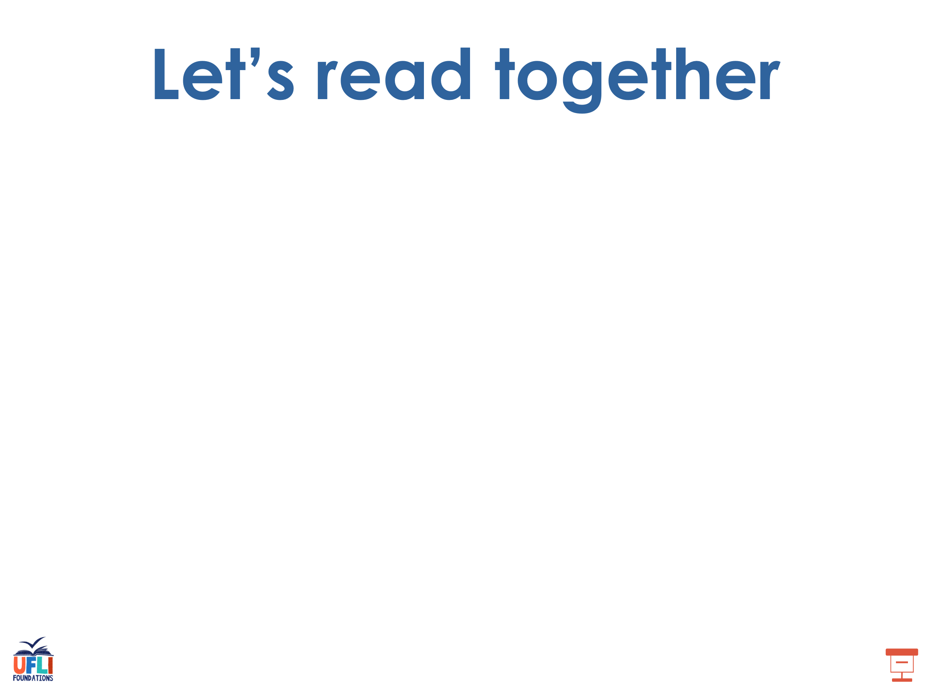
wet
wetter
wettest

Slide 44
slim
slimmer
slimmest

Slide 45
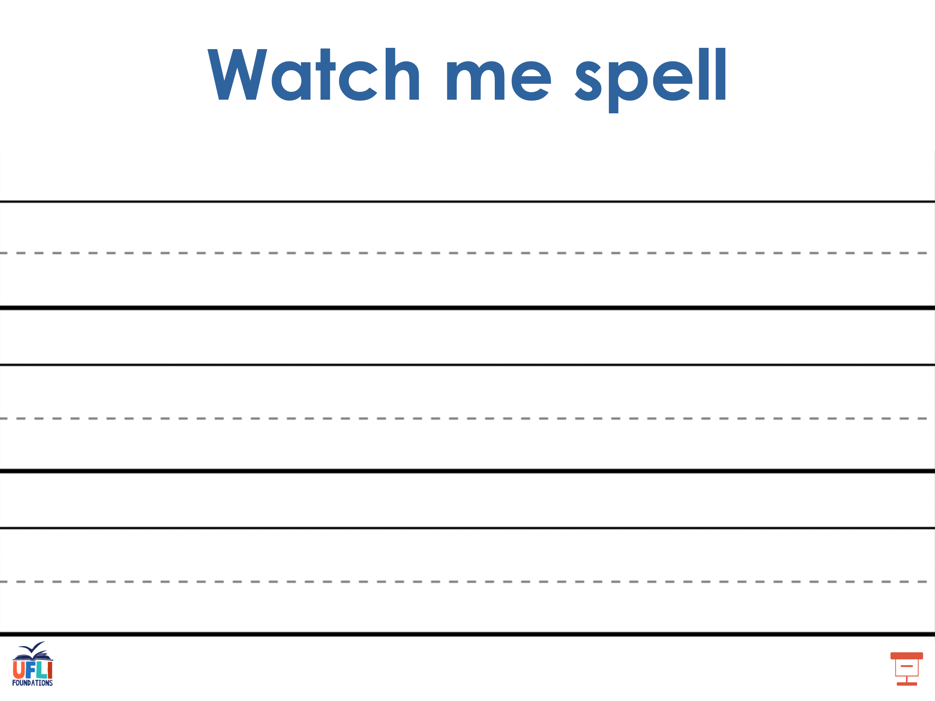
Notes:
See UFLI Foundations lesson plan Step 5 for words to spell.
Handwriting paper to model spelling.

Slide 46
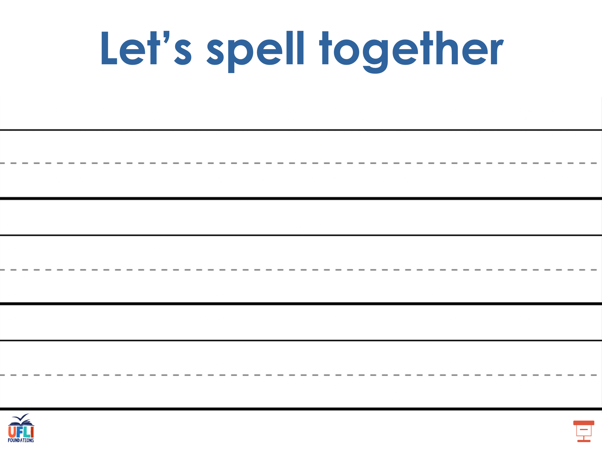
Notes:
See UFLI Foundations lesson plan Step 5 for words to spell.
Handwriting paper for guided spelling practice.

Slide 47
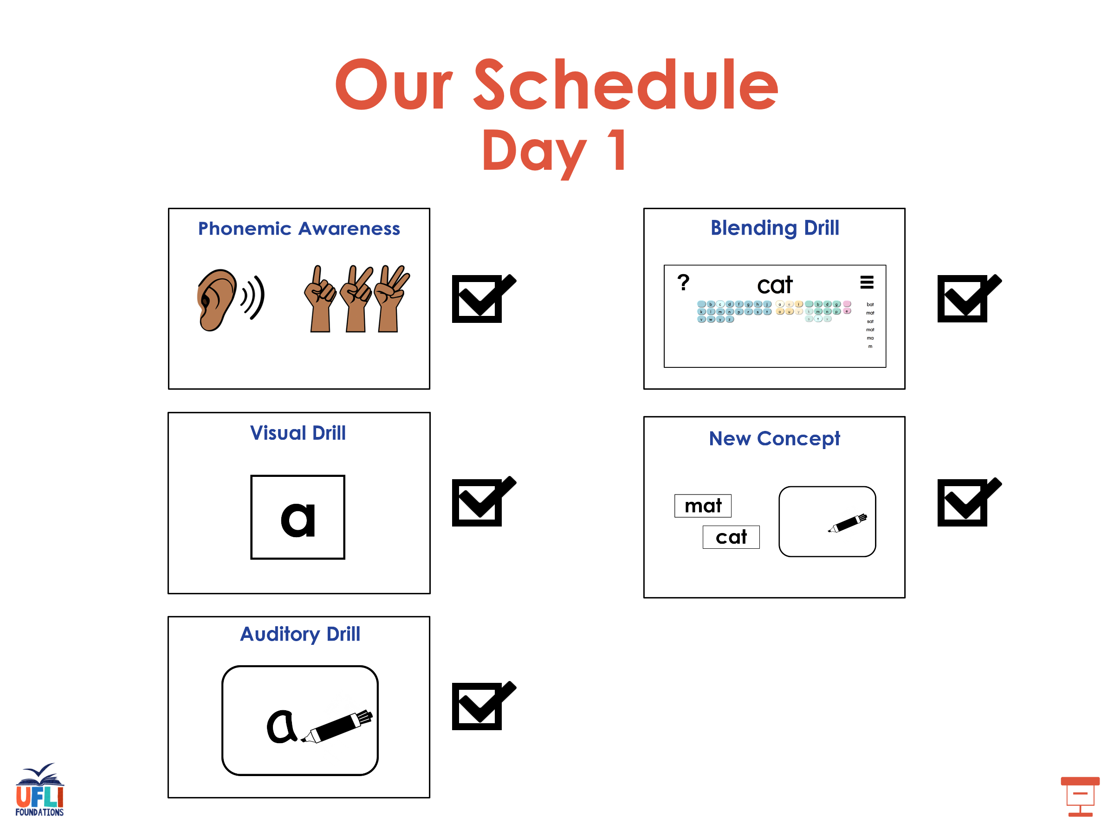

Slide 48

Insert brief reinforcement activity and/or transition to next part of reading block.

Slide 49

Lesson 108
Doubling Rule -er, -est

Slide 50
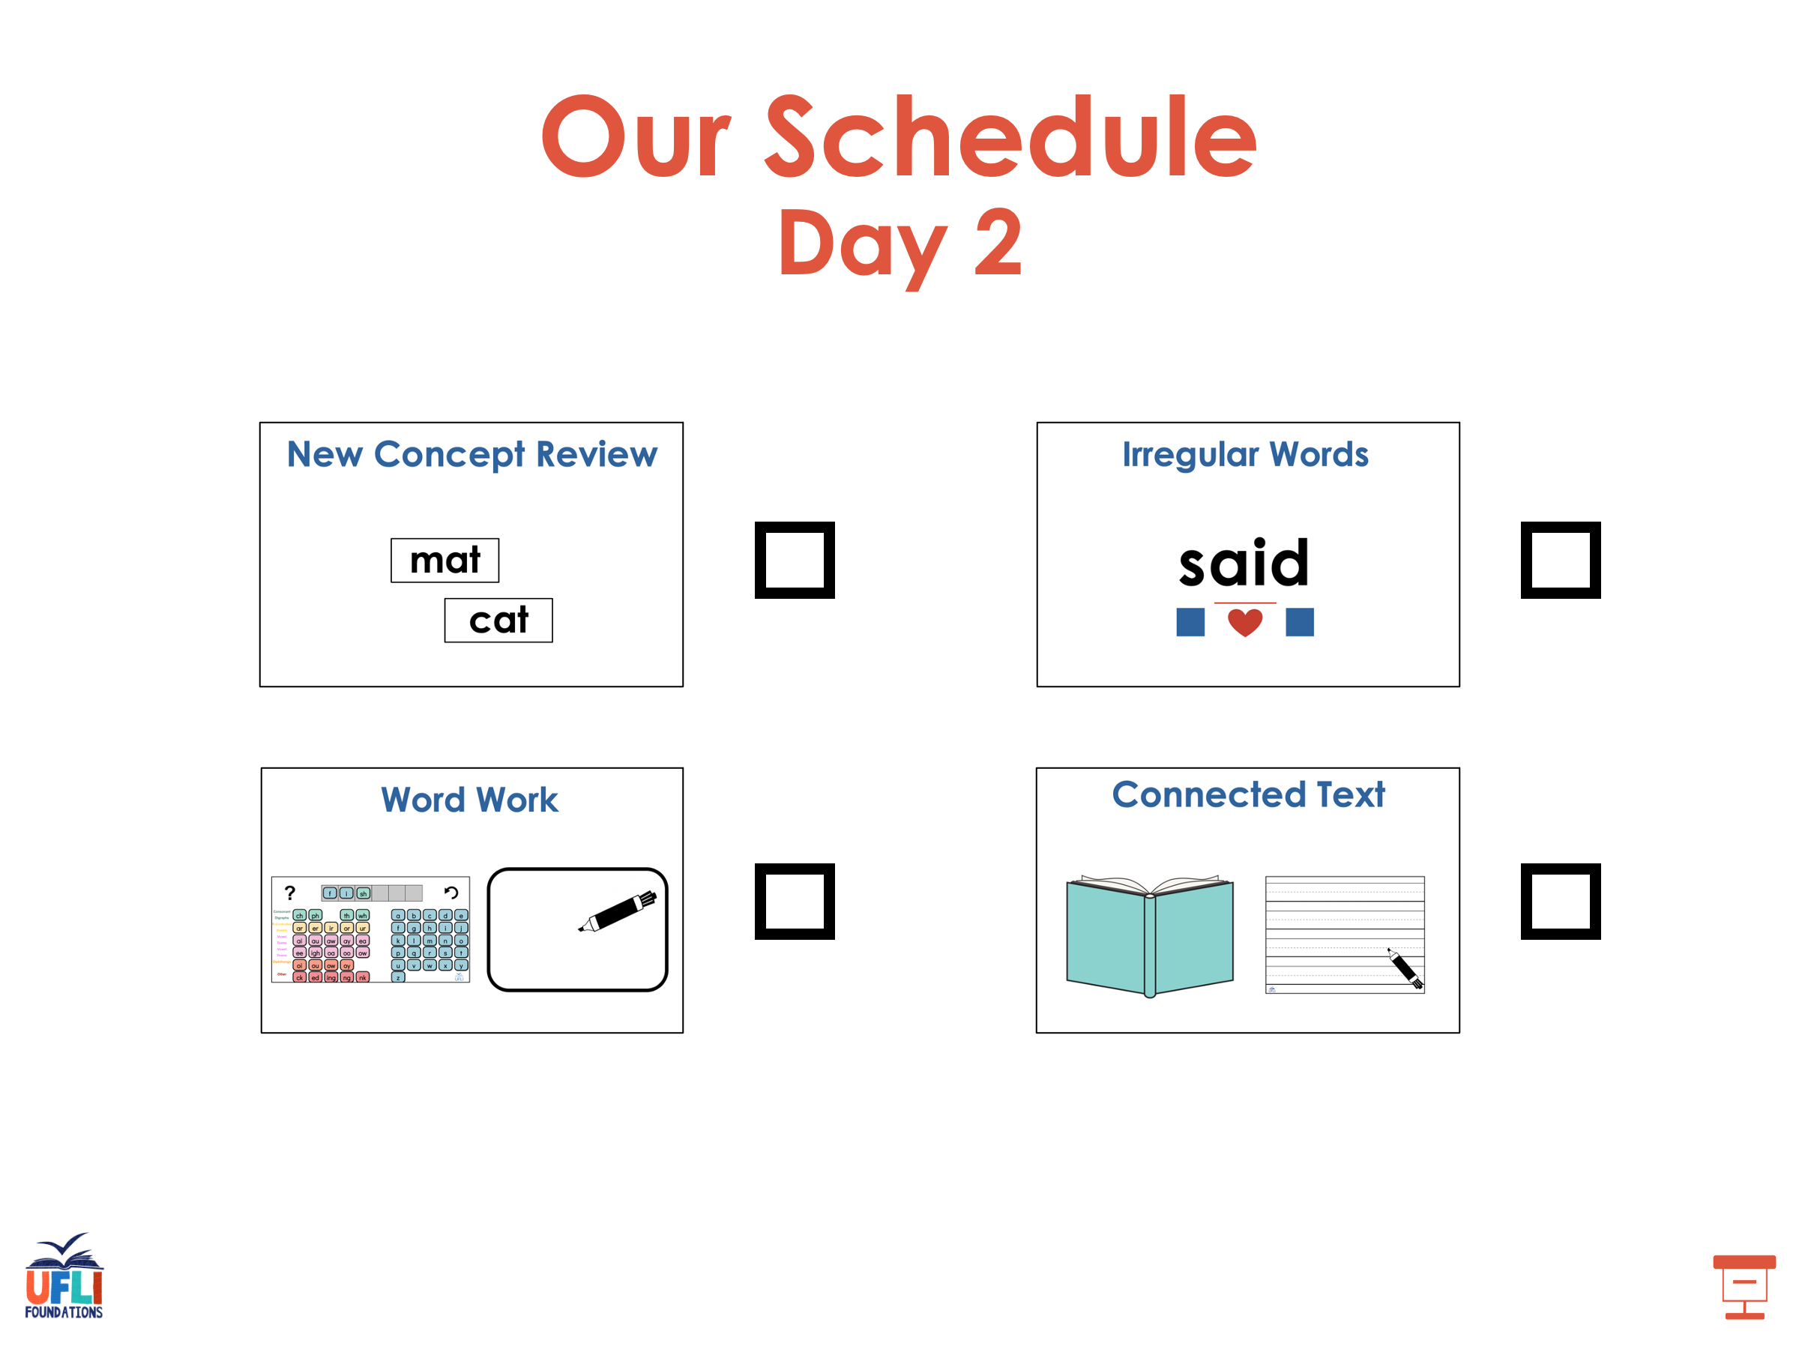

Slide 51



New Concept Review
Notes:
See UFLI Foundations lesson plan Step 5 for recommended teacher language and activities to review the new concept.

Slide 52
-ed
-ing
stop
stop
ped
ping
stop
stop
v c
1 1
v c
1 1

Slide 53
-er
-est

Slide 54
big

Slide 55
big
v c
1 1

Slide 56
big
ger
v c
1 1

Slide 57
big
ger
v c
1 1
big
gest
v c
1 1

Slide 58
big
ger
v c
1 1
big
gest
v c
1 1

Slide 59
hot
hotter
hottest

Slide 60
sad
sadder
saddest

Slide 61
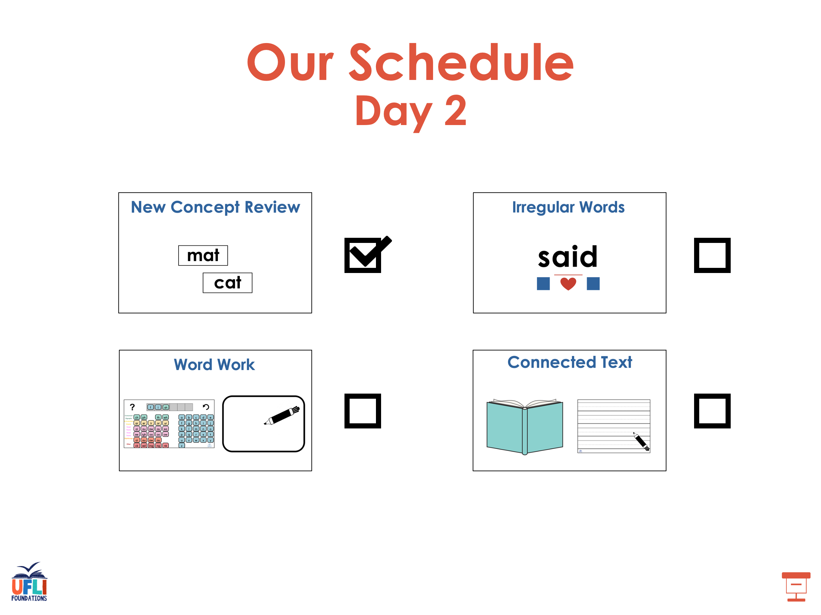

Slide 62
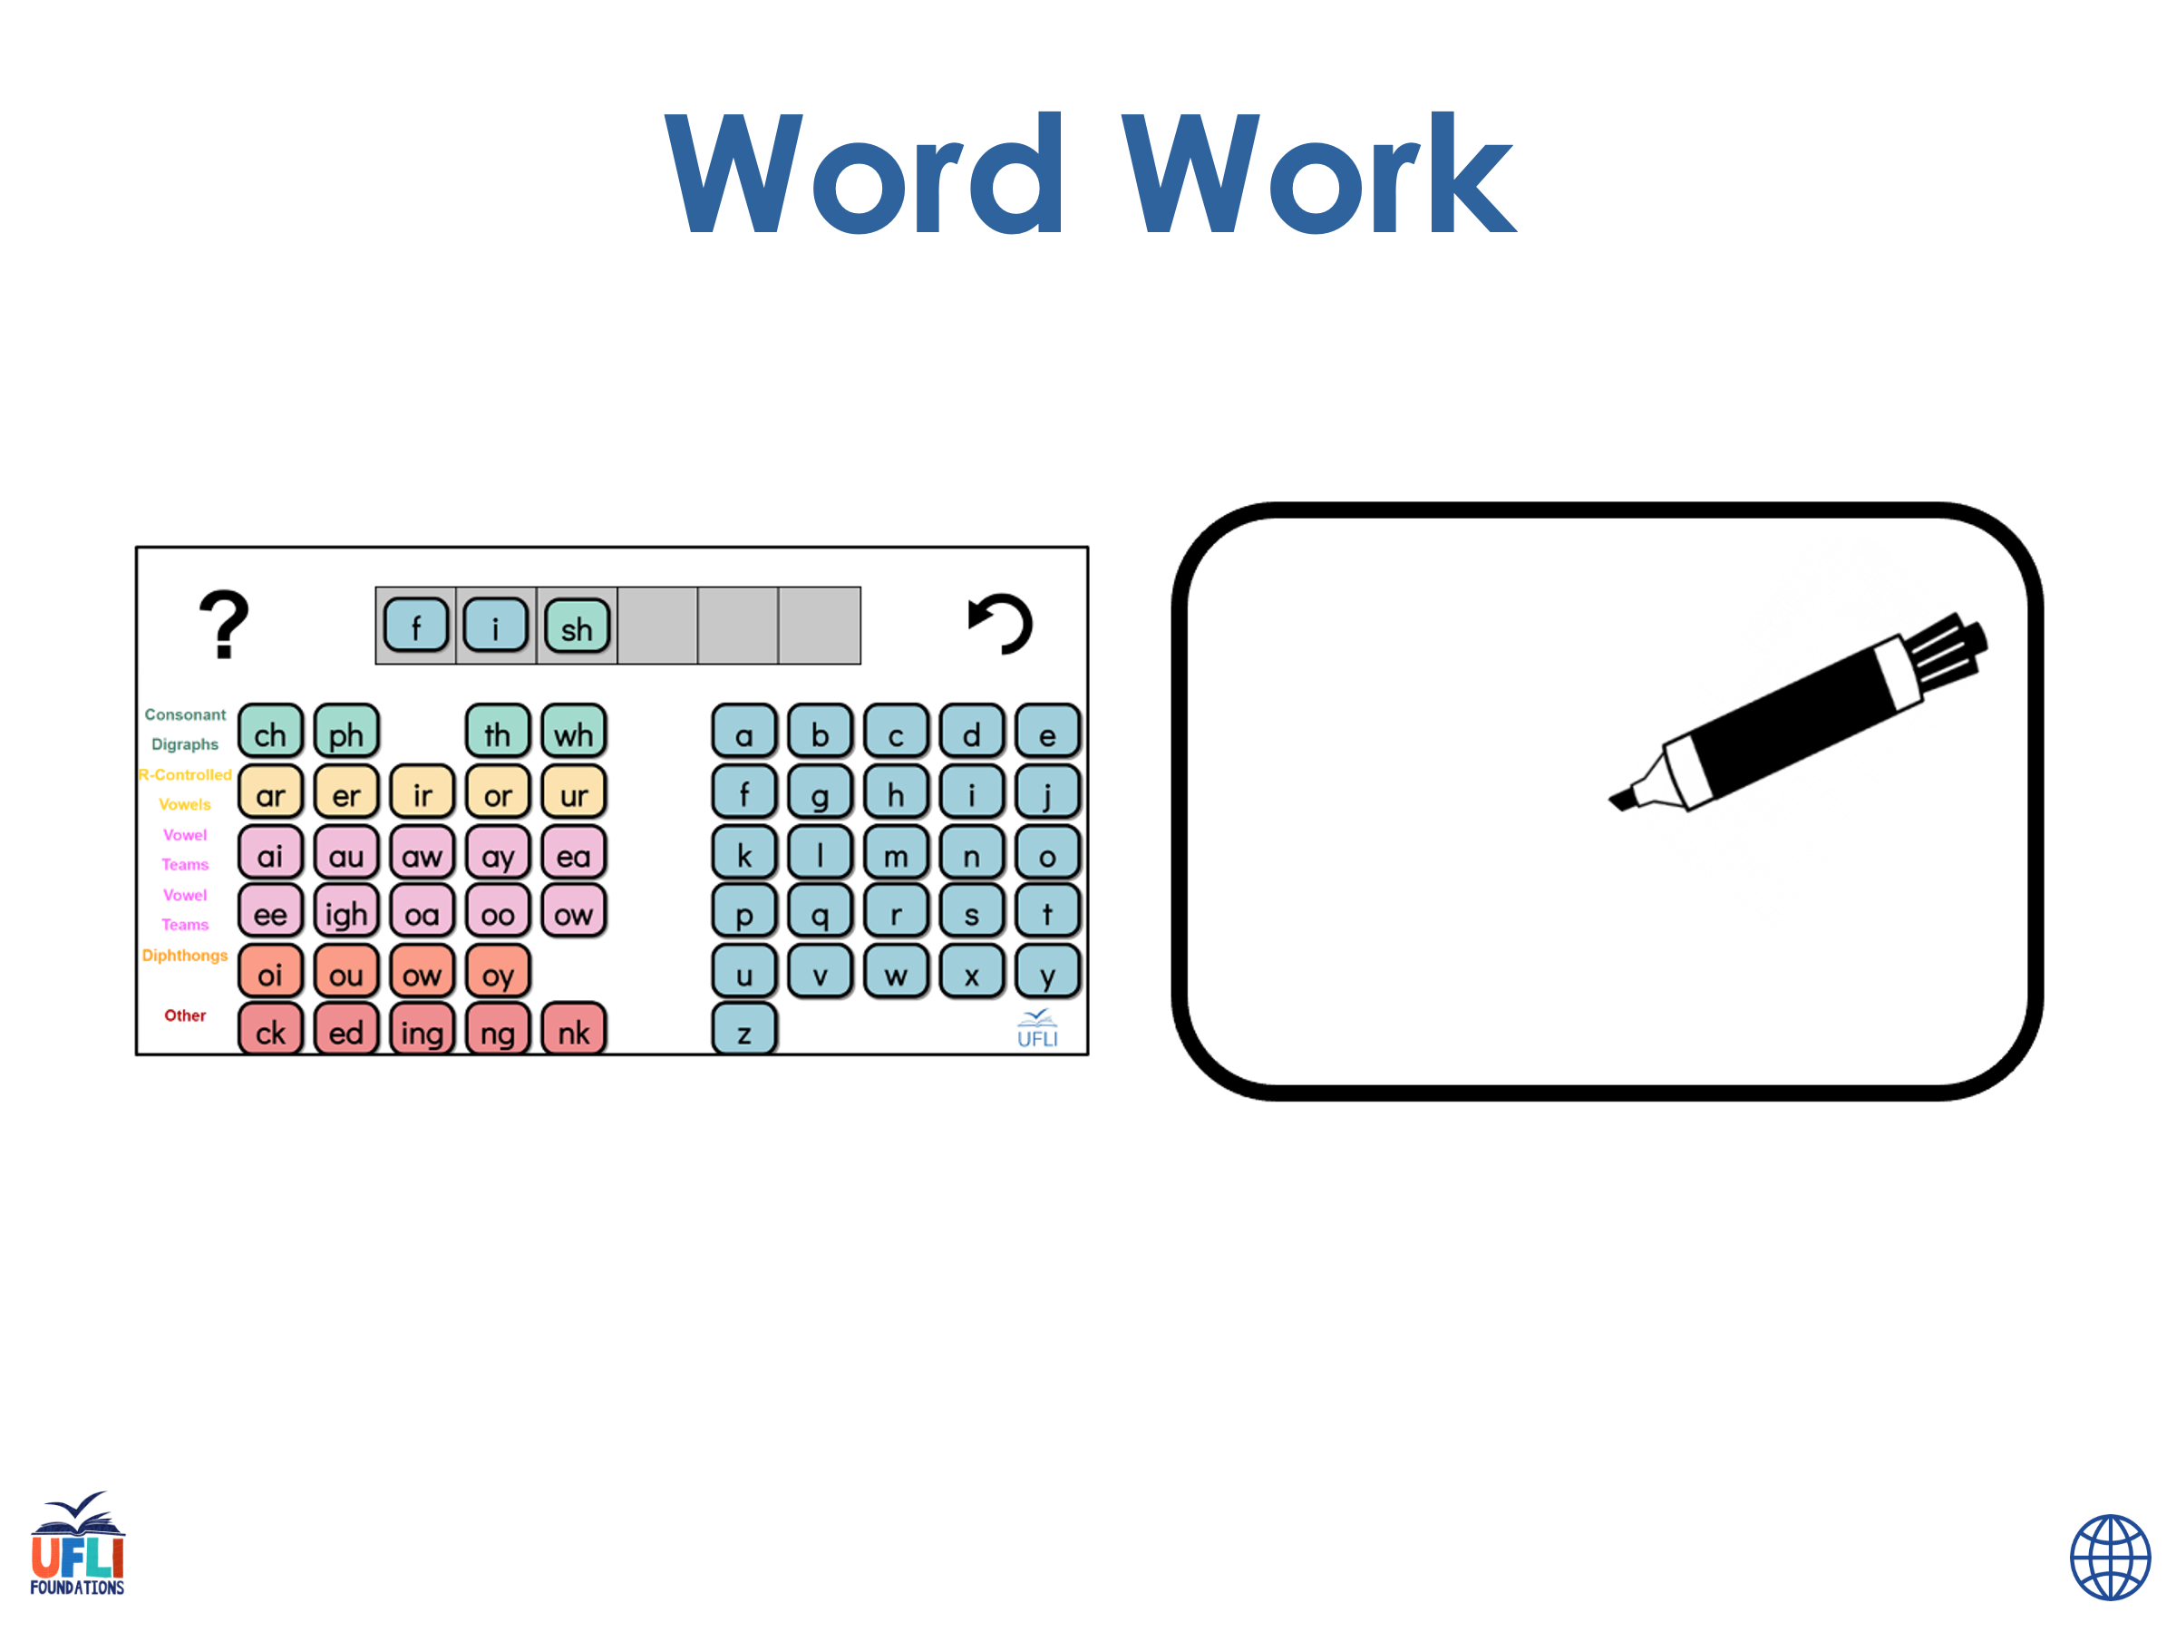
Notes:
See UFLI Foundations lesson plan Step 6 for word work activity.
Visit ufliteracy.org to access the Word Work Mat apps.

Slide 63
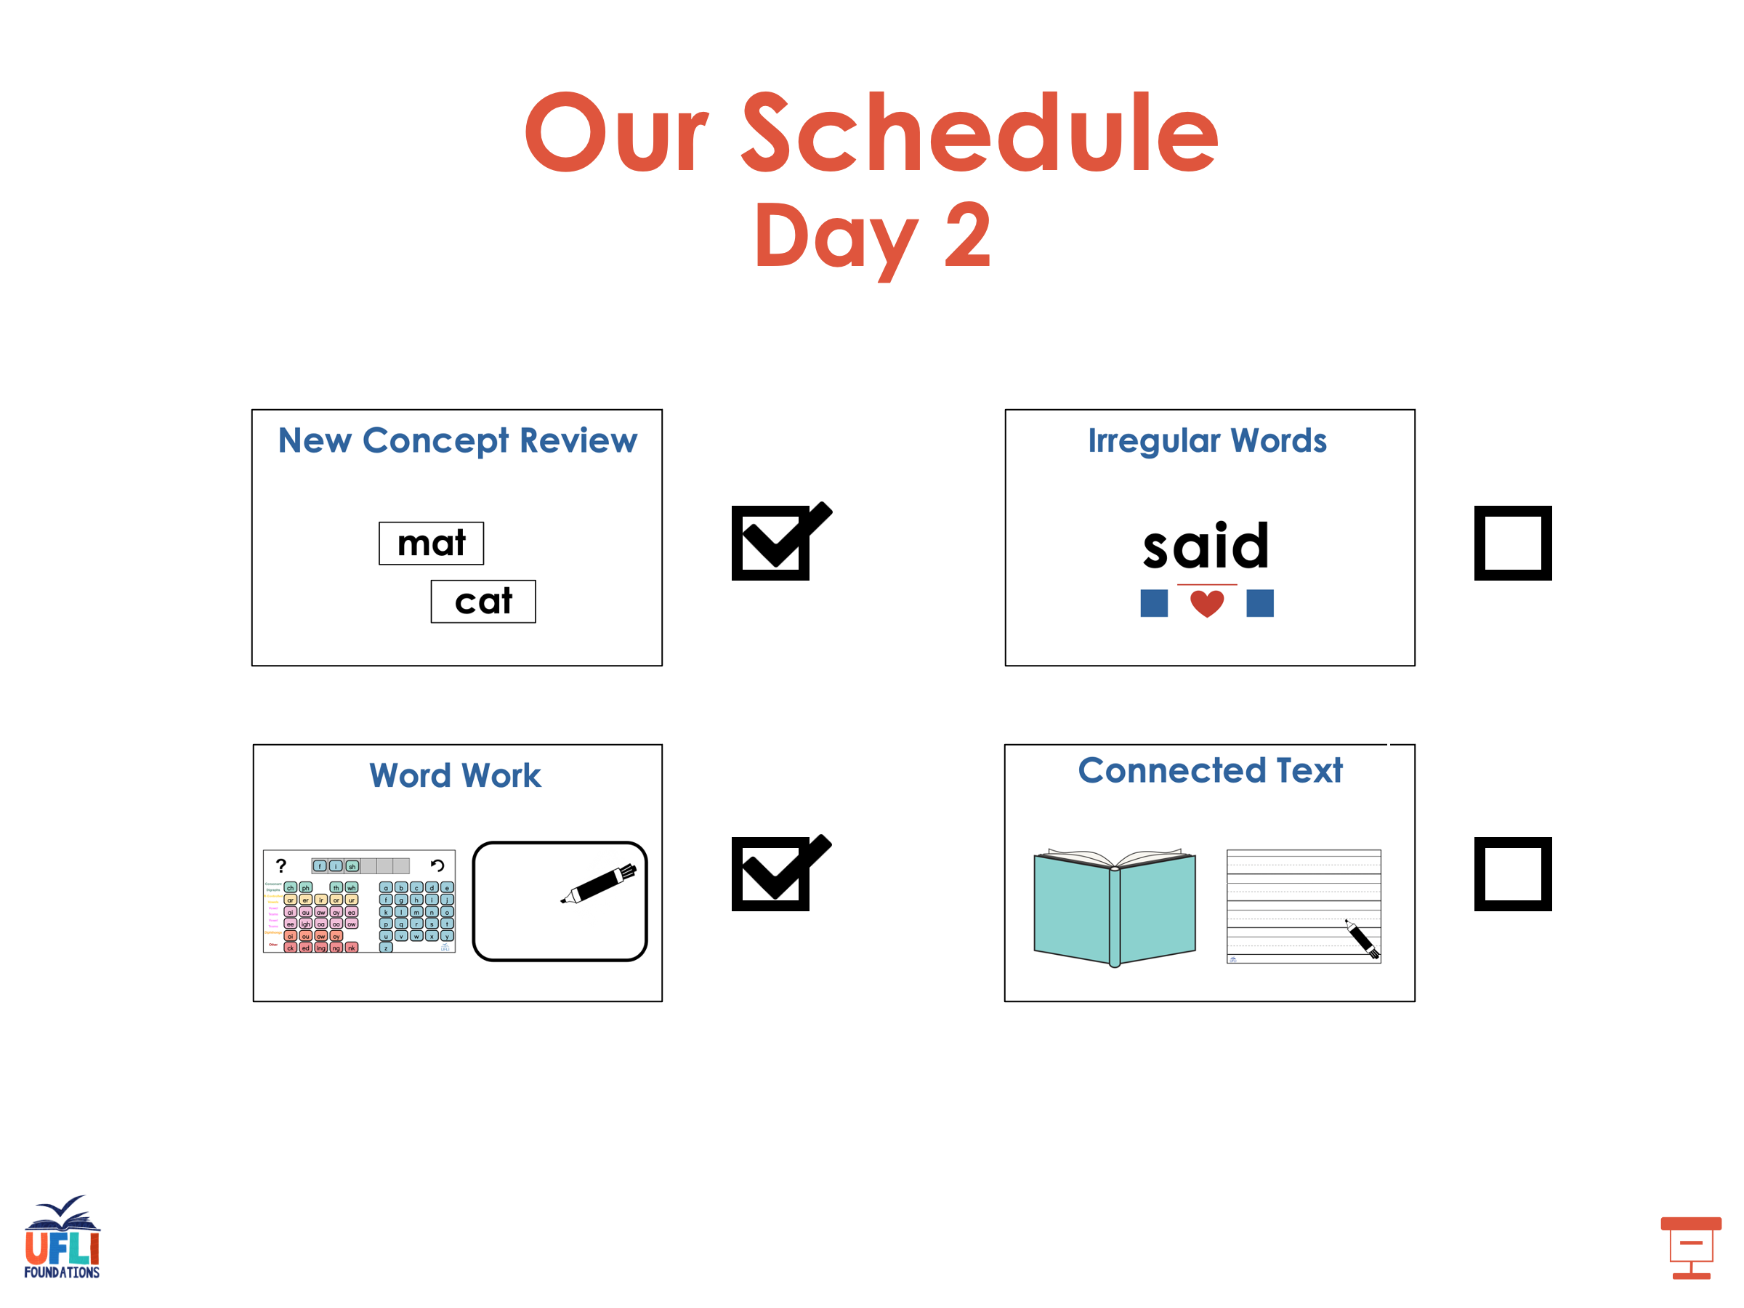

Slide 64
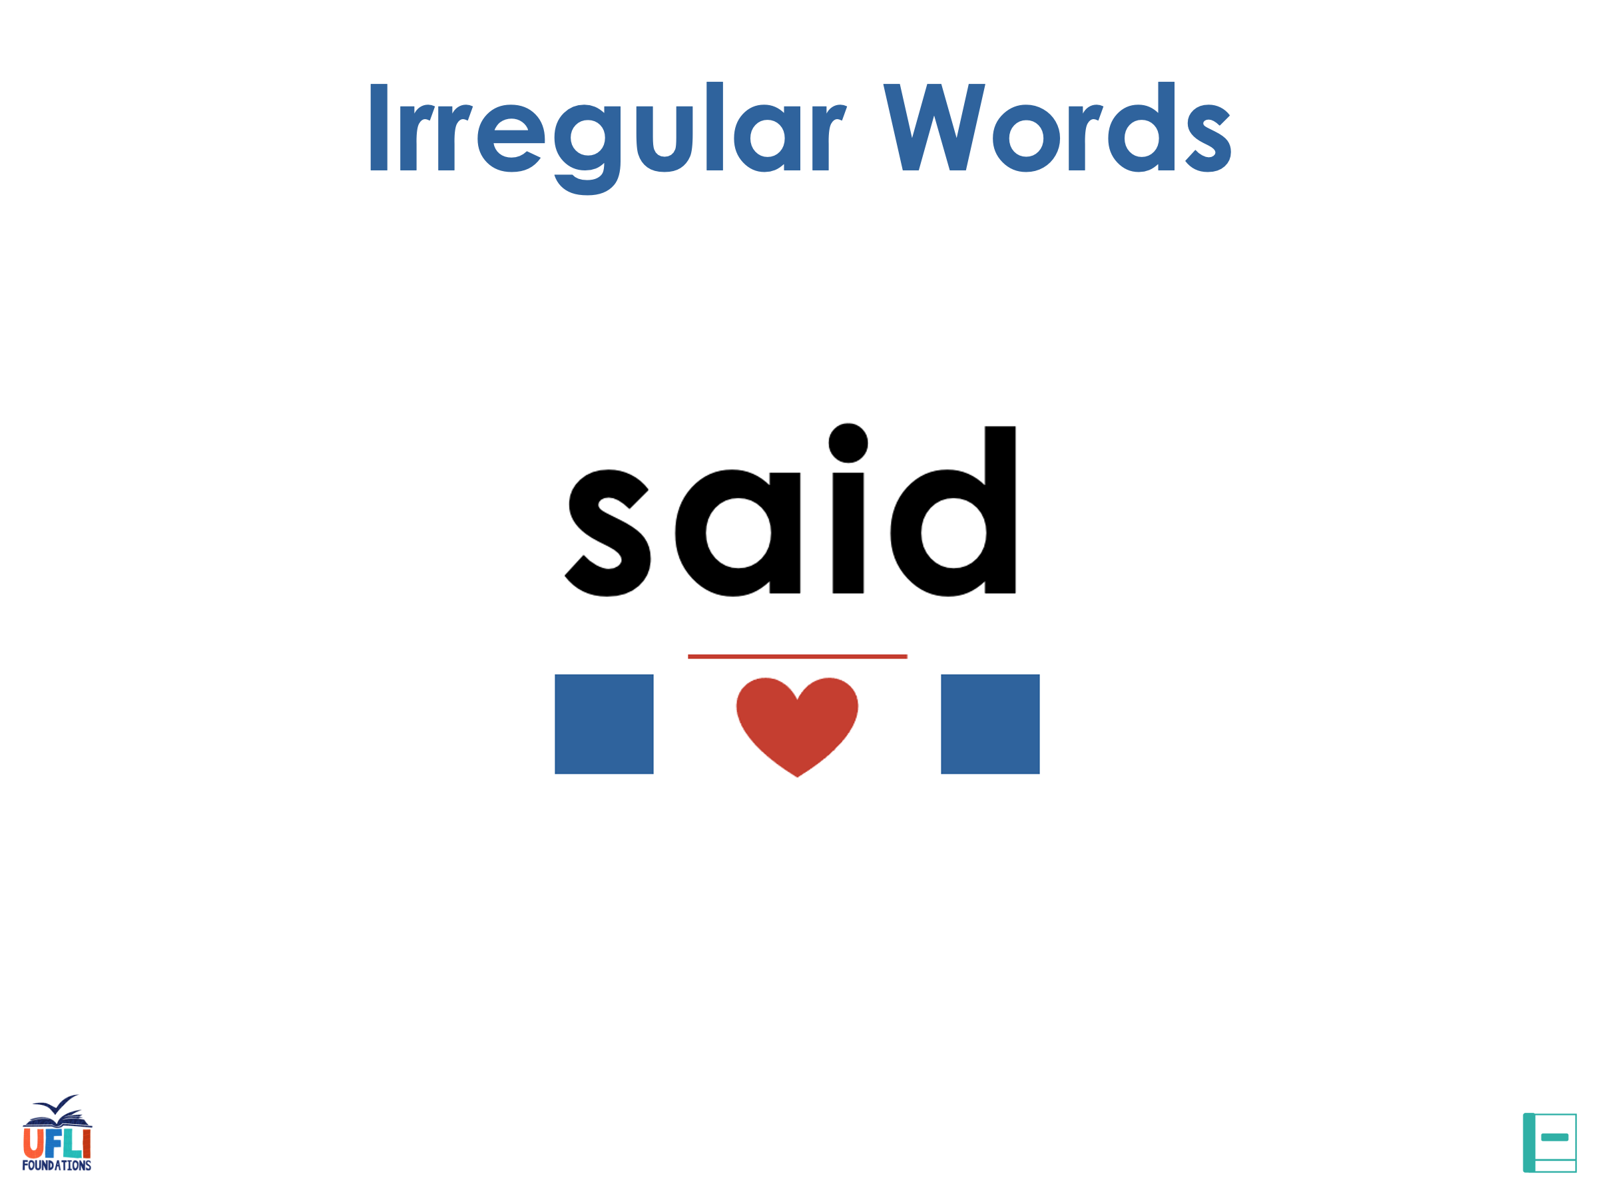
Notes:
See UFLI Foundations lesson plan Step 7 for irregular word activities.
The white rectangle under each word may be used in editing mode. Cover the heart and square icons then reveal them one at a time during instruction.

Slide 65

Notes:
See UFLI Foundations manual for more information about reviewing irregular words.

Slide 66
truth
Notes:
Lesson 103+
U represents the /ū/ sound, which is only irregular because it come in the middle of a word (i.e., no silent e at the end, no UI vowel team).
The white rectangle under the word may be used in editing mode. Cover the heart and square icons then reveal them one at a time during instruction.

Slide 67
truly
Notes:
Lesson 103+
U represents the /ū/ sound, which is only irregular because it come in the middle of a word (i.e., no silent e at the end, no UI vowel team).
The white rectangle under the word may be used in editing mode. Cover the heart and square icons then reveal them one at a time during instruction.

Slide 68
busy
Notes:
Lesson 107+
U represents the /ĭ/ sound.
The white rectangle under the word may be used in editing mode. Cover the heart and square icons then reveal them one at a time during instruction.

Slide 69
Notes:
Handwriting paper for irregular word spelling practice. Use as needed.
See UFLI Foundations manual for more information about reviewing irregular words.

Slide 70

Teach
Notes:
The orange star indicates these are new irregular words that need to be introduced.
See UFLI Foundations manual for more information about teaching irregular words.

Slide 71
build
Notes:
Lesson 108+
UI represents the /ĭ/ sound.
The white rectangle under the word may be used in editing mode. Cover the heart and square icons then reveal them one at a time during instruction.

Slide 72
built
Notes:
Lesson 108+
UI represents the /ĭ/ sound.
The white rectangle under the word may be used in editing mode. Cover the heart and square icons then reveal them one at a time during instruction.

Slide 73
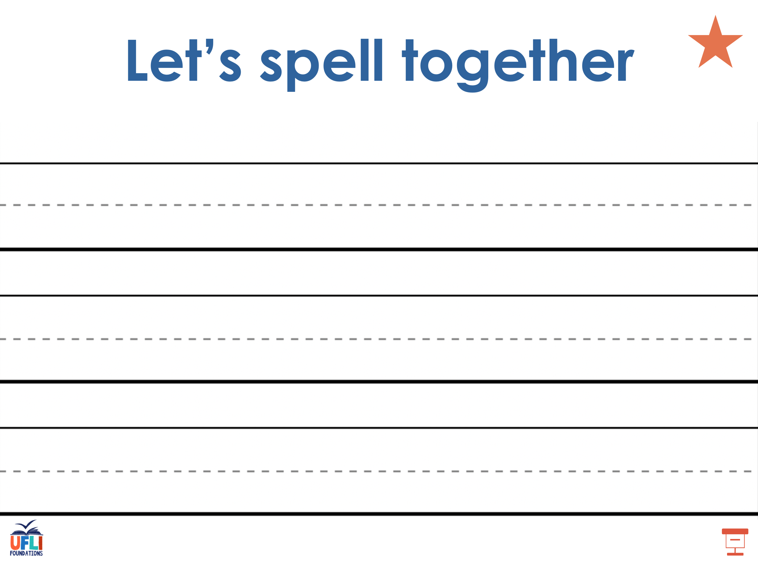
Notes:
Handwriting paper for irregular word spelling practice. Use as needed.
See UFLI Foundations manual for more information about teaching irregular words.

Slide 74
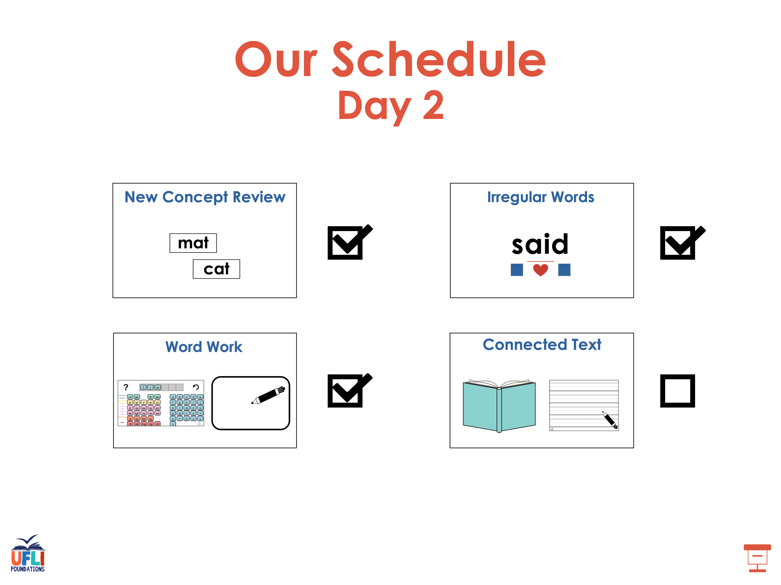

Slide 75
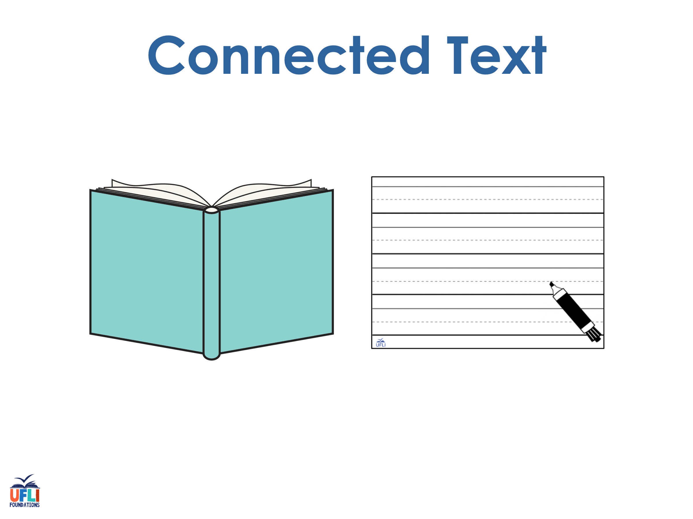
Notes:
See UFLI Foundations lesson plan Step 8 for connected text activities.

Slide 76
It has been another one of the glummest days.

Slide 77
That is the saddest I have ever seen my mother.

Slide 78
My brother can build the biggest tower.

Slide 79
Notes:
See UFLI Foundations lesson plan Step 8 for sentences to write.

Slide 80

Notes:
The UFLI Foundations decodable text is provided here. See UFLI Foundations decodable text guide for additional text options.

Slide 81
The Hottest Day
One August day, Tyler went outside to play tag with his friends. The sun was high in the sky. It felt like the hottest day of the year. As Tyler was running around, his face got redder and redder and he felt hotter and hotter. “It’s too hot outside to play tag,” Tyler called to his friends, “let’s go swimming instead.”

Slide 82
Tyler and his friends hopped on their bikes and rode to the pool. At the pool, they had a contest to see who could make the biggest splash in the water. Tyler made a pretty big splash, but his friends made bigger ones.

Slide 83
The friends had lots of fun at the pool. The saddest part of the day was when they had to stop playing and go back
home.

Slide 84
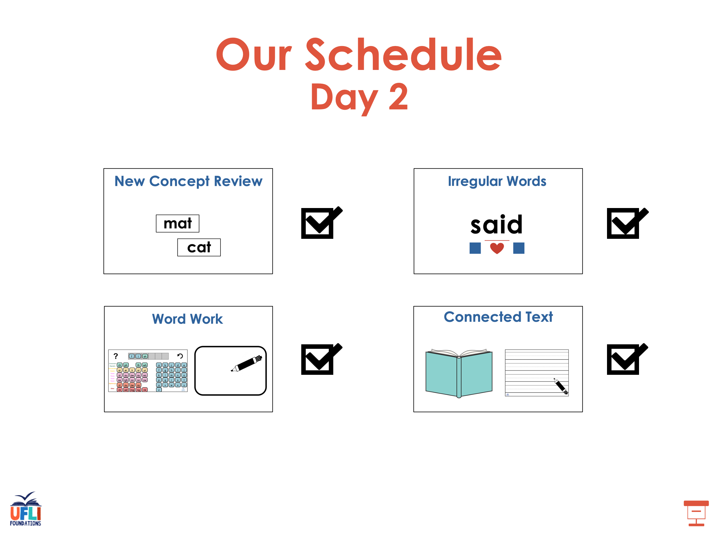

Slide 85
Insert brief reinforcement activity and/or transition to next part of reading block.

