Slide 1
Lesson 103
un-

Slide 2
Notes:
ufliteracy.org

Slide 4
Lesson 103
un-

Slide 6
Notes:
See UFLI Foundations lesson plan Step 1 for phonemic awareness activity.

Slide 8
Notes:
See UFLI Foundations lesson plan Step 2 for student phoneme responses.

Slide 9
l

Slide 10
y

Slide 11
er

Slide 12
e

Slide 13
t

Slide 14
s

Slide 15
kn

Slide 16
wr

Slide 17
mb

Slide 18
ou

Slide 19
ow

Slide 20
oi

Slide 21
oy

Slide 22
ea

Slide 23
au

Slide 24
aw

Slide 25
augh

Slide 26
ew

Slide 27
ui

Slide 28
ue

Slide 30
Notes:
See UFLI Foundations lesson plan Step 3 for auditory drill activity.

Slide 31
Notes:
No slides needed for auditory drill.

Slide 33
Notes:
See UFLI Foundations lesson plan Step 4 for blending drill word chain and grid.
Visit ufliteracy.org to access the Blending Board app.

Slide 35
Notes:
See UFLI Foundations lesson plan Step 5 for recommended teacher language and activities to introduce the new concept.

Slide 36
Morphemes
word parts that change a word’s meaning

Slide 37
Suffix
morpheme added to the end of a word

Slide 38
Prefix
morpheme added to the beginning of a word

Slide 39
un-
not or opposite

Slide 40
un-
not or opposite
unhappy
= not happy
unkind
= not kind

Slide 41
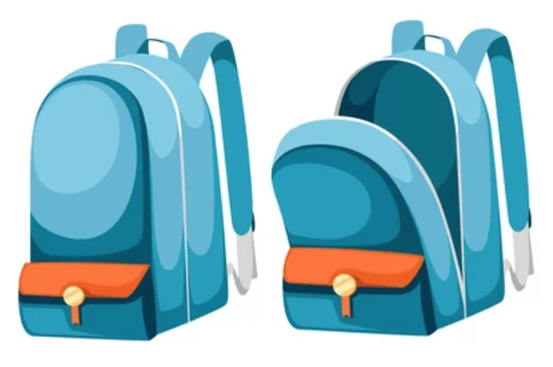
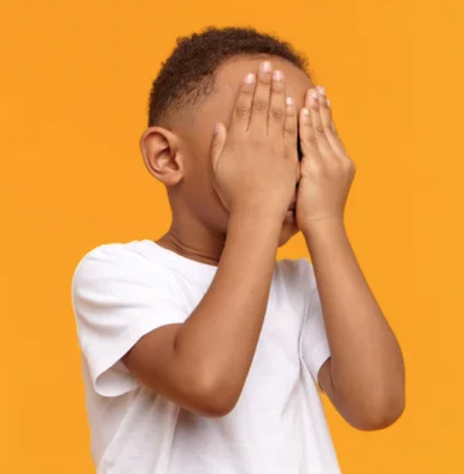
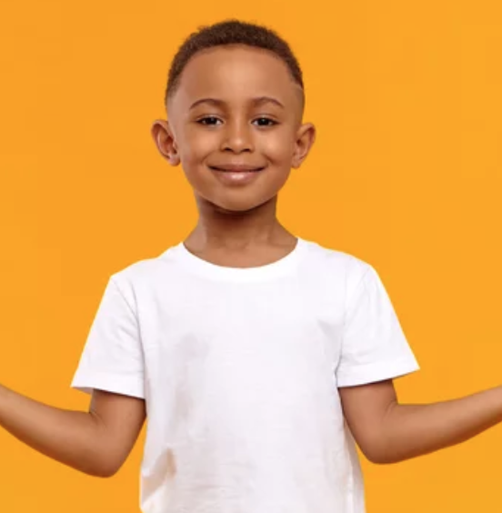
un-
not or opposite
unzip
uncover

Slide 42
unwrap
untamed

Slide 43
unsafe
undo
untie

Slide 44
unkind
unclean
unhappy

Slide 45
unfinished
uncover

Slide 46
Notes:
See UFLI Foundations lesson plan Step 5 for words to spell.
Handwriting paper to model spelling.

Slide 47
Notes:
See UFLI Foundations lesson plan Step 5 for words to spell.
Handwriting paper for guided spelling practice.

Slide 49
Insert brief reinforcement activity and/or transition to next part of reading block.

Slide 50
Lesson 103
un-

Slide 52
New Concept Review
Notes:
See UFLI Foundations lesson plan Step 5 for recommended teacher language and activities to review the new concept.

Slide 53
Prefix
morpheme added to the beginning of a word

Slide 54
un-
not or opposite

Slide 55
un-
not or opposite
unhappy
= not happy
unkind
= not kind

Slide 56
un-
not or opposite
unzip
uncover

Slide 57
undo
unlucky

Slide 58
unhappy
unwell

Slide 60
Notes:
See UFLI Foundations lesson plan Step 6 for word work activity.
Visit ufliteracy.org to access the Word Work Mat apps.

Slide 62
Notes:
See UFLI Foundations lesson plan Step 7 for irregular word activities.
The white rectangle under each word may be used in editing mode. Cover the heart and square icons then reveal them one at a time during instruction.

Slide 63
Notes:
See UFLI Foundations manual for more information about reviewing irregular words.

Slide 64
answer
Notes:
Lesson 99+
W is silent.
The white rectangle under the word may be used in editing mode. Cover the heart and square icons then reveal them one at a time during instruction.

Slide 65
honest
Notes:
Lesson 101+
H is silent
The white rectangle under the word may be used in editing mode. Cover the heart and square icons then reveal them one at a time during instruction.

Slide 66
honour
Notes:
Lessons 101-110
H is silent
OUR /ə/ at the end of 2-syllable words is not introduced until lesson 111.
The white rectangle under the word may be used in editing mode. Cover the heart and square icons then reveal them one at a time during instruction.

Slide 67
Notes:
Handwriting paper for irregular word spelling practice. Use as needed.
See UFLI Foundations manual for more information about reviewing irregular words.

Slide 68
Teach
Notes:
The orange star indicates these are new irregular words that need to be introduced.
See UFLI Foundations manual for more information about teaching irregular words.

Slide 69
truth
Notes:
Lesson 103+
U represents the /ū/ sound, which is only irregular because it come in the middle of a word (i.e., no silent e at the end, no UI vowel team).
The white rectangle under the word may be used in editing mode. Cover the heart and square icons then reveal them one at a time during instruction.

Slide 70
truly
Notes:
Lesson 103+
U represents the /ū/ sound, which is only irregular because it come in the middle of a word (i.e., no silent e at the end, no UI vowel team).
The white rectangle under the word may be used in editing mode. Cover the heart and square icons then reveal them one at a time during instruction.

Slide 71
Notes:
Handwriting paper for irregular word spelling practice. Use as needed.
See UFLI Foundations manual for more information about teaching irregular words.

Slide 73
Notes:
See UFLI Foundations lesson plan Step 8 for connected text activities.

Slide 74
The trip was truly unlike any other.

Slide 75
Please unlock the car so I can unload it.

Slide 76
Tell me the truth, why does he look so unhappy?

Slide 77
Notes:
See UFLI Foundations lesson plan Step 8 for sentences to write.

Slide 78
Notes:
The UFLI Foundations decodable text is provided here. See UFLI Foundations decodable text guide for additional text options.

Slide 79
Unlucky
Something very unlucky happened to Lee last week. As he was walking into his classroom, he did not see the puddle on the floor. He slid and fell before his entire class. That’s not even the worst part! Lee was holding a jar of marbles with the lid unscrewed. When he fell, the marbles flew everywhere.

Slide 80
Lee laid on the floor, hid his face and wanted to cry. But then, all of a sudden, his best friend, Jayden, sat down next to
him. Jayden took Lee’s hands off his face and helped him up. “Don’t worry,” Jayden said, “people fall all the time.” At first, Lee felt uneasy. When he looked around at his classmates, nobody made fun of him for falling.

Slide 81
Instead, Lee’s classmates began picking up all the marbles that spilled. Some of them even told him about times when mistakes like this happened to them. It turns out, it is not that uncommon to slip and fall. “I am thankful to have such nice friends,” Lee said.

Slide 83
Insert brief reinforcement activity and/or transition to next part of reading block.

