Slide 1
Lesson 41b
Short Vowels Advanced 1

Slide 2
Notes:
ufliteracy.org

Slide 4
Lesson 41b
Short Vowels Advanced 1

Slide 6
Notes:
See UFLI Foundations lesson plan Step 1 for phonemic awareness activity.

Slide 8
Notes:
See UFLI Foundations lesson plan Step 2 for student phoneme responses.

Slide 9
o

Slide 10
i

Slide 11
a

Slide 12
m

Slide 13
s

Slide 14
t

Slide 15
p

Slide 16
f

Slide 17
n

Slide 18
d

Slide 19
c

Slide 20
g

Slide 21
b

Slide 22
k

Slide 23
h

Slide 24
r

Slide 25
l

Slide 26
w

Slide 27
j

Slide 28
y

Slide 29
x

Slide 30
qu

Slide 31
v

Slide 32
z

Slide 34
Notes:
See UFLI Foundations lesson plan Step 3 for auditory drill activity.

Slide 35
Notes:
No slides needed for auditory drill.

Slide 37
Notes:
See UFLI Foundations lesson plan Step 4 for blending drill word chain and grid.
Visit ufliteracy.org to access the Blending Board app.

Slide 39
Notes:
See UFLI Foundations lesson plan Step 5 for recommended teacher language and activities to introduce the new concept.

Slide 40
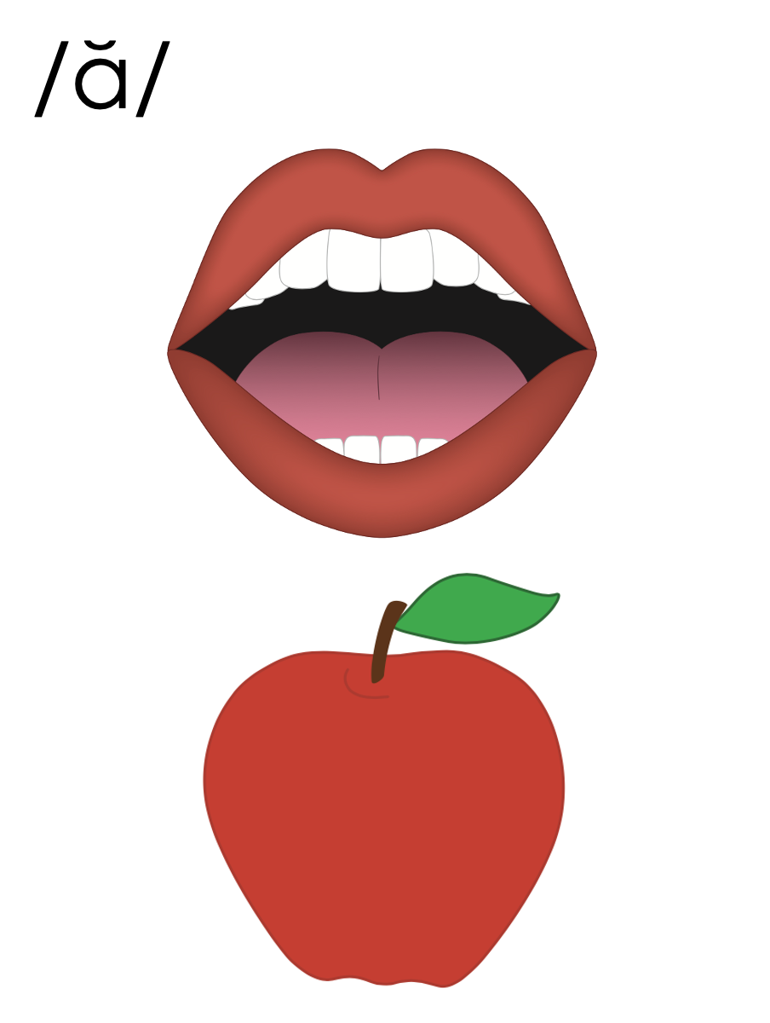
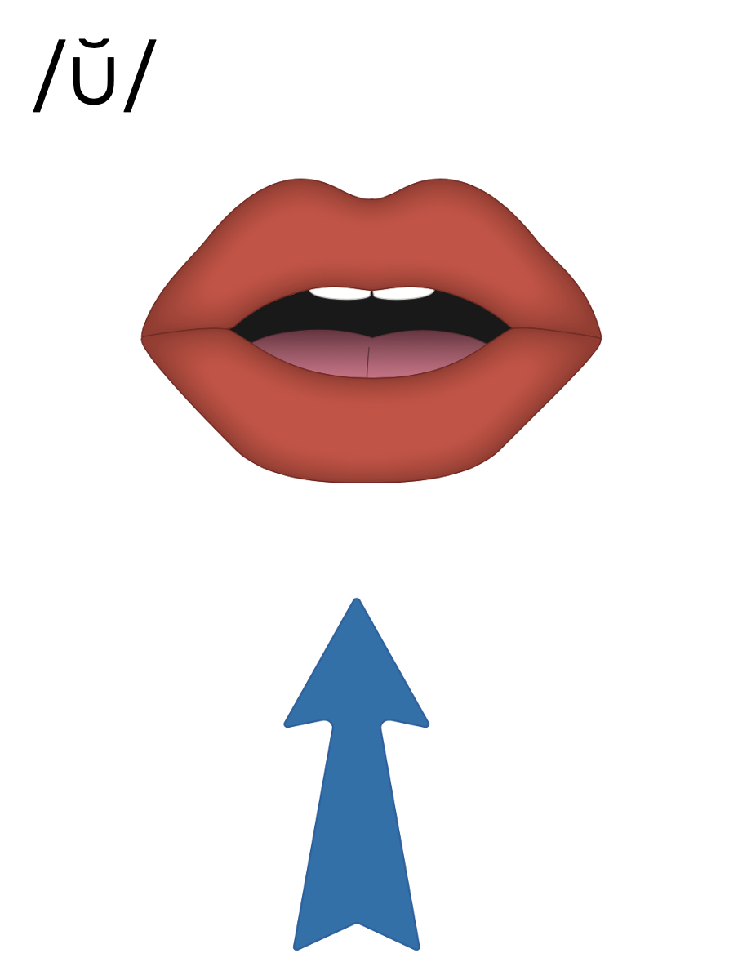
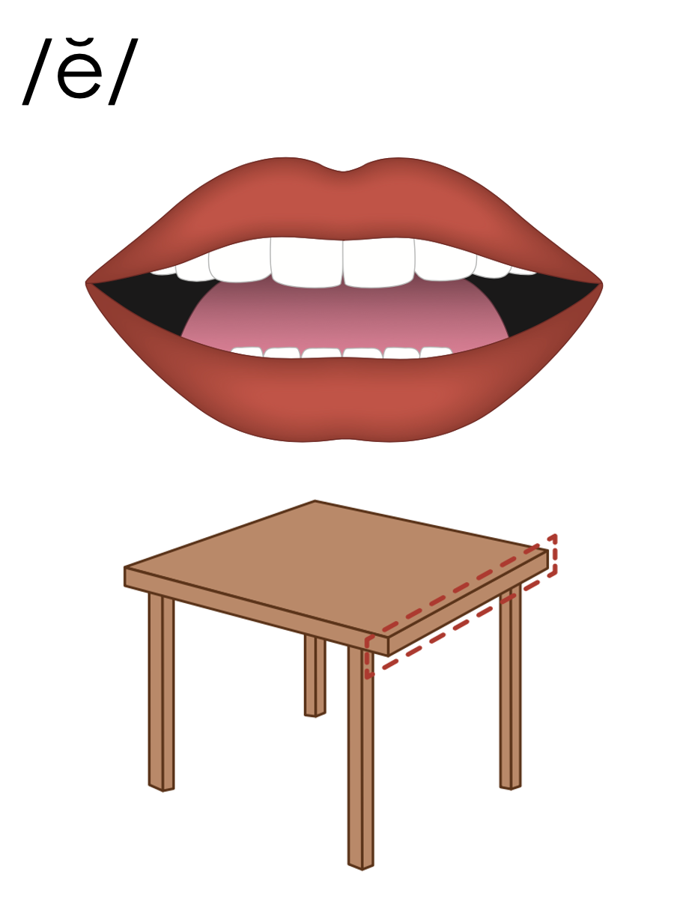

Slide 41
r u s t

Slide 42
s e n d

Slide 43
a

Slide 44
clap
glad
a

Slide 45
ask
as
a

Slide 46
am
an
slam
land
clam

Slide 47
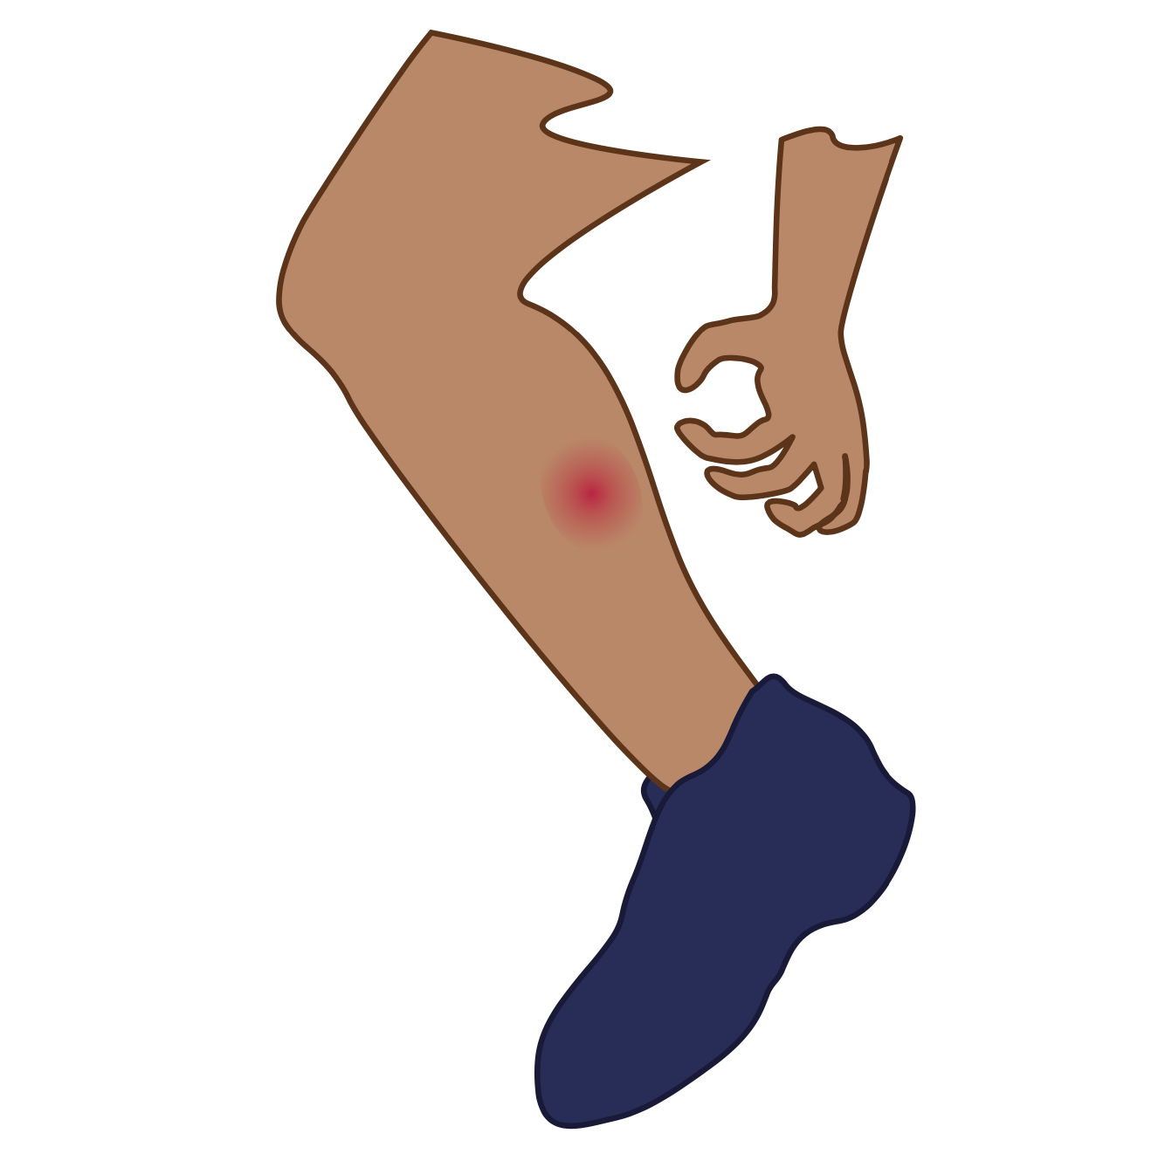
i

Slide 48
skip
grin
i

Slide 49
is
in
i

Slide 50
o

Slide 51
spot
drop
o

Slide 52
on
ox
o

Slide 53
u

Slide 54
snug
just
u

Slide 55
up
us
u

Slide 56
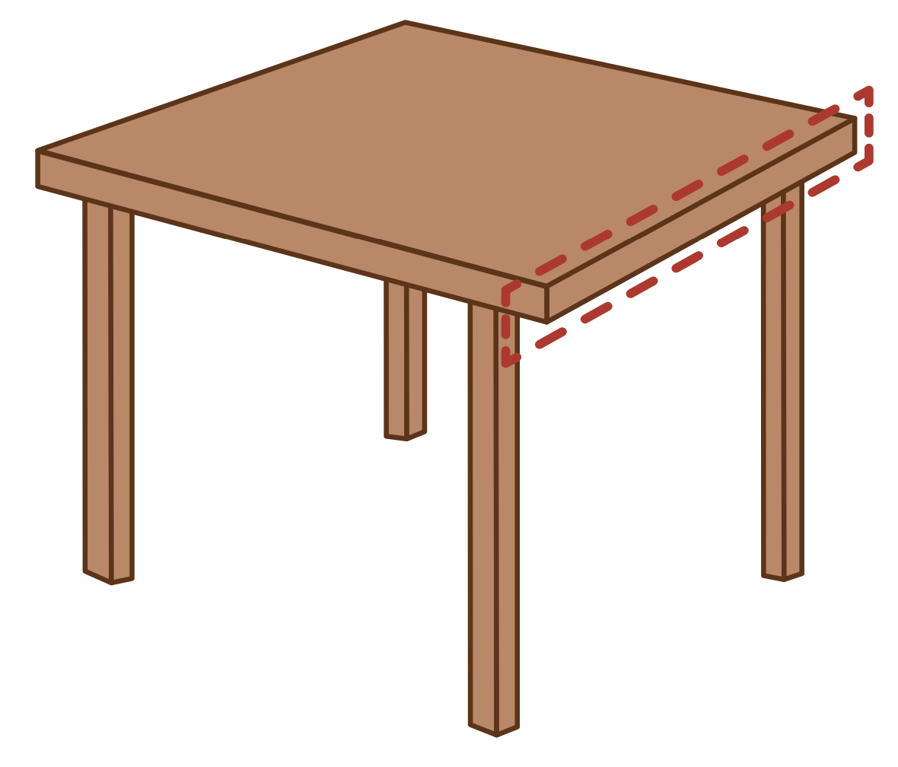
e

Slide 57
help
left
e

Slide 58
elf
end
e

Slide 59
a
i
o
u
e

Slide 60
Notes:
Handwriting paper for letter formation practice. Use as needed.
See UFLI Foundations manual for more information about letter formation.

Slide 61
must
bend

Slide 62
cats
last
hand
fits
lift
slip

Slide 63
lots
spot
drop
runs
jump
dust

Slide 64
end
best
step

Slide 65
Notes:
See UFLI Foundations lesson plan Step 5 for words to spell.
Handwriting paper to model spelling.

Slide 66
Notes:
See UFLI Foundations lesson plan Step 5 for words to spell.
Handwriting paper for guided spelling practice.

Slide 68
Insert brief reinforcement activity and/or transition to next part of reading block.

Slide 69
Lesson 41b
Short Vowels Advanced 1

Slide 71
New Concept Review
Notes:
See UFLI Foundations lesson plan Step 5 for recommended teacher language and activities to review the new concept.

Slide 73
r u s t

Slide 74
s e n d

Slide 75
a

Slide 76
clap
glad
a

Slide 77
ask
as
a

Slide 78
am
an
slam
land
clam

Slide 79
i

Slide 80
skip
grin
i

Slide 81
is
in
i

Slide 82
o

Slide 83
spot
drop
o

Slide 84
on
ox
o

Slide 85
u

Slide 86
snug
just
u

Slide 87
up
us
u

Slide 88
e

Slide 89
help
left
e

Slide 90
elf
end
e

Slide 91
a
i
o
u
e

Slide 92
ask
its
stop
just
end

Slide 94
Notes:
See UFLI Foundations lesson plan Step 6 for word work activity.
Visit ufliteracy.org to access the Word Work Mat apps.

Slide 96
Notes:
See UFLI Foundations lesson plan Step 7 for irregular word activities.
The white rectangle under each word may be used in editing mode. Cover the heart and square icons then reveal them one at a time during instruction.

Slide 97
Notes:
See UFLI Foundations manual for more information about reviewing irregular words.

Slide 98
the
Notes:
Lessons 1-45
The digraph TH has not been introduced yet.
E represents the /ŭ/ or /ə/ sound depending on stress.
The white rectangle under the word may be used in editing mode. Cover the heart and square icons then reveal them one at a time during instruction.

Slide 99
I
Notes:
Lessons 3-65
*Temporarily irregular
I /ī/ has not been introduced yet.
The white rectangle under the word may be used in editing mode. Cover the heart and square icons then reveal them one at a time during instruction.

Slide 100
a
Notes:
Lesson 7+
A as a word can be pronounced /ā/ or /ŭ/.
The white rectangle under the word may be used in editing mode. Cover the heart and square icons then reveal them one at a time during instruction.

Slide 101
said
Notes:
Lesson 13+
AI represents the /ĕ/ sound.
The white rectangle under the word may be used in editing mode. Cover the heart and square icons then reveal them one at a time during instruction.

Slide 102
to
Notes:
Lesson 15+
O represents the /ū/ sound.
The white rectangle under the word may be used in editing mode. Cover the heart and square icons then reveal them one at a time during instruction.

Slide 103
do
Notes:
Lesson 15+
O represents the /ū/ sound.
The white rectangle under the word may be used in editing mode. Cover the heart and square icons then reveal them one at a time during instruction.

Slide 104
of
Notes:
Lesson 17+
O represents the /ŭ/ sound.
F represents the /v/ sound.
The white rectangle under the word may be used in editing mode. Cover the heart and square icons then reveal them one at a time during instruction.

Slide 105
see
Notes:
Lessons 19-84
*Temporarily irregular
EE /ē/ has not been introduced yet.
The white rectangle under the word may be used in editing mode. Cover the heart and square icons then reveal them one at a time during instruction.

Slide 106
he
Notes:
Lessons 23-65
*Temporarily irregular
E /ē/ has not been introduced yet.
The white rectangle under the word may be used in editing mode. Cover the heart and square icons then reveal them one at a time during instruction.

Slide 107
be
Notes:
Lessons 23-65
*Temporarily irregular
E /ē/ has not been introduced yet.
The white rectangle under the word may be used in editing mode. Cover the heart and square icons then reveal them one at a time during instruction.

Slide 108
me
Notes:
Lessons 23-65
*Temporarily irregular
E /ē/ has not been introduced yet.
The white rectangle under the word may be used in editing mode. Cover the heart and square icons then reveal them one at a time during instruction.

Slide 109
from
Notes:
Lesson 25+
O represents the /ŭ/ sound.
The white rectangle under the word may be used in editing mode. Cover the heart and square icons then reveal them one at a time during instruction.

Slide 110
look
Notes:
Lessons 26-88
*Temporarily irregular
OO /oo/ has not been introduced yet.
The white rectangle under the word may be used in editing mode. Cover the heart and square icons then reveal them one at a time during instruction.

Slide 111
book
Notes:
Lessons 26-88
*Temporarily irregular
OO /oo/ has not been introduced yet.
The white rectangle under the word may be used in editing mode. Cover the heart and square icons then reveal them one at a time during instruction.

Slide 112
are
Notes:
Lessons 27-76
AR /ar/ has not been introduced yet.
The final E is silent but does not follow the long vowel VCe pattern.
The white rectangle under the word may be used in editing mode. Cover the heart and square icons then reveal them one at a time during instruction.

Slide 113
was
Notes:
Lesson 29+
A represents the /ŭ/ sound.​
S /z/ has already been introduced.
The white rectangle under the word may be used in editing mode. Cover the heart and square icons then reveal them one at a time during instruction.

Slide 114
you
Notes:
Lessons 31-114
*Temporarily irregular
OU /ū/ has not been introduced yet.
The white rectangle under the word may be used in editing mode. Cover the heart and square icons then reveal them one at a time during instruction.

Slide 115
what
Notes:
Lessons 33-49
WH /w/ has not been introduced yet.
A represents the /ŭ/ sound or the /ŏ/ sound, depending on dialect.
The white rectangle under the word may be used in editing mode. Cover the heart and square icons then reveal them one at a time during instruction.

Slide 116
have
Notes:
Lessons 33-61
*Temporarily irregular
The final E is silent but does not follow the long vowel VCe pattern.
The silent E is there because English words can not end with the letter V.
The white rectangle under the word may be used in editing mode. Cover the heart and square icons then reveal them one at a time during instruction.

Slide 117
Notes:
Handwriting paper for irregular word spelling practice. Use as needed.
See UFLI Foundations manual for more information about reviewing irregular words.

Slide 119
Notes:
See UFLI Foundations lesson plan Step 8 for connected text activities.

Slide 120
Tom said he can do a flip!

Slide 121
You have the best spot to rest.

Slide 122
What did mom and dad send you?

Slide 123
Notes:
See UFLI Foundations lesson plan Step 8 for sentences to write.

Slide 124
Notes:
The UFLI Foundations decodable text is provided here. See UFLI Foundations decodable text guide for additional text options.

Slide 125
The Frog and the Slug
Glen is a frog with black spots.
Glen is in the pond.
The pond has pads.
Glen can jump from pad to pad.

Slide 126
He can flip and flop on the pads in the pond.
Glen sees a slug in the pond.
The slug is on a pad.
“Do you have legs to jump?” Glen asks the slug.

Slide 127
“I do not have legs. I can not jump.” said the slug.
Glen lets the slug get on his back.
Look! Glen and the slug can jump from pad to pad!

Slide 129
Insert brief reinforcement activity and/or transition to next part of reading block.

