Slide 1
Lesson 40b
Short E Advanced

Slide 2
Notes:
ufliteracy.org

Slide 4
Lesson 40b
Short E Advanced

Slide 6
Notes:
See UFLI Foundations lesson plan Step 1 for phonemic awareness activity.

Slide 8
Notes:
See UFLI Foundations lesson plan Step 2 for student phoneme responses.

Slide 9
u

Slide 10
o

Slide 11
i

Slide 12
a

Slide 13
m

Slide 14
s

Slide 15
t

Slide 16
p

Slide 17
f

Slide 18
n

Slide 19
d

Slide 20
c

Slide 21
g

Slide 22
b

Slide 23
k

Slide 24
h

Slide 25
r

Slide 26
l

Slide 27
w

Slide 28
j

Slide 29
y

Slide 30
x

Slide 31
qu

Slide 32
v

Slide 33
z

Slide 35
Notes:
See UFLI Foundations lesson plan Step 3 for auditory drill activity.

Slide 36
Notes:
No slides needed for auditory drill.

Slide 38
Notes:
See UFLI Foundations lesson plan Step 4 for blending drill word chain and grid.
Visit ufliteracy.org to access the Blending Board app.

Slide 40
Notes:
See UFLI Foundations lesson plan Step 5 for recommended teacher language and activities to introduce the new concept.

Slide 41
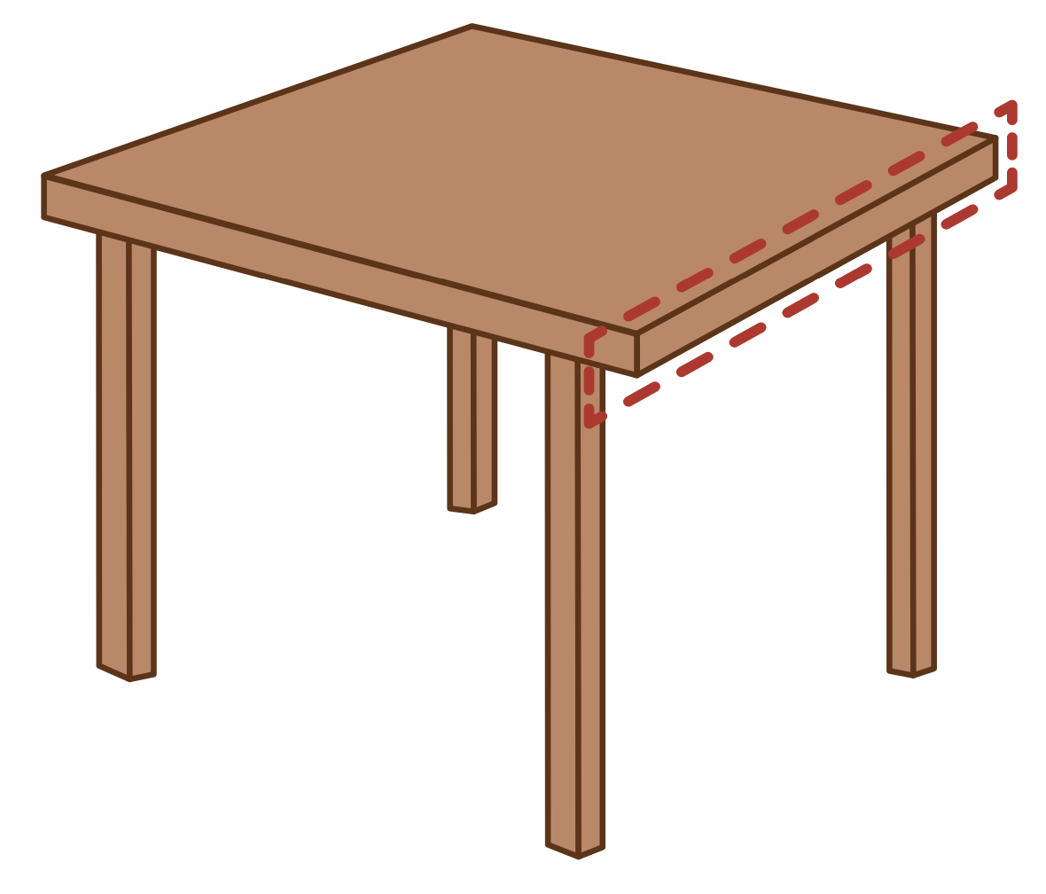
e

Slide 42
men
get
e

Slide 43
elf
end
e

Slide 44
p e t s

Slide 45
s e n d

Slide 46
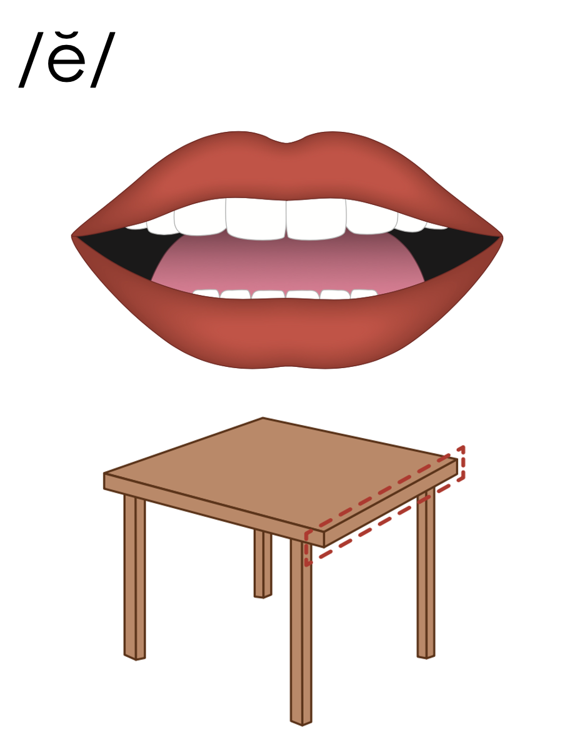
e

Slide 47
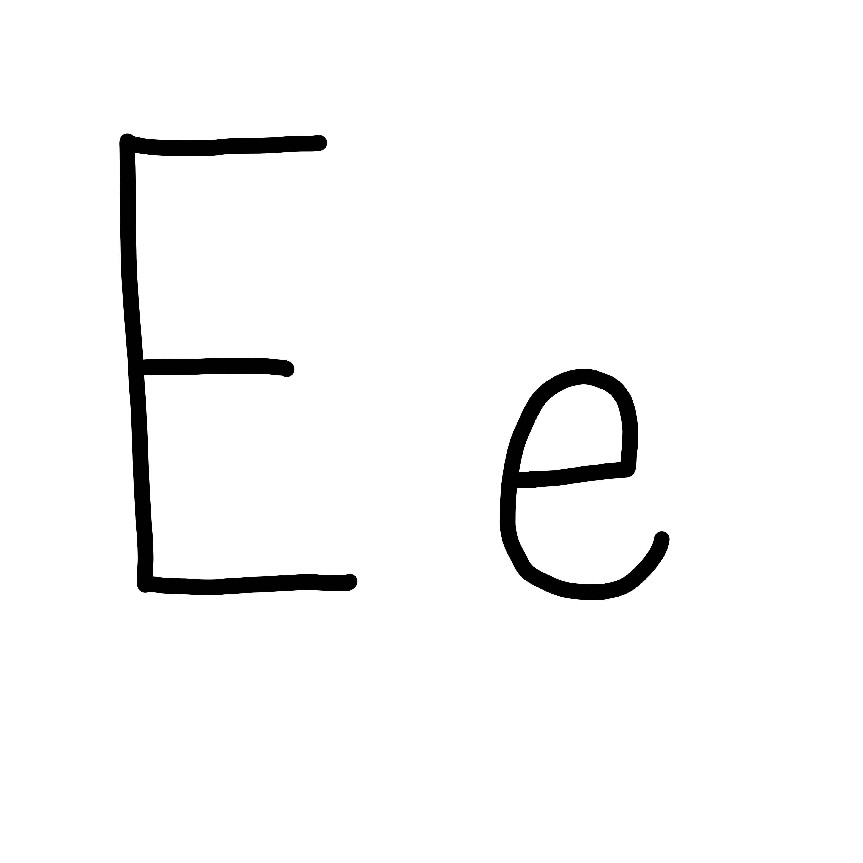

Slide 49
Notes:
Lowercase e gif

Slide 50
let
west

Slide 51
set
men
yes
end
gets
help

Slide 52
rest
left
next
went
sled
step

Slide 53
Notes:
See UFLI Foundations lesson plan Step 5 for words to spell.
Handwriting paper to model spelling.

Slide 54
Notes:
See UFLI Foundations lesson plan Step 5 for words to spell.
Handwriting paper for guided spelling practice.

Slide 56
Insert brief reinforcement activity and/or transition to next part of reading block.

Slide 57
Lesson 40b
Short E Advanced

Slide 59
New Concept Review
Notes:
See UFLI Foundations lesson plan Step 5 for recommended teacher language and activities to review the new concept.

Slide 60
e

Slide 61
men
get
e

Slide 62
elf
end
e

Slide 63
p e t s

Slide 64
s e n d

Slide 65
e

Slide 66
Notes:
Lowercase e gif

Slide 67
end
best
next
went

Slide 69
Notes:
See UFLI Foundations lesson plan Step 6 for word work activity.
Visit ufliteracy.org to access the Word Work Mat apps.

Slide 71
Notes:
See UFLI Foundations lesson plan Step 7 for irregular word activities.
The white rectangle under each word may be used in editing mode. Cover the heart and square icons then reveal them one at a time during instruction.

Slide 72
Notes:
See UFLI Foundations manual for more information about reviewing irregular words.

Slide 73
you
Notes:
Lessons 31-114
*Temporarily irregular
OU /ū/ has not been introduced yet.
The white rectangle under the word may be used in editing mode. Cover the heart and square icons then reveal them one at a time during instruction.

Slide 74
what
Notes:
Lessons 33-49
WH /w/ has not been introduced yet.
A represents the /ŭ/ sound or the /ŏ/ sound, depending on dialect.
The white rectangle under the word may be used in editing mode. Cover the heart and square icons then reveal them one at a time during instruction.

Slide 75
have
Notes:
Lessons 33-61
*Temporarily irregular
The final E is silent but does not follow the long vowel VCe pattern.
The silent E is there because English words can not end with the letter V.
The white rectangle under the word may be used in editing mode. Cover the heart and square icons then reveal them one at a time during instruction.

Slide 76
Notes:
Handwriting paper for irregular word spelling practice. Use as needed.
See UFLI Foundations manual for more information about reviewing irregular words.

Slide 78
Notes:
See UFLI Foundations lesson plan Step 8 for connected text activities.

Slide 79
I have to be at the end.

Slide 80
What did you send to Ben?

Slide 81
Did you get a text from Jen?

Slide 82
Notes:
See UFLI Foundations lesson plan Step 8 for sentences to write.

Slide 83
Notes:
The UFLI Foundations decodable text is provided here. See UFLI Foundations decodable text guide for additional text options.

Slide 84
Fred and the Tent
Fred is at camp.
He must set up his tent.
Oh no! The tent has a rip in it.
Fred must mend the tent.

Slide 85
What can help Fred mend the tent?
A kit can help him mend the tent.
Fred mends and tests the tent.
It is set up!

Slide 87
Insert brief reinforcement activity and/or transition to next part of reading block.

