Slide 1
Lesson 40a
Short E Review

Slide 2
Notes:
ufliteracy.org

Slide 4
Lesson 40a
Short E Review

Slide 6
Notes:
See UFLI Foundations lesson plan Step 1 for phonemic awareness activity.

Slide 8
Notes:
See UFLI Foundations lesson plan Step 2 for student phoneme responses.

Slide 9
u

Slide 10
o

Slide 11
i

Slide 12
a

Slide 13
m

Slide 14
s

Slide 15
t

Slide 16
p

Slide 17
f

Slide 18
n

Slide 19
d

Slide 20
c

Slide 21
g

Slide 22
b

Slide 23
k

Slide 24
h

Slide 25
r

Slide 26
l

Slide 27
w

Slide 28
j

Slide 29
y

Slide 30
x

Slide 31
qu

Slide 32
v

Slide 33
z

Slide 35
Notes:
See UFLI Foundations lesson plan Step 3 for auditory drill activity.

Slide 36
Notes:
No slides needed for auditory drill.

Slide 38
Notes:
See UFLI Foundations lesson plan Step 4 for blending drill word chain and grid.
Visit ufliteracy.org to access the Blending Board app.

Slide 40
Notes:
See UFLI Foundations lesson plan Step 5 for recommended teacher language and activities to introduce the new concept.

Slide 41
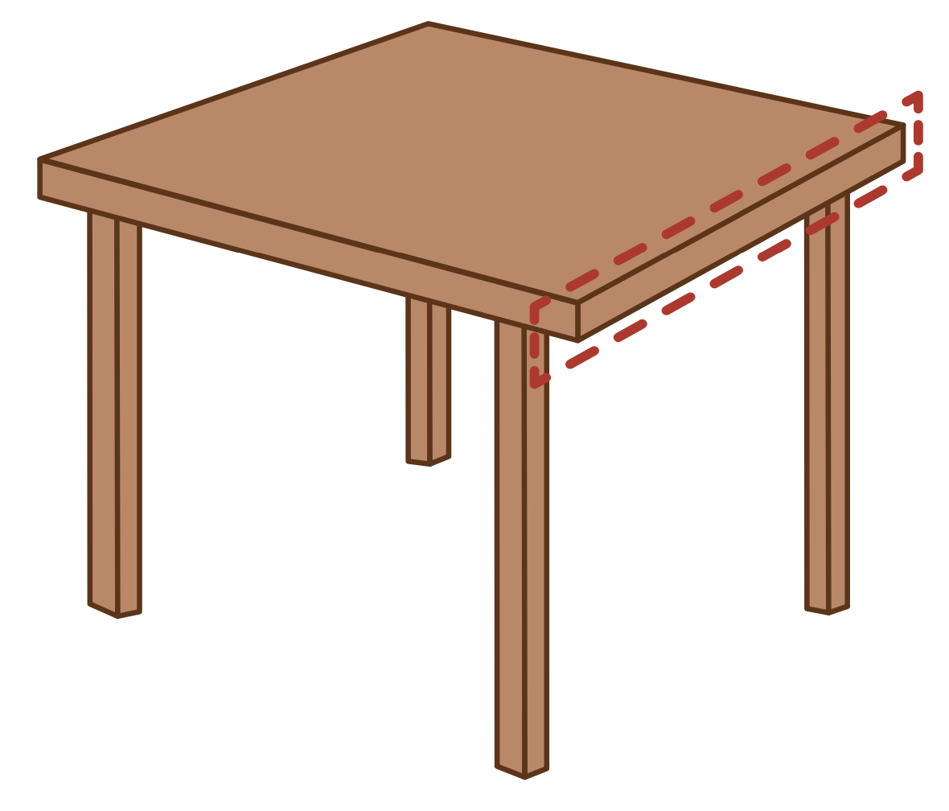
e

Slide 42
men
get
e

Slide 43
elf
end
e

Slide 44
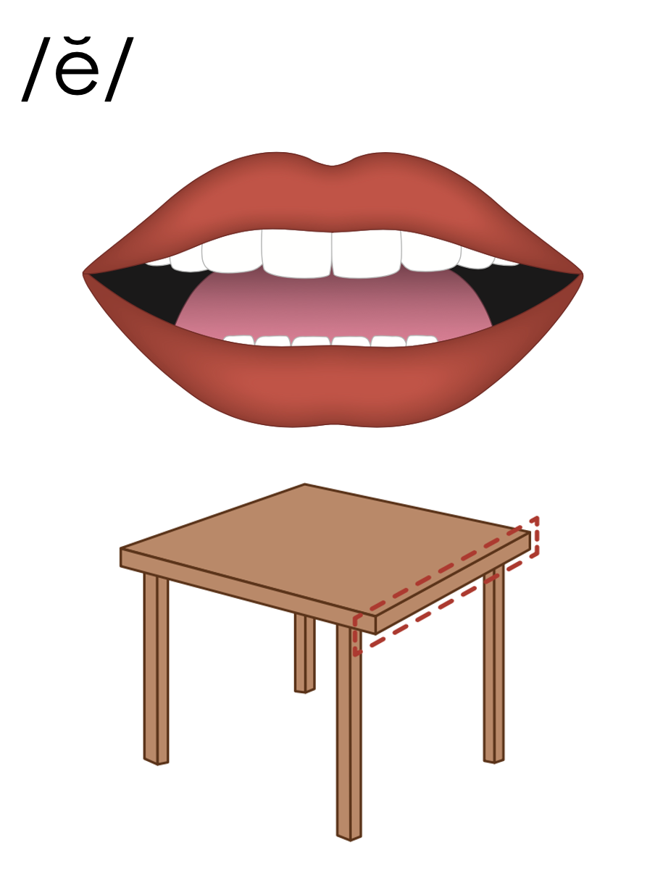
e

Slide 45
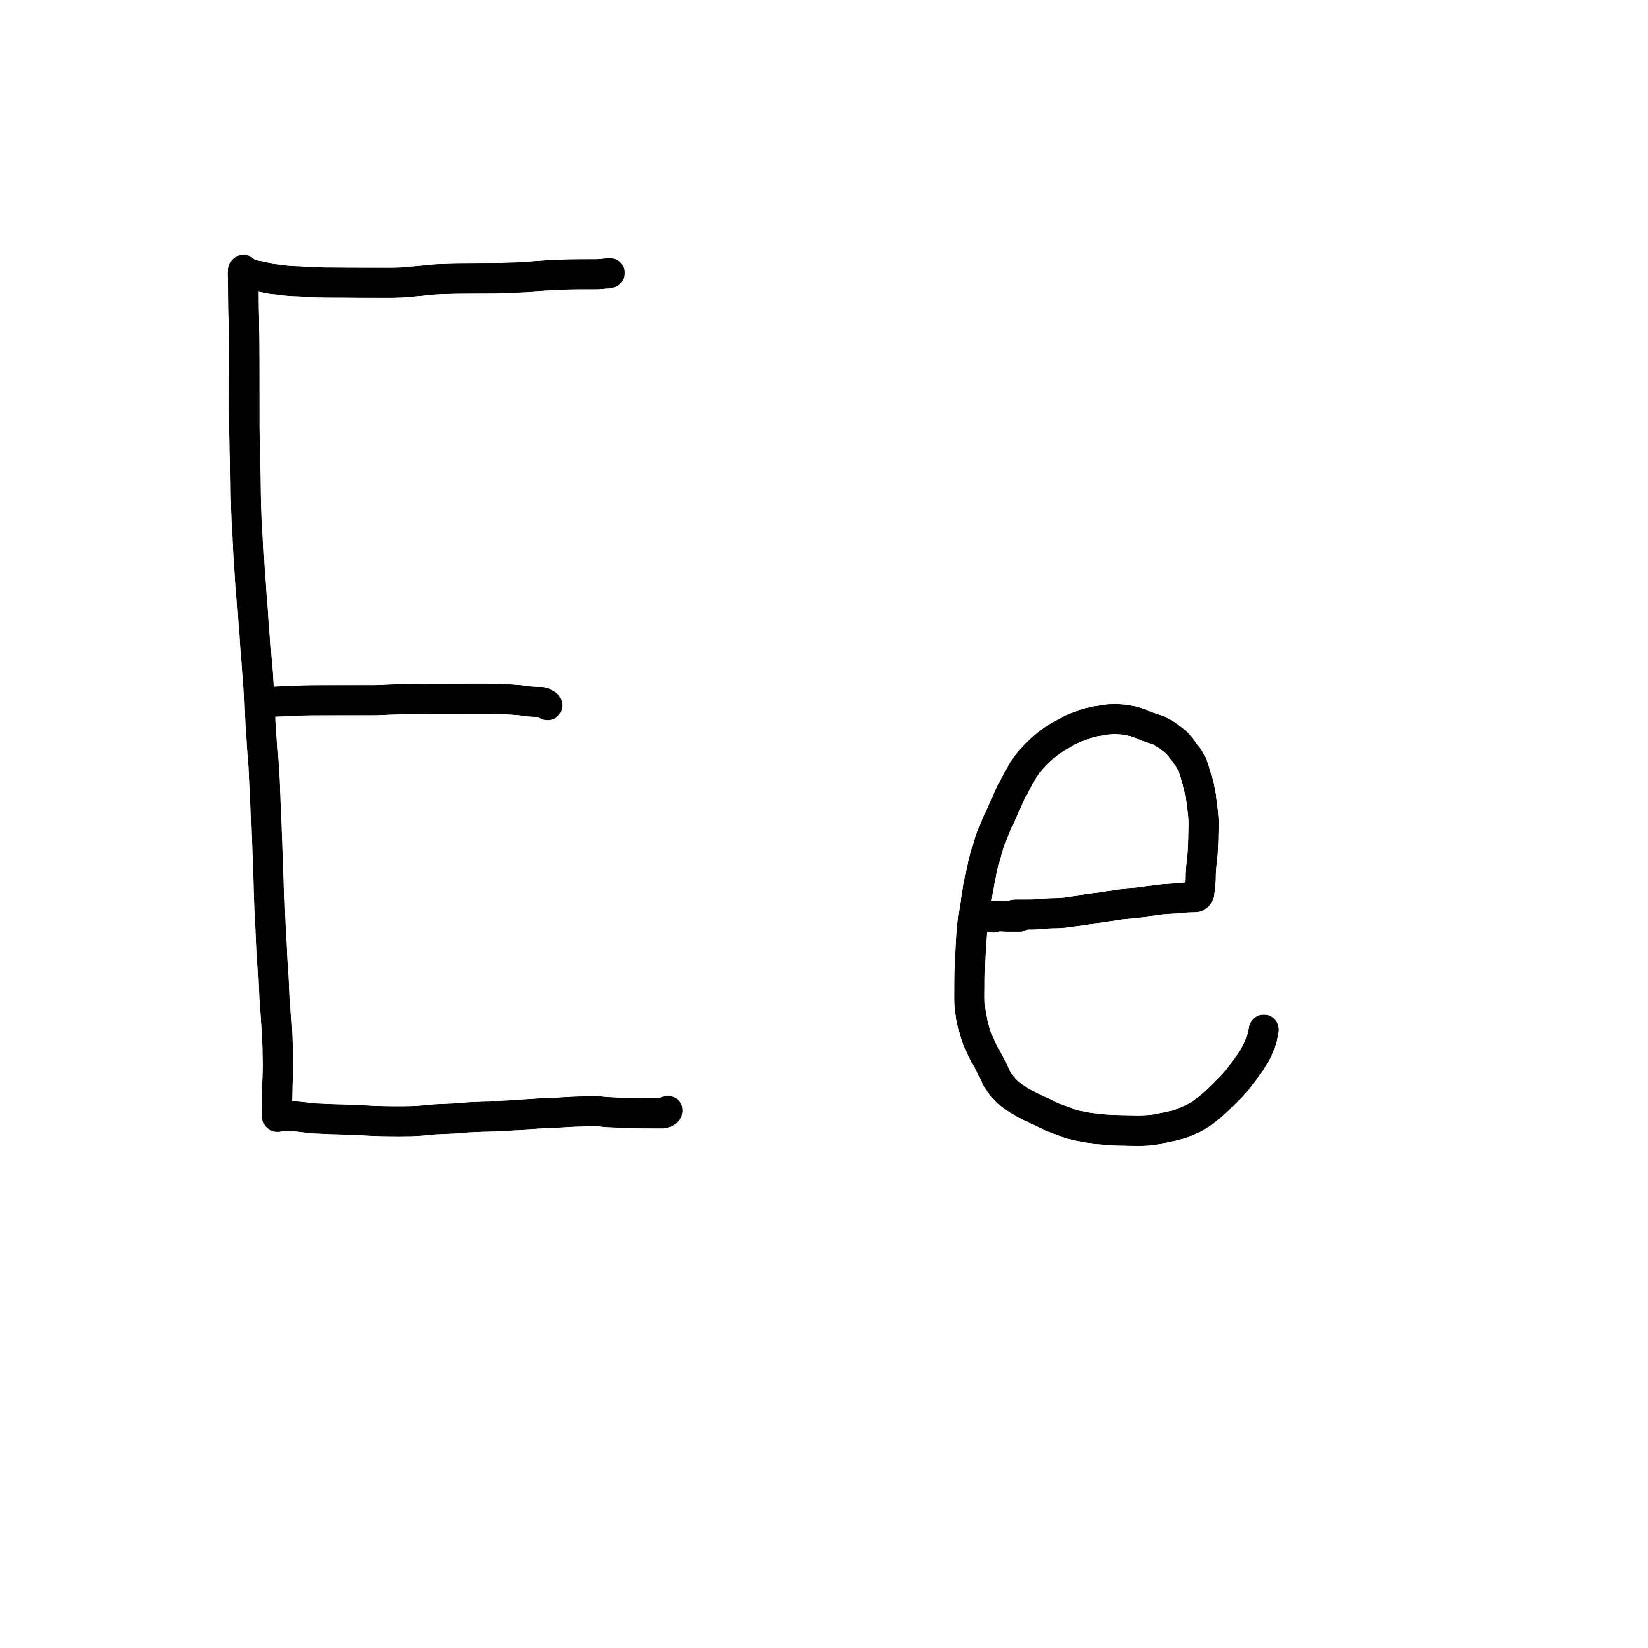

Slide 46
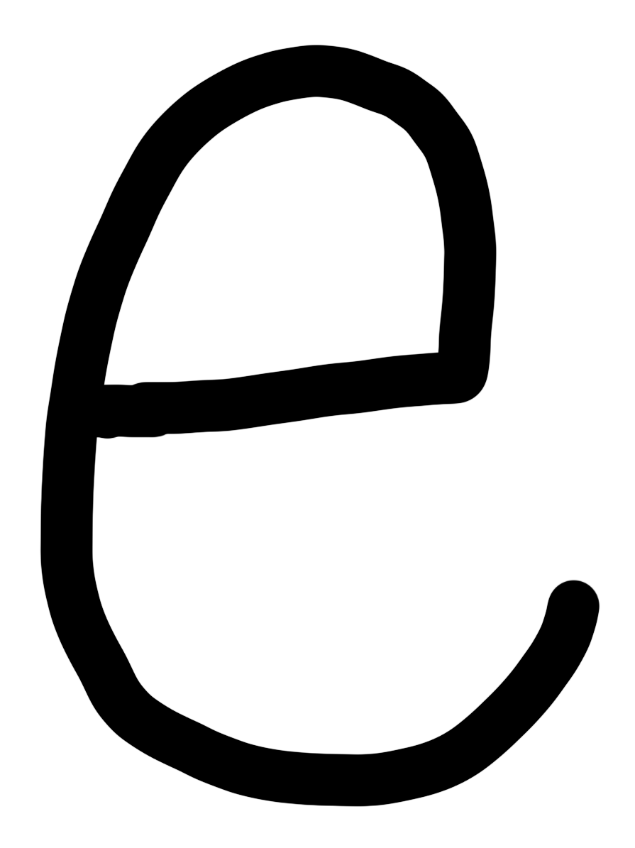

Slide 47
Notes:
Lowercase e gif

Slide 48
hen

Slide 49
let
yes
set
get
ten
pet

Slide 50
red
bed
men

Slide 51
Notes:
See UFLI Foundations lesson plan Step 5 for words to spell.
Handwriting paper to model spelling.

Slide 52
Notes:
See UFLI Foundations lesson plan Step 5 for words to spell.
Handwriting paper for guided spelling practice.

Slide 54
Insert brief reinforcement activity and/or transition to next part of reading block.

Slide 55
Lesson 40a
Short E Review

Slide 57
New Concept Review
Notes:
See UFLI Foundations lesson plan Step 5 for recommended teacher language and activities to review the new concept.

Slide 58
e

Slide 59
men
get
e

Slide 60
elf
end
e

Slide 61
e

Slide 62
Notes:
Lowercase e gif

Slide 63
ten
red
let
yes

Slide 65
Notes:
See UFLI Foundations lesson plan Step 6 for word work activity.
Visit ufliteracy.org to access the Word Work Mat apps.

Slide 67
Notes:
See UFLI Foundations lesson plan Step 7 for irregular word activities.
The white rectangle under each word may be used in editing mode. Cover the heart and square icons then reveal them one at a time during instruction.

Slide 68
Notes:
See UFLI Foundations manual for more information about reviewing irregular words.

Slide 69
you
Notes:
Lessons 31-114
*Temporarily irregular
OU /ū/ has not been introduced yet.
The white rectangle under the word may be used in editing mode. Cover the heart and square icons then reveal them one at a time during instruction.

Slide 70
what
Notes:
Lessons 33-49
WH /w/ has not been introduced yet.
A represents the /ŭ/ sound or the /ŏ/ sound, depending on dialect.
The white rectangle under the word may be used in editing mode. Cover the heart and square icons then reveal them one at a time during instruction.

Slide 71
have
Notes:
Lessons 33-61
*Temporarily irregular
The final E is silent but does not follow the long vowel VCe pattern.
The silent E is there because English words can not end with the letter V.
The white rectangle under the word may be used in editing mode. Cover the heart and square icons then reveal them one at a time during instruction.

Slide 72
Notes:
Handwriting paper for irregular word spelling practice. Use as needed.
See UFLI Foundations manual for more information about reviewing irregular words.

Slide 74
Notes:
See UFLI Foundations lesson plan Step 8 for connected text activities.

Slide 75
I do not have pets.

Slide 76
Have you fed the hen?

Slide 77
What do you see on the jet?

Slide 78
Notes:
See UFLI Foundations lesson plan Step 8 for sentences to write.

Slide 79
Notes:
The UFLI Foundations decodable text is provided here. See UFLI Foundations decodable text guide for additional text options.

Slide 80
The Pet Hen
Dex has a pet hen.
The hen is big and red.
Dex let his hen run.
But the hen ran into a pig pen.

Slide 81
The hen has a big welt.
Dex must tend to his red hen.
He gets the hen in its bed.
“You must rest,” Dex said.

Slide 83
Insert brief reinforcement activity and/or transition to next part of reading block.

