Slide 1
Lesson 88
Vowel Teams Review 1

Slide 2
Notes:
ufliteracy.org

Slide 4
Lesson 88
Vowel Teams Review 1

Slide 6
Notes:
See UFLI Foundations lesson plan Step 1 for phonemic awareness activity.

Slide 8
Notes:
See UFLI Foundations lesson plan Step 2 for student phoneme responses.

Slide 9
ie

Slide 10
igh

Slide 11
oa

Slide 12
ow

Slide 13
oe

Slide 14
ee

Slide 15
ea

Slide 16
ey

Slide 17
ai

Slide 18
ay

Slide 19
ir

Slide 20
ur

Slide 21
er

Slide 22
or

Slide 23
ore

Slide 24
ar

Slide 25
y

Slide 26
dge

Slide 27
g

Slide 28
tch

Slide 30
Notes:
See UFLI Foundations lesson plan Step 3 for auditory drill activity.

Slide 31
Notes:
No slides needed for auditory drill.

Slide 33
Notes:
See UFLI Foundations lesson plan Step 4 for blending drill word chain and grid.
Visit ufliteracy.org to access the Blending Board app.

Slide 35
Notes:
See UFLI Foundations lesson plan Step 5 for recommended teacher language and activities to introduce the new concept.

Slide 36
Vowel Team
2 or more letters that work together to make 1 sound.

Slide 37
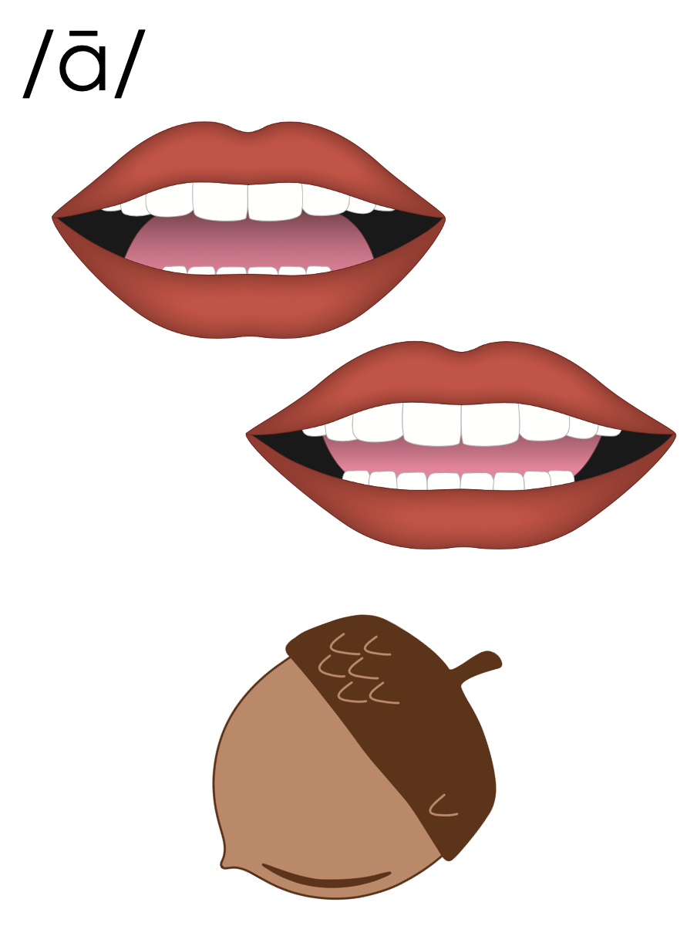
a_e
a
ai
ay

Slide 38
bait
mail
ai

Slide 39
aim
aid
ai

Slide 40
may
say
ay

Slide 41
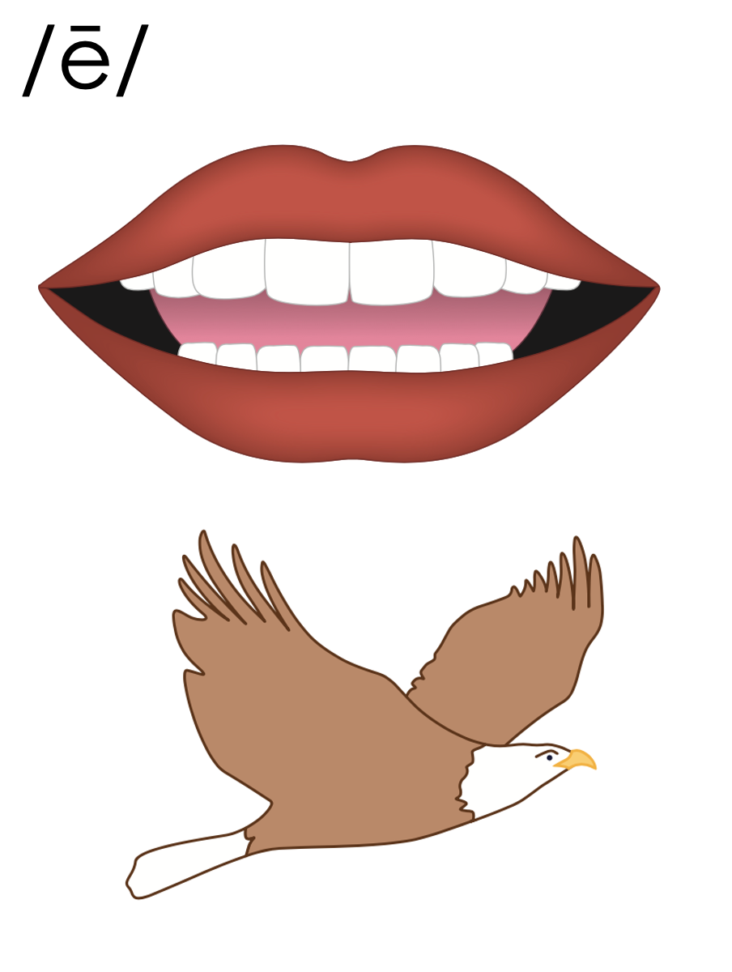
e_e
e
y
ee
ea
ey

Slide 42
need
feet
ee

Slide 43
see
tree
ee

Slide 44
mean
team
ea

Slide 45
eat
each
ea

Slide 46
tea
flea
ea

Slide 47
kidney
turkey
ey
1st syllable
2nd syllable

Slide 48
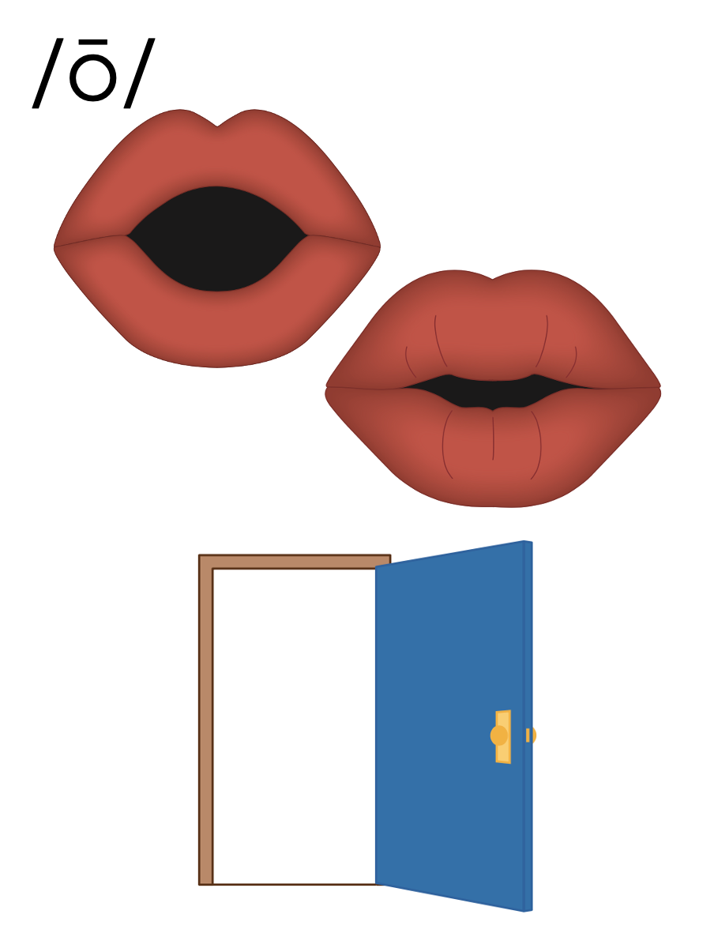
o_e
o
oa
ow
oe

Slide 49
boat
road
oa

Slide 50
oat
oak
oa

Slide 51
show
grow
ow

Slide 52
bowl
flown
ow

Slide 53
toe
oe

Slide 54
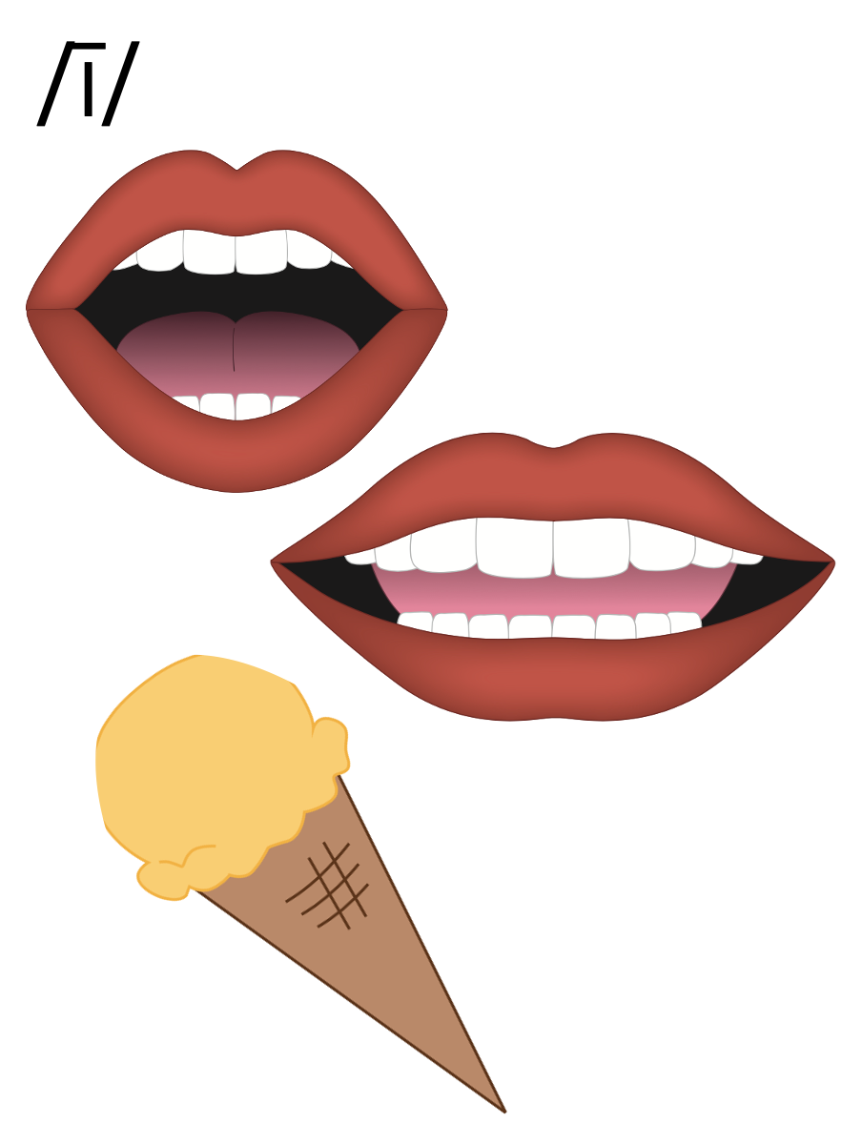
i_e
i
y
ie
igh

Slide 55
pie
tie
ie

Slide 56
light
might
igh

Slide 57
high
sigh
igh

Slide 58
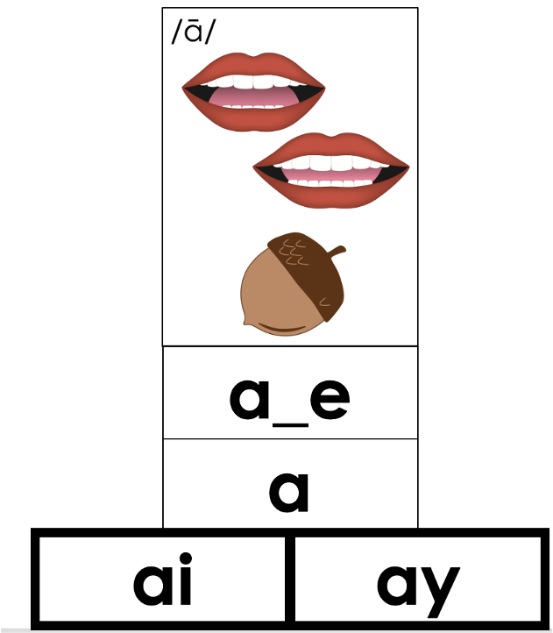
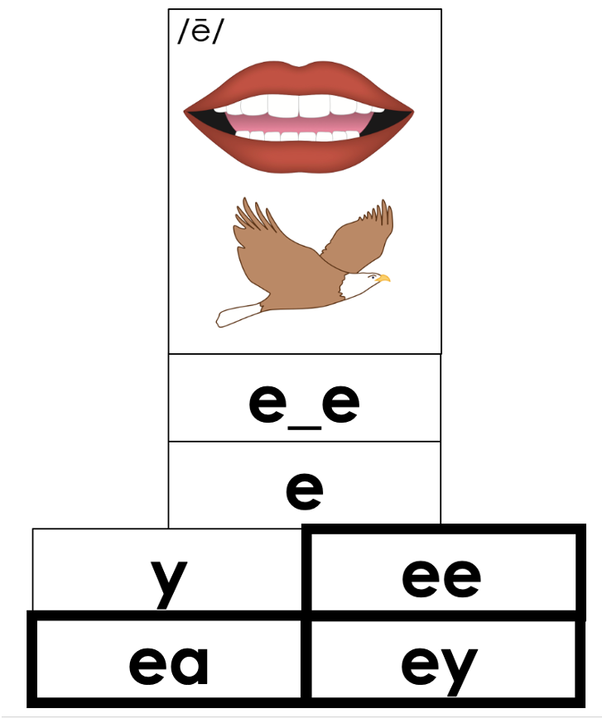
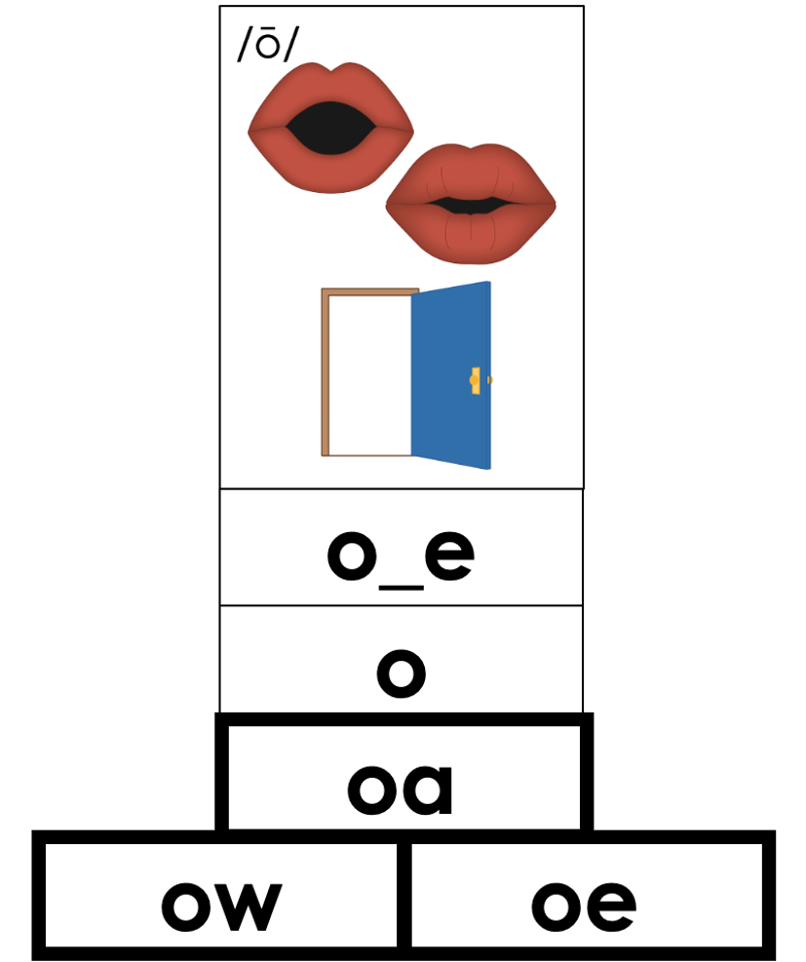
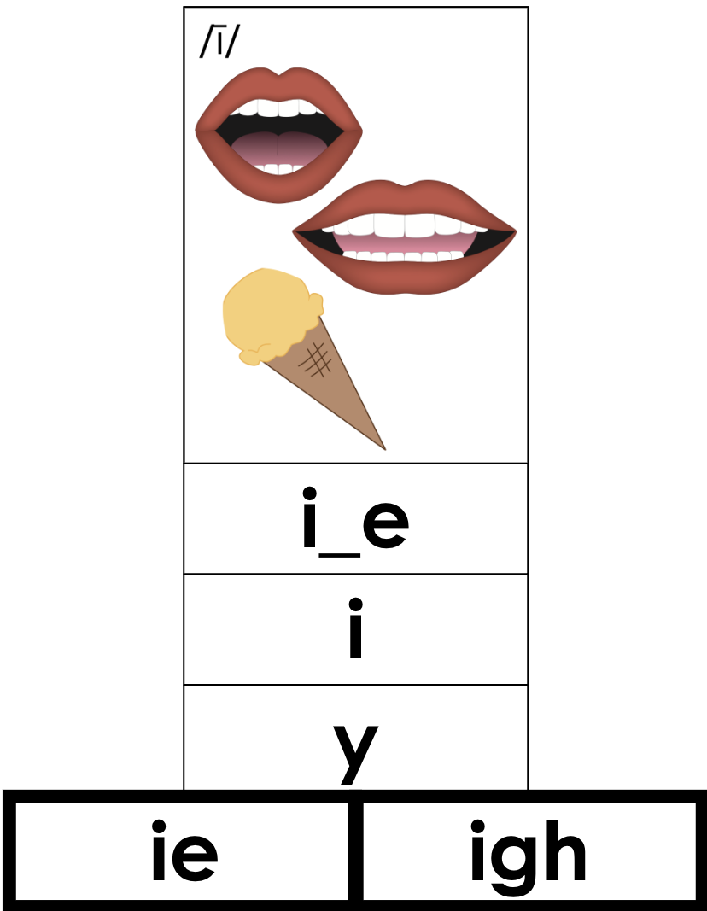

Slide 59
Notes:
Handwriting paper for letter formation practice. Use as needed.
See UFLI Foundations manual for more information about letter formation.

Slide 60
stray
oatmeal

Slide 61
way
day
gain
greet
scream
float

Slide 62
boast
show
night
fright
follow
untie

Slide 63
between
below
daylight
railroad
highway
jersey

Slide 64
raincoat

Slide 65
Notes:
See UFLI Foundations lesson plan Step 5 for words to spell.
Handwriting paper to model spelling.

Slide 66
Notes:
See UFLI Foundations lesson plan Step 5 for words to spell.
Handwriting paper for guided spelling practice.

Slide 68
Insert brief reinforcement activity and/or transition to next part of reading block.

Slide 69
Lesson 88
Vowel Teams Review 1

Slide 71
New Concept Review
Notes:
See UFLI Foundations lesson plan Step 5 for recommended teacher language and activities to review the new concept.

Slide 72
Vowel Team
2 or more letters that work together to make 1 sound.

Slide 73
a_e
a
ai
ay

Slide 74
bait
mail
ai

Slide 75
aim
aid
ai

Slide 76
may
say
ay

Slide 77
e_e
e
y
ee
ea
ey

Slide 78
need
feet
ee

Slide 79
see
tree
ee

Slide 80
mean
team
ea

Slide 81
eat
each
ea

Slide 82
tea
flea
ea

Slide 83
kidney
turkey
ey
1st syllable
2nd syllable

Slide 84
o_e
o
oa
ow
oe

Slide 85
boat
road
oa

Slide 86
oat
oak
oa

Slide 87
show
grow
ow

Slide 88
bowl
flown
ow

Slide 89
toe
oe

Slide 90
i_e
i
y
ie
igh

Slide 91
pie
tie
ie

Slide 92
light
might
igh

Slide 93
high
sigh
igh

Slide 95
play
read
feet
right
below

Slide 97
Notes:
See UFLI Foundations lesson plan Step 6 for word work activity.
Visit ufliteracy.org to access the Word Work Mat apps.

Slide 99
Notes:
See UFLI Foundations lesson plan Step 7 for irregular word activities.
The white rectangle under each word may be used in editing mode. Cover the heart and square icons then reveal them one at a time during instruction.

Slide 100
Notes:
See UFLI Foundations manual for more information about reviewing irregular words.

Slide 101
today
Notes:
Lesson 84+
O represents the /ū/ sound or the /ə/ sound depending on stress and dialect.
The white rectangle under the word may be used in editing mode. Cover the heart and square icons then reveal them one at a time during instruction.

Slide 102
above
Notes:
Lesson 85+
A represents the /ə/ or the /ŭ/ sound, depending on stress.
O represents the /ŭ/ sound.
The final E is silent but does not follow the long vowel VCe pattern. In this case, the silent E is there because English words do not end in V.
The white rectangle under the word may be used in editing mode. Cover the heart and square icons then reveal them one at a time during instruction.

Slide 103
among
Notes:
Lesson 85+
A represents the /ə/ or the /ŭ/ sound, depending on stress.
O represents the /ŭ/ sound.
The white rectangle under the word may be used in editing mode. Cover the heart and square icons then reveal them one at a time during instruction.

Slide 104
again
Notes:
Lesson 86+
The first A represents the /ə/ or the /ŭ/ sound, depending on stress.
AI represents the /ĕ/ or /ĭ/ sound, depending on dialect.
In some dialects, the AI in again is pronounced /ā/. In this case, this part of the word would not be irregular.
The white rectangle under the word may be used in editing mode. Cover the heart and square icons then reveal them one at a time during instruction.

Slide 105
against
Notes:
Lesson 86+
The first A represents the /ə/ or the /ŭ/ sound, depending on stress.
AI represents the /ĕ/ or /ĭ/ sound, depending on dialect.
In some dialects, the AI in against is pronounced /ā/. In this case, this part of the word would not be irregular.
The white rectangle under the word may be used in editing mode. Cover the heart and square icons then reveal them one at a time during instruction.

Slide 106
always
Notes:
Lesson 87+
The first A represents the /ŏ/ or /aw/ sound.
The white rectangle under the word may be used in editing mode. Cover the heart and square icons then reveal them one at a time during instruction.

Slide 107
almost
Notes:
Lesson 87+
A represents the /ŏ/ or /aw/ sound.
The white rectangle under the word may be used in editing mode. Cover the heart and square icons then reveal them one at a time during instruction.

Slide 108
Notes:
Handwriting paper for irregular word spelling practice. Use as needed.
See UFLI Foundations manual for more information about reviewing irregular words.

Slide 110
Notes:
See UFLI Foundations lesson plan Step 8 for connected text activities.

Slide 111
It is very bright on the road today.

Slide 112
The team almost scored one more goal!

Slide 113
I always use soap when I take a bath at night.

Slide 114
Notes:
See UFLI Foundations lesson plan Step 8 for sentences to write.

Slide 115
Notes:
The UFLI Foundations decodable text is provided here. See UFLI Foundations decodable text guide for additional text options.

Slide 116
Aiden’s Goal
Aiden had to find a way to make money. He needed to save up for his dream car. He wanted to get a jeep, but jeeps are not cheap. He needed to find a job that paid very well, so he could own his dream car. What could he do?

Slide 117
Aiden went to his father for advice. His father said he should study. “How will studying get me my dream car?” Aiden asked. His father explained that he could study a trade like welding or carpentry. He could also take more classes to get a degree.

Slide 118
People who had a trade or a degree could make a lot of money. Aiden needed to think over what his father had told him. It would take longer to study, but in the end, Aiden would be able to get his dream car and more.

Slide 119
After days of thinking, Aiden chose to take more classes. This would help him reach this goal and his next one, whatever that might be. Aiden’s father was almost always right.

Slide 121
Insert brief reinforcement activity and/or transition to next part of reading block.

