Slide 1
Lesson 28
w /w/

Slide 2
Notes:
ufliteracy.org

Slide 4
Lesson 28
w /w/

Slide 6
Notes:
See UFLI Foundations lesson plan Step 1 for phonemic awareness activity.

Slide 8
Notes:
See UFLI Foundations lesson plan Step 2 for student phoneme responses.

Slide 9
l

Slide 10
r

Slide 11
h

Slide 12
k

Slide 13
s

Slide 14
e

Slide 15
b

Slide 16
g

Slide 17
u

Slide 18
c

Slide 19
d

Slide 20
o

Slide 21
n

Slide 22
i

Slide 23
f

Slide 24
p

Slide 25
t

Slide 26
m

Slide 27
a

Slide 29
Notes:
See UFLI Foundations lesson plan Step 3 for auditory drill activity.

Slide 30
Notes:
No slides needed for auditory drill.

Slide 32
Notes:
See UFLI Foundations lesson plan Step 4 for blending drill word chain and grid.
Visit ufliteracy.org to access the Blending Board app.

Slide 34
Notes:
See UFLI Foundations lesson plan Step 5 for recommended teacher language and activities to introduce the new concept.

Slide 35
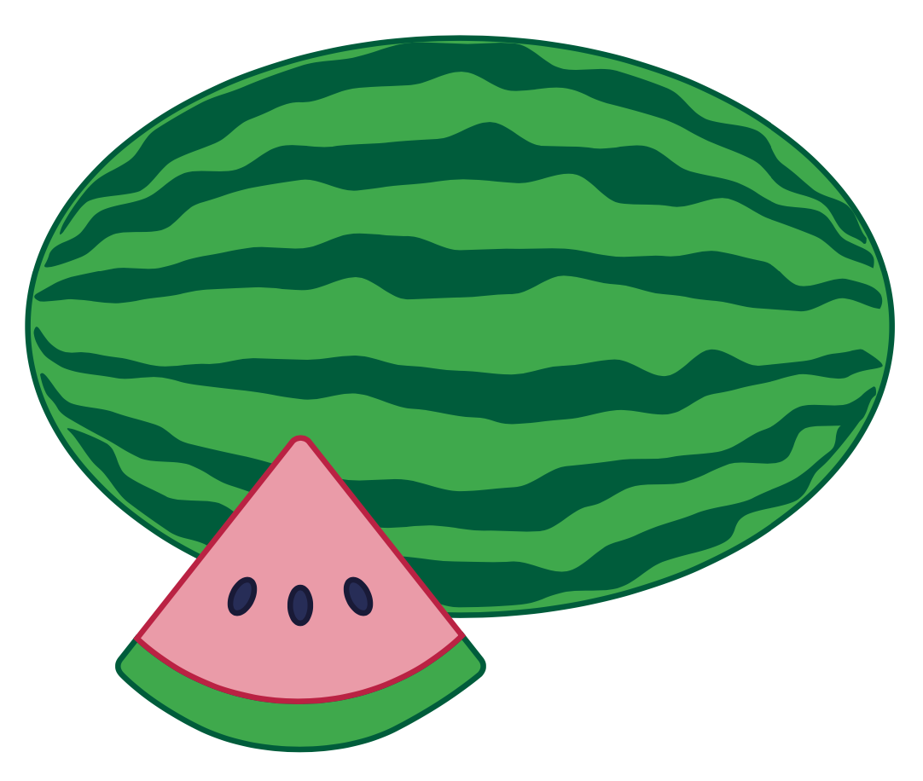
w

Slide 36
win
wag
w

Slide 37
swim
twin

Slide 38
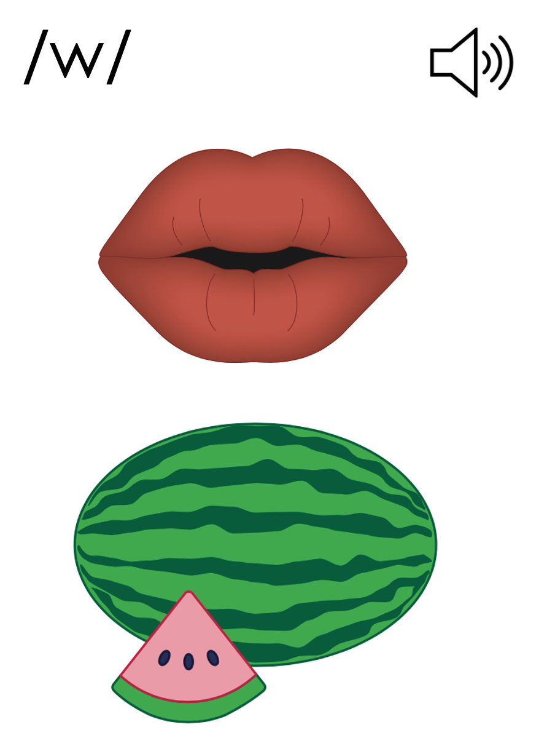
w

Slide 41
Notes:
Uppercase W gif

Slide 43
Notes:
Lowercase w gif

Slide 44
web
west

Slide 45
wag
win
wig
wet
went
wept

Slide 46
swam
twin
twig

Slide 47
Notes:
See UFLI Foundations lesson plan Step 5 for words to spell.
Handwriting paper to model spelling.

Slide 48
Notes:
See UFLI Foundations lesson plan Step 5 for words to spell.
Handwriting paper for guided spelling practice.

Slide 50
Insert brief reinforcement activity and/or transition to next part of reading block.

Slide 51
Lesson 28
w /w/

Slide 53
New Concept Review
Notes:
See UFLI Foundations lesson plan Step 5 for recommended teacher language and activities to review the new concept.

Slide 54
w

Slide 55
win
wag
w

Slide 56
swim
twin

Slide 57
w

Slide 58
Notes:
Lowercase w gif

Slide 59
wet
win
went
swim

Slide 61
Notes:
See UFLI Foundations lesson plan Step 6 for word work activity.
Visit ufliteracy.org to access the Word Work Mat apps.

Slide 63
Notes:
See UFLI Foundations lesson plan Step 7 for irregular word activities.
The white rectangle under each word may be used in editing mode. Cover the heart and square icons then reveal them one at a time during instruction.

Slide 64
Notes:
See UFLI Foundations manual for more information about reviewing irregular words.

Slide 65
from
Notes:
Lesson 25+
O represents the /ŭ/ sound.
The white rectangle under the word may be used in editing mode. Cover the heart and square icons then reveal them one at a time during instruction.

Slide 66
look
Notes:
Lessons 26-88
*Temporarily irregular
OO /oo/ has not been introduced yet.
The white rectangle under the word may be used in editing mode. Cover the heart and square icons then reveal them one at a time during instruction.

Slide 67
book
Notes:
Lessons 26-88
*Temporarily irregular
OO /oo/ has not been introduced yet.
The white rectangle under the word may be used in editing mode. Cover the heart and square icons then reveal them one at a time during instruction.

Slide 68
are
Notes:
Lessons 27-76
AR /ar/ has not been introduced yet.
The final E is silent but does not follow the long vowel VCe pattern.
The white rectangle under the word may be used in editing mode. Cover the heart and square icons then reveal them one at a time during instruction.

Slide 69
Notes:
Handwriting paper for irregular word spelling practice. Use as needed.
See UFLI Foundations manual for more information about reviewing irregular words.

Slide 71
Notes:
See UFLI Foundations lesson plan Step 8 for connected text activities.

Slide 72
The twig got wet.

Slide 73
Did Brad swim fast?

Slide 74
Ken and Ben are twins.

Slide 75
Notes:
See UFLI Foundations lesson plan Step 8 for sentences to write.

Slide 76
Notes:
The UFLI Foundations decodable text is provided here. See UFLI Foundations decodable text guide for additional text options.

Slide 77
A Hog in the Mud
Wes is a hog.
A hog is a big pig.
The sun is up.
Wes’ skin is hot.

Slide 78
He sits in the mud in his pen.
Wes is wet.
The mud drip, drip, drips from his skin.

Slide 79
“Ahh!,” said Wes.
He is glad he gets to sit in the mud.

Slide 81
Insert brief reinforcement activity and/or transition to next part of reading block.

