Slide 1
Lesson 41c
Short Vowels Advanced 2

Slide 2
Notes:
ufliteracy.org

Slide 4
Lesson 41c
Short Vowels Advanced 2

Slide 6
Notes:
See UFLI Foundations lesson plan Step 1 for phonemic awareness activity.

Slide 8
Notes:
See UFLI Foundations lesson plan Step 2 for student phoneme responses.

Slide 9
o

Slide 10
i

Slide 11
a

Slide 12
m

Slide 13
s

Slide 14
t

Slide 15
p

Slide 16
f

Slide 17
n

Slide 18
d

Slide 19
c

Slide 20
g

Slide 21
b

Slide 22
k

Slide 23
h

Slide 24
r

Slide 25
l

Slide 26
w

Slide 27
j

Slide 28
y

Slide 29
x

Slide 30
qu

Slide 31
v

Slide 32
z

Slide 34
Notes:
See UFLI Foundations lesson plan Step 3 for auditory drill activity.

Slide 35
Notes:
No slides needed for auditory drill.

Slide 37
Notes:
See UFLI Foundations lesson plan Step 4 for blending drill word chain and grid.
Visit ufliteracy.org to access the Blending Board app.

Slide 39
Notes:
See UFLI Foundations lesson plan Step 5 for recommended teacher language and activities to introduce the new concept.

Slide 40
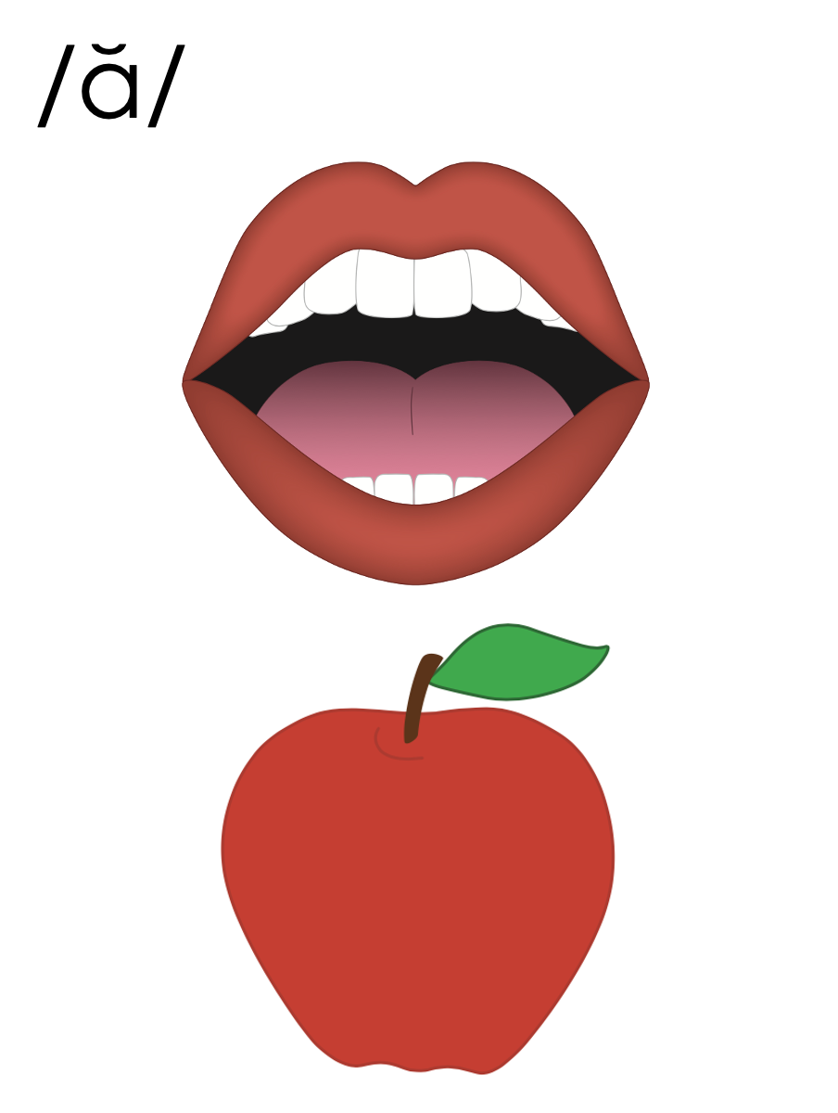
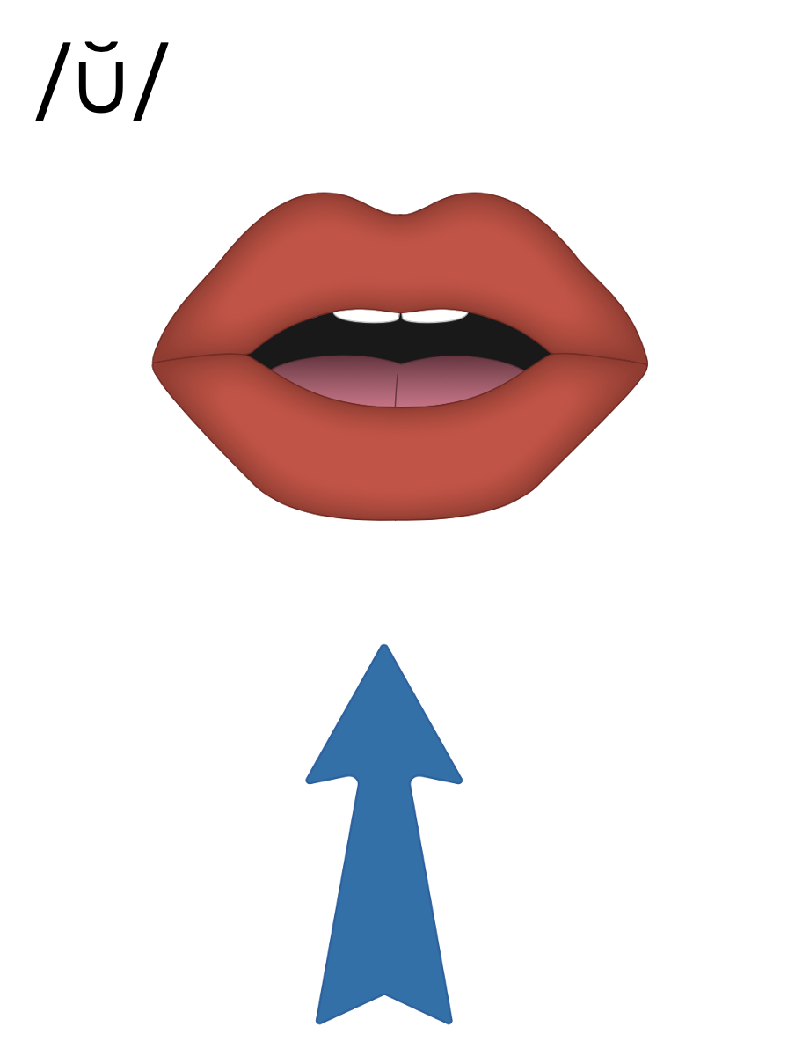
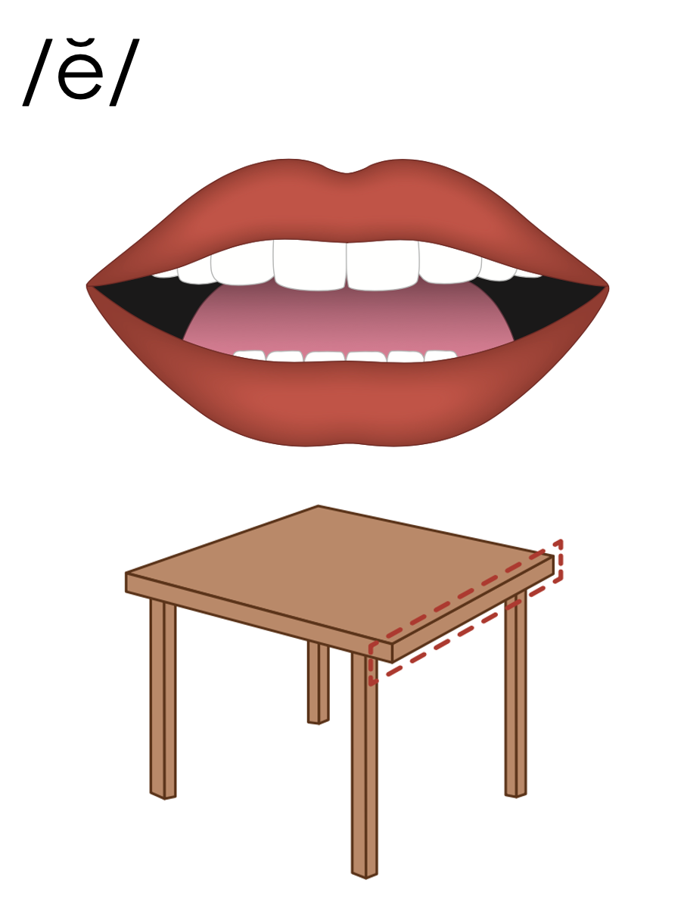

Slide 41
t r u s t

Slide 42
s p e n t

Slide 43
s p l i t

Slide 44
a

Slide 45
splat
scrap
a

Slide 46
ask
as
a

Slide 47
am
stamp
an
stand

Slide 48
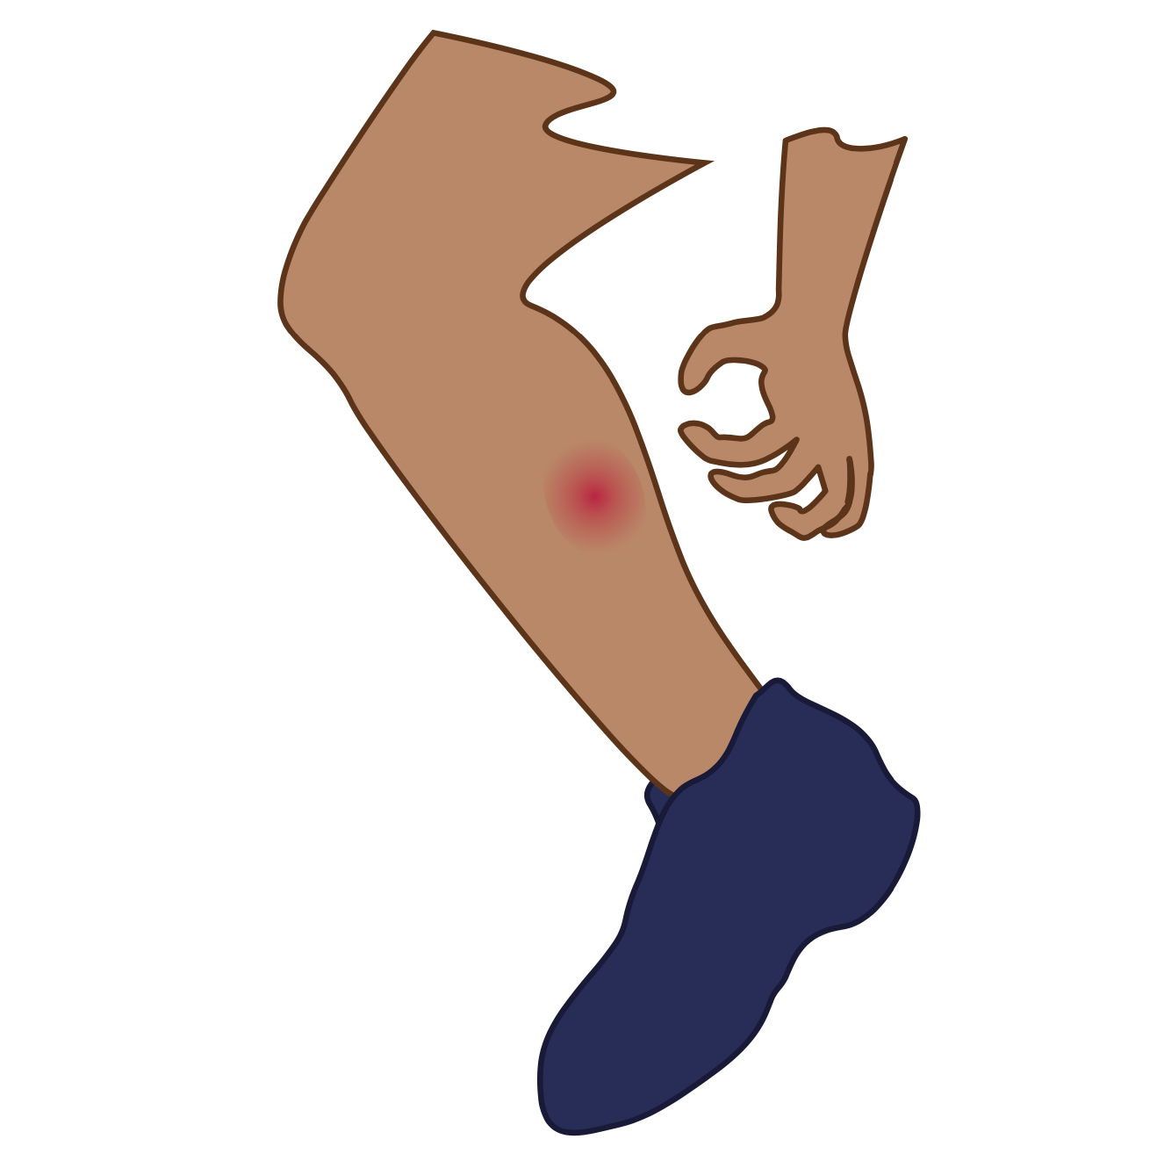
i

Slide 49
swift
crisp
i

Slide 50
is
in
i

Slide 51
o

Slide 52
frost
stomp
o

Slide 53
on
ox
o

Slide 54
u

Slide 55
trust
slump
u

Slide 56
up
us
u

Slide 57
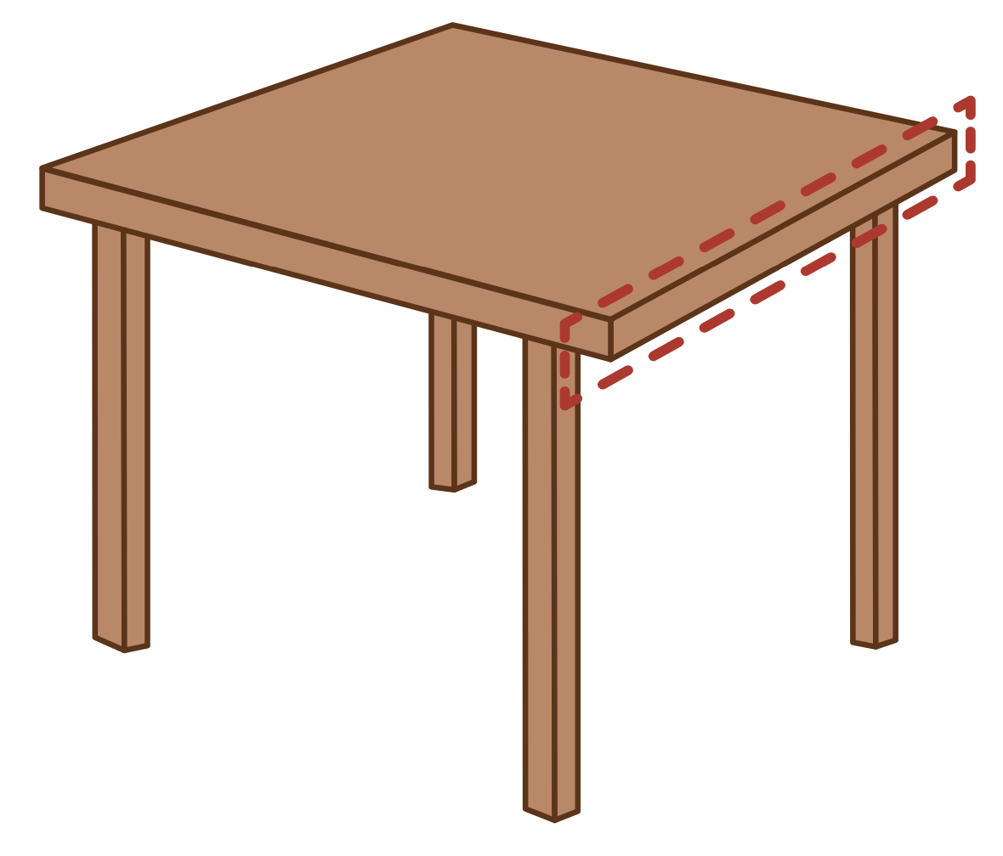
e

Slide 58
spent
blend
e

Slide 59
elf
end
e

Slide 60
a
i
o
u
e

Slide 61
Notes:
Handwriting paper for letter formation practice. Use as needed.
See UFLI Foundations manual for more information about letter formation.

Slide 62
blast
scrub

Slide 63
craft
stand
swift
twist
frost
stunt

Slide 64
crust
spend
blend
scrap
strip
sprint

Slide 65
Notes:
See UFLI Foundations lesson plan Step 5 for words to spell.
Handwriting paper to model spelling.

Slide 66
Notes:
See UFLI Foundations lesson plan Step 5 for words to spell.
Handwriting paper for guided spelling practice.

Slide 68
Insert brief reinforcement activity and/or transition to next part of reading block.

Slide 69
Lesson 41c
Short Vowels Advanced 2

Slide 71
New Concept Review
Notes:
See UFLI Foundations lesson plan Step 5 for recommended teacher language and activities to review the new concept.

Slide 73
t r u s t

Slide 74
s p e n t

Slide 75
s p l i t

Slide 76
a

Slide 77
splat
scrap
a

Slide 78
ask
as
a

Slide 79
am
stamp
an
stand

Slide 80
i

Slide 81
swift
crisp
i

Slide 82
is
in
i

Slide 83
o

Slide 84
frost
stomp
o

Slide 85
on
ox
o

Slide 86
u

Slide 87
trust
slump
u

Slide 88
up
us
u

Slide 89
e

Slide 90
spent
blend
e

Slide 91
elf
end
e

Slide 92
a
i
o
u
e

Slide 93
stand
print
frost
trust
slept

Slide 95
Notes:
See UFLI Foundations lesson plan Step 6 for word work activity.
Visit ufliteracy.org to access the Word Work Mat apps.

Slide 97
Notes:
See UFLI Foundations lesson plan Step 7 for irregular word activities.
The white rectangle under each word may be used in editing mode. Cover the heart and square icons then reveal them one at a time during instruction.

Slide 98
Notes:
See UFLI Foundations manual for more information about reviewing irregular words.

Slide 99
the
Notes:
Lessons 1-45
The digraph TH has not been introduced yet.
E represents the /ŭ/ or /ə/ sound depending on stress.
The white rectangle under the word may be used in editing mode. Cover the heart and square icons then reveal them one at a time during instruction.

Slide 100
I
Notes:
Lessons 3-65
*Temporarily irregular
I /ī/ has not been introduced yet.
The white rectangle under the word may be used in editing mode. Cover the heart and square icons then reveal them one at a time during instruction.

Slide 101
a
Notes:
Lesson 7+
A as a word can be pronounced /ā/ or /ŭ/.
The white rectangle under the word may be used in editing mode. Cover the heart and square icons then reveal them one at a time during instruction.

Slide 102
said
Notes:
Lesson 13+
AI represents the /ĕ/ sound.
The white rectangle under the word may be used in editing mode. Cover the heart and square icons then reveal them one at a time during instruction.

Slide 103
to
Notes:
Lesson 15+
O represents the /ū/ sound.
The white rectangle under the word may be used in editing mode. Cover the heart and square icons then reveal them one at a time during instruction.

Slide 104
do
Notes:
Lesson 15+
O represents the /ū/ sound.
The white rectangle under the word may be used in editing mode. Cover the heart and square icons then reveal them one at a time during instruction.

Slide 105
of
Notes:
Lesson 17+
O represents the /ŭ/ sound.
F represents the /v/ sound.
The white rectangle under the word may be used in editing mode. Cover the heart and square icons then reveal them one at a time during instruction.

Slide 106
see
Notes:
Lessons 19-84
*Temporarily irregular
EE /ē/ has not been introduced yet.
The white rectangle under the word may be used in editing mode. Cover the heart and square icons then reveal them one at a time during instruction.

Slide 107
he
Notes:
Lessons 23-65
*Temporarily irregular
E /ē/ has not been introduced yet.
The white rectangle under the word may be used in editing mode. Cover the heart and square icons then reveal them one at a time during instruction.

Slide 108
be
Notes:
Lessons 23-65
*Temporarily irregular
E /ē/ has not been introduced yet.
The white rectangle under the word may be used in editing mode. Cover the heart and square icons then reveal them one at a time during instruction.

Slide 109
me
Notes:
Lessons 23-65
*Temporarily irregular
E /ē/ has not been introduced yet.
The white rectangle under the word may be used in editing mode. Cover the heart and square icons then reveal them one at a time during instruction.

Slide 110
from
Notes:
Lesson 25+
O represents the /ŭ/ sound.
The white rectangle under the word may be used in editing mode. Cover the heart and square icons then reveal them one at a time during instruction.

Slide 111
look
Notes:
Lessons 26-88
*Temporarily irregular
OO /oo/ has not been introduced yet.
The white rectangle under the word may be used in editing mode. Cover the heart and square icons then reveal them one at a time during instruction.

Slide 112
book
Notes:
Lessons 26-88
*Temporarily irregular
OO /oo/ has not been introduced yet.
The white rectangle under the word may be used in editing mode. Cover the heart and square icons then reveal them one at a time during instruction.

Slide 113
are
Notes:
Lessons 27-76
AR /ar/ has not been introduced yet.
The final E is silent but does not follow the long vowel VCe pattern.
The white rectangle under the word may be used in editing mode. Cover the heart and square icons then reveal them one at a time during instruction.

Slide 114
was
Notes:
Lesson 29+
A represents the /ŭ/ sound.​
S /z/ has already been introduced.
The white rectangle under the word may be used in editing mode. Cover the heart and square icons then reveal them one at a time during instruction.

Slide 115
you
Notes:
Lessons 31-114
*Temporarily irregular
OU /ū/ has not been introduced yet.
The white rectangle under the word may be used in editing mode. Cover the heart and square icons then reveal them one at a time during instruction.

Slide 116
what
Notes:
Lessons 33-49
WH /w/ has not been introduced yet.
A represents the /ŭ/ sound or the /ŏ/ sound, depending on dialect.
The white rectangle under the word may be used in editing mode. Cover the heart and square icons then reveal them one at a time during instruction.

Slide 117
have
Notes:
Lessons 33-61
*Temporarily irregular
The final E is silent but does not follow the long vowel VCe pattern.
The silent E is there because English words can not end with the letter V.
The white rectangle under the word may be used in editing mode. Cover the heart and square icons then reveal them one at a time during instruction.

Slide 118
Notes:
Handwriting paper for irregular word spelling practice. Use as needed.
See UFLI Foundations manual for more information about reviewing irregular words.

Slide 120
Notes:
See UFLI Foundations lesson plan Step 8 for connected text activities.

Slide 121
Can you get the crust?

Slide 122
Stand next to the plants.

Slide 123
Stan and Ben are the best at sprints.

Slide 124
Notes:
See UFLI Foundations lesson plan Step 8 for sentences to write.

Slide 125
Notes:
The UFLI Foundations decodable text is provided here. See UFLI Foundations decodable text guide for additional text options.

Slide 126
A Craft from Us
Brent and Clint must get Mom a gift.
The kids went to Gram’s Craft Stand.
Brent helps Clint cut ten red dots.

Slide 127
Next, Clint helps Brent stamp six red spots.
The gift Brent and Clint craft is a crest.
The kids set the crest in a box.

Slide 128
The crest Brent and Clint craft is grand.
“Yes!” said Mom, “This is the best gift. You are the best kids.”

Slide 130
Insert brief reinforcement activity and/or transition to next part of reading block.

