Slide 1
Lesson 22
k /k/

Slide 2
Notes:
ufliteracy.org

Slide 4
Lesson 22
k /k/

Slide 6
Notes:
See UFLI Foundations lesson plan Step 1 for phonemic awareness activity.

Slide 8
Notes:
See UFLI Foundations lesson plan Step 2 for student phoneme responses.

Slide 9
s

Slide 10
e

Slide 11
b

Slide 12
g

Slide 13
u

Slide 14
c

Slide 15
d

Slide 16
o

Slide 17
n

Slide 18
i

Slide 19
f

Slide 20
p

Slide 21
t

Slide 22
m

Slide 23
a

Slide 25
Notes:
See UFLI Foundations lesson plan Step 3 for auditory drill activity.

Slide 26
Notes:
No slides needed for auditory drill.

Slide 28
Notes:
See UFLI Foundations lesson plan Step 4 for blending drill word chain and grid.
Visit ufliteracy.org to access the Blending Board app.

Slide 30
Notes:
See UFLI Foundations lesson plan Step 5 for recommended teacher language and activities to introduce the new concept.

Slide 31
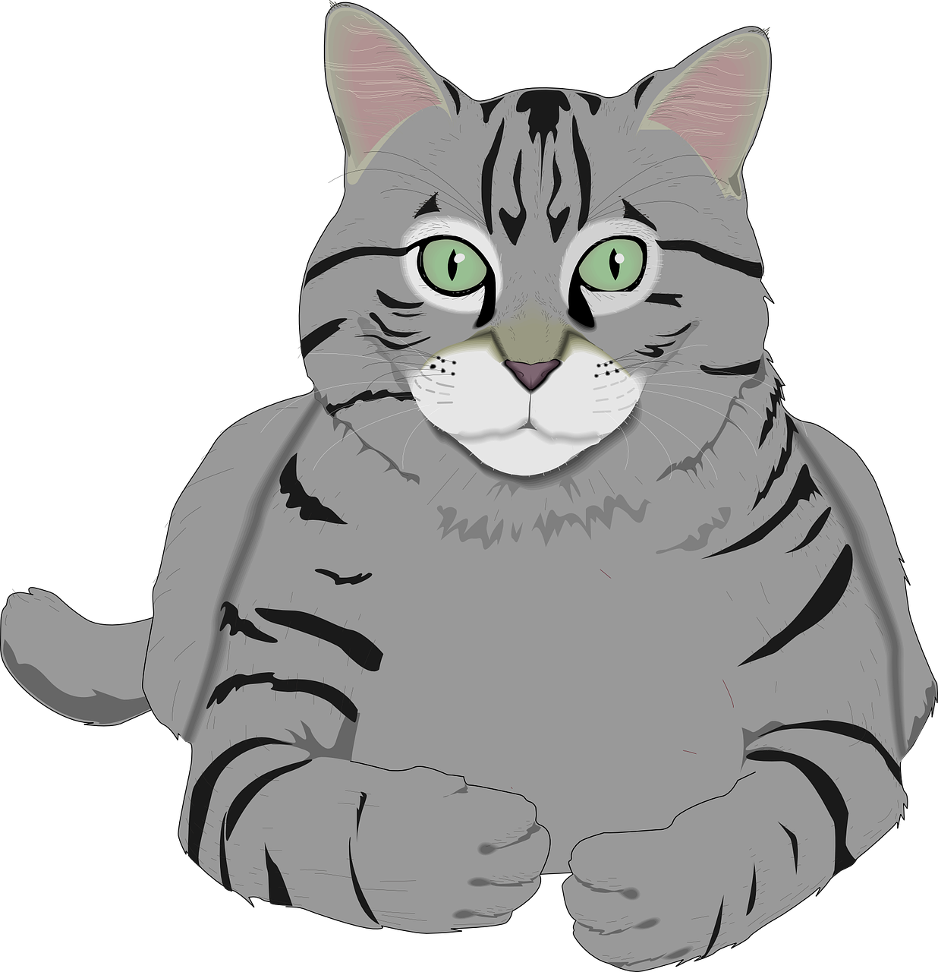
c

Slide 32
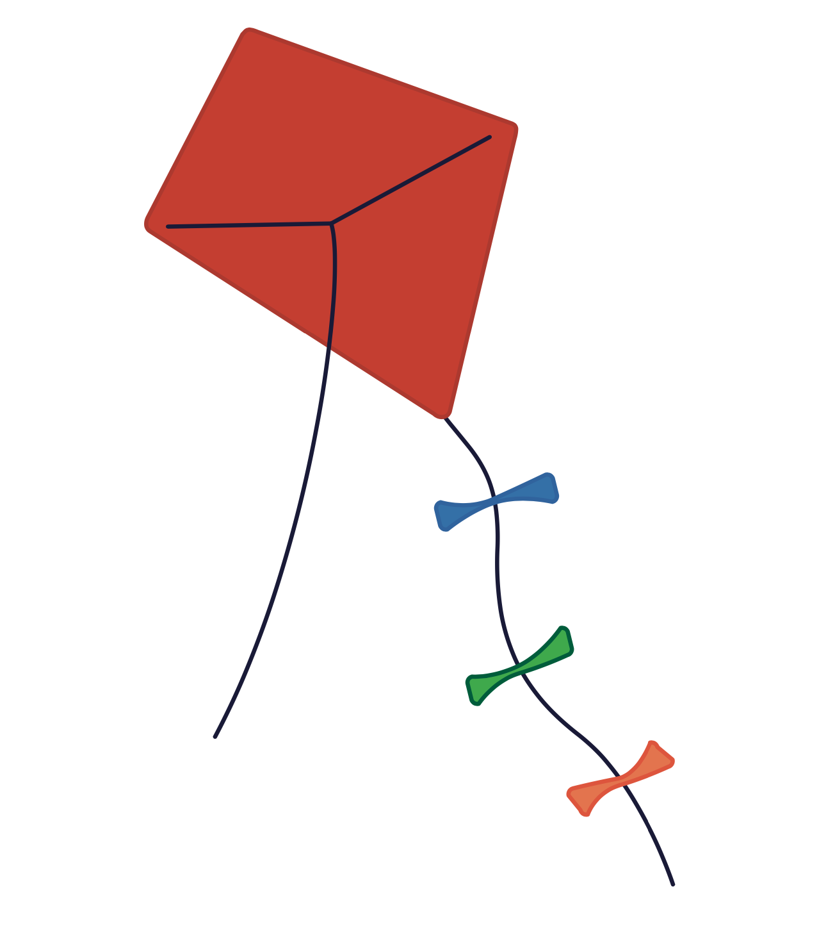
k

Slide 33
kid
kit
k

Slide 34
s
k
s k i p
m a s k

Slide 35
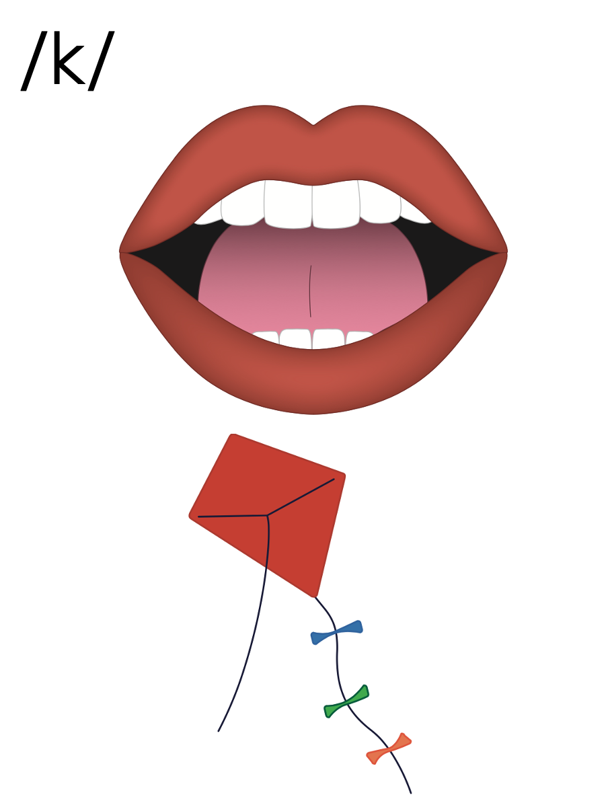
c
k

Slide 36
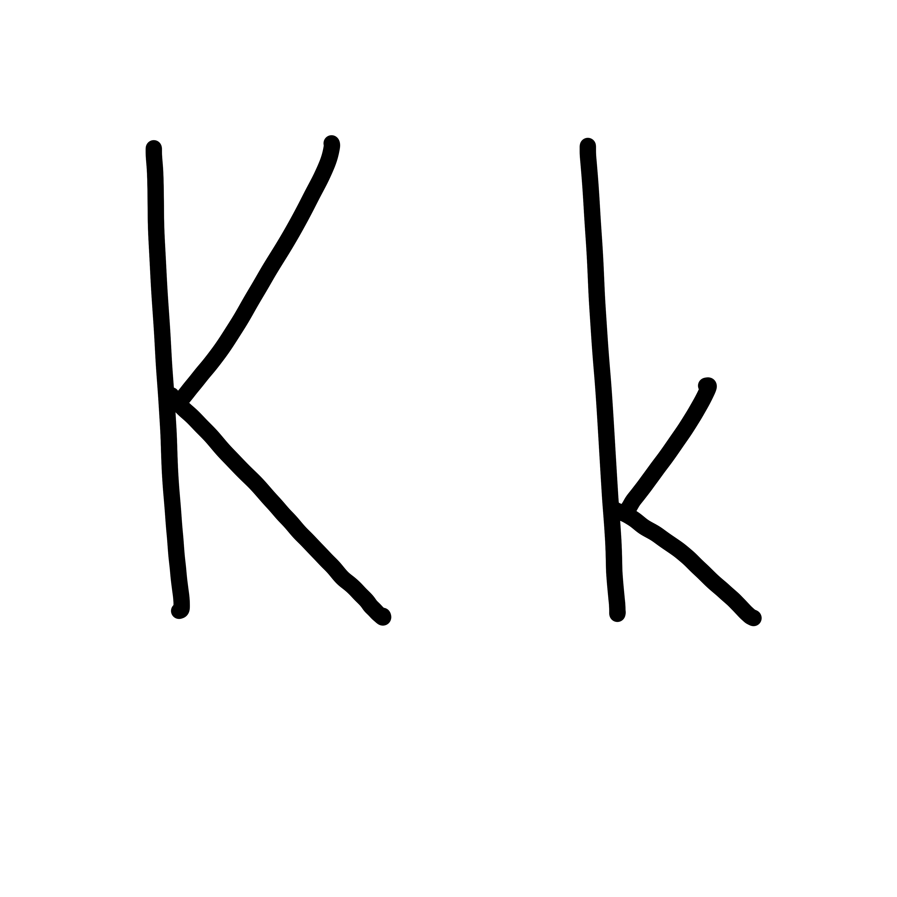

Slide 38
Notes:
Uppercase K gif

Slide 40
Notes:
Lowercase k gif

Slide 41
kit
task

Slide 42
kin
kit
ask
kids
skim
skit

Slide 43
skin
desk

Slide 44
Notes:
See UFLI Foundations lesson plan Step 5 for words to spell.
Handwriting paper to model spelling.

Slide 45
Notes:
See UFLI Foundations lesson plan Step 5 for words to spell.
Handwriting paper for guided spelling practice.

Slide 47
Insert brief reinforcement activity and/or transition to next part of reading block.

Slide 48
Lesson 22
k /k/

Slide 50
New Concept Review
Notes:
See UFLI Foundations lesson plan Step 5 for recommended teacher language and activities to review the new concept.

Slide 51
c

Slide 52
k

Slide 53
kid
kit
k

Slide 54
s
k
s k i p
m a s k

Slide 55
c
k

Slide 56
Notes:
Lowercase k gif

Slide 57
kid
kit
skip
ask

Slide 59
Notes:
See UFLI Foundations lesson plan Step 6 for word work activity.
Visit ufliteracy.org to access the Word Work Mat apps.

Slide 61
Notes:
See UFLI Foundations lesson plan Step 7 for irregular word activities.
The white rectangle under each word may be used in editing mode. Cover the heart and square icons then reveal them one at a time during instruction.

Slide 62
Notes:
See UFLI Foundations manual for more information about reviewing irregular words.

Slide 63
said
Notes:
Lesson 13+
AI represents the /ĕ/ sound.
The white rectangle under the word may be used in editing mode. Cover the heart and square icons then reveal them one at a time during instruction.

Slide 64
to
Notes:
Lesson 15+
O represents the /ū/ sound.
The white rectangle under the word may be used in editing mode. Cover the heart and square icons then reveal them one at a time during instruction.

Slide 65
do
Notes:
Lesson 15+
O represents the /ū/ sound.
The white rectangle under the word may be used in editing mode. Cover the heart and square icons then reveal them one at a time during instruction.

Slide 66
of
Notes:
Lesson 17+
O represents the /ŭ/ sound.
F represents the /v/ sound.
The white rectangle under the word may be used in editing mode. Cover the heart and square icons then reveal them one at a time during instruction.

Slide 67
see
Notes:
Lessons 19-84
*Temporarily irregular
EE /ē/ has not been introduced yet.
The white rectangle under the word may be used in editing mode. Cover the heart and square icons then reveal them one at a time during instruction.

Slide 68
Notes:
Handwriting paper for irregular word spelling practice. Use as needed.
See UFLI Foundations manual for more information about reviewing irregular words.

Slide 70
Notes:
See UFLI Foundations lesson plan Step 8 for connected text activities.

Slide 71
The kids skip.

Slide 72
Can Kat get the kit?

Slide 73
I see a mask on the desk.

Slide 74
Notes:
See UFLI Foundations lesson plan Step 8 for sentences to write.

Slide 75
Notes:
The UFLI Foundations decodable text is provided here. See UFLI Foundations decodable text guide for additional text options.

Slide 76
Kip is the Best Pup
Kip is the best pup.
Kip digs.
Kip skips.
Kip sits in the sun.

Slide 77
Dad gets a disk.
Dad spins the disk up, up, up.
“Kip, get the disk,” said dad.
Kip is fast. Kip can see the disk.

Slide 78
But Kip did not see the mud.
“Stop, Kip!,” Dad said.
But Kip can not stop.
Kip skids into the mud.
Dad gets Kip and the disk in the tub.

Slide 80
Insert brief reinforcement activity and/or transition to next part of reading block.

