Slide 1
Lesson 13
d /d/

Slide 2
Notes:
ufliteracy.org

Slide 4
Lesson 13
d /d/

Slide 6
Notes:
See UFLI Foundations lesson plan Step 1 for phonemic awareness activity.

Slide 8
Notes:
See UFLI Foundations lesson plan Step 2 for student phoneme responses.

Slide 9
o

Slide 10
n

Slide 11
i

Slide 12
f

Slide 13
p

Slide 14
t

Slide 15
s

Slide 16
m

Slide 17
a

Slide 19
Notes:
See UFLI Foundations lesson plan Step 3 for auditory drill activity.

Slide 20
Notes:
No slides needed for auditory drill.

Slide 22
Notes:
See UFLI Foundations lesson plan Step 4 for blending drill word chain and grid.
Visit ufliteracy.org to access the Blending Board app.

Slide 24
Notes:
See UFLI Foundations lesson plan Step 5 for recommended teacher language and activities to introduce the new concept.

Slide 25
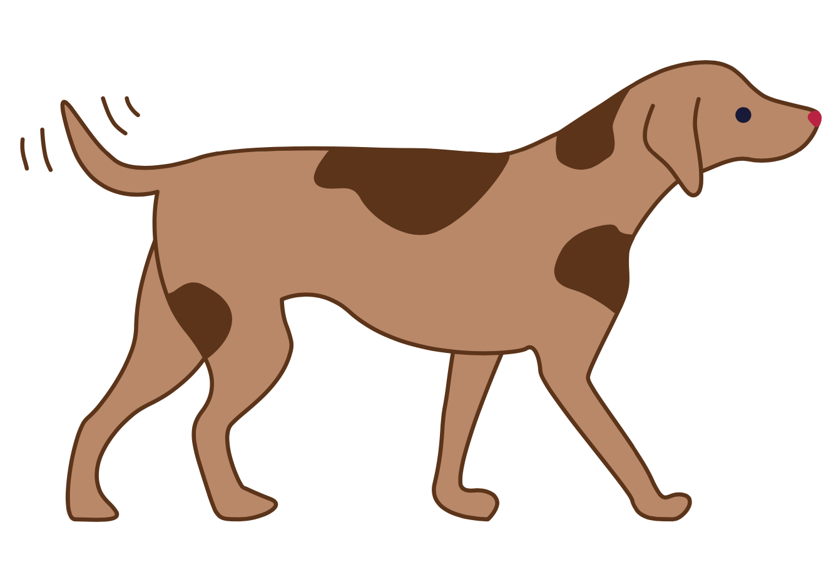
d

Slide 26
dip
dad
d

Slide 27
mad
pad
d

Slide 28
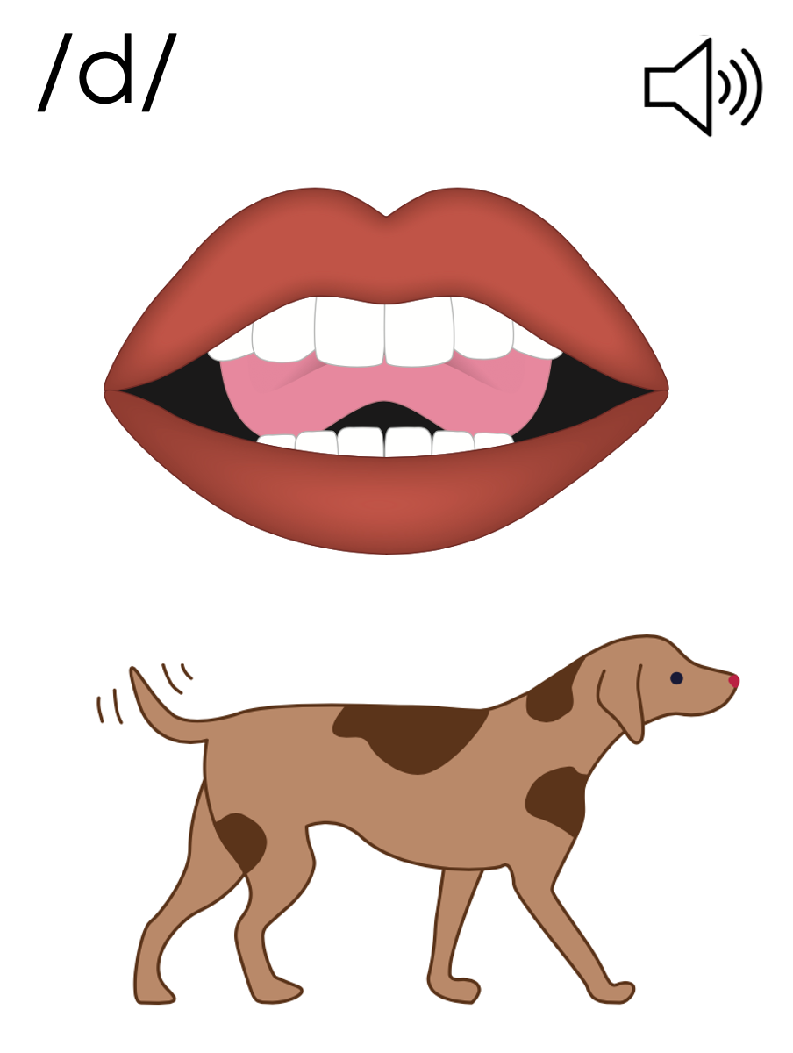
d

Slide 31
Notes:
Uppercase D gif

Slide 33
Notes:
Lowercase d gif

Slide 34
dad

Slide 35
ad
sad
mad
pad
tad
dip

Slide 36
dim
did
dot
and

Slide 37
Notes:
See UFLI Foundations lesson plan Step 5 for words to spell.
Handwriting paper to model spelling.

Slide 38
Notes:
See UFLI Foundations lesson plan Step 5 for words to spell.
Handwriting paper for guided spelling practice.

Slide 40
Insert brief reinforcement activity and/or transition to next part of reading block.

Slide 41
Lesson 13
d /d/

Slide 43
New Concept Review
Notes:
See UFLI Foundations lesson plan Step 5 for recommended teacher language and activities to review the new concept.

Slide 44
d

Slide 45
dip
dad
d

Slide 46
mad
pad
d

Slide 47
d

Slide 48
Notes:
Lowercase d gif

Slide 49
dad
dot
did
sad

Slide 51
Notes:
See UFLI Foundations lesson plan Step 6 for word work activity.
Visit ufliteracy.org to access the Word Work Mat apps.

Slide 53
Notes:
See UFLI Foundations lesson plan Step 7 for irregular word activities.
The white rectangle under each word may be used in editing mode. Cover the heart and square icons then reveal them one at a time during instruction.

Slide 54
Notes:
See UFLI Foundations manual for more information about reviewing irregular words.

Slide 55
the
Notes:
Lessons 1-45
The digraph TH has not been introduced yet.
E represents the /ŭ/ or /ə/ sound depending on stress.
The white rectangle under the word may be used in editing mode. Cover the heart and square icons then reveal them one at a time during instruction.

Slide 56
I
Notes:
Lessons 3-65
*Temporarily irregular
I /ī/ has not been introduced yet.
The white rectangle under the word may be used in editing mode. Cover the heart and square icons then reveal them one at a time during instruction.

Slide 57
and
Notes:
Lessons 13+
This temporarily irregular word is now decodable because nasalized A and D /d/ have been introduced.
The white rectangle under the word may be used in editing mode. Cover the heart and square icons then reveal them one at a time during instruction.

Slide 58
a
Notes:
Lesson 7+
A as a word can be pronounced /ā/ or /ŭ/.
The white rectangle under the word may be used in editing mode. Cover the heart and square icons then reveal them one at a time during instruction.

Slide 59
is
Notes:
Lessons 9-20
*Temporarily irregular
S /z/ has not been introduced yet.
The white rectangle under the word may be used in editing mode. Cover the heart and square icons then reveal them one at a time during instruction.

Slide 60
as
Notes:
Lessons 11-20
*Temporarily irregular
S /z/ has not been introduced yet.
The white rectangle under the word may be used in editing mode. Cover the heart and square icons then reveal them one at a time during instruction.

Slide 61
Notes:
Handwriting paper for irregular word spelling practice. Use as needed.
See UFLI Foundations manual for more information about reviewing irregular words.

Slide 62
Teach
Notes:
The orange star indicates these are new irregular words that need to be introduced.
See UFLI Foundations manual for more information about teaching irregular words.

Slide 63
said
Notes:
Lesson 13+
AI represents the /ĕ/ sound.
The white rectangle under the word may be used in editing mode. Cover the heart and square icons then reveal them one at a time during instruction.

Slide 64
Notes:
Handwriting paper for irregular word spelling practice. Use as needed.
See UFLI Foundations manual for more information about teaching irregular words.

Slide 66
Notes:
See UFLI Foundations lesson plan Step 8 for connected text activities.

Slide 67
It did not pop.

Slide 68
I am as sad as dad.

Slide 69
Did Tom tap the pad?

Slide 70
Notes:
See UFLI Foundations lesson plan Step 8 for sentences to write.

Slide 71
Notes:
The UFLI Foundations decodable text is provided here. See UFLI Foundations decodable text guide for additional text options.

Slide 72
Sid and Dad
Dad is sad.
Dad did not fit in the pit.
Sid is not sad.
Sid did fit in the pit.

Slide 73
Dad is mad.
Dad did not sit in the pit.
Sid is not mad.
Sid sat in the pit.

Slide 75
Insert brief reinforcement activity and/or transition to next part of reading block.

