Slide 1
Getting Ready
Lesson F

Slide 2
Notes:
ufliteracy.org

Slide 4
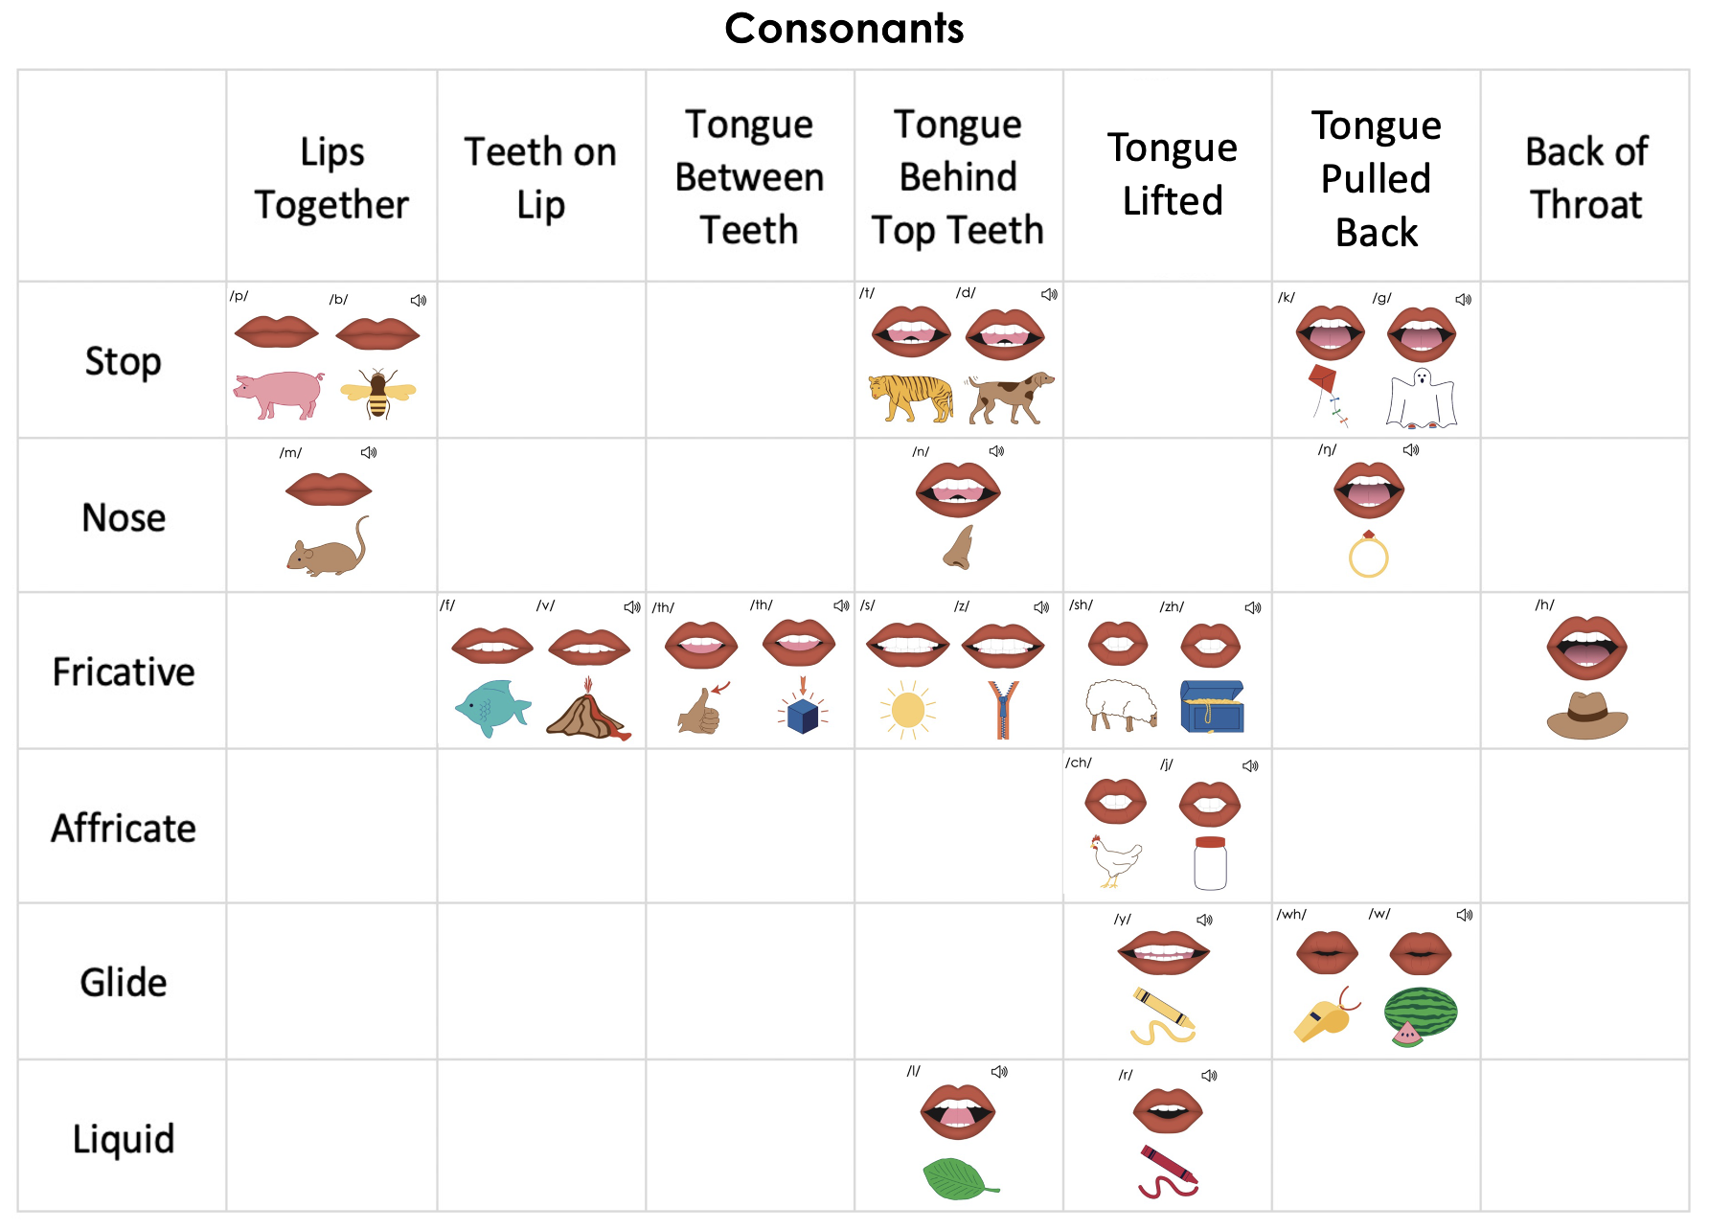
Notes:
This slide shows the parts of the sound wall that will be used during this lesson. If using physical sound wall cards, have these cards ready to display and refer to during the sound wall step.

Slide 6
Notes:
See UFLI Foundations Getting Ready lesson plans for sound wall activity.
The sound wall activity may be completed with either the digital sound wall slides provided here or physical sound wall cards displayed in your classroom.

Slide 7
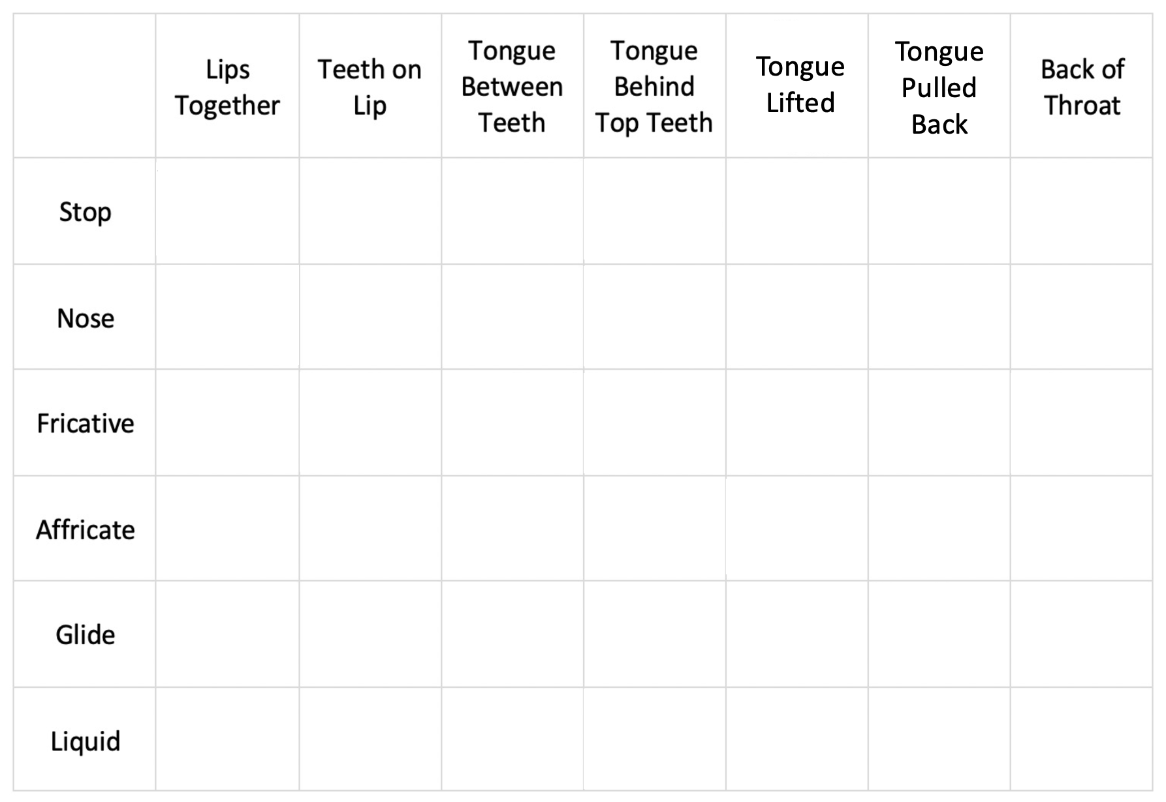
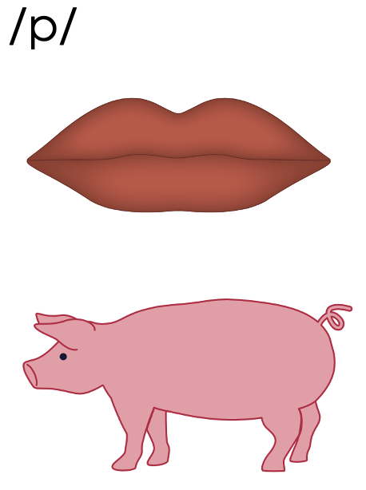
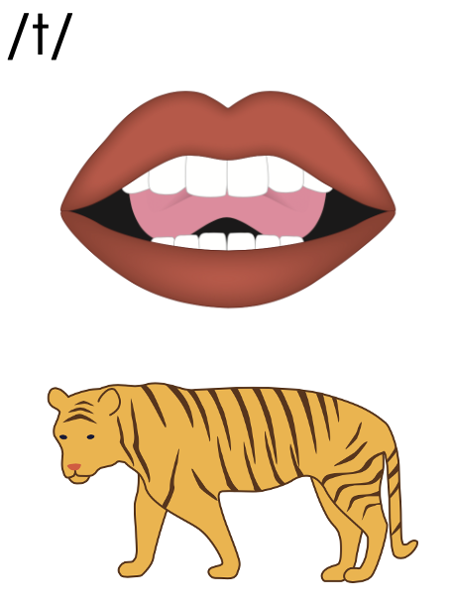
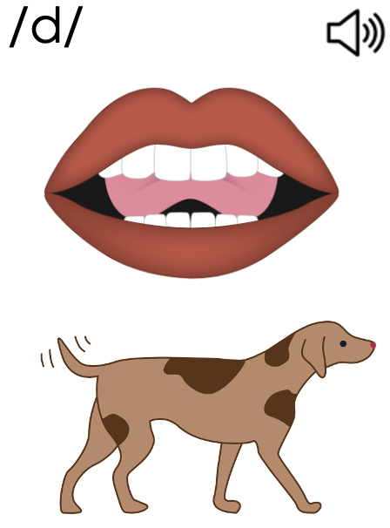
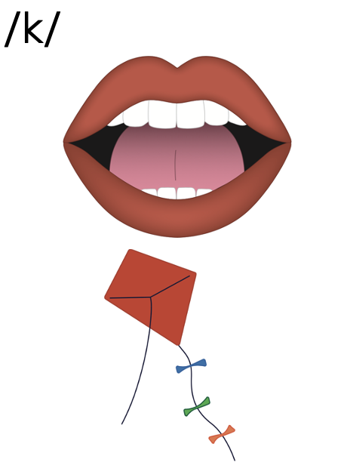
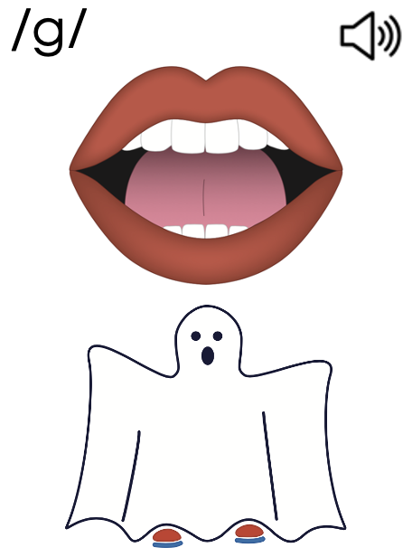
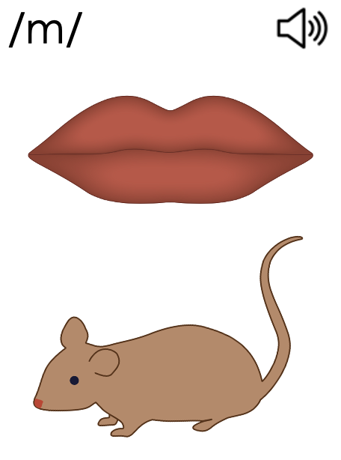
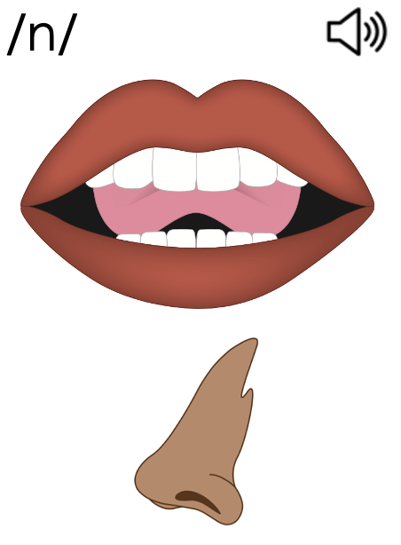
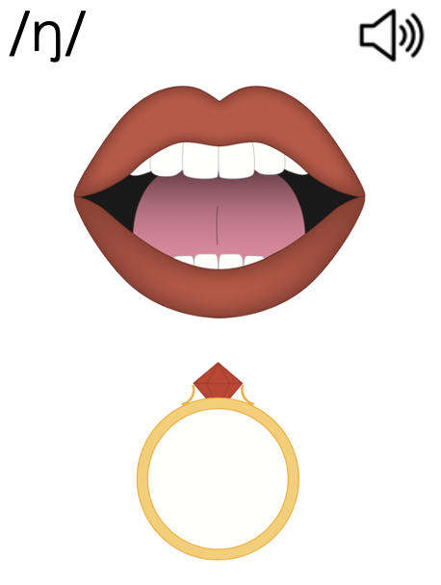
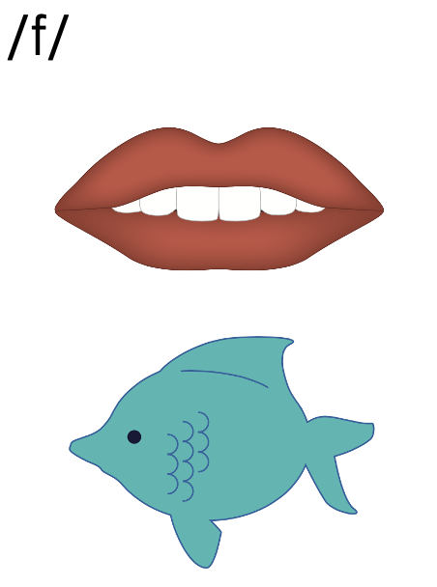
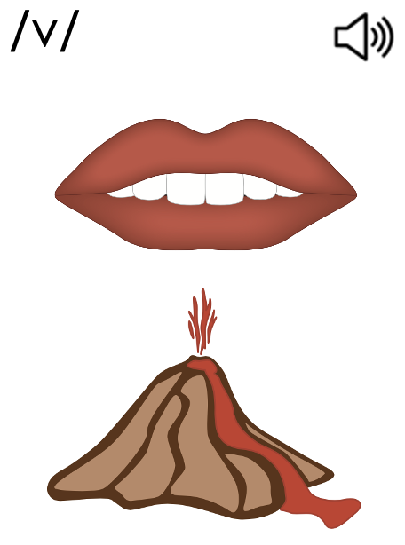
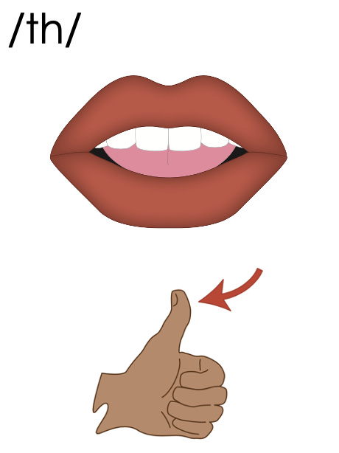
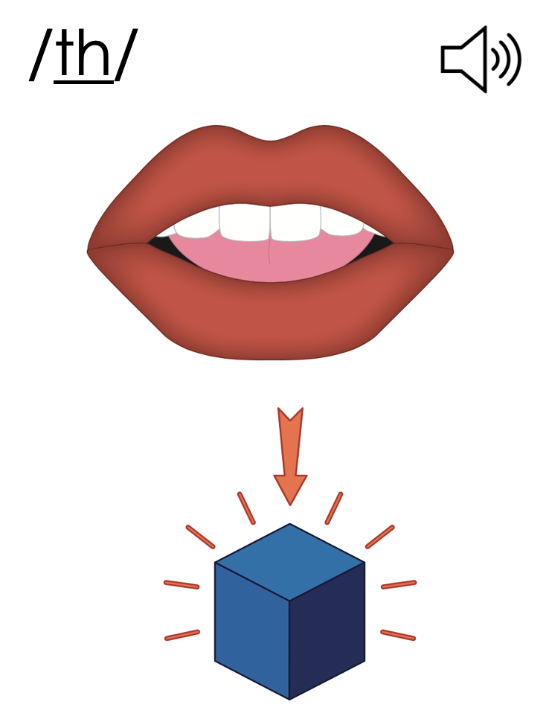
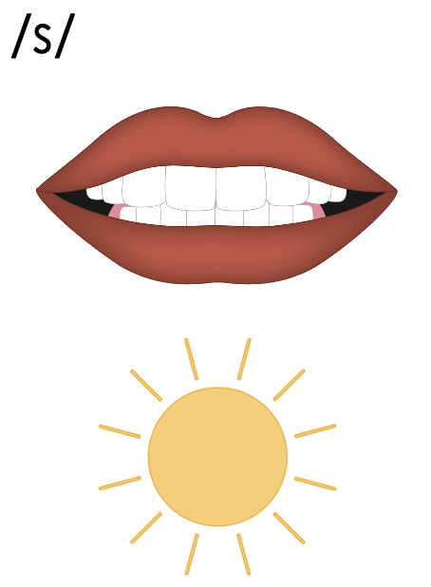
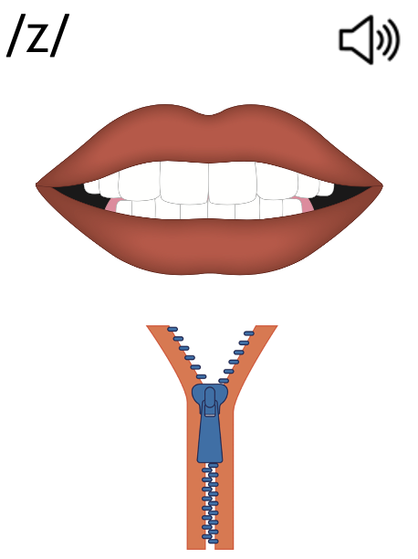
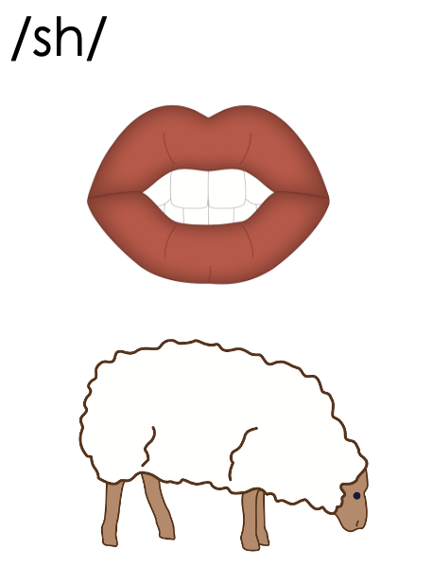
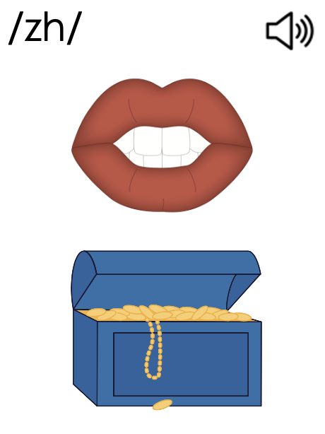
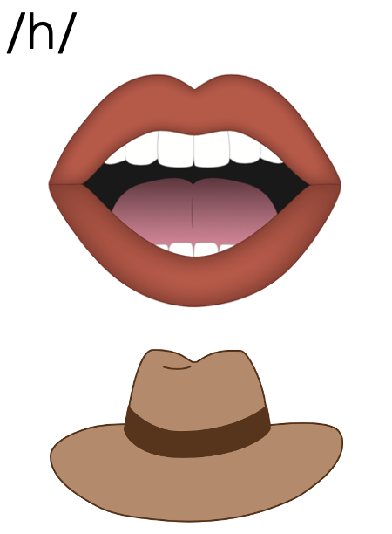
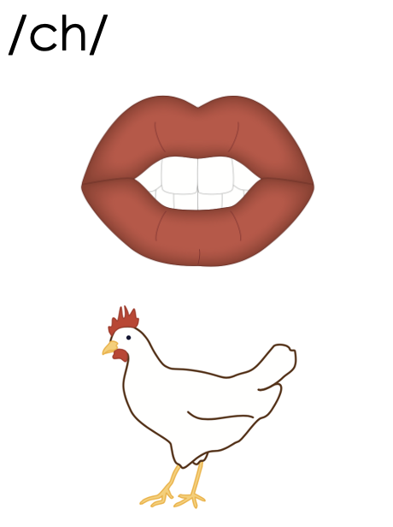
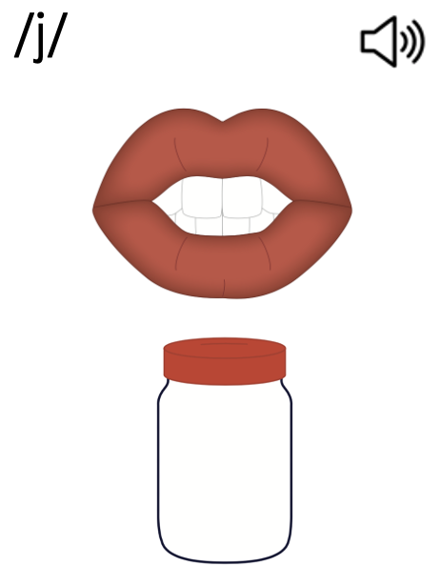
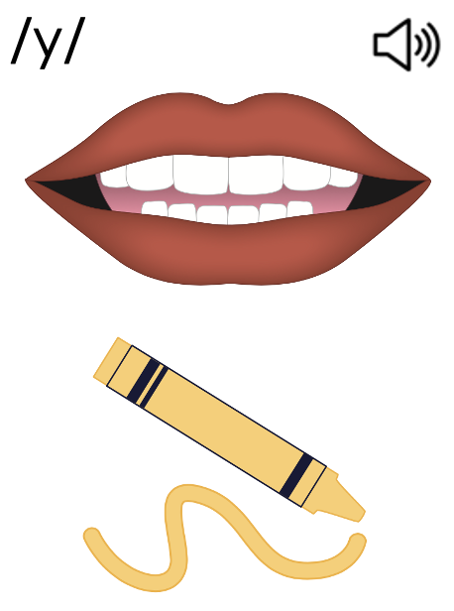
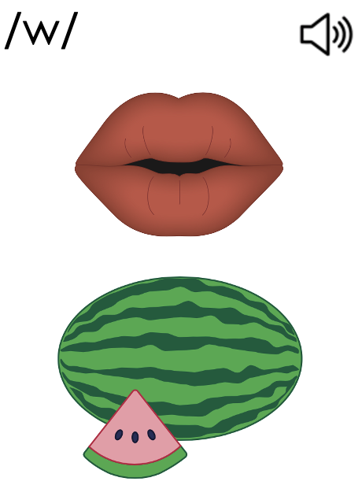
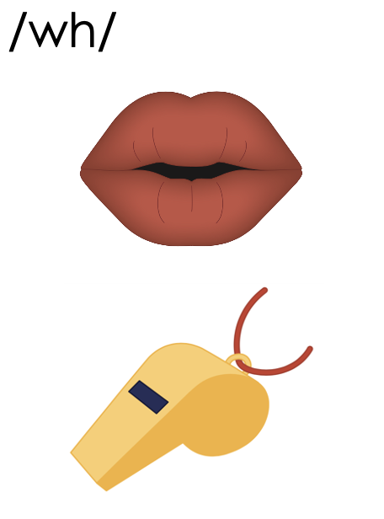
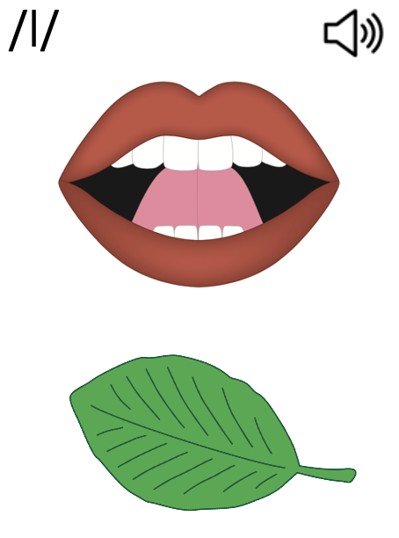
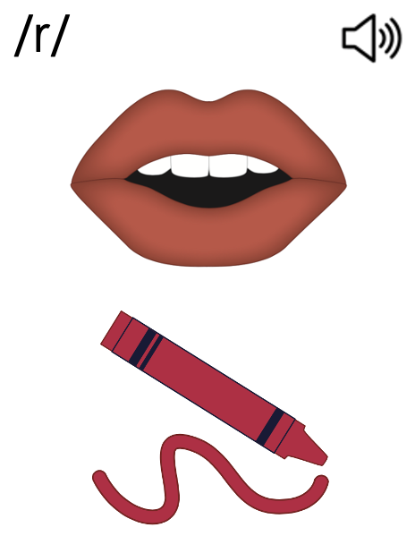
Consonants
Notes:
Consonant Review

Slide 8
Consonants
Notes:
Place of Articulation

Slide 9
Consonants
Notes:
Manner of Articulation

Slide 10
Consonants
Notes:
Voiced Consonants

Slide 11
Consonants
Notes:
Unvoiced Consonants

Slide 12
Consonants

Slide 14
Notes:
See UFLI Foundations Getting Ready lesson plans for alphabet knowledge and letter formation activity.

Slide 18
Notes:
Uppercase U gif

Slide 21
Notes:
Uppercase J gif

Slide 24
Notes:
Uppercase S gif

Slide 26
Insert brief reinforcement activity and/or transition to next part of reading block.

