Slide 1
Getting Ready
Lesson C

Slide 2
Notes:
ufliteracy.org

Slide 4
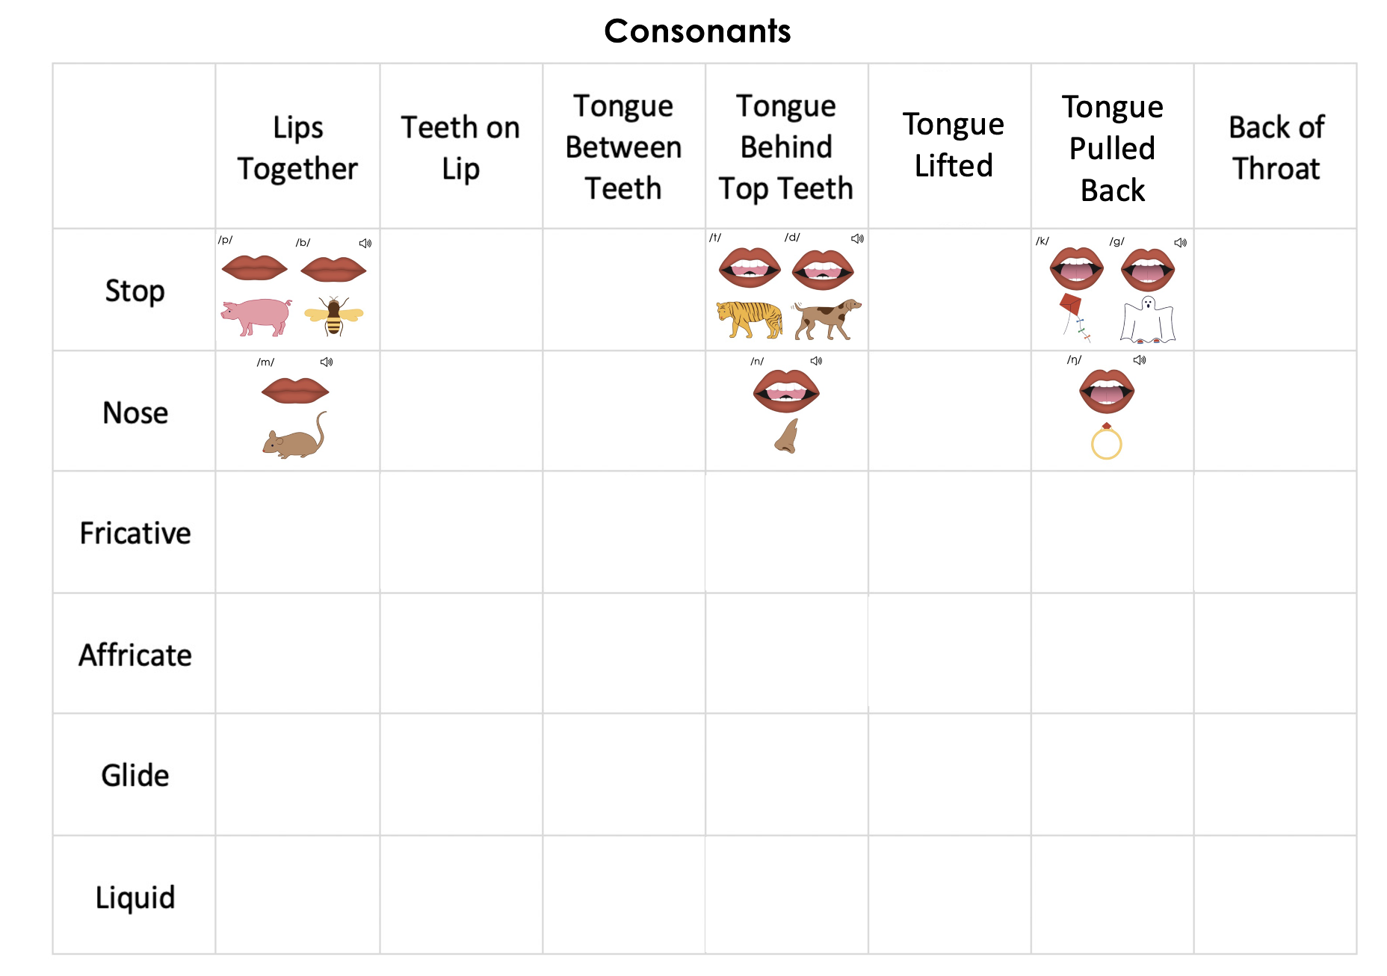
Notes:
This slide shows the parts of the sound wall that will be used during this lesson. If using physical sound wall cards, have these cards ready to display and refer to during the sound wall step.

Slide 6
Notes:
See UFLI Foundations Getting Ready lesson plans for sound wall activity.
The sound wall activity may be completed with either the digital sound wall slides provided here or physical sound wall cards displayed in your classroom.

Slide 7
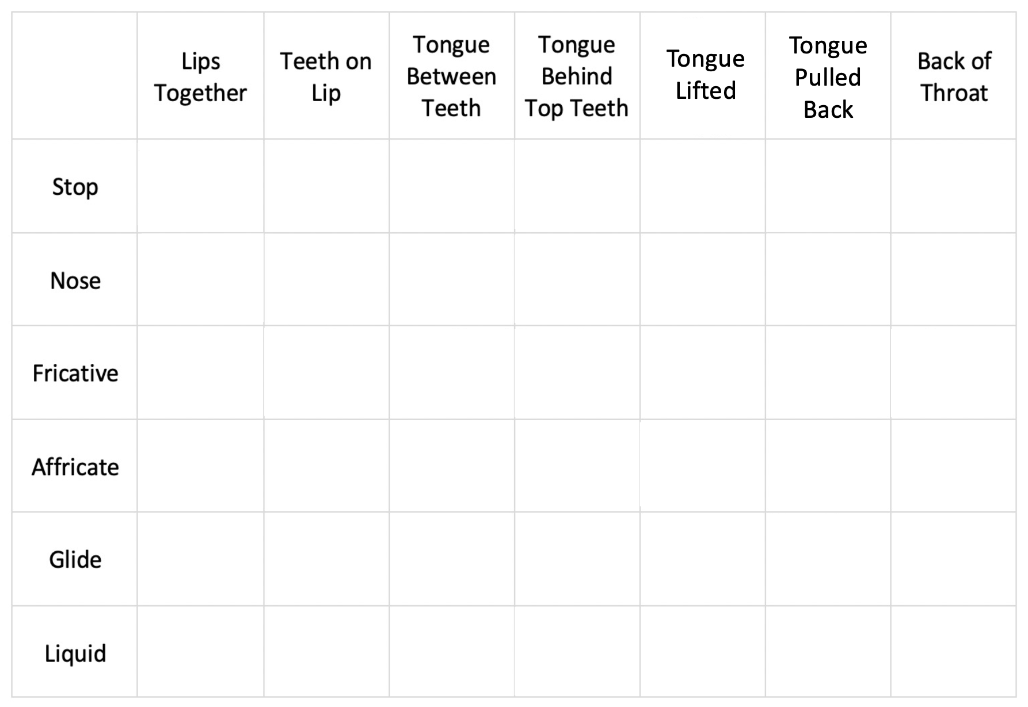
Consonants
Notes:
Introduction: Manner of Articulation

Slide 8
Consonants

Slide 9
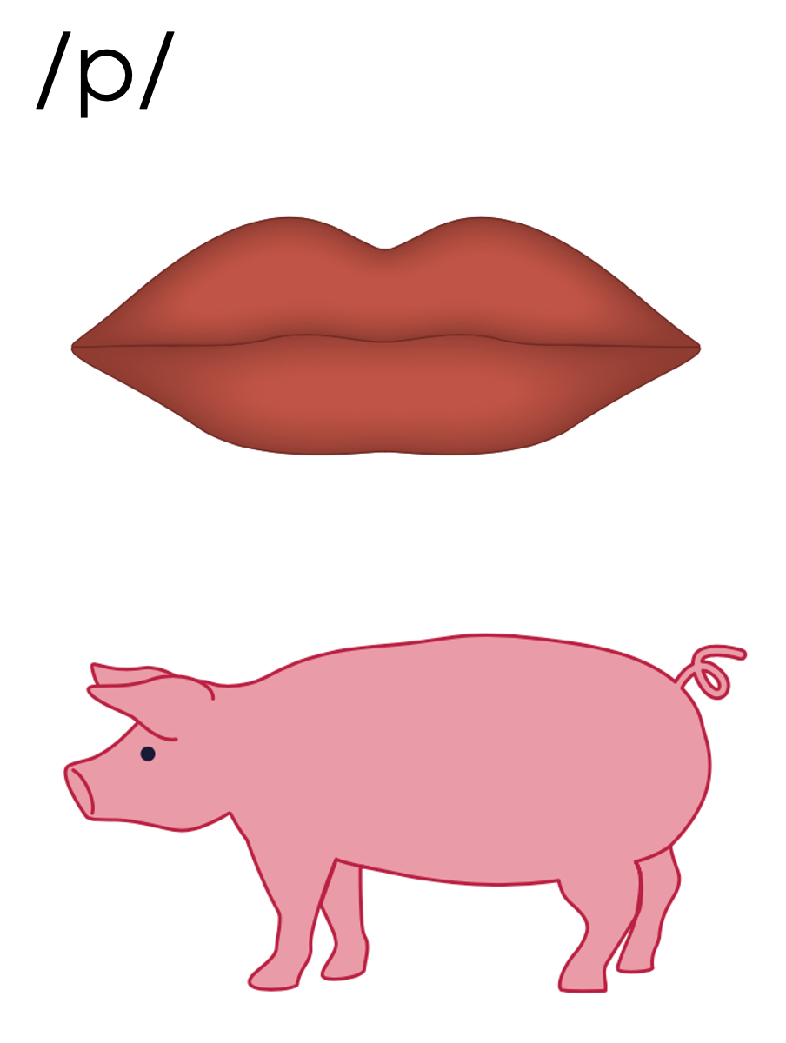
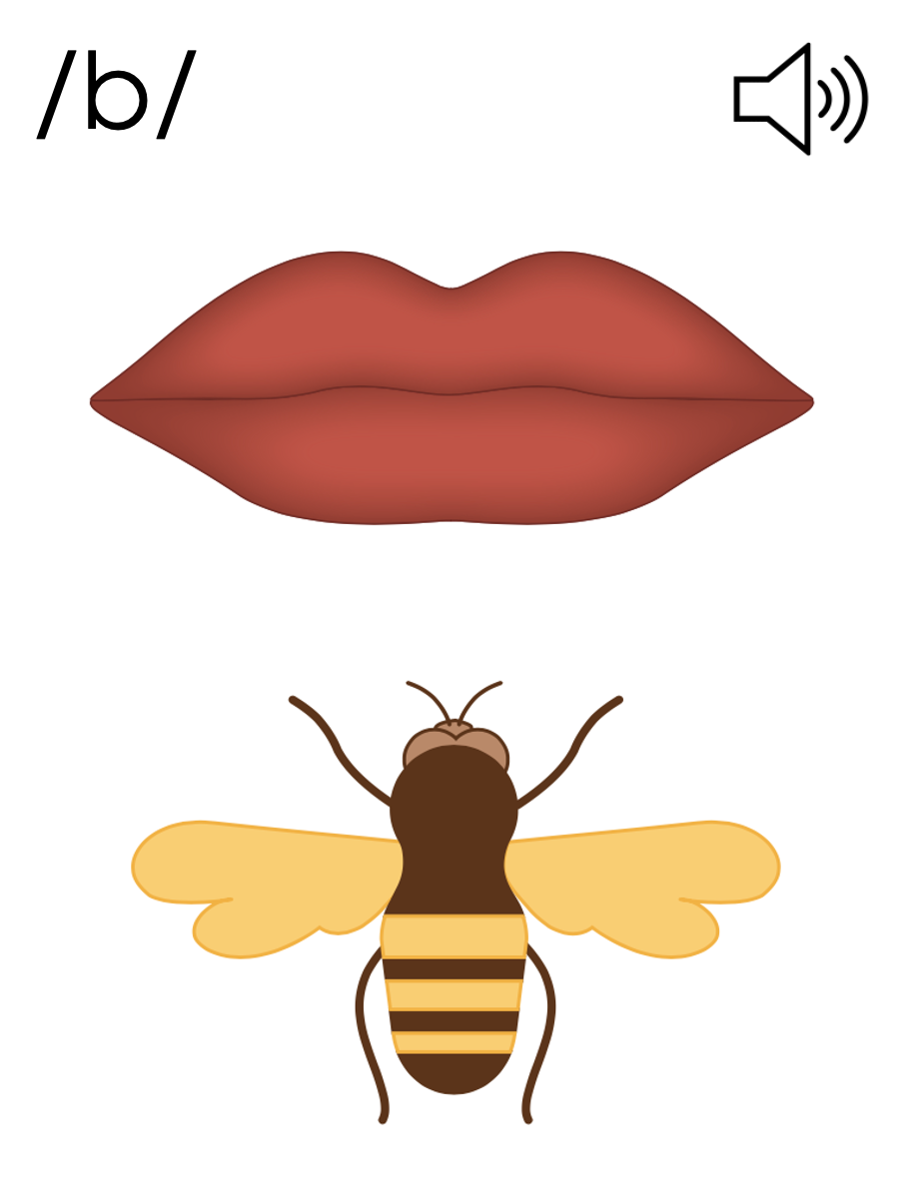
Notes:
/p/ (pig)
/b/ (bee)

Slide 10
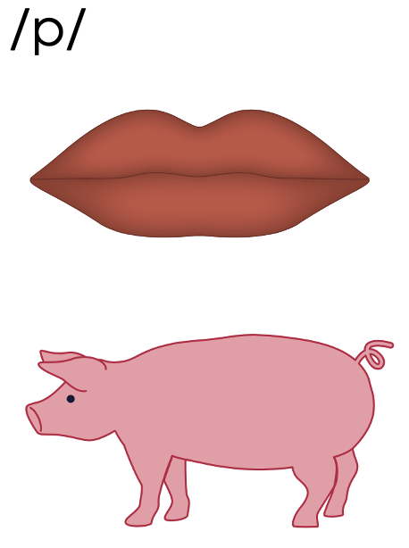
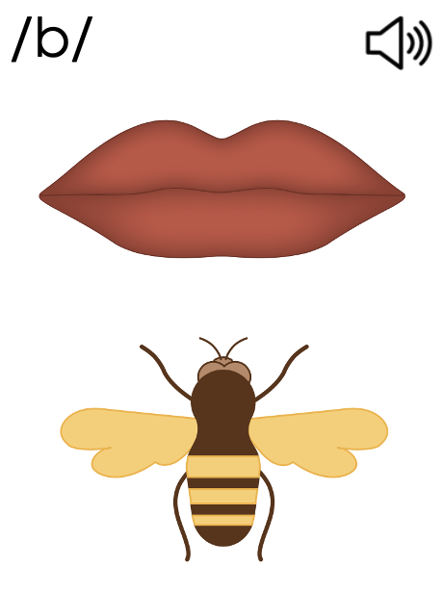
Consonants

Slide 11
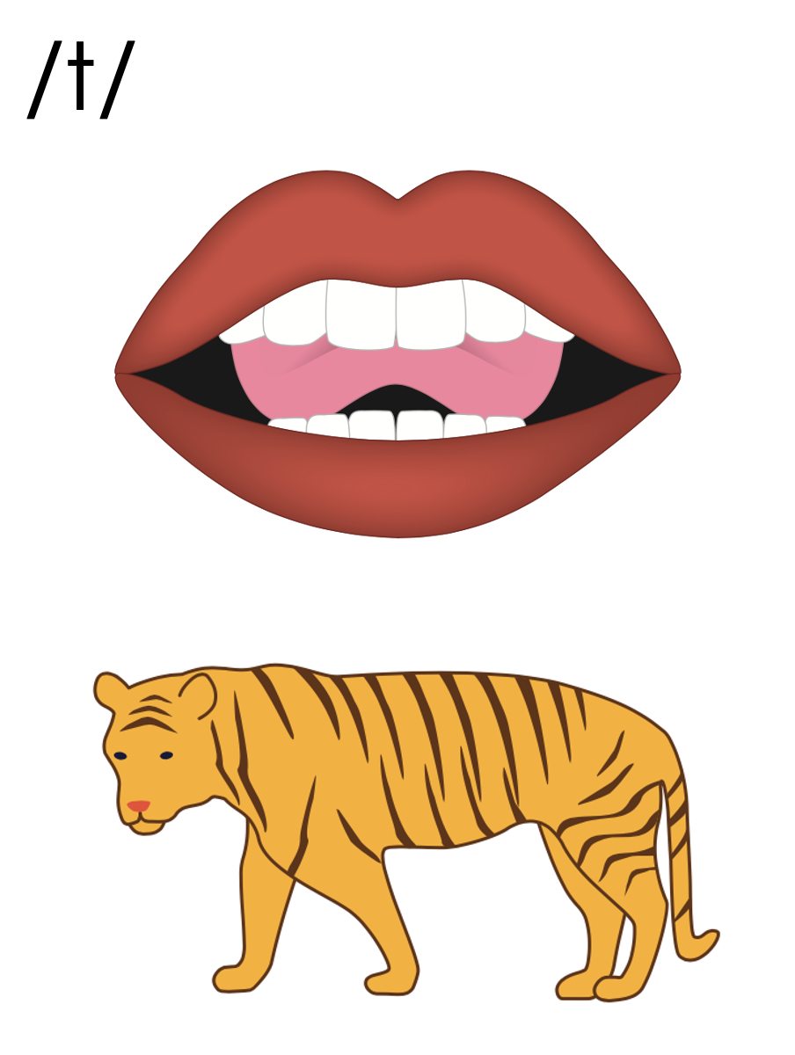
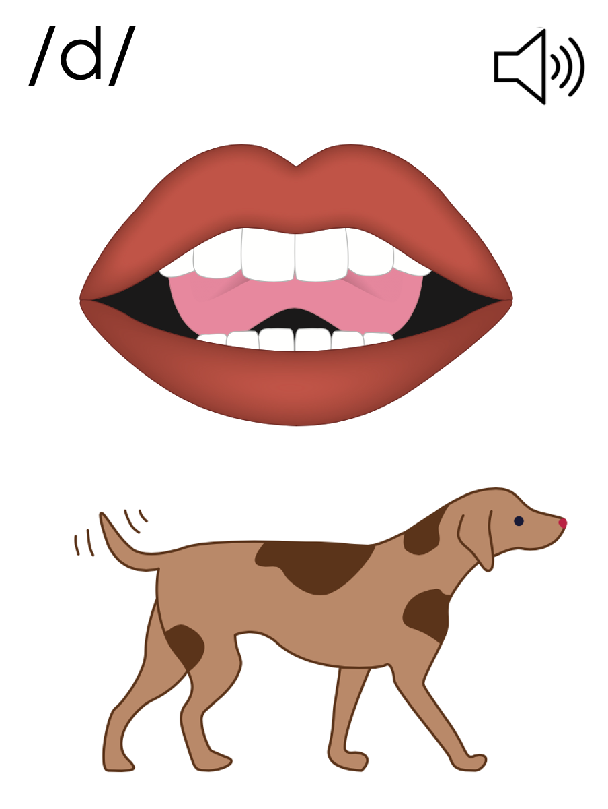
Notes:
/t/ (tiger)
/d/ (dog)

Slide 12
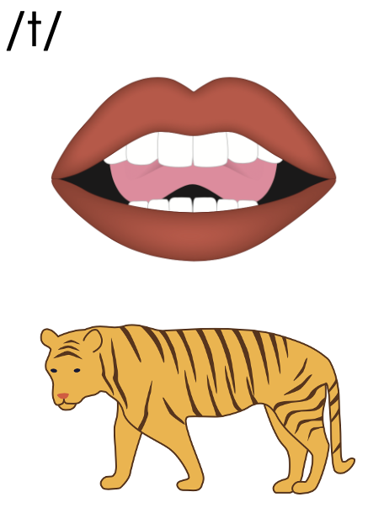
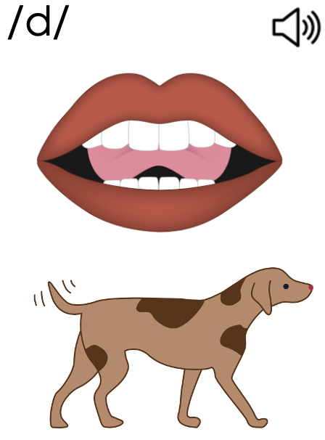
Consonants

Slide 13
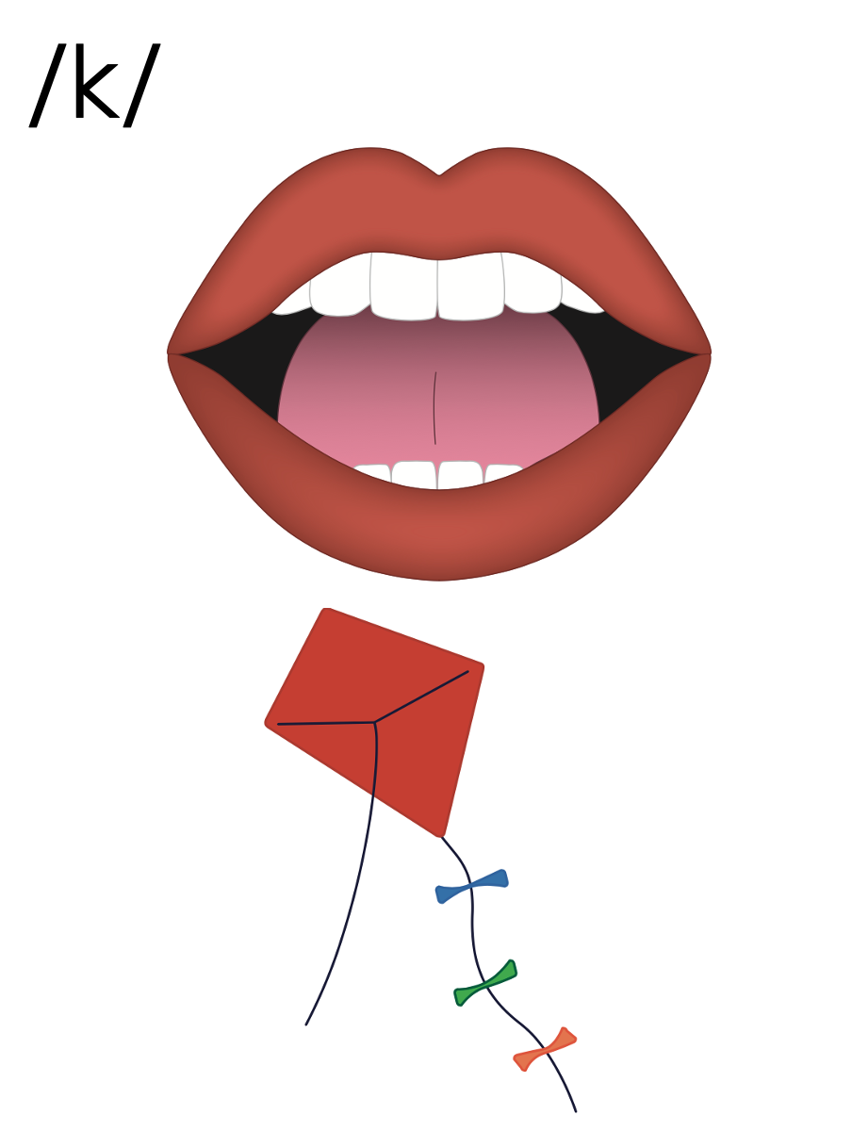
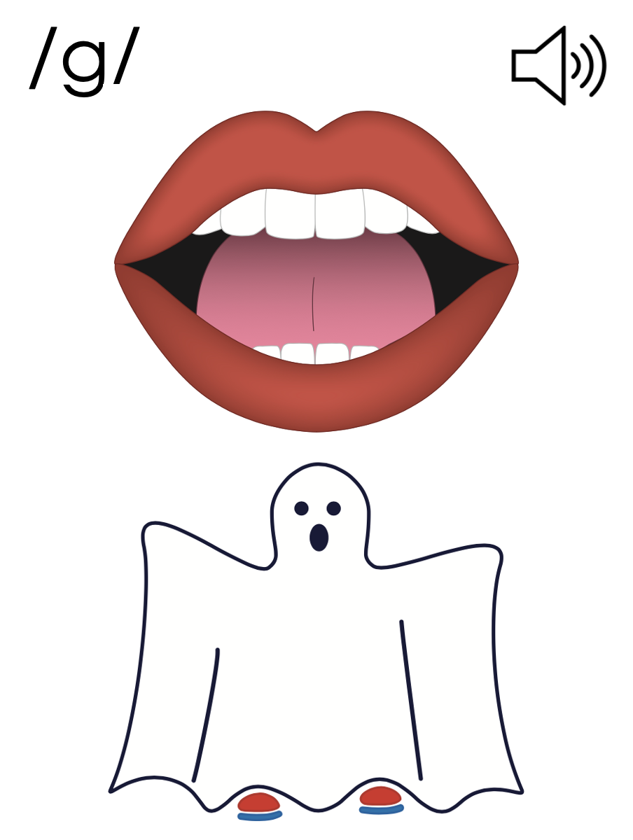
Notes:
/k/ (kite)
/g/ (ghost)

Slide 14
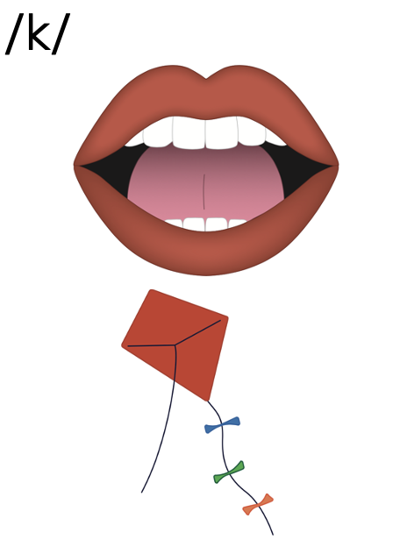
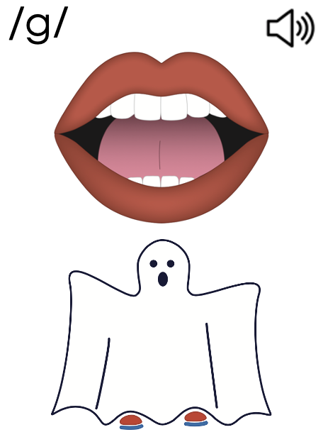
Consonants

Slide 15
Consonants

Slide 16
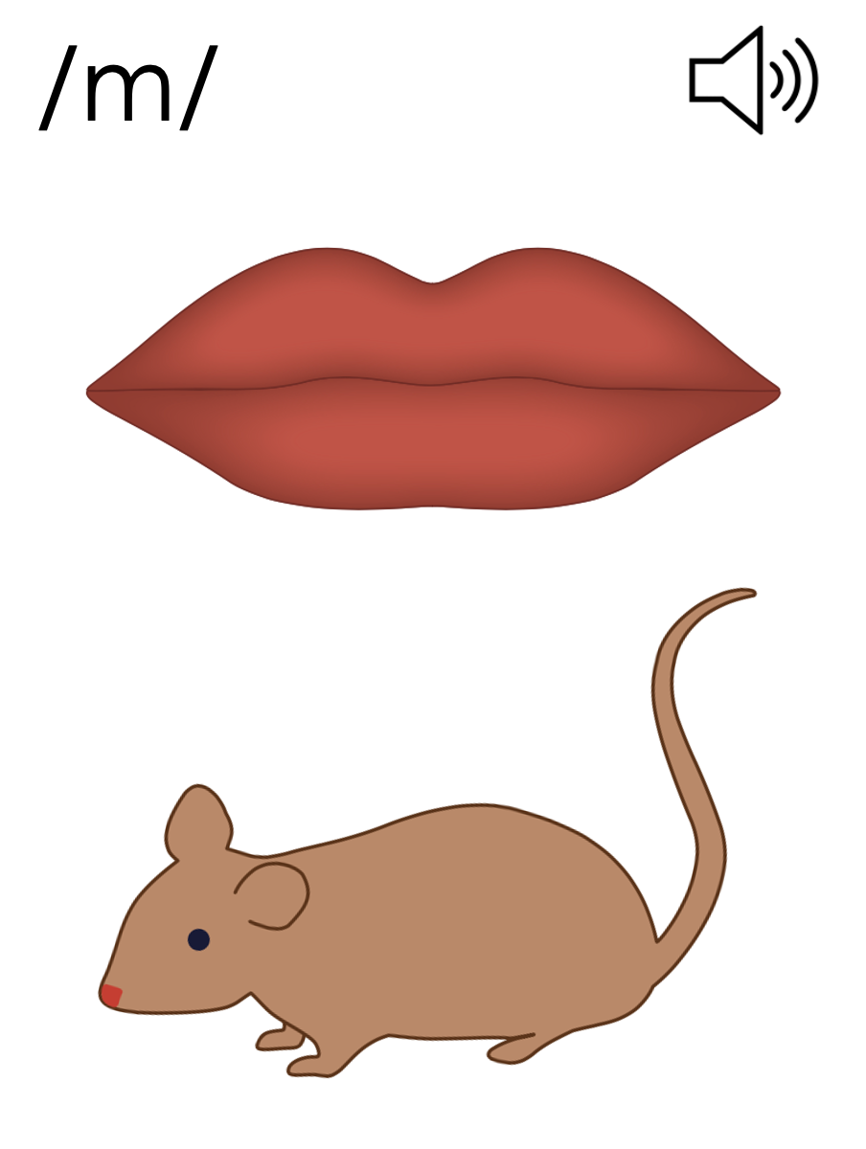
Notes:
/m/ (mouse)

Slide 17
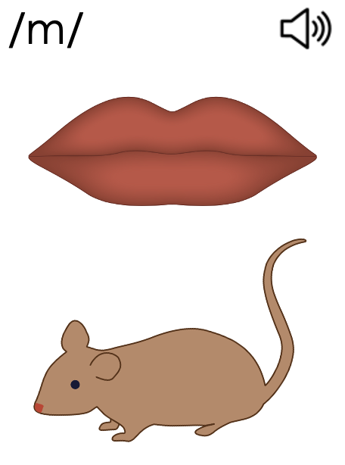
Consonants

Slide 18
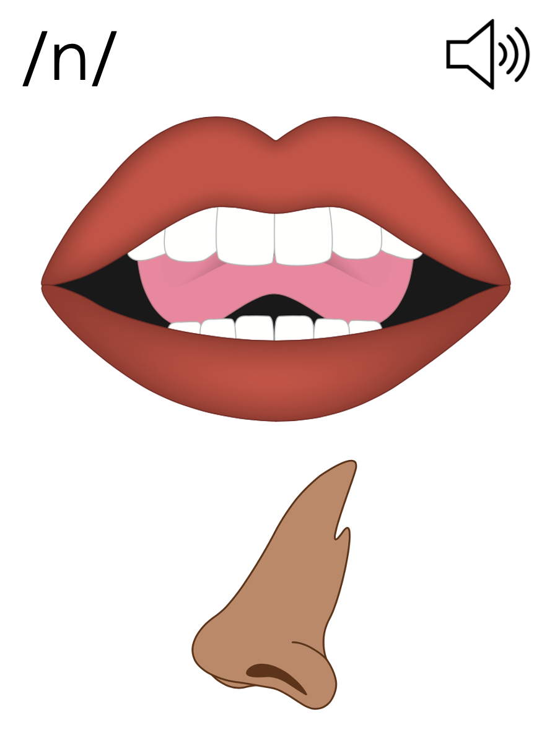
Notes:
/n/ (nose)

Slide 19
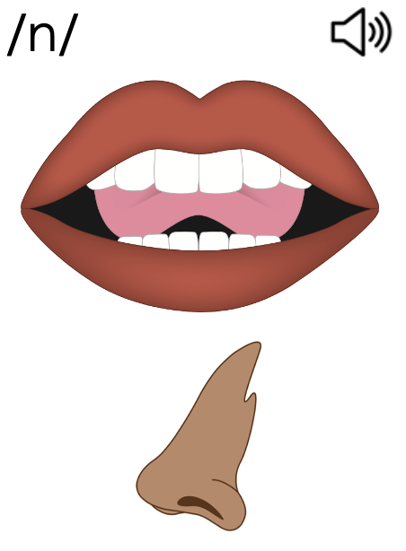
Consonants

Slide 20
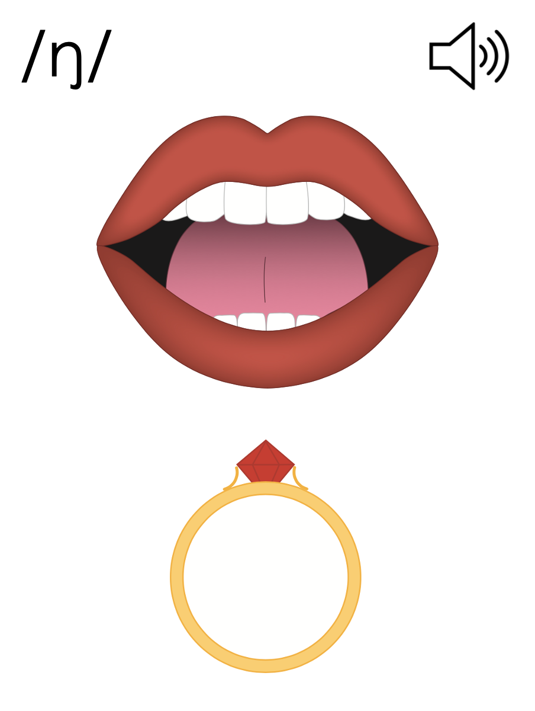
Notes:
/ŋ/ (ring)

Slide 21
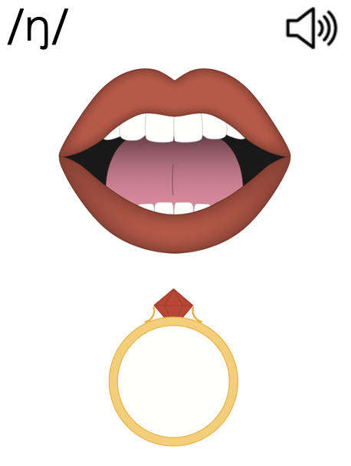
Consonants

Slide 23
Notes:
See UFLI Foundations Getting Ready lesson plans for alphabet knowledge and letter formation activity.

Slide 27
Notes:
Uppercase L gif

Slide 30
Notes:
Uppercase F gif

Slide 33
Notes:
Uppercase E gif

Slide 35
Insert brief reinforcement activity and/or transition to next part of reading block.

