Slide 1
Getting Ready
Lesson B

Slide 2
Notes:
ufliteracy.org

Slide 4
Consonants
Notes:
This slide shows the parts of the sound wall that will be used during this lesson. If using physical sound wall cards, have these cards ready to display and refer to during the sound wall step.

Slide 6
Notes:
See UFLI Foundations Getting Ready lesson plans for sound wall activity.
The sound wall activity may be completed with either the digital sound wall slides provided here or physical sound wall cards displayed in your classroom.

Slide 7
Consonants
Notes:
Introduction: Place of Articulation

Slide 8
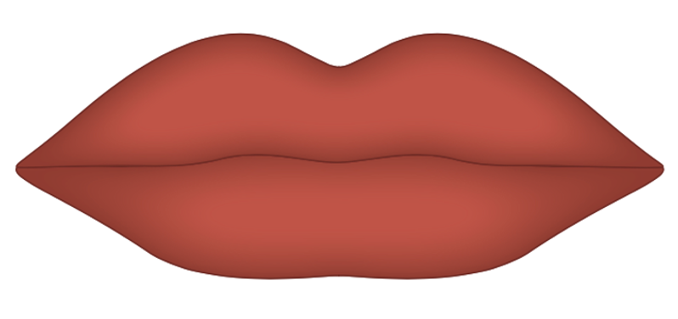
Consonants
Notes:
/p/, /b/, /m/

Slide 9
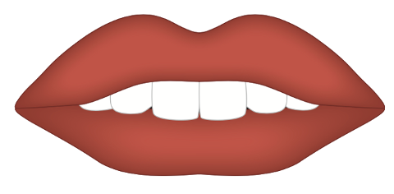
Consonants
Notes:
/f/, /v/

Slide 10
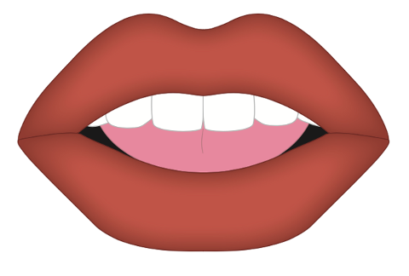
Consonants
Notes:
/th/, /th/

Slide 11
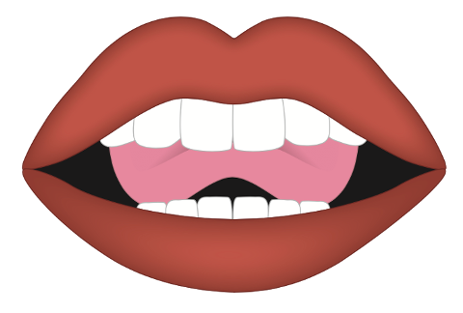
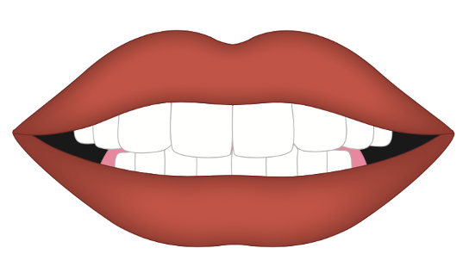
Consonants
Notes:
/t/, /d/, /n/
/s/, /z/

Slide 12
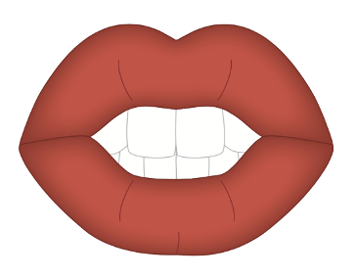
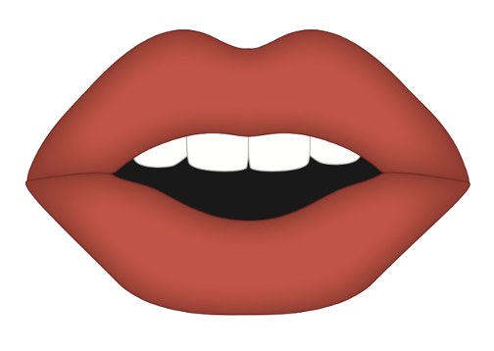
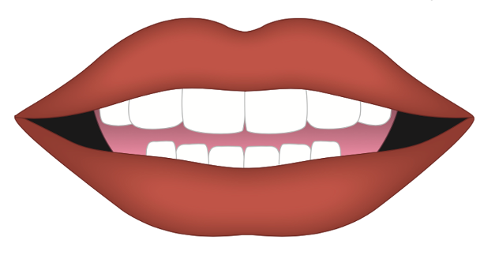
Consonants
Notes:
/sh/, /zh/, /ch/, /j/
/y/
/r/

Slide 13
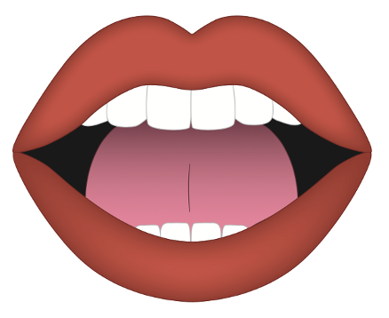
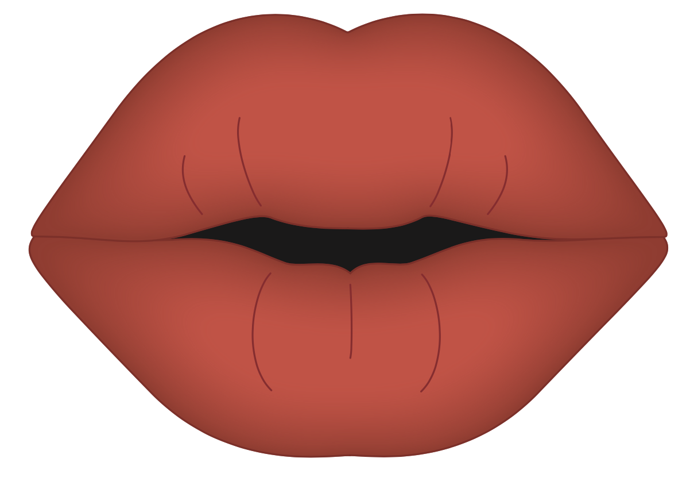
Consonants
Notes:
/k/, /g/, /ŋ/
/w/

Slide 14
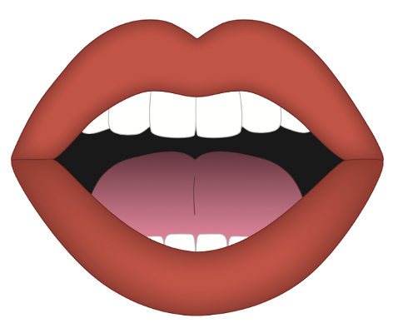
Consonants
Notes:
/h/

Slide 16
Notes:
See UFLI Foundations Getting Ready lesson plans for alphabet knowledge and letter formation activity.

Slide 17
Vertical Lines

Slide 19
Watch me write

Slide 20
Let’s write together
Notes:
vertical line gif

Slide 21
Horizontal Lines

Slide 23
Watch me write

Slide 24
Let’s write together
Notes:
horizontal line gif

Slide 25
Slanted Lines

Slide 27
Watch me write

Slide 28
Let’s write together
Notes:
\ slant gif

Slide 29
Watch me write

Slide 30
Let’s write together
Notes:
/ slant gif

Slide 32
Insert brief reinforcement activity and/or transition to next part of reading block.

