Slide 1
Lesson 4
t /t/

Slide 2
Notes:
ufliteracy.org

Slide 4
Lesson 4
t /t/

Slide 6
Notes:
See UFLI Foundations lesson plan Step 1 for phonemic awareness activity.

Slide 8
Notes:
See UFLI Foundations lesson plan Step 2 for student phoneme responses.

Slide 9
s

Slide 10
m

Slide 11
a

Slide 13
Notes:
See UFLI Foundations lesson plan Step 3 for auditory drill activity.

Slide 14
Notes:
No slides needed for auditory drill.

Slide 16
Notes:
See UFLI Foundations lesson plan Step 5 for recommended teacher language and activities to introduce the new concept.

Slide 17
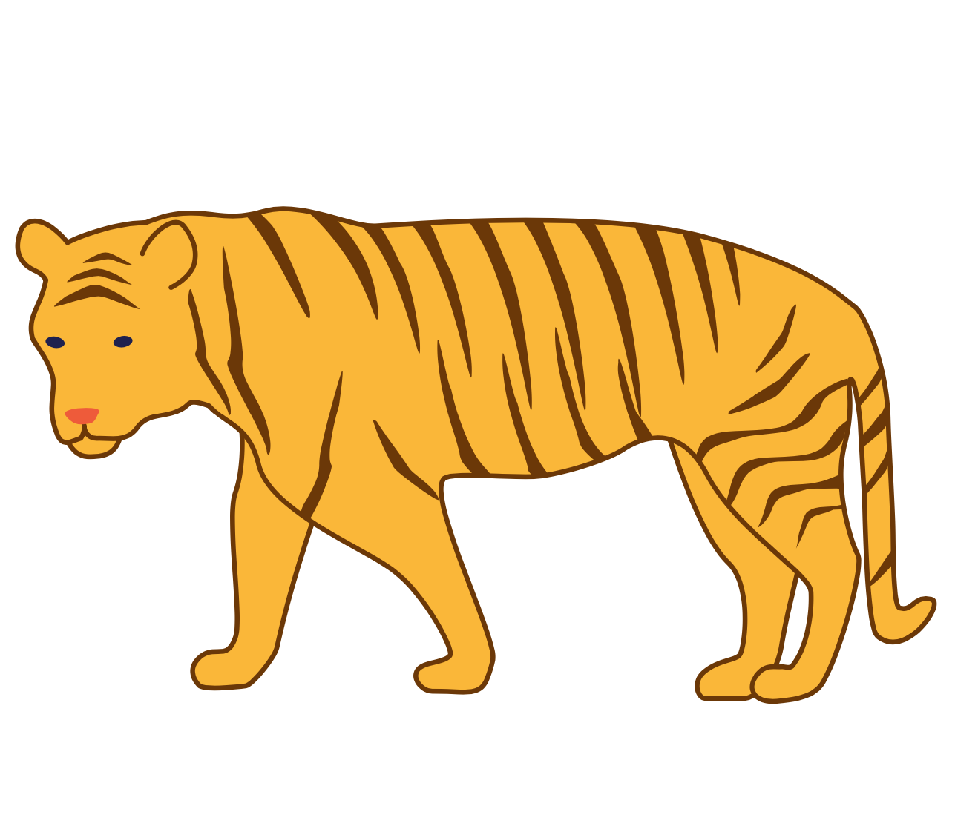
t

Slide 18
at
sat
t

Slide 19
tap
top
t

Slide 20
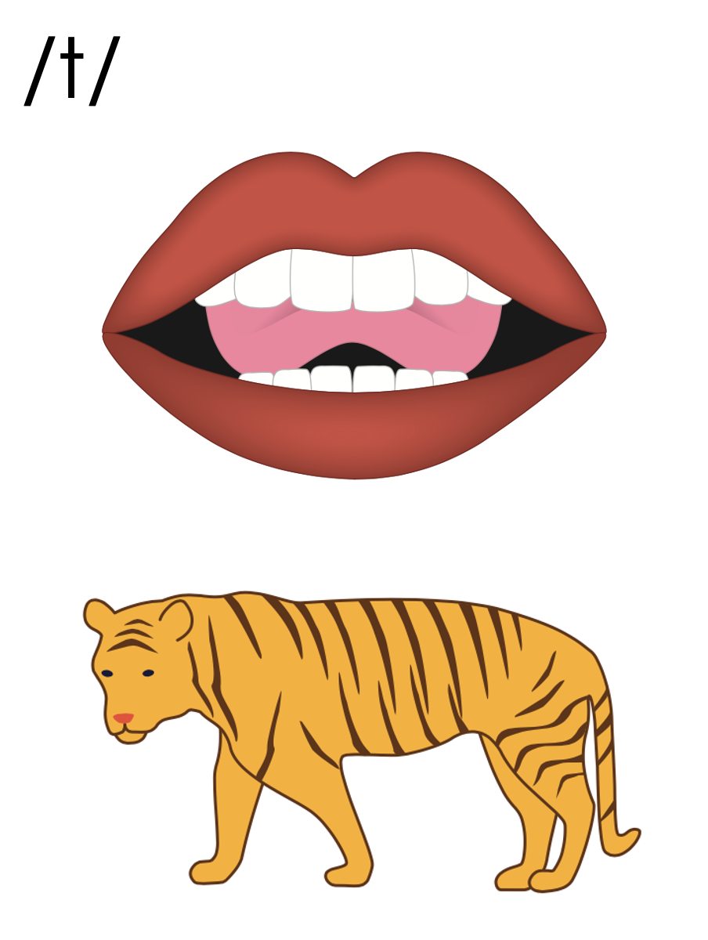
t

Slide 21
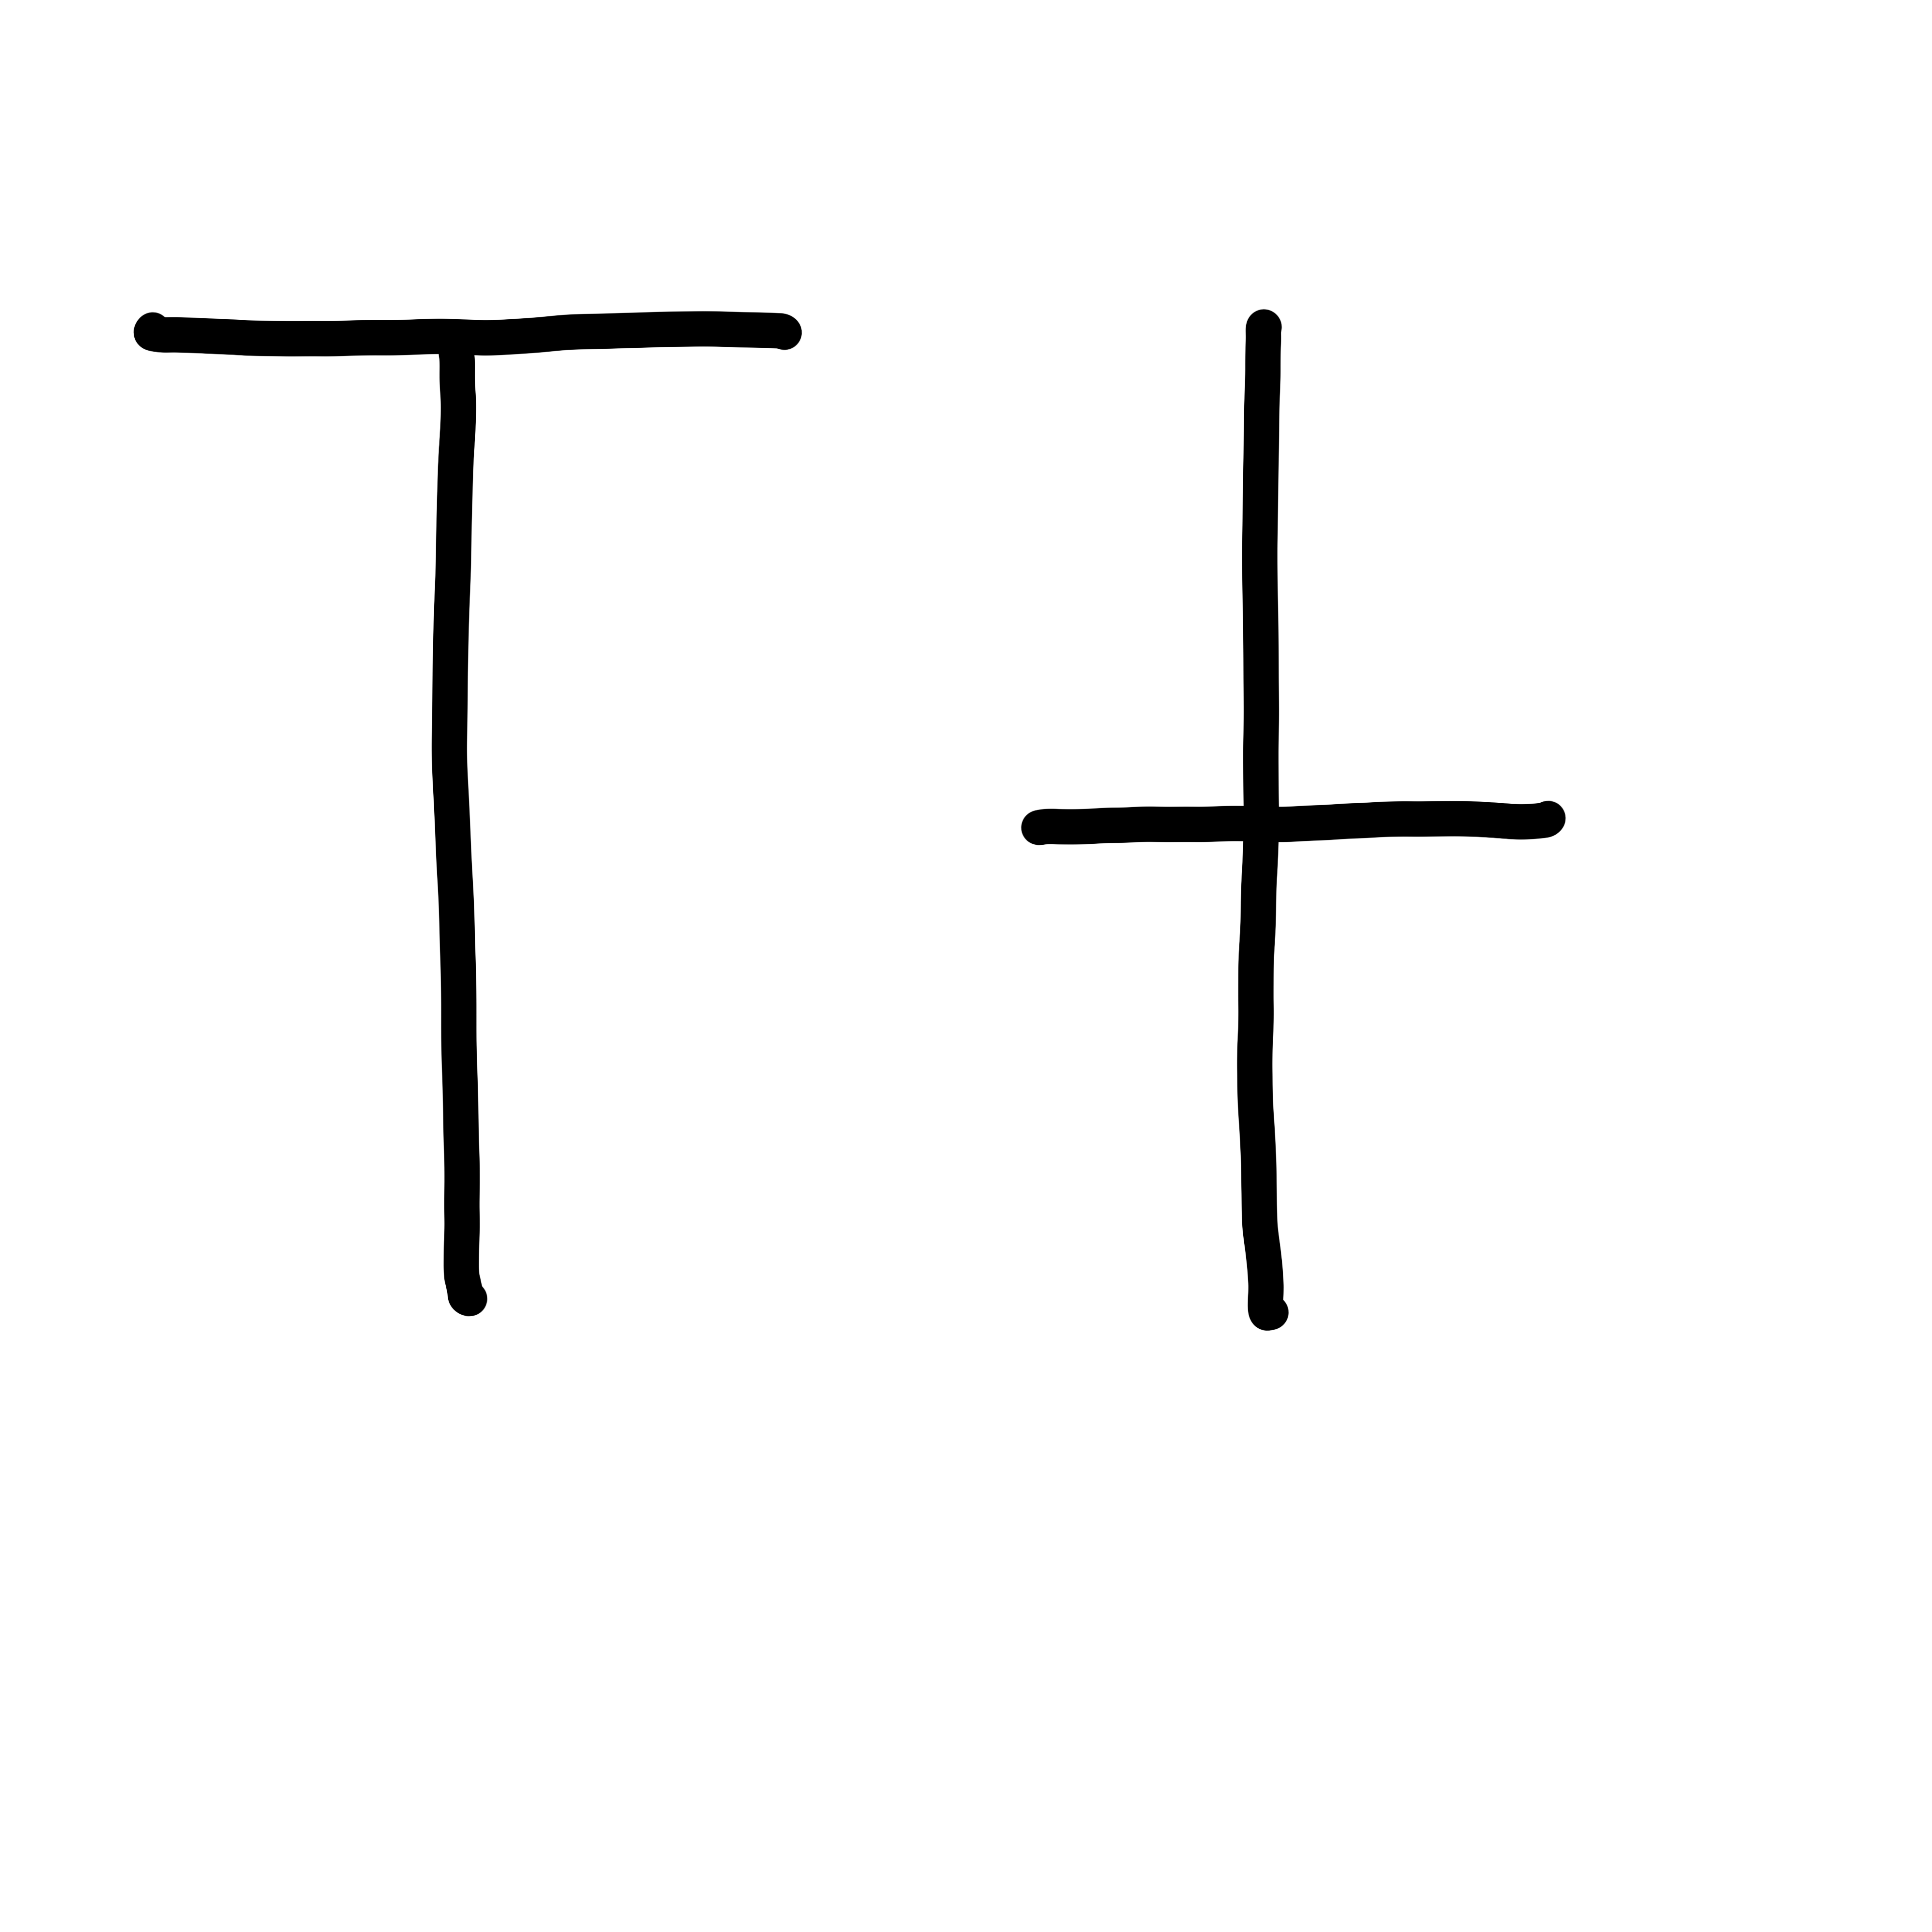

Slide 23
Notes:
Uppercase T gif

Slide 25
Notes:
Lowercase t gif

Slide 26
at
mat
sat

Slide 27
at
mat
sat

Slide 28
Notes:
See UFLI Foundations lesson plan Step 5 for words to spell.
Handwriting paper to model spelling.

Slide 29
Notes:
See UFLI Foundations lesson plan Step 5 for words to spell.
Handwriting paper for guided spelling practice.

Slide 31
Insert brief reinforcement activity and/or transition to next part of reading block.

Slide 32
Lesson 4
t /t/

Slide 34
New Concept Review
Notes:
See UFLI Foundations lesson plan Step 5 for recommended teacher language and activities to review the new concept.

Slide 35
t

Slide 36
at
sat
t

Slide 37
tap
top
t

Slide 38
t

Slide 39
Notes:
Lowercase t gif

Slide 40
at
mat
sat

Slide 42
Notes:
See UFLI Foundations lesson plan Step 6 for word work activity.
Visit ufliteracy.org to access the Word Work Mat apps.

Slide 44
Notes:
See UFLI Foundations lesson plan Step 7 for irregular word activities.
The white rectangle under each word may be used in editing mode. Cover the heart and square icons then reveal them one at a time during instruction.

Slide 45
Notes:
See UFLI Foundations manual for more information about reviewing irregular words.

Slide 46
the
Notes:
Lessons 1-45
The digraph TH has not been introduced yet.
E represents the /ŭ/ or /ə/ sound depending on stress.
The white rectangle under the word may be used in editing mode. Cover the heart and square icons then reveal them one at a time during instruction.

Slide 47
I
Notes:
Lessons 3-65
*Temporarily irregular
I /ī/ has not been introduced yet.
The white rectangle under the word may be used in editing mode. Cover the heart and square icons then reveal them one at a time during instruction.

Slide 48
Notes:
Handwriting paper for irregular word spelling practice. Use as needed.
See UFLI Foundations manual for more information about reviewing irregular words.

Slide 50
Insert brief reinforcement activity and/or transition to next part of reading block.

