Slide 1
Lesson 76
Ending Patterns Review

Slide 2
Notes:
ufliteracy.org

Slide 4
Lesson 76
Endings Pattern Review

Slide 6
Notes:
See UFLI Foundations lesson plan Step 1 for phonemic awareness activity.

Slide 8
Notes:
See UFLI Foundations lesson plan Step 2 for student phoneme responses.

Slide 9
dge

Slide 10
g

Slide 11
tch

Slide 12
ch

Slide 13
-ed

Slide 14
c

Slide 15
a

Slide 16
i

Slide 17
o

Slide 18
e

Slide 19
u

Slide 20
nk

Slide 21
ng

Slide 22
wh

Slide 23
ph

Slide 24
th

Slide 25
sh

Slide 26
ck

Slide 28
Notes:
See UFLI Foundations lesson plan Step 3 for auditory drill activity.

Slide 29
Notes:
No slides needed for auditory drill.

Slide 31
Notes:
See UFLI Foundations lesson plan Step 4 for blending drill word chain and grid.
Visit ufliteracy.org to access the Blending Board app.

Slide 33
Notes:
See UFLI Foundations lesson plan Step 5 for recommended teacher language and activities to introduce the new concept.

Slide 34
ild
wild

Slide 35
ind
mind

Slide 36
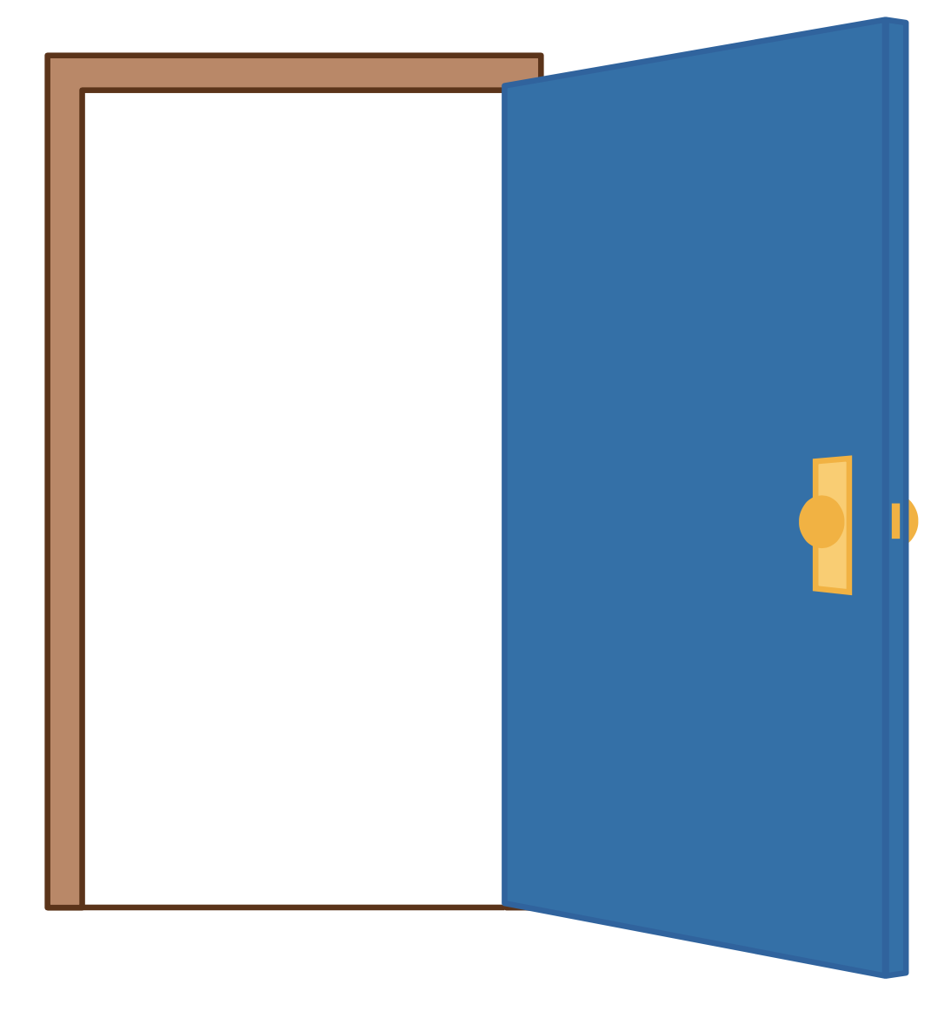
old
told

Slide 37
olt
bolt

Slide 38
ost
host

Slide 39
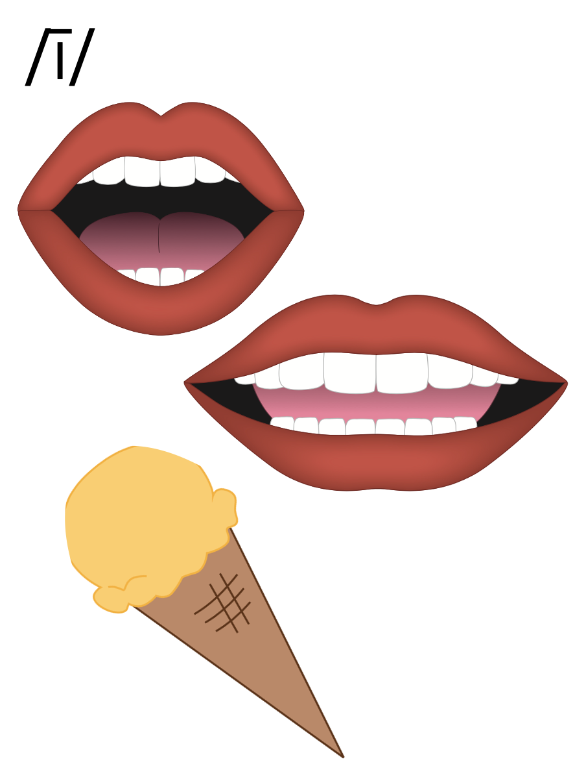
my
y

Slide 40
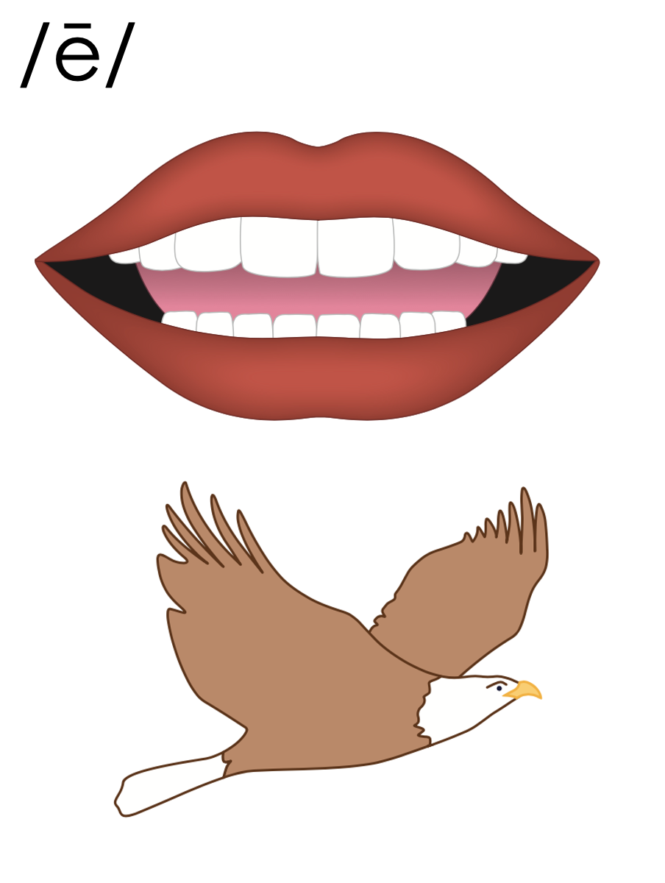
baby
puppy
y
1st syllable
2nd syllable

Slide 41
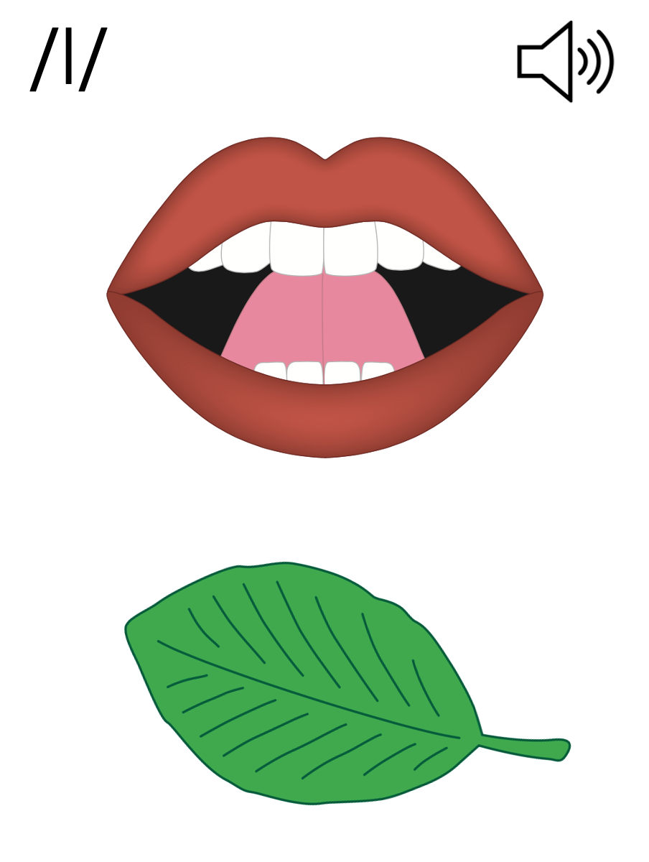
Final Stable Syllable
__ le
table
puzzle

Slide 42
Notes:
Handwriting paper for letter formation practice. Use as needed.
See UFLI Foundations manual for more information about letter formation.

Slide 43
rind
sly
lady
noble

Slide 44
wild
hold
mind
my
sky
by

Slide 45
puppy
baby
lumpy
dazzle
table
middle

Slide 46
Notes:
See UFLI Foundations lesson plan Step 5 for words to spell.
Handwriting paper to model spelling.

Slide 47
Notes:
See UFLI Foundations lesson plan Step 5 for words to spell.
Handwriting paper for guided spelling practice.

Slide 49
Insert brief reinforcement activity and/or transition to next part of reading block.

Slide 50
Lesson 76
Endings Pattern Review

Slide 52
New Concept Review
Notes:
See UFLI Foundations lesson plan Step 5 for recommended teacher language and activities to review the new concept.

Slide 53
ild
wild

Slide 54
ind
mind

Slide 55
old
told

Slide 56
olt
bolt

Slide 57
ost
host

Slide 58
my
y

Slide 59
baby
puppy
y
1st syllable
2nd syllable

Slide 60
Final Stable Syllable
__ le
table
puzzle

Slide 61
hold
try
study
little

Slide 63
Notes:
See UFLI Foundations lesson plan Step 6 for word work activity.
Visit ufliteracy.org to access the Word Work Mat apps.

Slide 65
Notes:
See UFLI Foundations lesson plan Step 7 for irregular word activities.
The white rectangle under each word may be used in editing mode. Cover the heart and square icons then reveal them one at a time during instruction.

Slide 66
Notes:
See UFLI Foundations manual for more information about reviewing irregular words.

Slide 67
four
Notes:
Lesson 73+
OUR represents the /or/ sound.
The white rectangle under the word may be used in editing mode. Cover the heart and square icons then reveal them one at a time during instruction.

Slide 68
fourth
Notes:
Lesson 73+
OUR represents the /or/ sound.
The white rectangle under the word may be used in editing mode. Cover the heart and square icons then reveal them one at a time during instruction.

Slide 69
forty
Notes:
Lesson 74+
This spelling is not irregular, but it can be confusing once a student has learned to spell FOUR and FOURTH. FORTY is often misspelled FOURTY.
Also, T may be pronounced /d/ depending on dialect.
The white rectangle under the word may be used in editing mode. Cover the heart and square icons then reveal them one at a time during instruction.

Slide 70
people
Notes:
Lesson 75+
EO represents the /ē/ sound.
The white rectangle under the word may be used in editing mode. Cover the heart and square icons then reveal them one at a time during instruction.

Slide 71
Notes:
Handwriting paper for irregular word spelling practice. Use as needed.
See UFLI Foundations manual for more information about reviewing irregular words.

Slide 73
Notes:
See UFLI Foundations lesson plan Step 8 for connected text activities.

Slide 74
Many people like candy apples.

Slide 75
Does the little pony have a bridle?

Slide 76
The lady holds the baby while walking.

Slide 77
Notes:
See UFLI Foundations lesson plan Step 8 for sentences to write.

Slide 78
Notes:
The UFLI Foundations decodable text is provided here. See UFLI Foundations decodable text guide for additional text options.

Slide 79
A Trip to the Jungle
Salma and Felix are going on a trip to the jungle. They packed their duffle bags and got on a plane to Brazil. Once in Brazil, they rode a shuttle to the jungle. In the jungle, they saw an anaconda in the grass. They also saw a sloth dangle from a vine.

Slide 80
At the end of their trip, they even got to see a puma! Pumas like to hide, so not many people get to see them in the wild. Salma and Felix were thrilled. “I am so happy we got to see these animals,” said Salma. “Me too!” said Felix.

Slide 82
Insert brief reinforcement activity and/or transition to next part of reading block.

