Slide 1
Lesson 71
tch /ch/, dge /j/
Review

Slide 2
Notes:
ufliteracy.org

Slide 4
Lesson 71
tch /ch/, dge /j/ Review

Slide 6
Notes:
See UFLI Foundations lesson plan Step 1 for phonemic awareness activity.

Slide 8
Notes:
See UFLI Foundations lesson plan Step 2 for student phoneme responses.

Slide 9
-ed

Slide 10
g

Slide 11
c

Slide 12
a

Slide 13
i

Slide 14
o

Slide 15
e

Slide 16
u

Slide 17
nk

Slide 18
ng

Slide 19
wh

Slide 20
ph

Slide 21
ch

Slide 22
th

Slide 23
sh

Slide 24
ck

Slide 25
s

Slide 27
Notes:
See UFLI Foundations lesson plan Step 3 for auditory drill activity.

Slide 28
Notes:
No slides needed for auditory drill.

Slide 30
Notes:
See UFLI Foundations lesson plan Step 4 for blending drill word chain and grid.
Visit ufliteracy.org to access the Blending Board app.

Slide 32
Notes:
See UFLI Foundations lesson plan Step 5 for recommended teacher language and activities to introduce the new concept.

Slide 33
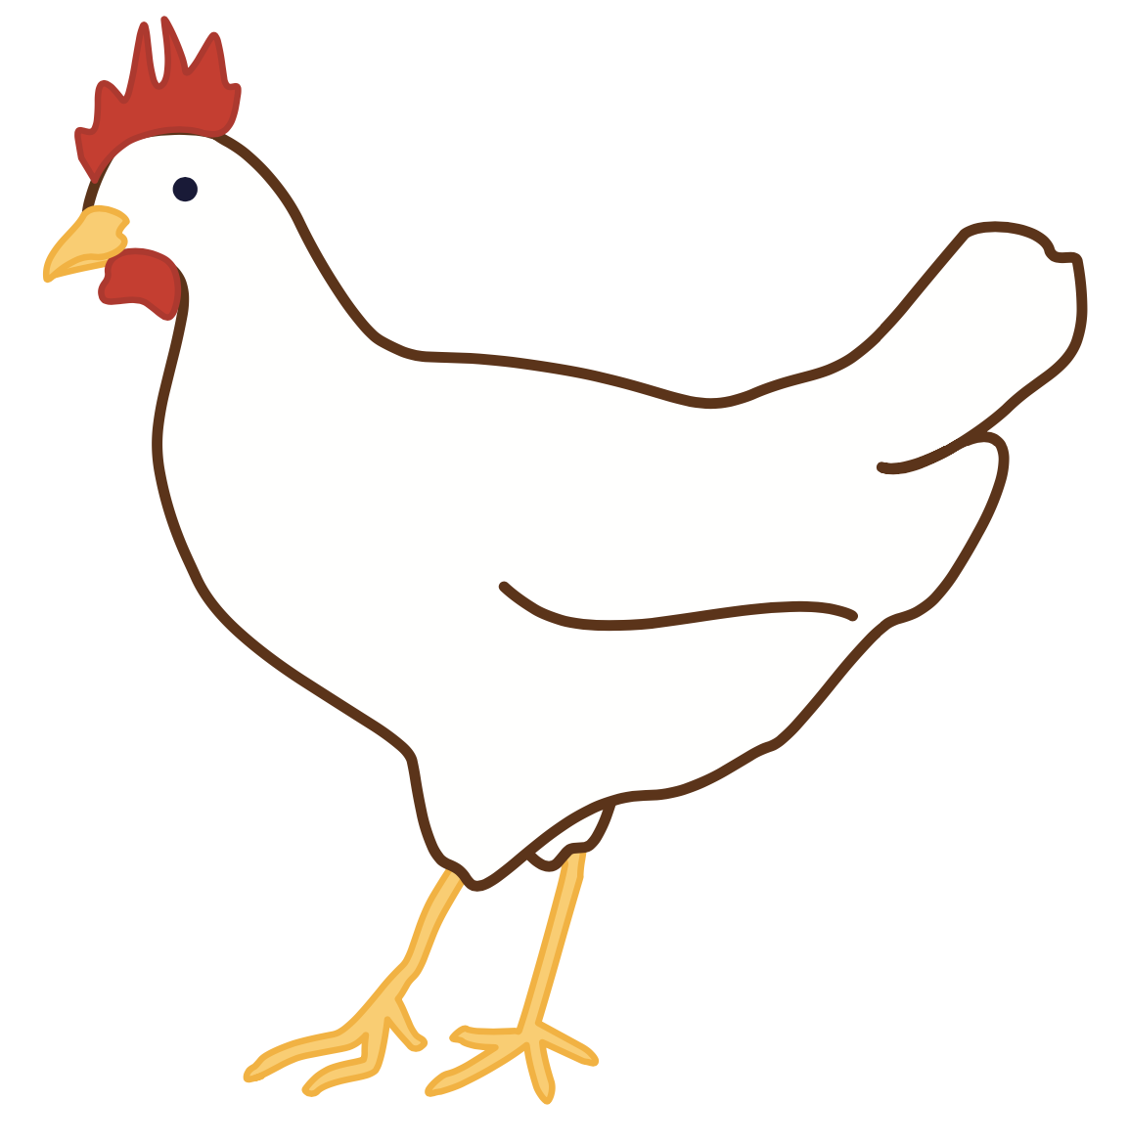
ch

Slide 34
chip
chin
ch

Slide 35
such
rich
ch

Slide 36
tch

Slide 37
catch
pitch
tch

Slide 38
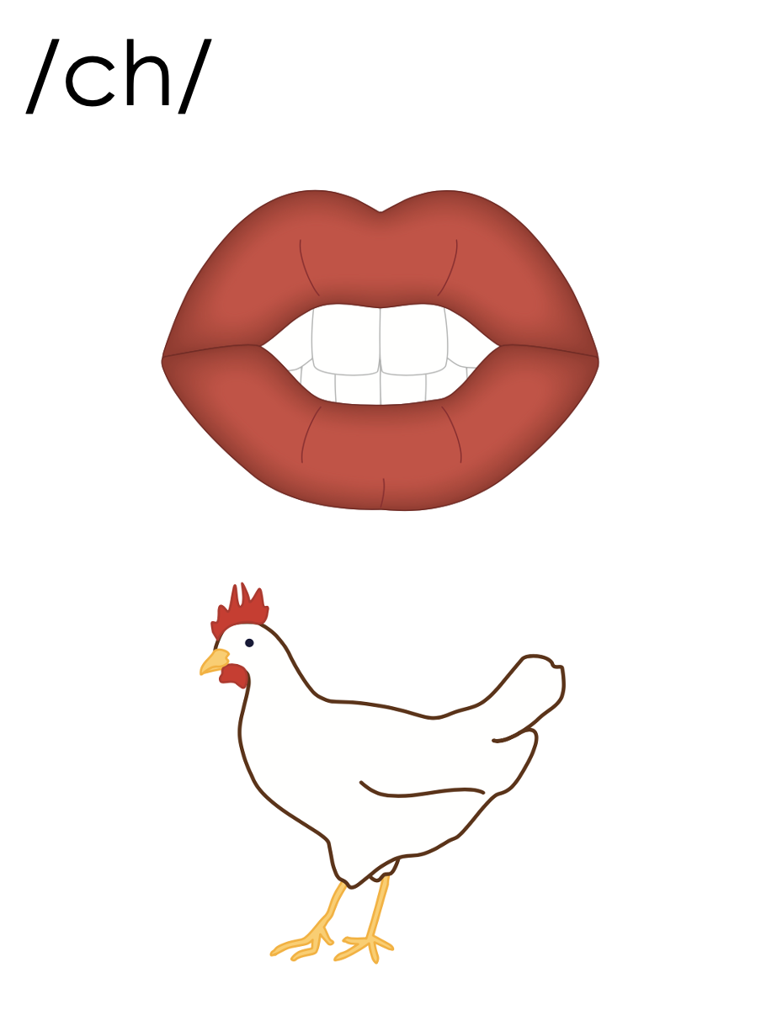
ch
tch

Slide 39
j

Slide 40
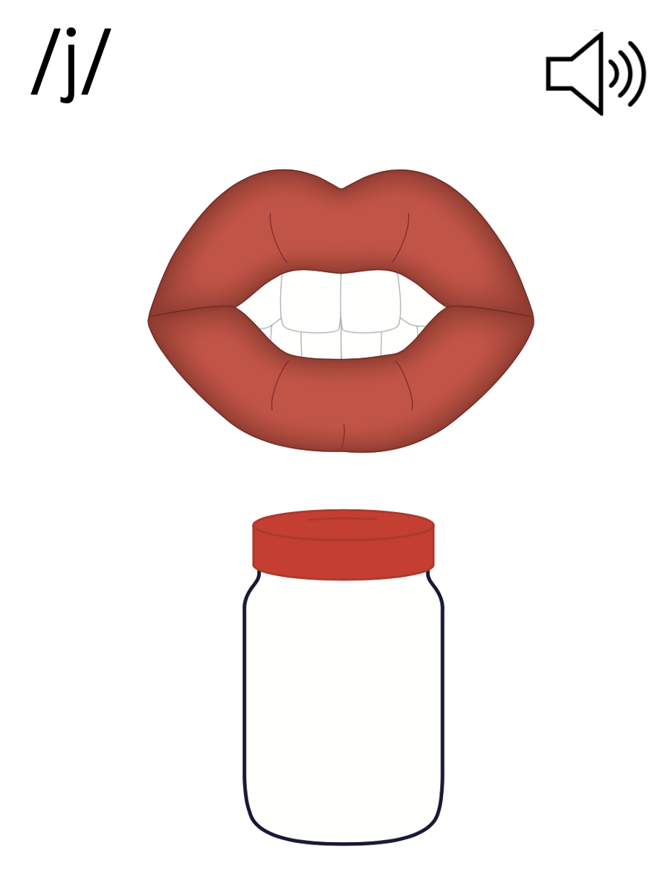
_ge
cage

Slide 41
dge

Slide 42
dodge
bridge
dge

Slide 43
j
_ge
dge

Slide 44
Notes:
Handwriting paper for letter formation practice. Use as needed.
See UFLI Foundations manual for more information about letter formation.

Slide 45
hatch
badge

Slide 46
match
ditch
patch
stretch
ridge
ledge

Slide 47
bridge
trudge
fridge

Slide 48
Notes:
See UFLI Foundations lesson plan Step 5 for words to spell.
Handwriting paper to model spelling.

Slide 49
Notes:
See UFLI Foundations lesson plan Step 5 for words to spell.
Handwriting paper for guided spelling practice.

Slide 51
Insert brief reinforcement activity and/or transition to next part of reading block.

Slide 52
Lesson 71
tch /ch/, dge /j/ Review

Slide 54
New Concept Review
Notes:
See UFLI Foundations lesson plan Step 5 for recommended teacher language and activities to review the new concept.

Slide 55
tch

Slide 56
catch
pitch
tch

Slide 57
ch
tch

Slide 58
dge

Slide 59
dodge
bridge
dge

Slide 60
j
_ge
dge

Slide 61
match
switch
fudge
pledge

Slide 63
Notes:
See UFLI Foundations lesson plan Step 6 for word work activity.
Visit ufliteracy.org to access the Word Work Mat apps.

Slide 65
Notes:
See UFLI Foundations lesson plan Step 7 for irregular word activities.
The white rectangle under each word may be used in editing mode. Cover the heart and square icons then reveal them one at a time during instruction.

Slide 66
Notes:
See UFLI Foundations manual for more information about reviewing irregular words.

Slide 67
woman
Notes:
Lesson 69+
O represents the /oo/ sound.
A represents the /ǝ/ sound.
The white rectangle under the word may be used in editing mode. Cover the heart and square icons then reveal them one at a time during instruction.

Slide 68
women
Notes:
Lesson 69+
O represents the /ĭ/ sound.
E represents the /ǝ/ sound.
The white rectangle under the word may be used in editing mode. Cover the heart and square icons then reveal them one at a time during instruction.

Slide 69
move
Notes:
Lesson 70+
O represents the /ū/ sound.
The final E is silent but does not follow the long vowel VCe pattern.
The white rectangle under the word may be used in editing mode. Cover the heart and square icons then reveal them one at a time during instruction.

Slide 70
Notes:
Handwriting paper for irregular word spelling practice. Use as needed.
See UFLI Foundations manual for more information about reviewing irregular words.

Slide 72
Notes:
See UFLI Foundations lesson plan Step 8 for connected text activities.

Slide 73
I see a smudge on my chin.

Slide 74
They have a patch that will match.

Slide 75
Mitch moved back home because he missed his friends.

Slide 76
Notes:
See UFLI Foundations lesson plan Step 8 for sentences to write.

Slide 77
Notes:
The UFLI Foundations decodable text is provided here. See UFLI Foundations decodable text guide for additional text options.

Slide 78
Robin and Stitch
Robin is walking Stitch the bulldog. They walk to a patch of grass beside a big ditch. Robin tosses a stick and Stitch dashes to fetch it. The stick lands on the edge of the ditch. “Oh no! That is a bad place for the stick to land,” thinks Robin.

Slide 79
“Stop Stitch!” she yells. Stitch stops and does not budge. Robin walks up to the edge and grabs the stick. “Good job Stitch! I got your stick. Do you want it back?” Robin tosses the stick and Stitch jumps to catch it.

Slide 81
Insert brief reinforcement activity and/or transition to next part of reading block.

