Slide 1
Lesson 98
kn /n/, wr /r/, mb /m/

Slide 2
Notes:
ufliteracy.org

Slide 4
Lesson 98
kn /n/, wr /r/, mb /m/

Slide 6
Notes:
See UFLI Foundations lesson plan Step 1 for phonemic awareness activity.

Slide 8
Notes:
See UFLI Foundations lesson plan Step 2 for student phoneme responses.

Slide 9
ou

Slide 10
ow

Slide 11
oi

Slide 12
oy

Slide 13
ea

Slide 14
a

Slide 15
aw

Slide 16
au

Slide 17
augh

Slide 18
ew

Slide 19
ui

Slide 20
ue

Slide 21
oo

Slide 22
u

Slide 23
igh

Slide 24
oa

Slide 25
ow

Slide 26
oe

Slide 27
ee

Slide 28
ai

Slide 29
ay

Slide 31
Notes:
See UFLI Foundations lesson plan Step 3 for auditory drill activity.

Slide 32
Notes:
No slides needed for auditory drill.

Slide 34
Notes:
See UFLI Foundations lesson plan Step 4 for blending drill word chain and grid.
Visit ufliteracy.org to access the Blending Board app.

Slide 36
Notes:
See UFLI Foundations lesson plan Step 5 for recommended teacher language and activities to introduce the new concept.

Slide 37
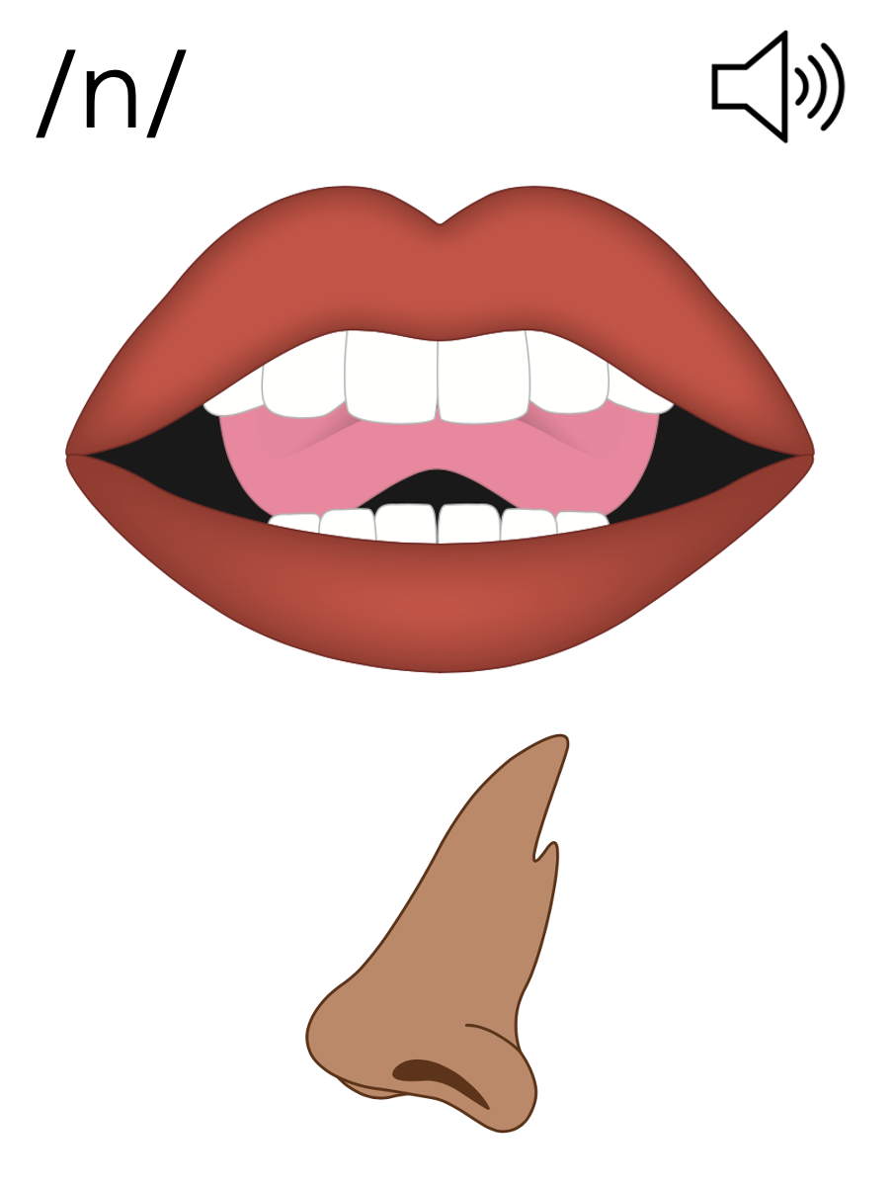
n
nose

Slide 38
kn
knee

Slide 39
knob
knit
kn

Slide 40
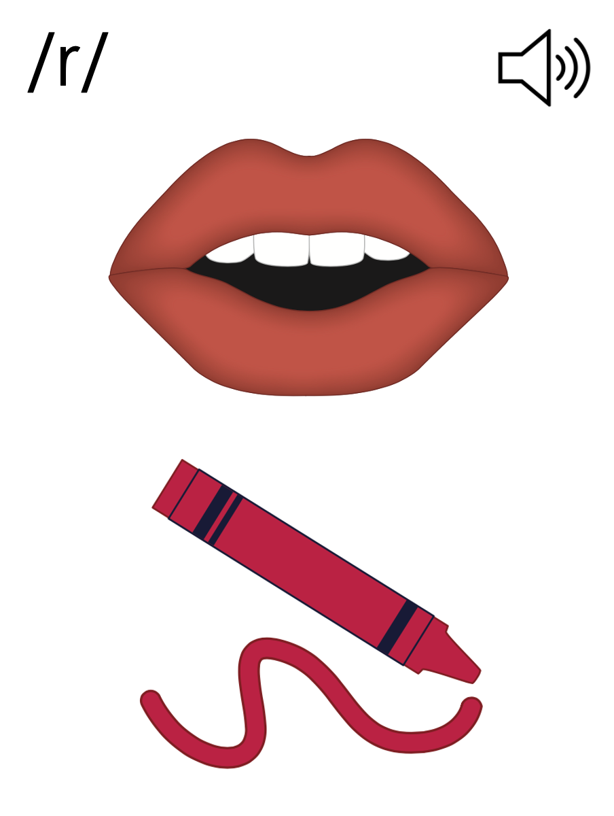
r
red

Slide 41
wr
write

Slide 42
wrap
wrist
wr

Slide 43
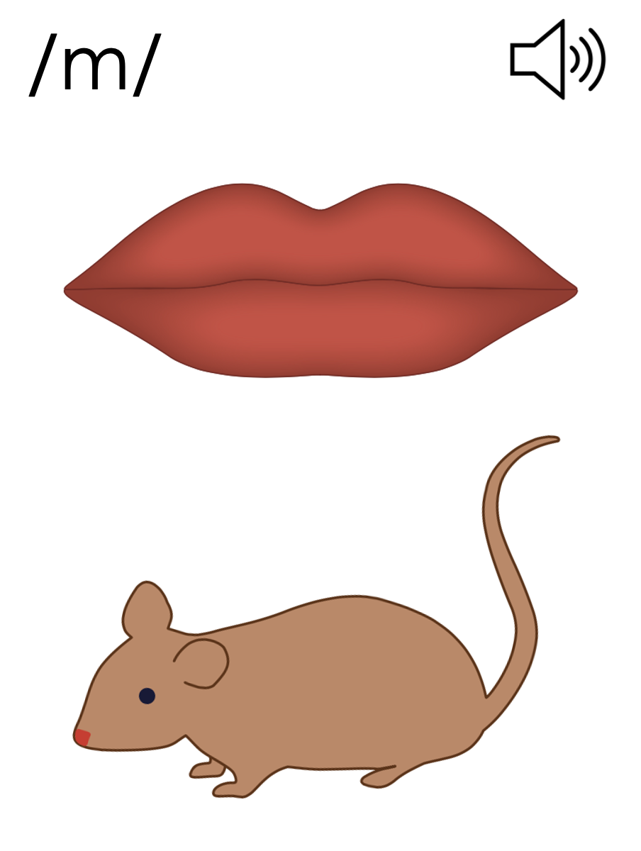
m
mouse

Slide 44
mb
comb

Slide 45
climb
numb
mb

Slide 46
n
r
m
kn
wr
mb

Slide 47
Notes:
Handwriting paper for letter formation practice. Use as needed.
See UFLI Foundations manual for more information about letter formation.

Slide 48
knot
wrap
thumb

Slide 49
know
write
wrench
knife
wreath
limb

Slide 50
crumb
knock
wreck
knelt

Slide 51
Notes:
See UFLI Foundations lesson plan Step 5 for words to spell.
Handwriting paper to model spelling.

Slide 52
Notes:
See UFLI Foundations lesson plan Step 5 for words to spell.
Handwriting paper for guided spelling practice.

Slide 54
Insert brief reinforcement activity and/or transition to next part of reading block.

Slide 55
Lesson 98
kn /n/, wr /r/, mb /m/

Slide 57
New Concept Review
Notes:
See UFLI Foundations lesson plan Step 5 for recommended teacher language and activities to review the new concept.

Slide 58
n
nose

Slide 59
kn
knee

Slide 60
knob
knit
kn

Slide 61
r
red

Slide 62
wr
write

Slide 63
wrap
wrist
wr

Slide 64
m
mouse

Slide 65
mb
comb

Slide 66
climb
numb
mb

Slide 67
n
r
m
kn
wr
mb

Slide 68
know
write
thumb

Slide 70
Notes:
See UFLI Foundations lesson plan Step 6 for word work activity.
Visit ufliteracy.org to access the Word Work Mat apps.

Slide 72
Notes:
See UFLI Foundations lesson plan Step 7 for irregular word activities.
The white rectangle under each word may be used in editing mode. Cover the heart and square icons then reveal them one at a time during instruction.

Slide 73
Notes:
See UFLI Foundations manual for more information about reviewing irregular words.

Slide 74
February
Notes:
Lesson 95+
AR represents the /air/ sound.
In some dialects, the R is silent, and U may be pronounced /yū/ or /ŭ/
The white rectangle under the word may be used in editing mode. Cover the heart and square icons then reveal them one at a time during instruction.

Slide 75
eye
Notes:
Lesson 96+
EYE represents the /ī/ sound.
The white rectangle under the word may be used in editing mode. Cover the heart and square icons then reveal them one at a time during instruction.

Slide 76
heart
Notes:
Lesson 96+
EAR represents the /ar/ sound.
The white rectangle under the word may be used in editing mode. Cover the heart and square icons then reveal them one at a time during instruction.

Slide 77
Notes:
Handwriting paper for irregular word spelling practice. Use as needed.
See UFLI Foundations manual for more information about reviewing irregular words.

Slide 78
Teach
Notes:
The orange star indicates these are new irregular words that need to be introduced.
See UFLI Foundations manual for more information about teaching irregular words.

Slide 79
about
Notes:
Lesson 98+
A represents the /ə/ or the /ŭ/ sound, depending on stress.
The white rectangle under the word may be used in editing mode. Cover the heart and square icons then reveal them one at a time during instruction.

Slide 80
Notes:
Handwriting paper for irregular word spelling practice. Use as needed.
See UFLI Foundations manual for more information about teaching irregular words.

Slide 82
Notes:
See UFLI Foundations lesson plan Step 8 for connected text activities.

Slide 83
Grandma knits for about twenty minutes each night.

Slide 84
Please clean up your crumbs after you eat.

Slide 85
I know how to wrap gifts very well.

Slide 86
Notes:
See UFLI Foundations lesson plan Step 8 for sentences to write.

Slide 87
Notes:
The UFLI Foundations decodable text is provided here. See UFLI Foundations decodable text guide for additional text options.

Slide 88
Birdwatching
With her notebook in hand, Cassie walked into the forest ready to study some birds. She loved birdwatching, and she had a knack for finding birds in new places. As she walked, she wrote down the names of the different birds she saw. She would even sketch a drawing of each bird in her notebook.

Slide 89
About one hour into her hike, Cassie knelt to rest and eat a snack. As she ate, large crumbs fell to the ground. Snap! Cassie heard a noise very close to her. When she turned around, she saw a small brown bird pecking at her leftover crumbs.

Slide 90
It was a wren! Cassie had never seen a wren in real life, but she knows about them from reading her books.
Cassie knows that wrens have short wings and hold their tails upright. Wrens are also known for singing loud, complex songs. This little wren seemed to love Cassie’s snack.

Slide 91
When all the crumbs were gone, the wren lifted its wings. Cassie watched it fly away into the forest. Cassie was so thrilled with her wren sighting that she sang a long tune all the way home.

Slide 93
Insert brief reinforcement activity and/or transition to next part of reading block.

