Slide 1
Lesson 94
ea /ĕ/, a /ŏ/

Slide 2
Notes:
ufliteracy.org

Slide 4
Lesson 94
ea /ĕ/, a /ŏ/

Slide 6
Notes:
See UFLI Foundations lesson plan Step 1 for phonemic awareness activity.

Slide 8
Notes:
See UFLI Foundations lesson plan Step 2 for student phoneme responses.

Slide 9
aw

Slide 10
au

Slide 11
augh

Slide 12
ew

Slide 13
ui

Slide 14
ue

Slide 15
oo

Slide 16
u

Slide 17
igh

Slide 18
oa

Slide 19
ow

Slide 20
oe

Slide 21
ee

Slide 22
ey

Slide 23
ea

Slide 24
ai

Slide 25
ay

Slide 26
ir

Slide 27
ur

Slide 28
er

Slide 29
or

Slide 30
ar

Slide 32
Notes:
See UFLI Foundations lesson plan Step 3 for auditory drill activity.

Slide 33
Notes:
No slides needed for auditory drill.

Slide 35
Notes:
See UFLI Foundations lesson plan Step 4 for blending drill word chain and grid.
Visit ufliteracy.org to access the Blending Board app.

Slide 37
Notes:
See UFLI Foundations lesson plan Step 5 for recommended teacher language and activities to introduce the new concept.

Slide 38
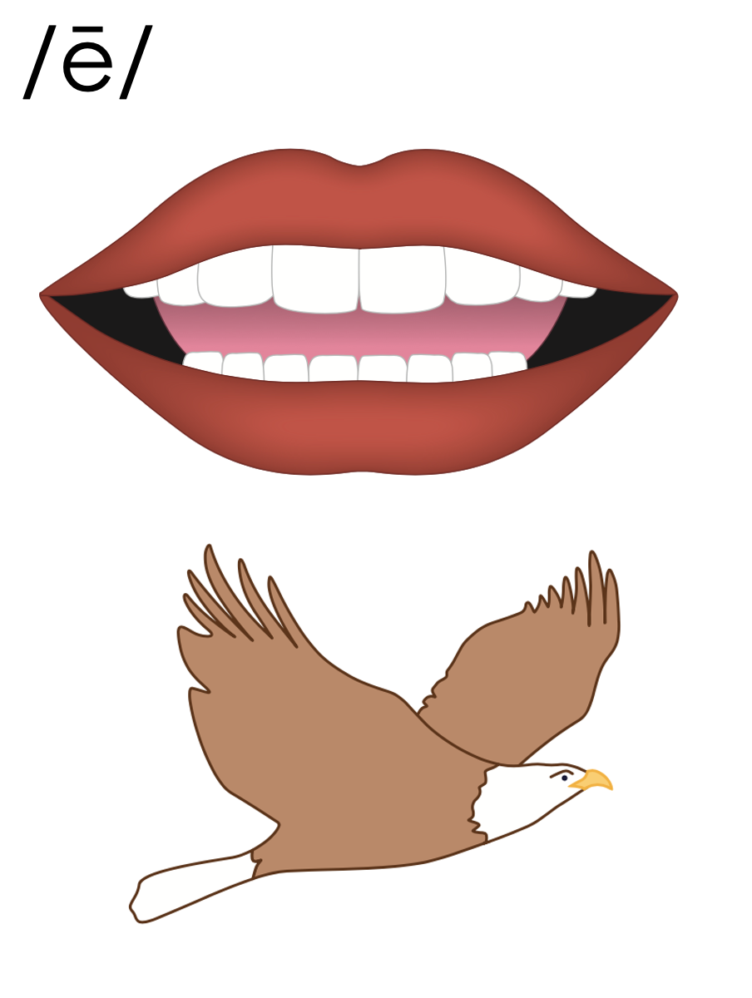
mean
ea
team

Slide 39
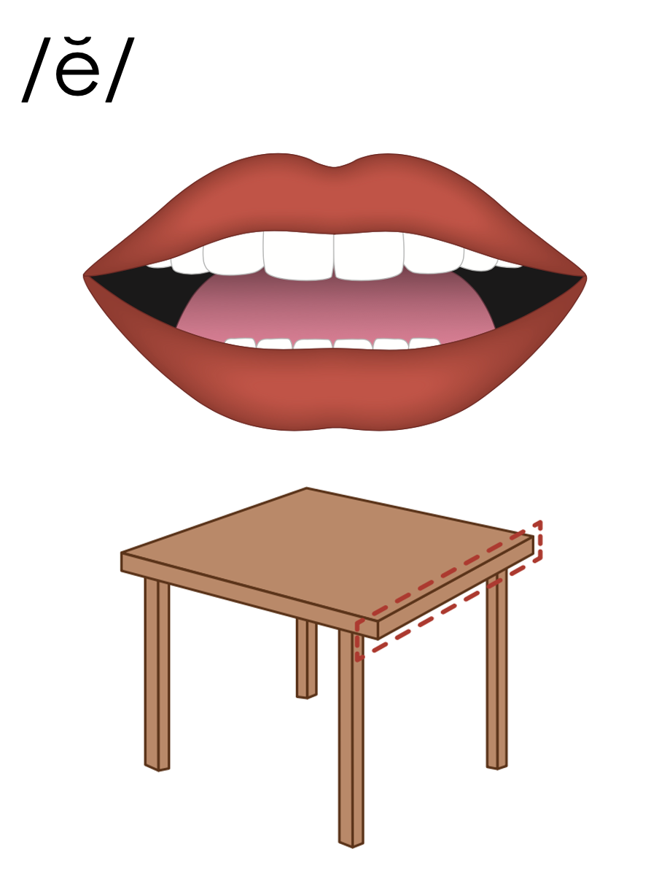
head
dead
ea
read
thread
bread

Slide 40
watch
water
a
father
wash
swamp

Slide 41
e
o
ea
a

Slide 42
Notes:
Handwriting paper for letter formation practice. Use as needed.
See UFLI Foundations manual for more information about letter formation.

Slide 43
head
wash

Slide 44
head
read
bread
meant
spread
heavy

Slide 45
feather
want
water
watch
father

Slide 46
Notes:
See UFLI Foundations lesson plan Step 5 for words to spell.
Handwriting paper to model spelling.

Slide 47
Notes:
See UFLI Foundations lesson plan Step 5 for words to spell.
Handwriting paper for guided spelling practice.

Slide 49
Insert brief reinforcement activity and/or transition to next part of reading block.

Slide 50
Lesson 94
ea /ĕ/, a /ŏ/

Slide 52
New Concept Review
Notes:
See UFLI Foundations lesson plan Step 5 for recommended teacher language and activities to review the new concept.

Slide 53
mean
ea
team

Slide 54
head
dead
ea
read
thread
bread

Slide 55
watch
water
a
father
wash
swamp

Slide 56
e
o
ea
a

Slide 57
head
read
watch
wash

Slide 59
Notes:
See UFLI Foundations lesson plan Step 6 for word work activity.
Visit ufliteracy.org to access the Word Work Mat apps.

Slide 61
Notes:
See UFLI Foundations lesson plan Step 7 for irregular word activities.
The white rectangle under each word may be used in editing mode. Cover the heart and square icons then reveal them one at a time during instruction.

Slide 62
Notes:
See UFLI Foundations manual for more information about reviewing irregular words.

Slide 63
won
Notes:
Lesson 90+
O represents the /ŭ/ sound.
The white rectangle under the word may be used in editing mode. Cover the heart and square icons then reveal them one at a time during instruction.

Slide 64
son
Notes:
Lesson 90+
O represents the /ŭ/ sound.
The white rectangle under the word may be used in editing mode. Cover the heart and square icons then reveal them one at a time during instruction.

Slide 65
month
Notes:
Lesson 91+
O represents the /ŭ/ sound.
The white rectangle under the word may be used in editing mode. Cover the heart and square icons then reveal them one at a time during instruction.

Slide 66
hour
Notes:
Lesson 93+
H is silent.
The white rectangle under the word may be used in editing mode. Cover the heart and square icons then reveal them one at a time during instruction.

Slide 67
minute
Notes:
Lesson 93+
U represents the /ə/ or /ĭ/ sound depending on stress.
The final E is silent but does not follow the long vowel VCe pattern.
The white rectangle under the word may be used in editing mode. Cover the heart and square icons then reveal them one at a time during instruction.

Slide 68
Notes:
Handwriting paper for irregular word spelling practice. Use as needed.
See UFLI Foundations manual for more information about reviewing irregular words.

Slide 69
Teach
Notes:
The orange star indicates these are new irregular words that need to be introduced.
See UFLI Foundations manual for more information about teaching irregular words.

Slide 70
Monday
Notes:
Lesson 94+
O represents the /ŭ/ sound.
Depending on dialect, AY may be pronounced /ē/.
The white rectangle under the word may be used in editing mode. Cover the heart and square icons then reveal them one at a time during instruction.

Slide 71
Wednesday
Notes:
Lesson 94+
D is silent.
E is silent.
Depending on dialect, AY may be pronounced /ē/.
The white rectangle under the word may be used in editing mode. Cover the heart and square icons then reveal them one at a time during instruction.

Slide 72
Notes:
Handwriting paper for irregular word spelling practice. Use as needed.
See UFLI Foundations manual for more information about teaching irregular words.

Slide 74
Notes:
See UFLI Foundations lesson plan Step 8 for connected text activities.

Slide 75
Watch out for sharks in the water.

Slide 76
On Monday we will sweat a lot.

Slide 77
We will wash the car on Wednesday.

Slide 78
Notes:
See UFLI Foundations lesson plan Step 8 for sentences to write.

Slide 79
Notes:
The UFLI Foundations decodable text is provided here. See UFLI Foundations decodable text guide for additional text options.

Slide 80
Surprise on the Track
“Ready, set, go!” yelled the track coach. The first race of the fourth-grade track meet had begun. Heather had been waiting for this track meet for months. She was ready to win.

Slide 81
At first, Heather took the lead. But, as she sprinted to the finish line, she saw some other fourth graders catching up to her. She did not want to give up her lead. She worked on keeping her breath steady as she ran and leaped over the hurdles.

Slide 82
Heather was almost to the finish line when, all of a sudden, she saw something white wander onto the track. “A swan!” yelled a child in the stands. A swan wandered onto the track from the swamp up the road. The swan began to waddle to the finish line.

Slide 83
Heather crossed the finish line at the same exact time as the swan. “So, who won the race?” asked the class. “It’s a tie! Heather and the swan both won!” exclaimed the track coach.

Slide 85
Insert brief reinforcement activity and/or transition to next part of reading block.

