Slide 1
Lesson 93
au, aw, augh /aw/

Slide 2
Notes:
ufliteracy.org

Slide 4
Lesson 93
au, aw, augh /aw/

Slide 6
Notes:
See UFLI Foundations lesson plan Step 1 for phonemic awareness activity.

Slide 8
Notes:
See UFLI Foundations lesson plan Step 2 for student phoneme responses.

Slide 9
ew

Slide 10
ui

Slide 11
ue

Slide 12
oo

Slide 13
u

Slide 14
igh

Slide 15
oa

Slide 16
ow

Slide 17
oe

Slide 18
ee

Slide 19
ea

Slide 20
ey

Slide 21
ai

Slide 22
ay

Slide 23
ir

Slide 24
ur

Slide 25
er

Slide 26
or

Slide 27
ore

Slide 28
ar

Slide 29
y

Slide 31
Notes:
See UFLI Foundations lesson plan Step 3 for auditory drill activity.

Slide 32
Notes:
No slides needed for auditory drill.

Slide 34
Notes:
See UFLI Foundations lesson plan Step 4 for blending drill word chain and grid.
Visit ufliteracy.org to access the Blending Board app.

Slide 36
Notes:
See UFLI Foundations lesson plan Step 5 for recommended teacher language and activities to introduce the new concept.

Slide 37
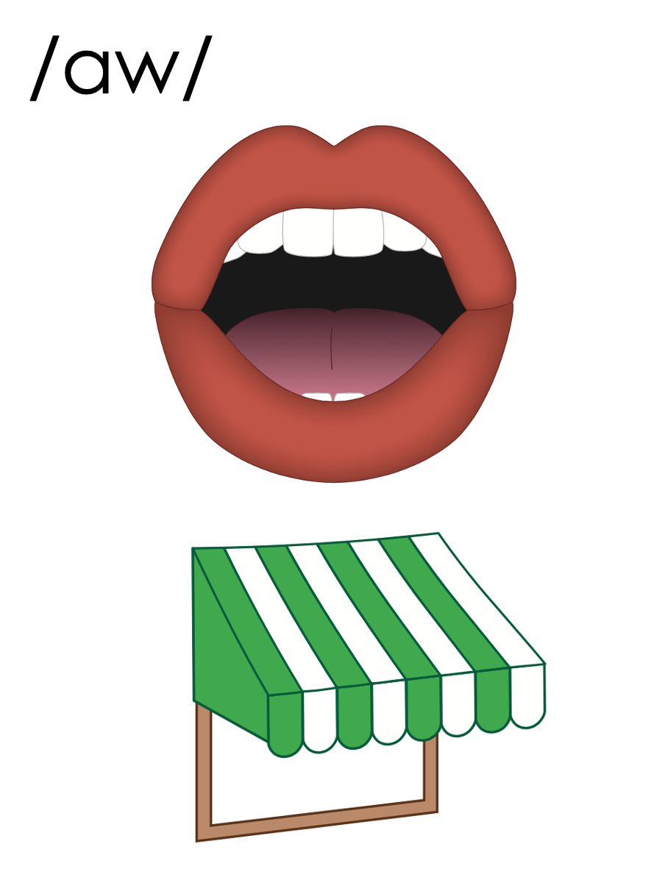
aw

Slide 38
lawn
hawk
aw

Slide 39
paw
law
aw

Slide 40
awe
aw

Slide 41
au

Slide 42
haul
fault
au

Slide 43
augh

Slide 44
caught
augh

Slide 45
au
aw
augh

Slide 46
Notes:
Handwriting paper for letter formation practice. Use as needed.
See UFLI Foundations manual for more information about letter formation.

Slide 47
draw
haul
taught
seesaw

Slide 48
law
saw
straw
crawl
launch
cause

Slide 49
fault
caught
withdraw

Slide 50
Notes:
See UFLI Foundations lesson plan Step 5 for words to spell.
Handwriting paper to model spelling.

Slide 51
Notes:
See UFLI Foundations lesson plan Step 5 for words to spell.
Handwriting paper for guided spelling practice.

Slide 53
Insert brief reinforcement activity and/or transition to next part of reading block.

Slide 54
Lesson 93
au, aw, augh /aw/

Slide 56
New Concept Review
Notes:
See UFLI Foundations lesson plan Step 5 for recommended teacher language and activities to review the new concept.

Slide 57
aw

Slide 58
lawn
hawk
aw

Slide 59
paw
law
aw

Slide 60
awe
aw

Slide 61
au

Slide 62
haul
fault
au

Slide 63
augh

Slide 64
caught
augh

Slide 65
au
aw
augh

Slide 66
fault
draw
saw
taught

Slide 68
Notes:
See UFLI Foundations lesson plan Step 6 for word work activity.
Visit ufliteracy.org to access the Word Work Mat apps.

Slide 70
Notes:
See UFLI Foundations lesson plan Step 7 for irregular word activities.
The white rectangle under each word may be used in editing mode. Cover the heart and square icons then reveal them one at a time during instruction.

Slide 71
Notes:
See UFLI Foundations manual for more information about reviewing irregular words.

Slide 72
floor
Notes:
Lesson 89+
OOR represents the /or/ sound.
The white rectangle under the word may be used in editing mode. Cover the heart and square icons then reveal them one at a time during instruction.

Slide 73
poor
Notes:
Lesson 89+
OOR represents the /or/ sound.
The white rectangle under the word may be used in editing mode. Cover the heart and square icons then reveal them one at a time during instruction.

Slide 74
door
Notes:
Lesson 89+
OOR represents the /or/ sound.
The white rectangle under the word may be used in editing mode. Cover the heart and square icons then reveal them one at a time during instruction.

Slide 75
won
Notes:
Lesson 90+
O represents the /ŭ/ sound.
The white rectangle under the word may be used in editing mode. Cover the heart and square icons then reveal them one at a time during instruction.

Slide 76
son
Notes:
Lesson 90+
O represents the /ŭ/ sound.
The white rectangle under the word may be used in editing mode. Cover the heart and square icons then reveal them one at a time during instruction.

Slide 77
month
Notes:
Lesson 91+
O represents the /ŭ/ sound.
The white rectangle under the word may be used in editing mode. Cover the heart and square icons then reveal them one at a time during instruction.

Slide 78
Notes:
Handwriting paper for irregular word spelling practice. Use as needed.
See UFLI Foundations manual for more information about reviewing irregular words.

Slide 79
Teach
Notes:
The orange star indicates these are new irregular words that need to be introduced.
See UFLI Foundations manual for more information about teaching irregular words.

Slide 80
hour
Notes:
Lesson 93+
H is silent.
The white rectangle under the word may be used in editing mode. Cover the heart and square icons then reveal them one at a time during instruction.

Slide 81
minute
Notes:
Lesson 93+
U represents the /ə/ or /ĭ/ sound depending on stress.
The final E is silent but does not follow the long vowel VCe pattern.
The white rectangle under the word may be used in editing mode. Cover the heart and square icons then reveal them one at a time during instruction.

Slide 82
Notes:
Handwriting paper for irregular word spelling practice. Use as needed.
See UFLI Foundations manual for more information about teaching irregular words.

Slide 84
Notes:
See UFLI Foundations lesson plan Step 8 for connected text activities.

Slide 85
I always yawn at this late hour.

Slide 86
She taught me to draw what I saw.

Slide 87
I picked up more sauce at the last minute.

Slide 88
Notes:
See UFLI Foundations lesson plan Step 8 for sentences to write.

Slide 89
Notes:
The UFLI Foundations decodable text is provided here. See UFLI Foundations decodable text guide for additional text options.

Slide 90
Trip to the Zoo
Audrey and Willow could not wait to see all the animals at the zoo. As they reached the entrance, Audrey paused and asked, “did you bring the tickets?” “Yes! I have them right here,” said Willow.

Slide 91
The first display they visited was full of birds. “Look at that pretty macaw! Its wings are like a rainbow,” exclaimed Audrey. “I see the macaw,” responded Willow, “but look at this hawk! It caught a fish in its claws.” Willow could have spent hours at the bird display, but Audrey said she wanted to see more animals.

Slide 92
The next display contained a lion sleeping on a large lawn. The lion woke up for five minutes, but then yawned and fell back asleep. “He seems to have day and night mixed up,” snickered Audrey.

Slide 93
“Well, it’s not his fault. If I had to hunt for my food, I would want a nap too,” Willow commented. Audrey smirked and said, “That reminds me, I am hungry. Can we go hunt for some food at the snack stand?”

Slide 95
Insert brief reinforcement activity and/or transition to next part of reading block.

