Slide 1
Lesson 92
Vowel Teams Review 2

Slide 2
Notes:
ufliteracy.org

Slide 4
Lesson 92
Vowel Teams Review 2

Slide 6
Notes:
See UFLI Foundations lesson plan Step 1 for phonemic awareness activity.

Slide 8
Notes:
See UFLI Foundations lesson plan Step 2 for student phoneme responses.

Slide 9
ew

Slide 10
ui

Slide 11
ue

Slide 12
oo

Slide 13
u

Slide 14
igh

Slide 15
oa

Slide 16
ow

Slide 17
oe

Slide 18
ee

Slide 19
ea

Slide 20
ey

Slide 21
ai

Slide 22
ay

Slide 23
ir

Slide 24
ur

Slide 25
er

Slide 26
or

Slide 27
ore

Slide 28
ar

Slide 29
y

Slide 31
Notes:
See UFLI Foundations lesson plan Step 3 for auditory drill activity.

Slide 32
Notes:
No slides needed for auditory drill.

Slide 34
Notes:
See UFLI Foundations lesson plan Step 4 for blending drill word chain and grid.
Visit ufliteracy.org to access the Blending Board app.

Slide 36
Notes:
See UFLI Foundations lesson plan Step 5 for recommended teacher language and activities to introduce the new concept.

Slide 37
Vowel Team
2 or more letters that work together to make 1 sound.

Slide 38
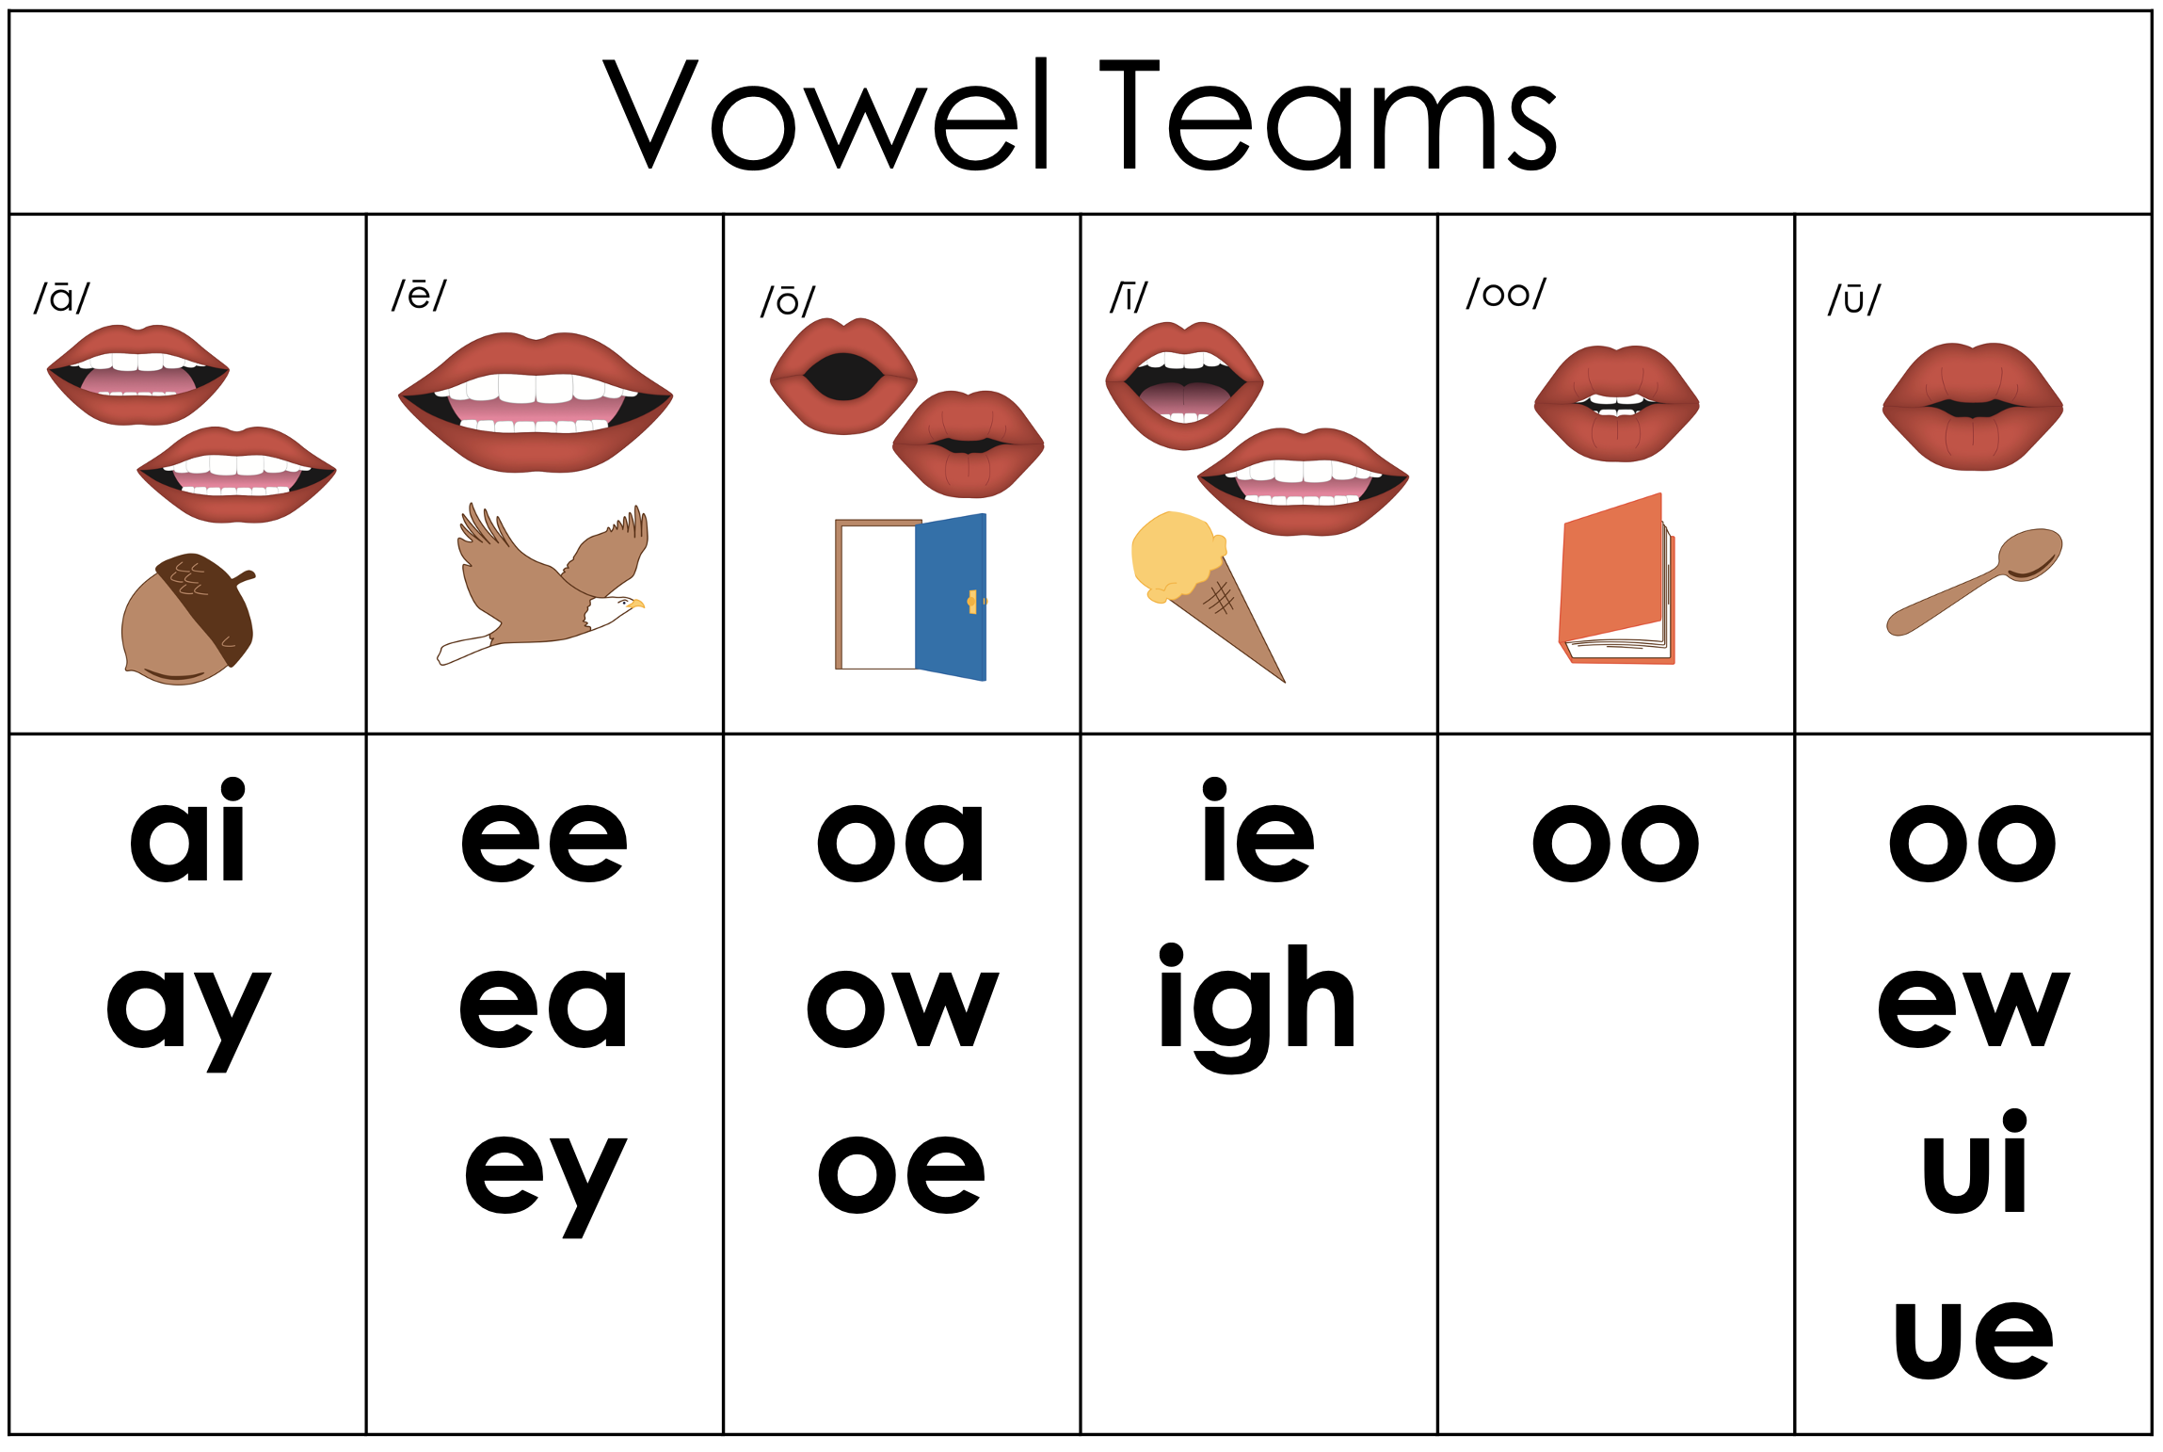

Slide 39
re
play
Notes:
**display in slideshow mode for animations

Slide 40
play
re
re
play
play
Notes:
**display in slideshow mode for animations

Slide 41
rain
coat
Notes:
**display in slideshow mode for animations

Slide 42
rain
coat
coat
rain
coat
Notes:
**display in slideshow mode for animations

Slide 43
moon
light
Notes:
**display in slideshow mode for animations

Slide 44
light
moon
light
moon
light
Notes:
**display in slideshow mode for animations

Slide 45
Notes:
Handwriting paper for letter formation practice. Use as needed.
See UFLI Foundations manual for more information about letter formation.

Slide 46
sunlight
grapefruit

Slide 47
maintain
replay
oatmeal
unhook
teaspoon
snowsuit

Slide 48
toothbrush
clueless
chewy

Slide 49
Notes:
See UFLI Foundations lesson plan Step 5 for words to spell.
Handwriting paper to model spelling.

Slide 50
Notes:
See UFLI Foundations lesson plan Step 5 for words to spell.
Handwriting paper for guided spelling practice.

Slide 52
Insert brief reinforcement activity and/or transition to next part of reading block.

Slide 53
Lesson 92
Vowel Teams Review 2

Slide 55
New Concept Review
Notes:
See UFLI Foundations lesson plan Step 5 for recommended teacher language and activities to review the new concept.

Slide 56
Vowel Team
2 or more letters that work together to make 1 sound.

Slide 58
rain
coat
Notes:
**display in slideshow mode for animations

Slide 59
rain
coat
coat
rain
coat
Notes:
**display in slideshow mode for animations

Slide 60
lunchroom
newborn

Slide 61
between
Sunday

Slide 63
Notes:
See UFLI Foundations lesson plan Step 6 for word work activity.
Visit ufliteracy.org to access the Word Work Mat apps.

Slide 65
Notes:
See UFLI Foundations lesson plan Step 7 for irregular word activities.
The white rectangle under each word may be used in editing mode. Cover the heart and square icons then reveal them one at a time during instruction.

Slide 66
Notes:
See UFLI Foundations manual for more information about reviewing irregular words.

Slide 67
floor
Notes:
Lesson 89+
OOR represents the /or/ sound.
The white rectangle under the word may be used in editing mode. Cover the heart and square icons then reveal them one at a time during instruction.

Slide 68
poor
Notes:
Lesson 89+
OOR represents the /or/ sound.
The white rectangle under the word may be used in editing mode. Cover the heart and square icons then reveal them one at a time during instruction.

Slide 69
door
Notes:
Lesson 89+
OOR represents the /or/ sound.
The white rectangle under the word may be used in editing mode. Cover the heart and square icons then reveal them one at a time during instruction.

Slide 70
won
Notes:
Lesson 90+
O represents the /ŭ/ sound.
The white rectangle under the word may be used in editing mode. Cover the heart and square icons then reveal them one at a time during instruction.

Slide 71
son
Notes:
Lesson 90+
O represents the /ŭ/ sound.
The white rectangle under the word may be used in editing mode. Cover the heart and square icons then reveal them one at a time during instruction.

Slide 72
month
Notes:
Lesson 91+
O represents the /ŭ/ sound.
The white rectangle under the word may be used in editing mode. Cover the heart and square icons then reveal them one at a time during instruction.

Slide 73
Notes:
Handwriting paper for irregular word spelling practice. Use as needed.
See UFLI Foundations manual for more information about reviewing irregular words.

Slide 75
Notes:
See UFLI Foundations lesson plan Step 8 for connected text activities.

Slide 76
Please clean the stain on the floor.

Slide 77
Their son got a scoop of ice cream as a sweet treat.

Slide 78
Put a teaspoon of toothpaste on your new toothbrush.

Slide 79
Notes:
See UFLI Foundations lesson plan Step 8 for sentences to write.

Slide 80
Notes:
The UFLI Foundations decodable text is provided here. See UFLI Foundations decodable text guide for additional text options.

Slide 81
Classroom Clean-up
Miss Booker had so many things to do. Classes would be starting next week. She wanted the classroom to be perfect for the children’s first day!

Slide 82
On Tuesday, she needed to clean the floors and closets. They were filled with dust and grime from the summer months. On Thursday, she would need to unpack all the boxes. The boxes contained her books, games, and puzzles.

Slide 83
On Friday, she would decorate the door and create a display in the hallway. She also wanted to put up a new welcome banner.
Then on the weekend, she was going to plan the cool games and projects they would do during their first week. Miss Booker was so excited for her new class!

Slide 85
Insert brief reinforcement activity and/or transition to next part of reading block.

