Slide 1
Lesson 91
ew, ui, ue /ū/

Slide 2
Notes:
ufliteracy.org

Slide 4
Lesson 91
ew, ui, ue /ū/

Slide 6
Notes:
See UFLI Foundations lesson plan Step 1 for phonemic awareness activity.

Slide 8
Notes:
See UFLI Foundations lesson plan Step 2 for student phoneme responses.

Slide 9
oo

Slide 10
u

Slide 11
ie

Slide 12
igh

Slide 13
oa

Slide 14
ow

Slide 15
oe

Slide 16
ee

Slide 17
ea

Slide 18
ey

Slide 19
ai

Slide 20
ay

Slide 21
ir

Slide 22
ur

Slide 23
er

Slide 24
or

Slide 25
ore

Slide 26
ar

Slide 27
y

Slide 28
dge

Slide 29
g

Slide 30
tch

Slide 32
Notes:
See UFLI Foundations lesson plan Step 3 for auditory drill activity.

Slide 33
Notes:
No slides needed for auditory drill.

Slide 35
Notes:
See UFLI Foundations lesson plan Step 4 for blending drill word chain and grid.
Visit ufliteracy.org to access the Blending Board app.

Slide 37
Notes:
See UFLI Foundations lesson plan Step 5 for recommended teacher language and activities to introduce the new concept.

Slide 38
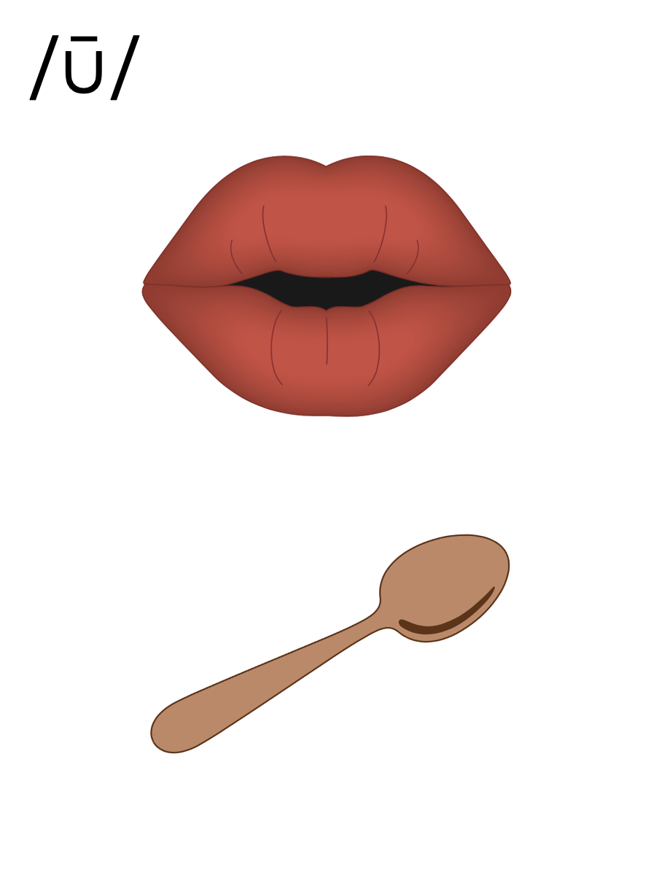
oo

Slide 39
ew
chew

Slide 40
flew
grew
ew

Slide 41
ui
fruit

Slide 42
suit
juice
ui

Slide 43
ue
blue

Slide 44
glue
sue
ue

Slide 45
u_e
u
oo
ew
ui
ue

Slide 46
Notes:
Handwriting paper for letter formation practice. Use as needed.
See UFLI Foundations manual for more information about letter formation.

Slide 47
blew
blueprint

Slide 48
new
drew
chew
cruise
fruit
juice

Slide 49
blue
newborn
Tuesday

Slide 50
Notes:
See UFLI Foundations lesson plan Step 5 for words to spell.
Handwriting paper to model spelling.

Slide 51
Notes:
See UFLI Foundations lesson plan Step 5 for words to spell.
Handwriting paper for guided spelling practice.

Slide 53
Insert brief reinforcement activity and/or transition to next part of reading block.

Slide 54
Lesson 91
ew, ui, ue /ū/

Slide 56
New Concept Review
Notes:
See UFLI Foundations lesson plan Step 5 for recommended teacher language and activities to review the new concept.

Slide 57
oo

Slide 58
ew
chew

Slide 59
flew
grew
ew

Slide 60
ui
fruit

Slide 61
suit
juice
ui

Slide 62
ue
blue

Slide 63
glue
sue
ue

Slide 64
u_e
u
oo
ew
ui
ue

Slide 65
new
threw
fruit
blue

Slide 67
Notes:
See UFLI Foundations lesson plan Step 6 for word work activity.
Visit ufliteracy.org to access the Word Work Mat apps.

Slide 69
Notes:
See UFLI Foundations lesson plan Step 7 for irregular word activities.
The white rectangle under each word may be used in editing mode. Cover the heart and square icons then reveal them one at a time during instruction.

Slide 70
Notes:
See UFLI Foundations manual for more information about reviewing irregular words.

Slide 71
floor
Notes:
Lesson 89+
OOR represents the /or/ sound.
The white rectangle under the word may be used in editing mode. Cover the heart and square icons then reveal them one at a time during instruction.

Slide 72
poor
Notes:
Lesson 89+
OOR represents the /or/ sound.
The white rectangle under the word may be used in editing mode. Cover the heart and square icons then reveal them one at a time during instruction.

Slide 73
door
Notes:
Lesson 89+
OOR represents the /or/ sound.
The white rectangle under the word may be used in editing mode. Cover the heart and square icons then reveal them one at a time during instruction.

Slide 74
won
Notes:
Lesson 90+
O represents the /ŭ/ sound.
The white rectangle under the word may be used in editing mode. Cover the heart and square icons then reveal them one at a time during instruction.

Slide 75
son
Notes:
Lesson 90+
O represents the /ŭ/ sound.
The white rectangle under the word may be used in editing mode. Cover the heart and square icons then reveal them one at a time during instruction.

Slide 76
Notes:
Handwriting paper for irregular word spelling practice. Use as needed.
See UFLI Foundations manual for more information about reviewing irregular words.

Slide 77
Teach
Notes:
The orange star indicates these are new irregular words that need to be introduced.
See UFLI Foundations manual for more information about teaching irregular words.

Slide 78
month
Notes:
Lesson 91+
O represents the /ŭ/ sound.
The white rectangle under the word may be used in editing mode. Cover the heart and square icons then reveal them one at a time during instruction.

Slide 79
Notes:
Handwriting paper for irregular word spelling practice. Use as needed.
See UFLI Foundations manual for more information about teaching irregular words.

Slide 81
Notes:
See UFLI Foundations lesson plan Step 8 for connected text activities.

Slide 82
Sue made stew for the whole crew.

Slide 83
What month will we go on the cruise?

Slide 84
Sue threw on her new suit to go to the pool.

Slide 85
Notes:
See UFLI Foundations lesson plan Step 8 for sentences to write.

Slide 86
Notes:
The UFLI Foundations decodable text is provided here. See UFLI Foundations decodable text guide for additional text options.

Slide 87
Cruise Ship Trip
Drew and Marley were thrilled as they walked onto their first cruise ship. They had been packing for this trip for months. Their suitcases were so full they almost did not close. When they got to their cabin, they looked out their window and saw the vast blue sea. It was very pretty!

Slide 88
They left their suitcases in the cabin and went to grab a bite to eat by the pool. Yes, the new cruise ship had a pool! How cool! Drew drank apple juice while Marley chewed on some fruit. They watched the crew greeting everyone as they came onto the ship.

Slide 89
“This is going to be a fantastic trip!” said Marley. “Yes, I think when we get back on Tuesday, I will feel relaxed and renewed!” Drew said as the ship’s horn blew. Honk! Honk! “And off we go!” Marley squealed. It was a dream come true.

Slide 91
Insert brief reinforcement activity and/or transition to next part of reading block.

