Slide 1
Lesson 89
oo, u /oo/

Slide 2
Notes:
ufliteracy.org

Slide 4
Lesson 89
oo, u /oo/

Slide 6
Notes:
See UFLI Foundations lesson plan Step 1 for phonemic awareness activity.

Slide 8
Notes:
See UFLI Foundations lesson plan Step 2 for student phoneme responses.

Slide 9
ie

Slide 10
igh

Slide 11
oa

Slide 12
ow

Slide 13
oe

Slide 14
ee

Slide 15
ea

Slide 16
ey

Slide 17
ai

Slide 18
ay

Slide 19
ir

Slide 20
ur

Slide 21
er

Slide 22
or

Slide 23
ore

Slide 24
ar

Slide 25
y

Slide 26
dge

Slide 27
g

Slide 28
tch

Slide 30
Notes:
See UFLI Foundations lesson plan Step 3 for auditory drill activity.

Slide 31
Notes:
No slides needed for auditory drill.

Slide 33
Notes:
See UFLI Foundations lesson plan Step 4 for blending drill word chain and grid.
Visit ufliteracy.org to access the Blending Board app.

Slide 35
Notes:
See UFLI Foundations lesson plan Step 5 for recommended teacher language and activities to introduce the new concept.

Slide 36
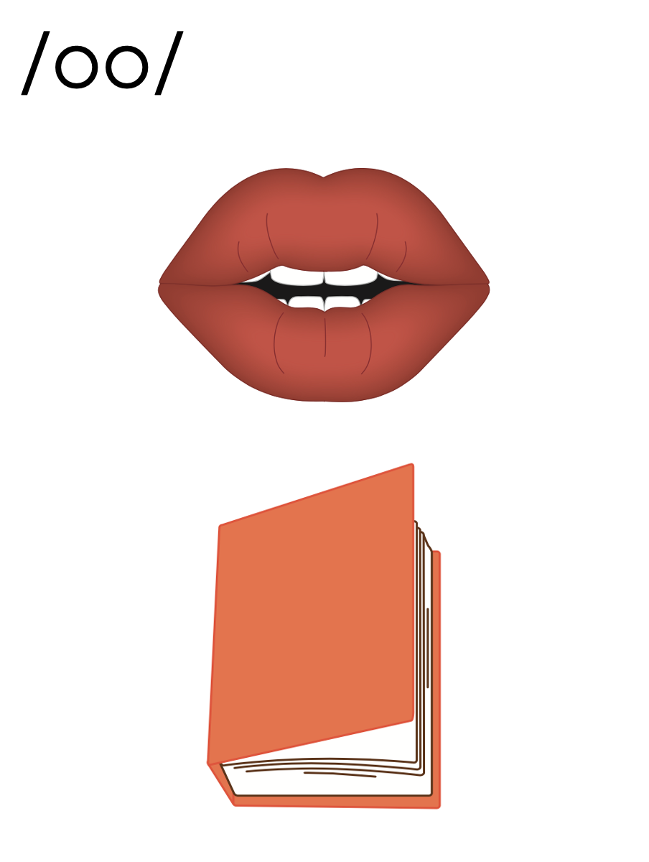
oo

Slide 37
good
look
oo

Slide 38
u

Slide 39
put
bush
u

Slide 40
oo
u

Slide 41
Notes:
Handwriting paper for letter formation practice. Use as needed.
See UFLI Foundations manual for more information about letter formation.

Slide 42
book
bush
pull
cooking

Slide 43
took
wood
look
good
shook
put

Slide 44
push
textbook
football

Slide 45
Notes:
See UFLI Foundations lesson plan Step 5 for words to spell.
Handwriting paper to model spelling.

Slide 46
Notes:
See UFLI Foundations lesson plan Step 5 for words to spell.
Handwriting paper for guided spelling practice.

Slide 48
Insert brief reinforcement activity and/or transition to next part of reading block.

Slide 49
Lesson 89
oo, u /oo/

Slide 51
New Concept Review
Notes:
See UFLI Foundations lesson plan Step 5 for recommended teacher language and activities to review the new concept.

Slide 52
oo

Slide 53
good
look
oo

Slide 54
u

Slide 55
put
bush
u

Slide 56
oo
u

Slide 57
put
took
good
foot

Slide 59
Notes:
See UFLI Foundations lesson plan Step 6 for word work activity.
Visit ufliteracy.org to access the Word Work Mat apps.

Slide 61
Notes:
See UFLI Foundations lesson plan Step 7 for irregular word activities.
The white rectangle under each word may be used in editing mode. Cover the heart and square icons then reveal them one at a time during instruction.

Slide 62
Notes:
See UFLI Foundations manual for more information about reviewing irregular words.

Slide 63
again
Notes:
Lesson 86+
The first A represents the /ə/ or the /ŭ/ sound, depending on stress.
AI represents the /ĕ/ or /ĭ/ sound, depending on dialect.
In some dialects, the AI in again is pronounced /ā/. In this case, this part of the word would not be irregular.
The white rectangle under the word may be used in editing mode. Cover the heart and square icons then reveal them one at a time during instruction.

Slide 64
against
Notes:
Lesson 86+
The first A represents the /ə/ or the /ŭ/ sound, depending on stress.
AI represents the /ĕ/ or /ĭ/ sound, depending on dialect.
In some dialects, the AI in against is pronounced /ā/. In this case, this part of the word would not be irregular.
The white rectangle under the word may be used in editing mode. Cover the heart and square icons then reveal them one at a time during instruction.

Slide 65
always
Notes:
Lesson 87+
The first A represents the /ŏ/ or /aw/ sound.
The white rectangle under the word may be used in editing mode. Cover the heart and square icons then reveal them one at a time during instruction.

Slide 66
almost
Notes:
Lesson 87+
A represents the /ŏ/ or /aw/ sound.
The white rectangle under the word may be used in editing mode. Cover the heart and square icons then reveal them one at a time during instruction.

Slide 67
Notes:
Handwriting paper for irregular word spelling practice. Use as needed.
See UFLI Foundations manual for more information about reviewing irregular words.

Slide 68
Teach
Notes:
The orange star indicates these are new irregular words that need to be introduced.
See UFLI Foundations manual for more information about teaching irregular words.

Slide 69
floor
Notes:
Lesson 89+
OOR represents the /or/ sound.
The white rectangle under the word may be used in editing mode. Cover the heart and square icons then reveal them one at a time during instruction.

Slide 70
poor
Notes:
Lesson 89+
OOR represents the /or/ sound.
The white rectangle under the word may be used in editing mode. Cover the heart and square icons then reveal them one at a time during instruction.

Slide 71
door
Notes:
Lesson 89+
OOR represents the /or/ sound.
The white rectangle under the word may be used in editing mode. Cover the heart and square icons then reveal them one at a time during instruction.

Slide 72
Notes:
Handwriting paper for irregular word spelling practice. Use as needed.
See UFLI Foundations manual for more information about teaching irregular words.

Slide 74
Notes:
See UFLI Foundations lesson plan Step 8 for connected text activities.

Slide 75
He put a hook on the door.

Slide 76
They stood on the clean floor.

Slide 77
Did you cook a full meal for these people?

Slide 78
Notes:
See UFLI Foundations lesson plan Step 8 for sentences to write.

Slide 79
Notes:
The UFLI Foundations decodable text is provided here. See UFLI Foundations decodable text guide for additional text options.

Slide 80
Brooklyn’s Reading Nook
Brooklyn got a new book. For weeks, Brooklyn had been looking for this book in every bookshop. She put it at the top of her list because she was confident that this story would be a good one. Brooklyn loved her reading time on the weekends.

Slide 81
Each Saturday, she was able to sit in her reading nook and dive into a good book. Last weekend, she finished a story of a famed football star. This weekend she would be starting Little Red Riding Hood. But this story is not the classic she remembers from her childhood.

Slide 82
In that book, Little Red Riding Hood is a small child. This modern story is a twisted tale. Little Red Riding Hood is a grown-up when she goes for a walk in the woods. Brooklyn could not wait to pull on her cozy hooded blanket and curl up in her nook with her book.

Slide 84
Insert brief reinforcement activity and/or transition to next part of reading block.

