Slide 1
Lesson 117
Signal Vowels

Slide 2
Notes:
ufliteracy.org

Slide 4
Lesson 117
Signal Vowels

Slide 6
Notes:
See UFLI Foundations lesson plan Step 1 for phonemic awareness activity.

Slide 8
Notes:
See UFLI Foundations lesson plan Step 2 for student phoneme responses.

Slide 9
ough

Slide 10
ew

Slide 11
eu

Slide 12
ue

Slide 13
ou

Slide 14
ei

Slide 15
eigh

Slide 16
ey

Slide 17
aigh

Slide 18
air

Slide 19
are

Slide 20
ear

Slide 21
or

Slide 22
ar

Slide 23
-ed

Slide 24
y

Slide 25
e

Slide 26
ow

Slide 27
oi

Slide 29
Notes:
See UFLI Foundations lesson plan Step 3 for auditory drill activity.

Slide 30
Notes:
No slides needed for auditory drill.

Slide 32
Notes:
See UFLI Foundations lesson plan Step 4 for blending drill word chain and grid.
Visit ufliteracy.org to access the Blending Board app.

Slide 34
Notes:
See UFLI Foundations lesson plan Step 5 for recommended teacher language and activities to introduce the new concept.

Slide 35
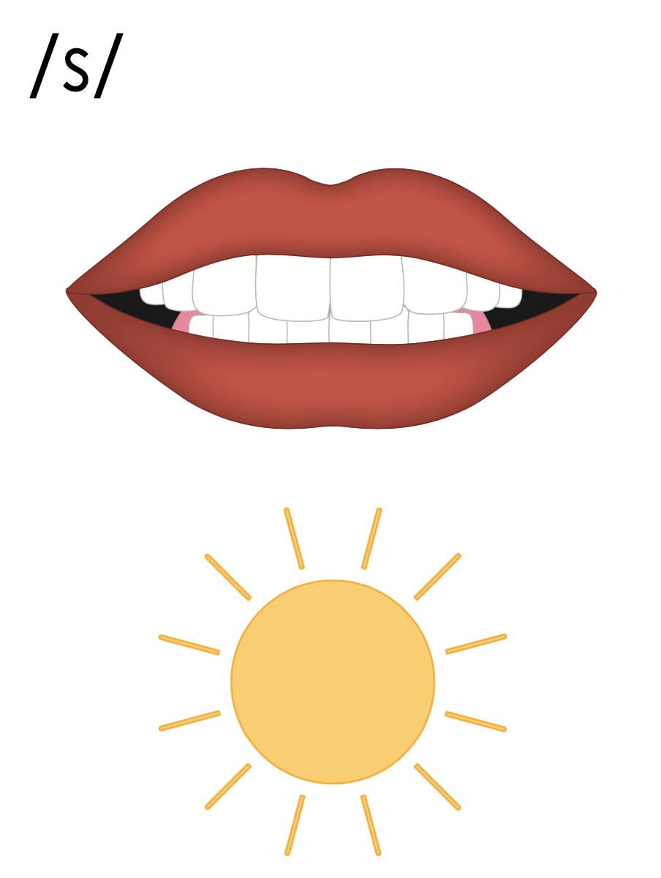
_ce
rice

Slide 36
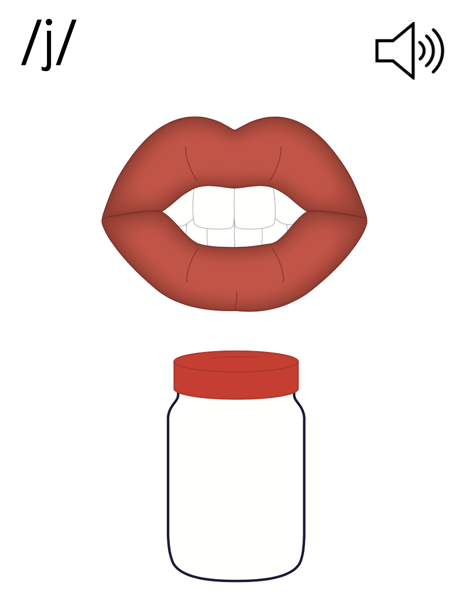
_ge
cage

Slide 37
vowels
a
e
i
o
u
y

Slide 38
signal vowels
e
i
y

Slide 39
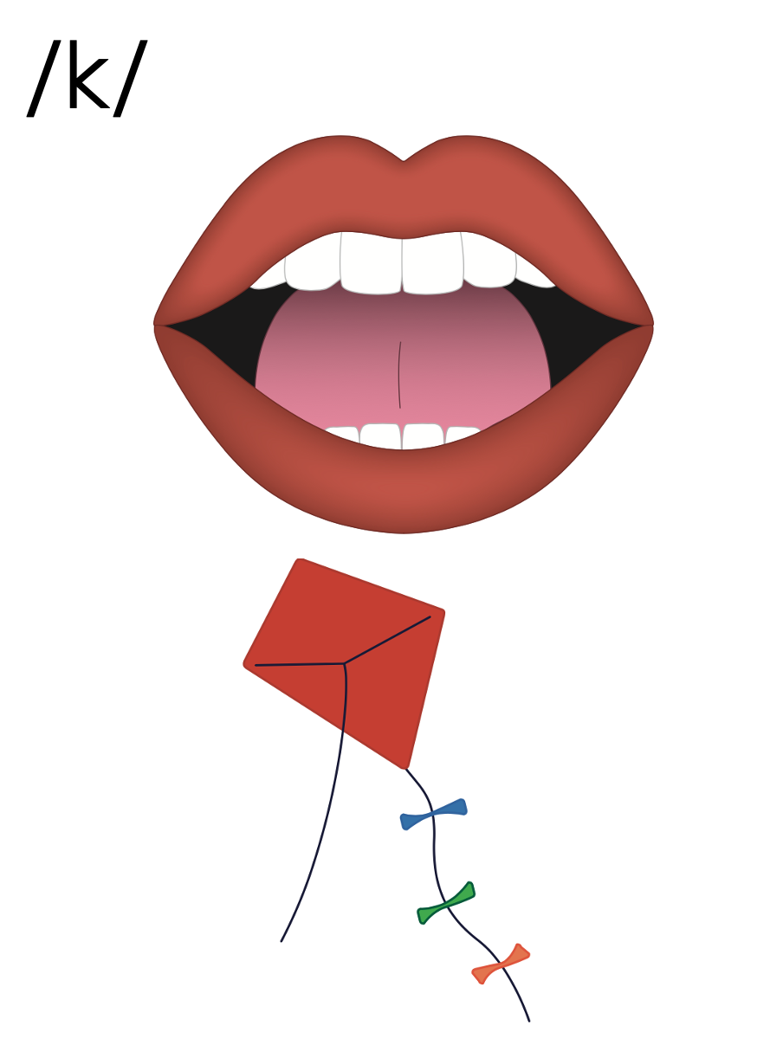
c
a
t
c
o
t
c
u
t

Slide 40
c
e
city
c
i
cent
c
y

Slide 41
city
cent

Slide 42
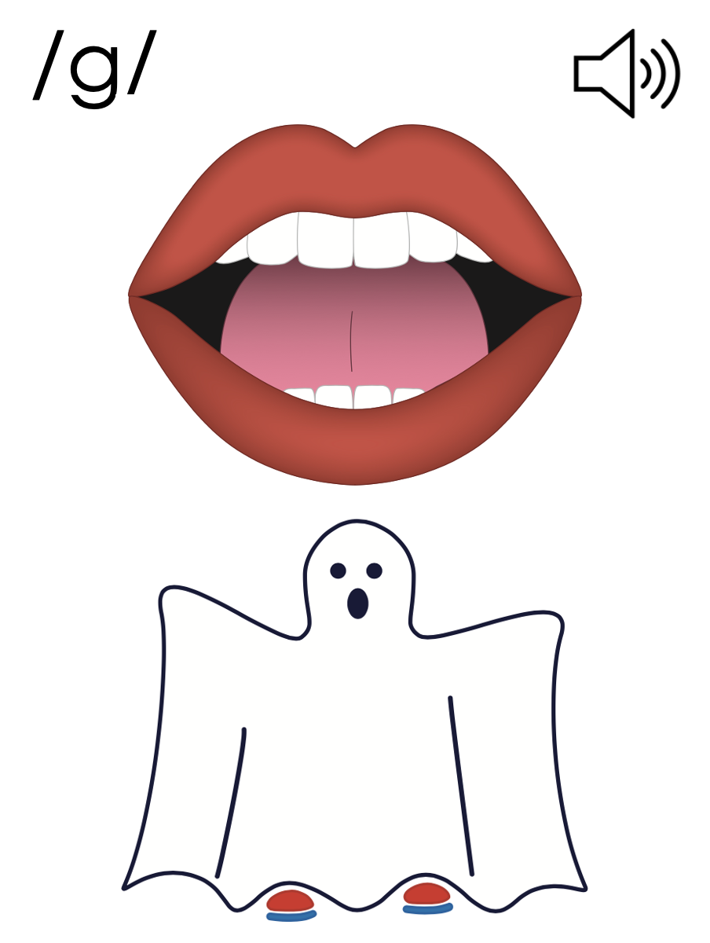
g
a
me
g
o
g
u
m

Slide 43
g
e
gem
g
i
gym
g
y

Slide 44
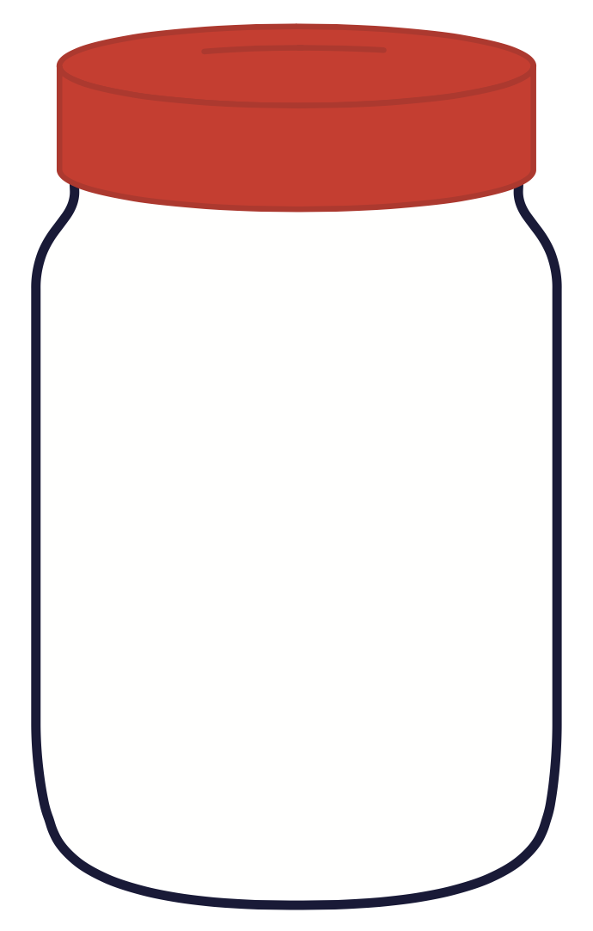
gem
gym

Slide 45
s
j
ss
_ge
_ce
g
c

Slide 46
city
gems

Slide 47
center
except
cell

Slide 48
place
energy
change

Slide 49
giant
magic

Slide 50
Notes:
See UFLI Foundations lesson plan Step 5 for words to spell.
Handwriting paper to model spelling.

Slide 51
Notes:
See UFLI Foundations lesson plan Step 5 for words to spell.
Handwriting paper for guided spelling practice.

Slide 53
Insert brief reinforcement activity and/or transition to next part of reading block.

Slide 54
Lesson 117
Signal Vowels

Slide 56
New Concept Review
Notes:
See UFLI Foundations lesson plan Step 5 for recommended teacher language and activities to review the new concept.

Slide 57
_ce
rice

Slide 58
_ge
cage

Slide 59
vowels
a
e
i
o
u
y

Slide 60
signal vowels
e
i
y

Slide 61
c
a
t
c
o
t
c
u
t

Slide 62
c
e
city
c
i
cent
c
y

Slide 63
city
cent

Slide 64
g
a
me
g
o
g
u
m

Slide 65
g
e
gem
g
i
gym
g
y

Slide 66
gem
gym

Slide 67
s
j
ss
_ge
_ce
g
c

Slide 68
city
circle
germ
gym

Slide 70
Notes:
See UFLI Foundations lesson plan Step 6 for word work activity.
Visit ufliteracy.org to access the Word Work Mat apps.

Slide 71
Notes:
Display this slide in editing mode. Click and hold to drag the word to the appropriate row.

Slide 72
Notes:
Display this slide in editing mode. Click and hold to drag the word to the appropriate row.

Slide 74
Notes:
See UFLI Foundations lesson plan Step 7 for irregular word activities.
The white rectangle under each word may be used in editing mode. Cover the heart and square icons then reveal them one at a time during instruction.

Slide 75
Notes:
See UFLI Foundations manual for more information about reviewing irregular words.

Slide 76
learn
Notes:
Lesson 115+
EAR represents the /er/ sound.
The white rectangle under the word may be used in editing mode. Cover the heart and square icons then reveal them one at a time during instruction.

Slide 77
earth
Notes:
Lesson 115+
EAR represents the /er/ sound.
The white rectangle under the word may be used in editing mode. Cover the heart and square icons then reveal them one at a time during instruction.

Slide 78
early
Notes:
Lesson 115+
EAR represents the /er/ sound.
The white rectangle under the word may be used in editing mode. Cover the heart and square icons then reveal them one at a time during instruction.

Slide 79
buy
Notes:
Lesson 116+
UY represents the /ī/ sound or U is silent.
The white rectangle under the word may be used in editing mode. Cover the heart and square icons then reveal them one at a time during instruction.

Slide 80
guy
Notes:
Lesson 116+
UY represents the /ī/ sound, or U is silent.
The white rectangle under the word may be used in editing mode. Cover the heart and square icons then reveal them one at a time during instruction.

Slide 81
Notes:
Handwriting paper for irregular word spelling practice. Use as needed.
See UFLI Foundations manual for more information about reviewing irregular words.

Slide 82
Teach
Notes:
The orange star indicates these are new irregular words that need to be introduced.
See UFLI Foundations manual for more information about teaching irregular words.

Slide 83
guess
Notes:
Lesson 117+
UE represents the /ĕ/ sound, or U is silent.
The white rectangle under the word may be used in editing mode. Cover the heart and square icons then reveal them one at a time during instruction.

Slide 84
guest
Notes:
Lesson 117+
UE represents the /ĕ/ sound, or U is silent.
The white rectangle under the word may be used in editing mode. Cover the heart and square icons then reveal them one at a time during instruction.

Slide 85
guide
Notes:
Lesson 117+
UI represents the /ī/ sound, or U is silent.
The white rectangle under the word may be used in editing mode. Cover the heart and square icons then reveal them one at a time during instruction.

Slide 86
Notes:
Handwriting paper for irregular word spelling practice. Use as needed.
See UFLI Foundations manual for more information about teaching irregular words.

Slide 88
Notes:
See UFLI Foundations lesson plan Step 8 for connected text activities.

Slide 89
We went through the city’s civic center with a guide.

Slide 90
The guests sat next to the giant fence.

Slide 91
Can you guess how the magic trick was done?

Slide 92
Notes:
See UFLI Foundations lesson plan Step 8 for sentences to write.

Slide 93
Notes:
The UFLI Foundations decodable text is provided here. See UFLI Foundations decodable text guide for additional text options.

Slide 94
A Trip to the City
Reginald took a train trip to New York City to visit his Uncle Quincy. When he arrived, Uncle Quincy was there to greet him at the station. “Welcome!” called Uncle Quincy with glee, “I am so excited to have you as my guest for the week. I can’t wait to be your city guide.”

Slide 95
“I’m excited too!” replied Reginald, “I have been imagining this trip for a long time.”
Their first excursion was to a fancy ice cream parlor. Reginald got a giant scoop of cinnamon ice cream. “This is incredible,” exclaimed Reginald between bites.

Slide 96
Next, the pair walked back to Uncle Quincy’s apartment. When they got there, they saw a letter taped to the door. It was marked urgent. “I wonder what that could be,” said Uncle Quincy with a sly smile, “open it up and see if there is a message inside.”

Slide 97
Reginald opened the letter and two tickets fell into his hands. “Surprise! I managed to get us tickets to a concert at Madison Square Garden. It was sold out, but my friend is a ticket agent. She got us the last two general admission seats.”

Slide 98
“Wow,” gasped Reginald, “I never would have guessed I’d get to see a real concert. Thank you, Uncle Quincy. This is the best trip ever!”

Slide 100
Insert brief reinforcement activity and/or transition to next part of reading block.

