Slide 1
Lesson 116
ough /aw/, /ō/

Slide 2
Notes:
ufliteracy.org

Slide 4
Lesson 116
ough /aw/, /ō/

Slide 6
Notes:
See UFLI Foundations lesson plan Step 1 for phonemic awareness activity.

Slide 8
Notes:
See UFLI Foundations lesson plan Step 2 for student phoneme responses.

Slide 9
ew

Slide 10
eu

Slide 11
ue

Slide 12
ou

Slide 13
ei

Slide 14
eigh

Slide 15
ey

Slide 16
aigh

Slide 17
air

Slide 18
are

Slide 19
ear

Slide 20
or

Slide 21
ar

Slide 22
-ed

Slide 23
y

Slide 24
e

Slide 25
ow

Slide 26
oi

Slide 27
oy

Slide 28
ea

Slide 30
Notes:
See UFLI Foundations lesson plan Step 3 for auditory drill activity.

Slide 31
Notes:
No slides needed for auditory drill.

Slide 33
Notes:
See UFLI Foundations lesson plan Step 4 for blending drill word chain and grid.
Visit ufliteracy.org to access the Blending Board app.

Slide 35
Notes:
See UFLI Foundations lesson plan Step 5 for recommended teacher language and activities to introduce the new concept.

Slide 36
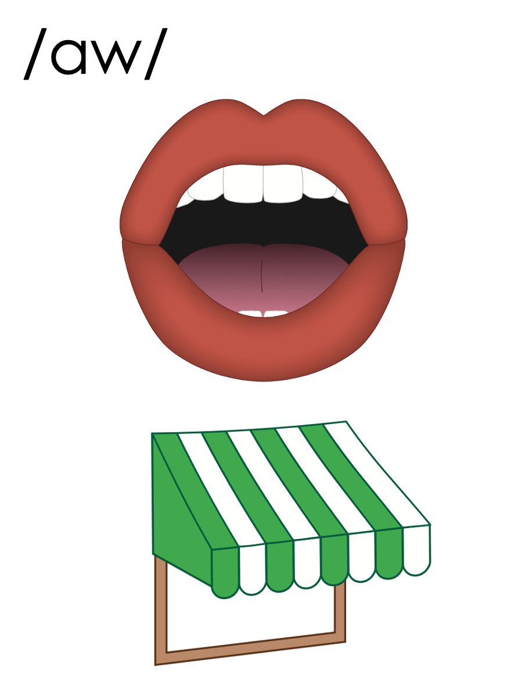
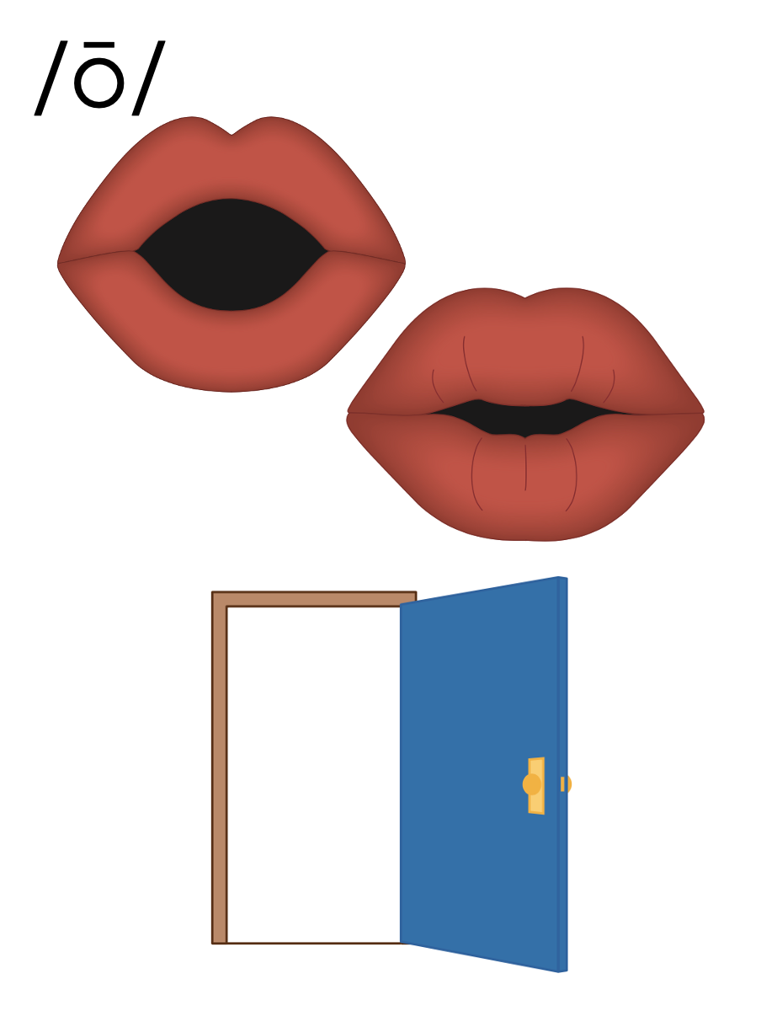
ough

Slide 37
ough
bought
fought

Slide 38
ough
although
dough

Slide 39
au
aw
o_e
o
augh
ough
oa
ow
oe
ough

Slide 40
ought
though

Slide 41
brought
fought
sought

Slide 42
wrought
thoughtful

Slide 43
although
thorough

Slide 44
Notes:
See UFLI Foundations lesson plan Step 5 for words to spell.
Handwriting paper to model spelling.

Slide 45
Notes:
See UFLI Foundations lesson plan Step 5 for words to spell.
Handwriting paper for guided spelling practice.

Slide 47
Insert brief reinforcement activity and/or transition to next part of reading block.

Slide 48
Lesson 116
ough /aw/, /ō/

Slide 50
New Concept Review
Notes:
See UFLI Foundations lesson plan Step 5 for recommended teacher language and activities to review the new concept.

Slide 51
ough

Slide 52
ough
bought
fought

Slide 53
ough
although
dough

Slide 54
au
aw
o_e
o
augh
ough
oa
ow
oe
ough

Slide 55
thought
bought

Slide 56
though
dough

Slide 58
Notes:
See UFLI Foundations lesson plan Step 6 for word work activity.
Visit ufliteracy.org to access the Word Work Mat apps.

Slide 59
Notes:
Display this slide in editing mode. Click and hold to drag the words to the appropriate row.

Slide 61
Notes:
See UFLI Foundations lesson plan Step 7 for irregular word activities.
The white rectangle under each word may be used in editing mode. Cover the heart and square icons then reveal them one at a time during instruction.

Slide 62
Notes:
See UFLI Foundations manual for more information about reviewing irregular words.

Slide 63
through
Notes:
Lesson 114+
OUGH represents the /ū/ sound.
The white rectangle under the word may be used in editing mode. Cover the heart and square icons then reveal them one at a time during instruction.

Slide 64
learn
Notes:
Lesson 115+
EAR represents the /er/ sound.
The white rectangle under the word may be used in editing mode. Cover the heart and square icons then reveal them one at a time during instruction.

Slide 65
earth
Notes:
Lesson 115+
EAR represents the /er/ sound.
The white rectangle under the word may be used in editing mode. Cover the heart and square icons then reveal them one at a time during instruction.

Slide 66
early
Notes:
Lesson 115+
EAR represents the /er/ sound.
The white rectangle under the word may be used in editing mode. Cover the heart and square icons then reveal them one at a time during instruction.

Slide 67
Notes:
Handwriting paper for irregular word spelling practice. Use as needed.
See UFLI Foundations manual for more information about reviewing irregular words.

Slide 68
Teach
Notes:
The orange star indicates these are new irregular words that need to be introduced.
See UFLI Foundations manual for more information about teaching irregular words.

Slide 69
buy
Notes:
Lesson 116+
UY represents the /ī/ sound or U is silent.
The white rectangle under the word may be used in editing mode. Cover the heart and square icons then reveal them one at a time during instruction.

Slide 70
guy
Notes:
Lesson 116+
UY represents the /ī/ sound, or U is silent.
The white rectangle under the word may be used in editing mode. Cover the heart and square icons then reveal them one at a time during instruction.

Slide 71
Notes:
Handwriting paper for irregular word spelling practice. Use as needed.
See UFLI Foundations manual for more information about teaching irregular words.

Slide 73
Notes:
See UFLI Foundations lesson plan Step 8 for connected text activities.

Slide 74
I thought you brought the snacks with you!

Slide 75
Although you are busy, you ought to be thorough.

Slide 76
That guy will buy sprinkle doughnuts for his kids.

Slide 77
Notes:
See UFLI Foundations lesson plan Step 8 for sentences to write.

Slide 78
Notes:
The UFLI Foundations decodable text is provided here. See UFLI Foundations decodable text guide for additional text options.

Slide 79
The Dough Guy
Stanley was preparing dinner one night when he thought to himself, “I would love to learn how to make fresh bread.” He looked down at the loaf of crusty bread he bought from the store. “I bet I can make better bread than this.”

Slide 80
The next morning, Stanley went to the store. He wanted to buy all the ingredients to make fresh bread. He needed flour and yeast to make the dough. He picked those up and brought his basket to the counter.

Slide 81
“Are you making bread?” asked the guy behind the counter. “Well, I’m going to try,” replied Stanley, although he still wasn’t quite sure what he was doing.

Slide 82
“You ought to buy a few more supplies,” said the guy. “Wait here.” A few minutes later, the guy returned with salt, oil and a few different seasonings. “This is what you need.” he said, “I also wrote down some tips to make your dough rise perfectly.” “Wow!” replied Stanley, “that is so kind, thank you.”

Slide 83
“No problem,” said the guy, “I love making bread. Everyone calls me Dough Guy. If your bread turns out well, would you bring back a slice for me to try?” “I’ll bring you a whole loaf!” chuckled Stanley. “Thanks, Dough Guy!”

Slide 85
Insert brief reinforcement activity and/or transition to next part of reading block.

