Slide 1
Lesson 115
Alternate Long U

Slide 2
Notes:
ufliteracy.org

Slide 4
Lesson 115
Alternate Long U

Slide 6
Notes:
See UFLI Foundations lesson plan Step 1 for phonemic awareness activity.

Slide 8
Notes:
See UFLI Foundations lesson plan Step 2 for student phoneme responses.

Slide 9
ei

Slide 10
eigh

Slide 11
ey

Slide 12
aigh

Slide 13
air

Slide 14
are

Slide 15
ear

Slide 16
or

Slide 17
ar

Slide 18
-ed

Slide 19
y

Slide 20
er

Slide 21
e

Slide 22
t

Slide 23
s

Slide 24
ou

Slide 25
ow

Slide 26
oi

Slide 27
oy

Slide 28
ea

Slide 30
Notes:
See UFLI Foundations lesson plan Step 3 for auditory drill activity.

Slide 31
Notes:
No slides needed for auditory drill.

Slide 33
Notes:
See UFLI Foundations lesson plan Step 4 for blending drill word chain and grid.
Visit ufliteracy.org to access the Blending Board app.

Slide 35
Notes:
See UFLI Foundations lesson plan Step 5 for recommended teacher language and activities to introduce the new concept.

Slide 36
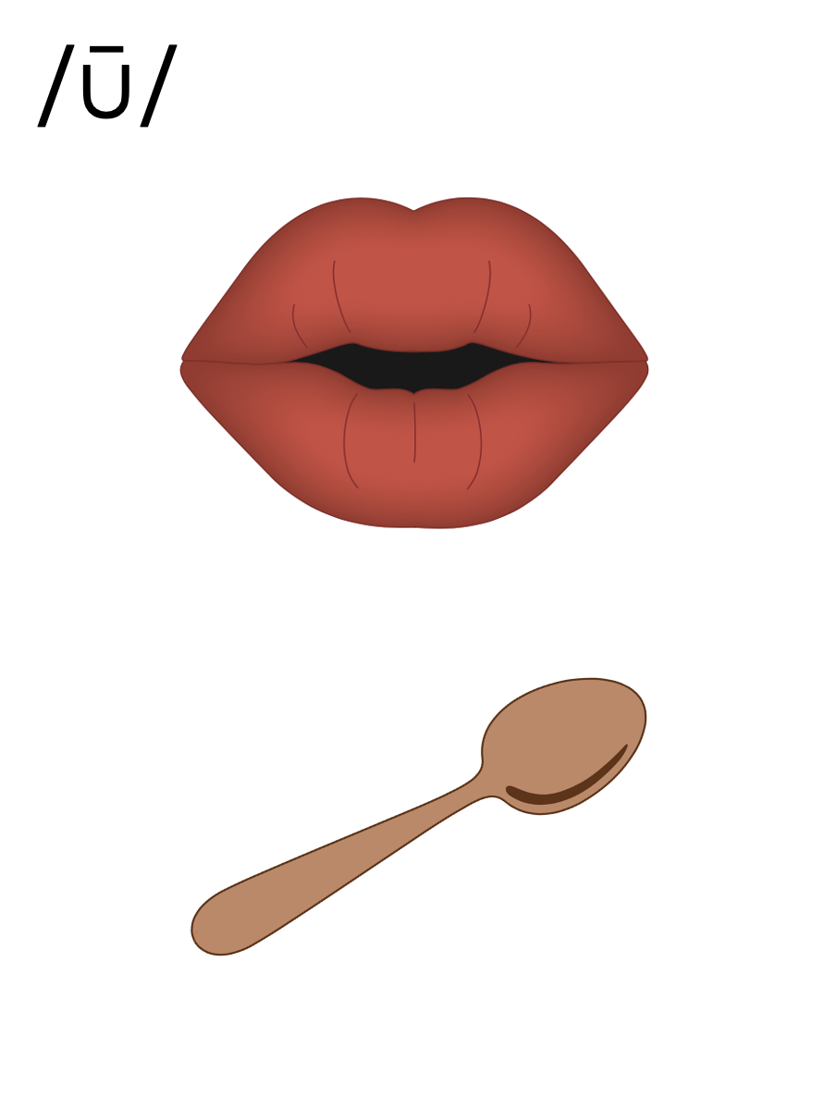
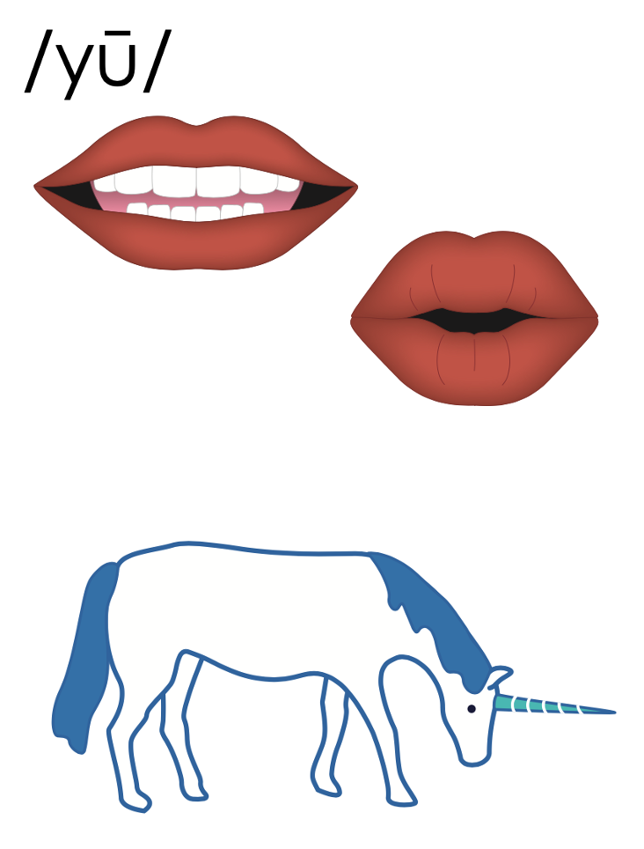
flew
cube

Slide 37
u_e
r
u
l
e

Slide 38
ew
chew

Slide 39
ui
fruit

Slide 40
ue
blue

Slide 41
ou

Slide 42
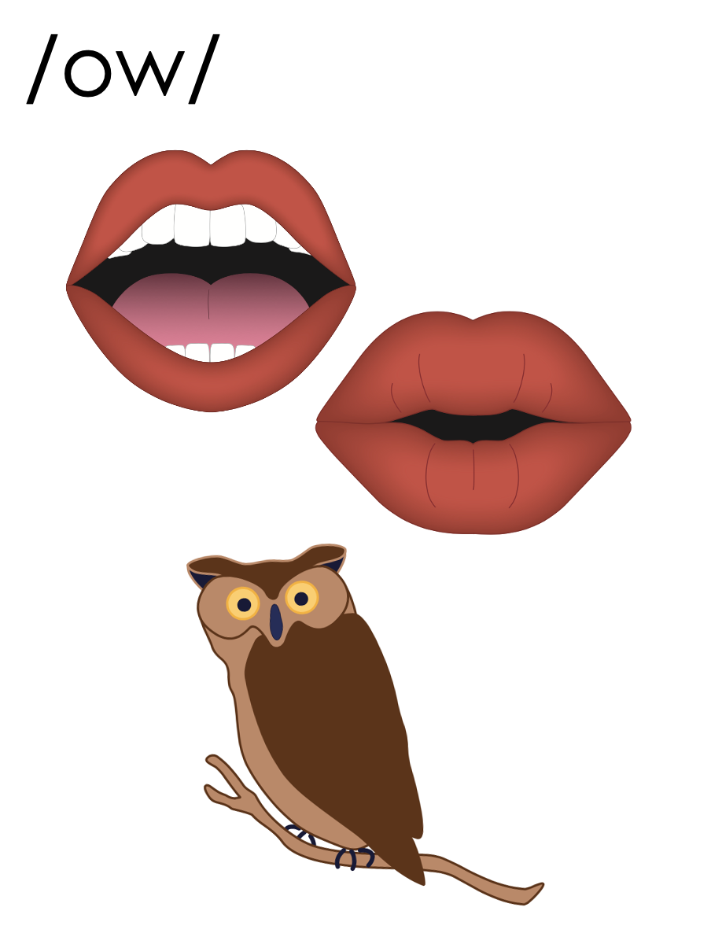
ou
shout

Slide 43
ou
soup
group

Slide 44
u_e
c
u
t
e

Slide 45
ew
ue
eu

Slide 46
spew
nephew
ew

Slide 47
value
rescue
ue

Slide 48
eucalyptus
eu

Slide 49
u_e | ew | ui | ue | ou | eu

Slide 50
u_e
u
u_e
u
oo
ew
ew
eu
ui
ue
ue
ou

Slide 51
curfew
venue
you

Slide 52
few
spew
skewed

Slide 53
nephew
hue
argue

Slide 54
rescue
value
group
youth

Slide 55
Notes:
See UFLI Foundations lesson plan Step 5 for words to spell.
Handwriting paper to model spelling.

Slide 56
Notes:
See UFLI Foundations lesson plan Step 5 for words to spell.
Handwriting paper for guided spelling practice.

Slide 58
Insert brief reinforcement activity and/or transition to next part of reading block.

Slide 59
Lesson 115
Alternate Long U

Slide 61
New Concept Review
Notes:
See UFLI Foundations lesson plan Step 5 for recommended teacher language and activities to review the new concept.

Slide 62
flew
cube

Slide 63
u_e
r
u
l
e

Slide 64
ew
chew

Slide 65
ui
fruit

Slide 66
ue
blue

Slide 67
ou

Slide 68
ou
shout

Slide 69
ou
soup
group

Slide 70
u_e
c
u
t
e

Slide 71
ew
ue
eu

Slide 72
spew
nephew
ew

Slide 73
value
rescue
ue

Slide 74
eucalyptus
eu

Slide 75
u_e | ew | ui | ue | ou | eu

Slide 76
u_e
u
u_e
u
oo
ew
ew
eu
ui
ue
ue
ou

Slide 77
few
feud
cue
group

Slide 79
Notes:
See UFLI Foundations lesson plan Step 6 for word work activity.
Visit ufliteracy.org to access the Word Work Mat apps.

Slide 80
Notes:
Display this slide in editing mode. Click and hold to drag the words to the correct row.

Slide 82
Notes:
See UFLI Foundations lesson plan Step 7 for irregular word activities.
The white rectangle under each word may be used in editing mode. Cover the heart and square icons then reveal them one at a time during instruction.

Slide 83
Notes:
See UFLI Foundations manual for more information about reviewing irregular words.

Slide 84
toward
Notes:
Lesson 113+
Depending on dialect, this word can be pronounced:
/t/+/or/+/d/,
/t/+/ə/+/w/+/or/ (or /er/) +/d/, or
/t/+/oo/+/w/+/or/ (or /er/) +/d/.
The white rectangle under the word may be used in editing mode. Cover the heart and square icons then reveal them one at a time during instruction.

Slide 85
through
Notes:
Lesson 114+
OUGH represents the /ū/ sound.
The white rectangle under the word may be used in editing mode. Cover the heart and square icons then reveal them one at a time during instruction.

Slide 86
Notes:
Handwriting paper for irregular word spelling practice. Use as needed.
See UFLI Foundations manual for more information about reviewing irregular words.

Slide 87
Teach
Notes:
The orange star indicates these are new irregular words that need to be introduced.
See UFLI Foundations manual for more information about teaching irregular words.

Slide 88
learn
Notes:
Lesson 115+
EAR represents the /er/ sound.
The white rectangle under the word may be used in editing mode. Cover the heart and square icons then reveal them one at a time during instruction.

Slide 89
earth
Notes:
Lesson 115+
EAR represents the /er/ sound.
The white rectangle under the word may be used in editing mode. Cover the heart and square icons then reveal them one at a time during instruction.

Slide 90
early
Notes:
Lesson 115+
EAR represents the /er/ sound.
The white rectangle under the word may be used in editing mode. Cover the heart and square icons then reveal them one at a time during instruction.

Slide 91
Notes:
Handwriting paper for irregular word spelling practice. Use as needed.
See UFLI Foundations manual for more information about teaching irregular words.

Slide 93
Notes:
See UFLI Foundations lesson plan Step 8 for connected text activities.

Slide 94
My nephew has the best rescue dog on earth.

Slide 95
We learned the true value of hard work early.

Slide 96
We need a few more people in this group.

Slide 97
Notes:
See UFLI Foundations lesson plan Step 8 for sentences to write.

Slide 98
Notes:
The UFLI Foundations decodable text is provided here. See UFLI Foundations decodable text guide for additional text options.

Slide 99
It’s No Fun to Argue
Corey lives down the street from his nephew, Louis. They love to spend time together. Corey calls Louis the best nephew on earth and Louis calls Corey the best uncle on earth.

Slide 100
Last Saturday, Corey took Louis to the park to play. Louis played a new game with a group of his friends. The game was going well, but then a few of the kids started to argue about the rules. The game could not continue while the kids were arguing. This made the rest of the group angry.

Slide 101
After a few minutes, Corey came to the rescue. He said, “if you all continue to argue, you will not have any time left to play.” This made everyone stop and think. The kids agreed that they wanted to spend their time playing instead of arguing. “See,” Louis yelled, “this is why Corey is the best uncle on earth!”

Slide 103
Insert brief reinforcement activity and/or transition to next part of reading block.

