Slide 1
Lesson 112
air, are, ear /air/

Slide 2
Notes:
ufliteracy.org

Slide 4
Lesson 112
air, are, ear /air/

Slide 6
Notes:
See UFLI Foundations lesson plan Step 1 for phonemic awareness activity.

Slide 8
Notes:
See UFLI Foundations lesson plan Step 2 for student phoneme responses.

Slide 9
or

Slide 10
ar

Slide 11
-ed

Slide 12
y

Slide 13
er

Slide 14
e

Slide 15
t

Slide 16
s

Slide 17
kn

Slide 18
wr

Slide 19
mb

Slide 20
ou

Slide 21
ow

Slide 22
oi

Slide 23
oy

Slide 24
ea

Slide 25
au

Slide 26
aw

Slide 27
augh

Slide 28
ew

Slide 30
Notes:
See UFLI Foundations lesson plan Step 3 for auditory drill activity.

Slide 31
Notes:
No slides needed for auditory drill.

Slide 33
Notes:
See UFLI Foundations lesson plan Step 4 for blending drill word chain and grid.
Visit ufliteracy.org to access the Blending Board app.

Slide 35
Notes:
See UFLI Foundations lesson plan Step 5 for recommended teacher language and activities to introduce the new concept.

Slide 36
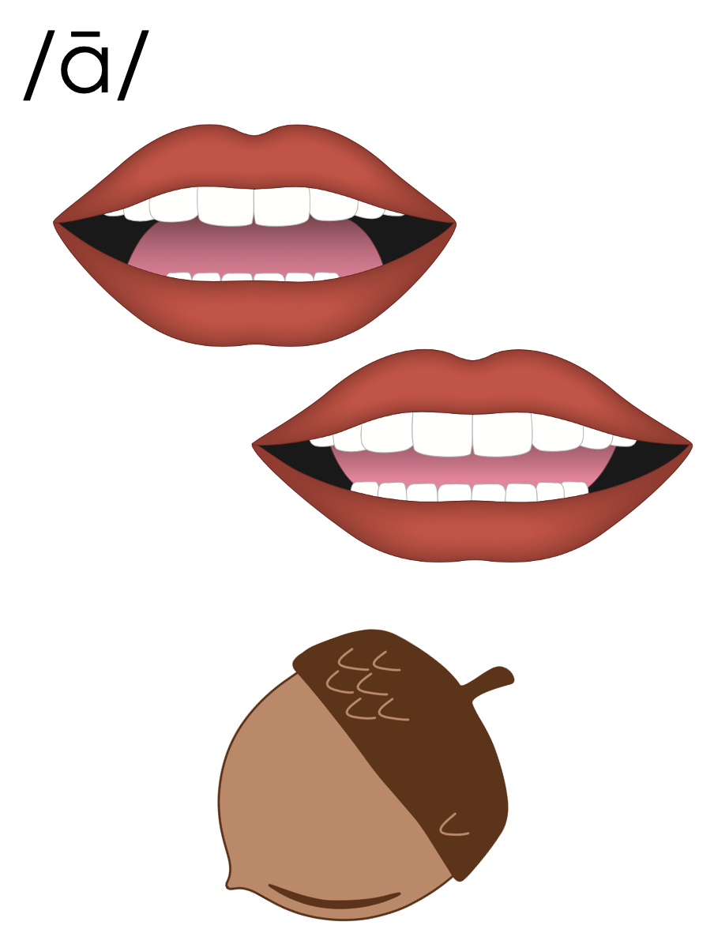
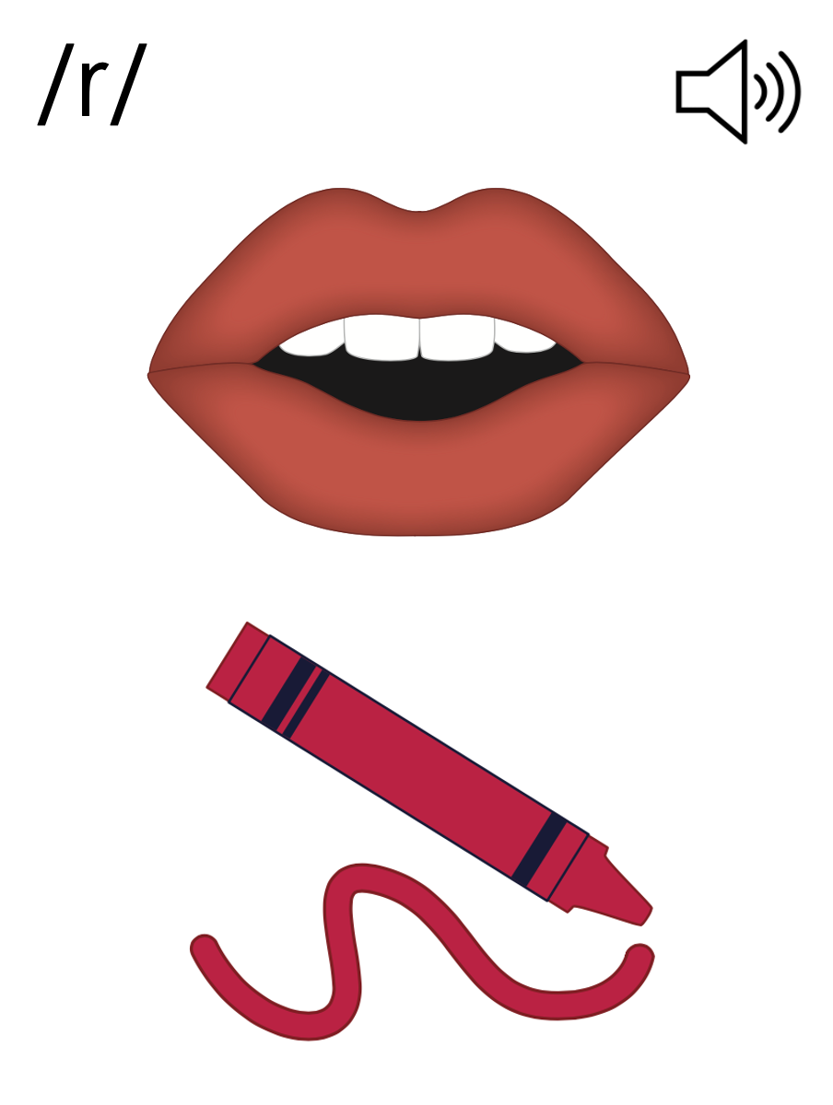

Slide 37
air
chair
stair

Slide 38
are
care
square

Slide 39
ear
bear
wear

Slide 40
air
care
tear

Slide 41
pair
stairs
share

Slide 42
scare
glare
dare

Slide 43
swear
bear

Slide 44
Notes:
See UFLI Foundations lesson plan Step 5 for words to spell.
Handwriting paper to model spelling.

Slide 45
Notes:
See UFLI Foundations lesson plan Step 5 for words to spell.
Handwriting paper for guided spelling practice.

Slide 47
Insert brief reinforcement activity and/or transition to next part of reading block.

Slide 48
Lesson 112
air, are, ear /air/

Slide 50
New Concept Review
Notes:
See UFLI Foundations lesson plan Step 5 for recommended teacher language and activities to review the new concept.

Slide 52
air
chair
stair

Slide 53
are
care
square

Slide 54
ear
bear
wear

Slide 55
air
chair
dare
wear

Slide 57
Notes:
See UFLI Foundations lesson plan Step 6 for word work activity.
Visit ufliteracy.org to access the Word Work Mat apps.

Slide 58
Notes:
Display this slide in editing mode. Click and hold to drag each word into the appropriate column.

Slide 60
Notes:
See UFLI Foundations lesson plan Step 7 for irregular word activities.
The white rectangle under each word may be used in editing mode. Cover the heart and square icons then reveal them one at a time during instruction.

Slide 61
Notes:
See UFLI Foundations manual for more information about reviewing irregular words.

Slide 62
sure
Notes:
Lesson 109+
S represents the /sh/ sound.
Depending on dialect, U represents the /ū/ sound or UR represents the /er/ sound.
The final E is silent but does not follow the long vowel VCe pattern.
The white rectangle under the word may be used in editing mode. Cover the heart and square icons then reveal them one at a time during instruction.

Slide 63
laugh
Notes:
Lesson 101+
AU represents the /ă/ sound.
GH represents the /f/ sound.
Alternatively, A represents the /ă/ sound, and UGH represents the /f/ sound.
The white rectangle under the word may be used in editing mode. Cover the heart and square icons then reveal them one at a time during instruction.

Slide 64
who
Notes:
Lesson 54+
WH represents the /h/ sound.
O represents the /ū/ sound.
The white rectangle under the word may be used in editing mode. Cover the heart and square icons then reveal them one at a time during instruction.

Slide 65
whom
Notes:
Lesson 111+
WH represents the /h/ sound.
O represents the /ū/ sound.
The white rectangle under the word may be used in editing mode. Cover the heart and square icons then reveal them one at a time during instruction.

Slide 66
Notes:
Handwriting paper for irregular word spelling practice. Use as needed.
See UFLI Foundations manual for more information about reviewing irregular words.

Slide 67
Teach
Notes:
The orange star indicates these are new irregular words that need to be introduced.
See UFLI Foundations manual for more information about teaching irregular words.

Slide 68
whose
Notes:
Lesson 112+
WH represents the /h/ sound.
O represents the /ū/ sound.
The final E is silent but does not follow the long vowel VCe pattern.
The white rectangle under the word may be used in editing mode. Cover the heart and square icons then reveal them one at a time during instruction.

Slide 69
Notes:
Handwriting paper for irregular word spelling practice. Use as needed.
See UFLI Foundations manual for more information about teaching irregular words.

Slide 71
Notes:
See UFLI Foundations lesson plan Step 8 for connected text activities.

Slide 72
Love is in the air tonight!

Slide 73
Blair won the toy fair and square.

Slide 74
Whose doll has rainbow hair?

Slide 75
Notes:
See UFLI Foundations lesson plan Step 8 for sentences to write.

Slide 76
Notes:
The UFLI Foundations decodable text is provided here. See UFLI Foundations decodable text guide for additional text options.

Slide 77
A New Pair of Pants
Clare went shopping for a new pair of pants. After going to five stores, she could not find the pair she wanted. Then, at the sixth store, she found them. The pair she picked flared out at the bottom. They were light as air and so comfortable.

Slide 78
When she put them on, she stared at herself in the mirror. Clare felt so fantastic in these pants that she twirled around and tossed her hair. She wanted to purchase two pairs so she would have a spare pair to wear.

Slide 79
She brought the pants to the checkout counter. “Those are nice pairs of pants,” said the clerk, “if you take good care of them, they will last forever.” “Thank you,” answered Clare with a big smile, “I sure will.”

Slide 81
Insert brief reinforcement activity and/or transition to next part of reading block.

