Slide 1
Lesson 111
-ar, -or /er/

Slide 2
Notes:
ufliteracy.org

Slide 4
Lesson 111
-ar, -or /er/

Slide 6
Notes:
See UFLI Foundations lesson plan Step 1 for phonemic awareness activity.

Slide 8
Notes:
See UFLI Foundations lesson plan Step 2 for student phoneme responses.

Slide 9
-ed

Slide 10
y

Slide 11
er

Slide 12
e

Slide 13
t

Slide 14
s

Slide 15
kn

Slide 16
wr

Slide 17
mb

Slide 18
ou

Slide 19
ow

Slide 20
oi

Slide 21
oy

Slide 22
ea

Slide 23
au

Slide 24
aw

Slide 25
augh

Slide 26
ew

Slide 27
ui

Slide 29
Notes:
See UFLI Foundations lesson plan Step 3 for auditory drill activity.

Slide 30
Notes:
No slides needed for auditory drill.

Slide 32
Notes:
See UFLI Foundations lesson plan Step 4 for blending drill word chain and grid.
Visit ufliteracy.org to access the Blending Board app.

Slide 34
Notes:
See UFLI Foundations lesson plan Step 5 for recommended teacher language and activities to introduce the new concept.

Slide 35
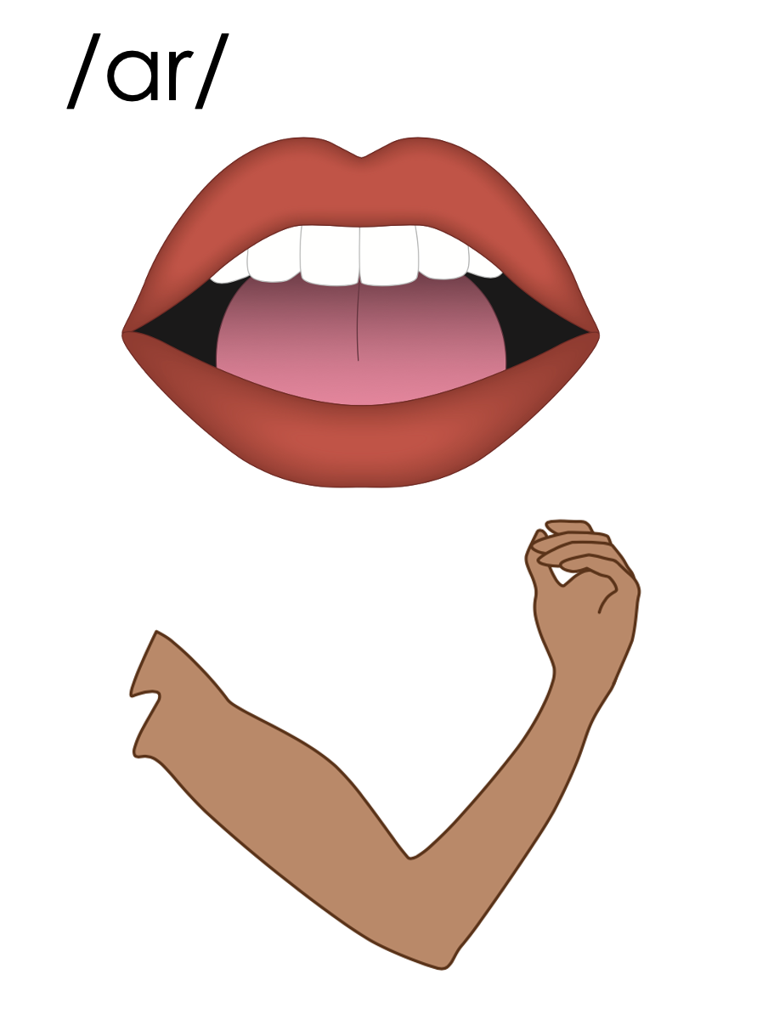
ar

Slide 36
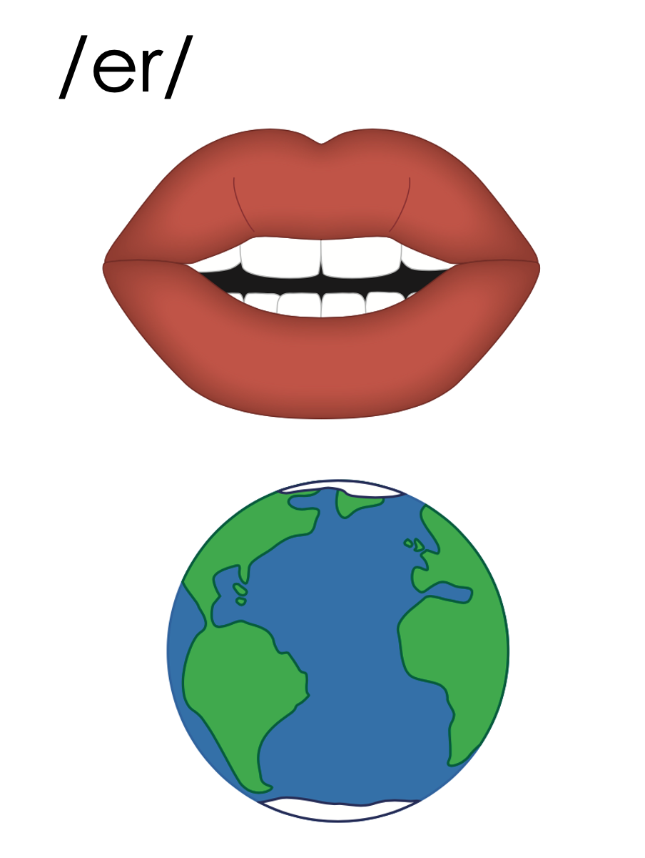
ar
dollar

Slide 37
dollar
nectar
ar
1st syllable
2nd syllable

Slide 38
upward
lizard
ar
1st syllable
2nd syllable

Slide 39
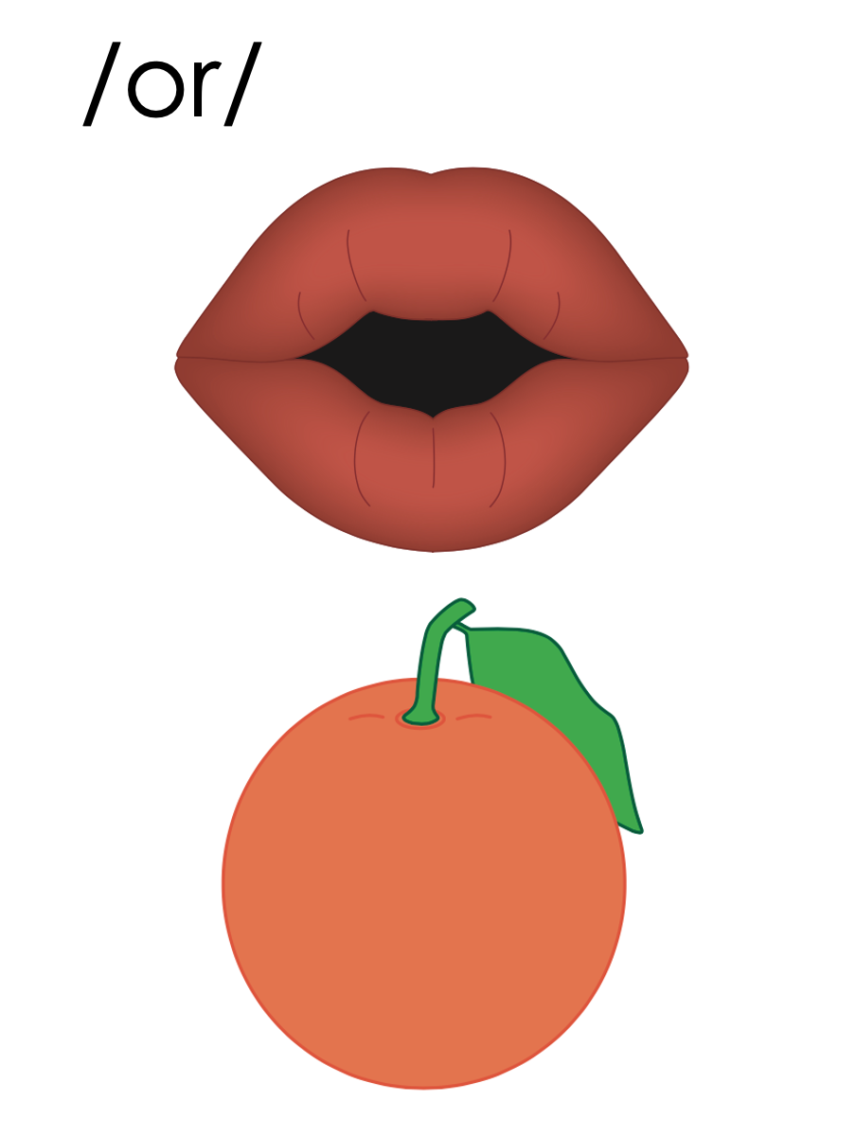
or

Slide 40
or
w
work

Slide 41
doctor
author
or
1st syllable
2nd syllable

Slide 42
er
ir
ur
or
ar

Slide 43
Notes:
Handwriting paper for letter formation practice. Use as needed.
See UFLI Foundations manual for more information about letter formation.

Slide 44
dollar
doctor

Slide 45
nectar
collar
lizard

Slide 46
factor
flavor
tutor

Slide 47
author
visitor
similar

Slide 48
Notes:
See UFLI Foundations lesson plan Step 5 for words to spell.
Handwriting paper to model spelling.

Slide 49
Notes:
See UFLI Foundations lesson plan Step 5 for words to spell.
Handwriting paper for guided spelling practice.

Slide 51
Insert brief reinforcement activity and/or transition to next part of reading block.

Slide 52
Lesson 111
-ar, -or /er/

Slide 54
New Concept Review
Notes:
See UFLI Foundations lesson plan Step 5 for recommended teacher language and activities to review the new concept.

Slide 55
ar

Slide 56
ar
dollar

Slide 57
dollar
nectar
ar
1st syllable
2nd syllable

Slide 58
upward
lizard
ar
1st syllable
2nd syllable

Slide 59
or

Slide 60
or
w
work

Slide 61
doctor
author
or
1st syllable
2nd syllable

Slide 62
er
ir
ur
or
ar

Slide 63
dollar
actor
solar
flavor

Slide 65
Notes:
See UFLI Foundations lesson plan Step 6 for word work activity.
Visit ufliteracy.org to access the Word Work Mat apps.

Slide 67
Notes:
See UFLI Foundations lesson plan Step 7 for irregular word activities.
The white rectangle under each word may be used in editing mode. Cover the heart and square icons then reveal them one at a time during instruction.

Slide 68
Notes:
See UFLI Foundations manual for more information about reviewing irregular words.

Slide 69
build
Notes:
Lesson 108+
UI represents the /ĭ/ sound.
The white rectangle under the word may be used in editing mode. Cover the heart and square icons then reveal them one at a time during instruction.

Slide 70
built
Notes:
Lesson 108+
UI represents the /ĭ/ sound.
The white rectangle under the word may be used in editing mode. Cover the heart and square icons then reveal them one at a time during instruction.

Slide 71
sure
Notes:
Lesson 109+
S represents the /sh/ sound.
Depending on dialect, U represents the /ū/ sound or UR represents the /er/ sound.
The final E is silent but does not follow the long vowel VCe pattern.
The white rectangle under the word may be used in editing mode. Cover the heart and square icons then reveal them one at a time during instruction.

Slide 72
laugh
Notes:
Lesson 101+
AU represents the /ă/ sound.
GH represents the /f/ sound.
Alternatively, A represents the /ă/ sound, and UGH represents the /f/ sound.
The white rectangle under the word may be used in editing mode. Cover the heart and square icons then reveal them one at a time during instruction.

Slide 73
who
Notes:
From Lesson 54 Introduction – review to introduce whom
WH represents the /h/ sound.
O represents the /ū/ sound.
The white rectangle under the word may be used in editing mode. Cover the heart and square icons then reveal them one at a time during instruction.

Slide 74
Notes:
Handwriting paper for irregular word spelling practice. Use as needed.
See UFLI Foundations manual for more information about reviewing irregular words.

Slide 75
Teach
Notes:
The orange star indicates these are new irregular words that need to be introduced.
See UFLI Foundations manual for more information about teaching irregular words.

Slide 76
whom
Notes:
Lesson 111+
WH represents the /h/ sound.
O represents the /ū/ sound.
The white rectangle under the word may be used in editing mode. Cover the heart and square icons then reveal them one at a time during instruction.

Slide 77
Notes:
Handwriting paper for irregular word spelling practice. Use as needed.
See UFLI Foundations manual for more information about teaching irregular words.

Slide 79
Notes:
See UFLI Foundations lesson plan Step 8 for connected text activities.

Slide 80
Who will the doctor help next?

Slide 81
To whom should I give this dollar?

Slide 82
The actor played the role of a powerful wizard.

Slide 83
Notes:
See UFLI Foundations lesson plan Step 8 for sentences to write.

Slide 84
Notes:
The UFLI Foundations decodable text is provided here. See UFLI Foundations decodable text guide for additional text options.

Slide 85
A Pet Lizard
Have you ever considered getting a pet lizard? They may seem like an unusual choice, but they can be lovely pets. Lizards are reptiles. They can be big or small and many different colors.

Slide 86
You can create a nice habitat for your lizard to live in. Start with a big cage so your lizard has room to roam. You will also need some food for your lizard. Lizards eat bugs and worms and plants. Some even like to eat flowers. Perhaps they like the flavor of the nectar inside the flowers.

Slide 87
Unlike dogs and cats, lizards do not need collars and do not need to be taken on walks. Just remember, if they ever get sick, take them to a doctor who can help them get better. So, what do you think? Would you want to have a pet lizard?

Slide 89
Insert brief reinforcement activity and/or transition to next part of reading block.

