Slide 1
Lesson 100
-er/-est

Slide 2
Notes:
ufliteracy.org

Slide 4
Lesson 100
-er/-est

Slide 6
Notes:
See UFLI Foundations lesson plan Step 1 for phonemic awareness activity.

Slide 8
Notes:
See UFLI Foundations lesson plan Step 2 for student phoneme responses.

Slide 9
s

Slide 10
kn

Slide 11
wr

Slide 12
mb

Slide 13
ou

Slide 14
ow

Slide 15
oi

Slide 16
oy

Slide 17
ea

Slide 18
a

Slide 19
aw

Slide 20
au

Slide 21
augh

Slide 22
ew

Slide 23
ui

Slide 24
ue

Slide 25
oo

Slide 26
u

Slide 27
ie

Slide 28
igh

Slide 29
oa

Slide 31
Notes:
See UFLI Foundations lesson plan Step 3 for auditory drill activity.

Slide 32
Notes:
No slides needed for auditory drill.

Slide 34
Notes:
See UFLI Foundations lesson plan Step 4 for blending drill word chain and grid.
Visit ufliteracy.org to access the Blending Board app.

Slide 36
Notes:
See UFLI Foundations lesson plan Step 5 for recommended teacher language and activities to introduce the new concept.

Slide 37
Adjectives
give us more information about people, places, and things

Slide 38
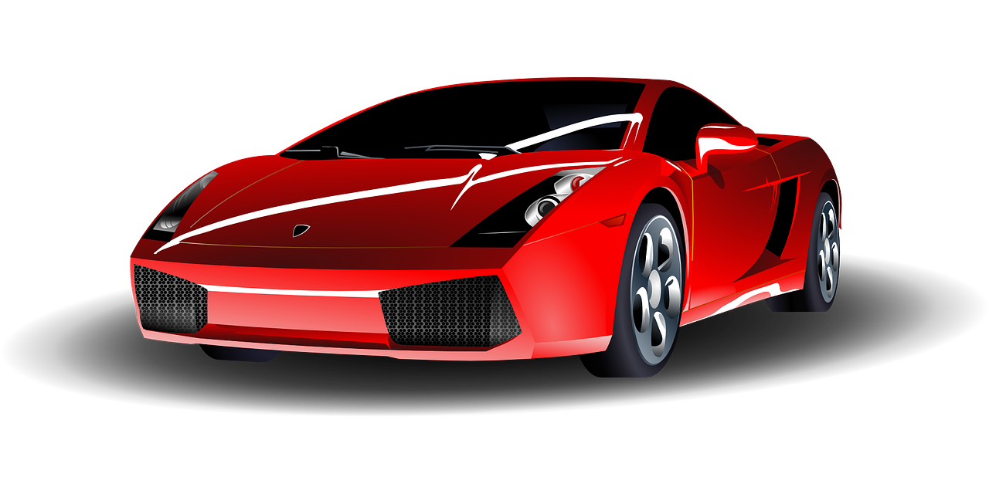
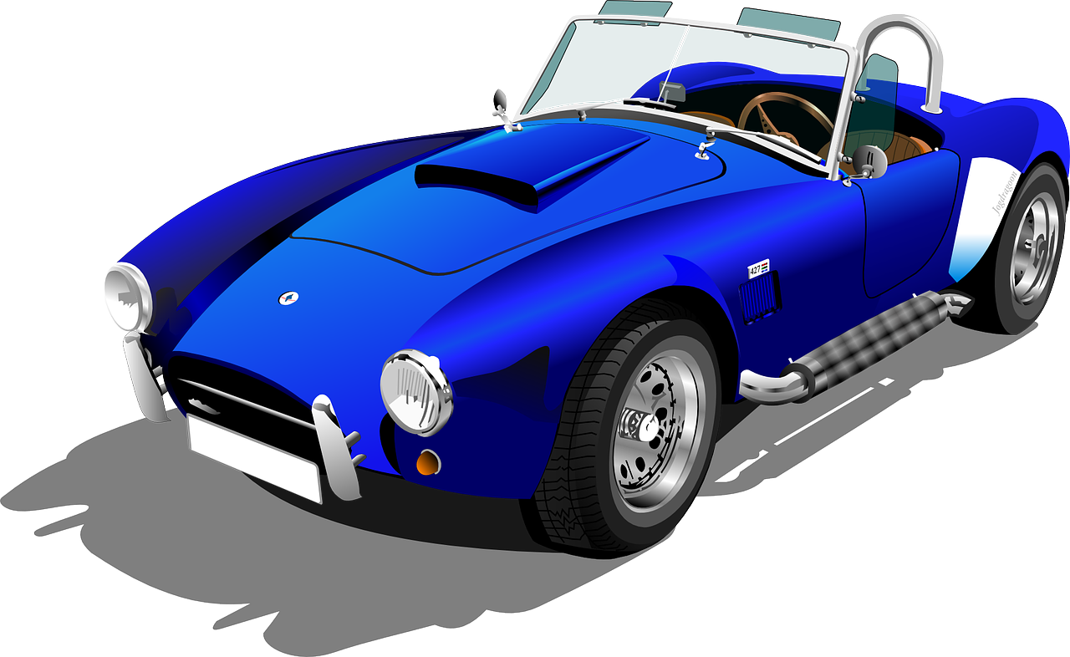
I see a red car.
I see a blue car.

Slide 39
Morphemes
word parts that change a word’s meaning

Slide 40
Suffix
morpheme added to the end of a word
-er
-est

Slide 41
-er
more than
Mae is taller than Jamie.

Slide 42
-est
the most
Ty is the fastest person on the team.

Slide 43
highest

Slide 44
smallest
sharper
softer
tallest
shortest
longest

Slide 45
newer
hardest
shorter

Slide 46
Notes:
See UFLI Foundations lesson plan Step 5 for words to spell.
Handwriting paper to model spelling.

Slide 47
Notes:
See UFLI Foundations lesson plan Step 5 for words to spell.
Handwriting paper for guided spelling practice.

Slide 49
Insert brief reinforcement activity and/or transition to next part of reading block.

Slide 50
Lesson 100
-er/-est

Slide 52
New Concept Review
Notes:
See UFLI Foundations lesson plan Step 5 for recommended teacher language and activities to review the new concept.

Slide 53
Suffix
morpheme added to the end of a word
-er
-est

Slide 54
-er
more than
Mae is taller than Jamie.

Slide 55
-est
the most
Ty is the fastest person on the team.

Slide 56
higher
highest

Slide 57
newer
newest

Slide 59
Notes:
See UFLI Foundations lesson plan Step 6 for word work activity.
Visit ufliteracy.org to access the Word Work Mat apps.

Slide 61
Notes:
See UFLI Foundations lesson plan Step 7 for irregular word activities.
The white rectangle under each word may be used in editing mode. Cover the heart and square icons then reveal them one at a time during instruction.

Slide 62
Notes:
See UFLI Foundations manual for more information about reviewing irregular words.

Slide 63
about
Notes:
Lesson 98+
A represents the /ə/ or the /ŭ/ sound, depending on stress.
The white rectangle under the word may be used in editing mode. Cover the heart and square icons then reveal them one at a time during instruction.

Slide 64
answer
Notes:
Lesson 99+
W is silent.
The white rectangle under the word may be used in editing mode. Cover the heart and square icons then reveal them one at a time during instruction.

Slide 65
Notes:
Handwriting paper for irregular word spelling practice. Use as needed.
See UFLI Foundations manual for more information about reviewing irregular words.

Slide 67
Notes:
See UFLI Foundations lesson plan Step 8 for connected text activities.

Slide 68
My bunny has the softest fur!

Slide 69
At this rate we could walk there faster!

Slide 70
Jayden is taller than Josh but Eve is the tallest.

Slide 71
Notes:
See UFLI Foundations lesson plan Step 8 for sentences to write.

Slide 72
Notes:
The UFLI Foundations decodable text is provided here. See UFLI Foundations decodable text guide for additional text options.

Slide 73
Growth Spurt
Akeem woke up one morning feeling quite strange. His arms stretched longer than they ever have before. When he stood up, he hit his head on a shelf! He felt like he had a brand new body.

Slide 74
When Akeem got dressed, none of his clothes fit. His arms were longer than his shirt sleeves. His shoes were smaller than his feet. Even his longest pants were now too short. What was he going to do?

Slide 75
Akeem walked into the kitchen with his too big body in his too small outfit. “Wow,” grandma exclaimed, “you had a growth spurt! You got taller overnight! Now you may be the tallest kid in your class!”

Slide 76
Akeem’s big brother got up from the table and stood next to him. The top of Akeem’s head only reached his brother’s elbows. “Well, you’re still shorter than me,” he said with a grin.

Slide 78
Insert brief reinforcement activity and/or transition to next part of reading block.

