Slide 1
Getting Ready
Lesson G

Slide 2
Notes:
ufliteracy.org

Slide 5
Notes:
See UFLI Foundations Getting Ready lesson plans for sound wall activity.

Slide 6
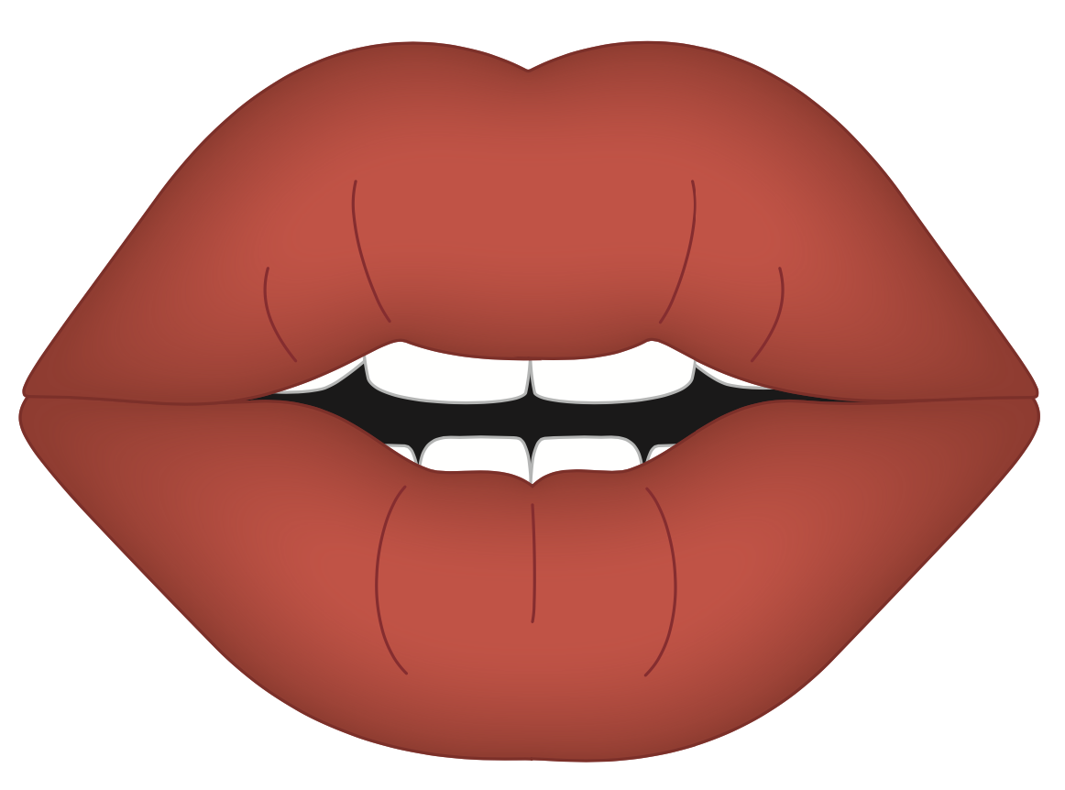
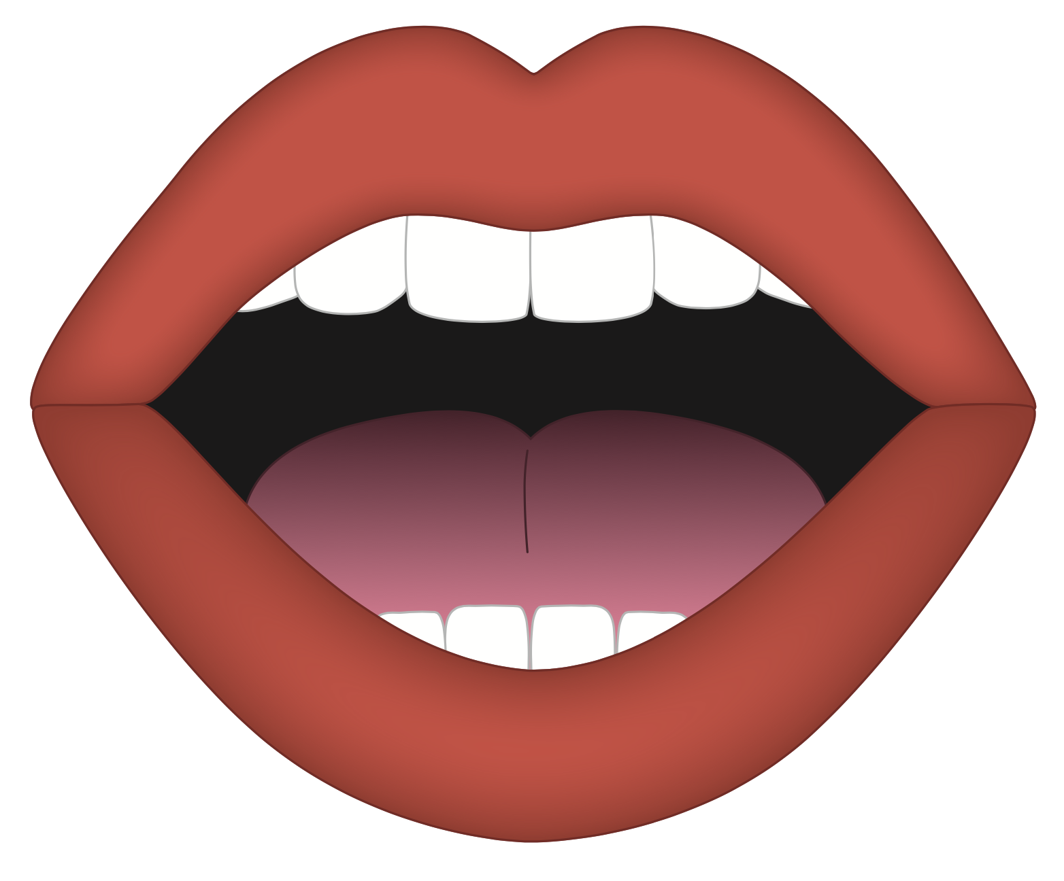
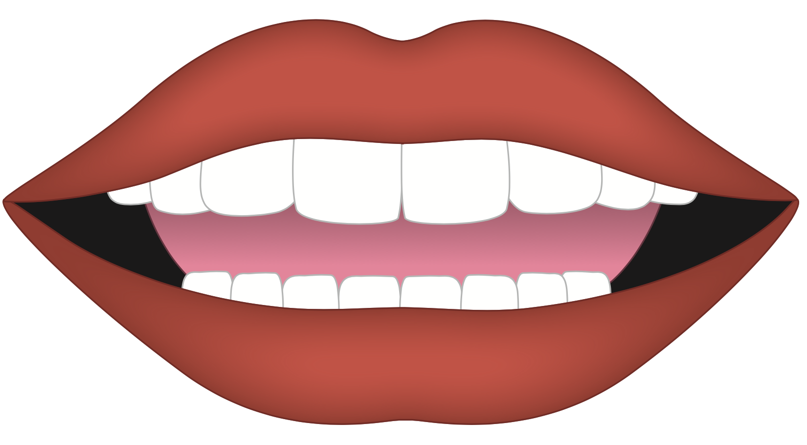
Notes:
Introduction: Vowels
/oo/, /ŏ/, /ē/

Slide 7
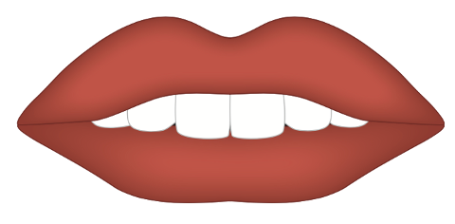
Notes:
/fff/ (consonant)

Slide 8
Notes:
/ăăă/ (vowel)

Slide 9
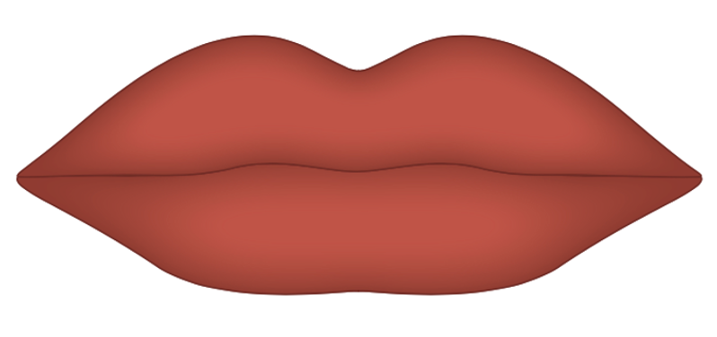
Notes:
/p/ (consonant)

Slide 10
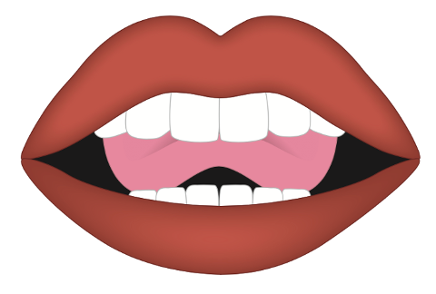
Notes:
/nnn/ (consonant)

Slide 11
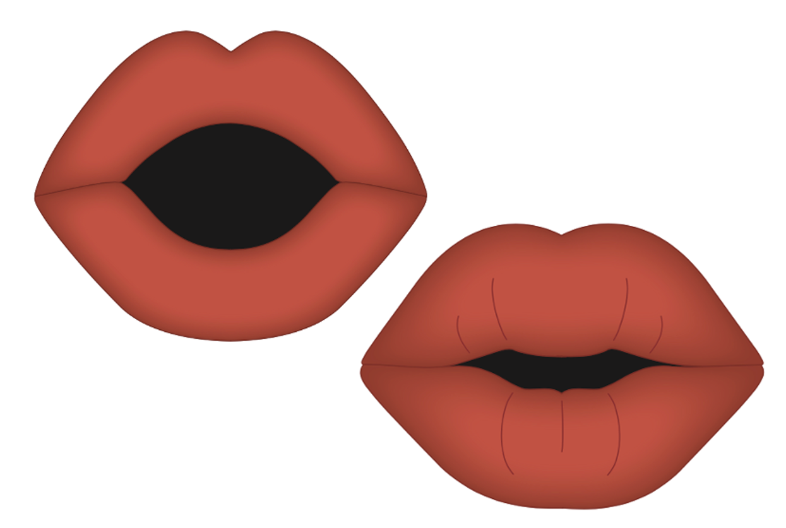
Notes:
/ōōō/ (vowel)

Slide 12
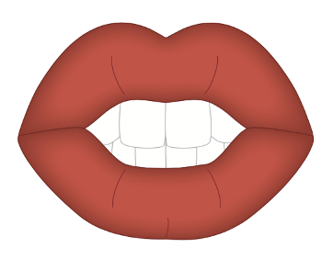
Notes:
/ch/ (consonant)

Slide 13
Notes:
/d/ (consonant)

Slide 14
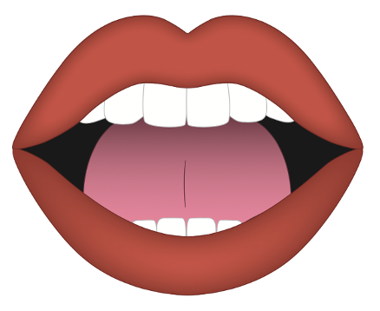
Notes:
/k/ (consonant)

Slide 15
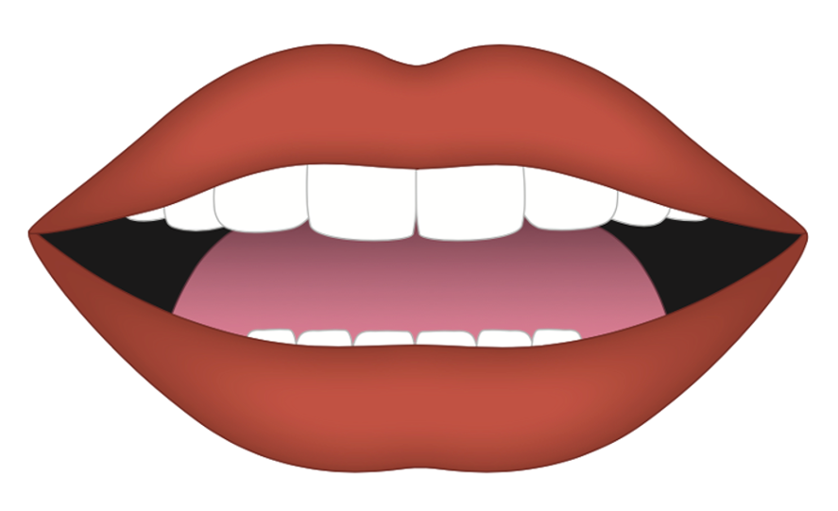
Notes:
/ĕĕĕ/ (vowel)

Slide 17
Notes:
See UFLI Foundations Getting Ready lesson plans for alphabet knowledge and letter formation activity.

Slide 21
Notes:
Uppercase D gif

Slide 24
Notes:
Uppercase P gif

Slide 27
Notes:
Uppercase B gif

Slide 30
Notes:
Uppercase R gif

Slide 32
Insert brief reinforcement activity and/or transition to next part of reading block.

