Slide 1
Lesson 14
c /k/

Slide 2
Notes:
ufliteracy.org

Slide 4
Lesson 14
c /k/

Slide 6
Notes:
See UFLI Foundations lesson plan Step 1 for phonemic awareness activity.

Slide 8
Notes:
See UFLI Foundations lesson plan Step 2 for student phoneme responses.

Slide 9
d

Slide 10
o

Slide 11
n

Slide 12
i

Slide 13
f

Slide 14
p

Slide 15
t

Slide 16
s

Slide 17
m

Slide 18
a

Slide 20
Notes:
See UFLI Foundations lesson plan Step 3 for auditory drill activity.

Slide 21
Notes:
No slides needed for auditory drill.

Slide 23
Notes:
See UFLI Foundations lesson plan Step 4 for blending drill word chain and grid.
Visit ufliteracy.org to access the Blending Board app.

Slide 25
Notes:
See UFLI Foundations lesson plan Step 5 for recommended teacher language and activities to introduce the new concept.

Slide 26
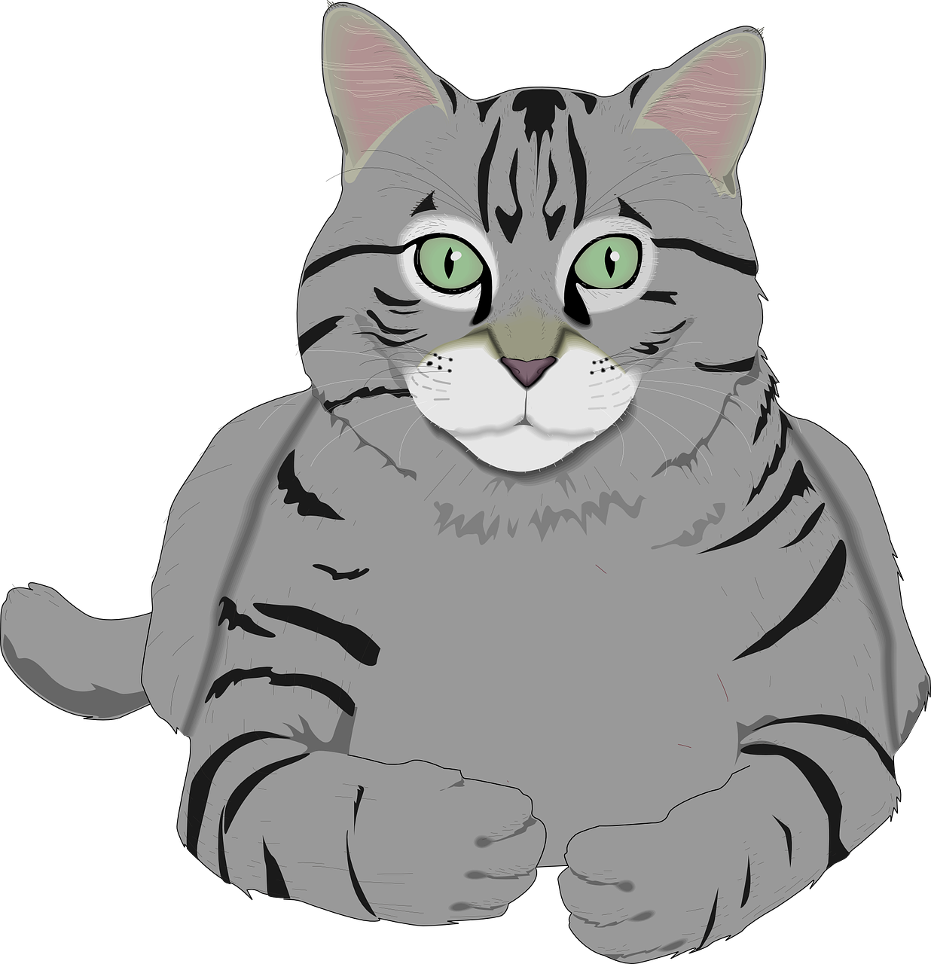
c

Slide 27
can
cat
c

Slide 28
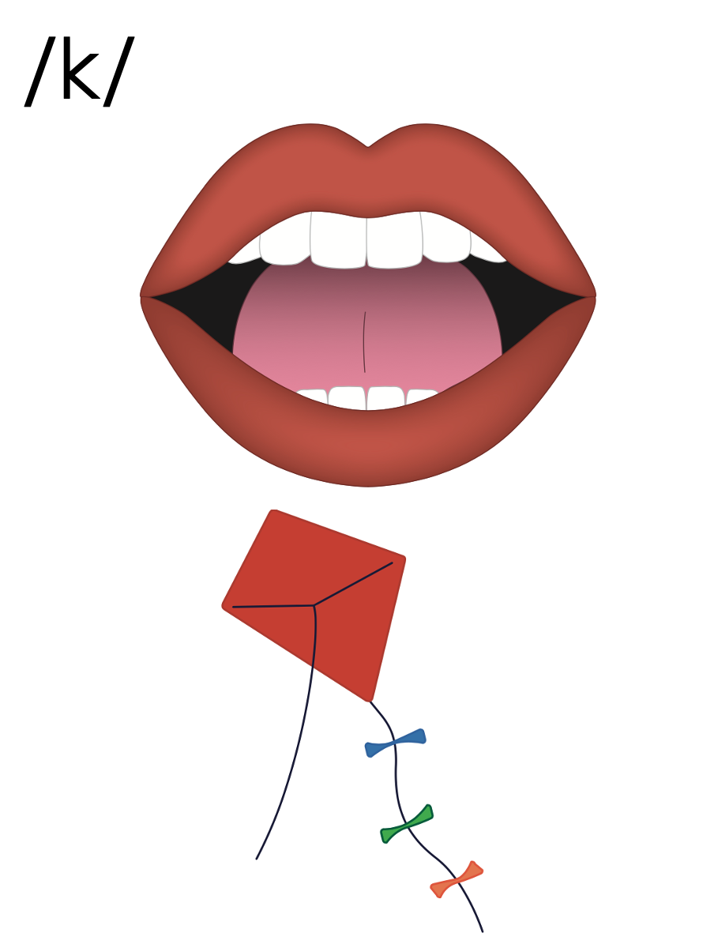
c

Slide 29
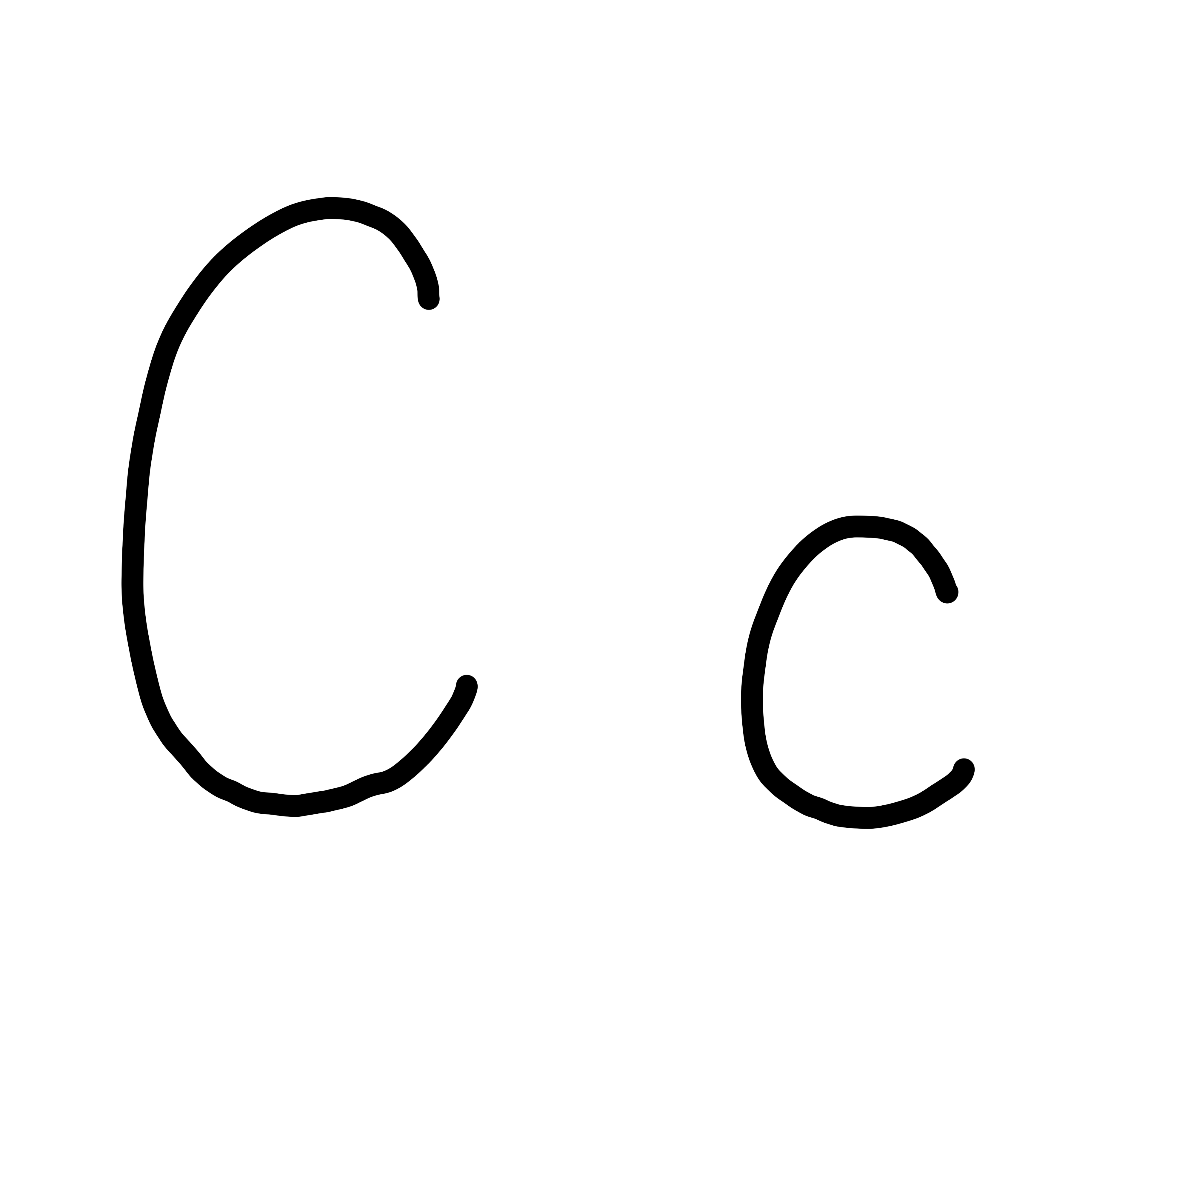

Slide 31
Notes:
Uppercase C gif

Slide 33
Notes:
Lowercase c gif

Slide 34
cap

Slide 35
cat
can
cot
cod
con

Slide 36
Notes:
See UFLI Foundations lesson plan Step 5 for words to spell.
Handwriting paper to model spelling.

Slide 37
Notes:
See UFLI Foundations lesson plan Step 5 for words to spell.
Handwriting paper for guided spelling practice.

Slide 39
Insert brief reinforcement activity and/or transition to next part of reading block.

Slide 40
Lesson 14
c /k/

Slide 42
New Concept Review
Notes:
See UFLI Foundations lesson plan Step 5 for recommended teacher language and activities to review the new concept.

Slide 43
c

Slide 44
can
cat
c

Slide 45
c

Slide 46
Notes:
Lowercase c gif

Slide 47
can
cat
cap
cot

Slide 49
Notes:
See UFLI Foundations lesson plan Step 6 for word work activity.
Visit ufliteracy.org to access the Word Work Mat apps.

Slide 51
Notes:
See UFLI Foundations lesson plan Step 7 for irregular word activities.
The white rectangle under each word may be used in editing mode. Cover the heart and square icons then reveal them one at a time during instruction.

Slide 52
Notes:
See UFLI Foundations manual for more information about reviewing irregular words.

Slide 53
the
Notes:
Lessons 1-45
The digraph TH has not been introduced yet.
E represents the /ŭ/ or /ə/ sound depending on stress.
The white rectangle under the word may be used in editing mode. Cover the heart and square icons then reveal them one at a time during instruction.

Slide 54
I
Notes:
Lessons 3-65
*Temporarily irregular
I /ī/ has not been introduced yet.
The white rectangle under the word may be used in editing mode. Cover the heart and square icons then reveal them one at a time during instruction.

Slide 55
and
Notes:
Lessons 11-12
*Temporarily irregular
D /d/ has not been introduced yet.
The white rectangle under the word may be used in editing mode. Cover the heart and square icons then reveal them one at a time during instruction.

Slide 56
a
Notes:
Lesson 7+
A as a word can be pronounced /ā/ or /ŭ/.
The white rectangle under the word may be used in editing mode. Cover the heart and square icons then reveal them one at a time during instruction.

Slide 57
is
Notes:
Lessons 9-20
*Temporarily irregular
S /z/ has not been introduced yet.
The white rectangle under the word may be used in editing mode. Cover the heart and square icons then reveal them one at a time during instruction.

Slide 58
as
Notes:
Lessons 11-20
*Temporarily irregular
S /z/ has not been introduced yet.
The white rectangle under the word may be used in editing mode. Cover the heart and square icons then reveal them one at a time during instruction.

Slide 59
said
Notes:
Lesson 13+
AI represents the /ĕ/ sound.
The white rectangle under the word may be used in editing mode. Cover the heart and square icons then reveal them one at a time during instruction.

Slide 60
Notes:
Handwriting paper for irregular word spelling practice. Use as needed.
See UFLI Foundations manual for more information about reviewing irregular words.

Slide 62
Notes:
See UFLI Foundations lesson plan Step 8 for connected text activities.

Slide 63
I can tap it.

Slide 64
The cap did not fit.

Slide 65
Dad said the cat can sit.

Slide 66
Notes:
See UFLI Foundations lesson plan Step 8 for sentences to write.

Slide 67
Notes:
The UFLI Foundations decodable text is provided here. See UFLI Foundations decodable text guide for additional text options.

Slide 68
The Cat Can
Can Cam fit on the cot?
Cam can not fit on the cot.
Can the cat fit on the cot?
The cat can fit on the cot.

Slide 69
The cat can nap on the cot.
Cam can not nap on the cot.
Cam can nap on the mat.

Slide 71
Insert brief reinforcement activity and/or transition to next part of reading block.

