Slide 1
Lesson 74
y /ē/

Slide 2
Notes:
ufliteracy.org

Slide 4
Lesson 74
y /ē/

Slide 6
Notes:
See UFLI Foundations lesson plan Step 1 for phonemic awareness activity.

Slide 8
Notes:
See UFLI Foundations lesson plan Step 2 for student phoneme responses.

Slide 9
y

Slide 10
dge

Slide 11
g

Slide 12
tch

Slide 13
ch

Slide 14
-ed

Slide 15
c

Slide 16
a

Slide 17
i

Slide 18
o

Slide 19
e

Slide 20
u

Slide 21
nk

Slide 22
ng

Slide 23
wh

Slide 24
ph

Slide 25
th

Slide 26
sh

Slide 27
ck

Slide 29
Notes:
See UFLI Foundations lesson plan Step 3 for auditory drill activity.

Slide 30
Notes:
No slides needed for auditory drill.

Slide 32
Notes:
See UFLI Foundations lesson plan Step 4 for blending drill word chain and grid.
Visit ufliteracy.org to access the Blending Board app.

Slide 34
Notes:
See UFLI Foundations lesson plan Step 5 for recommended teacher language and activities to introduce the new concept.

Slide 35
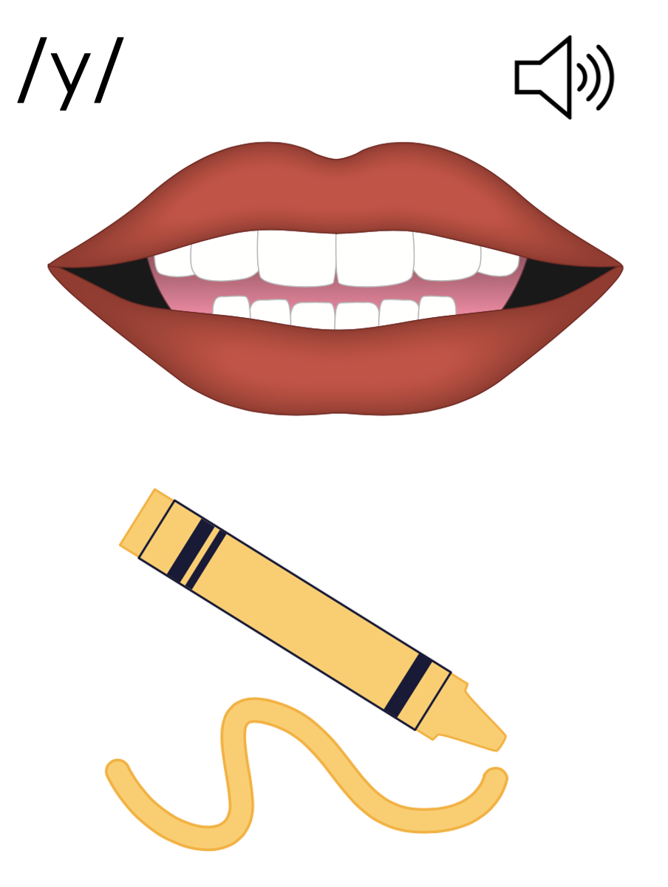
y
yes

Slide 36
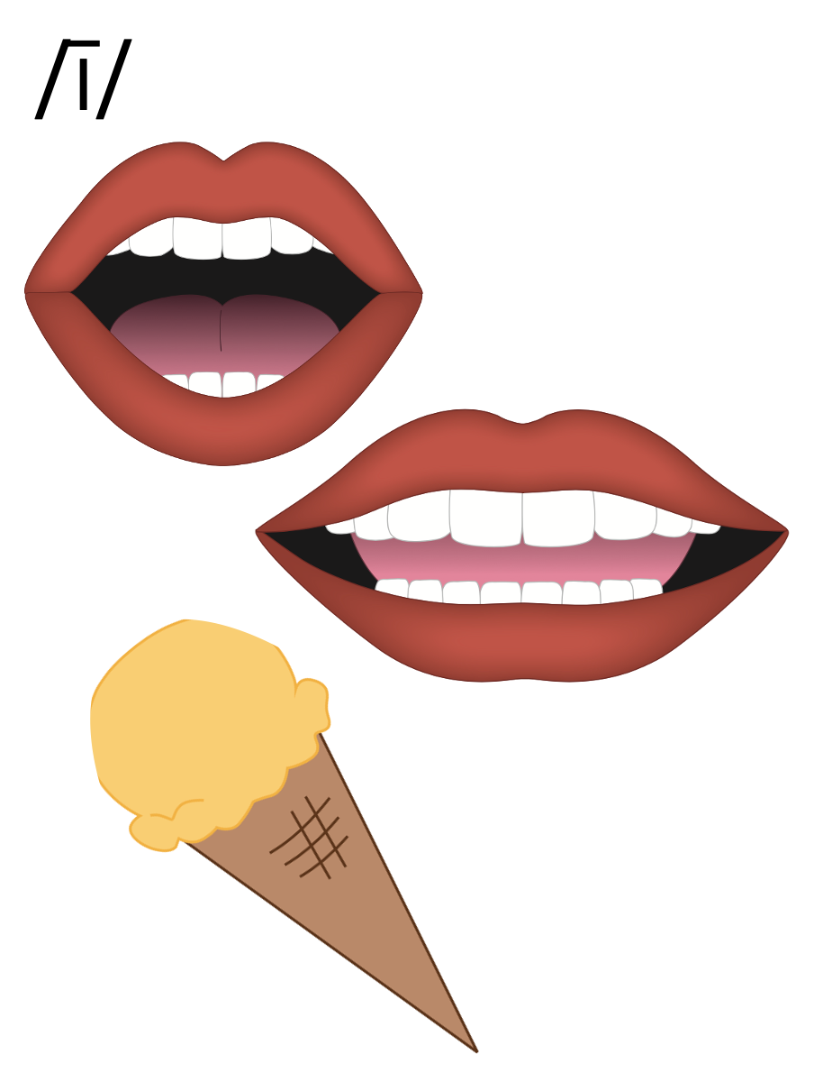
y
by
my

Slide 37
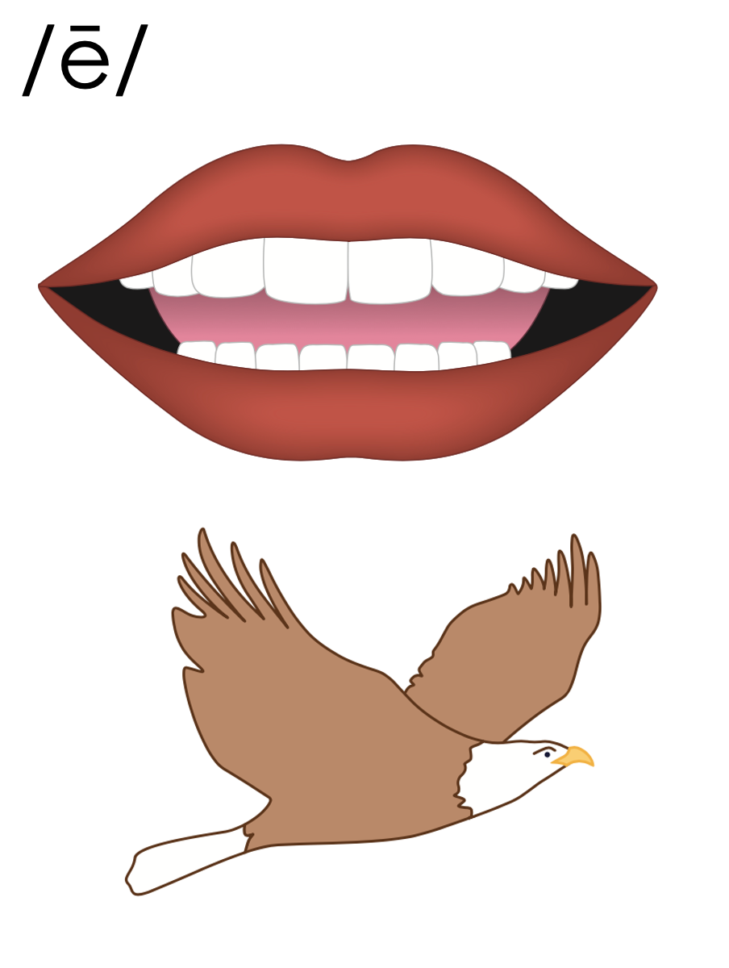
baby
y
puppy
y
1st syllable
2nd syllable

Slide 38
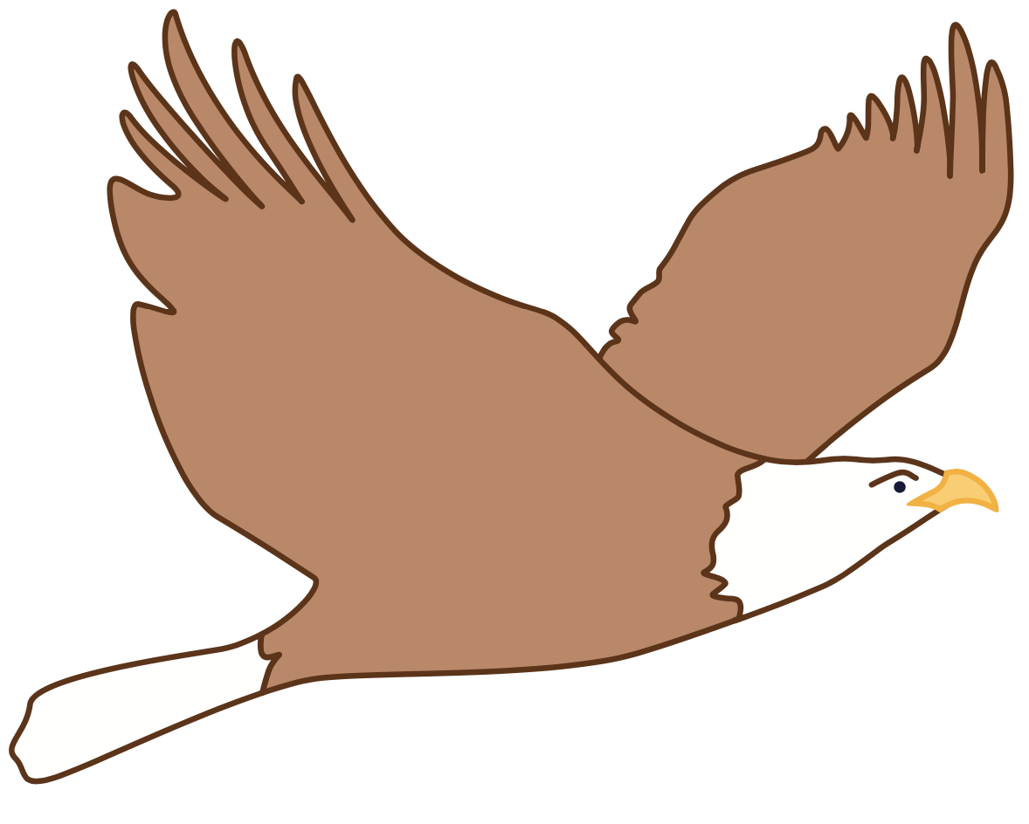
puppy
mommy
sunny

Slide 39
e_e
e
y

Slide 40
Notes:
Handwriting paper for letter formation practice. Use as needed.
See UFLI Foundations manual for more information about letter formation.

Slide 41
happy
lady

Slide 42
funny
lucky
candy
mommy
sunny
study

Slide 43
only
baby
tiny

Slide 44
Notes:
See UFLI Foundations lesson plan Step 5 for words to spell.
Handwriting paper to model spelling.

Slide 45
Notes:
See UFLI Foundations lesson plan Step 5 for words to spell.
Handwriting paper for guided spelling practice.

Slide 47
Insert brief reinforcement activity and/or transition to next part of reading block.

Slide 48
Lesson 74
y /ē/

Slide 50
New Concept Review
Notes:
See UFLI Foundations lesson plan Step 5 for recommended teacher language and activities to review the new concept.

Slide 51
y
yes

Slide 52
y
by
my

Slide 53
baby
y
puppy
y
1st syllable
2nd syllable

Slide 54
puppy
mommy
sunny

Slide 55
e_e
e
y

Slide 56
baby
only
study
puppy

Slide 58
Notes:
See UFLI Foundations lesson plan Step 6 for word work activity.
Visit ufliteracy.org to access the Word Work Mat apps.

Slide 60
Notes:
See UFLI Foundations lesson plan Step 7 for irregular word activities.
The white rectangle under each word may be used in editing mode. Cover the heart and square icons then reveal them one at a time during instruction.

Slide 61
Notes:
See UFLI Foundations manual for more information about reviewing irregular words.

Slide 62
move
Notes:
Lesson 70+
O represents the /ū/ sound.
The final E is silent but does not follow the long vowel VCe pattern.
The white rectangle under the word may be used in editing mode. Cover the heart and square icons then reveal them one at a time during instruction.

Slide 63
both
Notes:
Lesson 72+
O represents the /ō/ sound. Since both is a CVC (closed syllable) word, it should be /ŏ/.
The white rectangle under the word may be used in editing mode. Cover the heart and square icons then reveal them one at a time during instruction.

Slide 64
four
Notes:
Lesson 73+
OUR represents the /or/ sound.
The white rectangle under the word may be used in editing mode. Cover the heart and square icons then reveal them one at a time during instruction.

Slide 65
fourth
Notes:
Lesson 73+
OUR represents the /or/ sound.
The white rectangle under the word may be used in editing mode. Cover the heart and square icons then reveal them one at a time during instruction.

Slide 66
Notes:
Handwriting paper for irregular word spelling practice. Use as needed.
See UFLI Foundations manual for more information about reviewing irregular words.

Slide 67
Teach
Notes:
The orange star indicates these are new irregular words that need to be introduced.
See UFLI Foundations manual for more information about teaching irregular words.

Slide 68
forty
Notes:
Lesson 74+
This spelling is not irregular, but it can be confusing once a student has learned to spell FOUR and FOURTH. FORTY is often misspelled FOURTY.
Also, T may be pronounced /d/ depending on dialect.
The white rectangle under the word may be used in editing mode. Cover the heart and square icons then reveal them one at a time during instruction.

Slide 69
Notes:
Handwriting paper for irregular word spelling practice. Use as needed.
See UFLI Foundations manual for more information about teaching irregular words.

Slide 71
Notes:
See UFLI Foundations lesson plan Step 8 for connected text activities.

Slide 72
Did your buddy bring you candy?

Slide 73
I will bring a funny gift for Tommy.

Slide 74
It was both foggy and windy by the lake.

Slide 75
Notes:
See UFLI Foundations lesson plan Step 8 for sentences to write.

Slide 76
Notes:
The UFLI Foundations decodable text is provided here. See UFLI Foundations decodable text guide for additional text options.

Slide 77
Lily’s Puppy
Lily had been wishing for a puppy for a long time. She wanted a silly puppy to run and jump with. But her mommy said Lily could not have one because she was only seven. Lily begged her mommy and daddy. She said, “I am not a baby. It would make me so happy to have a puppy.”

Slide 78
Lily’s mommy and daddy talked for a long time. They said, “We do think you will try your best. We will let you have a puppy.” Lily was so happy. She went to the pet shop and picked a tiny puppy. She named him Cody. Cody is the best puppy for this family.

Slide 80
Insert brief reinforcement activity and/or transition to next part of reading block.

