Slide 1
Getting Ready
Lesson I

Slide 2
Notes:
ufliteracy.org

Slide 4
Notes:
This slide shows the parts of the sound wall that will be used during this lesson. If using physical sound wall cards, have these cards ready to display and refer to during the sound wall step.

Slide 6
Notes:
See UFLI Foundations Getting Ready lesson plans for sound wall activity.
The sound wall activity may be completed with either the digital sound wall slides provided here or physical sound wall cards displayed in your classroom.

Slide 7
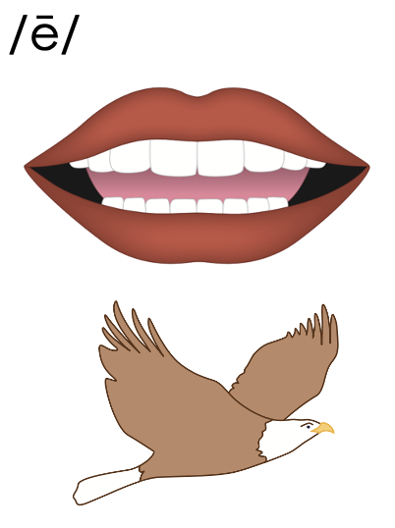
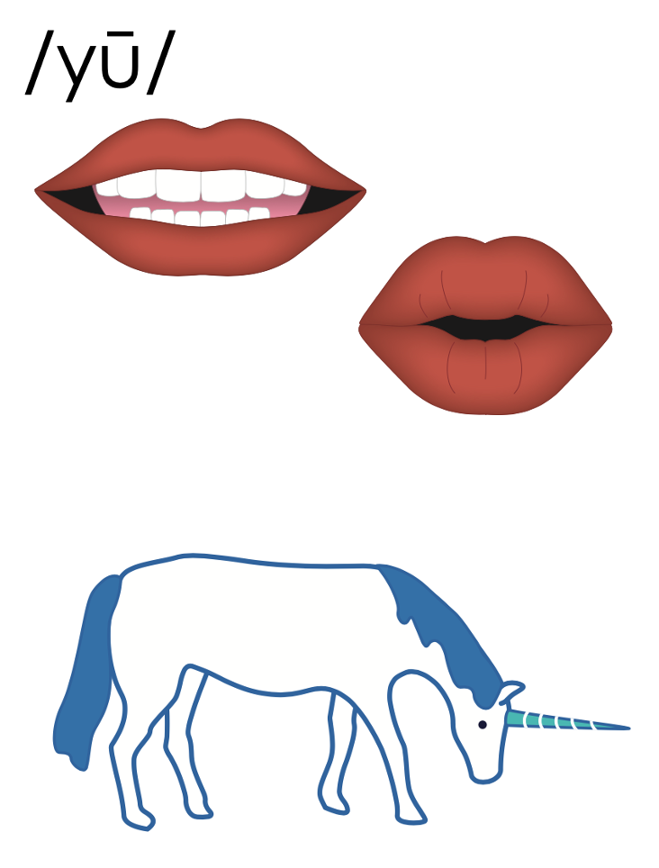
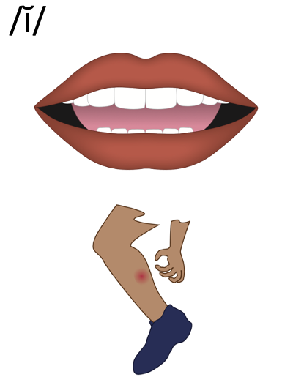
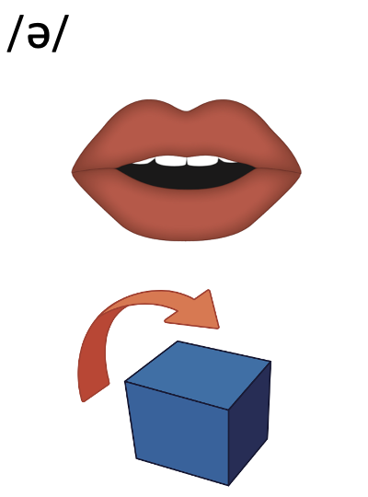
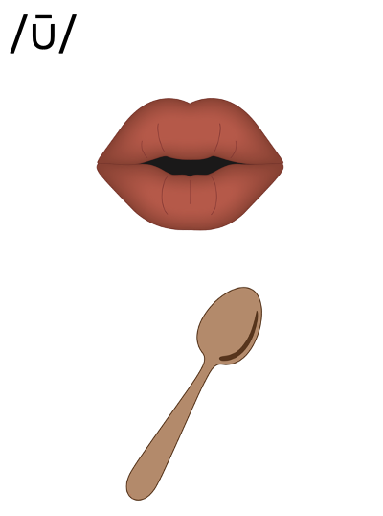
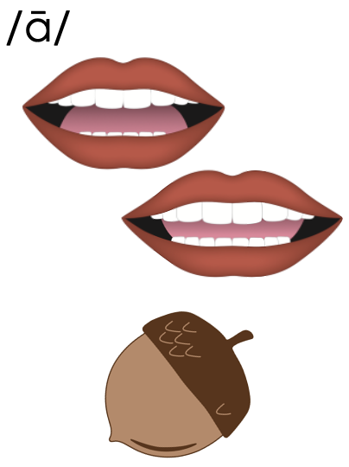
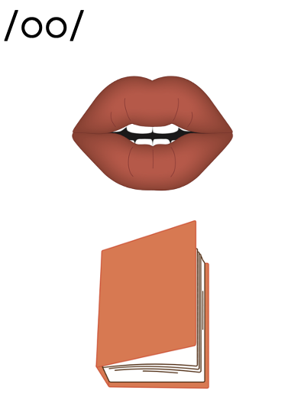
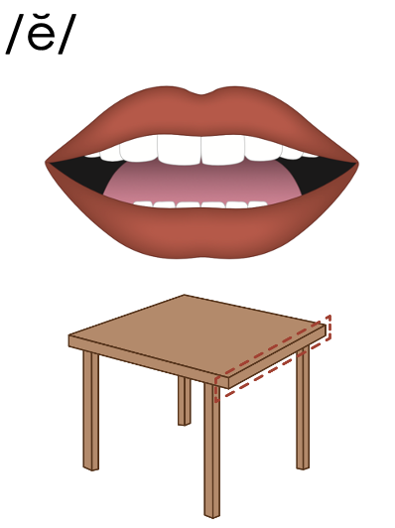
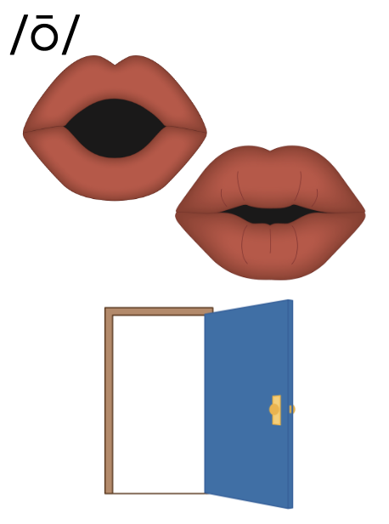
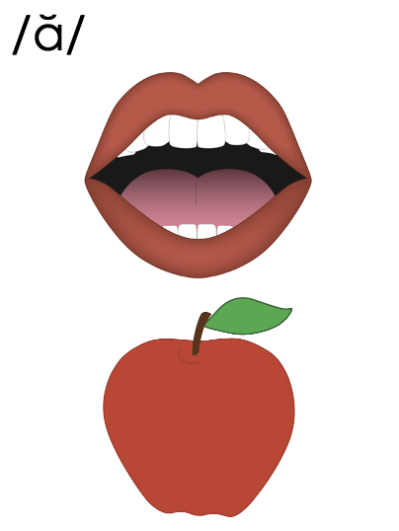
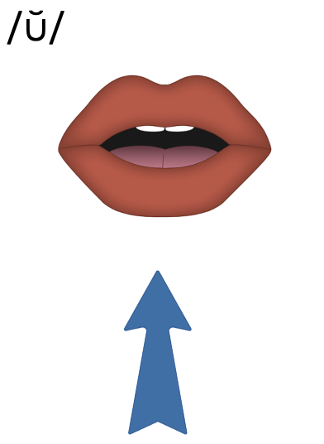
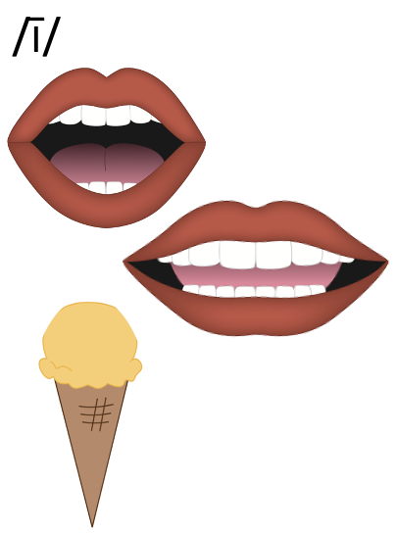
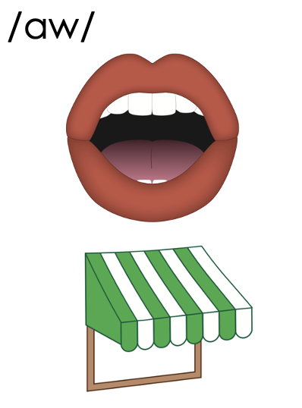
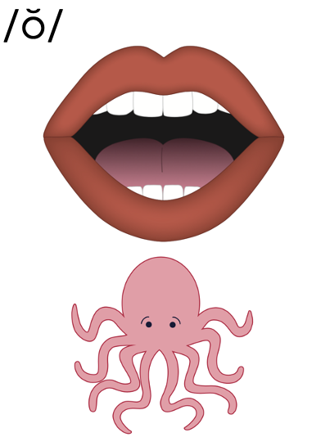
Vowels
Notes:
Schwa /ə/ (above)

Slide 8
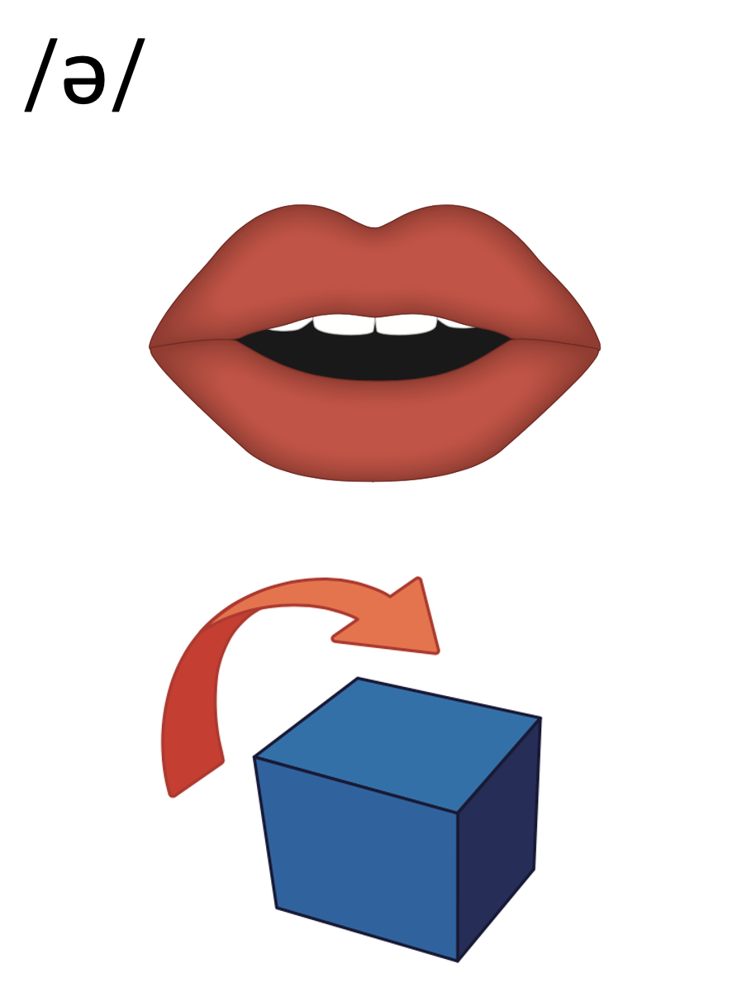
Notes:
/ə/ (above)

Slide 9
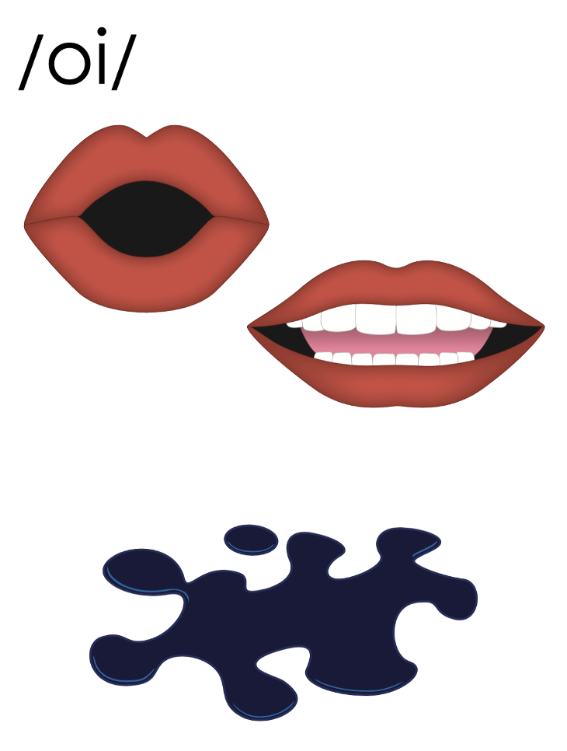
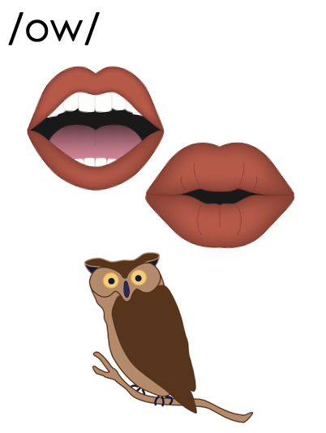
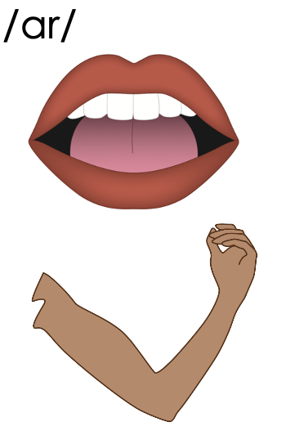
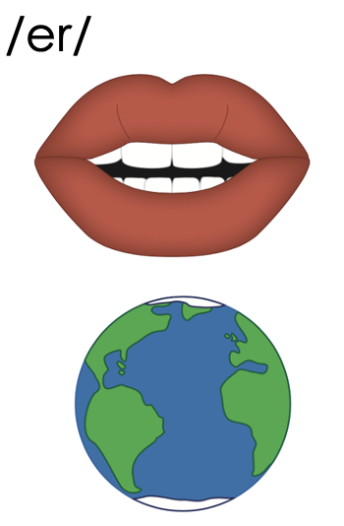
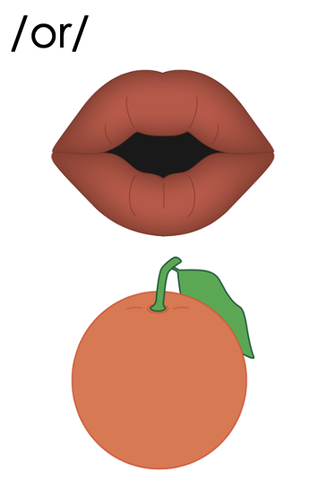
Vowels
Notes:
Diphthongs
R-Controlled Vowels

Slide 10
Vowels
Notes:
Diphthongs
/oi/ (oil)
/ow/ (owl)

Slide 11
Notes:
Diphthongs
/oi/ (oil)
/ow/ (owl)

Slide 12
Vowels
Notes:
R-Controlled Vowels
/ar/ (arm)
/er/ (earth)
/or/ (orange)

Slide 13
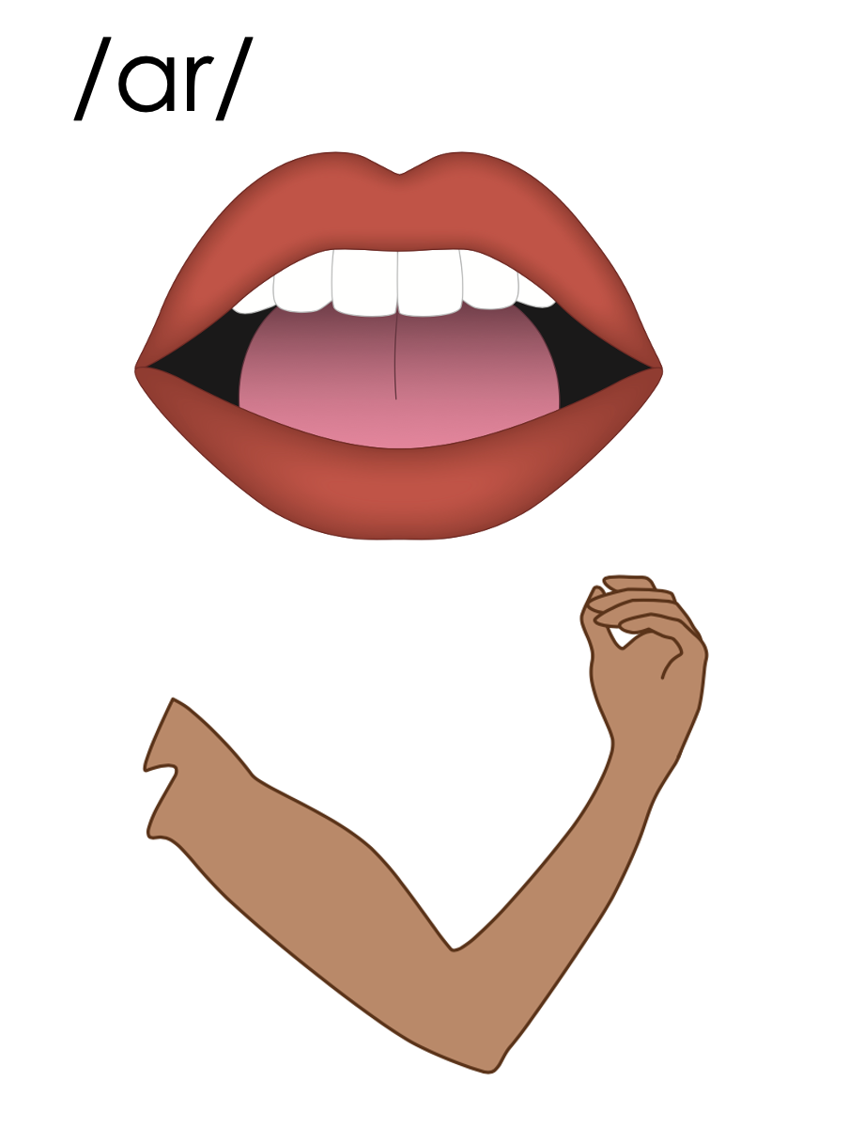
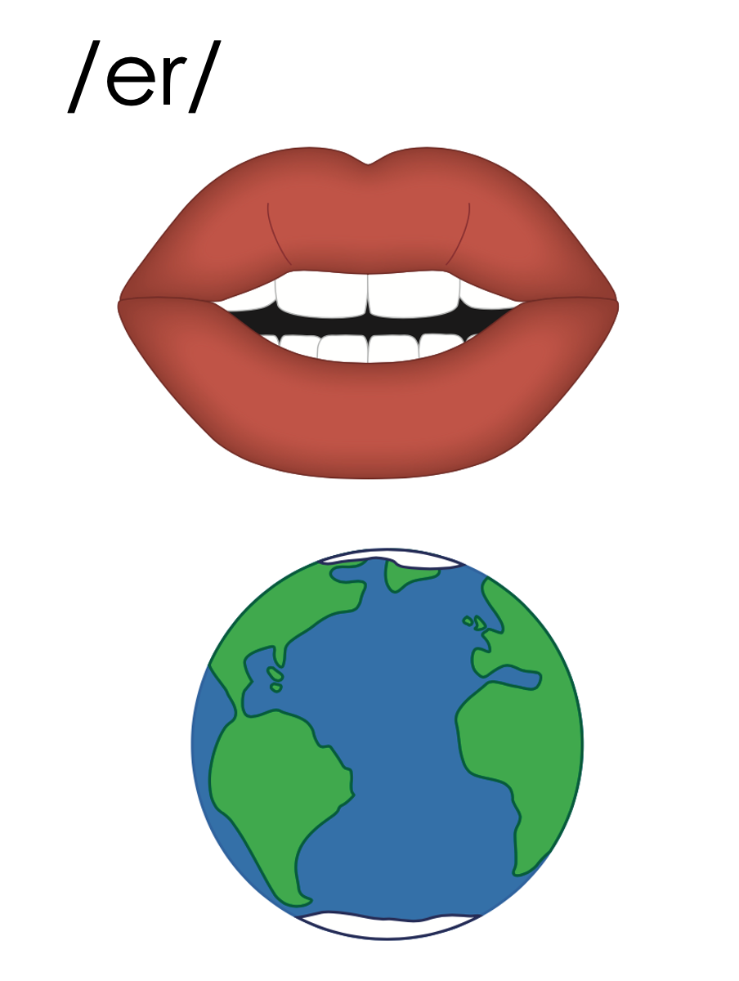
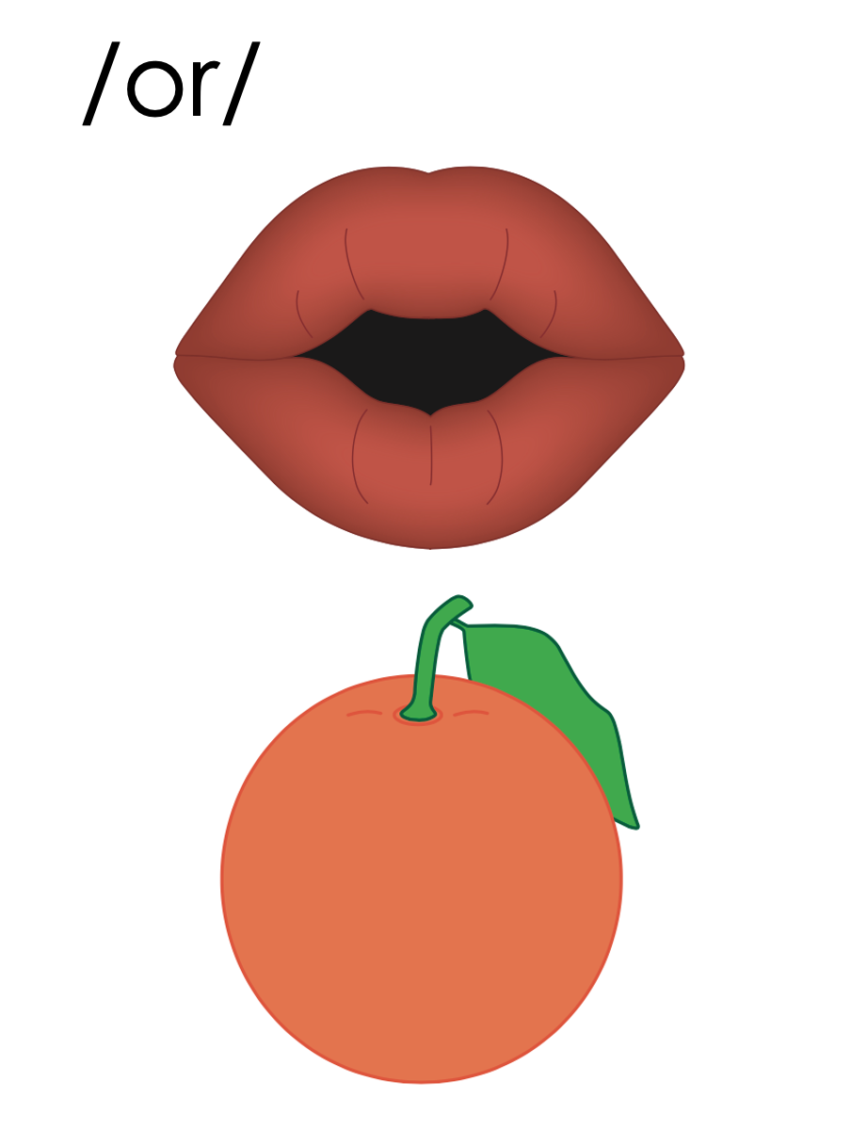
Notes:
R-Controlled Vowels
/ar/ (arm)
/er/ (earth)
/or/ (orange)

Slide 14
Vowels

Slide 16
Notes:
See UFLI Foundations Getting Ready lesson plans for alphabet knowledge and letter formation activity.

Slide 20
Notes:
Uppercase V gif

Slide 23
Notes:
Uppercase W gif

Slide 26
Notes:
Uppercase X gif

Slide 28
Insert brief reinforcement activity and/or transition to next part of reading block.

