Slide 1
Lesson 87
ie, igh /ī/

Slide 2
Notes:
ufliteracy.org

Slide 4
Lesson 87
ie, igh /ī/

Slide 6
Notes:
See UFLI Foundations lesson plan Step 1 for phonemic awareness activity.

Slide 8
Notes:
See UFLI Foundations lesson plan Step 2 for student phoneme responses.

Slide 9
oa

Slide 10
ow

Slide 11
oe

Slide 12
ee

Slide 13
ea

Slide 14
ey

Slide 15
ai

Slide 16
ay

Slide 17
ir

Slide 18
ur

Slide 19
er

Slide 20
or

Slide 21
ore

Slide 22
ar

Slide 23
y

Slide 24
dge

Slide 25
g

Slide 26
tch

Slide 27
ch

Slide 28
i

Slide 30
Notes:
See UFLI Foundations lesson plan Step 3 for auditory drill activity.

Slide 31
Notes:
No slides needed for auditory drill.

Slide 33
Notes:
See UFLI Foundations lesson plan Step 4 for blending drill word chain and grid.
Visit ufliteracy.org to access the Blending Board app.

Slide 35
Notes:
See UFLI Foundations lesson plan Step 5 for recommended teacher language and activities to introduce the new concept.

Slide 36
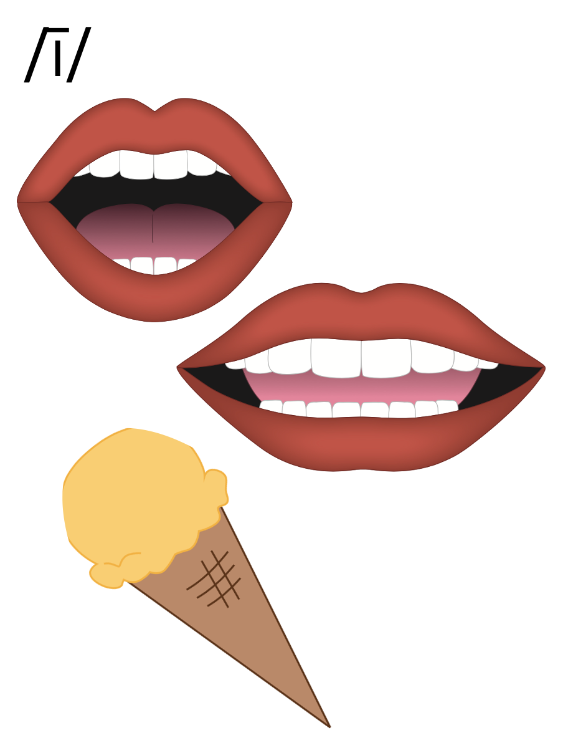

Slide 37
i_e
k
i
t
e

Slide 38
i
Open Syllable
tiger

Slide 39
y
y
fly

Slide 40
Vowel Team
2 or more letters that work together to make 1 sound.

Slide 41
ie

Slide 42
pie
tie
ie

Slide 43
igh

Slide 44
light
might
igh

Slide 45
high
sigh
igh

Slide 46
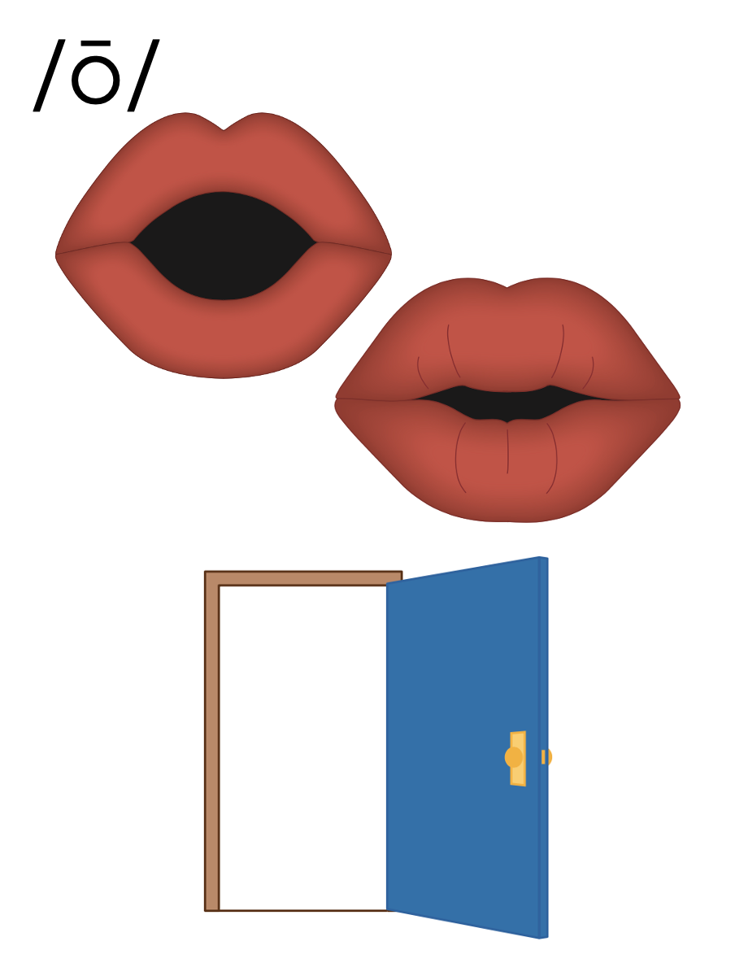
i_e
i
y
ie
igh

Slide 47
Notes:
Handwriting paper for letter formation practice. Use as needed.
See UFLI Foundations manual for more information about letter formation.

Slide 48
tie
sight

Slide 49
lie
pie
high
right
night
fight

Slide 50
bright
flight
sunlight

Slide 51
Notes:
See UFLI Foundations lesson plan Step 5 for words to spell.
Handwriting paper to model spelling.

Slide 52
Notes:
See UFLI Foundations lesson plan Step 5 for words to spell.
Handwriting paper for guided spelling practice.

Slide 54
Insert brief reinforcement activity and/or transition to next part of reading block.

Slide 55
Lesson 87
ie, igh /ī/

Slide 57
New Concept Review
Notes:
See UFLI Foundations lesson plan Step 5 for recommended teacher language and activities to review the new concept.

Slide 59
i_e
k
i
t
e

Slide 60
i
Open Syllable
tiger

Slide 61
y
y
fly

Slide 62
Vowel Team
2 or more letters that work together to make 1 sound.

Slide 63
ie

Slide 64
pie
tie
ie

Slide 65
igh

Slide 66
light
might
igh

Slide 67
high
sigh
igh

Slide 68
i_e
i
y
ie
igh

Slide 69
tie
lie
might
night

Slide 71
Notes:
See UFLI Foundations lesson plan Step 6 for word work activity.
Visit ufliteracy.org to access the Word Work Mat apps.

Slide 73
Notes:
See UFLI Foundations lesson plan Step 7 for irregular word activities.
The white rectangle under each word may be used in editing mode. Cover the heart and square icons then reveal them one at a time during instruction.

Slide 74
Notes:
See UFLI Foundations manual for more information about reviewing irregular words.

Slide 75
above
Notes:
Lesson 85+
A represents the /ə/ or the /ŭ/ sound, depending on stress.
O represents the /ŭ/ sound.
The final E is silent but does not follow the long vowel VCe pattern. In this case, the silent E is there because English words do not end in V.
The white rectangle under the word may be used in editing mode. Cover the heart and square icons then reveal them one at a time during instruction.

Slide 76
among
Notes:
Lesson 85+
A represents the /ə/ or the /ŭ/ sound, depending on stress.
O represents the /ŭ/ sound.
The white rectangle under the word may be used in editing mode. Cover the heart and square icons then reveal them one at a time during instruction.

Slide 77
again
Notes:
Lesson 86+
The first A represents the /ə/ or the /ŭ/ sound, depending on stress.
AI represents the /ĕ/ or /ĭ/ sound, depending on dialect.
In some dialects, the AI in again is pronounced /ā/. In this case, this part of the word would not be irregular.
The white rectangle under the word may be used in editing mode. Cover the heart and square icons then reveal them one at a time during instruction.

Slide 78
against
Notes:
Lesson 86+
The first A represents the /ə/ or the /ŭ/ sound, depending on stress.
AI represents the /ĕ/ or /ĭ/ sound, depending on dialect.
In some dialects, the AI in against is pronounced /ā/. In this case, this part of the word would not be irregular.
The white rectangle under the word may be used in editing mode. Cover the heart and square icons then reveal them one at a time during instruction.

Slide 79
Notes:
Handwriting paper for irregular word spelling practice. Use as needed.
See UFLI Foundations manual for more information about reviewing irregular words.

Slide 80
Teach
Notes:
The orange star indicates these are new irregular words that need to be introduced.
See UFLI Foundations manual for more information about teaching irregular words.

Slide 81
always
Notes:
Lesson 87+
The first A represents the /ŏ/ or /aw/ sound.
The white rectangle under the word may be used in editing mode. Cover the heart and square icons then reveal them one at a time during instruction.

Slide 82
almost
Notes:
Lesson 87+
A represents the /ŏ/ or /aw/ sound.
The white rectangle under the word may be used in editing mode. Cover the heart and square icons then reveal them one at a time during instruction.

Slide 83
Notes:
Handwriting paper for irregular word spelling practice. Use as needed.
See UFLI Foundations manual for more information about teaching irregular words.

Slide 85
Notes:
See UFLI Foundations lesson plan Step 8 for connected text activities.

Slide 86
Do you always fight for the last slice of pie?

Slide 87
We are almost done fixing the bright lights.

Slide 88
She tried to help because it was the right thing to do.

Slide 89
Notes:
See UFLI Foundations lesson plan Step 8 for sentences to write.

Slide 90
Notes:
The UFLI Foundations decodable text is provided here. See UFLI Foundations decodable text guide for additional text options.

Slide 91
The Right Job
Curt is a pilot. This means he must fly planes for work. He sports a white shirt and a necktie when he is on the plane. He has been flying for a long time. Sometimes Curt must fly at night when there is no light in the sky.

Slide 92
At night, everyone on the plane is asleep and it is silent. This is peaceful, but sometimes it gets boring. Curt prefers to fly in the daylight. This is when he can see the land below and talk to people.

Slide 93
Curt also likes seeing the sights in the places he goes. He delights in exploring the parks, theaters, and stores wherever his flights take him. But what he likes best is being high up in the sky. Being a pilot is the right job for Curt!

Slide 95
Insert brief reinforcement activity and/or transition to next part of reading block.

